Slide 1
Antonio Torralba, 2012
Lecture 12
Image features
With some slides from Darya Frolova, Denis Simakov, David Lowe, Bill Freeman

Slide 2
Finding the “same” thing across images
Categories
Find a bottle:
Instances
Find these two objects
Can’t do
unless you do not care about few errors…
Can nail it

Slide 4
But where is that point?

Slide 5
Building a Panorama
M. Brown and D. G. Lowe. Recognising Panoramas. ICCV 2003

Slide 6
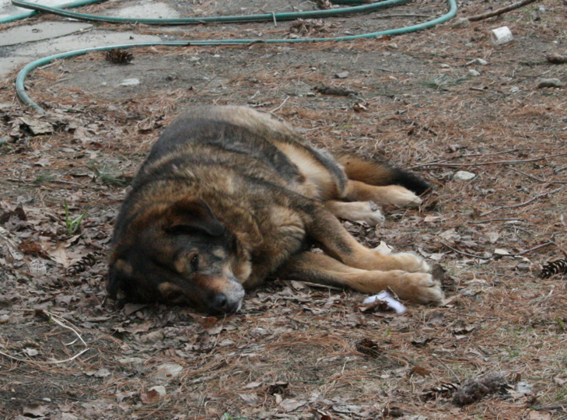
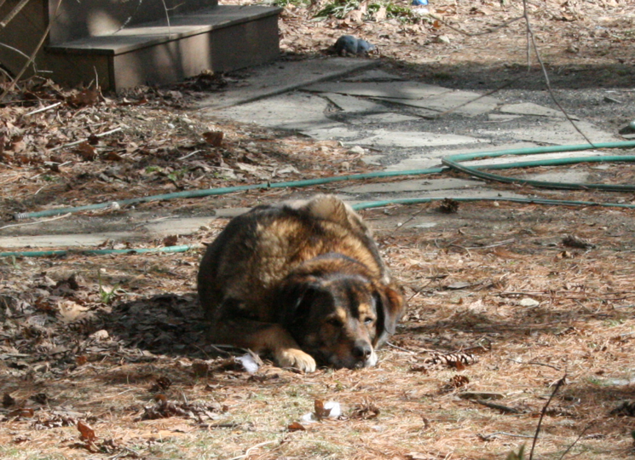
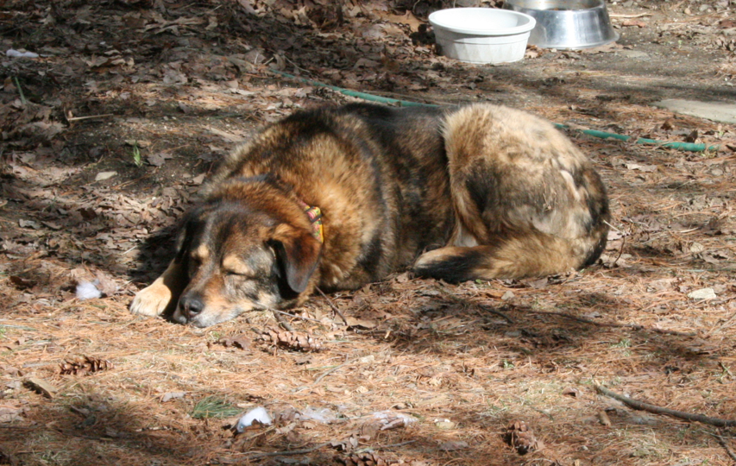

Slide 7
Uses for feature point detectors and descriptors in computer vision and graphics.
Image alignment and building panoramas
3D reconstruction
Motion tracking
Object recognition
Indexing and database retrieval
Robot navigation
… other

Slide 8
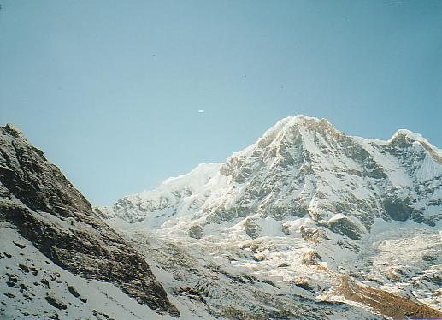
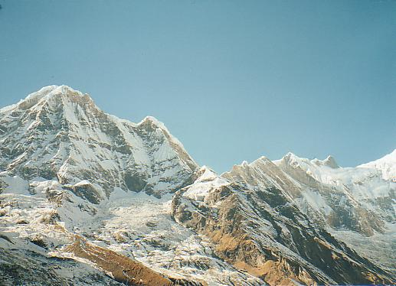
How do we build a panorama?
We need to match (align) images

Slide 9
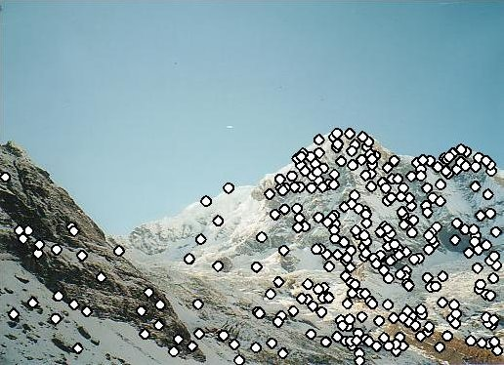
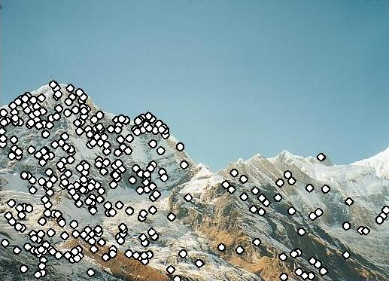
Matching with Features
Detect feature points in both images

Slide 10
Matching with Features
Detect feature points in both images
Find corresponding pairs

Slide 11
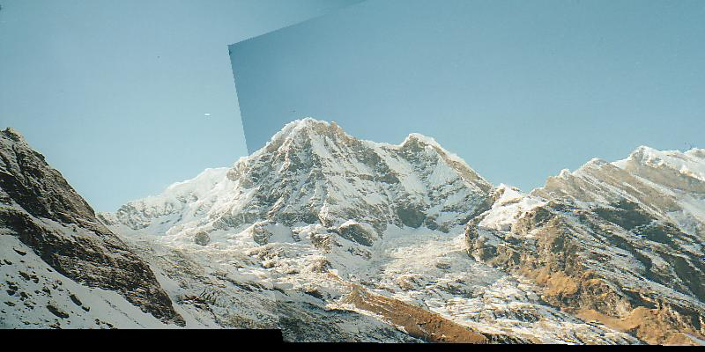
Matching with Features
Detect feature points in both images
Find corresponding pairs
Use these matching pairs to align images - the required mapping is called a homography.

Slide 12
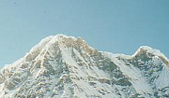
Matching with Features
Problem 1:
Detect the same point independently in both images
counter-example:
no chance to match!
We need a repeatable detector

Slide 13
Matching with Features
Problem 2:
For each point correctly recognize the corresponding one
?
We need a reliable and distinctive descriptor

Slide 14
Building a Panorama
M. Brown and D. G. Lowe. Recognising Panoramas. ICCV 2003

Slide 15
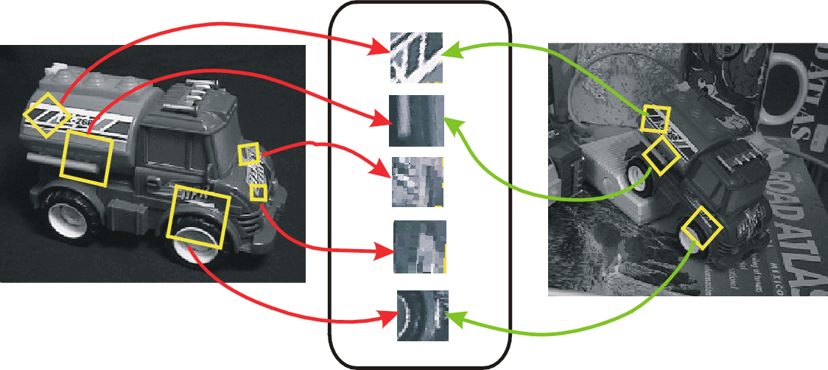
Preview
Detector: detect same scene points independently in both images
Descriptor: encode local neighboring window
Note how scale & rotation of window are the same in both image (but computed independently)
Correspondence: find most similar descriptor in other image
detector location
Note: here viewpoint is different, not panorama (they show off)
Descriptor

Slide 16
Outline
Feature point detection
Harris corner detector
finding a characteristic scale: DoG or Laplacian of Gaussian
Local image description
SIFT features
16

Slide 17
Harris corner detector
Darya Frolova, Denis Simakov The Weizmann Institute of Science
http://www.wisdom.weizmann.ac.il/~deniss/vision_spring04/files/InvariantFeatures.ppt
C.Harris, M.Stephens. “A Combined Corner and Edge Detector”. 1988

Slide 18
The Basic Idea
We should easily localize the point by looking through a small window
Shifting a window in any direction should give a large change in pixels intensities in window
makes location precisely define
Darya Frolova, Denis Simakov The Weizmann Institute of Science
http://www.wisdom.weizmann.ac.il/~deniss/vision_spring04/files/InvariantFeatures.ppt

Slide 19
Corner Detector: Basic Idea
Darya Frolova, Denis Simakov The Weizmann Institute of Science
http://www.wisdom.weizmann.ac.il/~deniss/vision_spring04/files/InvariantFeatures.ppt
“flat” region: no change in all directions
“edge”: no change along the edge direction
“corner”: significant change in all directions

Slide 20
Harris Detector: Mathematics
Window-averaged squared change of intensity induced by shifting the image data by [u,v]:
Darya Frolova, Denis Simakov The Weizmann Institute of Science
http://www.wisdom.weizmann.ac.il/~deniss/vision_spring04/files/InvariantFeatures.ppt
Window function
Shifted intensity
Intensity
Window function w(x,y) =
or
1 in window, 0 outside
Gaussian

Slide 21
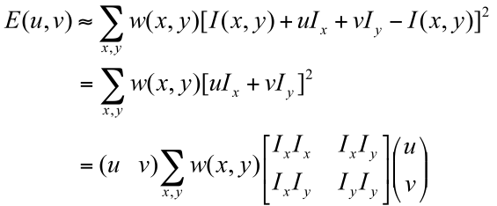
Taylor series approximation to shifted image gives quadratic form for error as function of image shifts.

Slide 22
Harris Detector: Mathematics
Expanding I(x,y) in a Taylor series expansion, we have, for small shifts [u,v], a quadratic approximation to the error surface between a patch and itself, shifted by [u,v]:
Darya Frolova, Denis Simakov The Weizmann Institute of Science
http://www.wisdom.weizmann.ac.il/~deniss/vision_spring04/files/InvariantFeatures.ppt
where M is a 2⋅2 matrix computed from image derivatives:
M is often called structure tensor

Slide 23
Harris Detector: Mathematics
Intensity change in shifting window: eigenvalue analysis
λ₁, λ₂ – eigenvalues of M
Darya Frolova, Denis Simakov The Weizmann Institute of Science
http://www.wisdom.weizmann.ac.il/~deniss/vision_spring04/files/InvariantFeatures.ppt
direction of the fastest change
Ellipse E(u,v) = const
direction of the slowest change
(λ_{max})^{-1/2}
Iso-contour of the squared error, E(u,v)
(λ_{min})^{-1/2}

Slide 24
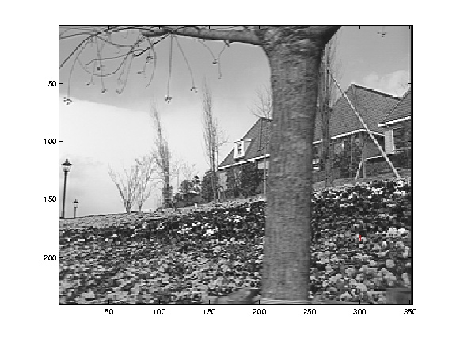
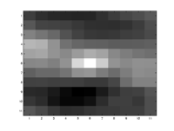
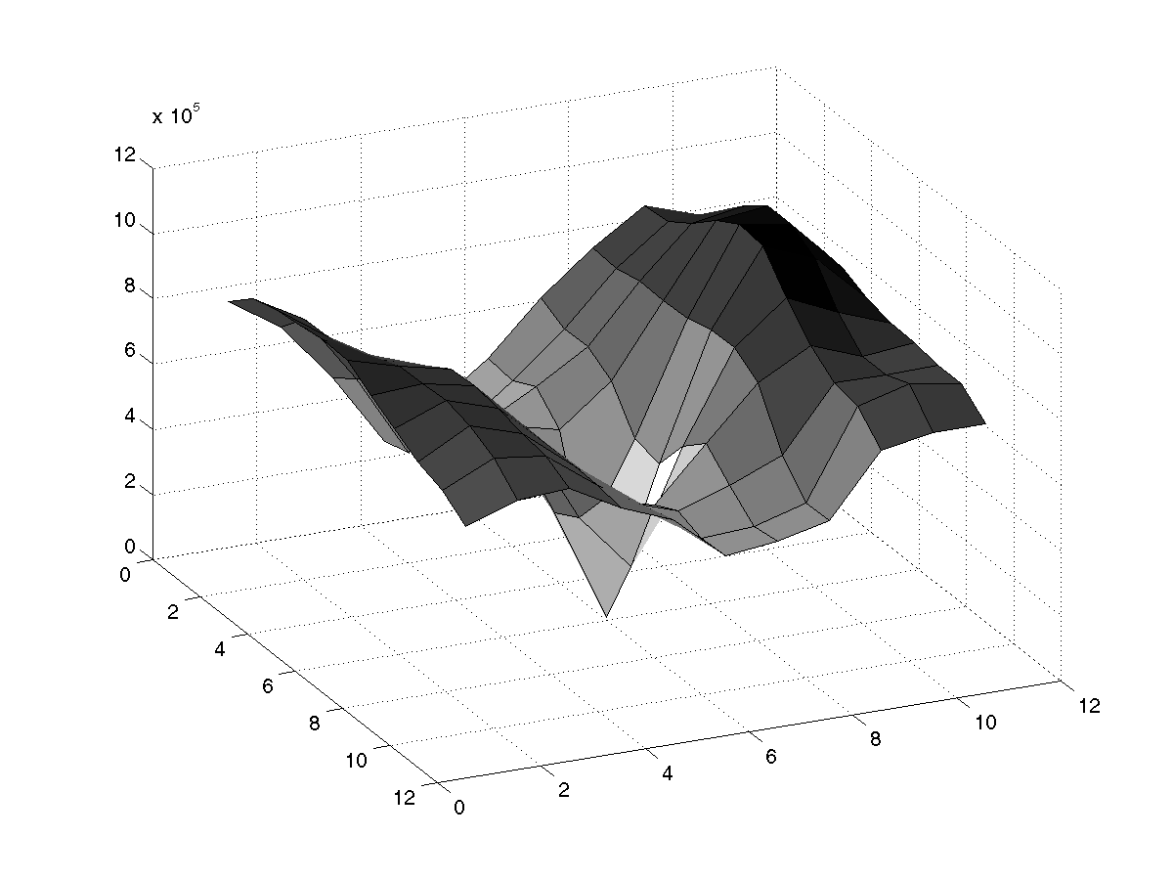
Selecting Good Features
Image patch
Darya Frolova, Denis Simakov The Weizmann Institute of Science
http://www.wisdom.weizmann.ac.il/~deniss/vision_spring04/files/InvariantFeatures.ppt
12x10^5
Error surface
λ₁ and λ₂ are large

Slide 25
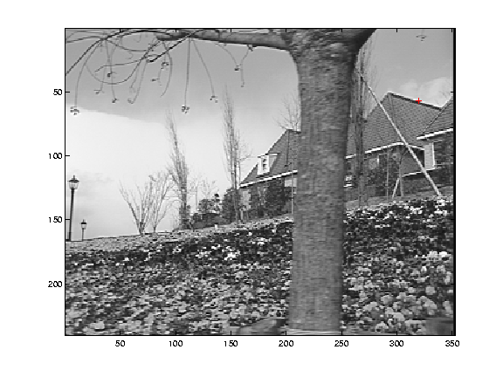
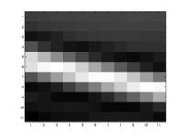
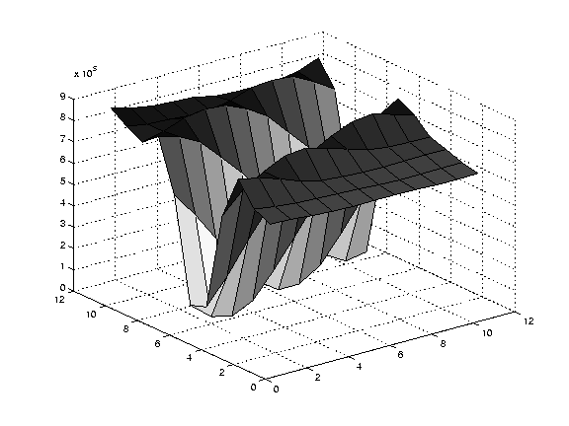
Selecting Good Features
Image patch
Darya Frolova, Denis Simakov The Weizmann Institute of Science
http://www.wisdom.weizmann.ac.il/~deniss/vision_spring04/files/InvariantFeatures.ppt
9x10^5
Error surface
large λ₁, small λ₂

Slide 26
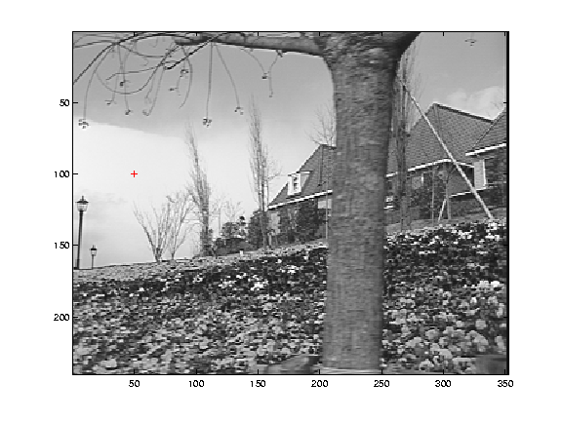
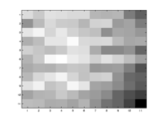
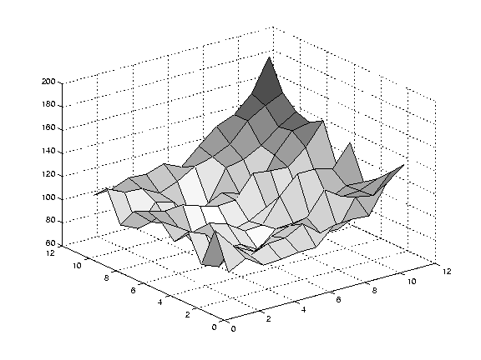
Selecting Good Features
Image patch
(contrast auto-scaled)
Darya Frolova, Denis Simakov The Weizmann Institute of Science
http://www.wisdom.weizmann.ac.il/~deniss/vision_spring04/files/InvariantFeatures.ppt
200
Error surface
(vertical scale exaggerated relative to previous plots)
small λ₁, small λ₂

Slide 27
Harris Detector: Mathematics
Classification of image points using eigenvalues of M:
λ₂
“Edge” λ₂ >> λ₁
“Corner” λ₁ and λ₂ are large, λ₁ ~ λ₂; E increases in all directions
http://www.wisdom.weizmann.ac.il/~deniss/vision_spring04/files/InvariantFeatures.ppt
Darya Frolova, Denis Simakov The Weizmann Institute of Science
λ₁ and λ₂ are small; E is almost constant in all directions
“Flat” region
“Edge” λ₁ >> λ₂
λ₁

Slide 28
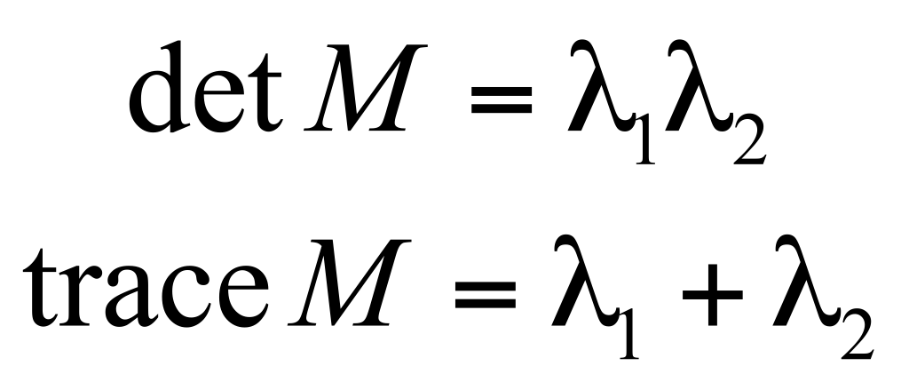
Harris Detector: Mathematics
Measure of corner response:
http://www.wisdom.weizmann.ac.il/~deniss/vision_spring04/files/InvariantFeatures.ppt
Darya Frolova, Denis Simakov The Weizmann Institute of Science
(k – empirical constant, k = 0.04-0.06)
(Shi-Tomasi variation: use min(λ1,λ2) instead of R)

Slide 29
Harris Detector: Mathematics
λ₂
“Edge”
“Corner”
R depends only on eigenvalues of M
R is large for a corner
R is negative with large magnitude for an edge
|R| is small for a flat region
R < 0
R > 0
http://www.wisdom.weizmann.ac.il/~deniss/vision_spring04/files/InvariantFeatures.ppt
Darya Frolova, Denis Simakov The Weizmann Institute of Science
“Flat”
“Edge”
|R| small
R < 0
λ₁

Slide 30
Harris Detector
The Algorithm:
Find points with large corner response function R (R > threshold)
Take the points of local maxima of R

Slide 31
Harris corner detector algorithm
Compute image gradients Ix Iy for all pixels
For each pixel
Compute by looping over neighbors x,y
compute
Find points with large corner response function R (R > threshold)
Take the points of locally maximum R as the detected feature points (ie, pixels where R is bigger than for all the 4 or 8 neighbors).
http://www.wisdom.weizmann.ac.il/~deniss/vision_spring04/files/InvariantFeatures.ppt
Darya Frolova, Denis Simakov The Weizmann Institute of Science
31

Slide 32
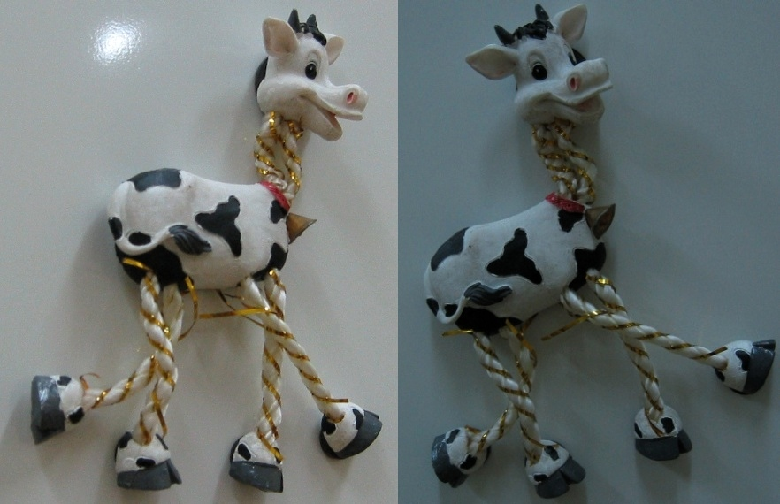
Harris Detector: Workflow
http://www.wisdom.weizmann.ac.il/~deniss/vision_spring04/files/InvariantFeatures.ppt
Darya Frolova, Denis Simakov The Weizmann Institute of Science

Slide 33
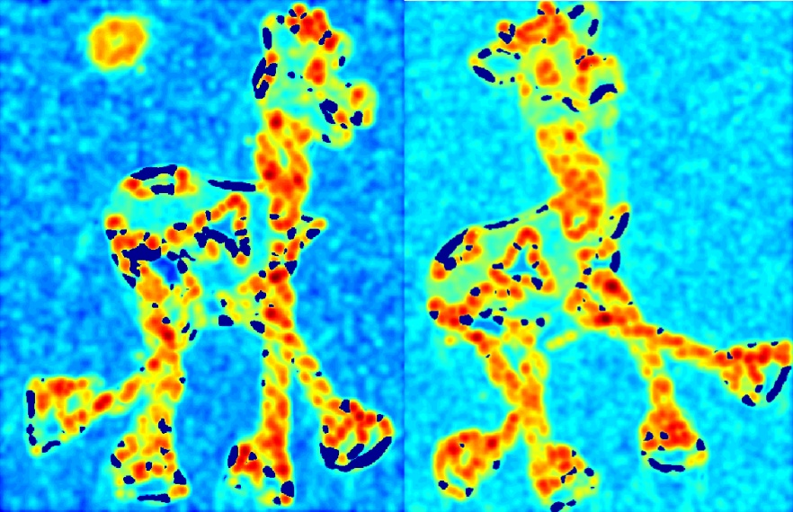
Harris Detector: Workflow
Compute corner response R
http://www.wisdom.weizmann.ac.il/~deniss/vision_spring04/files/InvariantFeatures.ppt
Darya Frolova, Denis Simakov The Weizmann Institute of Science

Slide 34
Harris Detector: Workflow
Find points with large corner response: R>threshold
http://www.wisdom.weizmann.ac.il/~deniss/vision_spring04/files/InvariantFeatures.ppt
Darya Frolova, Denis Simakov The Weizmann Institute of Science

Slide 35
Harris Detector: Workflow
Take only the points of local maxima of R
http://www.wisdom.weizmann.ac.il/~deniss/vision_spring04/files/InvariantFeatures.ppt
Darya Frolova, Denis Simakov The Weizmann Institute of Science

Slide 36
Harris Detector: Workflow
http://www.wisdom.weizmann.ac.il/~deniss/vision_spring04/files/InvariantFeatures.ppt
Darya Frolova, Denis Simakov The Weizmann Institute of Science

Slide 37
Selecting Good Features
What’s a “good feature”?
Satisfies brightness constancy—looks the same in both images
Has sufficient texture variation
Does not have too much texture variation
Corresponds to a “real” surface patch—see below:
Does not deform too much over time
Bad feature
Left eye view
Right eye view
Good feature

Slide 38
Analysis of Harris corner detector invariance properties
Geometry
rotation
scale
Photometry
intensity change
38

Slide 39
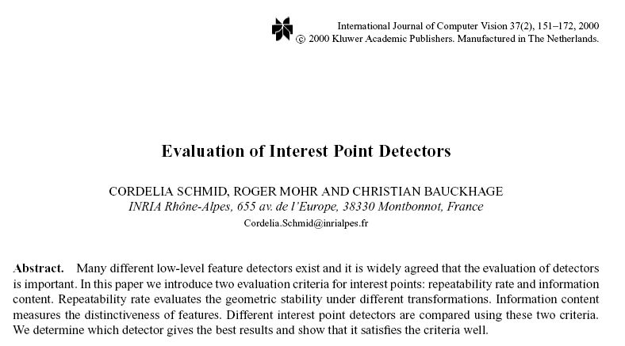
Evaluation plots are from this paper

Slide 40
Models of Image Change
Geometry
Rotation
Similarity (rotation + uniform scale)
Affine (scale dependent on direction) valid for: orthographic camera, locally planar object
Photometry
Affine intensity change (I → a I + b)

Slide 41
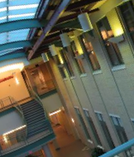
Harris Detector: Some Properties
Rotation invariance?

Slide 42
Harris Detector: Some Properties
Rotation invariance
Ellipse rotates but its shape (i.e. eigenvalues) remains the same
Corner response R is invariant to image rotation
Eigen analysis allows us to work in the canonical frame of the linear form.

Slide 43
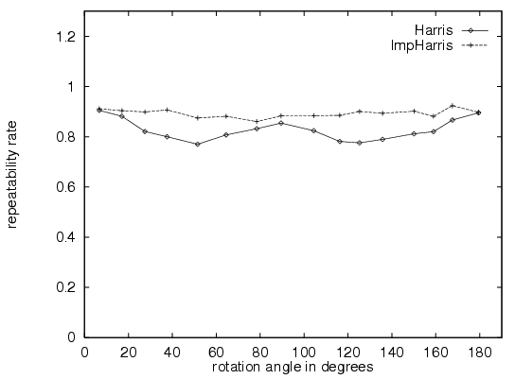
Rotation Invariant Detection
ImpHarris: derivatives are computed more precisely by replacing the [-2 -1 0 1 2] mask with derivatives of a Gaussian (sigma = 1).
Harris Corner Detector
This gives us rotation invariant detection, but we’ll need to do more to ensure a rotation invariant descriptor...
C.Schmid et.al. “Evaluation of Interest Point Detectors”. IJCV 2000

Slide 44
Harris Detector: Some Properties
Invariance to image intensity change?

Slide 45
Harris Detector: Some Properties
Partial invariance to additive and multiplicative intensity changes
Only derivatives are used => invariance to intensity shift I → I + b
Intensity scaling: I → a I fine, except for the threshold that’s used to specify when R is large enough.
http://www.wisdom.weizmann.ac.il/~deniss/vision_spring04/files/InvariantFeatures.ppt
Darya Frolova, Denis Simakov The Weizmann Institute of Science
R
R
threshold
x (image coordinate)
x (image coordinate)

Slide 46
Harris Detector: Some Properties
Invariant to image scale?
image
zoomed image

Slide 47
Harris Detector: Some Properties
Not invariant to image scale!
http://www.wisdom.weizmann.ac.il/~deniss/vision_spring04/files/InvariantFeatures.ppt
Darya Frolova, Denis Simakov The Weizmann Institute of Science
All points will be classified as edges
Corner !

Slide 48
Harris Detector: Some Properties
Quality of Harris detector for different scale changes
Repeatability rate:
# correspondences # possible correspondences
http://www.wisdom.weizmann.ac.il/~deniss/vision_spring04/files/InvariantFeatures.ppt
Darya Frolova, Denis Simakov The Weizmann Institute of Science
C.Schmid et.al. “Evaluation of Interest Point Detectors”. IJCV 2000

Slide 49
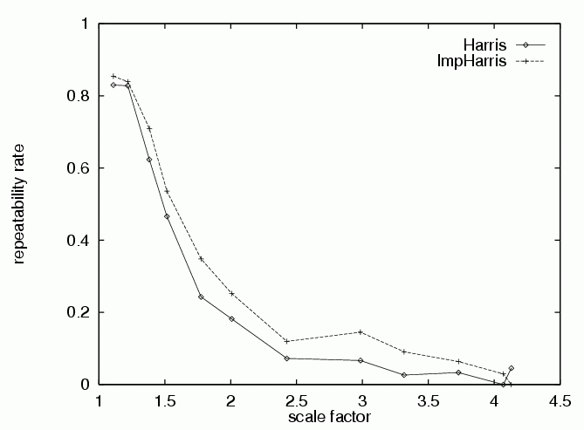
Harris Detector: Some Properties
Quality of Harris detector for different scale changes
Repeatability rate:
# correspondences # possible correspondences
http://www.wisdom.weizmann.ac.il/~deniss/vision_spring04/files/InvariantFeatures.ppt
Darya Frolova, Denis Simakov The Weizmann Institute of Science
C.Schmid et.al. “Evaluation of Interest Point Detectors”. IJCV 2000

Slide 50
Scale Invariant Detection
Consider regions (e.g. circles) of different sizes around a point
Regions of corresponding sizes will look the same in both images
The features look the same to these two operators.
http://www.wisdom.weizmann.ac.il/~deniss/vision_spring04/files/InvariantFeatures.ppt
Darya Frolova, Denis Simakov The Weizmann Institute of Science

Slide 51
Scale Invariant Detection
The problem: how do we choose corresponding circles independently in each image?
Do objects in the image have a characteristic scale that we can identify?
http://www.wisdom.weizmann.ac.il/~deniss/vision_spring04/files/InvariantFeatures.ppt
Darya Frolova, Denis Simakov The Weizmann Institute of Science

Slide 52
Scale Invariant Detection
Solution:
Design a function on the region (circle), which is “scale invariant” (the same for corresponding regions, even if they are at different scales)
Example: average intensity. For corresponding regions (even of different sizes) it will be the same.
For a point in one image, we can consider it as a function of region size (circle radius)
f
Image 1
f
Image 2
scale = 1/2
region size
region size

Slide 53
Scale Invariant Detection
Common approach:
Take a local maximum of this function
Observation: region size, for which the maximum is achieved, should be invariant to image scale.
Important: this scale invariant region size is found in each image independently!
f
Image 1
f
Image 2
scale = 1/2
s₁
region size
s₂
region size

Slide 54
Scale Invariant Detection
A “good” function for scale detection: has one stable sharp peak
f
f
f
Good !
bad
bad
region size
region size
region size
For usual images: a good function would be a one which responds to contrast (sharp local intensity change)

Slide 55
Detection over scale
Requires a method to repeatably select points in location and scale:
The only reasonable scale-space kernel is a Gaussian (Koenderink, 1984; Lindeberg, 1994)
An efficient choice is to detect peaks in the difference of Gaussian pyramid (Burt & Adelson, 1983; Crowley & Parker, 1984 – but examining more scales)
Difference-of-Gaussian with constant ratio of scales is a close approximation to Lindeberg’s scale-normalized Laplacian (can be shown from the heat diffusion equation)

Slide 56
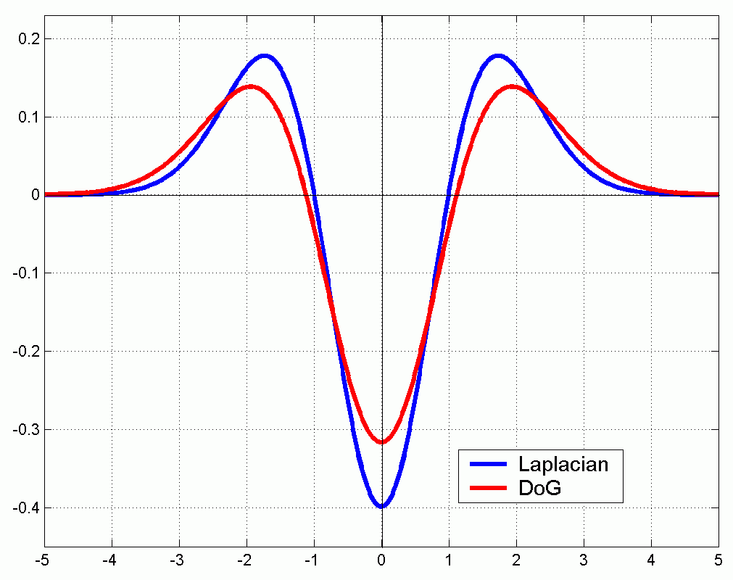
Scale Invariant Detection
Functions for determining scale
Kernels:
(Laplacian: 2nd derivative of Gaussian)
(Difference of Gaussians)
http://www.wisdom.weizmann.ac.il/~deniss/vision_spring04/files/InvariantFeatures.ppt
Darya Frolova, Denis Simakov The Weizmann Institute of Science
where Gaussian
Note: both kernels are invariant to scale and rotation

Slide 57
Scale Invariant Detectors
scale
Harris-Laplacian¹ Find local maximum of:
Harris corner detector in space (image coordinates)
Laplacian in scale
← Laplacian →
y
← Harris →
x
http://www.wisdom.weizmann.ac.il/~deniss/vision_spring04/files/InvariantFeatures.ppt
Darya Frolova, Denis Simakov The Weizmann Institute of Science
¹ K.Mikolajczyk, C.Schmid. “Indexing Based on Scale Invariant Interest Points”. ICCV 2001

Slide 58
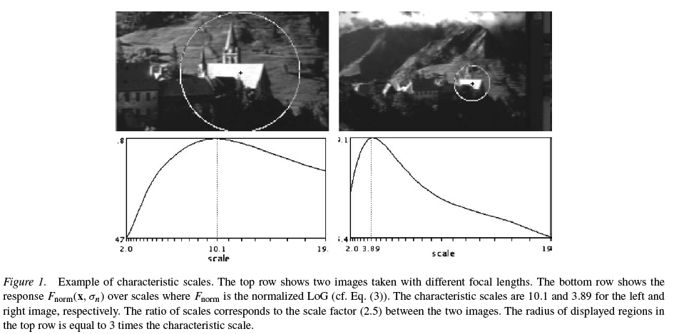
Laplacian of Gaussian for selection of characteristic scale
http://www.robots.ox.ac.uk/~vgg/research/affine/det_eval_files/mikolajczyk_ijcv2004.pdf

Slide 59
Scale Invariant Detectors
scale
Harris-Laplacian¹ Find local maximum of:
Harris corner detector in space (image coordinates)
Laplacian in scale
← Laplacian →
y
← Harris →
x
http://www.wisdom.weizmann.ac.il/~deniss/vision_spring04/files/InvariantFeatures.ppt
Darya Frolova, Denis Simakov The Weizmann Institute of Science
scale
SIFT (Lowe)² Find local maximum (minimum) of:
Difference of Gaussians in space and scale
← DoG →
y
← DoG →
x
¹ K.Mikolajczyk, C.Schmid. “Indexing Based on Scale Invariant Interest Points”. ICCV 2001 ² D.Lowe. “Distinctive Image Features from Scale-Invariant Keypoints”. Accepted to IJCV 2004

Slide 60
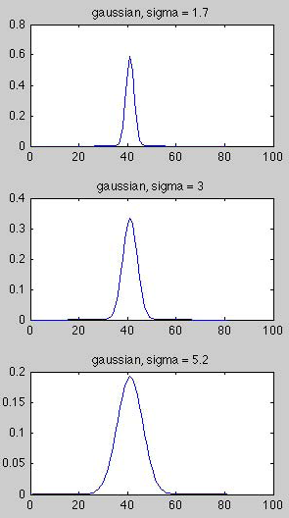
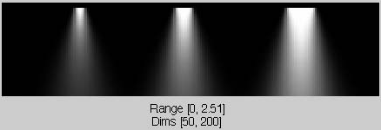
Scale-space example: 3 bumps of different widths.
1-d bumps
display as an image
scale
blur with Gaussians of increasing width
space

Slide 61
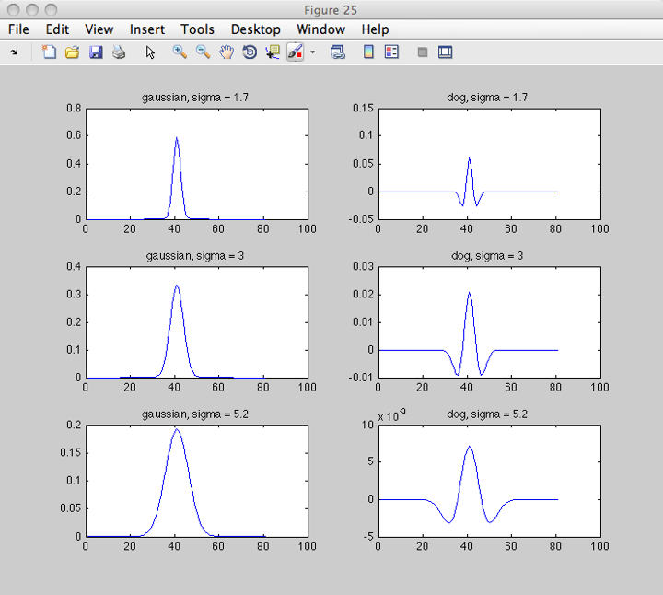
Gaussian and difference-of-Gaussian filters
61

Slide 62
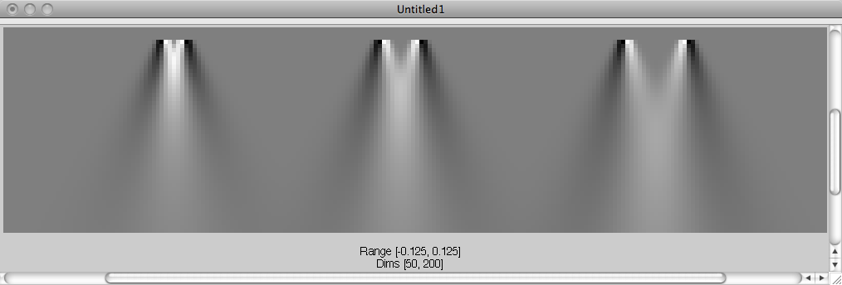
The bumps, filtered by difference-of-Gaussian filters
scale
space

Slide 63
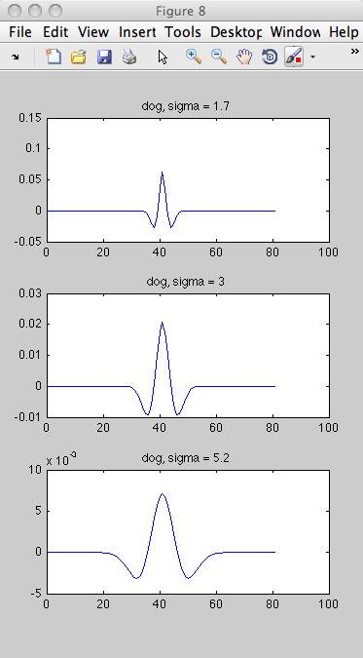
The bumps, filtered by difference-of-Gaussian filters
1.7
3.0
5.2
a
b
c
cross-sections along red lines plotted next slide

Slide 64
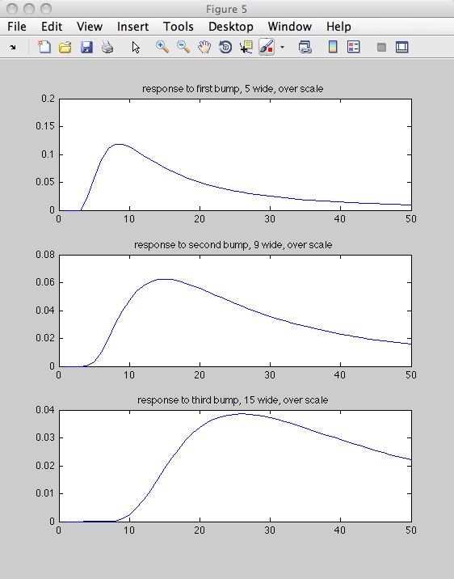
Scales of peak responses are proportional to bump width (the characteristic scale of each bump): [1.7, 3, 5.2] ./ [5, 9, 15] = 0.3400 0.3333 0.3467
a
sigma = 1.7
b
sigma = 3
sigma = 5.2
c
Diff of Gauss filter giving peak response
5
9
15
64

Slide 65
Scales of peak responses are proportional to bump width (the characteristic scale of each bump):
[1.7, 3, 5.2] ./ [5, 9, 15] = 0.3400 0.3333 0.3467
Note that the max response filters each has the same relationship to the bump that it favors (the zero crossings of the filter are about at the bump edges). So the scale space analysis correctly picks out the “characteristic scale” for each of the bumps.
More generally, this happens for the features of the images we analyze.

Slide 66
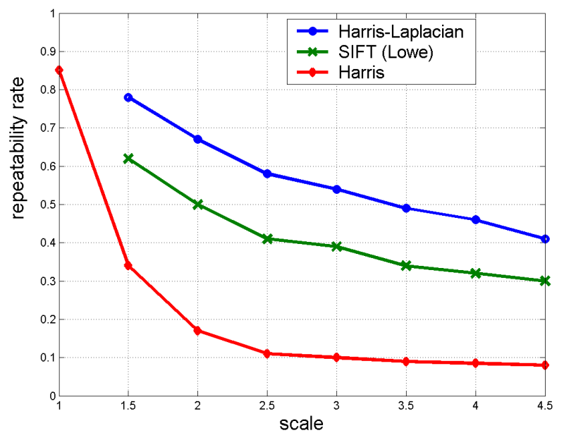
Scale Invariant Detectors
Experimental evaluation of detectors w.r.t. scale change
Repeatability rate:
# correspondences # possible correspondences
http://www.wisdom.weizmann.ac.il/~deniss/vision_spring04/files/InvariantFeatures.ppt
Darya Frolova, Denis Simakov The Weizmann Institute of Science
K.Mikolajczyk, C.Schmid. “Indexing Based on Scale Invariant Interest Points”. ICCV 2001

Slide 67
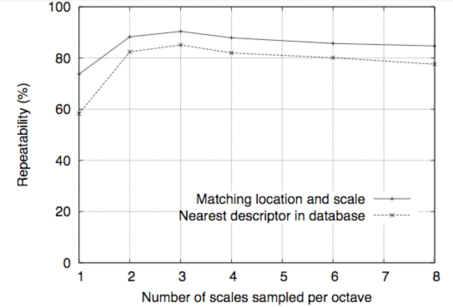
Repeatability vs number of scales sampled per octave
David G. Lowe, "Distinctive image features from scale-invariant keypoints," International Journal of Computer Vision, 60, 2 (2004), pp. 91-110

Slide 68
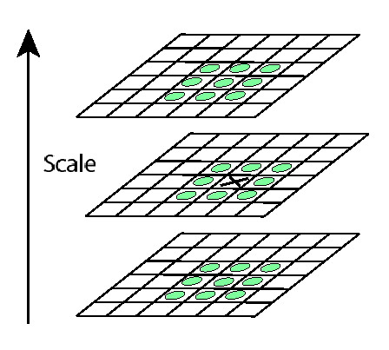
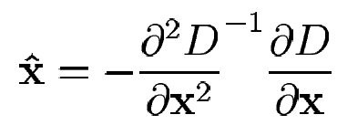
Some details of key point localization over scale and space
Detect maxima and minima of difference-of-Gaussian in scale space
Fit a quadratic to surrounding values for sub-pixel and sub-scale interpolation (Brown & Lowe, 2002)
Taylor expansion around point:
Offset of extremum (use finite differences for derivatives):
http://www.wisdom.weizmann.ac.il/~deniss/vision_spring04/files/InvariantFeatures.ppt
Darya Frolova, Denis Simakov The Weizmann Institute of Science

Slide 69
Scale and Rotation Invariant Detection: Summary
Given: two images of the same scene with a large scale difference and/or rotation between them
Goal: find the same interest points independently in each image
Solution: search for maxima of suitable functions in scale and in space (over the image). Also, find characteristic orientation.
Methods:
Harris-Laplacian [Mikolajczyk, Schmid]: maximize Laplacian over scale, Harris’ measure of corner response over the image
SIFT [Lowe]: maximize Difference of Gaussians over scale and space

Slide 70
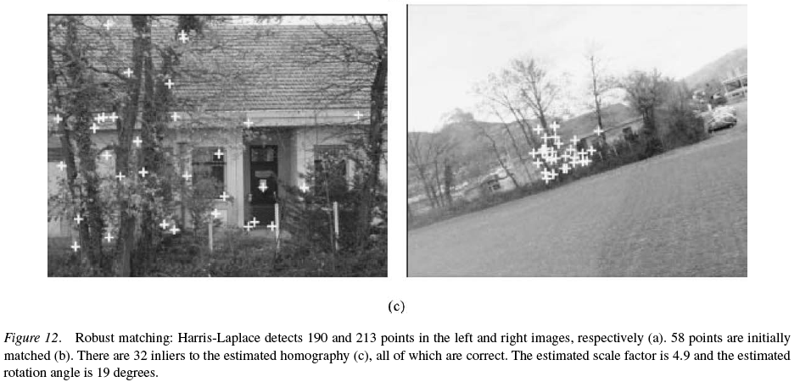
Example of keypoint detection
http://www.robots.ox.ac.uk/~vgg/research/affine/det_eval_files/mikolajczyk_ijcv2004.pdf

Slide 71
Outline
Feature point detection
Harris corner detector
finding a characteristic scale
Local image description
SIFT features
71

Slide 72
Recall: Matching with Features
Problem 1:
Detect the same point independently in both images
no chance to match!
Good
We need a repeatable detector

Slide 73
Recall: Matching with Features
Problem 2:
For each point correctly recognize the corresponding one
?
We need a reliable and distinctive descriptor

Slide 74
CVPR 2003 Tutorial Recognition and Matching Based on Local Invariant Features
David Lowe
Computer Science Department
University of British Columbia
http://www.cs.ubc.ca/~lowe/papers/ijcv04.pdf

Slide 75
SIFT vector formation
Computed on rotated and scaled version of window according to computed orientation & scale
resample the window
Based on gradients weighted by a Gaussian of variance half the window (for smooth falloff)

Slide 76
SIFT vector formation
4x4 array of gradient orientation histograms
not really histogram, weighted by magnitude
8 orientations x 4x4 array = 128 dimensions
Motivation: some sensitivity to spatial layout, but not too much.
showing only 2x2 here but is 4x4

Slide 77
Reduce effect of illumination
128-dim vector normalized to 1
Threshold gradient magnitudes to avoid excessive influence of high gradients
after normalization, clamp gradients >0.2
renormalize

Slide 78
Tuning and evaluating the SIFT descriptors
Database images were subjected to rotation, scaling, affine stretch, brightness and contrast changes, and added noise. Feature point detectors and descriptors were compared before and after the distortions, and evaluated for:
Sensitivity to number of histogram orientations and subregions.
Stability to noise.
Stability to affine change.
Feature distinctiveness
78

Slide 79
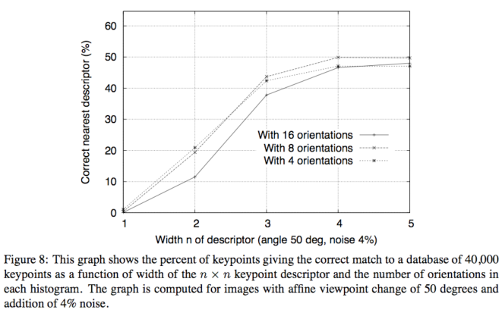
Sensitivity to number of histogram orientations and subregions, n.

Slide 80
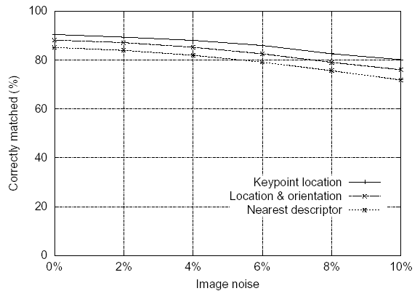
Feature stability to noise
Match features after random change in image scale & orientation, with differing levels of image noise
Find nearest neighbor in database of 30,000 features

Slide 81
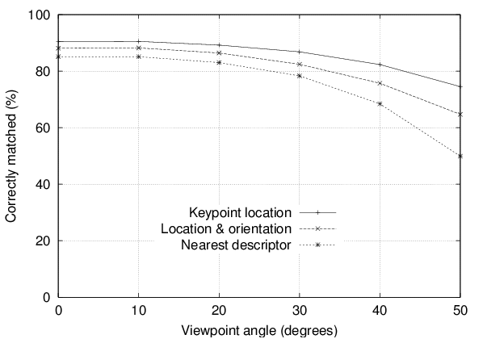
Feature stability to affine change
Match features after random change in image scale & orientation, with 2% image noise, and affine distortion
Find nearest neighbor in database of 30,000 features

Slide 82
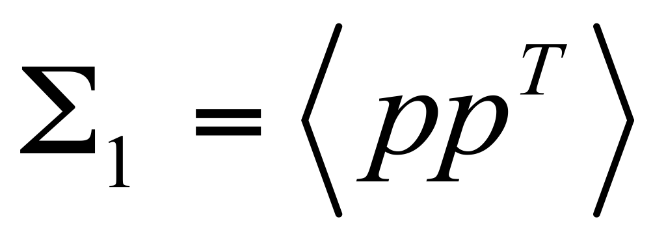
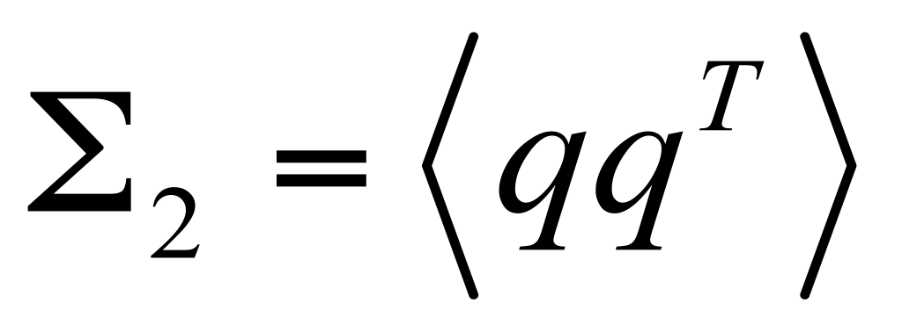
Affine Invariant Descriptors
Find affine normalized frame
A
A₁
A₂
rotation
Compute rotational invariant descriptor in this normalized frame
J.Matas et.al. “Rotational Invariants for Wide-baseline Stereo”. Research Report of CMP, 2003

Slide 83
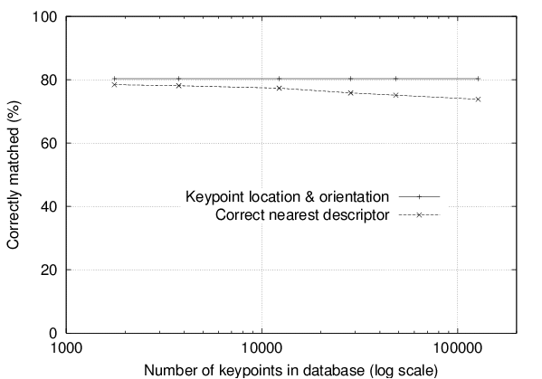
Distinctiveness of features
Vary size of database of features, with 30 degree affine change, 2% image noise
Measure % correct for single nearest neighbor match

Slide 84
Application of invariant local features to object (instance) recognition.
Image content is transformed into local feature coordinates that are invariant to translation, rotation, scale, and other imaging parameters
SIFT Features

Slide 86
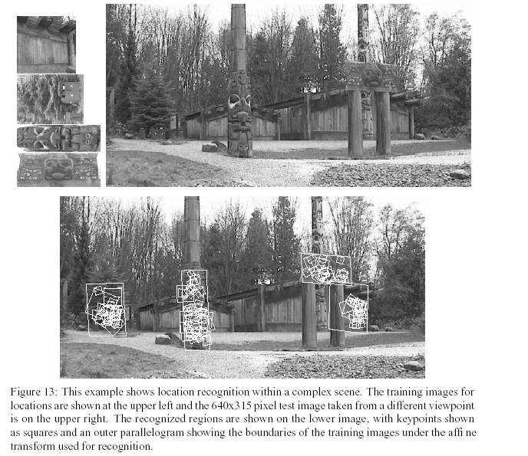
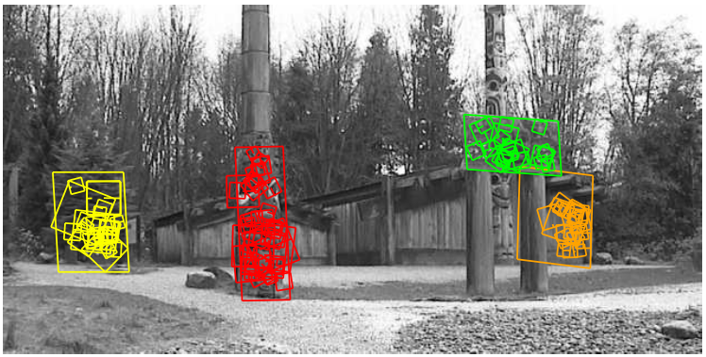

Slide 87
SIFT features impact
SIFT feature paper citations:
Distinctive image features from scale-invariant keypointsDG Lowe - International journal of computer vision, 2004 - Springer International Journal of Computer Vision 60(2), 91–110, 2004 cс 2004 Kluwer Academic Publishers. Computer Science Department, University of British Columbia ...Cited by 16232 (google)
A good SIFT features tutorial:
http://www.cs.toronto.edu/~jepson/csc2503/tutSIFT04.pdf
By Estrada, Jepson, and Fleet.
The original SIFT paper: http://www.cs.ubc.ca/~lowe/papers/ijcv04.pdf

Slide 88
Now we have
Well-localized feature points
Distinctive descriptor
Now we need to
match pairs of feature points in different images
Robustly compute homographies (in the presence of errors/outliers)

