Slide 1
Lecture 13
Homographies and RANSAC

Slide 2
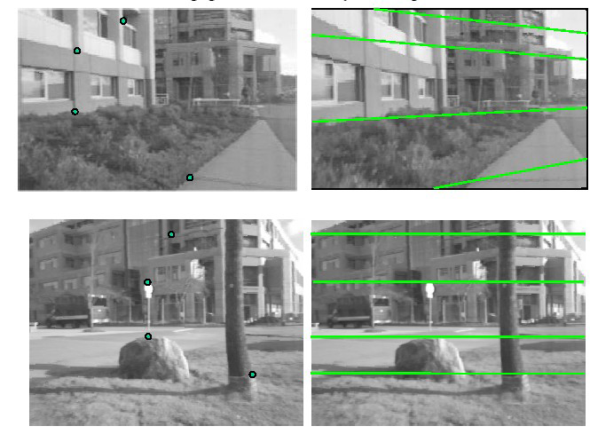
Depth-based ambiguity of position
Camera A
Camera B

Slide 3
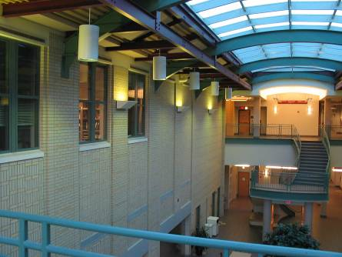
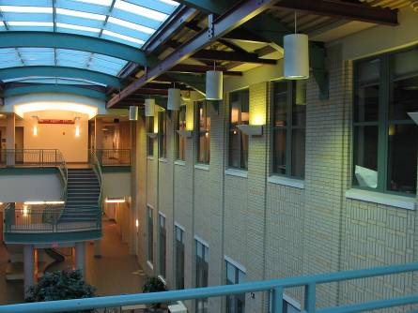
Under what conditions can you know where to translate each point of image A to where it would appear in camera B (with calibrated cameras), knowing nothing about image depths?
Camera A
Camera B

Slide 4
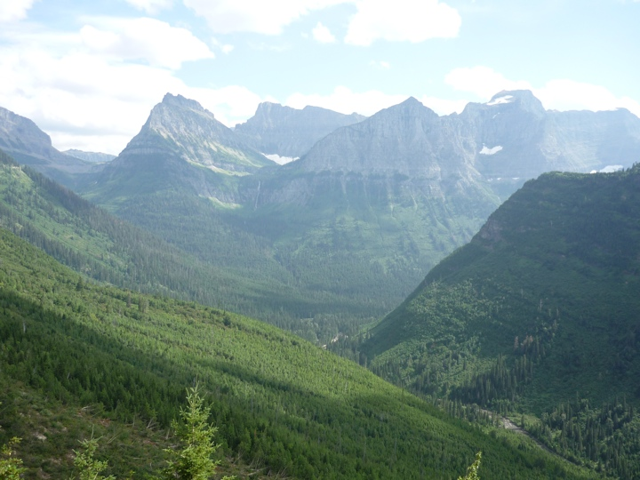
(a) camera rotation

Slide 5
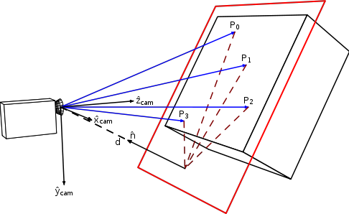
and (b) imaging a planar surface

Slide 6
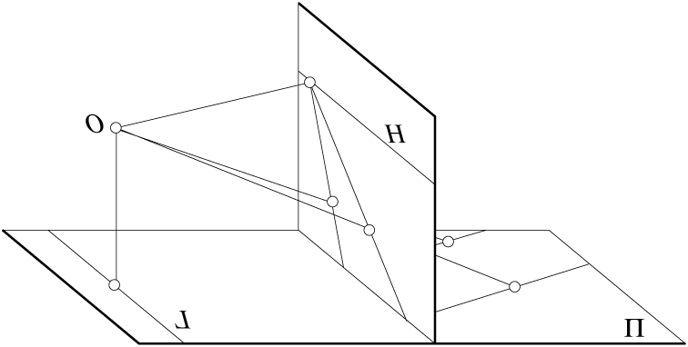
Geometry of perspective projection
sensor plane
inverted copy of sensor plane
pinhole
Let’s look at this scene from above...

Slide 7
Two cameras with same center of projection
camera A
camera B
common pinhole position of the cameras
Can generate any synthetic camera view
as long as it has the same center of projection!

Slide 8
Two cameras with offset centers of projection
camera A
camera B
camera A center
camera B center

Slide 9
Recap
When we only rotate the camera (around nodal point) depth does not matter
It only performs a 2D warp
one-to-one mapping of the 2D plane
plus of course reveals stuff that was outside the field of view
Now we just need to figure out this mapping
A
camera
B
camera

Slide 10
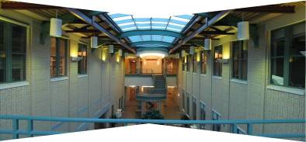
Aligning images: translation?
left on top
right on top
Translations are not enough to align the images

Slide 11
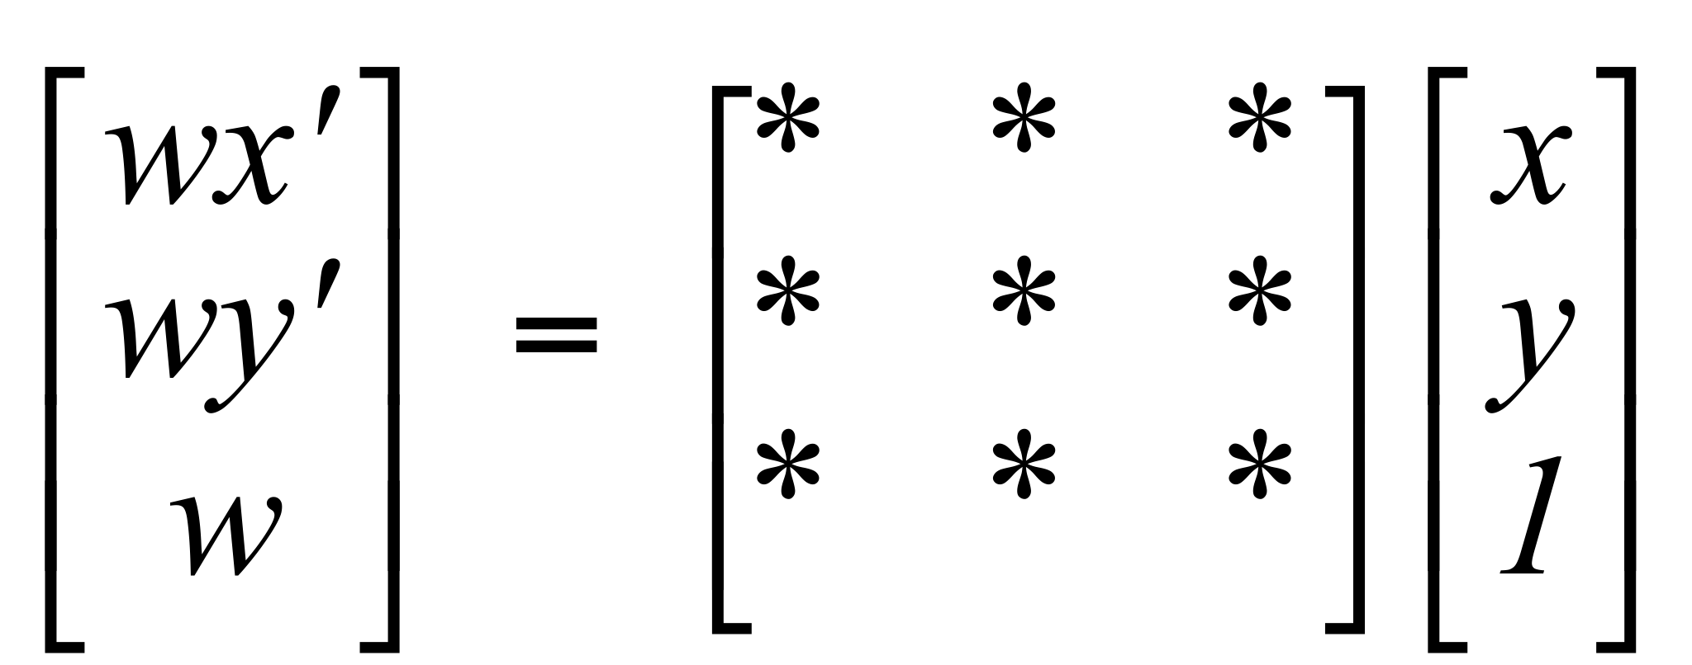
Homography
Projective – mapping between any two projection planes with the same center of projection
called Homography
represented as 3x3 matrix in homogenous coordinates
PP2
See Szeliski Sect 2.1.5, Mapping from one camera to another.
p’
H
p
PP1
To apply a homography H
Compute p’ = Hp (regular matrix multiply)
Convert p’ from homogeneous to image coordinates (divide by w)

Slide 12
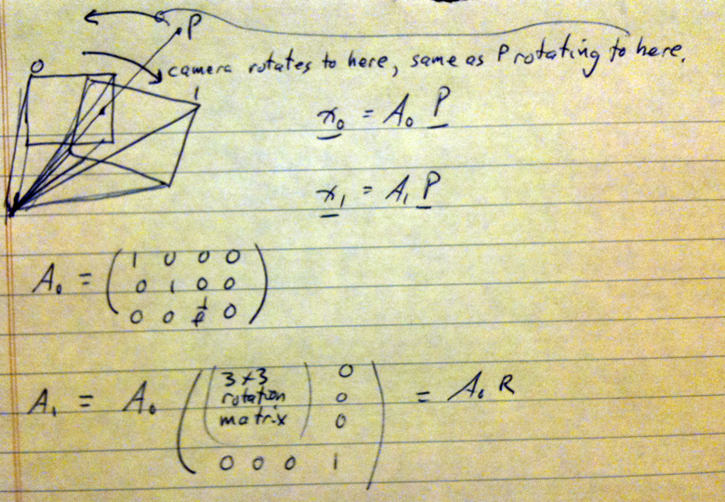
homography

Slide 13
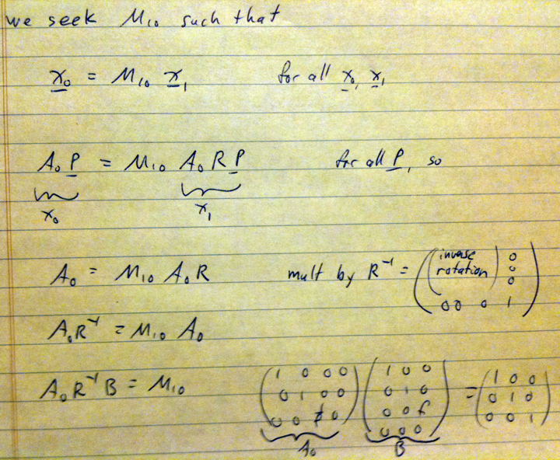
homography

Slide 14
homography
How many pairs of points does it take to specify M_10?

Slide 15
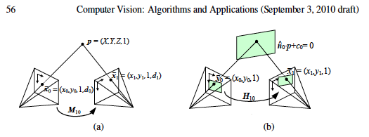
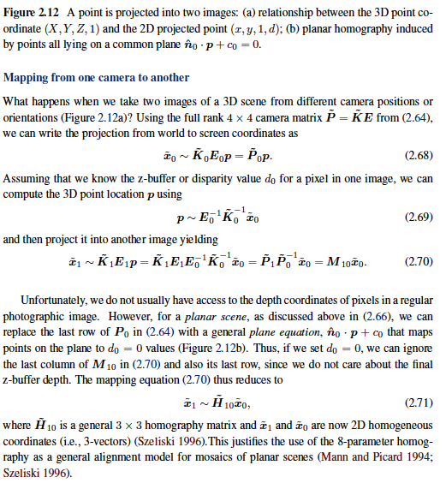
Images of planar objects, taken by generically offset cameras, are also related by a homography.
Planar objects
camera A
camera B
From Szeliski book

Slide 16
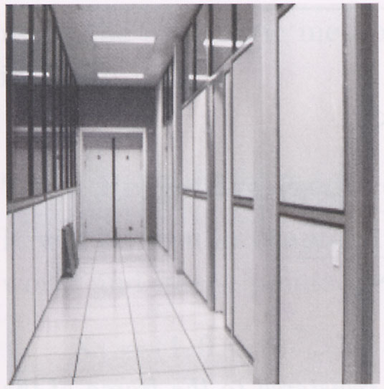
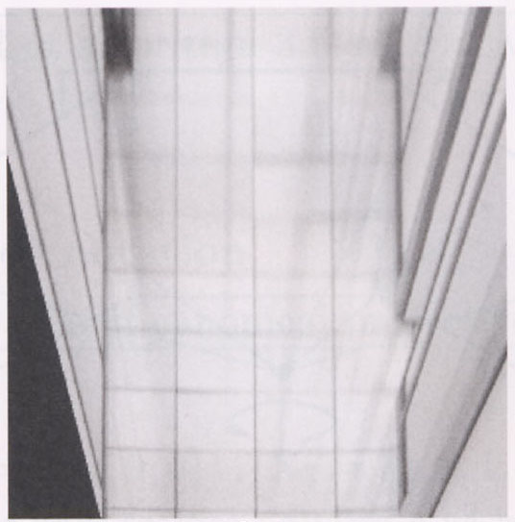
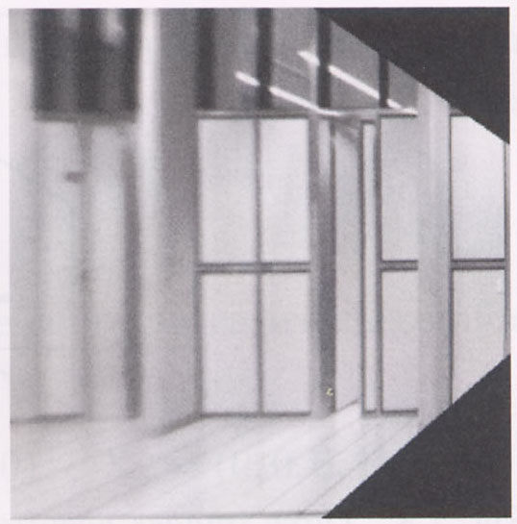
Measurements on planes
4
3
2
1
1
2
3
4
Approach: unwarp then measure
How to unwarp?
CSE 576, Spring 2008
Projective Geometry
6
Notes:
homography!

Slide 17
Image rectification
p’
p
To unwarp (rectify) an image
solve for homography H given p and p’
solve equations of the form: wp’ = Hp
linear in unknowns: w and coefficients of H
H is defined up to an arbitrary scale factor
how many points are necessary to solve for H?
CSE 576, Spring 2008
Projective Geometry
7

Slide 18
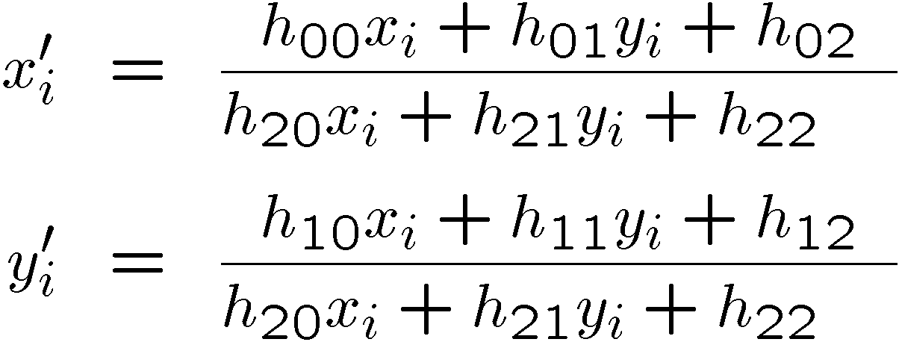
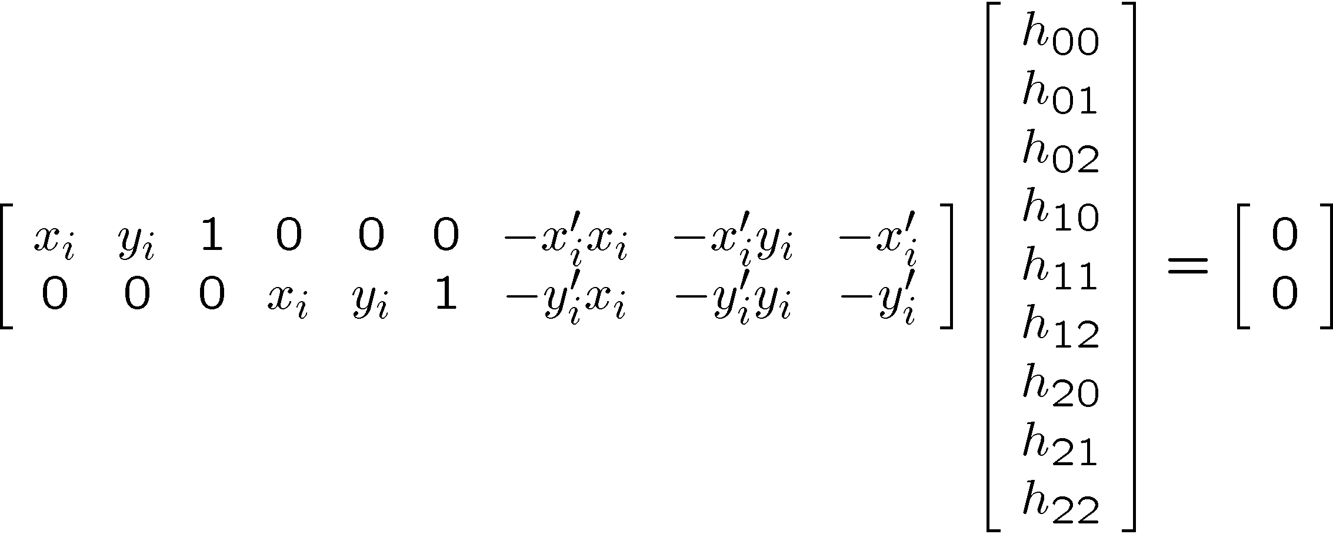
Solving for homographies
w
w
w
CSE 576, Spring 2008
Projective Geometry
8

Slide 19
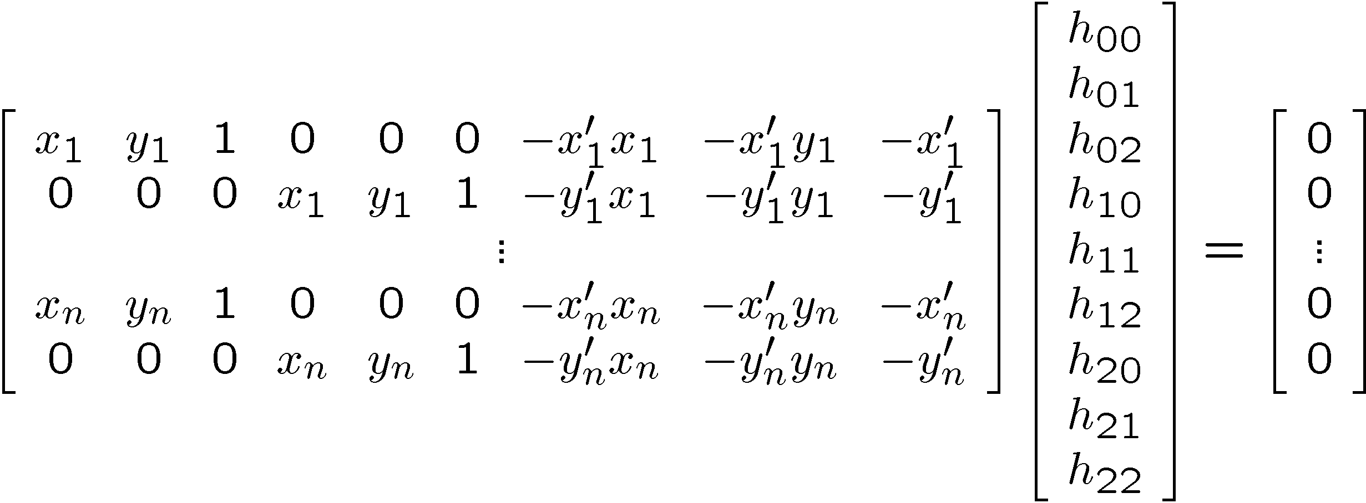
Solving for homographies
A
h
0
2n × 9
9
2n
Defines a least squares problem:
Since h is only defined up to scale, solve for unit vector ĥ
Solution: ĥ = eigenvector of A^{T}A with smallest eigenvalue
Works with 4 or more points
CSE 576, Spring 2008
Projective Geometry
9

Slide 20
Image warping with homographies
homography so that image is parallel to floor
homography so that image is parallel to right wall
image plane below
black area
where no pixel
maps to

Slide 21
automatic image mosaicing
Basic Procedure
Take a sequence of images from the same position.
Rotate the camera about its optical center (entrance pupil).
Robustly compute the homography transformation between second image and first.
Transform (warp) the second image to overlap with first.
Blend the two together to create a mosaic.
If there are more images, repeat.

Slide 22
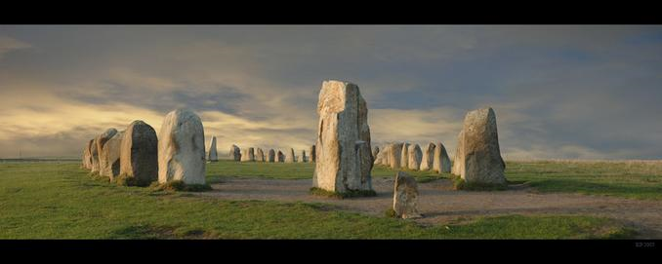
Robust feature matching through RANSAC
© Krister Parmstrand
Nikon D70. Stitched Panorama. The sky has been retouched. No other image manipulation.
15-463: Computational Photography
Alexei Efros, CMU, Fall 2005
with a lot of slides stolen from
Steve Seitz and Rick Szeliski

Slide 23
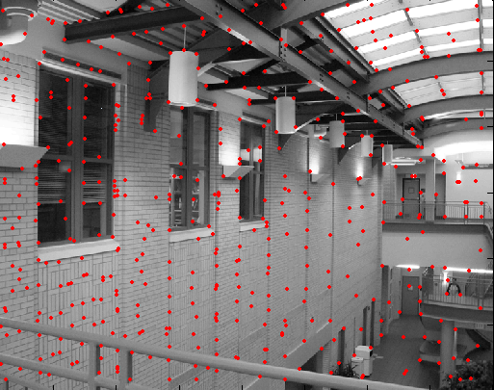
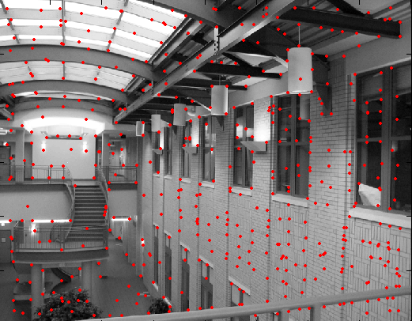
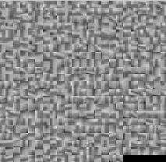
Feature matching
descriptors for left image feature points
descriptors for right image feature points
?

Slide 24
Strategies to match images robustly
(a) Working with individual features: For each feature point, find most similar point in other image (SIFT distance)
Reject ambiguous matches where there are too many similar points
(b) Working with all the features: Given some good feature matches, look for possible homographies relating the two images
Reject homographies that don’t have many feature matches.
24

Slide 25
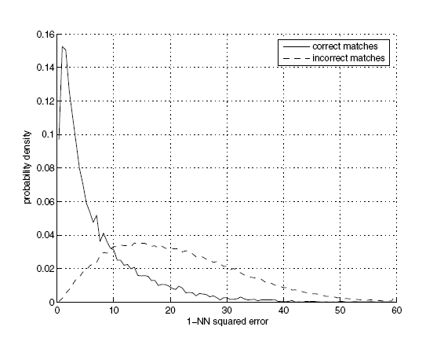
(a) Feature-space outlier rejection
Let’s not match all features, but only these that have “similar enough” matches?
How can we do it?
SSD(patch1,patch2) < threshold
How to set threshold? Not so easy.

Slide 26
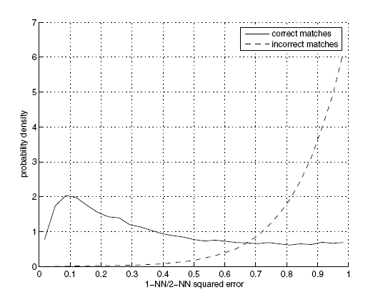
Feature-space outlier rejection
A better way [Lowe, 1999]:
1-NN: SSD of the closest match
2-NN: SSD of the second-closest match
Look at how much better 1-NN is than 2-NN, e.g. 1-NN/2-NN
That is, is our best match so much better than the rest?

Slide 27
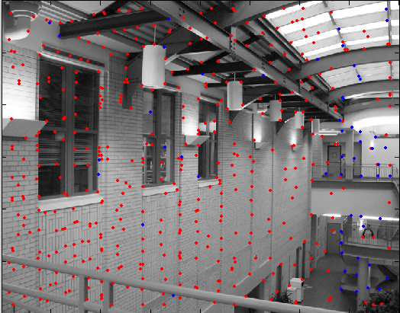
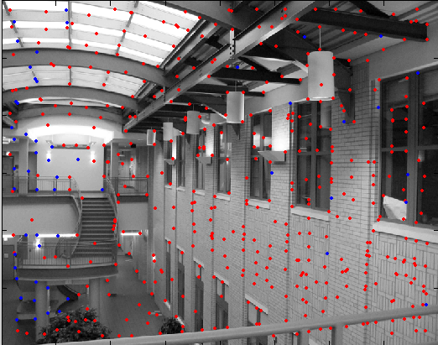
Feature-space outlier rejection
Can we now compute H from the blue points?
No! Still too many outliers…
What can we do?

Slide 28
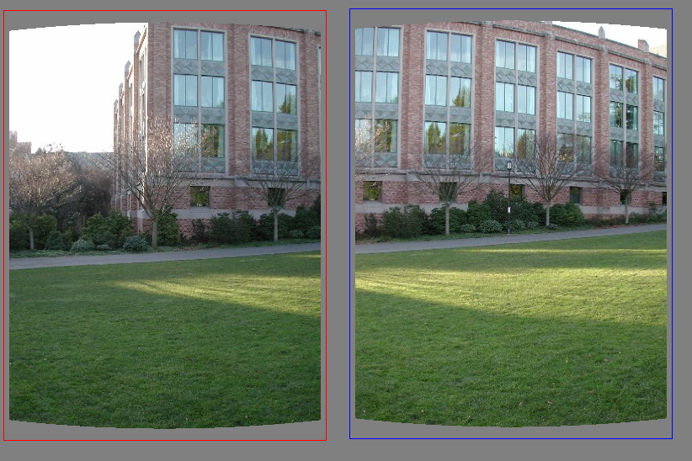
(b) Matching many features--looking for a good homography
Simplified illustration with translation instead of homography
What do we do about the “bad” matches?
Note: at this point we don’t know which ones are good/bad

Slide 29
RAndom SAmple Consensus
Select one match, count inliers

Slide 30
RAndom SAmple Consensus
Select one match, count inliers
0 inliers

Slide 31
RAndom SAmple Consensus
Select one match, count inliers
4 inliers

Slide 32
RAndom SAmple Consensus
Select one match, count inliers
Select one match, count inliers
Keep match with largest set of inliers

Slide 33
At the end: Least squares fit
Find “average” translation vector, but with only inliers

Slide 34
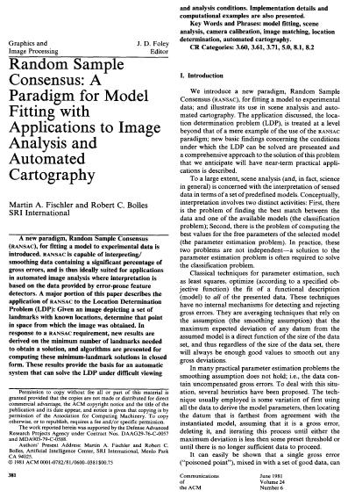
Reference
M. A. Fischler, R. C. Bolles. Random Sample Consensus: A Paradigm for Model Fitting with Applications to Image Analysis and Automated Cartography. Comm. of the ACM, Vol 24, pp 381-395, 1981.
http://portal.acm.org/citation.cfm?id=358692

Slide 35
RANSAC for estimating homography
RANSAC loop:
Select four feature pairs (at random)
Compute homography H (exact)
Compute inliers where ||p_{i}’, H p_{i}|| < ε
Keep largest set of inliers
Re-compute least-squares H estimate using all of the inliers

Slide 36
Simple example: fit a line
Rather than homography H (8 numbers) fit y=ax+b (2 numbers a, b) to 2D pairs
36

Slide 37
Simple example: fit a line
Pick 2 points
Fit line
Count inliers
3 inlier
37

Slide 38
Simple example: fit a line
Pick 2 points
Fit line
Count inliers
4 inlier
38

Slide 39
Simple example: fit a line
Pick 2 points
Fit line
Count inliers
9 inlier
39

Slide 40
Simple example: fit a line
Pick 2 points
Fit line
Count inliers
8 inlier
40

Slide 41
Simple example: fit a line
Use biggest set of inliers
Do least-square fit
41

Slide 42
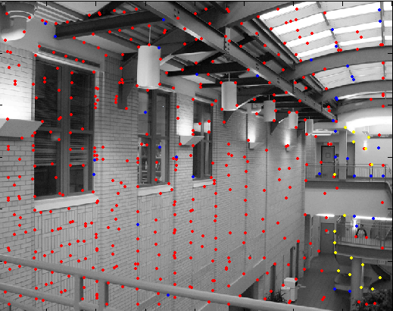
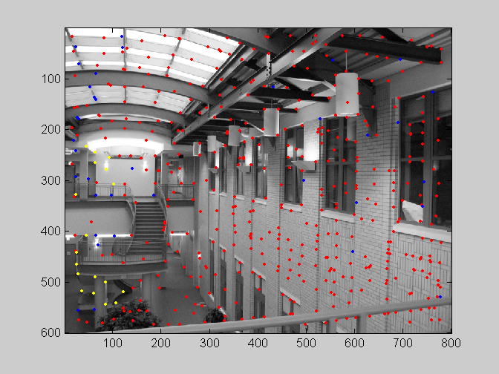
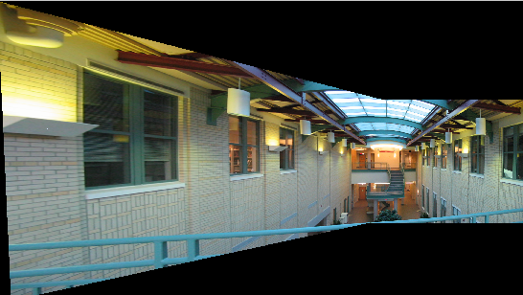
RANSAC
red:
rejected by 2nd nearest neighbor criterion
blue:
Ransac outliers
yellow:
inliers

Slide 43
Robustness
Proportion of inliers in our pairs is G (for “good”)
Our model needs P pairs
P=4 for homography
Probability that we pick P inliers?
G^{P}
Probability that after N RANSAC iterations we have not picked a set of inliers?
(1-G^{P})^{N}
43

Slide 44
Robustness: example
Matlab: p=4; x=0.5; n=1000; (1-x^p)^n
Proportion of inliers G=0.5
Probability that we pick P=4 inliers?
0.5⁴=0.0625 (6% chance)
Probability that we have not picked a set of inliers?
N=100 iterations: (1-0.5⁴)¹⁰⁰=0.00157 (1 chance in 600)
N=1000 iterations: 1 chance in 1e28
44

Slide 45
Robustness: example
Proportion of inliers G=0.3
Probability that we pick P=4 inliers?
0.3⁴=0.0081 (0.8% chance)
Probability that we have not picked a set of inliers?
N=100 iterations: (1-0.3⁴)¹⁰⁰=0.44 (1 chance in 2)
N=1000 iterations: 1 chance in 3400
45

Slide 46
Robustness: example
Proportion of inliers G=0.1
Probability that we pick P=4 inliers?
0.1⁴=0.0001 (0.01% chances, 1 in 10,000)
Probability that we have not picked a set of inliers?
N=100 iterations: (1-0.1⁴)¹⁰⁰=0.99
N=1000 iterations: 90%
N=10,000: 36%
N=100,000: 1 in 22,000
46

Slide 47
Robustness: conclusions
Effect of number of parameters of model/number of necessary pairs
Bad exponential
Effect of percentage of inliers
Base of the exponential
Effect of number of iterations
Good exponential
47

Slide 48
RANSAC recap
For fitting a model with low number P of parameters (8 for homographies)
Loop
Select P random data points
Fit model
Count inliers (other data points well fit by this model)
Keep model with largest number of inliers
48

Slide 49
Example: Recognising Panoramas
M. Brown and D. Lowe,
University of British Columbia
* M. Brown and D. Lowe. Automatic Panoramic Image Stitching using Invariant Features. International Journal of Computer Vision, 74(1), pages 59-73, 2007 (pdf 3.5Mb | bib) * M. Brown and D. G. Lowe. Recognising Panoramas. In Proceedings of the 9th International Conference on Computer Vision (ICCV2003), pages 1218-1225, Nice, France, 2003 (pdf 820kb | ppt | bib)

Slide 50
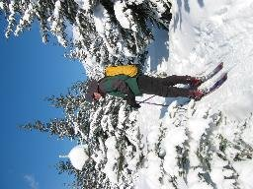
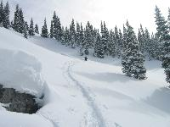
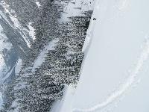
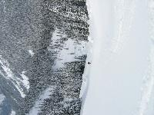
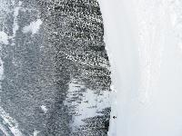
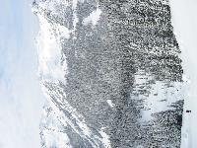
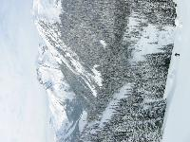
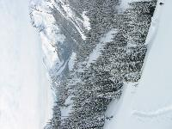
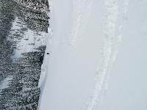
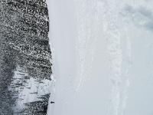
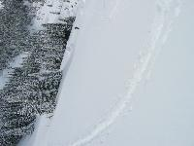
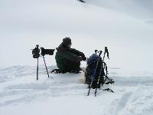
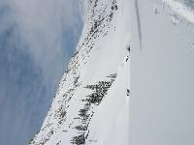
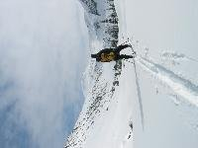
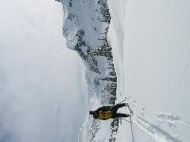
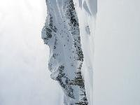
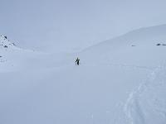
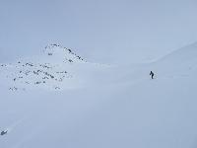
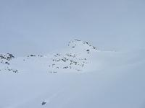
“Recognising Panoramas”?

Slide 51
RANSAC for Homography

Slide 52
RANSAC for Homography

Slide 53
RANSAC for Homography

Slide 54
Finding the panoramas

Slide 55
Finding the panoramas

Slide 56
Finding the panoramas

Slide 57
Finding the panoramas

Slide 58
Results

Slide 60
Benefits of Laplacian image compositing
M. Brown and D. Lowe. Automatic Panoramic Image Stitching using Invariant Features. International Journal of Computer Vision, 74(1), pages 59-73, 2007

Slide 61
Photo Tourism: Exploring Photo Collections in 3D
Noah Snavely
Steven M. Seitz
University of Washington
Richard Szeliski
Microsoft Research
© 2006 Noah Snavely

Slide 62
15,464
37,383
76,389

Slide 63
Movie

Slide 64
Photo Tourism overview
Photo Explorer
Scene reconstruction
Input photographs
Relative camera positions and orientations
Point cloud
Sparse correspondence
[Note: change to Trevi for consistency]
Notes:
Our system takes as input an unordered set of photos, either from an Internet search or from a large personal collection. We assume the photos are largely from the same static scene.
The first step of our system is to apply a computer vision techniques to reconstruct the geometry of the scene. The output of this procedure is the relative positions and orientation for the cameras used to take a connected set of the photographs, as well as a point cloud representing the geometry of the scene, and a sparse set of correspondences between the photos.
This information is then loaded into our interactive photo explorer tool.

Slide 65
Photo Tourism overview
Photo Explorer
Scene reconstruction
Input photographs
[Note: change to Trevi for consistency]
Notes:
Now I will describe the Photo Tourism system, beginning with the scene reconstruction procedure.

Slide 66
Scene reconstruction
Automatically estimate
position, orientation, and focal length of cameras
3D positions of feature points
Feature detection
Incremental structure from motion
Pairwise
feature matching
Correspondence estimation
Notes:
Again, the goal of the reconstruction procedure is to automatically estimate the relative positions and orientations, as well as the focal length or zoom, of each of the photographs in a connected component of the scene. The process consists of four steps: detecting features in each of the input photos; matching features between each pair of photos; grouping the matches into correspondences across multiple photos; and using the correspondences to estimate the geometry of the scene and the cameras in a technique known as structure from motion.
I’ll now describe each of these steps in more detail.
[Structure from motion techniques for unordered image collections have also been developed by others, such as Brown and Lowe and Schaffalitzky and Zisserman, and the basic pipeline of our system closely follows that of Brown and Lowe. To our knowledge, our system is the first to have been demonstrated on large collections of photos from the Internet.]

Slide 67
Feature detection
Detect features using SIFT [Lowe, IJCV 2004]
Notes:
The core of the reconstruction process is the ability to reliably match feature points between images. Fortunately, over the last few years feature detection and matching techniques have improved dramatically. Many different technique exist – we use SIFT, or scale-invariant feature transform, developed by David Lowe. SIFT is designed to be invariant to image scale and rotation, as well as affine changes in image intensity.
Here is an image from the Trevi Fountain, and here are the features SIFT detects in the image, shown as square patches. The squares are scaled and rotated to reflect the scale and orientation of the features.

Slide 68
Feature detection
Detect features using SIFT [Lowe, IJCV 2004]
Notes:
So, we begin by detecting SIFT features in each photo.
[We detect SIFT features in each photo, resulting in a set of feature locations and 128-byte feature descriptors…]

Slide 69
Feature detection
Detect features using SIFT [Lowe, IJCV 2004]

Slide 70
Feature matching
Match features between each pair of images
Notes:
Next, we match features across each pair of photos using approximate nearest neighbor matching.

Slide 71
Feature matching
Refine matching using RANSAC [Fischler & Bolles 1987] to estimate fundamental matrices between pairs
(See 6.801/6.866 for fundamental matrix, or Hartley and Zisserman, Multi-View Geometry.
See also the fundamental matrix song: http://danielwedge.com/fmatrix/ )
Notes:
The matches are refined by using RANSAC, which is a robust model-fitting technique, to estimate a fundamental matrix between each pair of matching images and keeping only matches consistent with that fundamental matrix.
We then link connected components of pairwise feature matches together to form correspondences across multiple images.
Once we have correspondences, we run structure from motion to recover the camera and scene geometry. Structure from motion solves the following problem:

Slide 72
Structure from motion
p₄
p₁
p₃
minimize
p₂
f (R, T, P)
p₅
p₇
p₆
Camera 1
Camera 3
R₁,t₁
R₃,t₃
Camera 2
R₂,t₂
Notes:
Structure from motion solves the following problem:
Given a set of images of a static scene with 2D points in correspondence, shown here as color-coded points, find…
a set of 3D points P and
a rotation R and position t of the cameras that explain the observed correspondences. In other words, when we project a point into any of the cameras, the reprojection error between the projected and observed 2D points is low.
This problem can be formulated as an optimization problem where we want to find the rotations R, positions t, and 3D point locations P that minimize sum of squared reprojection errors f. This is a non-linear least squares problem and can be solved with algorithms such as Levenberg-Marquart. However, because the problem is non-linear, it can be susceptible to local minima. Therefore, it’s important to initialize the parameters of the system carefully. In addition, we need to be able to deal with erroneous correspondences.

Slide 73
Links
Code available: http://phototour.cs.washington.edu/bundler/
http://phototour.cs.washington.edu/
http://livelabs.com/photosynth/
http://www.cs.cornell.edu/~snavely/

