Slide 1

Lecture 19
Object recognition II

Slide 2
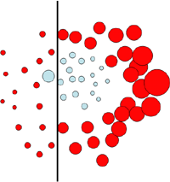
A simple object detector
Simple but contains some of same basic elements of many state of the art detectors.
Based on boosting which makes all the stages of the training and testing easy to understand.
Most of the slides are from the ICCV 05 short course
http://people.csail.mit.edu/torralba/shortCourseRLOC/

Slide 3
Discriminative methods
Object detection and recognition is formulated as a classification problem.
The image is partitioned into a set of overlapping windows
… and a decision is taken at each window about if it contains a target object or not.
Decision boundary
Background
Where are the screens?
Bag of image patches
Computer screen
In some feature space
Notes:
Object detection and recognition is formulated as a classification problem. The image is partitioned into a set of overlapping windows, and a decision is taken at each window about if it contains a target object or not.
Each window is represented by extracting a large number of features that encode information such as boundaries, textures, color, spatial structure.
The classification function, that maps an image window into a binary decision, is learnt using methods such as SVMs, boosting or neural networks.

Slide 4
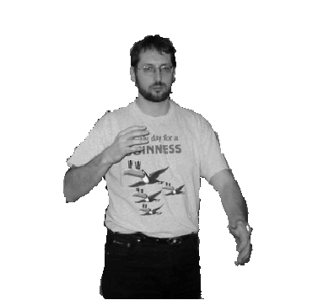
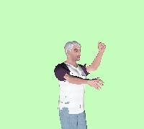
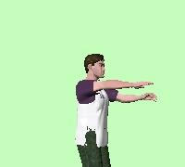
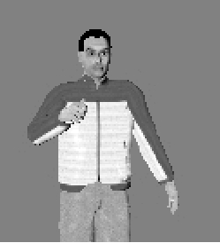
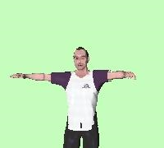
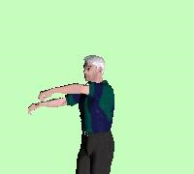
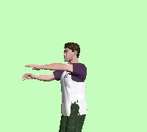
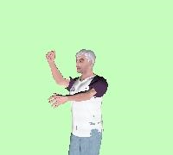
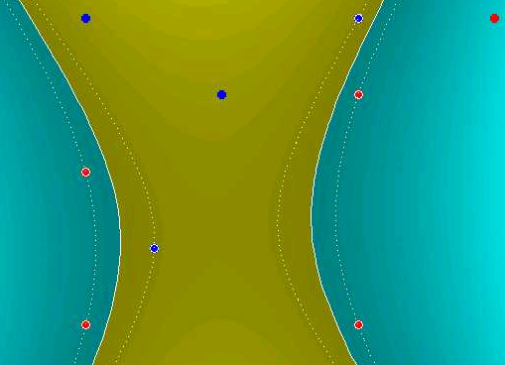
Discriminative methods
Nearest neighbor
Neural networks
10⁶ examples
Shakhnarovich, Viola, Darrell 2003
Berg, Berg, Malik 2005
…
LeCun, Bottou, Bengio, Haffner 1998
Rowley, Baluja, Kanade 1998
…
Support Vector Machines and Kernels
Conditional Random Fields
Guyon, Vapnik
Heisele, Serre, Poggio, 2001
…
McCallum, Freitag, Pereira 2000
Kumar, Hebert 2003
…

Slide 5
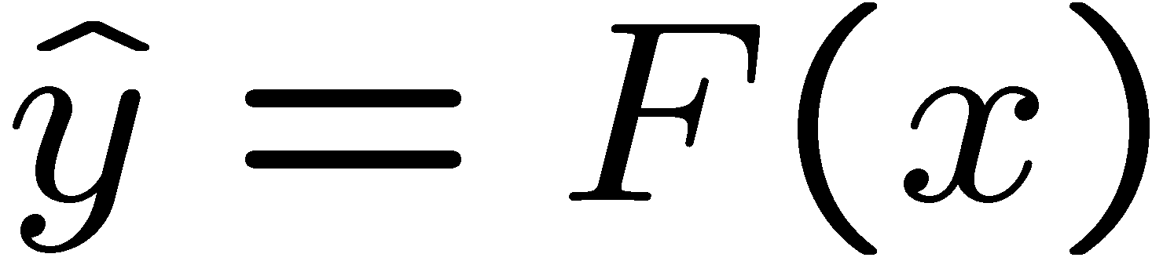

Formulation
Formulation: binary classification
…
x₁
x₂
x₃
…
x_{N}
x_{N+1}
x_{N+2}
…
x_{N+M}
Features x =
Labels
y =
-1
+1
-1
-1
?
?
?
Training data: each image patch is labeled
as containing the object or background
Test data
Classification function
Where belongs to some family of functions
Minimize misclassification error
(Not that simple: we need some guarantees that there will be generalization)
Notes:
In many cases, F(x) will give a real value and the classification is perform with a Threshold. If F(x)>0 then y =+1

Slide 6
Overview of section
Object detection with classifiers
Boosting
  Gentle boosting
  Weak detectors
  Object model
  Object detection

Slide 7
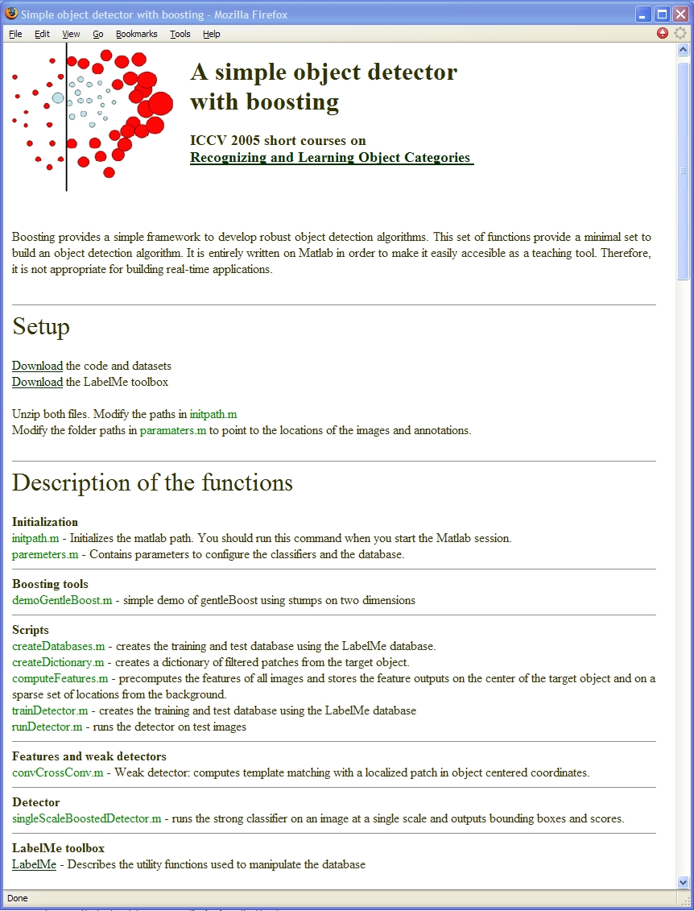
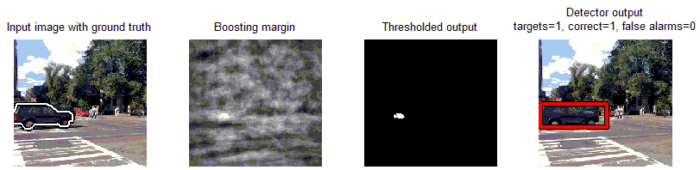
A simple object detector with Boosting
Download
Toolbox for manipulating dataset
Code and dataset
Matlab code
Gentle boosting
Object detector using a part based model
Dataset with cars and computer monitors
http://people.csail.mit.edu/torralba/iccv2005/
Notes:
In the next part I will focus on particular technique, and I will provide a detailed description of things you need to know to make it work. This part is accompanied by a Matlab toolbox that you can find on the web site of the class. Is entirely self contained and written in matlab. It has an implementation of gentle boosting, and an object detector. The demo shows results on detecting screens and cars and can be easily trained to detect other objects.

Slide 8
Why boosting?
A simple algorithm for learning robust classifiers
  Freund & Shapire, 1995
  Friedman, Hastie, Tibshhirani, 1998
Provides efficient algorithm for sparse visual feature selection
  Tieu & Viola, 2000
  Viola & Jones, 2003
Easy to implement, not requires external optimization tools.
For a description of several methods:
Friedman, J. H., Hastie, T. and Tibshirani, R.
Additive Logistic Regression: a Statistical View of Boosting. 1998

Slide 9
Boosting
Defines a classifier using an additive model:
Strong
classifier
Weak classifier
Weight
Features
vector

Slide 10
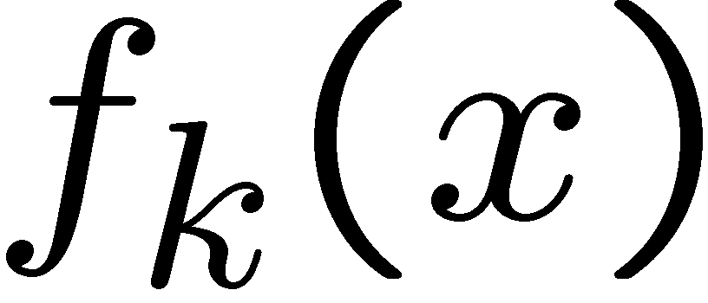
Boosting
Defines a classifier using an additive model:
Strong
classifier
Weak classifier
Weight
Features
vector
We need to define a family of weak classifiers
from a family of weak classifiers

Slide 11
Boosting
It is a sequential procedure:
x_{t=1}
x_{t}
Each data point has
a class label:
x_{t=2}
+1 ( )
y_{t} =
-1 ( )
and a weight:
w_{t} =1

Slide 12
Toy example
Weak learners from the family of lines
Each data point has
a class label:
+1 ( )
y_{t} =
-1 ( )
and a weight:
w_{t} =1
h => p(error) = 0.5 it is at chance

Slide 13
Toy example
Each data point has
a class label:
+1 ( )
y_{t} =
-1 ( )
and a weight:
w_{t} =1
This one seems to be the best
This is a ‘weak classifier’: It performs slightly better than chance.

Slide 14
Toy example
Each data point has
a class label:
+1 ( )
y_{t} =
-1 ( )
We update the weights:
w_{t} w_{t} exp{-y_{t} H_{t}}
We set a new problem for which the previous weak classifier performs at chance again

Slide 15
Toy example
Each data point has
a class label:
+1 ( )
y_{t} =
-1 ( )
We update the weights:
w_{t} w_{t} exp{-y_{t} H_{t}}
We set a new problem for which the previous weak classifier performs at chance again

Slide 16
Toy example
Each data point has
a class label:
+1 ( )
y_{t} =
-1 ( )
We update the weights:
w_{t} w_{t} exp{-y_{t} H_{t}}
We set a new problem for which the previous weak classifier performs at chance again

Slide 17
Toy example
Each data point has
a class label:
+1 ( )
y_{t} =
-1 ( )
We update the weights:
w_{t} w_{t} exp{-y_{t} H_{t}}
We set a new problem for which the previous weak classifier performs at chance again

Slide 18
Toy example
f₁
f₂
f₄
f₃
The strong (non- linear) classifier is built as the combination of all the weak (linear) classifiers.

Slide 19
Boosting
Different cost functions and minimization algorithms result is various flavors of Boosting
In this demo, I will use gentleBoosting: it is simple to implement and numerically stable.

Slide 20
Overview of section
Object detection with classifiers
Boosting
  Gentle boosting
  Weak detectors
  Object model
  Object detection

Slide 21
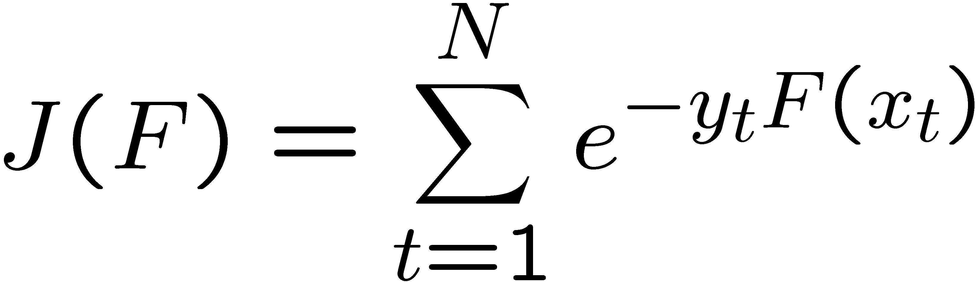
Boosting
Boosting fits the additive model
by minimizing the exponential loss
Training samples
The exponential loss is a differentiable upper bound to the misclassification error.

Slide 22
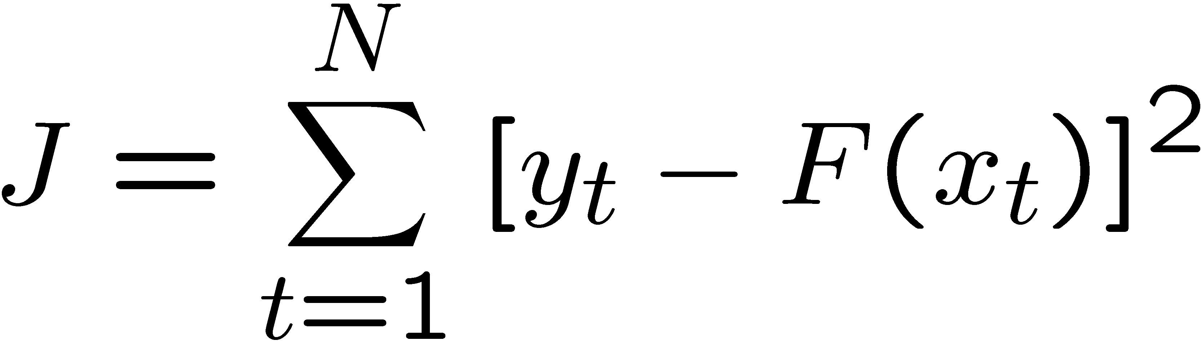
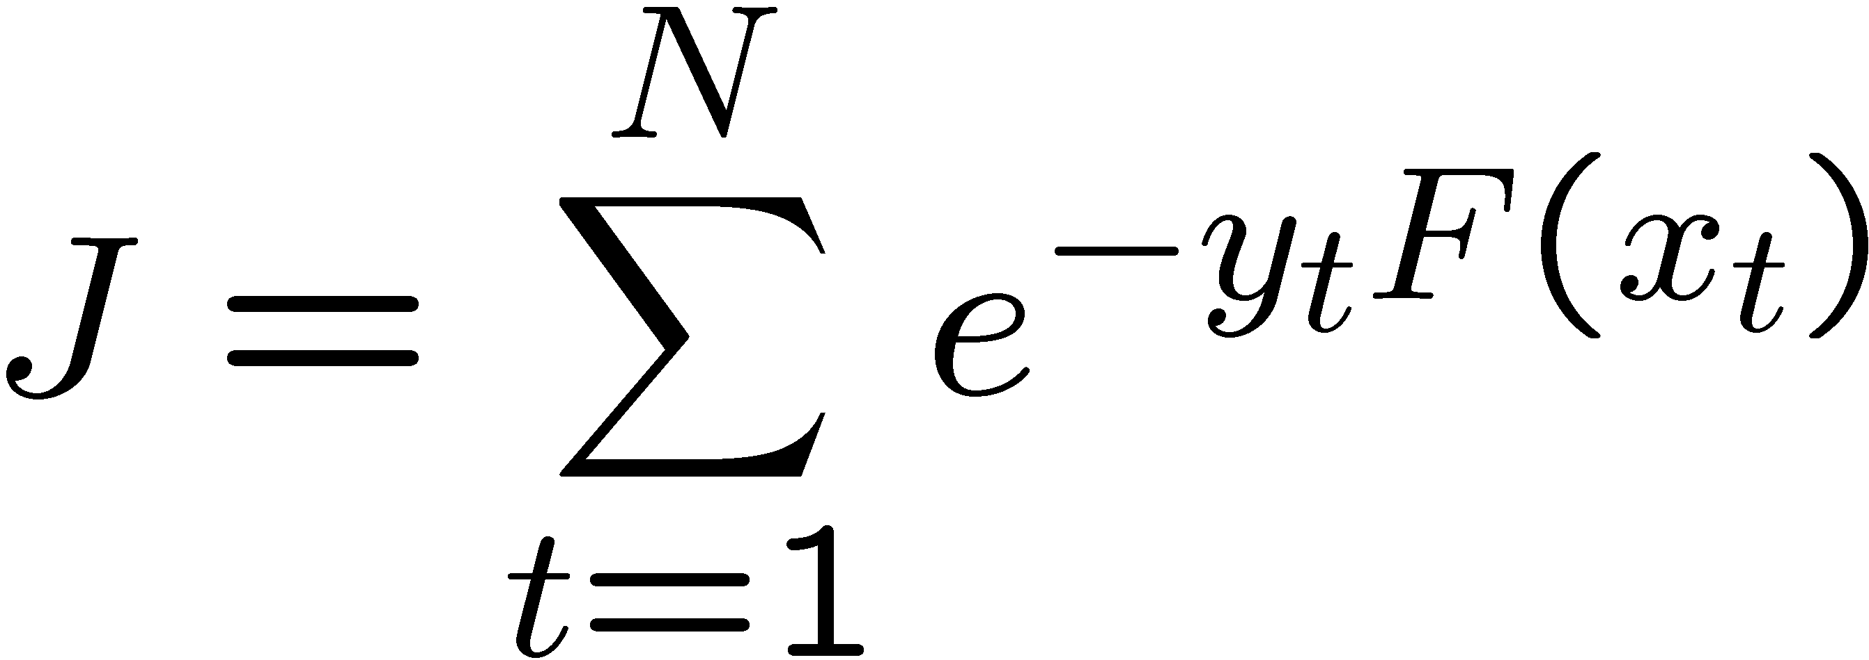
Exponential loss
Loss
Squared error
4
Misclassification error
3.5
Squared error
3
Exponential loss
2.5
2
1.5
Exponential loss
1
0.5
0
-1.5
-1
-0.5
0
0.5
1
1.5
2
yF(x) = margin

Slide 23
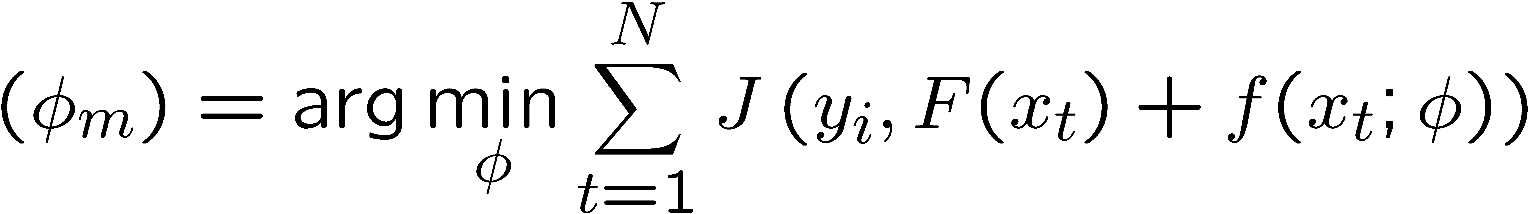
Boosting
Sequential procedure. At each step we add
to minimize the residual loss
Parameters
weak classifier
Desired output
input
For more details: Friedman, Hastie, Tibshirani. “Additive Logistic Regression: a Statistical View of Boosting” (1998)

Slide 24

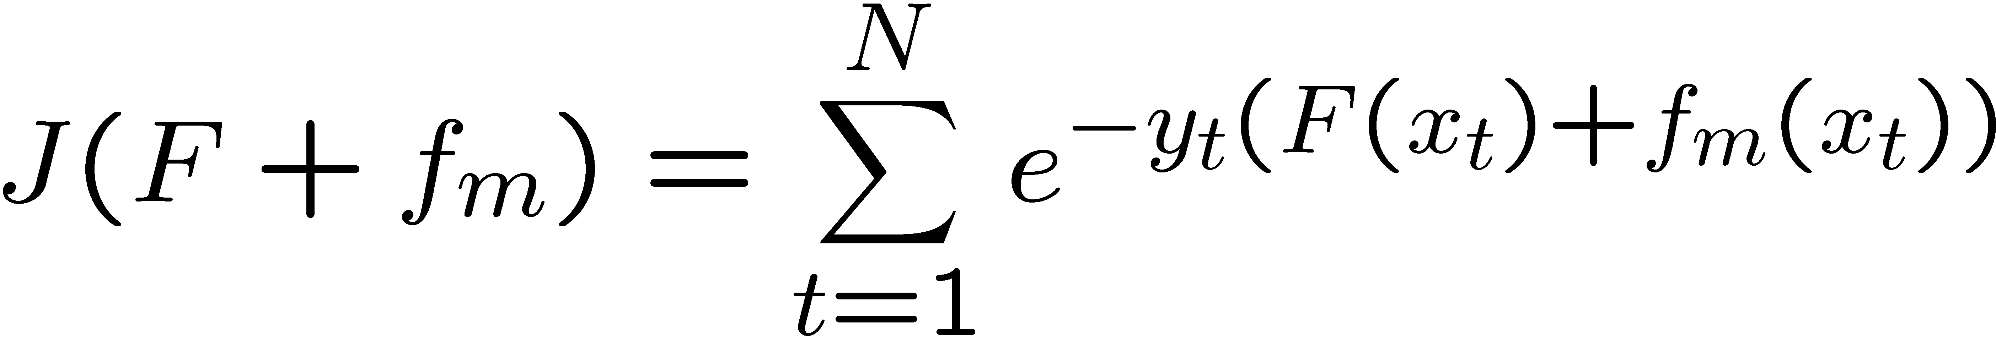
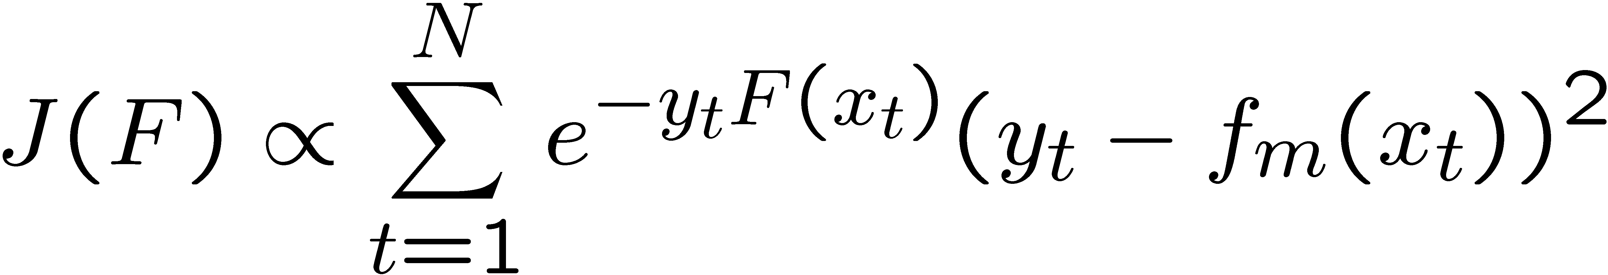
gentleBoosting
At each iteration:
We chose that minimizes the cost:
Instead of doing exact optimization, gentle Boosting minimizes a Taylor approximation of the error:
At each iterations we just need to solve a weighted least squares problem
Weights at this iteration
For more details: Friedman, Hastie, Tibshirani. “Additive Logistic Regression: a Statistical View of Boosting” (1998)

Slide 25
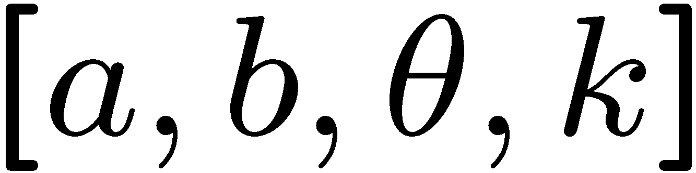
Weak classifiers
The input is a set of weighted training samples (x,y,w)
Regression stumps: simple but commonly used in object detection.
f_{m}(x)
b=E_{w}(y [x> θ])
Four parameters:
a=E_{w}(y [x< θ])
θ
x
fitRegressionStump.m

Slide 26
gentleBoosting.m
function classifier = gentleBoost(x, y, Nrounds)
…
for m = 1:Nrounds
fm = selectBestWeakClassifier(x, y, w);
w = w .* exp(- y .* fm);
% store parameters of fm in classifier
…
end
Initialize weights w = 1
Solve weighted least-squares
Re-weight training samples

Slide 27
Demo gentleBoosting
Demo using Gentle boost and stumps with hand selected 2D data:
> demoGentleBoost.m

Slide 28
Flavors of boosting
AdaBoost (Freund and Shapire, 1995)
Real AdaBoost (Friedman et al, 1998)
LogitBoost (Friedman et al, 1998)
Gentle AdaBoost (Friedman et al, 1998)
BrownBoosting (Freund, 2000)
FloatBoost (Li et al, 2002)
…

Slide 29
Overview of section
Object detection with classifiers
Boosting
  Gentle boosting
  Weak detectors
  Object model
  Object detection

Slide 30
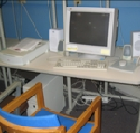
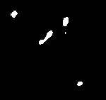
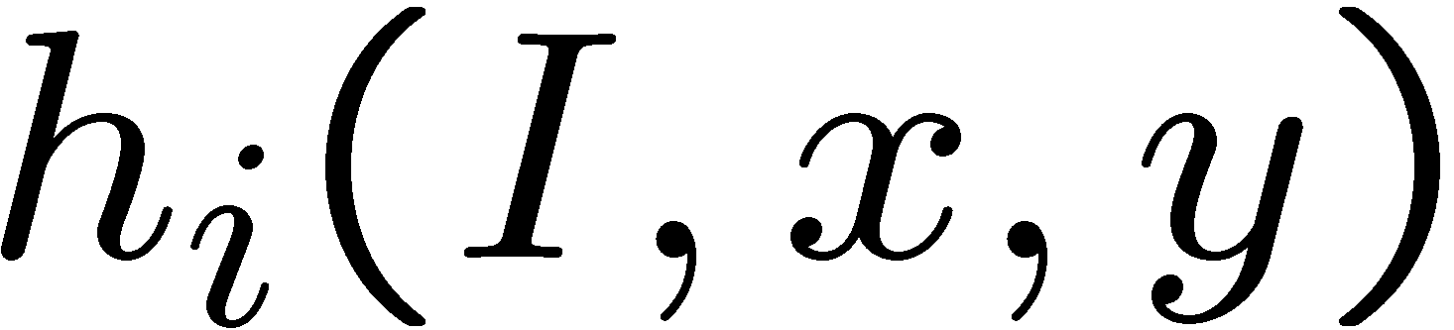
From images to features:
Weak detectors
We will now define a family of visual features that can be used as weak classifiers (“weak detectors”)
Takes image as input and the output is binary response.
The output is a weak detector.

Slide 31
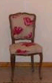
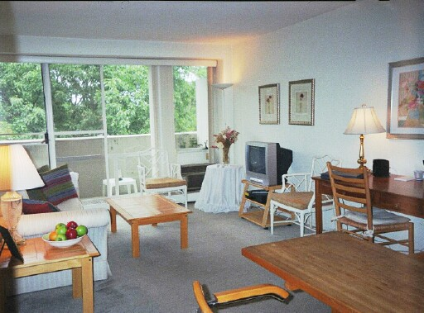
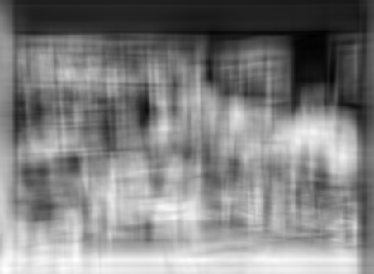
Object recognition
Is it really so hard?
Find the chair in this image
But what if we use smaller patches? Just a part of the chair?

Slide 32
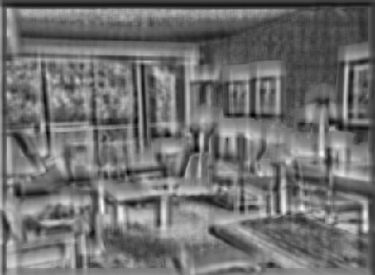
Parts
But what if we use smaller patches? Just a part of the chair?
Find a chair in this image
Seems to fire on legs… not so bad

Slide 33
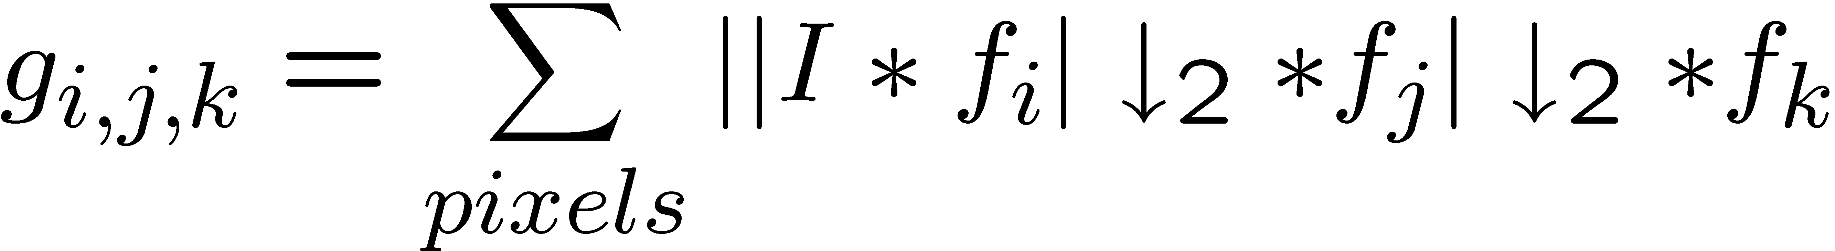
Weak detectors
Textures of textures
Tieu and Viola, CVPR 2000. One of the first papers to use boosting for vision.
Every combination of three filters generates a different feature
This gives thousands of features. Boosting selects a sparse subset, so computations on test time are very efficient. Boosting also avoids overfitting to some extend.
Notes:
One of the first papers to use boosting for a vision task.
Take one filter, filter the image, take the absolute value and downsample. Take another filter, take absolute value of the output and downsample. Do this once more. Then, for each color channel independently, sum the value of all the pixels and the resulting number will be one of the features. If you do this for all triples of filters, you’ll end up with 46875 features.

Slide 34
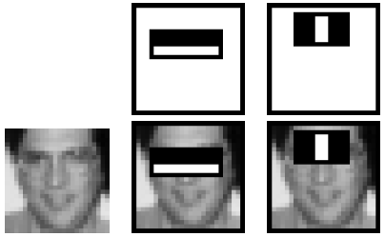
Weak detectors
Haar filters and integral image
Viola and Jones, ICCV 2001
The average intensity in the block is computed with four sums independently of the block size.
Notes:
No need of image pyramid in order to achieve scale invariance. Very efficient. Works well for faces which are objects well defined by the intensity pattern. Combined with a cascade, achieves real time performance for face detection even on large images.

Slide 35
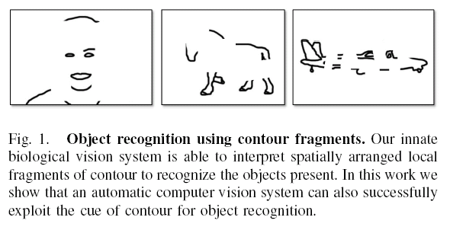
Edge fragments
J. Shotton, A. Blake, R. Cipolla.
Multi-Scale Categorical Object Recognition Using Contour Fragments. In IEEE Trans. on PAMI, 30(7):1270-1281, July 2008.
Opelt, Pinz, Zisserman, ECCV 2006

Slide 36
Weak detectors
Other weak detectors:
Carmichael, Hebert 2004
Yuille, Snow, Nitzbert, 1998
Amit, Geman 1998
Papageorgiou, Poggio, 2000
Heisele, Serre, Poggio, 2001
Agarwal, Awan, Roth, 2004
Schneiderman, Kanade 2004
…

Slide 37
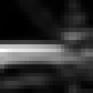

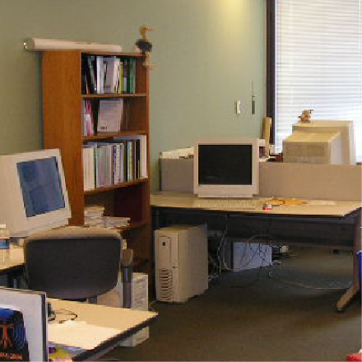
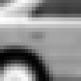
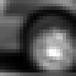

Weak detectors
Part based: similar to part-based generative models. We create weak detectors by using parts and voting for the object center location
Car model
Screen model
These features are used for the detector on the course web site.
Notes:
This will be better than a full object template because it allows for some flexibility in the location of the parts. It is still easy to compute.

Slide 38








Weak detectors
First we collect a set of part templates from a set of training objects.
Vidal-Naquet, Ullman (2003)
…
Notes:
The simplest weak detector will be using template matching. In this case we use template matching to detect the presence of a part of the object. Once the presence is detected it will vote for the object in the center of the object coordinates frame. In this example, we are trying to detect a computer screen. We use the top left corner of the screen. The first thing we do is compute a normalize correlation between the image and the template. This will give a pick in the response near the top-left corner of the screen and, of course, many other matches that do not correspond to screen. Now we displace the output of the correlation taking into account the relative positions between the top left corner of the screen and the center of the screen. We also blur the output. Now, if we apply a threshold we can see that the center of the screen has a value above the threshold while most of the background gets suppressed. There are a lot of other locations that also are above the threshold. Therefore, this is not a good detector. But it is better than chance!

Slide 39
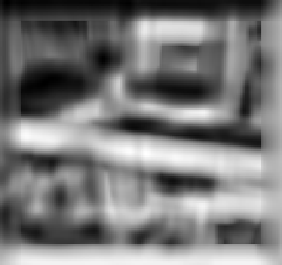
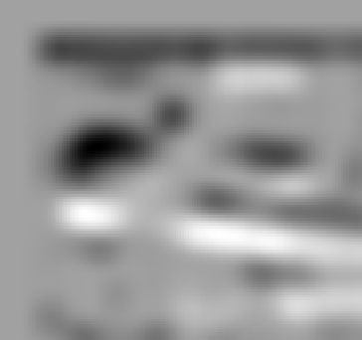






Weak detectors
We now define a family of “weak detectors” as:
=
*
=
Better than chance
Notes:
The simplest weak detector will be using template matching. In this case we use template matching to detect the presence of a part of the object. Once the presence is detected it will vote for the object in the center of the object coordinates frame. In this example, we are trying to detect a computer screen. We use the top left corner of the screen. The first thing we do is compute a normalize correlation between the image and the template. This will give a pick in the response near the top-left corner of the screen and, of course, many other matches that do not correspond to screen. Now we displace the output of the correlation taking into account the relative positions between the top left corner of the screen and the center of the screen. We also blur the output. Now, if we apply a threshold we can see that the center of the screen has a value above the threshold while most of the background gets suppressed. There are a lot of other locations that also are above the threshold. Therefore, this is not a good detector. But it is better than chance!

Slide 40
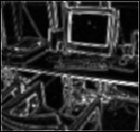
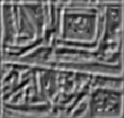
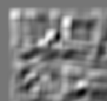











Weak detectors
We can do a better job using filtered images
*
=
=
*
=
Still a weak detector
but better than before

Slide 41
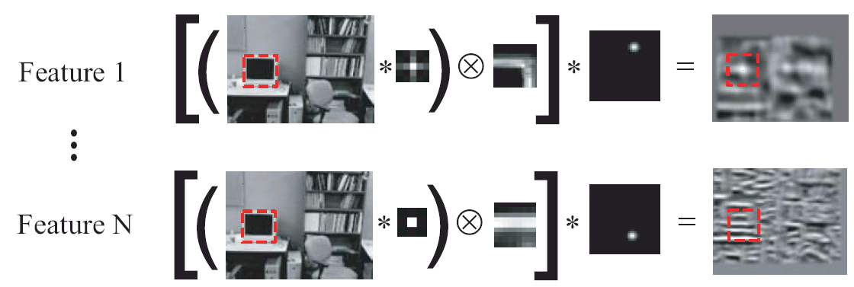
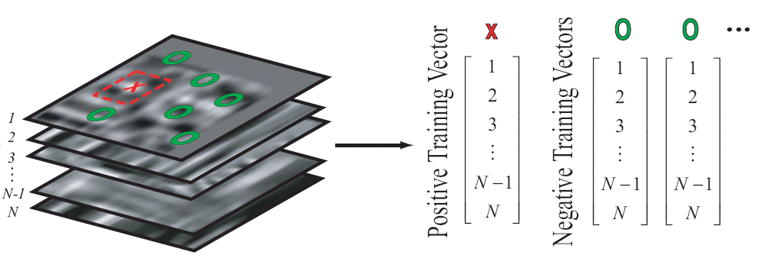
Training
First we evaluate all the N features on all the training images.
Then, we sample the feature outputs on the object center and at random locations in the background:
Notes:
So, now we have to train. We need positive and negative examples. So we do the next thing: get positive samples by taking the values of all the features in the center of the target. Then take negative samples from the background.

Slide 42






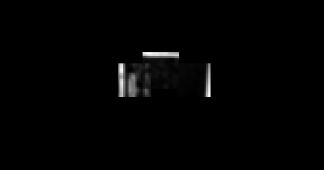
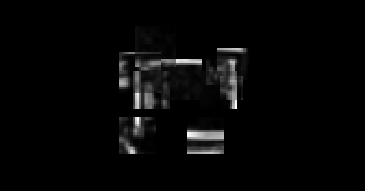
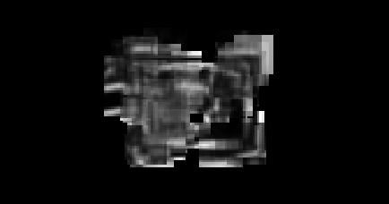
Representation and object model
Selected features for the screen detector
…
…
1
2
3
4
10
100
Lousy painter

Slide 43






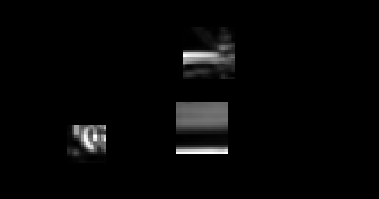
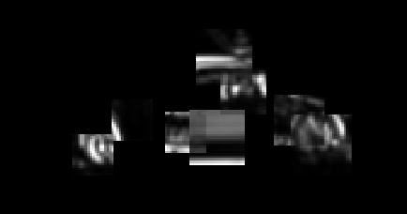
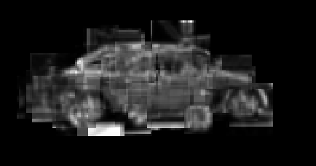
Representation and object model
Selected features for the car detector
…
…
1
2
3
4
10
100

Slide 44
Overview of section
Object detection with classifiers
Boosting
  Gentle boosting
  Weak detectors
  Object model
  Object detection

Slide 45
Object model
Voting
Invariance: search strategy
f_{i}, P_{i}
g_{i}
Here, invariance in translation and scale is achieved by the search strategy: the classifier is evaluated at all locations (by translating the image) and at all scales (by scaling the image in small steps).
The search cost can be reduced using a cascade.
Notes:
Finally, the object model is very similar to the one built with the generative model. Here, invariance in translation and scale is achieved by the search strategy: the classifier is evaluated at all locations (by translating the image) and at all scales (by reescaling the image in small steps).

Slide 46
Example: screen detection
Feature
output

Slide 47
Example: screen detection
Feature
output
Thresholded
output
Weak ‘detector’
Produces many false alarms.

Slide 48
Example: screen detection
Feature
output
Thresholded
output
Strong classifier
at iteration 1

Slide 49
Example: screen detection
Feature
output
Thresholded
output
Strong
classifier
Second weak ‘detector’
Produces a different set of false alarms.

Slide 50
Example: screen detection
Feature
output
Thresholded
output
Strong
classifier
+
Strong classifier
at iteration 2

Slide 51
Example: screen detection
Feature
output
Thresholded
output
Strong
classifier
+
…
Strong classifier
at iteration 10

Slide 52
Example: screen detection
Feature
output
Thresholded
output
Strong
classifier
+
…
Adding
features
Final
classification
Strong classifier
at iteration 200

Slide 53
Maximal suppression
Detect local maximum of the response. We are only allowed detecting each object once. The rest will be considered false alarms.
This post-processing stage can have a very strong impact in the final performance.

Slide 54
Evaluation
When do we have a correct
detection?
Is this correct?
Area intersection
> 0.5
Area union
ROC
Precision-recall

Slide 55
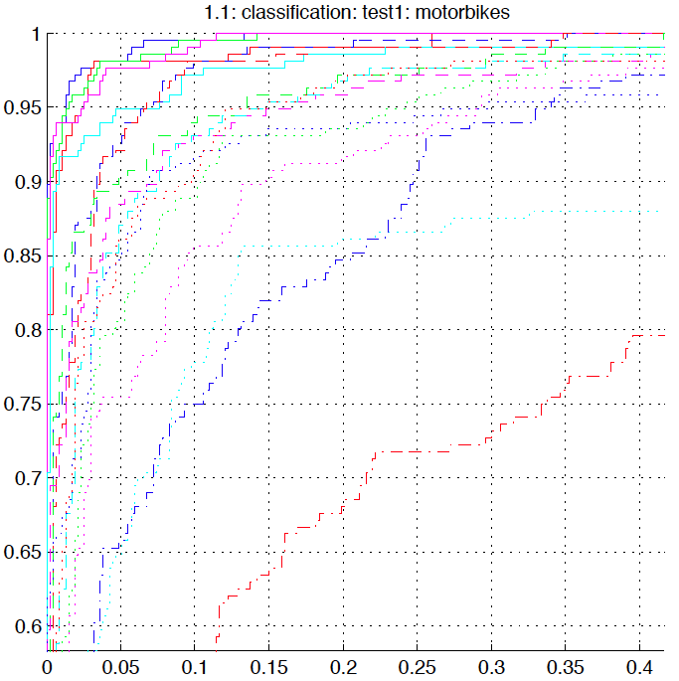
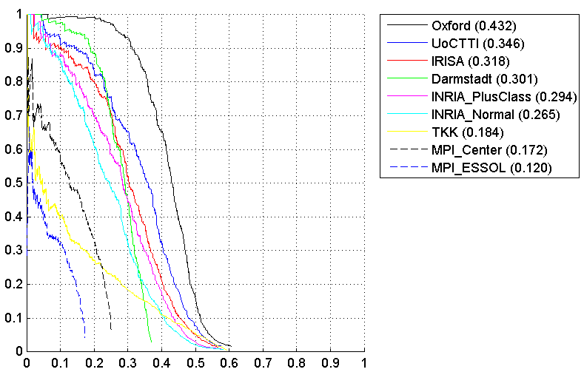
ROC and Precision-Recall
Detection
rate
Precision
False alarm rate
Recall
Plots from PASCAL competition

Slide 56
Rapid Object Detection Using a Boosted Cascade of Simple Features
Paul Viola Michael J. Jones
Mitsubishi Electric Research Laboratories (MERL)
Cambridge, MA
Most of this work was done at Compaq CRL before the authors moved to MERL
Manuscript available on web:
http://citeseer.ist.psu.edu/cache/papers/cs/23183/http:zSzzSzwww.ai.mit.eduzSzpeoplezSzviolazSzresearchzSzpublicationszSzICCV01-Viola-Jones.pdf/viola01robust.pdf
Notes:
While the title of this talk emphasizes the application of our ideas to an important real-world task
There are two nice ideas which could have broader impact in machine learning

Slide 57
What is novel about this approach?
Feature set (… is huge about 16,000,000 features)
Efficient feature selection using AdaBoost
New image representation: Integral Image
Cascaded Classifier for rapid detection
  Hierarchy of Attentional Filters
What is new is the combination of these ideas. This yields the fastest known face detector for gray scale images.
Viola and Jones, Robust object detection using a boosted cascade of simple features, CVPR 2001

Slide 58

Image Features
“Rectangle filters”
Similar to Haar wavelets
Differences between sums of pixels in adjacent rectangles
{
+1 if f_{t}(x) > θ_{t}
-1 otherwise
h_{t}(x) =
Unique Features
Viola and Jones, Robust object detection using a boosted cascade of simple features, CVPR 2001
Notes:
For real problems results are only as good as the features used...
This is the main piece of ad-hoc (or domain) knowledge
Rather than the pixels, we have selected a very large set of simple functions
Sensitive to edges and other critcal features of the image
** At multiple scales
Since the final classifier is a perceptron it is important that the features be non-linear… otherwise the final classifier will be a simple perceptron.
We introduce a threshold to yield binary features

Slide 59


Integral Image
Define the Integral Image
Any rectangular sum can be computed in constant time:
Rectangle features can be computed as differences between rectangles
Viola and Jones, Robust object detection using a boosted cascade of simple features, CVPR 2001

Slide 60
Huge “Library” of Filters
Viola and Jones, Robust object detection using a boosted cascade of simple features, CVPR 2001

Slide 61





Example Classifier for Face Detection
A classifier with 200 rectangle features was learned using AdaBoost
95% correct detection on test set with 1 in 14084
false positives.
Not quite competitive.
Need to add more features,
but then that slows it down.
ROC curve for 200 feature classifier
Viola and Jones, Robust object detection using a boosted cascade of simple features, CVPR 2001

Slide 62
Fast and accurate classifier using a cascade
Fleuret and Geman 2001, Viola and Jones 2001
Given a nested set of classifier hypothesis classes
Cascade
% False Pos
0
50
vs
false
neg
determined by
50 99
% Detection
T
T
T
IMAGE
SUB-WINDOW
T
Classifier 1
Classifier 2
Classifier 3
FACE
F
F
F
F
NON-FACE
NON-FACE
NON-FACE
NON-FACE
Notes:
In general simple classifiers, while they are more efficient, they are also weaker.
We could define a computational risk hierarchy (in analogy with structural risk minimization)…
A nested set of classifier classes
The training process is reminiscent of boosting…
- previous classifiers reweight the examples used to train subsequent classifiers
The goal of the training process is different
- instead of minimizing errors minimize false positives

Slide 63
Cascaded Classifier
IMAGE
SUB-WINDOW
50%
20%
2%
1 Feature
5 Features
20 Features
FACE
F
F
F
NON-FACE
NON-FACE
NON-FACE
A 1 feature classifier achieves 100% detection rate and about 50% false positive rate.
A 5 feature classifier achieves 100% detection rate and 40% false positive rate (20% cumulative)
  using data from previous stage.
A 20 feature classifier achieve 100% detection rate with 10% false positive rate (2% cumulative)
Viola and Jones, Robust object detection using a boosted cascade of simple features, CVPR 2001

Slide 64

A Real-time Face Detection System
Training faces: 4916 face images (24 x 24 pixels) plus vertical flips for a total of 9832 faces
Training non-faces: 350 million sub-windows from 9500 non-face images
Final detector: 38 layer cascaded classifier
The number of features per layer was 1, 10, 25, 25, 50, 50, 50, 75, 100, …, 200, …
Final classifier contains 6061 features.
Viola and Jones, Robust object detection using a boosted cascade of simple features, CVPR 2001

Slide 65
Speed of Face Detector
Speed is proportional to the average number of features computed per sub-window.
On the MIT+CMU test set, an average of 9 features out of a total of 6061 are computed per sub-window.
On a 700 Mhz Pentium III, a 384x288 pixel image takes about 0.067 seconds to process (15 fps).
Roughly 15 times faster than Rowley-Baluja-Kanade and 600 times faster than Schneiderman-Kanade.
Viola and Jones, Robust object detection using a boosted cascade of simple features, CVPR 2001

Slide 66





Output of Face Detector on Test Images
Viola and Jones, Robust object detection using a boosted cascade of simple features, CVPR 2001

Slide 67




Number checks
Fleuret and Geman 2001

Slide 68
Cascade of classifiers
Perhaps, enough efficiency can overcome combinatorics…
Fleuret and Geman 2001

Slide 69
Edge based descriptors

Slide 70



Edge based descriptors
What makes an image memorable?
Gavrila, Philomin, ICCV 1999
Papageorgiou & Poggio (2000)
J. Shotton, A. Blake, R. Cipolla. PAMI 2008.
Opelt, Pinz, Zisserman, ECCV 2006

Slide 71
Edges and chamfer distance
Gavrila, Philomin, ICCV 1999
Gavrila, Philomin, ICCV 1999

Slide 72
Edges and chamfer distance
Template
Gavrila, Philomin, ICCV 1999

Slide 73

Chamfer distance
Find closest edge location after
displacement x
Sum over pixels on the
edge template F
E = edge map of the image

Slide 74
Chamfer distance
Edges
Distance transform
DT(E) = Function that assigns
to each pixel the distance to the
nearest edge.
Using the distance transform, the Chamfer distance can be written as a convolution

Slide 75

Edges and chamfer distance
Gavrila, Philomin, ICCV 1999

Slide 76

Distance transform
Edges

Slide 77
Distance transform
Edges
Distance transform
(with Manhattan distance)

Slide 78

Efficient computation of DT
P = set of edge pixels.

Slide 79
Chamfer distance
= F * DT(E)
Find closest edge location after
displacement x
Sum over pixels on the
edge template F
E = edge map of the image

Slide 80



Slide 81


To deal with multiple appearances…

Slide 82
Issues
Global templates are sensitive to:
Partial occlusions
Non-rigid deformations
Constellation of local edge fragments

Slide 83










Building a Fragment Dictionary
Masks
(~10 images)
…
…
Contour
Fragments T_{n}
(~1000 fragments)
…
…

Slide 84



Matching Features
Gaussian weighted oriented chamfer matching
  aligns features to image
Canny
Edge
Detector
Distance
Transform
Opelt, Pinz, Zisserman, ECCV 2006
J. Shotton, A. Blake, R. Cipolla. PAMI 2008.

Slide 85




Matching Features
Gaussian weighted oriented chamfer matching
  aligns features to image
Chamfer
Matching
feature match score at optimal position
optimal position

Slide 86

Location Sensitive Classification
Feature match scores make detection simple
Detection uses a boosted classification function K(c):
confidence weighted weak learner
thresholded match score
match score
M | number of features
F_{m} | feature m
E | canny edge map
c | object centroid
θ _{m} | weak learner threshold
a_{m} | weak learner confidence
b_{m} | weak learner confidence
δ | 0-1 indicator function
Notes:
boosted additive model combines feature responses

Slide 87



Object Detection
Evaluate K(c) for all c gives a classification map
  confidence as function of position
Globally thresholded local maxima give final detections
object
no object
test
image
classification
map
contours
Notes:
separate classifiers
for each detection, contour fragments that contributed positively to the detection at their optimal positions

Slide 88
Learning System
Background
Training Data
Test Data
Segmented
Training Data
Boosting
Algorithm
K(c)
Detection
Object
Detections

Slide 89
Training Data

Slide 90


Boosting as Feature Selection
1. Fragment Selection
1000 random fragments
50 discriminative fragments
2. Model Parameter Estimation
Select σ, λ for each feature
3. Weak-Learner Estimation
Select θ, a, b for each feature

Slide 91

Contour Results

Slide 92





Contour Results

Slide 93
Histograms of oriented gradients

Slide 94

Histograms of oriented gradients
Shape context
Belongie, Malik, Puzicha, NIPS 2000
SIFT, D. Lowe, ICCV 1999

Slide 95


Image features:
Histograms of oriented gradients (HOG)
Bin gradients from 8x8 pixel neighborhoods into 9 orientations
(Dalal & Triggs CVPR 05)
Source: Deva Ramanan
Notes:
One can do this by working with invariant features instead of raw pixel values. One of the more successful features is something called a histogram of gradient descriptor. At every pixel, first compute its derivate in the x and y direction. Quantize the resulting gradient vector into one of 9 orientations. Compute a histogram, over 8x8 pixel regions, of the number of pixels with particular orientations. Here, I’m visualizing the histogram by drawing a line at the orientation, whose intensity is proportional to the count of pixels with that gradient orientation. For example, we see lots of vertical edges toward the right of the image, and these are manifested as strong counts in the vertical bin. This is what the HOG feature sees when it looks at an image. If the bike was red or green, or the wheel was slightly deformed or shifted by a few pixels, the descriptor would look the same. Any questions?

Slide 96



Slide 97

[-1 0 1]

Slide 98

HOG

Slide 99

SVM
A Support Vector Machine (SVM) learns a classifier with the form:
Where {x_{m}, y_{m}}, for m = 1 . . .M, are the training data with x_{m} being
the input feature vector and y_{m} = +1,-1 the class label. k(x, x_{m}) is the kernel and it can be any symmetric function satisfying the Mercer Theorem.
The classification is obtained by thresholding the value of H(x).
There is a large number of possible kernels, each yielding a different
family of decision boundaries:
Linear kernel: k(x, x_{m}) = x^{T} x_{m}
Radial basis function: k(x, x_{m}) = exp(−|x − x_{m}|²/σ²).
Histogram intersection: k(x,x_{m}) = sum_{i}(min(x(i), x_{m}(i)))

Slide 100
Linear SVM
margin
w
f(x) = (w . x + b)

Slide 101







Scanning-window templates
Dalal and Triggs CVPR05 (HOG)
Papageorgiou and Poggio ICIP99 (wavelets)
pos
neg
w
w = weights for orientation and spatial bins
w·x > 0
Train with a linear classifier (perceptron, logistic regression, SVMs...)
Source: Deva Ramanan
Notes:
A reasonable model might be a simple linear classifier defined on such features. To build a person detector, we would assemble positive and negative examples of cropped images of people. For each example, we encode it using a HOG descriptor, and feed these features into a linear classifier such as a SVM. For a linear classifier, we can visualize the learned weight vector ‘w’ as a spacial template defined on gradient orientation features, just like in the previous slide. For example, the template favors image regions with lots of edges near the head. *Click* One can then use this template to scan over the entire image, reporting back windows that score above some threshold.

Slide 102


How to interpret positive and negative weights?
w·x > 0
(wpos - wneg)·x > 0
wpos·x > wneg·x
Pedestrian
background
template
Pedestrian
template
>
wpos,wneg = weighted average of positive, negative support vectors
Right approach is to compete pedestrian, pillar, doorway... models
Background class is hard to model - easier to penalize particular vertical edges
Source: Deva Ramanan
Notes:
When doing this, you will discover that not all learned weights are positive. Let w+ be the positive portion of w, with negative values zeroed out. Let w- be the negative component of w, with positive values zeroed out. The final weight vector is simply the difference between these two templates. In other words the original classifier reports a detection when the positive template outscores the negative template. My interpretation of what’s going on, is that if you just built a template by averaging together positive examples, the resulting detector would look like the positive template, which tends to fire on image regions with strong vertical edges. This produces false positives on doorways and pillars. The “right” approach, in a Bayesian sense, is to compete a pedestrian model with all other object models, including doorway and pillar models. Such a complex background hypothesis is difficult to build. Instead, it is easer to penalize particular vertical edges in particular locations. In essence, this is the classic argument for discriminative models over generative ones; model your decision boundary rather than the complex class distributions that generate it.

Slide 103

Histograms of oriented gradients
Dalal & Trigs, 2006
x
Not a person
x
person

Slide 104


Slide 105

Constellation models
Source: short course on object recognition. Fergus, Fei-fei, Torralba

Slide 106

Representation
Object as set of parts
  Generative representation
Model:
  Relative locations between parts
  Appearance of part
Issues:
  How to model location
  How to represent appearance
  Sparse or dense (pixels or regions)
  How to handle occlusion/clutter
Figure from [Fischler & Elschlager 73]

Slide 107
History of Parts and Structure approaches
Fischler & Elschlager 1973
Yuille ‘91
Brunelli & Poggio ‘93
Lades, v.d. Malsburg et al. ‘93
Cootes, Lanitis, Taylor et al. ‘95
Amit & Geman ‘95, ‘99
Perona et al. ‘95, ‘96, ’98, ’00, ’03, ‘04, ‘05
Felzenszwalb & Huttenlocher ’00, ’04
Crandall & Huttenlocher ’05, ’06
Leibe & Schiele ’03, ’04
Many papers since 2000

Slide 108



Slide 109


Slide 110


Sparse representation
  + Computationally tractable (10⁵ pixels → 10¹ -- 10² parts)
  + Generative representation of class
  + Avoid modeling global variability
  + Success in specific object recognition
  - Throw away most image information
  - Parts need to be distinctive to separate from other classes

Slide 111

Structure models
Voting models
Constellation models
Deformable models
Many patches (>100)
Few parts (~6)
No parts

Slide 112


Region operators
  Local maxima of interest operator function
  Can give scale/orientation invariance
Figures from [Kadir, Zisserman and Brady 04]

Slide 113





The correspondence problem
Model with P parts
Image with N possible assignments for each part
Consider mapping to be 1-1
N^{P} combinations!!!
Notes:
Key problem with approach & motivates design choices. Assume for the moment that we have a set of regions.

Slide 114
from Sparse Flexible Models of Local Features
Gustavo Carneiro and David Lowe, ECCV 2006
Different connectivity structures
Fergus et al. ’03
Fei-Fei et al. ‘03
Crandall et al. ‘05
Fergus et al. ’05
Crandall et al. ‘05
Felzenszwalb & Huttenlocher ‘00
O(N²)
O(N⁶)
O(N²)
O(N³)
Csurka ’04
Vasconcelos ‘00
Bouchard & Triggs ‘05
Carneiro & Lowe ‘06

Slide 115




How much does shape help?
Crandall, Felzenszwalb, Huttenlocher CVPR’05
Shape variance increases with increasing model complexity
Do get some benefit from shape

Slide 116


Some class-specific graphs
Articulated motion
  People
  Animals
Special parameterisations
  Limb angles
Images from [Kumar, Torr and Zisserman 05, Felzenszwalb & Huttenlocher 05]

Slide 117


Dense layout of parts
Layout CRF: Winn & Shotton, CVPR ‘06
Part labels (color-coded)
Notes:
Each pixel is labelled – regions of pixels have the same part label.
117

Slide 118
How to model location?
Explicit: Probability density functions
Implicit: Voting scheme
Invariance
  Translation
  Scaling
  Similarity/affine
  Viewpoint
Similarity transformation
Translation and Scaling
Affine transformation
Translation

Slide 119




Explicit shape model
Cartesian
  E.g. Gaussian distribution
  Parameters of model, μ and Σ
  Independence corresponds to zeros in Σ
  Burl et al. ’96, Weber et al. ‘00, Fergus et al. ’03
Polar
  Convenient for
  invariance to
  rotation
Mikolajczyk et al., CVPR ‘06

Slide 120





Implicit shape model
Use Hough space voting to find object
Leibe and Schiele ’03,’05
y
y
Learning
Learn appearance codebook
  Cluster over interest points on training images
Learn spatial distributions
  Match codebook to training images
  Record matching positions on object
  Centroid is given
s
s
x
x
y
y
s
s
x
x
Spatial occurrence distributions
Recognition
Interest Points
Matched Codebook
Entries
Probabilistic
Voting

Slide 121



Deformable Template Matching
Berg, Berg and Malik CVPR 2005
Template
Query
Formulate problem as Integer Quadratic Programming
O(N^{P}) in general
Use approximations that allow P=50 and N=2550 in <2 secs
Notes:
% The idea of deformable templates is not new. In
% the early 1970's at least three groups were
% working on similar ideas:
% Grenander in statistical pattern theory
% von der Malsburg in neural networks
% and Fischler and Eschlager in computer vision
On the left we have the model template of a helicopter. We characterize the template by a set of feature points sampled from edges in the image. These are shown as the approximately 40 colored dots in the left image. On the right we show a query image. Here feature points are extracted along edges in the entire image. Many of these will be on background or clutter, but some are on the object of interest. Our problem is to find a correspondence between the model points at left and the correct subset of feature points on the right.

Slide 122


Multiple view points
Hoiem, Rother, Winn, 3D LayoutCRF for Multi-View Object Class Recognition and Segmentation, CVPR ‘07
Thomas, Ferrari, Leibe, Tuytelaars, Schiele, and L. Van Gool. Towards Multi-View Object Class Detection, CVPR 06

Slide 123

Representation of appearance
Needs to handle intra-class variation
  Task is no longer matching of descriptors
  Implicit variation (VQ to get discrete appearance)
  Explicit model of appearance (e.g. Gaussians in SIFT space)
Dependency structure
  Often assume each part’s appearance is independent
  Common to assume independence with location

Slide 124


Representation of appearance
Invariance needs to match that of shape model
Insensitive to small shifts in translation/scale
  Compensate for jitter of features
  e.g. SIFT
Illumination invariance
  Normalize out

Slide 125




Appearance representation
SIFT
Decision trees
[Lepetit and Fua CVPR 2005]
PCA
Figure from Winn & Shotton, CVPR ‘06

Slide 126
Background clutter
Explicit model
  Generative model for clutter as well as foreground object
Use a sub-window
  At correct position,
  no clutter is present

Slide 127

Demo Web Page

Slide 128


Demo (2)

Slide 129

Demo (3)

Slide 130

Demo (4)

Slide 131


Slide 132


PASCAL Visual Object Challenge
5000 training images
5000 testing images
20 everyday object categories
aeroplane bike bird boat bottle bus car cat chair cow table dog horse motorbike person plant sheep sofa train tv
Source: Deva Ramanan
Notes:
I’ll discuss object recognition within the context of the PASCAL Visual Object Challenge. This is an annual image benchmark competition that is widely considered to be the most difficult and realistic testbed for object detection. The dataset consists of 10,000 Flickr images labeled with 20 everyday object categories, split into a training and test set with held-out labels. Given the labeled training images on the left, the challenge is to learn models that produce accurate bounding box labels on the test images. In this talk, I will describe our winning entry into this competition.

Slide 133

5 years of PASCAL people detection
average
precision
1% to 45% in 5 years
Discriminative mixtures of star models 2007-2010 Felzenszwalb, McAllester, Ramanan CVPR 2008
Felzenszwalb, Girshick, McAllester, and Ramanan PAMI 2009
Source: Deva Ramanan

Slide 134

Deformable part models
Model encodes local appearance + pairwise geometry
Source: Deva Ramanan
Notes:
We can visualize this model, more simply as a collection of templates, each representing the local appearance of a part. These templates are constrained to be in relative spatial arrangements by springs that connect pairs of parts. This model, originally introduced 30 years ago, has a rich history in vision.

Slide 135


Slide 136
Scoring function
score(x,z) = Σ w_{i} Φ(x, z_{i}) + Σ w_{ij} Ψ(z_{i}, z_{j})
i
i,j
x = image
zi = (xi,yi)
z = {z1,z2...}
part template
scores
spring deformation model
Source: Deva Ramanan
Notes:
Given an image window x, we would like to score a particular arrangement of parts. To do so, let z_i be the pixel position of part i. For simplicity, lets encode position by the x-y coordinate of the part, though later we’ll introduce an orientation to model rotated parts.

Slide 137
Scoring function
score(x,z) = Σ w_{i} φ (x, z_{i}) + Σ w_{ij} Ψ(z_{i}, z_{j})
i
i,j
x = image
zi = (xi,yi)
z = {z1,z2...}
part template
scores
spring deformation model
Source: Deva Ramanan
Notes:
The local score for each part is the correlation of the part template with the image feature extracted from that location.

Slide 138

Scoring function
score(x,z) = Σ w_{i} φ (x, z_{i}) + Σ w_{ij} Ψ(z_{i}, z_{j})
i
i,j
x = image
zi = (xi,yi)
z = {z1,z2...}
part template
scores
spring deformation model
E = relational graph
Source: Deva Ramanan
Notes:
We add to that a spring score that scores the deformation between pairs of parts. Here psi is a 4 element vector of the relative x-y location of a part with respect to a partner. The weights ij encode the rest location and rigidity of the spring connecting part i to part j. We can visualize the spring score

Slide 139
Scoring function
score(x,z) = Σ w_{i} φ(x, z_{i}) + Σ w_{ij} Ψ(z_{i}, z_{j})
i
i,j
x = image
zi = (xi,yi)
z = {z1,z2...}
part template
scores
spring deformation model
Score is linear in local templates wi and spring parameters wij
score(x,z) = w . Φ(x, z)
Source: Deva Ramanan
Notes:
We add to that a spring score that scores the deformation between pairs of parts. Here psi is a 4 element vector of the relative x-y location of a part with respect to a partner. The weights ij encode the rest location and rigidity of the spring connecting part i to part j. We can visualize the spring score

Slide 140
Inference: max score(x,z)
z
Felzenszwalb & Huttenlocher 05
root
root
Star model: the location of the root filter is the anchor point
Given the root location, all part locations are independent
Source: Deva Ramanan

Slide 141

Classification
f_{w}(x)>0
f_{w}(x)=w . Φ(x)
Source: Deva Ramanan

Slide 142

Latent-variable classification
f_{w}(x)>0
f_{w}(x)=w . Φ(x)
f_{w}(x)=max S(x,z)
=max w . Φ(x, z)
z
z
Source: Deva Ramanan

Slide 143

Latent SVMs
pos
neg
Given positive and negative training windows {xn}
L(w) is “almost” convex
Source: Deva Ramanan

Slide 144

Latent SVMs
pos
neg
Given positive and negative training windows {xn}
L(w) is convex if we fix latent values for positives
Source: Deva Ramanan

Slide 145


Coordinate descent
1) Given positive part locations, learn w with a convex program
2) Given w, estimate part locations on positives
The above steps perform coordinate descent on a joint loss
Source: Deva Ramanan

Slide 146

Treat ground-truth labels as partially latent
Allows for “cleaning up” of noisy labels (in blue) during iterative learning
Source: Deva Ramanan

Slide 147

Initialization
Learn root filter with SVM
Initialize part filters to regions in root filter with lots of energy
Source: Deva Ramanan

Slide 148


Example models
Source: Deva Ramanan

Slide 149


Example models
Source: Deva Ramanan

Slide 150


Example models
False positive due to imprecise bounding box
Source: Deva Ramanan

Slide 151

Other tricks:
Mining hard negative examples
Noisy annotations

Slide 152


