Slide 1

Lecture 5
Statistical Image Models

Slide 2
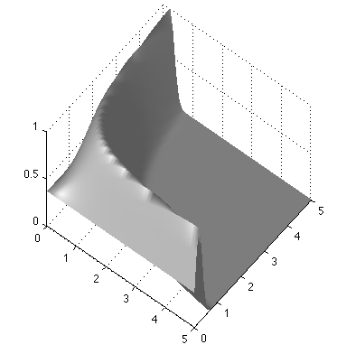
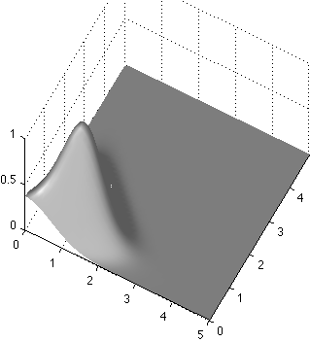
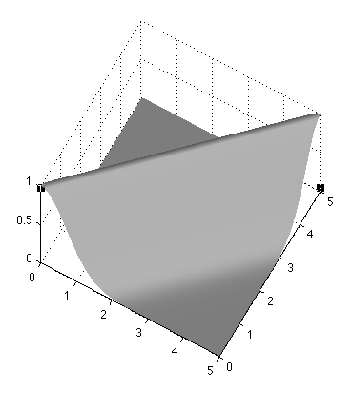
Bayesian approach
Use P(a, b | y = 1) = k P(y=1|a, b) P(a, b)
Likelihood function
P(a, b | y = 1)
a=b=1
b
a
Prior probability
b
If a>0, b>0
a
= 0 otherwise
b
a

Slide 3
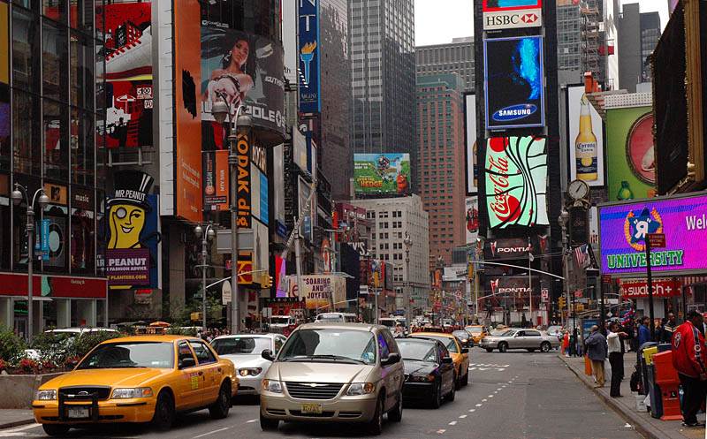
Statistical modeling of images
The pixel
Another pixel

Slide 4
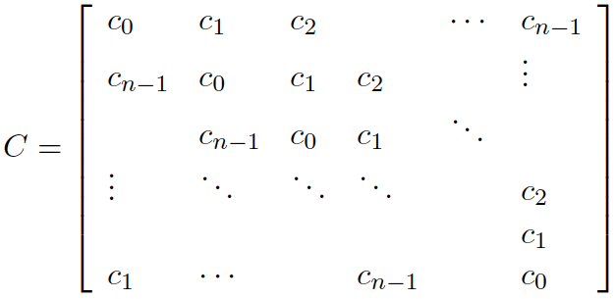
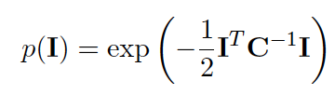
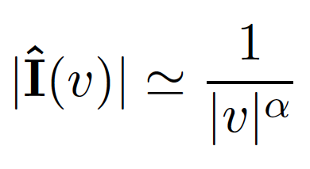
Gaussian model
We want a distribution that captures the correlation structure typical of natural images.
Let C be the covariance matrix of the image:
Stationarity assumption: Symmetrical circulant matrix
Diagonalization of circulant matrices: C = EDE^{T}
The eigenvectors are the Fourier basis
The eigenvalues are the squared magnitude of the Fourier coefficients
 |  |  | …
D=
2
2

Slide 5
Statistical modeling of images
A small neighborhood

Slide 6
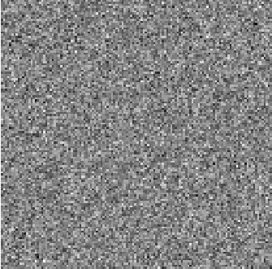
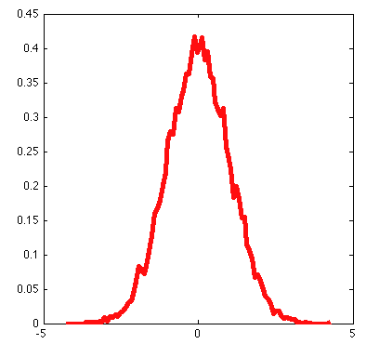

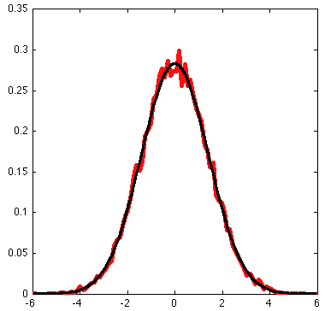
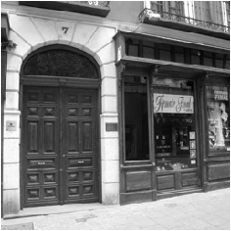
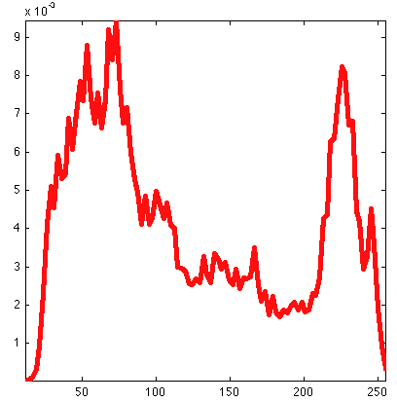
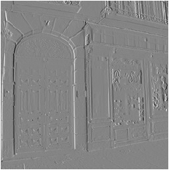
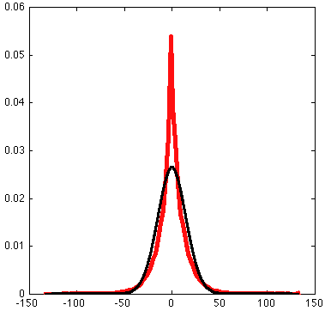
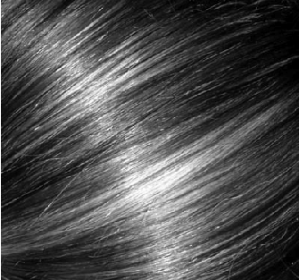
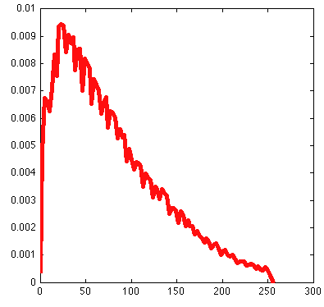
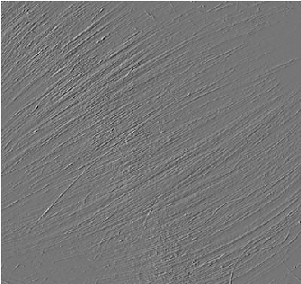
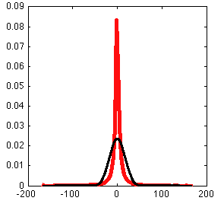
Image
Intensity histogram
[1 -1] filter output
[1 -1] output histogram
Red – true pdf
Black – best Gaussian fit

Slide 7
A model for the distribution of filter outputs
Red – true pdf
Black – best Gaussian fit
exp(-x²/2σ²)
p(x) =
2πσ²
exp(-|x/s|^{r})
p(x) =
2s/rΓ(1/r)
r ~ 0.8 (< 2)
Note: this is not a good model for ALL filter outputs

Slide 8
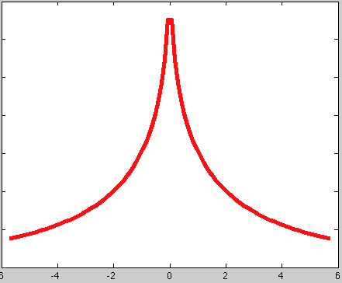
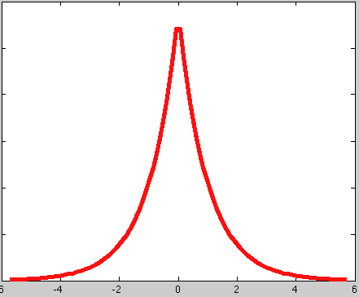
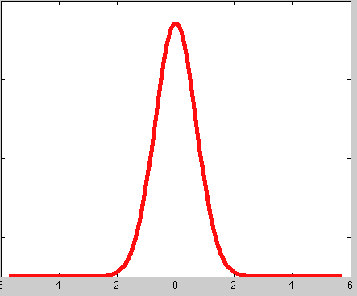
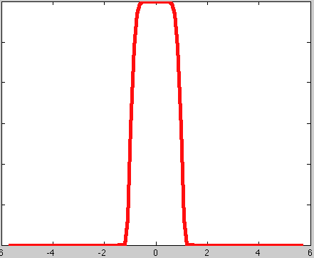
Generalized Gaussian
exp(-|x/s|^{r})
p(x) =
2s/rΓ(1/r)
r = 1
r = 2
r = 0.5
Laplacian distribution
Gaussian distribution
r = 10
Uniform distribution
r -> infinite

Slide 9
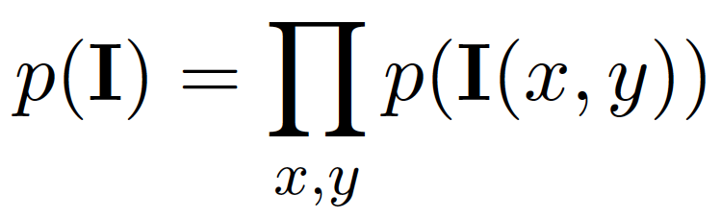
The wavelet marginal model
A small neighborhood
p(h_{k}(x,y))
k
All pixels and all outputs are independent
Filter outputs

Slide 10
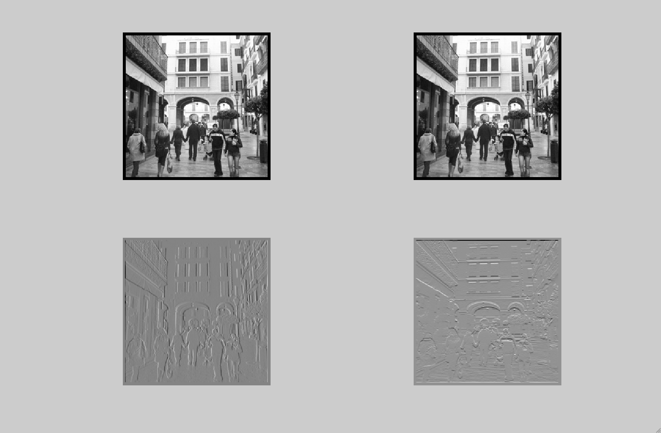
The wavelet marginal model
[1 -1]
[1 -1]^{T}
p(h_{k}(x,y))
k

Slide 11
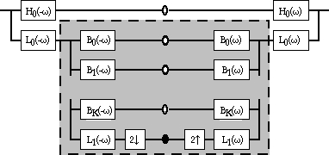
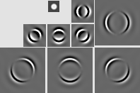
Steerable Pyramid
We may combine Steerability with Pyramids to get a Steerable Laplacian Pyramid as
shown below
Decomposition
Reconstruction
…
…
Images from: http://www.cis.upenn.edu/~eero/steerpyr.html

Slide 12
Steerable Pyramid
We may combine Steerability with Pyramids to get a Steerable Laplacian Pyramid as
shown below
Decomposition
Reconstruction
p(h_{k}(x,y))
k

Slide 13
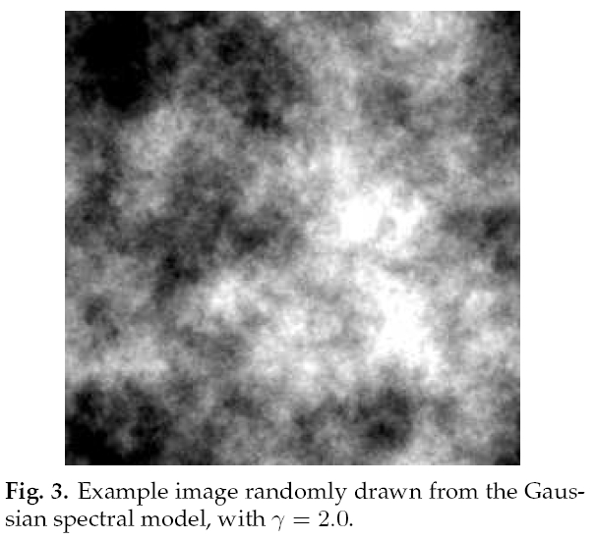
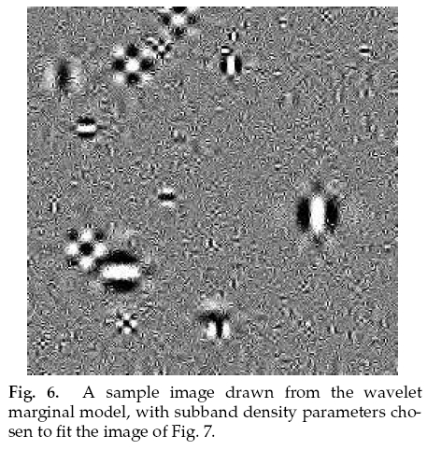
Sampling images
Gaussian model
Wavelet marginal model

Slide 14
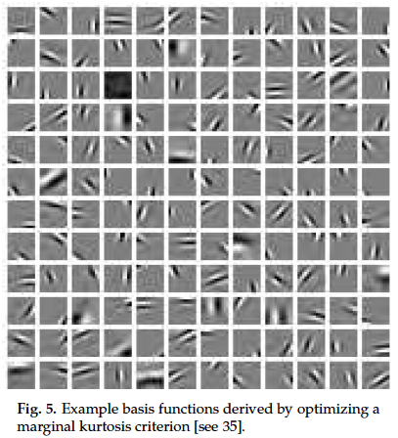

Slide 15
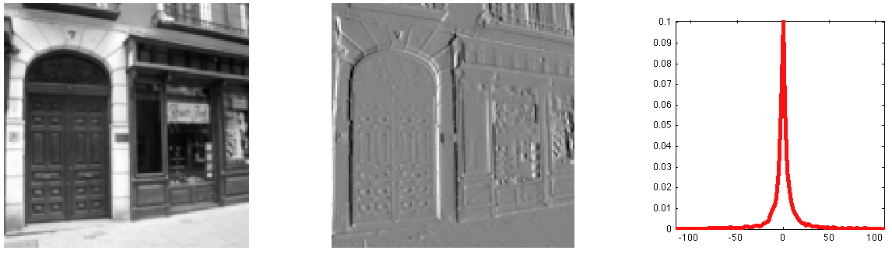
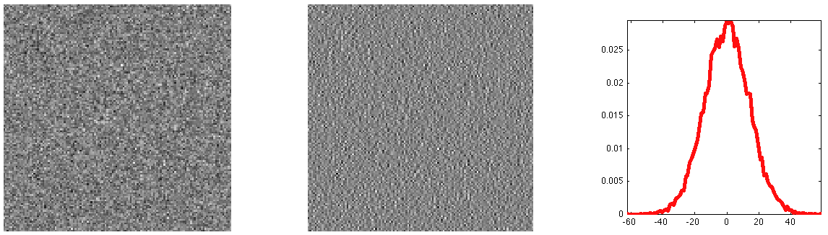

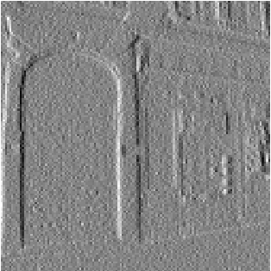
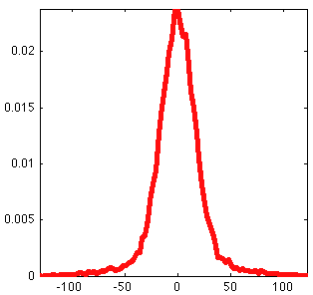
Denoising
+
+
*
White
Gaussian
noise
=
=
=
Noisy
image

Slide 16
Denoising with the marginal wavelet model
Let x = bandpassed image value before adding noise.
Let y = noise-corrupted observation.
By Bayes theorem
P(x)
y = 25
P(x|y) ~ P(y|x) P(x)
y
P(y|x)
P(x|y)

Slide 17
Denoising with the marginal wavelet model
Let x = bandpassed image value before adding noise.
Let y = noise-corrupted observation.
By Bayes theorem
y = 50
P(x|y) ~ P(y|x) P(x)
y
P(y|x)
P(x|y)

Slide 18
Denoising with the marginal wavelet model
Let x = bandpassed image value before adding noise.
Let y = noise-corrupted observation.
By Bayes theorem
y = 115
P(x|y) ~ P(y|x) P(x)
y
P(y|x)
P(x|y)

Slide 19
Denoising with the marginal wavelet model
y = 25
y = 115
P(x)
y
P(x)
P(y|x)
P(y|x)
P(x|y)
y
P(x|y)
For small y: probably it is due to noise and y should be set to 0
For large y: probably it is due to an image edge and it should be kept untouched

Slide 20
MAP estimate, , as function of observed coefficient value, y
Simoncelli and Adelson, Noise Removal via Bayesian Wavelet Coring
http://www-bcs.mit.edu/people/adelson/pub_pdfs/simoncelli_noise.pdf

Slide 21
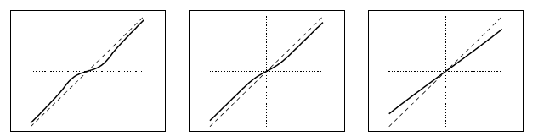
r = 0.5
r = 1
r = 2
Laplacian distribution
Gaussian distribution

Slide 22
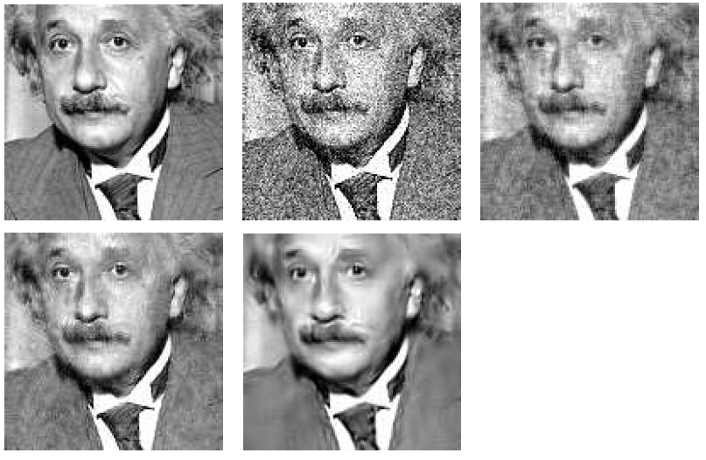
With Gaussian noise of std. dev. 21.4 added, giving PSNR=22.06
(1) Denoised with Gaussian model, PSNR=27.87
original
(2) Denoised with wavelet marginal model, PSNR=29.24
http://www.cns.nyu.edu/pub/eero/simoncelli05a-preprint.pdf

Slide 23
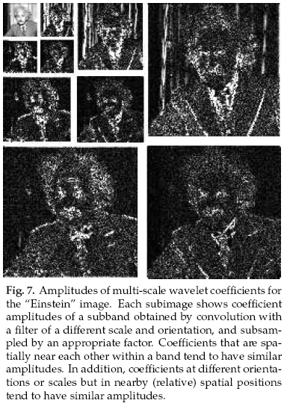
Gaussian scale mixtures
Note correlations between the amplitudes of each wavelet subband.
http://www.cns.nyu.edu/pub/eero/simoncelli05a-preprint.pdf

Slide 24
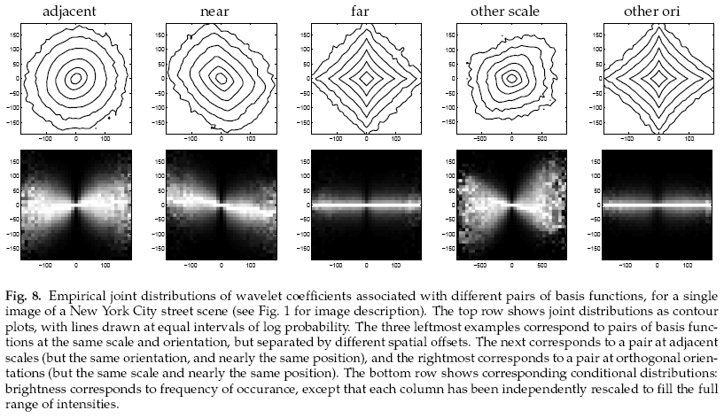
Statistics of pairs of wavelet coefficients
Contour plots of the joint histogram of various wavelet coefficient pairs
Conditional distributions of the corresponding wavelet pairs
http://www.cns.nyu.edu/pub/eero/simoncelli05a-preprint.pdf

Slide 25
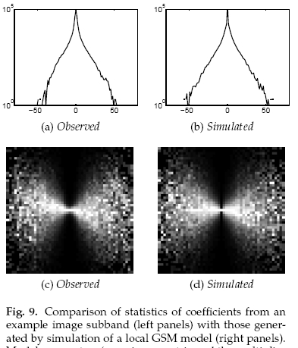
Gaussian scale mixtures
Gaussian scale mixture model simulation
observed
Wavelet coefficient probability
A mixture of Gaussians of scaled covariances
z is a spatially varying hidden variable that can be used to
(a) Create the non-gaussian histograms from a mixture of Gaussian densities, and (b) model correlations between the neighboring wavelet coefficients.

Slide 26
With Gaussian noise of std. dev. 21.4 added, giving PSNR=22.06
(1) Denoised with Gaussian model, PSNR=27.87
original
(3) Denoised with Gaussian scale mixture model, PSNR=30.86
(2) Denoised with wavelet marginal model, PSNR=29.24
http://www.cns.nyu.edu/pub/eero/simoncelli05a-preprint.pdf

Slide 27

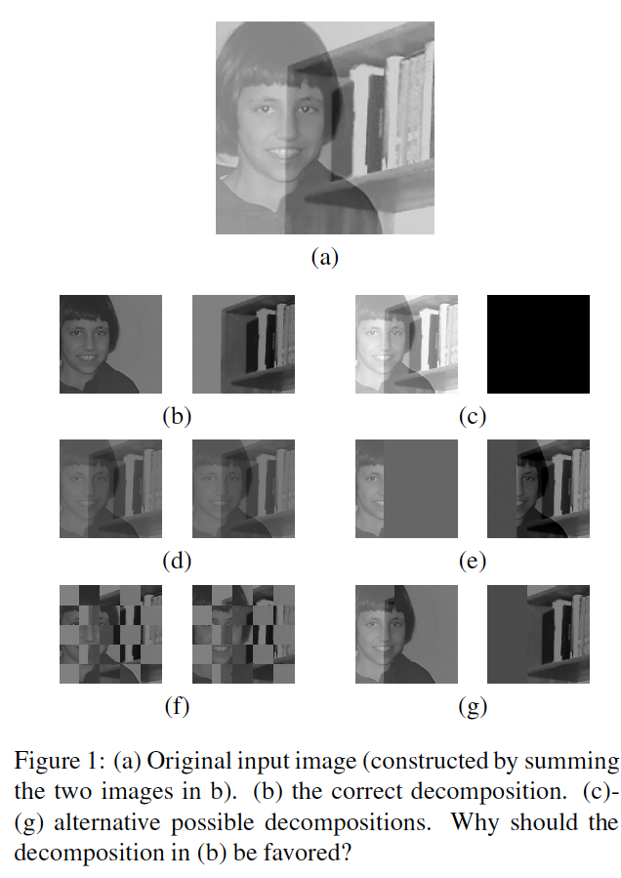

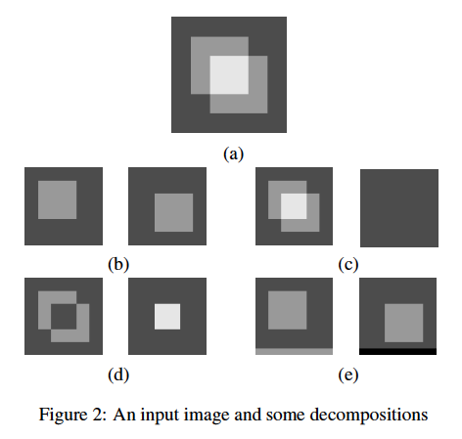

Slide 28
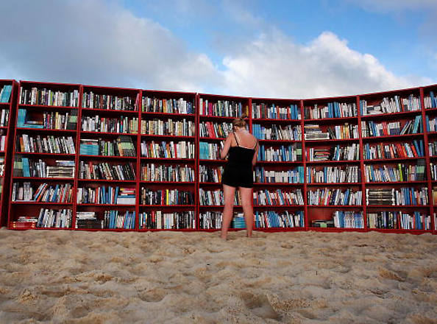
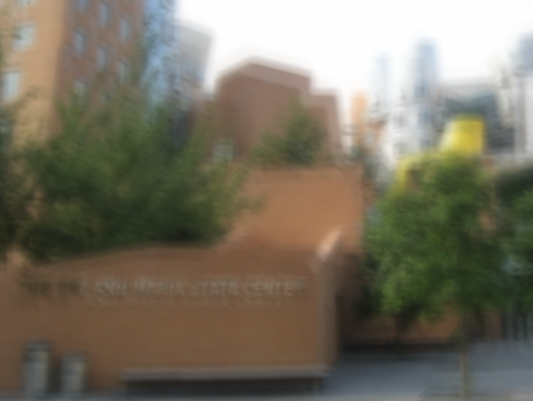
Applications
Detecting fake images
Camera shake removal

Slide 29
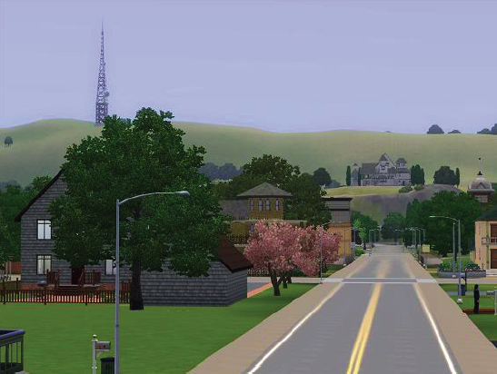
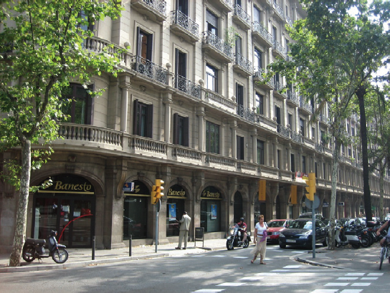
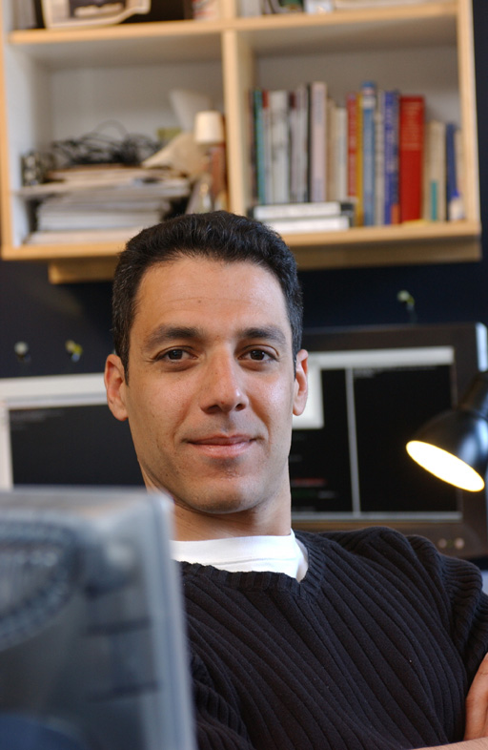
Visual Worlds
Prof. Hany Farid,
Dartmouth University

Slide 30
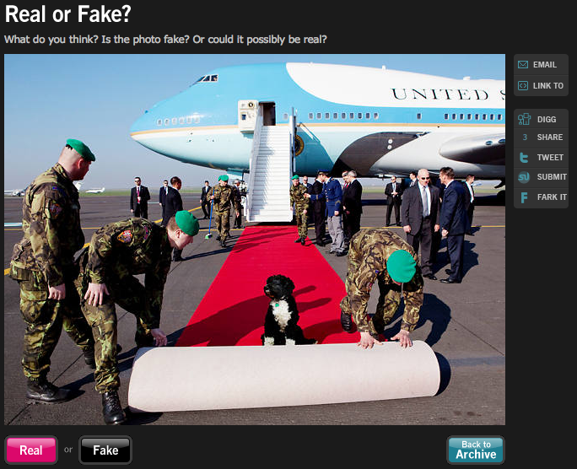
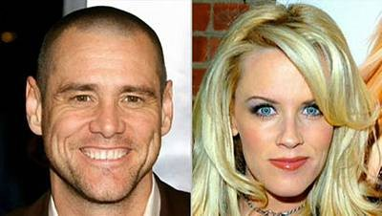
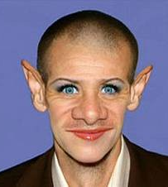
How do you tell if an image is fake?
+
=
http://www.life.com/archive/realfake

Slide 31
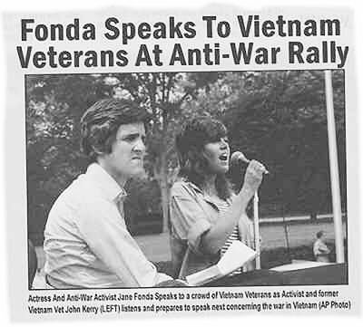
Image circulated on internet
http://www.cs.dartmouth.edu/farid/publications/deception09.pdf
http://www.cs.dartmouth.edu/farid/publications/significance06.pdf

Slide 32
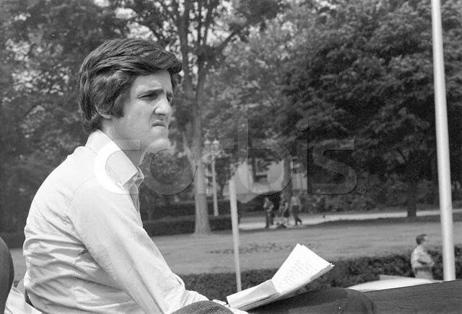


The source images

Slide 33

IEEE Transactions on Signal Processing, 53(2):845-850, 2005

Slide 34

Input image

Slide 35


Representation of color input image in wavelet subbands

Slide 36

Filter bank
Separable Quadrature Mirror Filters
Each output is called subband

Slide 37

Histograms of wavelet subband coefficients

Slide 38

There are correlations between subband coefficients

Slide 39


Slide 40

Hypothesis: there is something different in the correlation between wavelet
coefficients between real images and computer generated images.

Slide 41

Summary of features used for image classification

Slide 42


Slide 43

Projection of measured features into a 3-d space: well separated even in that low-dimensional space
First 3 principal
components

Slide 44

Photographic training set:
downloaded from www.freefoto.com
(40,000)

Slide 45

Photorealistic training set:
downloaded from www.raph.com and www.irtc.org

Slide 46

Classifier 1: LDA. Simple, amenable to analysis

Slide 47

Classifier 2: SVM. State of the art.

Slide 48

Easily classified photographic images

Slide 49

Easily classified photorealistic images

Slide 50

Incorrectly classified photographic images

Slide 51

Incorrectly classified photorealistic images

Slide 52


www.fakeorfoto.com

Slide 53

Results of algorithm
Photographic images
Photorealistic images
Correct
Incorrect

Slide 54


Taking a picture…
What the camera give us…
How do we correct this?
Slides R. Fergus
Notes:
Here is a photo blurred by camera shake. Our algorithm takes this image and removes the camera shake, giving a sharp image, like the one on the right.

Slide 55


Close-up
Original
Naïve Sharpening
Our algorithm
Slides R. Fergus
Notes:
Double image in eyes

Slide 56
Why does picture appear blurry?

Slide 57

Let’s take a photo
Blurry result
Slides R. Fergus

Slide 58

Slow-motion replay
Slides R. Fergus

Slide 59


Slow-motion replay
Motion of camera
Slides R. Fergus
Notes:
Even though you thought the camera was still, in fact lots of things happening while the shutter is open.

Slide 60


Image formation process
=
⊗
Blur
kernel
Blurry image
Sharp image
Input to algorithm
Desired output
Convolution
operator
Model is approximation
Notes:
Start with: we use the following model. …….
Approximation since there are lots of effects we don’t model.

Slide 61
Why is this hard?
Simple analogy:
11 is the product of two numbers.
What are they?
No unique solution:
11 = 1 x 11
11 = 2 x 5.5
11 = 3 x 3.667
etc…..
Need more information !!!!
Slides R. Fergus

Slide 62
Multiple possible solutions
Sharp image
Blur kernel
=
⊗
=
⊗
Blurry image
=
⊗
Notes:
Say middle one does convolve back to blurry. Goal to get true image.

Slide 63


Natural image statistics
Characteristic distribution with heavy tails
Histogram of image gradients
Slides R. Fergus

Slide 64


Blury images have different statistics
Histogram of image gradients
Slides R. Fergus

Slide 65


Parametric distribution
Histogram of image gradients
Use parametric model of sharp image statistics
Slides R. Fergus
Notes:
We use green curve which was fit to the red curve. We use this distribution for all examples in the paper. Remove blur curve

Slide 66
Existing work on image deblurring
Software algorithms:
  Extensive literature in signal processing community
  Mainly Fourier and/or Wavelet based
  Strong assumptions about blur
  → not true for camera shake
Assumed forms of blur kernels
  Image constraints are frequency-domain power-laws
Slides R. Fergus
Notes:
Previous methods have used image statistics in the form of FD power-laws but these a weak constraints that do not preserve local image structure.

Slide 67




Hardware approaches
Existing work on image deblurring
Image stabilizers
Dual cameras
Coded shutter
Ben-Ezra and
Nayar 2004
Raskar et al. SIGGRAPH 2006
Our approach can be combined with these hardware methods
Notes:
There are a variety of hardware approaches, for example, image stabilizers move the light path to correct for camera motion. Ben-ezra and nayar propose adding a second, video camera to estimate the camera motion. Also the next paper in the session proposes to flutter the shutter to remove blur when the camera or object motion within the scene is known.
These methods all require you to modify the camera, while our approach works with any blurry image.

Slide 68

Three sources of information
1. Reconstruction constraint:
⊗
=
Estimated
blur kernel
Estimated sharp image
Input blurry image
2. Image prior:
3. Blur prior:
Positive
&
Sparse
Distribution of gradients
Notes:
Add in + noise
Three things we know.
Reconstruct to the blurry image plus noise.

Slide 69


Slide 70


Slide 71


Slide 72


Slide 73
How do we use this information?
Obvious thing to do:
  Combine 3 terms into an objective function
  Run conjugate gradient descent
  This is Maximum a-Posteriori (MAP)

Slide 74


Results from MAP estimation
Input blurry image
Maximum a-Posteriori (MAP)
Our method: Variational Bayes

Slide 75

Variational Bayesian method
Based on work of Miskin & Mackay 2000
Keeps track of uncertainty in estimates of image and blur by using a distribution instead of a single estimate
Helps avoid local maxima and over-fitting
Notes:
Go slow. 1 pixel → single variable. Way to precisely fit data even though it isn’t too stable.

Slide 76
Overview of algorithm
Input image
Pre-processing
Kernel estimation
  Multi-scale approach
Image reconstruction
  - Standard non-blind deconvolution routine

Slide 77
Preprocessing
Input image
Convert to
grayscale
Remove gamma
correction
User selects patch
from image
Bayesian inference too slow to run on whole image
Infer kernel
from this patch

Slide 78

Initialization
Input image
Convert to
grayscale
Remove gamma
correction
User selects patch
from image
Initialize 3x3
blur kernel
Blurry patch
Initial image estimate
Initial blur kernel

Slide 79

Inferring the kernel: multiscale method
Input image
Convert to
grayscale
Remove gamma
correction
User selects patch
from image
Loop over scales
Upsample
estimates
Variational
Bayes
Initialize 3x3
blur kernel
Use multi-scale approach to avoid local minima:

Slide 80

Image Reconstruction
Input image
Convert to
grayscale
Remove gamma
correction
User selects patch
from image
Loop over scales
Upsample
estimates
Variational
Bayes
Initialize 3x3
blur kernel
Full resolution
blur estimate
Non-blind deconvolution (Richardson-Lucy)
Deblurred
image
Notes:
Use different words to non-blind: “final deconvolution” maybe

Slide 81
Results on real images
Submitted by people from their own photo collections
Type of camera unknown
Output does contain artifacts
  Increased noise
  Ringing
Compares well to existing methods
Notes:
Off the shelf non-blind deconvolution. Needs improvement.

Slide 82

Original photograph

Slide 83


Our output
Blur kernel
Notes:
Kernel look like nice smooth trajectory

Slide 84
Original photograph
Matlab’s deconvblind

Slide 85
Close-up of garland
Original
Matlab’s
deconvblind
Our output
Notes:
Add matlab zoom in

Slide 86

Original photograph
Notes:
UPDATED IMAGE.

Slide 87
Matlab’s deconvblind
Notes:
UPDATED IMAGE.

Slide 88

Photoshop sharpen more
Notes:
UPDATED IMAGE.

Slide 89


Our output
Notes:
UPDATED IMAGE. Less ringing on Guiseppe (and elsewhere) than in old version. Brightness increased to increase clarity. Partially responsible for increased noise levels.

Slide 90



Notes:
UPDATED IMAGE.

Slide 91

Original photograph
Notes:
UPDATED IMAGE.

Slide 92


Our output
Notes:
UPDATED IMAGE. Nice image. Letter become razor sharp. Possible paralax with pole in foreground?

Slide 93
Original photograph

Slide 94

Our output

Slide 95
Matlab’s deconvblind

Slide 96

Original photograph

Slide 97


Our output
Blur kernel

Slide 98


Close-up of bird
Original
Unsharp mask
Our output

Slide 99

Original photograph

Slide 100


Blur kernel
output

Slide 101


Image artifacts & estimated kernels
Blur kernels
Image patterns
Note: blur kernels were inferred from large image patches,
NOT the image patterns shown
Notes:
Comment about not runnnig on yther patches themselves.
Shape important, not profile. Can’t always find these patterns in all images….

Slide 102

Bayesian methods

