Slide 1
http://6.869.csail.mit.edu/fa13
Instructors Antonio Torralba
TA Aditya Khosla
Lecture TR 1:00PM - 2:30PM (Room 4-163)

Slide 2
Assignments
Problem sets (2/3)
Almost weekly
Graded as 1-3
Late policy (6 days)
Collaboration policy
Final project (1/3)
Project proposal
5(?) min class presentation
Report
No exams or quizzes

Slide 3
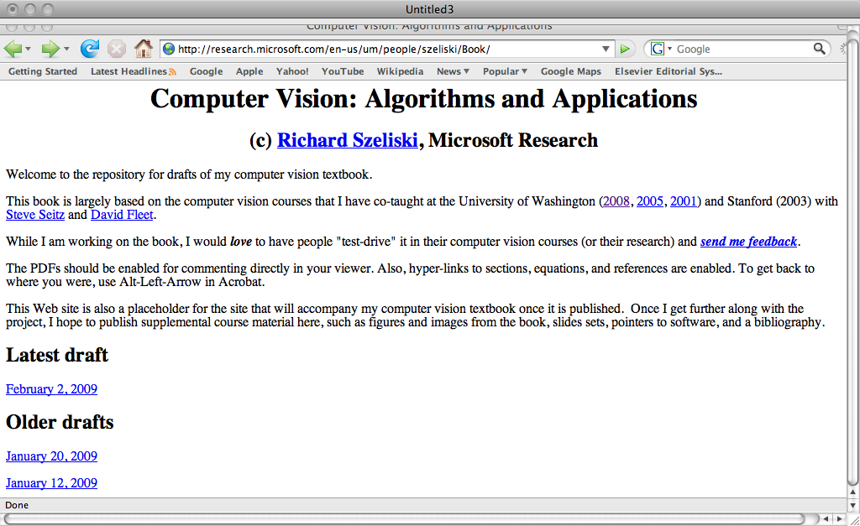
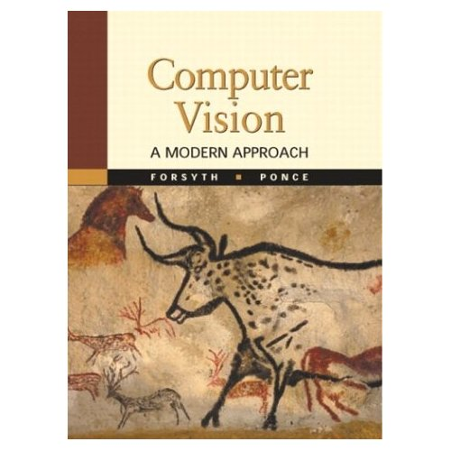
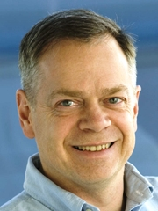
Readings
http://6.869.csail.mit.edu/fa13/materials.html

Slide 4
Matlab Tutorial TBA
If you are a Matlab expert, no need to attend.

Slide 5
Lecture 1
A Simple Vision System

Slide 6
What is vision?
What does it mean, to see? “to know what is where by looking”.
How to discover from images what is present in the world, where things are, what actions are taking place.
from Marr, 1982

Slide 7
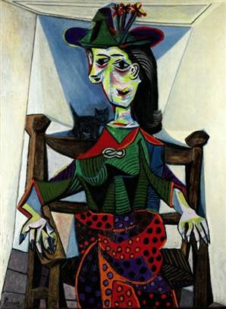
The importance of images
Some images are more important than others
“Dora Maar au Chat”
Pablo Picasso, 1941
100 million $

Slide 8
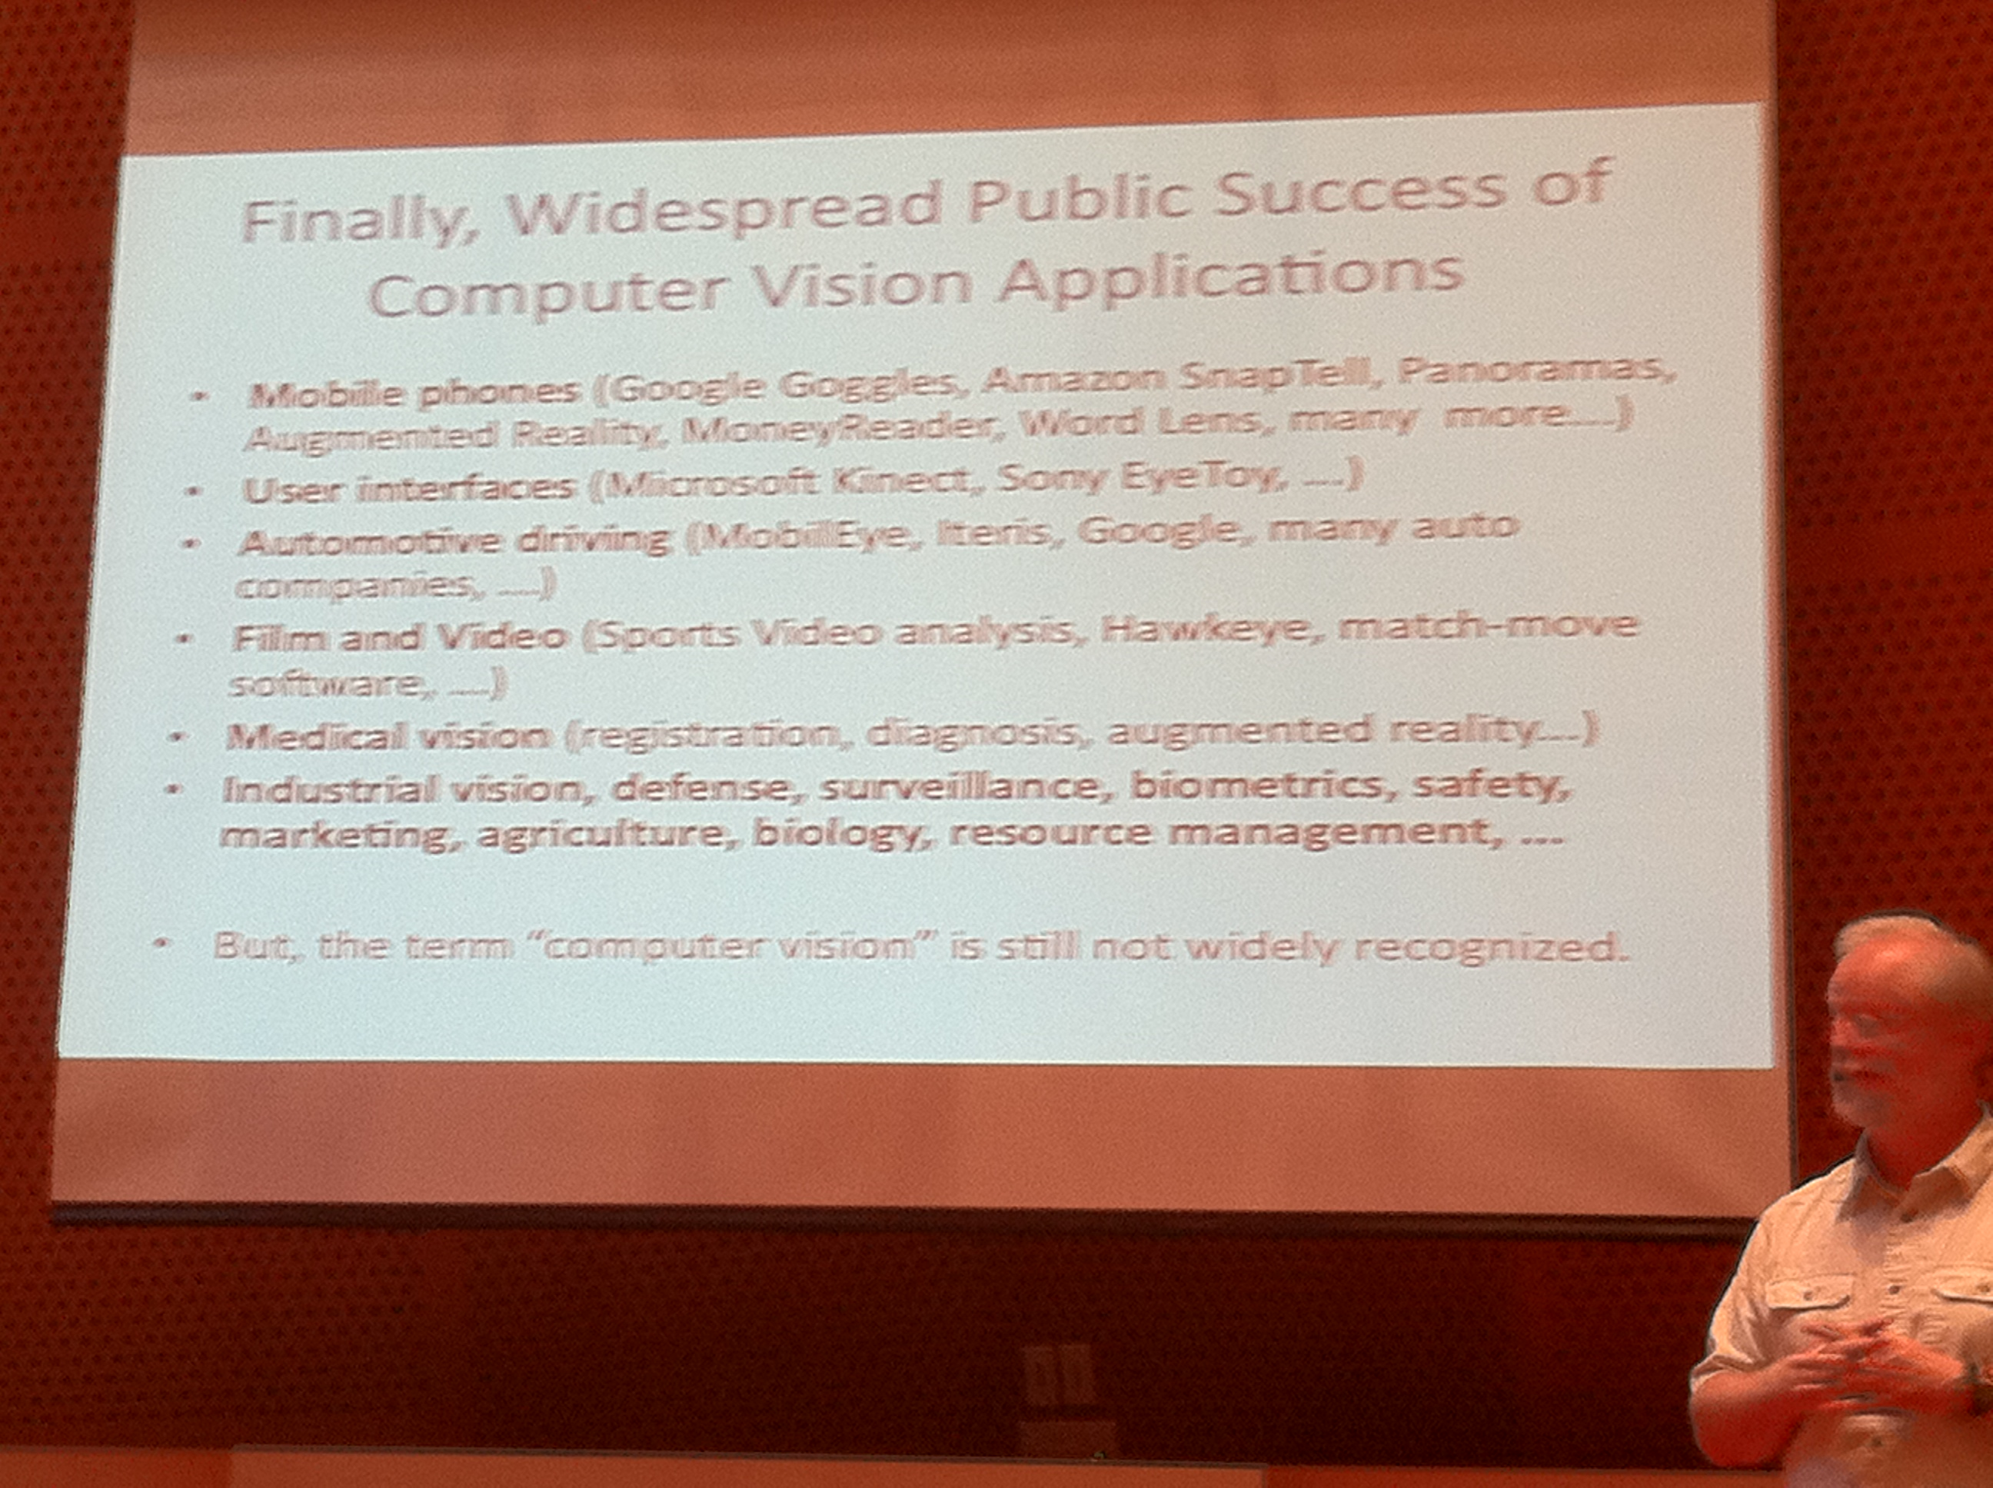
NSF Frontiers in computer vision workshop, 2011

Slide 9
Why is vision hard?

Slide 10
The structure of ambient light
Notes:
100 million miles

Slide 11
The structure of ambient light

Slide 12
The Plenoptic Function
Adelson & Bergen, 91
The intensity P can be parameterized as:
P
(θ, φ,
λ,
t,
X, Y, Z)
“The complete set of all convergence points constitutes the permanent possibilities of vision.” Gibson
Notes:
The significance of the plenoptic function is this: The world is made of three-dimensional objects, but these objects do not communicate their properties directly to an observer. Rather, the objects fill the space around them with the pattern of light rays that constitutes the plenoptic function, and the observer takes samples from this function. The plenoptic function serves as the sole communication link between physical objects and their corre- sponding retinal images.

Slide 15
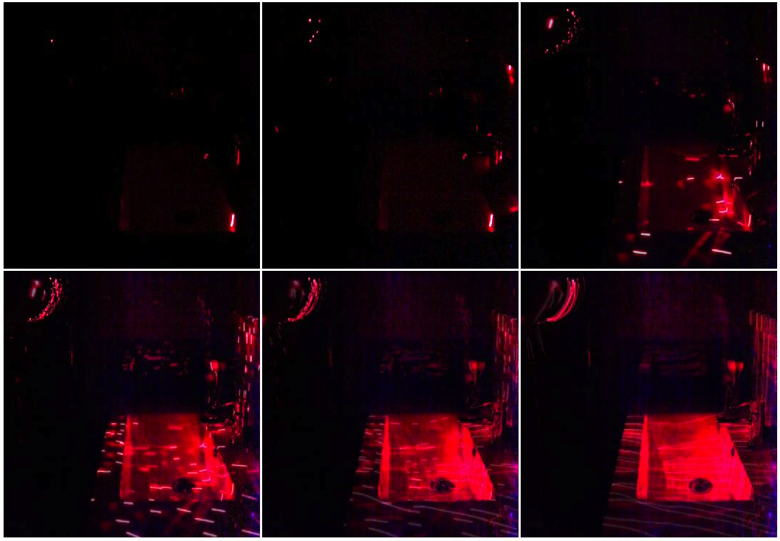
1
5
50
200
600
1300

Slide 16
1
5
50
200
600
1300

Slide 17
1
5
50
200
600
1300

Slide 18
1
5
50
200
600
1300

Slide 19
1
5
50
200
600
1300

Slide 20
1
5
50
200
600
1300

Slide 21
Why is vision hard?

Slide 22
Measuring light vs. measuring scene properties
We perceive two squares, one on top of each other.

Slide 23
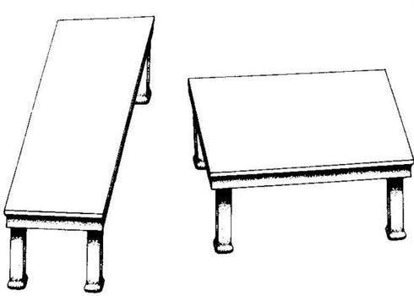
Measuring light vs. measuring scene properties
by Roger Shepard (”Turning the Tables”)
Depth processing is automatic, and we can not shut it down…

Slide 24
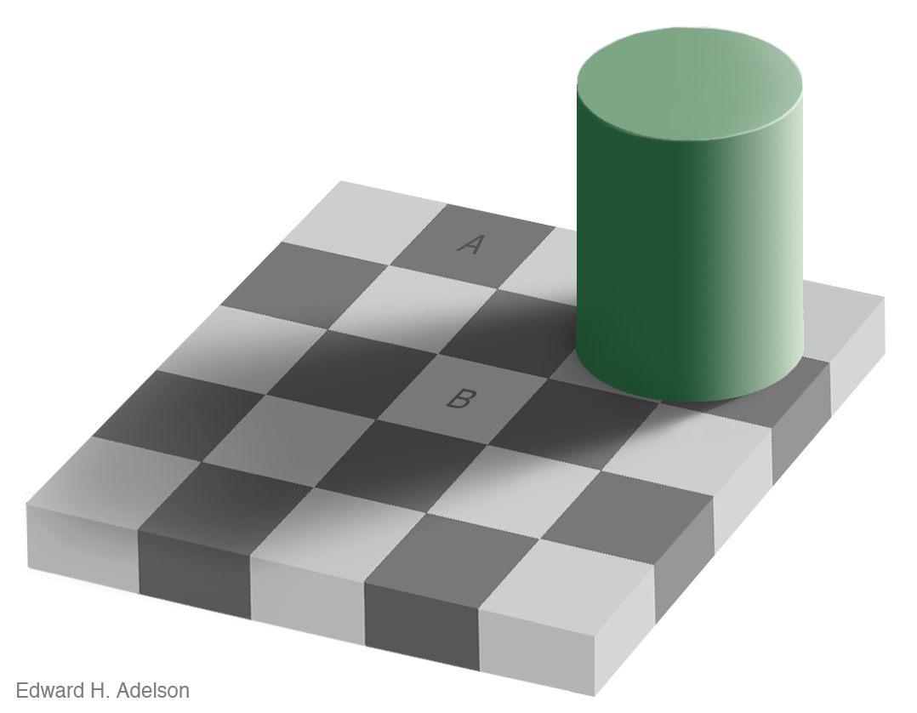
Measuring light vs. measuring scene properties

Slide 25
Measuring light vs. measuring scene properties

Slide 26
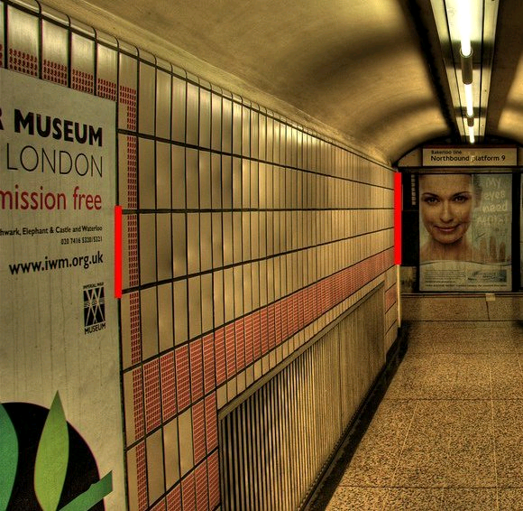
Measuring light vs. measuring scene properties
(c) 2006 Walt Anthony

Slide 27
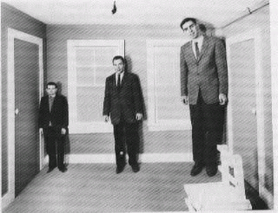
Assumptions can be wrong
Ames room

Slide 29
Why is vision hard?

Slide 30
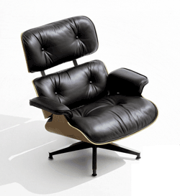
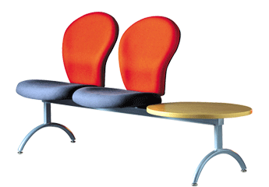
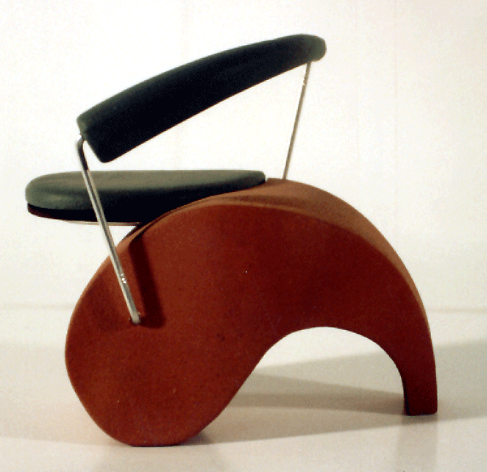
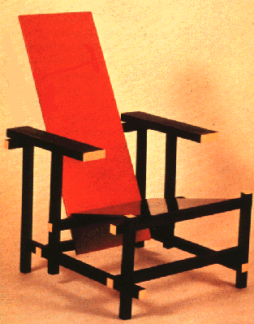
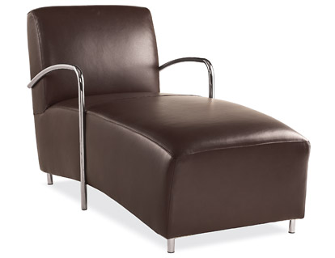
Some things have strong variations in appearance

Slide 31
Some things know that you have eyes
Brady, M. J., & Kersten, D. (2003). Bootstrapped learning of novel objects. J Vis, 3(6), 413-422

Slide 32
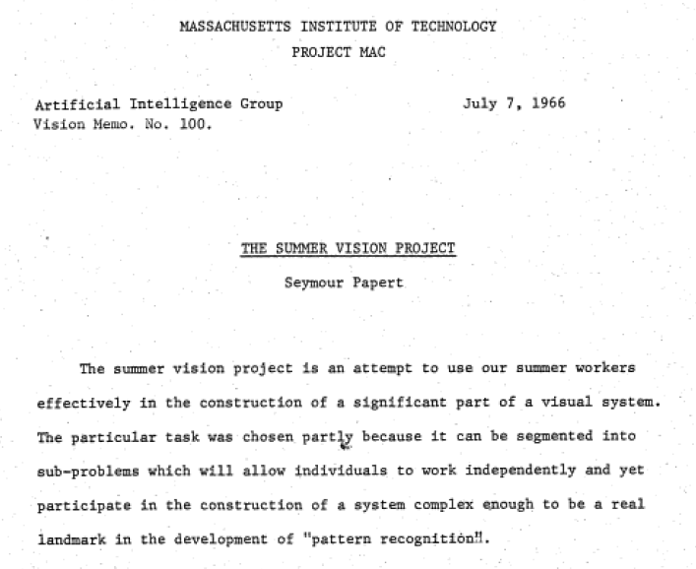

Slide 33
Problem set 1 The “one week” vision project
The goal of the first problem set is to solve vision

Slide 34
A Simple Visual System
A simple world
A simple image formation model
A simple goal

Slide 35
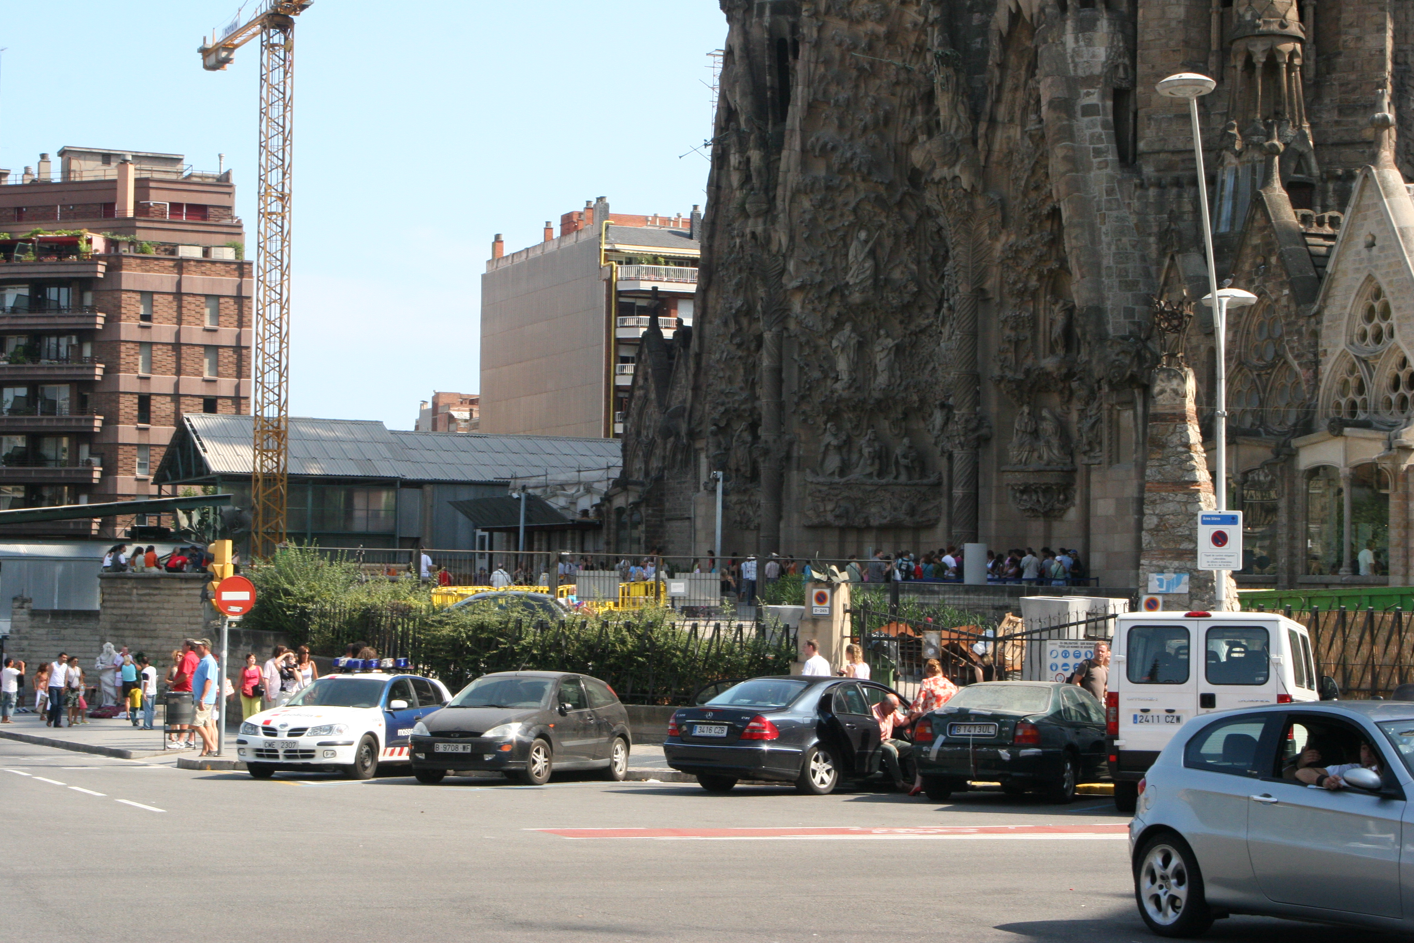
A Simple World

Slide 36
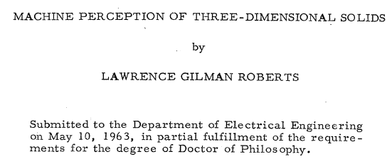
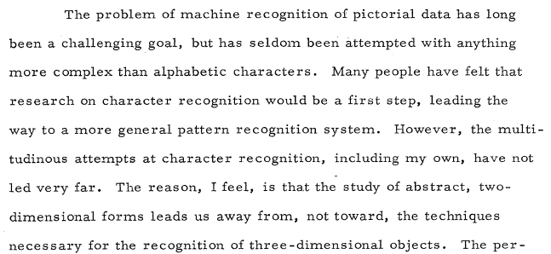
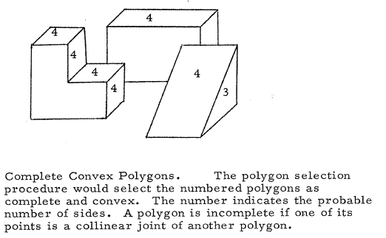
A Simple World
http://www.packet.cc/files/mach-per-3D-solids.html

Slide 37
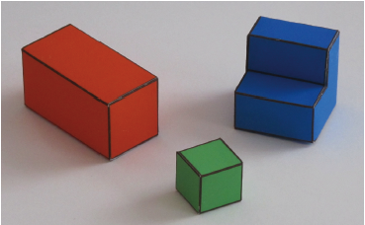
A Simple World

Slide 38
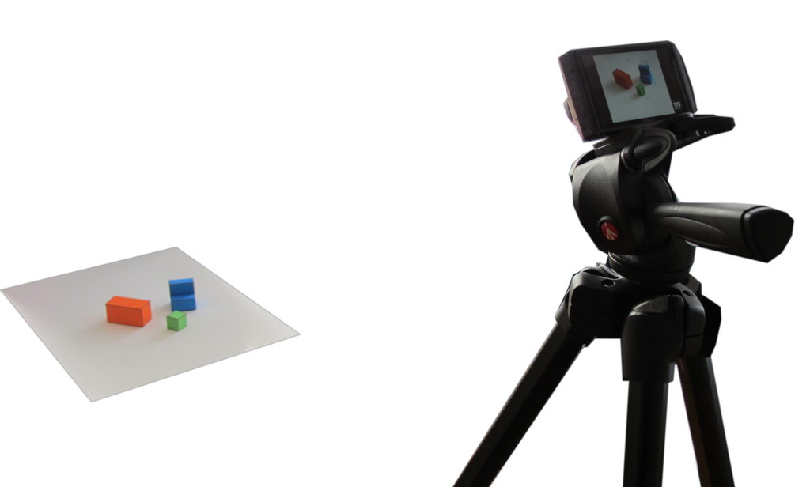
A simple image formation model
Simple world rules:
Surfaces can be horizontal or vertical.
Objects will be resting on a white horizontal ground plane

Slide 39
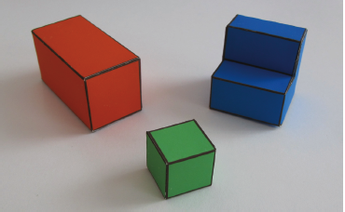
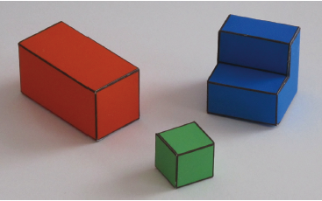
A simple image formation model
Perspective projection
Parallel (orthographic) projection

Slide 40
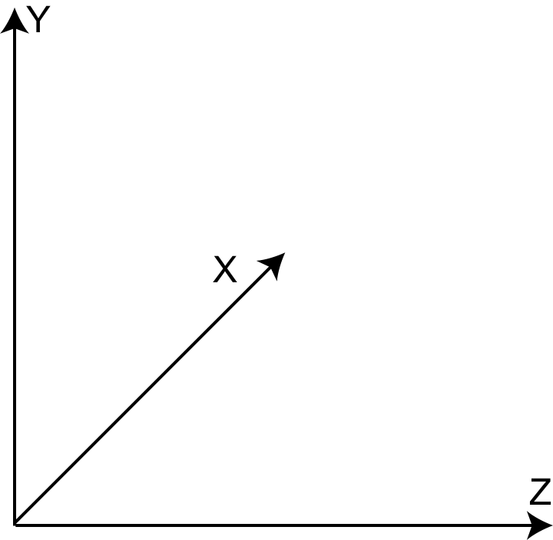
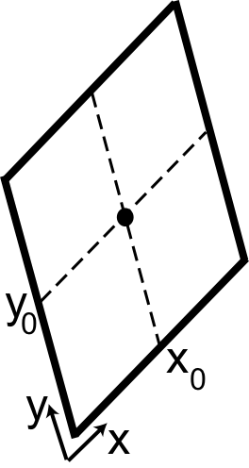
A simple image formation model
World reference system
Camera plane
(right-handed reference system)

Slide 41
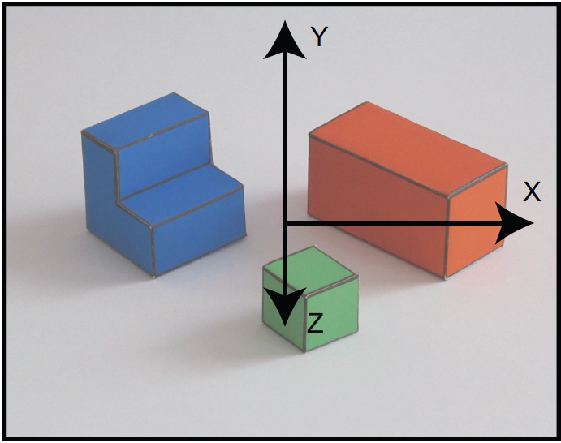
A simple image formation model
Image and projection of the world coordinate axes into the image plane
World coordinates
image coordinates
World coordinates
x =
X + x₀
y =
cos(θ) Y – sin(θ) Z + y₀
image coordinates

Slide 42
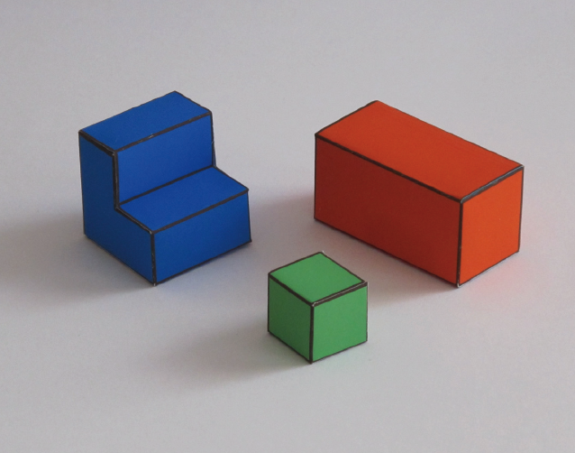
A simple goal
To recover the 3D structure of the world
We want to recover X(x,y), Y(x,y), Z(x,y) using as input I(x,y)

Slide 43
Why is this hard?
Sinha & Adelson 93

Slide 44
Why is this hard?
Sinha & Adelson 93

Slide 45
Why is this hard?
Sinha & Adelson 93

Slide 46
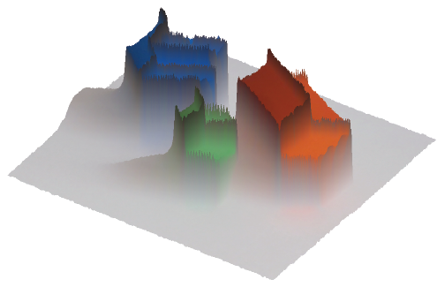
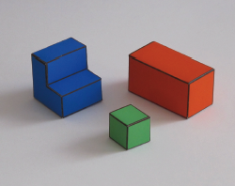
A simple visual system The input image
I(x,y)
0
y
255
x

Slide 47
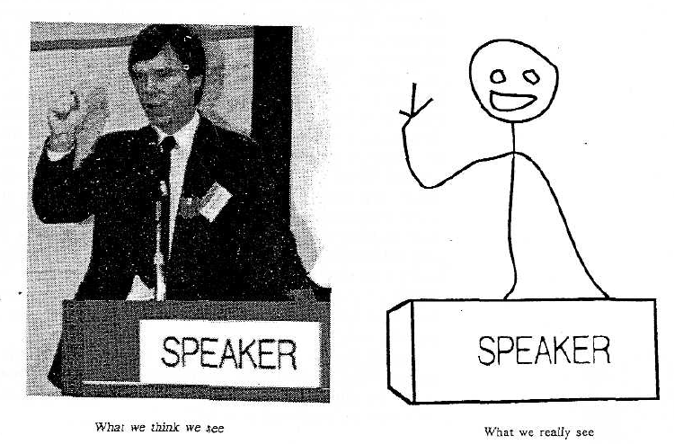
Proposition 1. The primary task of early vision is to deliver a small set of useful measurements about each observable location in the plenoptic function.
Proposition 2. The elemental operations of early vision involve the measurement of local change along various directions within the plenoptic function.
Goal: to transform the image into other representations (rather than pixel values) that makes scene information more explicit
Adelson, Bergen. 91
Cavanagh, Perception 95

Slide 48
Edges
Occlusion
Horizontal 3D edge
Change of
Surface orientation
Vertical 3D edge
Contact edge
Shadow boundary

Slide 49
Finding edges in the image
Image gradient:
Approximation image derivative:
Edge strength
Edge orientation:
Edge normal:

Slide 50
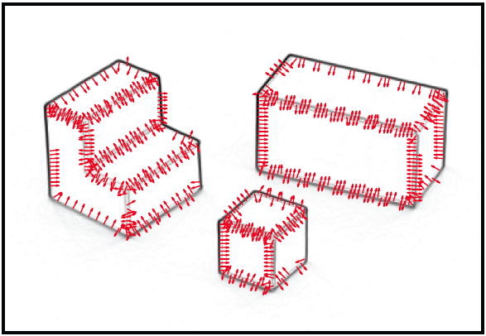
Finding edges in the image

Slide 51
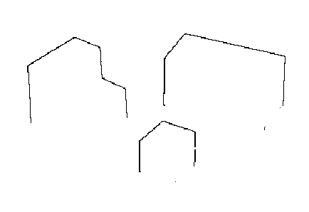
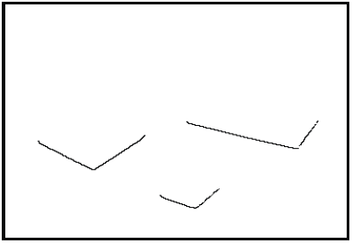
Edge classification
Figure/ground segmentation
Occlusion edges
Occlusion edges are owned by the foreground
Contact edges

Slide 52
From edges to surface constraints
Ground
Y(x,y) = 0 if (x,y) belongs to a ground pixel
Contact edge
Y(x,y) = 0 if (x,y) belongs to foreground and is a contact edge
Next, things get a bit more complicated.

Slide 53
Generic view assumption
3D world
3D world
Image
3D world
Generic view assumption: the observer should not assume that he has a special position in the world… The most generic interpretation is to see a vertical line as a vertical line in 3D.
Freeman, 93

Slide 54
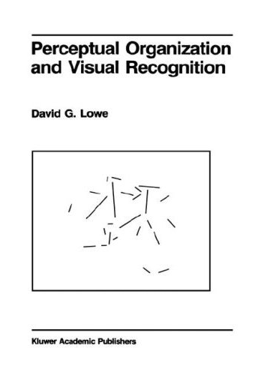
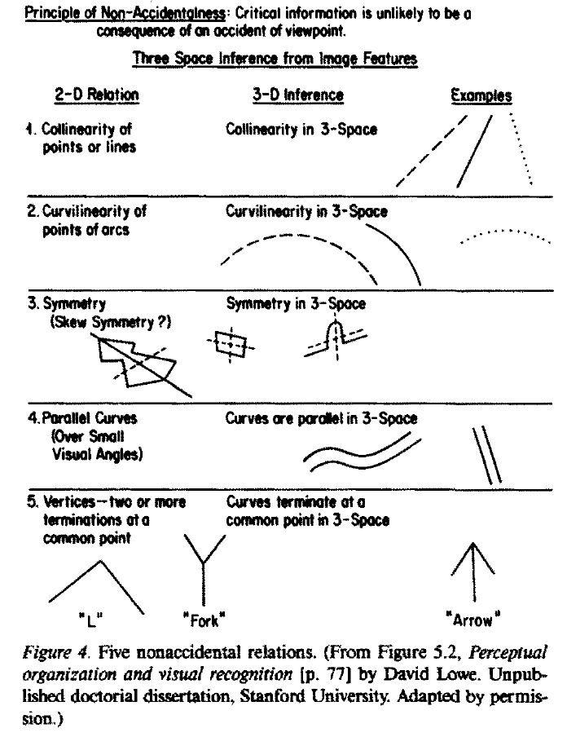
Non-accidental properties
D. Lowe, 1985
Biederman_RBC_1987

Slide 55
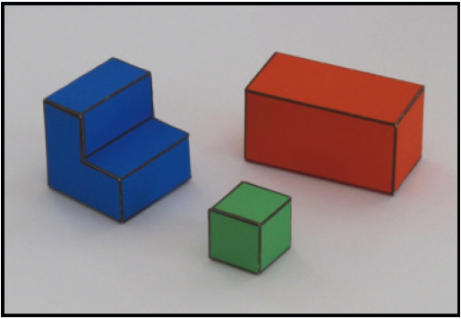
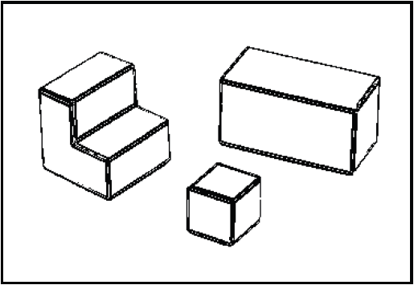
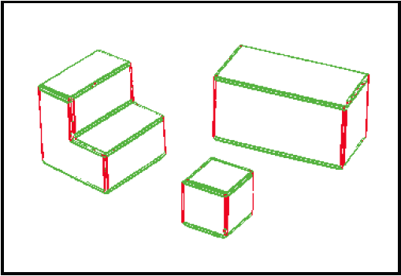
Non-accidental properties in the simple world
generic
generic
generic
accidental
generic
generic
generic
Using E(x,y)
Using θ(x,y)

Slide 56
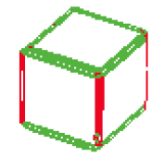
From edges to surface constraints
How can we relate the information in the pixels with 3D surfaces in the world?
Vertical edges
World coordinates
x =
X + x₀
y =
cos(θ) Y – sin(θ) Z + y₀
image coordinates
Given the image, what can we say about X, Y and Z in the pixels that belong to a vertical edge?
Z = constant along the edge

Slide 57
From edges to surface constraints
Horizontal edges
World coordinates
x =
X + x₀
y =
cos(θ) Y – sin(θ) Z + y₀
image coordinates
Given the image, what can we say about X, Y and Z in the pixels that belong to an horizontal 3D edge?
Y = constant along the edge
Where t is the vector parallel to the edge

Slide 58
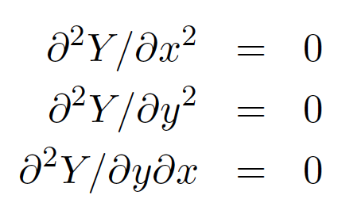
From edges to surface constraints
What happens where there are no edges?
?
Assumption of planar faces:
Information has to be propagated from from the edges

Slide 59
A simple inference scheme
All the constraints are linear
Y(x,y) = 0
if (x,y) belongs to a ground pixel
if (x,y) belongs to a vertical edge
if (x,y) belongs to an horizontal edge
if (x,y) is not an edge

Slide 60
Discrete approximation
We can transform every differential constrain into a discrete linear constraint on Y(x,y)
Y(x,y)
111 | 115 | 113 | 111 | 112 | 111 | 112 | 111
135 | 138 | 137 | 139 | 145 | 146 | 149 | 147
163 | 168 | 188 | 196 | 206 | 202 | 206 | 207
180 | 184 | 206 | 219 | 202 | 200 | 195 | 193
189 | 193 | 214 | 216 | 104 | 79 | 83 | 77
191 | 201 | 217 | 220 | 103 | 59 | 60 | 68
195 | 205 | 216 | 222 | 113 | 68 | 69 | 83
199 | 203 | 223 | 228 | 108 | 68 | 71 | 77
dY
dx
≈ Y(x,y) – Y(x-1,y)
-1 | 1
A slightly better approximation
(it is symmetric, and it averages horizontal derivatives over 3 vertical locations)
-1 | 0 | 1
-2 | 0 | 2
-1 | 0 | 1

Slide 61
Discrete approximation
Transform the “image” Y(x,y) into a column vector:
x=2, y=2
dY
Y(x,y)
dx
≈ Y(x,y) – Y(x-1,y) = Y(2,2) – Y(1,2)=
 |  |  |  |  | -1 |  |  |  | 1
x=0 y=0

Slide 62
A simple inference scheme
Y
b
=
Constraint weights
A Y = b
Y = (A^{T}A)⁻¹ A^{T}b

Slide 63
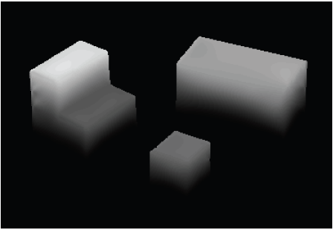
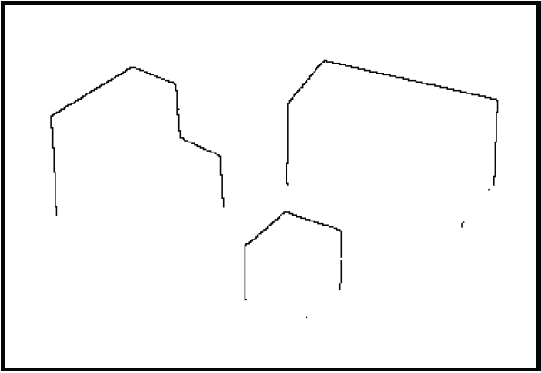
Results
X
Edge strength
3D orientation
Y
Edge normals
Contact edges
Z
Depth discontinuities

Slide 64
Changing view point
Input
New view points:

Slide 65
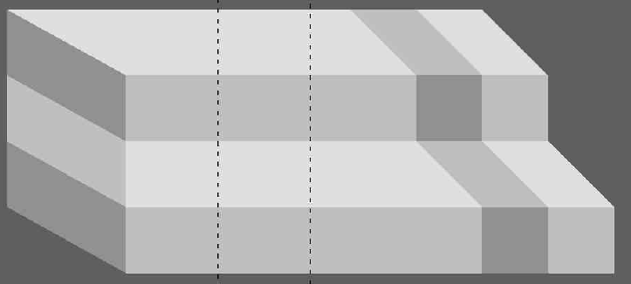
Violations of simple world assumptions
Shading is due to painted stripes

Slide 66
Violations of simple world assumptions
Shading is due to illumination

Slide 67
Violations of simple world assumptions

Slide 68
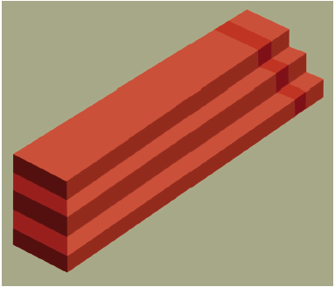
Impossible steps

Slide 69
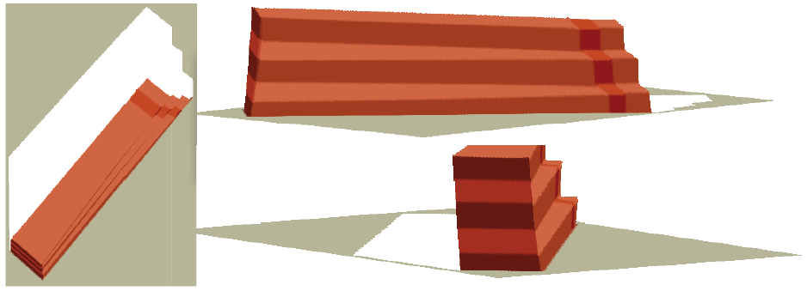
Impossible steps

Slide 70
What is missing?
Recognition

Slide 71
Problem set 1 The “one week” vision project
The goal of the first problem set is to solve vision

