Slide 1


6.819 / 6.869:
Advances in Computer Vision
Image Features:
Harris detector & SIFT
Website: http://6.869.csail.mit.edu/fa15/
Instructor: Aude Oliva
Lecture TR 9:30AM – 11:00AM
(Room 34-101)

Slide 2
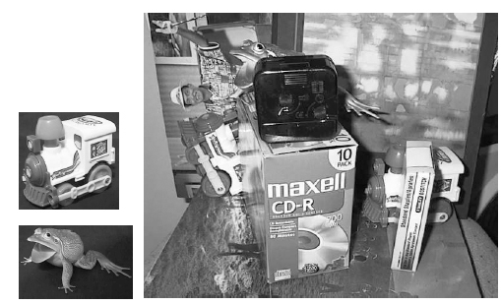
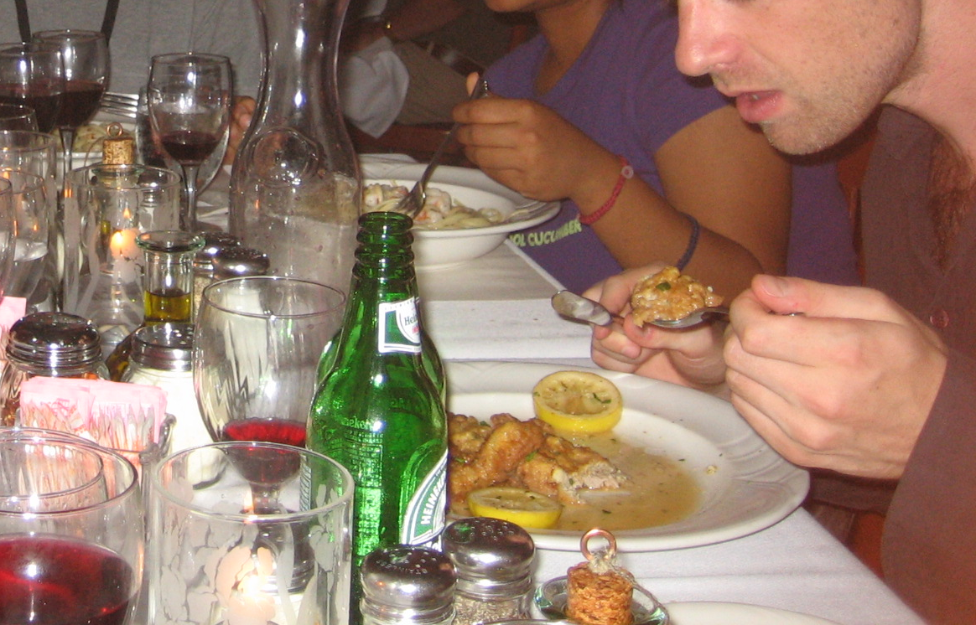
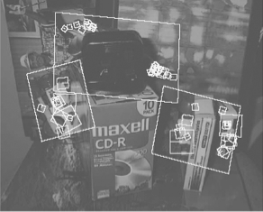
Finding the same thing across images
Instances
Find these two objects
Categories
Find a bottle:

Slide 3
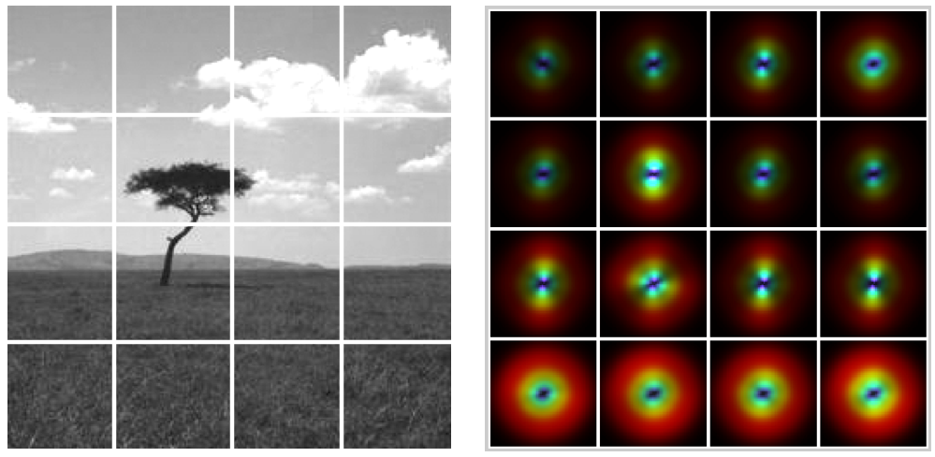
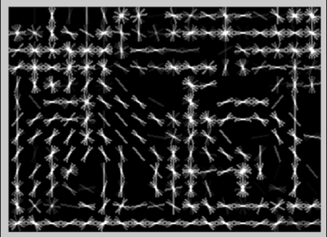
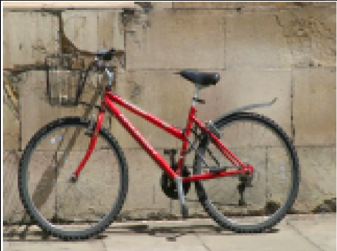
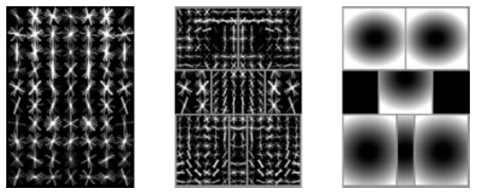
Finding similar instances
SIFT: Scale-Invariant Feature Transform
(Lowe, 1999)
Gist: Grid of gabors
(Oliva & Torralba, 2001)
HOG: Histograms of oriented gradients
DPM: Deformable Part Models
(Felzenszwalb, McAllester, Ramanan, 2008)
(Dalal & Triggs CVPR 05)

Slide 4
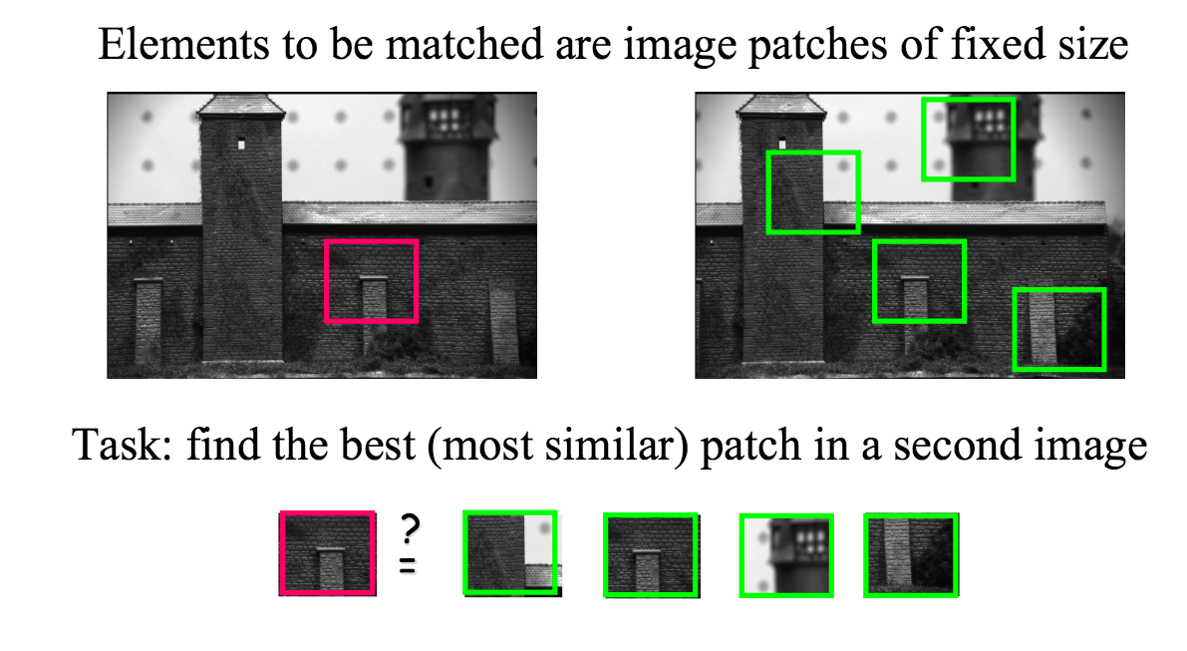
Goal: Find the same patch
Task: find the most similar patch in a second image

Slide 5
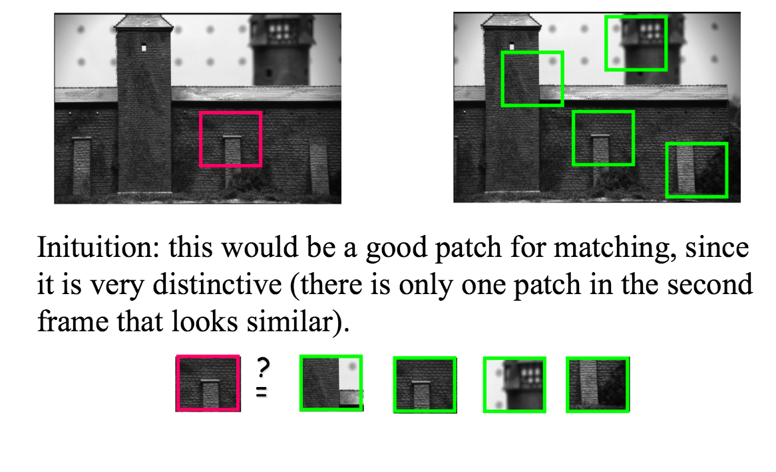
Not all patches are created equal
Intuition: this would be a good patch for matching, since it is very distinctive (there is only one patch in the second frame that looks similar)

Slide 6
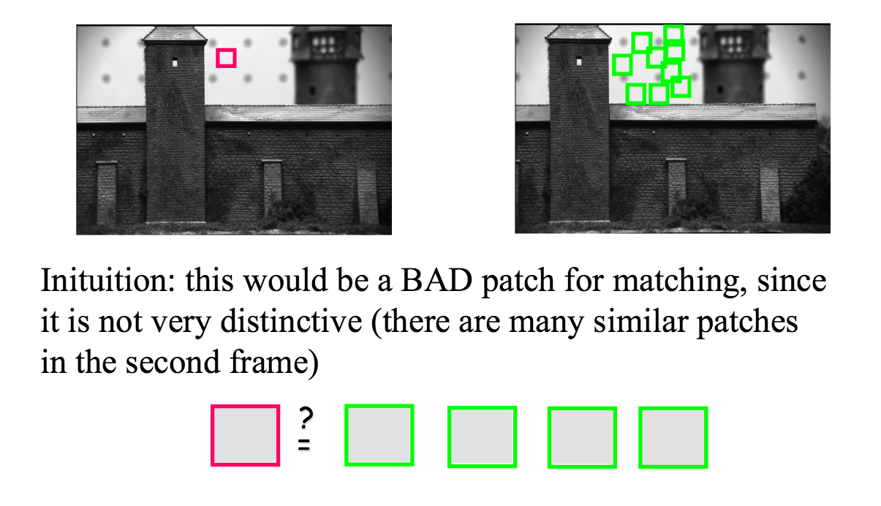
Not all patches are created equal
Intuition: this would be a bad patch for matching, since it is not very distinctive (there are many similar patches in the second frame)

Slide 7












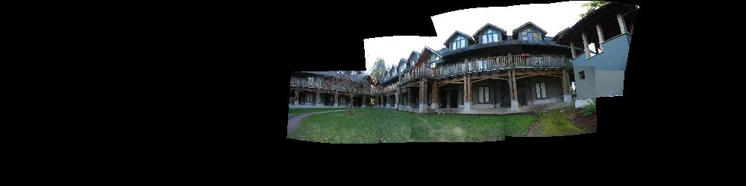
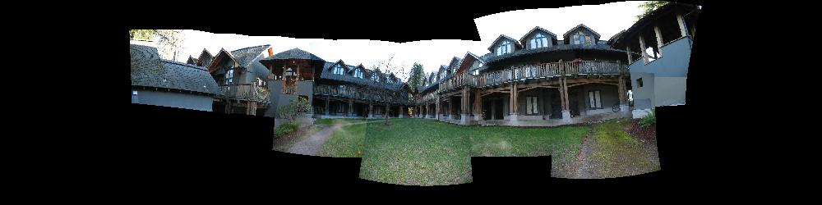
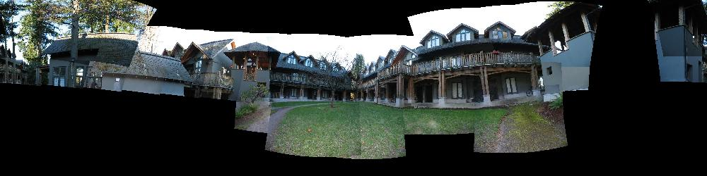
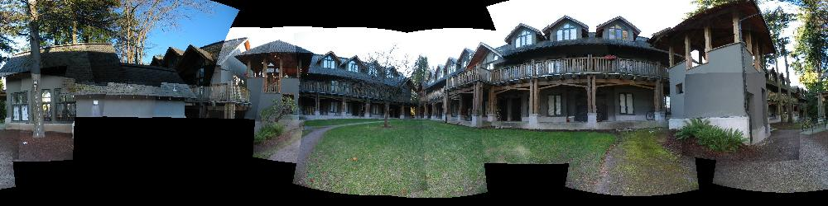
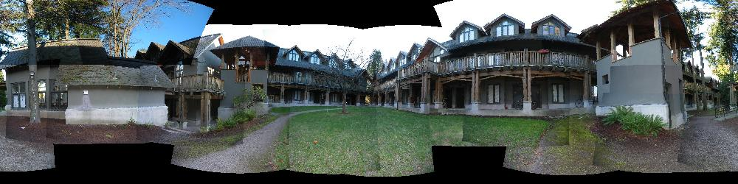
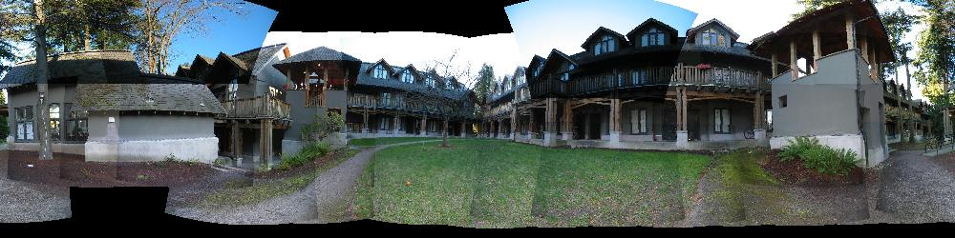
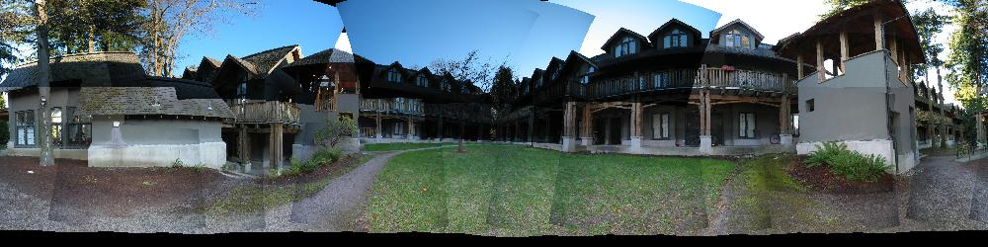
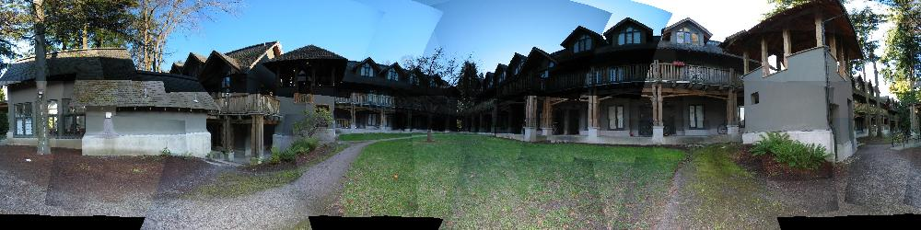
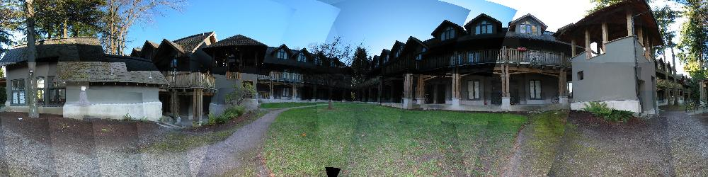

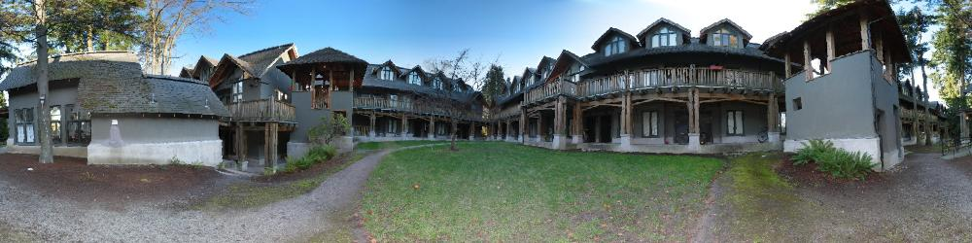
Building a Panorama
M. Brown and D. G. Lowe. Recognising Panoramas. ICCV 2003

Slide 8


How do we build a panorama?
We need to match (align) images

Slide 9


Matching with Features
Detect feature points in both images

Slide 10
Matching with Features
Detect feature points in both images
Find corresponding pairs

Slide 11

Matching with Features
Detect feature points in both images
Find corresponding pairs
Use these matching pairs to align images - the required mapping is called a homography.

Slide 12
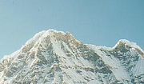

Matching with Features
Problem 1:
  Detect the same point independently in both images
counter-example:
no chance to match!
We need a repeatable detector

Slide 13
Matching with Features
Problem 2:
  For each point correctly recognize the corresponding one
?
We need a reliable and distinctive descriptor

Slide 14

Preview
Detector: detect same scene points independently in both images
Descriptor: encode local neighboring window
Correspondence: find most similar descriptor in other image
detector
location
Note: here viewpoint is different, not panorama
Descriptor

Slide 15
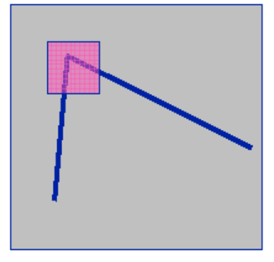
Basic Ideas of Corner Points
Junctions and Corners: they are the most
stable features over changes in viewpoint
Intuitively, there is a large variations in the
neighborhood of the point in all directions
We should easily recognize the point by looking at intensity values within a small window
Shifting the window in any direction should yield a large change in appearance.

Slide 16
Corner Detector: Basic Idea
“flat” region:
no change in all directions
“edge”:
no change along the edge direction
“corner”:
significant change in all directions

Slide 17
Harris corner detector: The Basic Idea
We should easily localize the point by looking through a small window
Shifting a window in any direction should give a large change in pixels intensities in window
  makes location precisely define

Slide 18
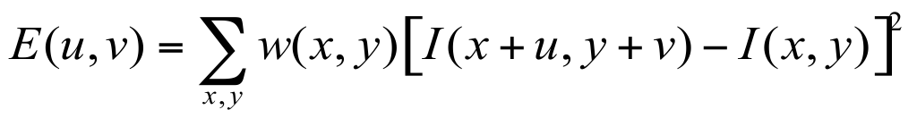
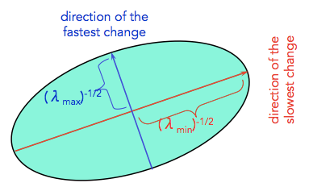
Harris Detector: Maths & Intuition
Window-averaged squared change of intensity induced by shifting the image data by [u,v]:
Ellipse
Window function
Shifted intensity
Intensity
For nearly constant patches, this will be near 0.
For very distinctive patches, this will be larger.
Hence... we want patches where E(u,v) is LARGE.
or
Window function w(x,y) =
1 in window, 0 outside
Gaussian

Slide 19
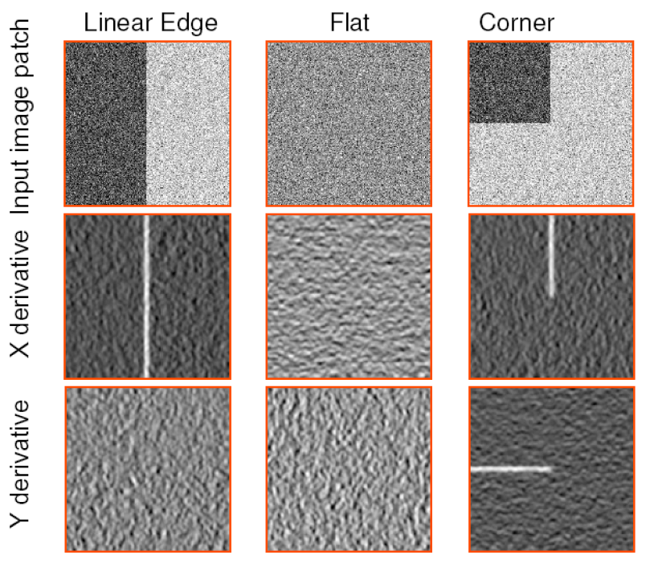
Intuitive way to understand Harris
Notes:
Treat gradient vectors as a set of (dx,dy) points with a center of mass defined as being at (0,0).
Fit an ellipse to that set of points via scatter matrix
Analyze ellipse parameters for varying cases…

Slide 20
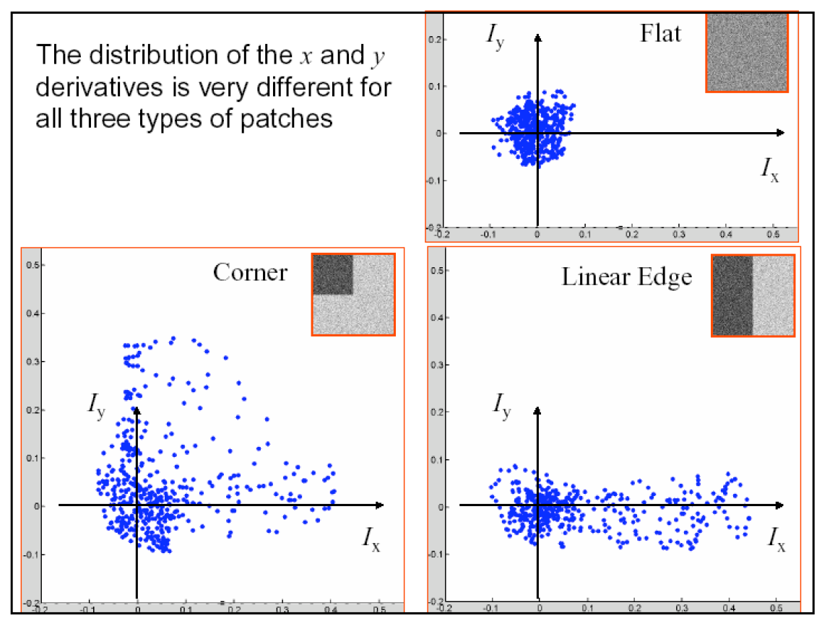
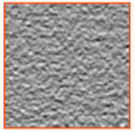
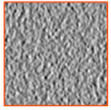
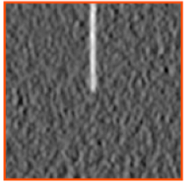
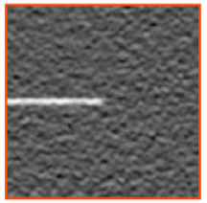
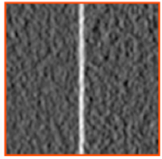
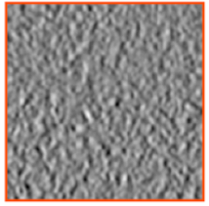
Plotting Derivatives as 2D points

Slide 21
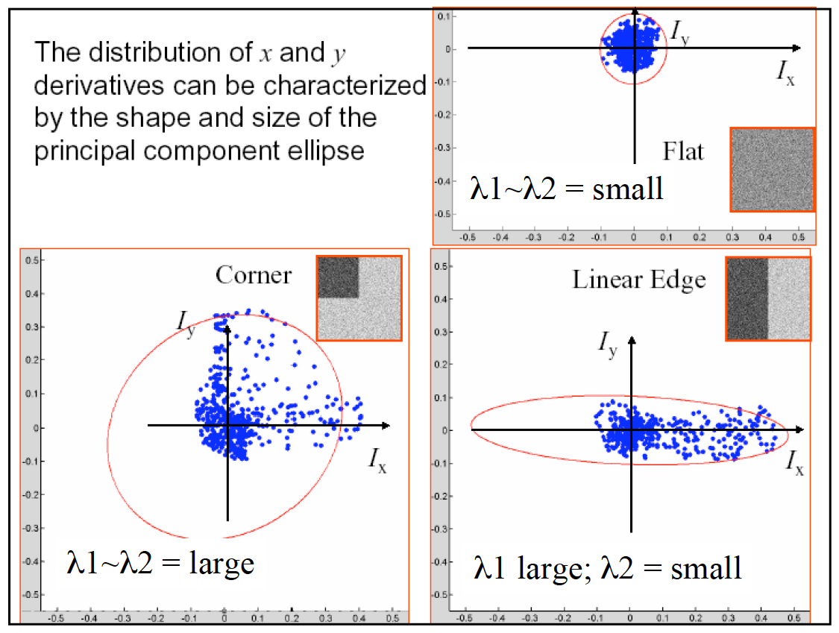
Fitting ellipses to each set of points

Slide 22
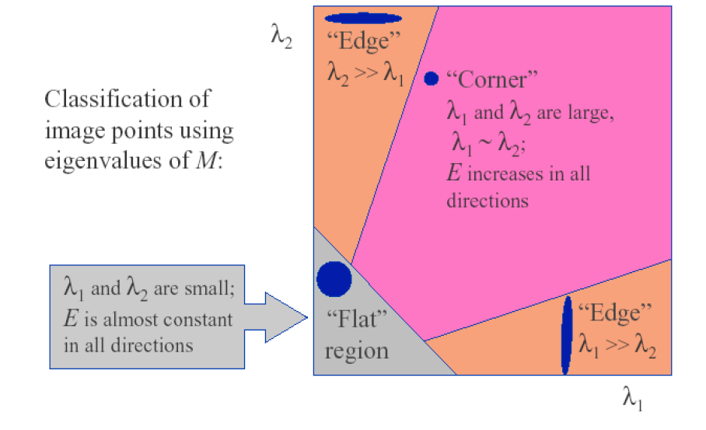
Classification via Eigenvalues

Slide 23
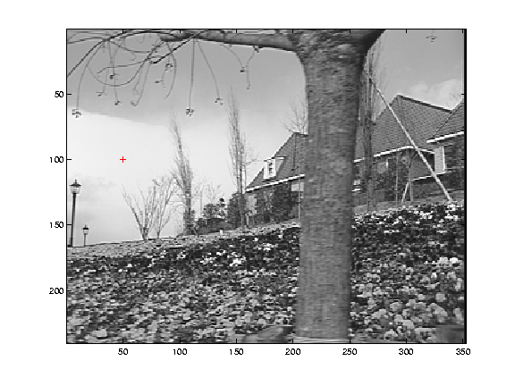
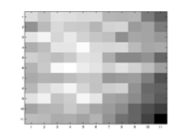
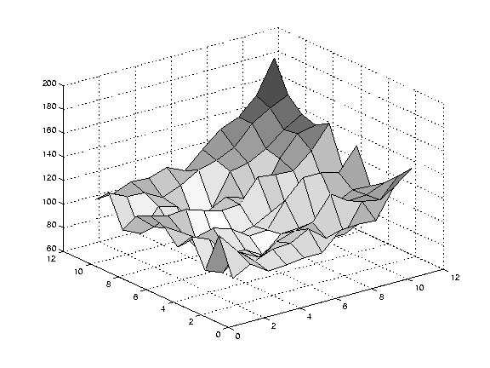
Selecting Good Features
Image patch
(contrast auto-scaled)
200
Error surface
(vertical scale exaggerated relative to previous plots)
small λ₁, small λ₂

Slide 24
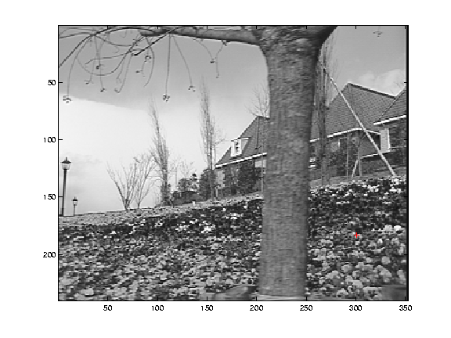
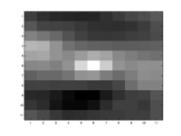
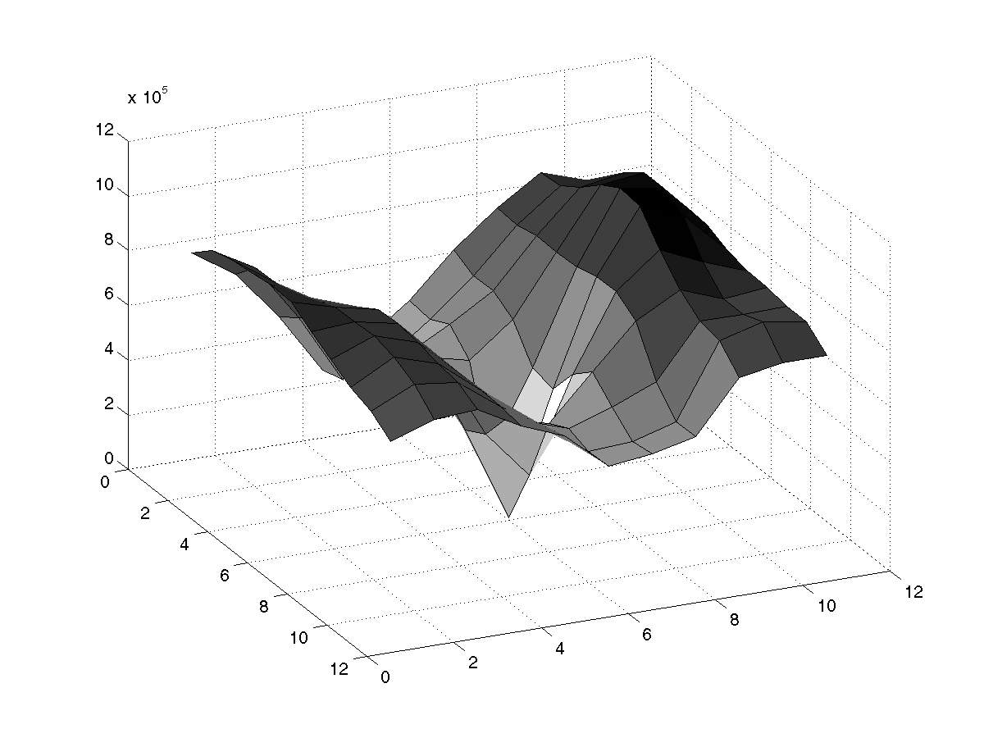
Selecting Good Features
Image patch
Error surface
12x10^5
λ₁ and λ₂ are large

Slide 25
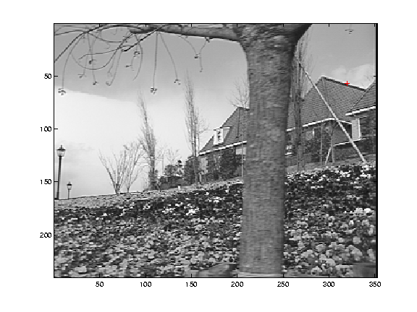
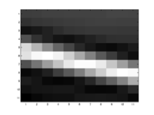
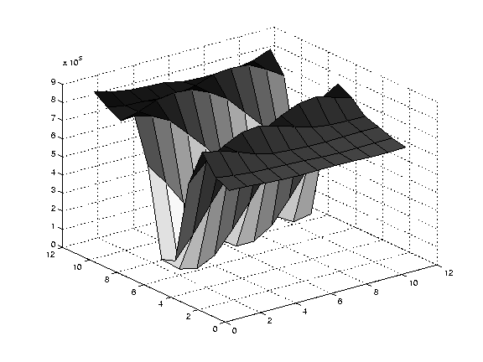
Selecting Good Features
Image patch
9x10^5
Error surface
large λ₁, small λ₂

Slide 26

Harris Detector: Workflow

Slide 27

Harris Detector: Workflow
Compute corner response R

Slide 28

Harris Detector: Workflow
Find points with large corner response: R>threshold

Slide 29
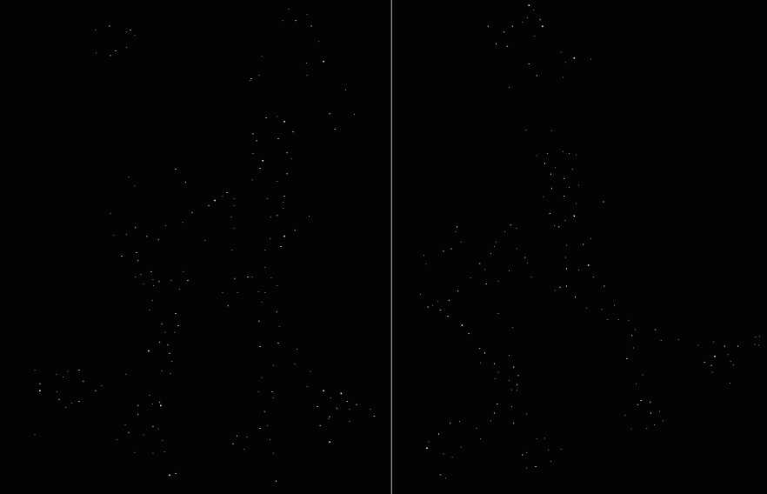
Harris Detector: Workflow
Take only the points of local maxima of R

Slide 30

Harris Detector: Workflow

Slide 31
Models of Image Change
Geometry
  Rotation
  Similarity (rotation + uniform scale)
  Affine (scale dependent on direction)
  valid for: orthographic camera, locally planar object
Photometry
  Affine intensity change (I → a I + b)

Slide 32
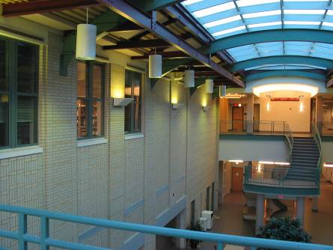
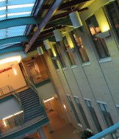
Harris Detector: Some Properties
Rotation invariance?

Slide 33
Harris Detector: Some Properties
Rotation invariance
Ellipse rotates but its shape (i.e. eigenvalues) remains the same
Corner response R is invariant to image rotation
Notes:
Eigen analysis allows us to work in the canonical frame of the linear form.

Slide 34
Harris Detector: Some Properties
Partial invariance to additive and multiplicative intensity changes
Only derivatives are used => invariance to intensity shift I → I + b
Intensity scaling: I → a I fine, except for the threshold that’s used to specify when R is large enough.
R
R
threshold
x (image coordinate)
x (image coordinate)

Slide 35
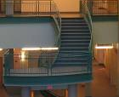
Harris Detector: Some Properties
Invariant to image scale?
image
zoomed image

Slide 36
Harris Detector: Some Properties
Not invariant to image scale!
All points will be classified as edges
Corner !

Slide 37
Scale Invariant Detection
Consider regions (e.g. circles) of different sizes around a point
Regions of corresponding sizes will look the same in both images
The features look the same to these two operators.

Slide 38
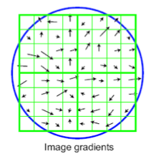
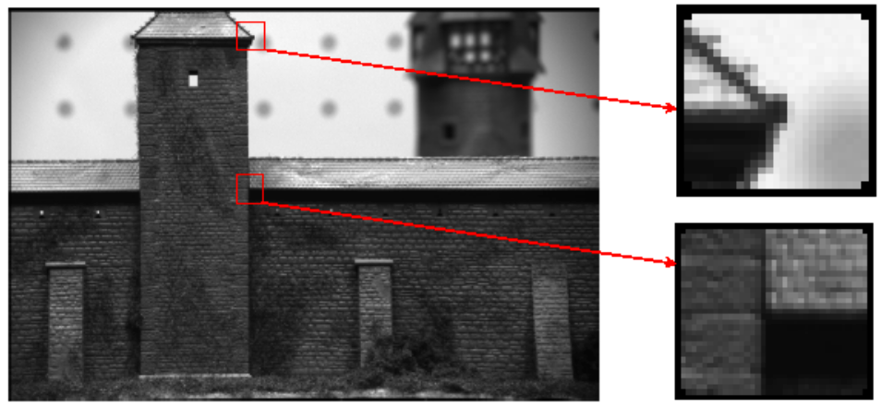
Finding same instance
Vision tasks such as stereo and motion estimation require finding corresponding features across two or more views.
Feature point detection
Local image description
  - Harris corner detector
  - finding a characteristic scale: DoG or Laplacian of Gaussian
SIFT: Scale-Invariant Feature Transform

Slide 39
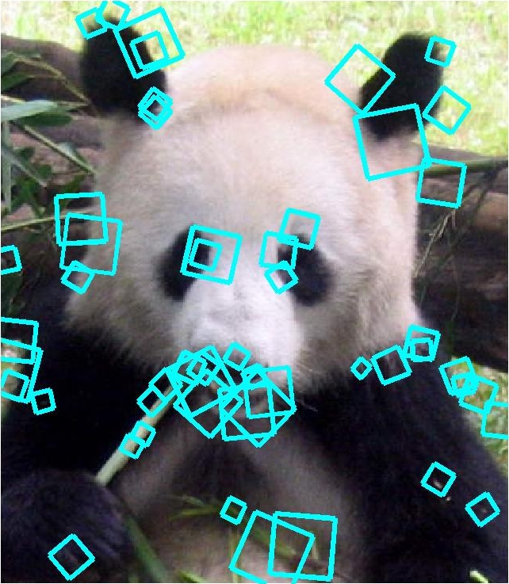
Scale-Invariant Feature Transform
Generates image features, “keypoints”
  invariant to image scaling and rotation
  partially invariant to change in illumination and 3D camera viewpoint
  many can be extracted from typical images
  highly distinctive
SIFT [Lowe]

Slide 40
SIFT Algorithm Stages
Scale-space Extrema Detection
  Uses difference-of-Gaussian function
Keypoint Localization
  Sub-pixel location and scale fit to a model
Orientation assignment
  1 or more for each keypoint
Keypoint descriptor
  Created from local image gradients
See document: SIFT-tutorial.pdf

Slide 41

Scale Space

Slide 42

Difference Of Gaussian Pyramid
Blur & Resample
A
B
A
B

Slide 43
Difference Of Gaussian Pyramid
A- B

Slide 44

Extrema Detection
Keypoint must be a minima or maxima of its 8 neighbors at it’s scale and the 9 neighbors above and 9 below.

Slide 45
Extrema Detection

Slide 46
Keypoint Localization and Refinement
Throw out points that have low contrast
Remove points that are too “edgy”.

Slide 47
Keypoint Localization and Refinement

Slide 48

Orientation
Assignment
Create histogram of local gradient directions computed at selected scale
Assign canonical orientation at peak of smoothed histogram
Each keypoint specifies stable 2D coordinates (x, y, scale, orientation)

Slide 49
3D object recognition example

Slide 50
SIFT Review
Generates image features, “keypoints”
  invariant to image scaling and rotation
  partially invariant to change in illumination and 3D camera viewpoint
  many can be extracted from typical images
Each “keypoint” has an associated descriptor that is
  Relative to keypoint orientation and scale
  Is robust to small affine transformations.

Slide 51



Slide 52

Uses for feature point detectors and descriptors in computer vision and graphics.
  Image alignment and building panoramas
  3D reconstruction
  Motion tracking
  Object and scene recognition
  Indexing and database retrieval
  Robot navigation
  … other

Slide 53

J. Sivic, B. Kaneva, A. Torralba, S. Avidan and W. T. Freeman (2008). Creating and exploring a large photorealistic virtual space

Slide 54

Notes:
his figure illustrates sequences generated from a large database of street images by inducing two camera motions: a) Camera
translation. Each consecutive image was obtained by inducing camera translation by half the image size as illustrated in figure 2. b) Camera
rotation. Each consecutive image was obtained by inducing camera rotation of 45 degrees as illustrated in figure 2. This produces changes in
the perspective between consecutive images.

