Slide 1


6.819 / 6.869:
Advances in Computer Vision
Basics of Image Processing III:
Image Operations for ConvNet
& Image/Dataset Statistics
Website: http://6.869.csail.mit.edu/fa15/
Instructor: Aude Oliva
Lecture TR 9:30AM – 11:00AM
(Room 34-101)

Slide 2
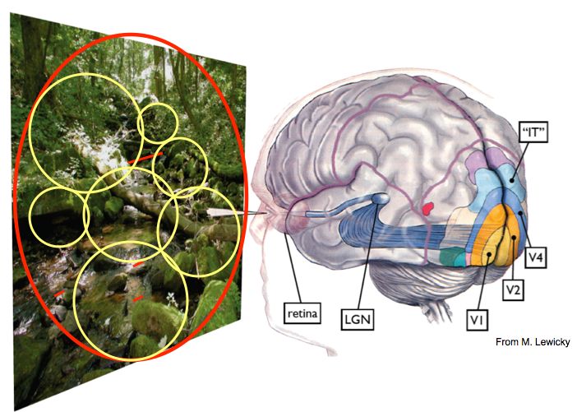
Vision: a multi-stage network
Optics
Notes:
Here implement a demo with many images

Slide 3

Vision is a learning process

Slide 4
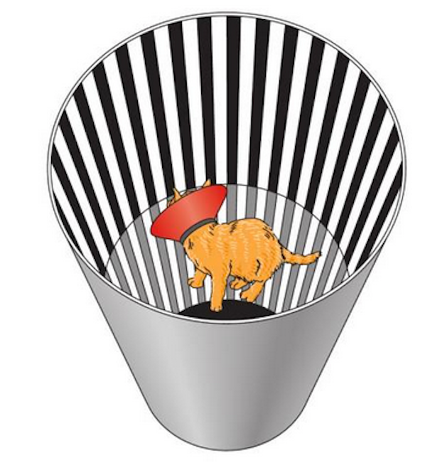
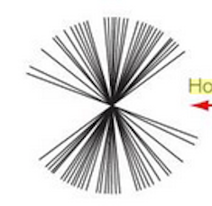
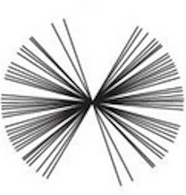
Selective rearing experiment
Blackmore & Cooper (1970) Development of the brain depends on the visual environment
Vertically reared cat
Horizontally reared cat
Distribution of optimal orientations for 72 cells in the early visual area of the reared cat

Slide 5
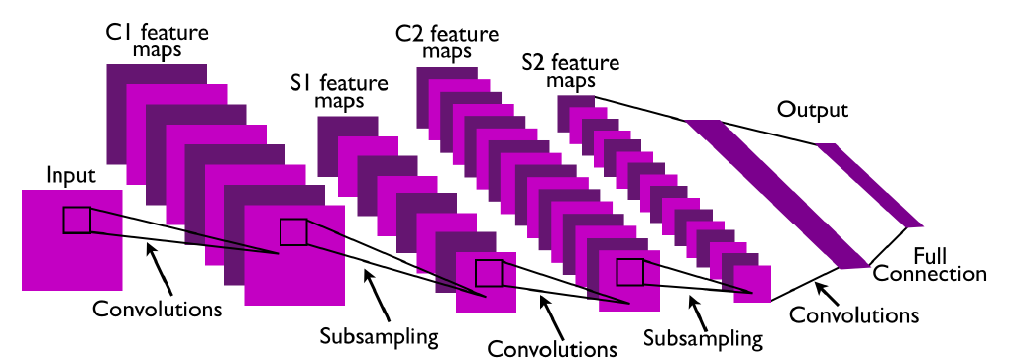
Why did we learn these image operations?
A ConvNet architecture with two feature maps
From Aysegul Dundar’s lecture
Notes:
See the paper in reading list for that lecture

Slide 6
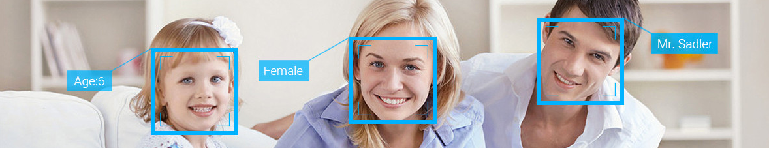
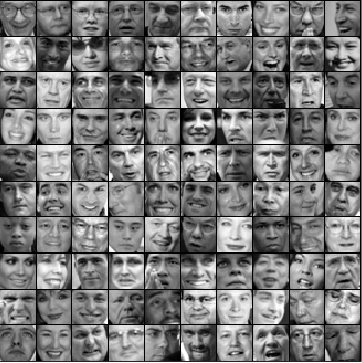
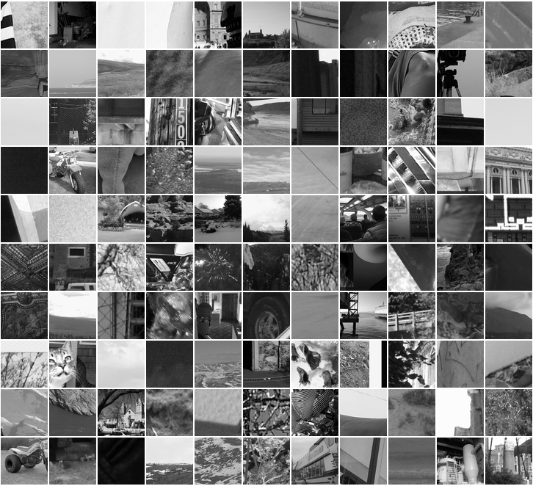
How to detect a face?
Introduction to Convolutional Neural Network Image Operations
Face
Face
Face
You need two groups of Images
Faces and Background (no faces)
Notes:
Explain the basic elements: the layers of the CNN: why these layers are chosen, and an example from yann le cun: the face detection problem or how to create a face detector
Ayesul Dungar

Slide 7


How can it detect a face?
Faces
Background
32 x 32
input
images
Output
from the
convnet
+1 -1
-1 +1
First category is white: face
Second category is white: background
32
2
Training: give the input and labeled
output so it can explore the features
that make a face look like a face
32
?
Notes:
Computer sees values, and it has to combine them in a valid way (your brain process them with spikes, neuron response activity, more or less)
White is +1, black is -: this is a classification problem: if the input is face or not face: for each category you have 1 output, which is +1/-1 if image is from face. If you have 4 categories, you could have more categories, like face, table, chair and background then you will need 4 outputs, one fore each class.
This network gives 2 final values
How 32 to 2? Learning and training: provide thousands of images of the two classes (determining the nb of images needed depends on the statistics of the image dataset, that we will see next). Here I will not teach how the training work, but explain which layers are chosen to be trained in CNN for face detection

Slide 8

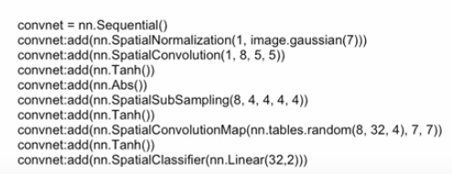
We will explain the layers of this network
2
32
32
Notes:
This is the complete network we will look at today, and review the terms as we go (normalization, convolution)
For now we know what input and output looks like

Slide 9


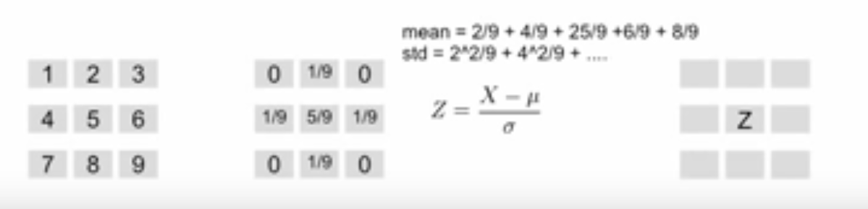
Let’s go through the network
1st layer
Spatial contrast normalization
32
32
http://setosa.io/ev/image-kernels/
Notes:
The network will learn features, and the features need to be reliable: the most reliable features are edges.
You can first filter your image to get the contours, and then spatial contrast normalization (it increases the training speed). Because this layer is used in the training
normalization is a process that changes the range of pixel intensity values.
In this examples, lena is normalized with band dimensional gaussian kernel: it works as an edge detector, it makes the edges stronger.
Here is a small example: left part of the image, and this is the kernel in the middle which performs these operations: it removes the mean and makes the stdev roughly 1. the mean and std are calculated as follow. And this operation increases the training speed.
The next operation is convolution. This is the most important part as it is the name of the network

Slide 10

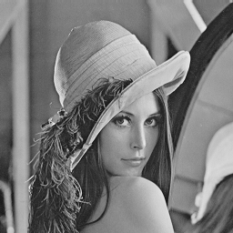
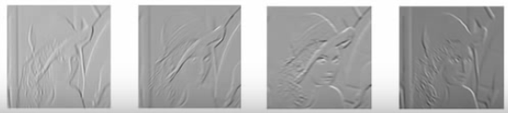

Convolution Example
Mexican hat edge detector filter (kernel)
(Laplacian of Gaussian filter)
*
sum
+1
+1
+1
0
+1
+1
+1
0
-3
+1
+1
+1
0
+1
-8
+1
+1
+1
+1
0
+1
+1
+1
Input image
Kernel
Output
Gabor filters
Notes:
Take the first part of the image 3 x 3 kernel size and multiply by the kernel and add the value together: it fine the result .. Zero
With this input and kernel we can only calculate 2 inputs: convolution decreases the size: we cannot go to the right, no more columns.
Note that this kernel is an edge detector: when the image pixels are uniform (all +1), the edge detector give a zero value, but when there is an edge (+1/0), it does not give zero. It is how it detect edges
This example of lena: the kernels are gabor filters. Gabor filters detect different orientations depending on their orientations (v1 cells can be modeled by gabor filters).
You can see the response output for each gabor filters

Slide 11


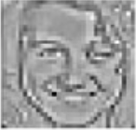

Spatial convolution
Tanh & Abs
Subsampling &
Tanh
filters
Convolution
Map & Tanh
2
32
32 x 32
5 x 5
7 x 7
28 x 28
28 x 28
Notes:
Input image: we have this image first we have the convolution layer which detect the features, so it is made of kernels or “filters”. We should expect to the kernels to look like gabor features: in fact, for CNN trained on many different types of natural images, and to discriminate many different categories, this first convolution layer is made of gabor kernel (we will see this fact in the lectures on deep learning). Or given that we know these gabor filters are the most generic, and will be created anyway, some models are hard wired with gabor kernels.
Here are the filters we have after the training: they do not look exactly like gabor filters. Why ? thisnetwork is trained with only faces and background so the network came up with these after training: these are the most discriminant kernels for this binary task of face detection.
But these kernels still function very well as edge detector: look at the output of the spatial convolution. The third one detect edges which have 45 degrees of slope, the 4rth one detect some vertical and horizontal edges. The fifth one is only horizontal. Note that the size of the output of different than the image size: it is 28 x 28, so it is decrease by 4 pixels (bc our filters are 5 x 5).

Slide 12
Spatial convolution
Tanh & Abs
filters
32 x 32
5 x 5
28 x 28
28 x 28

Slide 13
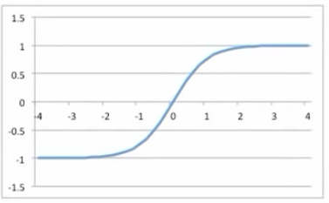
Spatial convolution
Tanh & Abs
filters
Tanh & Abs = very important
Factor to improve accuracy
a) The polarity of features is often
Irrelevant to recognize parts, objects
b) The rectification eliminates
cancellations between neigh-boring
filter outputs when combined with
average pooling
(Biologically plausible)
32 x 32
5 x 5
28 x 28
28 x 28
Notes:
Tanh is the hyperbolic tangent function, which is the hyperbolic analogue of the Tan circular function used throughout trigonometry. Tanh[α] is defined as the ratio of the corresponding hyperbolic sine and hyperbolic cosine functions via .
the hyperbolic tangent function and the absolute transformation is the second part of the feature extraction: it is an important factor to improve accuracy.
You can see what Tanh does by the graph: it is increasing information between -1 and + 1 and the absolute transformation is making the negative value positive.
These operations are increasing the accuracy and the reasons for that are explored in this paper by LeCun. The first reason is that the polarity of feature is often irrelevant
because our next stage is subsampling, we do not want positive and negative value to cancel each other

Slide 14
Spatial convolution
Tanh & Abs
Subsampling &
Tanh
filters
Subsampling
decreases
the resolution.
Distortion invariance
32 x 32
5 x 5
7 x 7
28 x 28
28 x 28
Notes:
The next layer is subsampling, also followed by a Tanh operation: this layer provides with distortion invariance: when we extract the feature with the conv kernels, we do not want the info on the exact location of the features to have any affect on learning, because the exact location can change and be different for diff faces. But the relative location of mouth, eyes, noise remains the same
to reduce the precise info about the location of the feature in the input image, we subsample the feature maps.

Slide 15
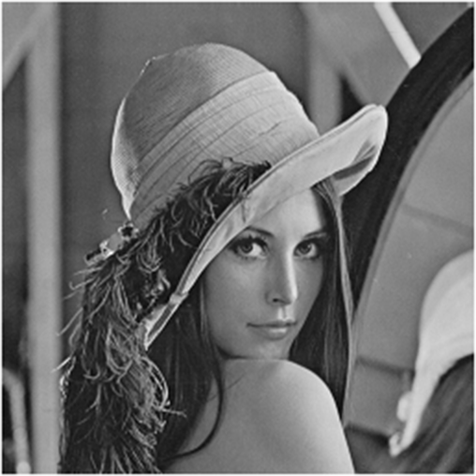

What is Subsampling?
508 x 508 pixels
254 x 254 pixels
down-sampled by 2 x 2
Spatial subsampling:
Compute the average
Multiplies it by a trainable
coefficient
Adds a training bias
down-sampled
by 2 x 2
+1
+1
+1
*
0.2
+
0.5
=
0.7
+1
+1
weight
Additive
bias
Notes:
Subsampling beings with downsample: if you want to subsample the image by 2 x 2, you average 4 pixels at a time
After downsampling, this layer also bias the results with a trainable coefficient and adds a trainable bias.
The operation results in reducing the resolution

Slide 16
Spatial convolution
Tanh & Abs
Subsampling &
Tanh
filters
Convolution
Map & Tanh
32
32 x 32
5 x 5
7 x 7
28 x 28
28 x 28
Notes:
The next layer is convolution maps followed by Tanh: lets see what convolution map is

Slide 17
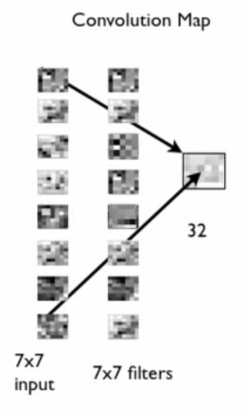
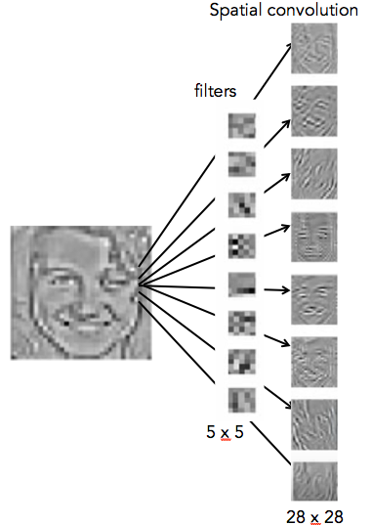
What is Convolution Map?
Feature maps (here 8)
Convolution Map Layer
Less number of connections
32
Breaks the symmetry:
Different maps receive
different feature maps
Therefore during the
training, they can explore
different features
7 x 7
input
7 x 7 filters
(learned)
Notes:
We already know what the spatial convolution layer is doing. We have a 32 x 32 input and 8 filters, each 5 x 5 pixels and we produce 8 feature maps, by convoluting the image with the 8 kernels learned.
Now in this convolution map layer we have 8 inputs, each is 7 x 7 pixels and 8 filters, each also 7 x 7 pixels (that were learned): convolution map is very similar to convolution layer: the convolution of each 7 x 7 input and a 7 x 7 filter will give you 1 number output.
if you convolve 8, 7 x 7 inputs with 8, 7 x 7 filters maps, you can only produce 1 output map: now we have 8 inputs and 8 filters, and if we convolve each input with each filter, 8 x 8 is 64 numbers as outputs. If we had a convolution layer, that will be the case, but this layer is a convolution map: convolution map does not convolve each filter with each input, but instead it randomly selects here 4 (half) inputs for each filter. Remember these filters are created by training, so providing different inputs to filters has the network exploring different features and it decreases the number of connections and the nb of coefficients trained in the next layer.

Slide 18
Spatial convolution
Tanh & Abs
Subsampling &
Tanh
filters
Convolution
Map & Tanh
2
32
y = Ax + b
32 x 32
5 x 5
7 x 7
28 x 28
28 x 28
Notes:
The last layer is linear classification: this is the layer whose output is +1 or -1, face or background
This layer applies a linear transformation to the input: here we have 32 inputs (from the convolution map) and we want 2 outputs:
for each output the layer takes the 32 inputs and multiple each of them with some trained coefficients, A, the multiplication and the bias all up )
The result should be closed to -1 and +1 because they represents the decision of classification. Remember these 32 inputs are outputs from the previous layers and carry information about edges and combination of edge. The linear classification job is to figure out which combination are more important, which ones are produced by faces or by background.
Now we know what it means to extract features and some of the main elements of a CNN (there are others, like max pooling

Slide 19
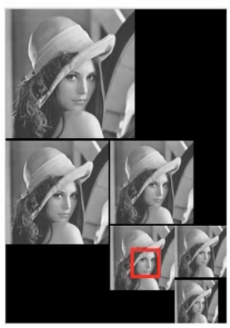
Does the face have to be 32 x 32 ?
Solution: Pyramid
32 x 32
box
Notes:
Does the face have to be 32 x 32 to be recognized? Unfortunately yes
Here lena face is bigger than and the network will not find the face bc it does not fit into the box
The solution is to make a pyramid and the network will find the face

Slide 20

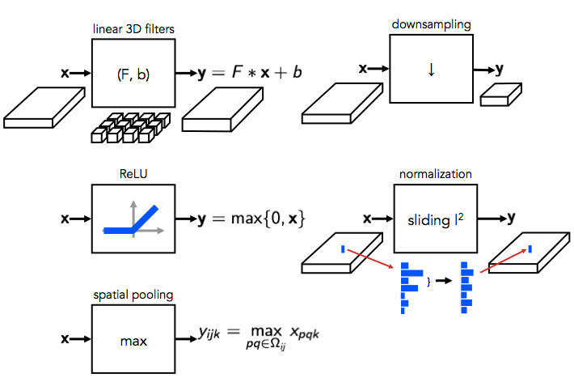
CNN: Many components
Notes:
This network in the figure has more conv and subsampling layers than the toy version for the face detector but you know now some logic behind CNN: extracting features and decreasing resolutions. You can increase the nb of layers for bigger classification problems

Slide 21
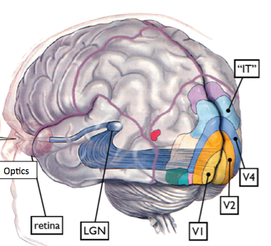
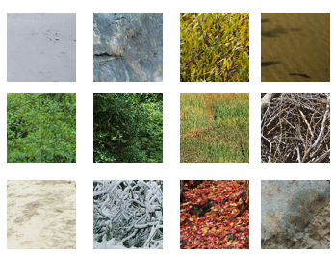
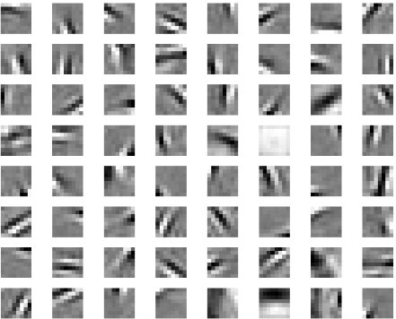
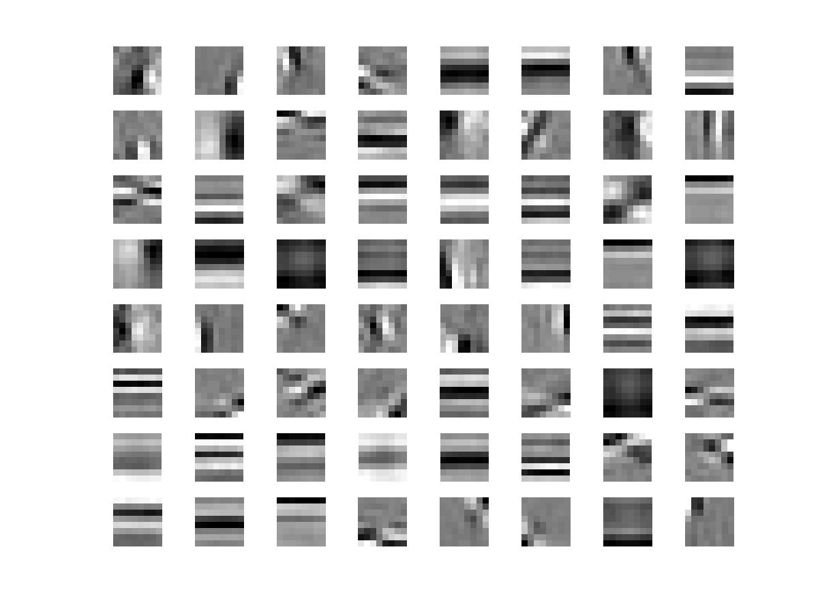
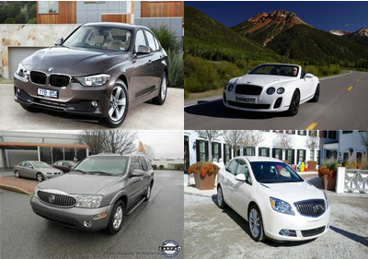
Real world image statistics shape the units’ network

Slide 22
I- Low level Natural Image Statistics
Every picture is a natural image. But some processes are going to be more likely than others in building the structures that one observer is going to see.
Computational investigations of the statistical structures of natural images suggest that the receptive fields of V1 cells may be optimized for extracting the structure information of natural images

Slide 23
I-1- Material Perception & Object Recognition

Slide 24
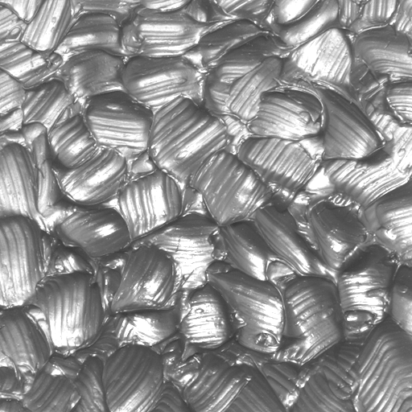
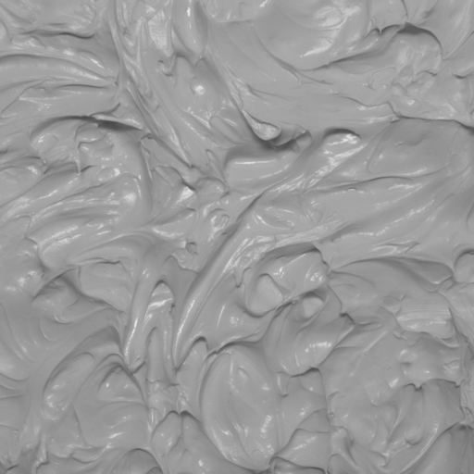
You can tell black stucco from white stucco?
Deeper shadows and higher contrast in black surfaces.
Notes:
Indeed if we replace the smooth paper discs with real world surfaces that do have texture and specularities, we find that it is impossible to reproduce the Gelb effect. No matter what you do with the lights, the two surfaces always look different. Here, we have a black stucco surface and a white stucco surface. The black stucco may not look very black, but it looks dark gray. The white stucco surface may not look very white but it looks light gray. But you can still tell the dark surface from the light surface. How do you that? One way you can do that is to notice that black surfaces have deeper shadows and higher contrast. This is so because black and white surfaces interact very differently with light. Light bounces around much more in white surfaces filling up shadows than in black surfaces. Our visual system might be picking up on these textural cues.
Thus you can tell black stucco from white stucco but not black paper from white paper. Textural cues are crucial here. As these surfaces are seen in isolation, in terms of the anchoring theory, there is no anchor available other than the surface itself. Textural cues seem to provide some kind of anchoring that enables us to tell black stucco from white stucco. We term this tendency “self-anchoring”.

Slide 25

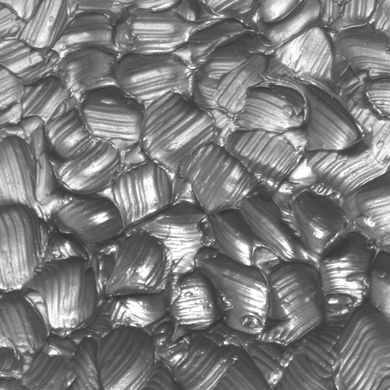

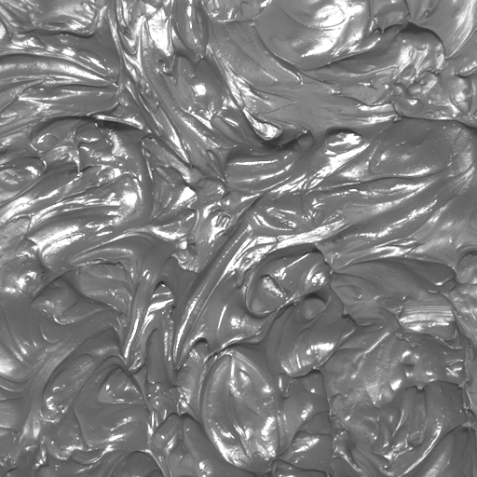
Luminance histograms of white and black surfaces look different
Statistics like moments or percentiles capture the differences in histograms e.g. standard deviation, skewness, 90th percentile.
(c.f. Nishida & Shinya JOSA 1998, Adelson et al VSS 2004, Motoyoshi et al VSS 2005)
Notes:
To study these textural cues further, we photographed several real-world surfaces and analyzed their images. We find that the luminance histograms of white and black surfaces look very different. This was first noted by Nishida and Shinya. The luminance histograms of white surfaces tend to be symmetric and have smaller spread unlike black surfaces that have skewed distributions with heavy tails. These differences in the shapes of histograms are related to the fact that black surfaces have deeper shadows and higher contrast. We have previously shown that the histograms differences can be captured by statistics like moments (standard deviation or skewness) and percentiles (10th,90th) etc.

Slide 26
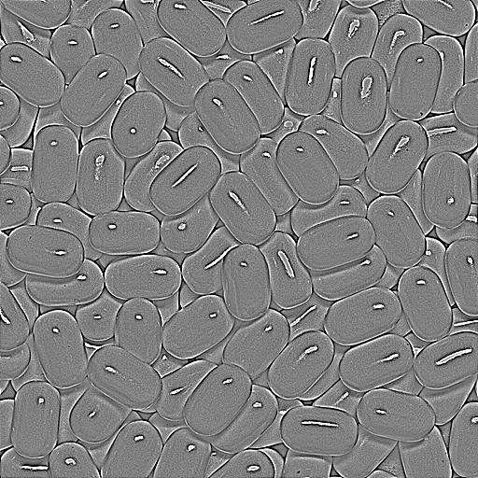
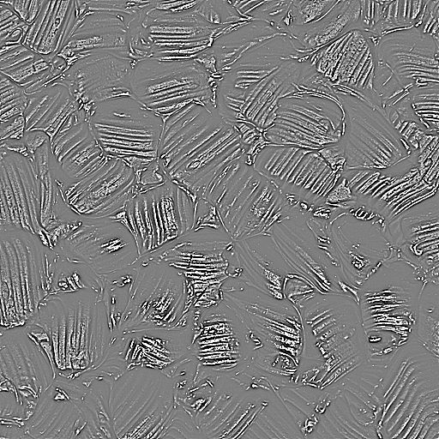
Filter outputs look different too.
white
black
Filters pick up on the deep shadows, bright specularities and higher local contrast of black materials.
Statistics of filter output histogram can be used to discriminate white and black surfaces e.g. standard deviation, skewness, 10th percentile etc.
Notes:
We find that filtering images of black and white surfaces with center surround or edge detection filters enhances the textural differences. Here we have the output of a center surround filter on a white and black surface along with the luminance histograms of the filtered images. We find that the histograms of filter outputs look very different. The filtered white image has a symmetric distribution while the filtered black image has a skewed distribution with heavy tails. The differences in the shapes of these histogram can be measured by a host of statistics e.g. moments (standard deviation, skewness) or percentiles (10th, 90th).
Therefore as the physical reflectance of the surfaces changes, the shape of the luminance histograms or filter output histograms change. It is interesting to ask if the converse holds? Can we change the reflectance of a surface by altering the shapes of these histograms?

Slide 27

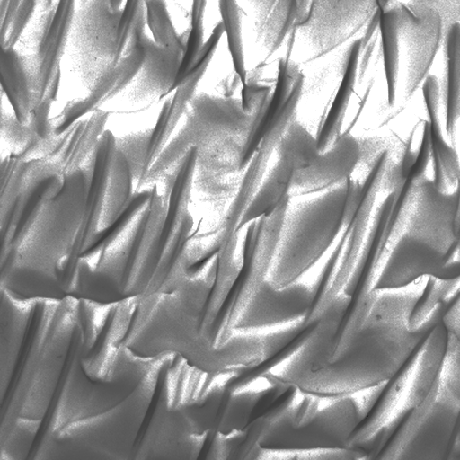
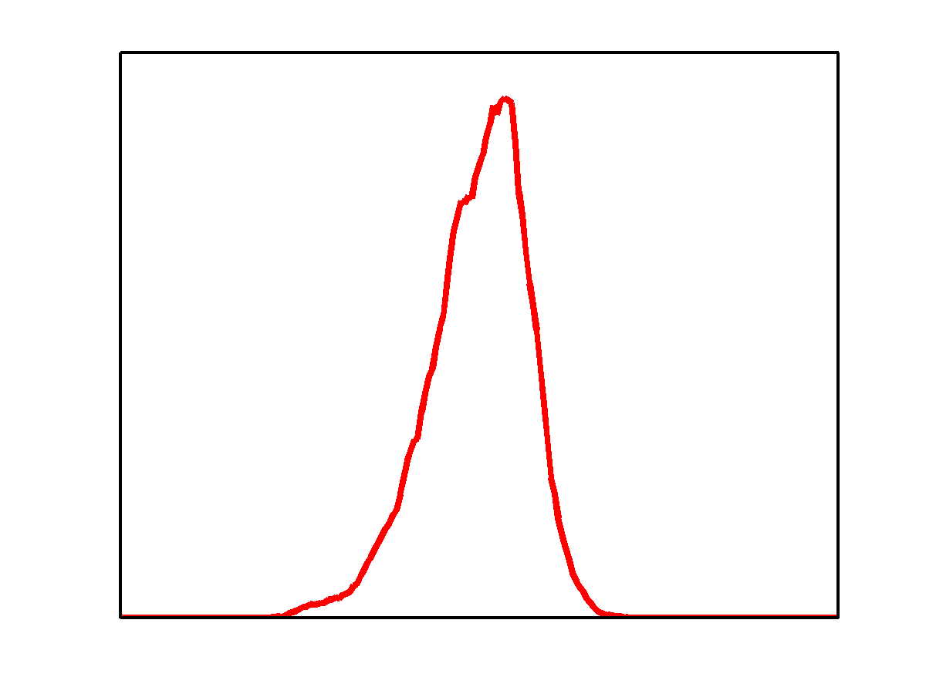
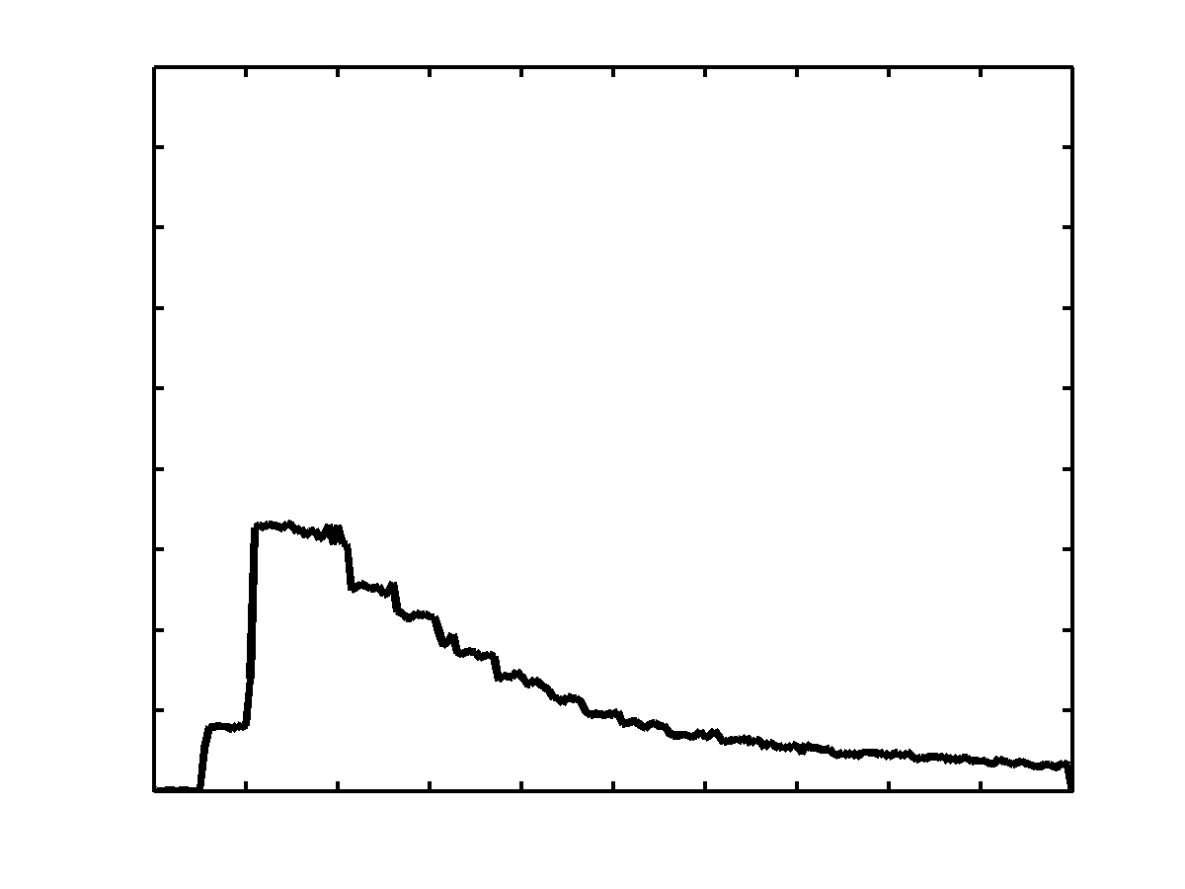
Manipulating histograms changes surface appearance
Changing the shape of the luminance histogram alters the lightness, and thus surface appearance
Image based statistics like moments and percentiles are diagnostic of diffuse reflectance. Altering these statistics of an image changes the surface appearance.
Notes:
The answer is yes. Here we have a white surface on the top with its luminance histogram indicated to the right. By altering the shape of the luminance histogram to a more “black-like” histogram, we obtain the image at the bottom. Note how the perceived reflectance changes, the surface looks middle gray now. The technique used for manipulating histograms, histogram matching, essentially involves applying a point-wise non-linearity to the image.

Slide 28

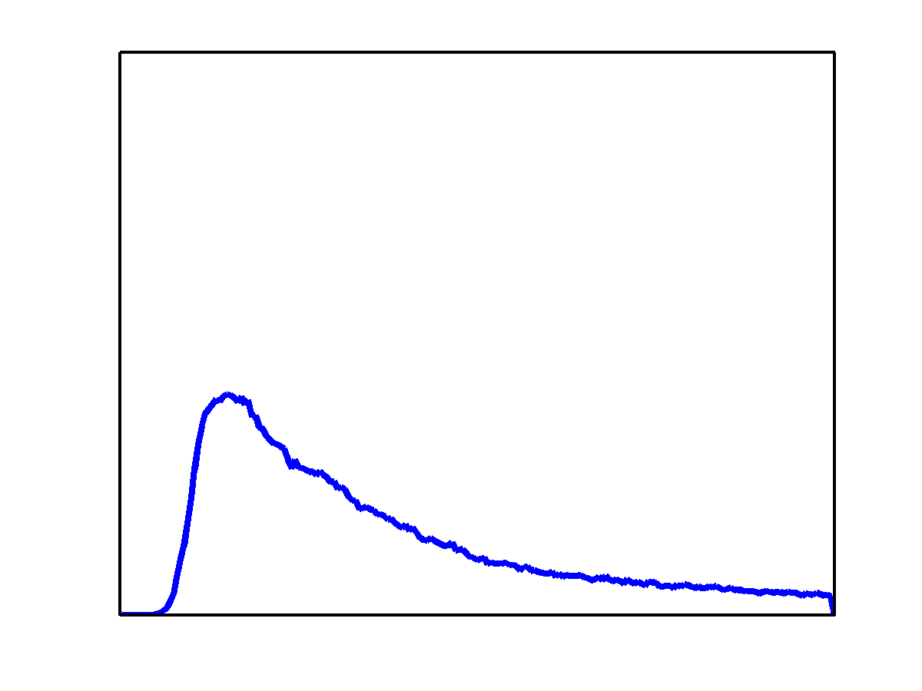

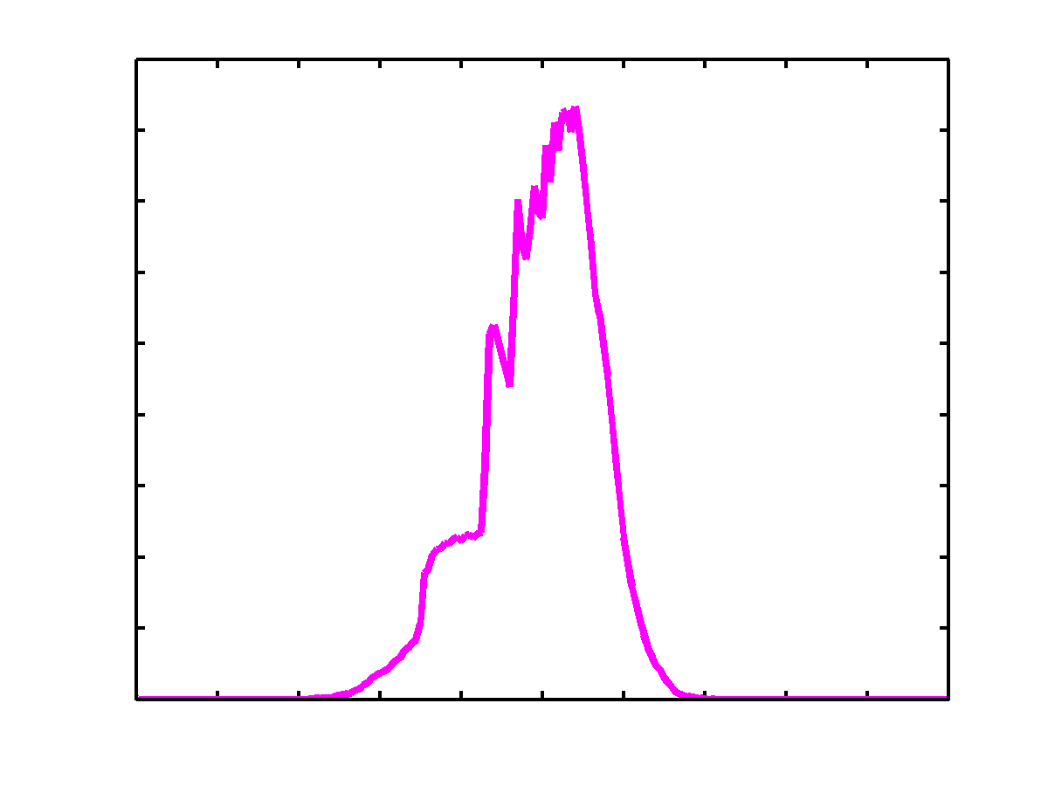
Effect of manipulating image statistics on perception
A
B
?
?
A B
B A

Slide 29
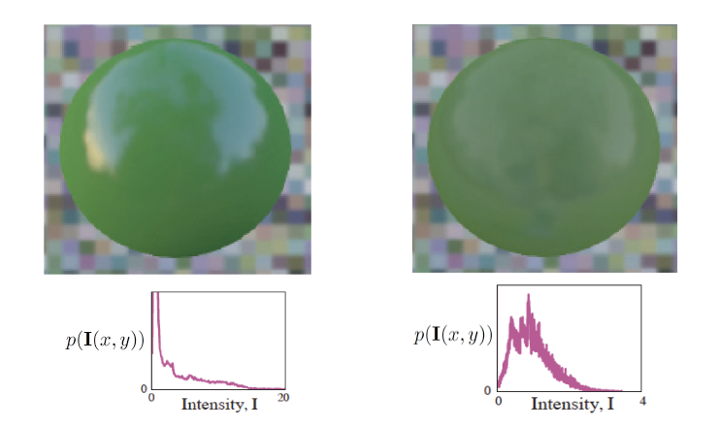
The importance of distribution of intensities

Slide 30
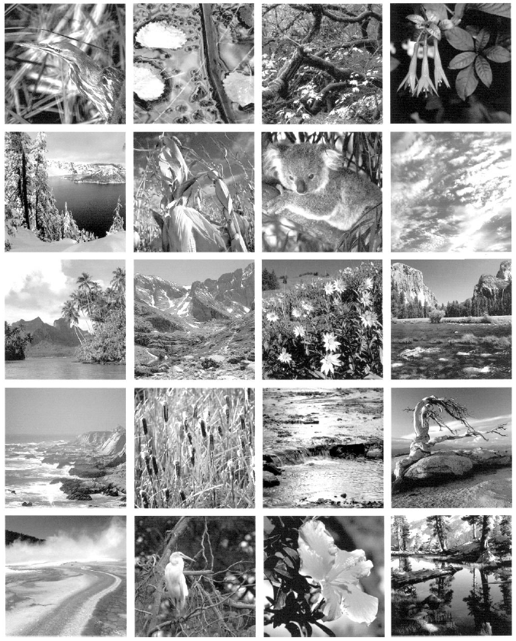
I-2. Contour grouping from natural image statistics
How well do the contour integration preferences of human vision actually mirror the characteristics of natural images ?
Hypothesis: the development of contour integration mechanisms is driven by the occurrence statistics of images encountered in the natural world.
Geisler et al (2001). Edges co-occurrence in natural images predicts contour grouping performances. Vision Research, 41, 711-724.

Slide 31
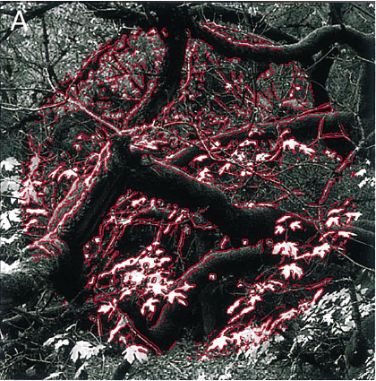
Geisler measured the contour formation properties of images. Each image was displayed on a computer screen and people moved a cursor to select all the oriented elements that belonged together in a single shared contour.
They computed the orientation and position differences among all pairs of segments belonging to a same contour.
Result: Adjacent segments of any single natural contour tend to have very similar orientations, but segments of the same contour that are further apart tend to have orientations disparate.
Geisler et al (2001). Edges co-occurrence in natural images predicts contour grouping performances. Vision Research, 41, 711-724.

Slide 32
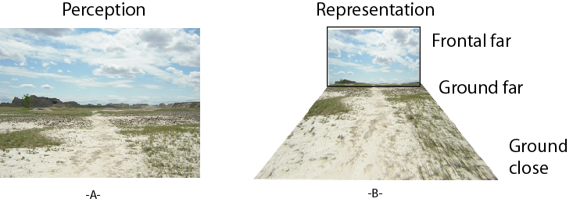
II- Mid-level Image Statistics
surfaces

Slide 33
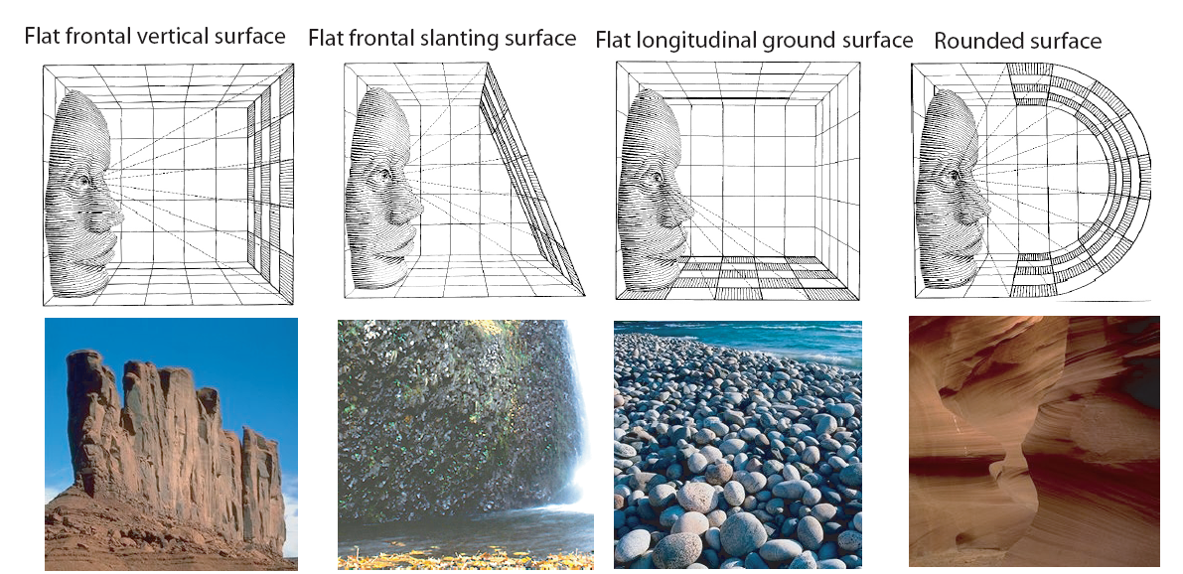
II-1 Texture Gradient
Texture gradient describes the correspondence between the pattern of a surface and the structure of the 3 D world.
There are several signature textural gradient: e.g. frontal surface project uniform gradients. Longitudinal surfaces such as floors and streets project gradient that diminish with greater distance from the observer.

Slide 34
II-2 Depth Perception
Mean depth refers to a global measurement of the mean distance
between the observer and the main objects and structures that
compose the scene.
Stimulus ambiguity: the three cubes produce the same retinal image.
Monocular information cannot give absolute depth measurements.
Only relative depth information such as shape from shading and
junctions (occlusions) can be obtained.

Slide 35
Depth Perception from Image Structure
d3
d2
d1
If d1>>d2>>d3 the structures of each view strongly differ. Structure provides monocular information about the scale (mean depth) of the space in front of the observer.
Torralba, A., & Oliva, A. (2002). Depth estimation from image structure. IEEE Pattern Analysis and Machine Intelligence, 24,1226-1238.

Slide 37


Slide 39
Water
Sand
“A beach”

Slide 40
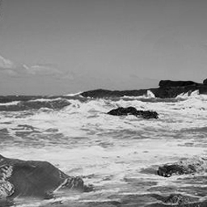

Slide 42
Depth Perception
Same Surface structure
“A close-up view
on a beach”
“A large scene scale,
a coastline”

Slide 43
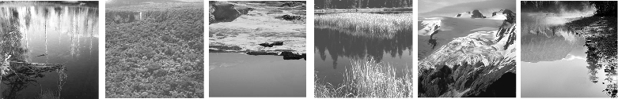
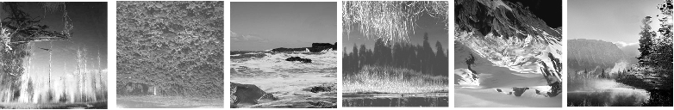
Close up view / Looking down
Large space / open space / looking at the horizon
The image inversion has two main effects:
Reverse lighting effects: mainly changes the interpretation of object/ground affiliation
2) Inversion of spatial organization: it can produce in some cases large changes in the perceived scale of the image
Notes:
See torralba oliva PAMI 2002 article

Slide 44
Statistical Regularities of Depth
When increasing the size of the space, natural environment structures become larger and smoother.
Close-up
Very far
Evolution of the slope of the global magnitude spectrum
For man-made environments, the clutter of the scene increases with increasing distance: close-up views on objects have large and homogeneous regions. When increasing the size of the space, the scene “surface” breaks down in smaller pieces (objects, walls, windows, etc).
Torralba & Oliva. (2002). Depth estimation from image structure. IEEE Pattern Analysis and Machine Intelligence
Notes:
Looking for regularities in the input that can be estimated by a system (here a human standing, with a given viewpoint and distance to the boundaries of the scene)
Depth is generally considered a local property. It is used to say things like "that object is 5 meters away from me". However, here we describe depth in a global sense to refer to the size of the space. We can say something like "the distance between me and the background of this space is at 100 meters'. This is not a very precise quantity and it is not as well defined as the distance between me and an object, but it has a strong relationship with the size of the space, and humans are consistent in defining this quantity.

Slide 45
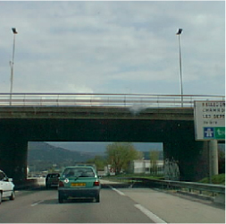
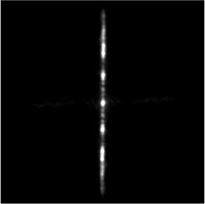
Natural Image Statistics
The group of natural images have particular second-order statistics
(quantity of orientation, quantity of frequencies).
Fourier Power Spectrum
fy
fx
Power Spectrum
1/fª
f_{y}
f_{x}
Spectrogram
Notes:
See torralba oliva network 2003

Slide 46
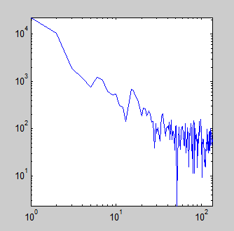
Rules of Power Spectra
P(f) = 1/f ²
ª
Power spectrum
Shape of the power spectra
(Kretzmer, 52; Field 87) for
natural images
(with a ~ 2 for power spectrum and
A ~ 1 for amplitude/magnitude spectrum)
Scale invariance (Ruderman), physical models of natural images (Mumford)

Slide 47

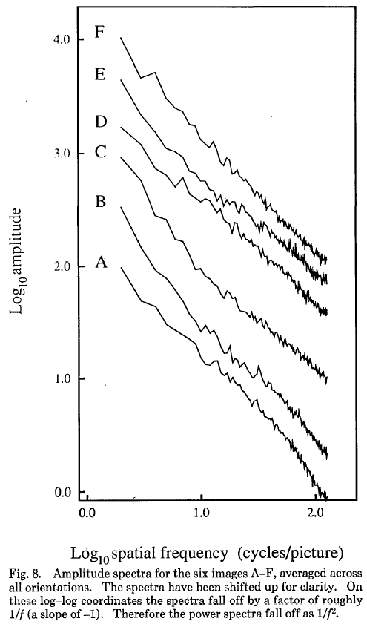
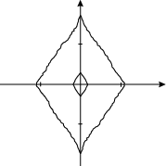
Fourier Characteristics of Natural Images
GlobalLocalFourierSpectra/AverageAndPowerSpectrum.m
Fourier
Power spectrum
Power spectra
fall off as 1/f
Low spatial frequencies
2
1/fª
f_{x}
High
spatial
frequencies
Vertical
f_{y}
Horizontal orientation
f_{x}
High spatial frequency
Low spatial frequency
D. J. Field, "Relations between the statistics of natural images and
the response properties of cortical cells," J. Opt. Soc. Am. A 4, 2379- (1987)
Notes:
Torralba oliva 2003 paper

Slide 48
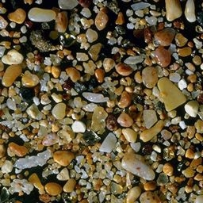
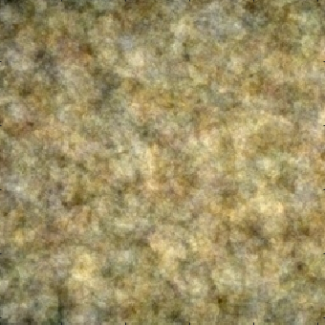










In a world of pebbles…
0 deg is 2.33; 90 deg is 2.34;
45 deg is 2.27; 135 deg is 2.27
GlobalLocalFourierSpectra/AverageAndPowerSpectrum.m
Notes:
0 deg is 2.33
45 deg is 2.27
90 deg is 2.34
135 deg is 2.27

Slide 49












In a world of plaids…
Slope ~2
Slope ~1
GlobalLocalFourierSpectra/AverageAndPowerSpectrum.m
Notes:
0 Deg is 2
45 deg is 1
90 deg is 2
135 deg is 1

Slide 50



Random Noise ?

Slide 51



Fractals?

Slide 52


Statistics of Scene Categories
f_{y}
Spectra
f_{y}
f_{x}
f_{x}
Field (87)
Natural scenes
(6000 images)
Natural scenes
spectral signature
1/fª
f_{y}
f_{x}
f_{y}
f_{y}
f_{x}
f_{x}
Man-made scenes
(6000 images)
Man-made scenes
spectral signature
  Torralba and Oliva, Statistics of Natural Image Categories. Network: Computation in Neural Systems 14 (2003). 391-412.

Slide 53

Statistics of Environments
Spectral signature of
man-made environments
Spectral signature of
natural environments

Slide 54


Spectral Regularities of Mean Depth
Slope of the magnitude spectrum (Vertical, Horizontal, Oblique)
with respect to the mean depth of the scene
1.2
1
1 10 100 1000
1 10 100 1000
Mean depth (meters)
Mean depth (meters)

Slide 55










Image Statistics and Scene Scale
Close-up views
Large scenes
On average, highly cluttered
On average, low clutter
Viewpoint is unconstrained
Point view is
Strongly constrained

Slide 56

Image Scale vs. World Scene Scale
  Torralba and Oliva, Statistics of Natural Image Categories. Network: Computation in Neural Systems 14 (2003) 391-412.

Slide 57


Spatially Localized Statistics
Image statistics become non-stationary as scene scale increases.
GlobalLocalFourierSpectra/LocalPowerSpectrum.m

Slide 58
III - High level image statistics
There are lots of regularities.. Which ones are important ?
http://cvcl.mit.edu/MM/sceneCategories.html

Slide 59

Statistics of Categories of Natural Images
Averaged pictures of categories of objects, scenes and objects in scenes, computed with 100 exemplars or more per category.
Exemplars were chosen to have the same basic level and viewpoint in regard to an observer. The group objects in scenes (third row) represent examples of the averaged peripheral information around an object centered in the image.

Slide 60

Statistical Regularities object-background
keyboard
Fire hydrant
Oliva & Torralba (2007) TICS

Slide 61
Statistical Regularities object-background

Slide 62
Statistical regularities object-object
Oliva & Torralba (2007) TICS

Slide 63




What is driving the scene regularities?
Physical processes that shape the environment?
Restrictions on possible observer points of view?
Functional constraints of the scene?

Slide 64
Spectral Signature of semantic categories
Man-made environments
Natural environments
Spectral signature of categories of man-made environments
Spectral signature of categories of natural environments
  Torralba and Oliva, Statistics of Natural Image Categories. Network: Computation in Neural Systems 14 (2003) 391-412.

Slide 65

Basic-level scene spectral signatures

Slide 66


Spectral Layout Signature
Spectral layout signatures of several scene categories (averaged from hundreds of exemplars)
Open man-made
scenes
Vertically
structured scenes
Perspective views
of streets
Far views of
city center
Close up views
of urban scenes
Open natural
scenes
Closed natural
scenes
Mountaneous
landscapes
Enclosed
forests
Close up views
of rocks, water
Image statistics are non-stationary when considering specific scene categories.
GlobalLocalFourierSpectra/LocalPowerSpectrum.m

