Slide 1
Antonio Torralba, 2016
Lecture 4
Motion filters Spatial pyramids

Slide 2
Recap

Slide 3
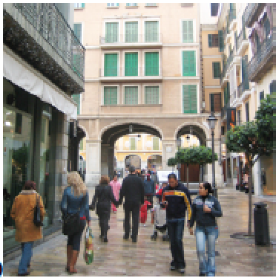
Box filter
=

Slide 4
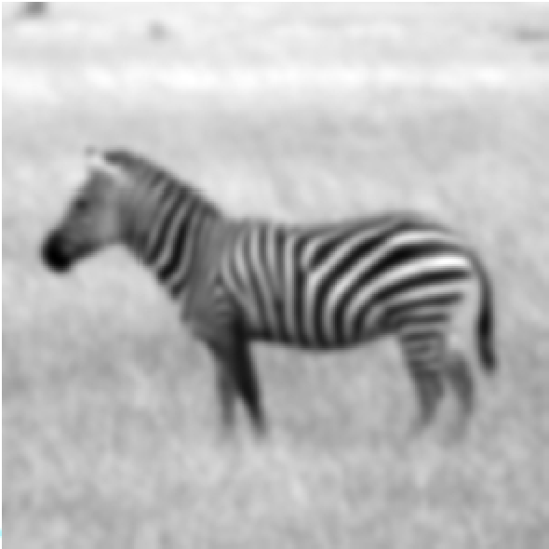
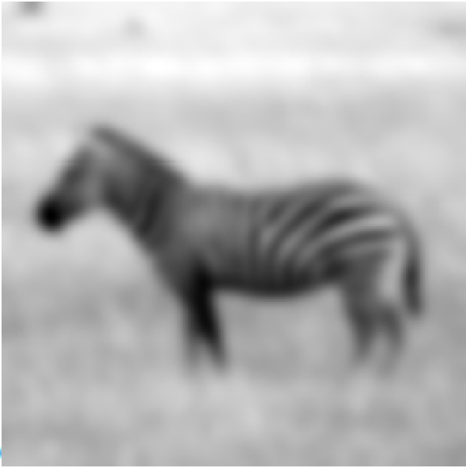
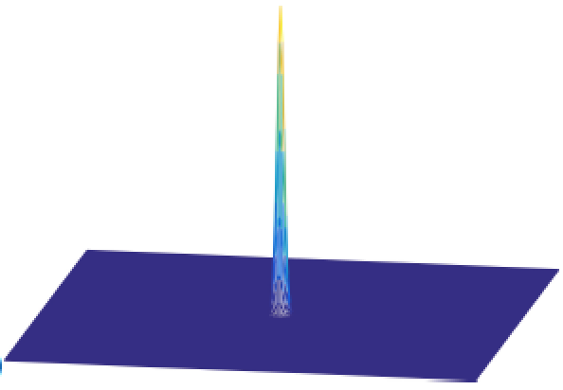
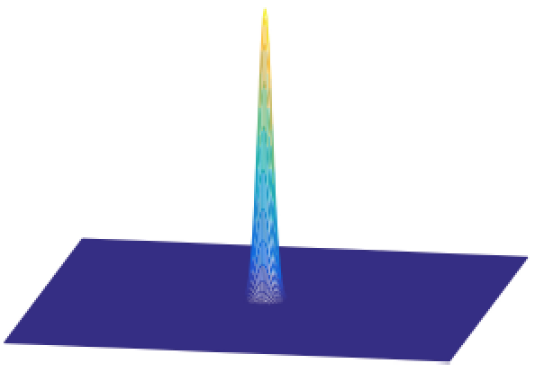
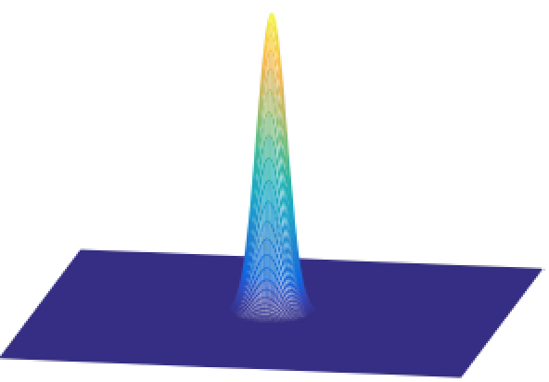
Gaussian filter
σ=2
σ=4
σ=8

Slide 5
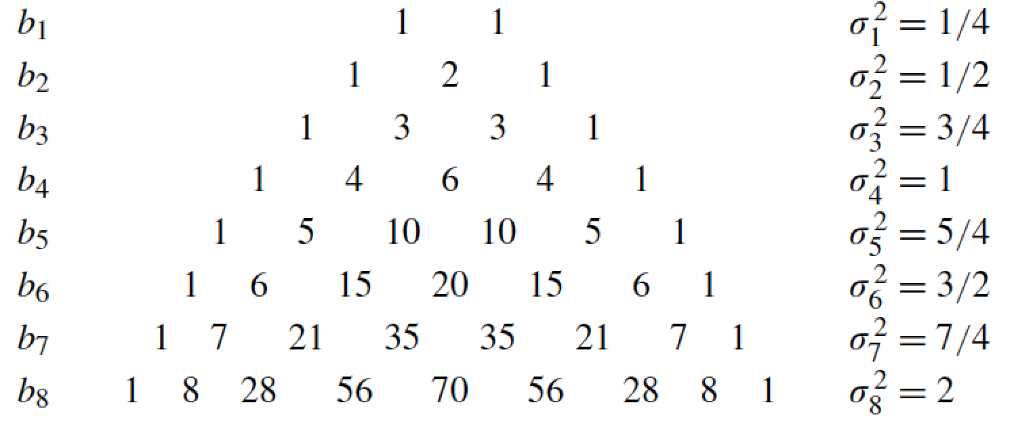
Binomial filter

Slide 6
[-1 1]
[-1, 1]
=
h[m,n]
f[m,n]
g[m,n]

Slide 7
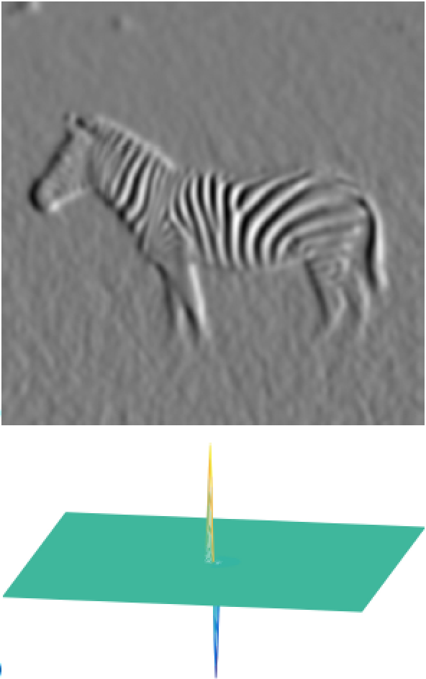
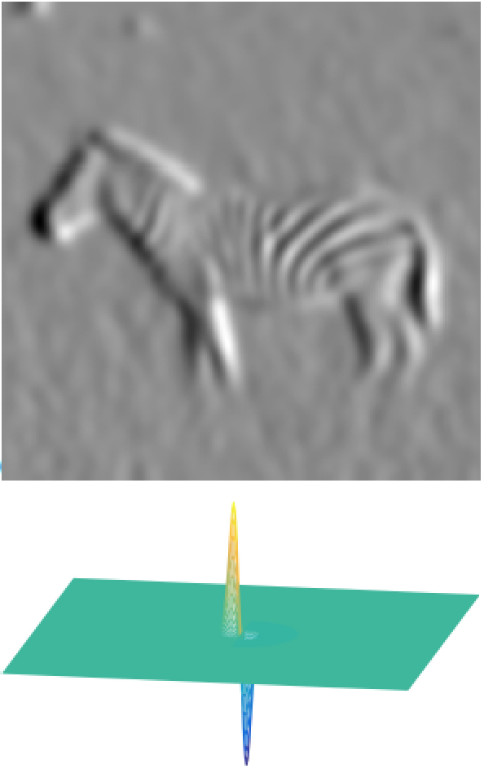
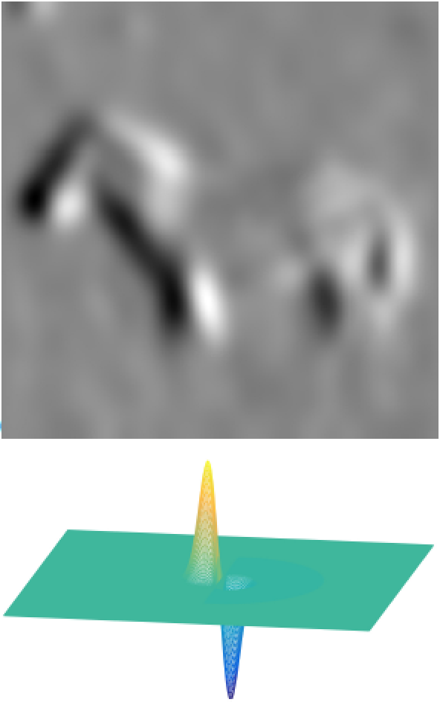
Derivatives of Gaussians: Scale
σ=2
σ=4
σ=8

Slide 8
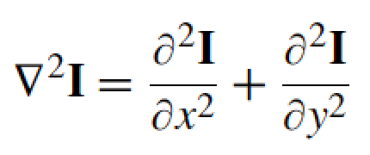
Laplacian filter
Made popular by Marr and Hildreth in 1980 in the search for
operators that locate the boundaries between objects.
The Laplacian operator is defined as the sum of the second order partial derivatives of a function:
To reduce noise and undefined derivatives, we use the same trick:
Where:

Slide 9
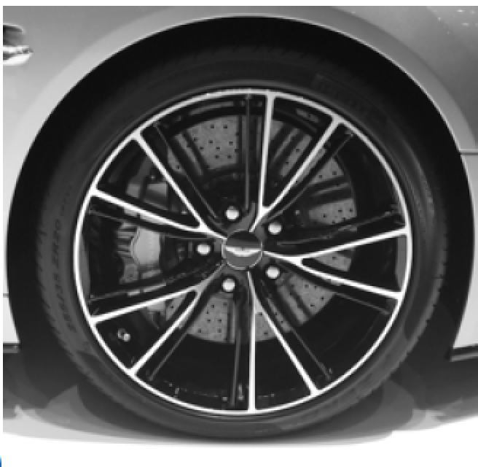
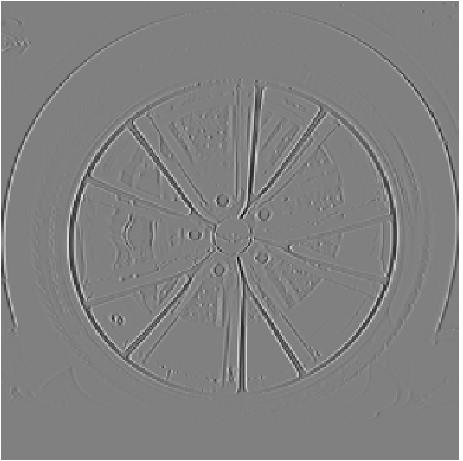
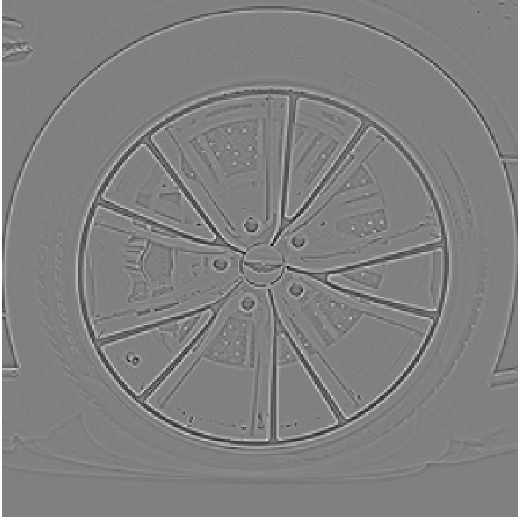
dx
dy
laplacian

Slide 10
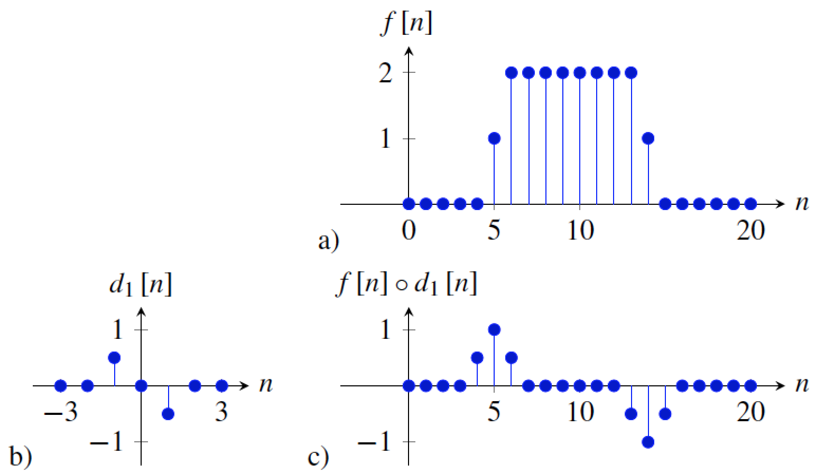
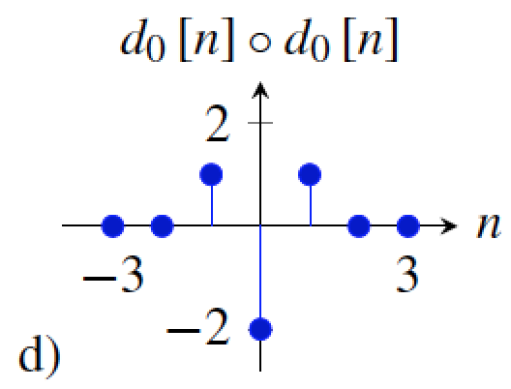
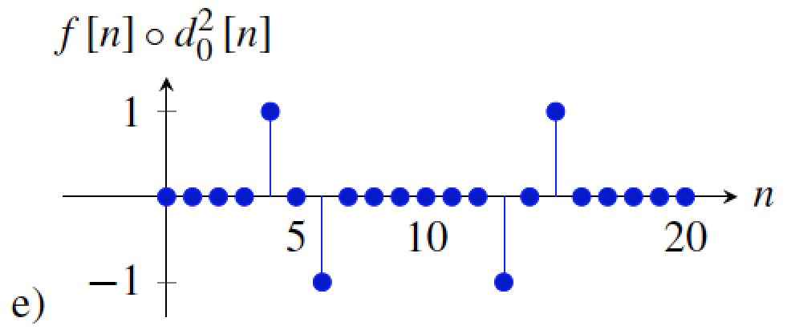
Comparison derivative and laplacian
Zero crossings

Slide 11
Contrast Sensitivity Function
Blackmore & Campbell (1969)
Maximum sensitivity
~ 6 cycles / degree of visual angle
Invisible
visible
Contrast sensitivity
0.1
1
10
100
Low
Spatial frequency (cycles/degree)
High
Things that are very close and large are hard to see
Things far away are hard to see

Slide 12
Vasarely visual illusion

Slide 13
?

Slide 15
Image sharpening filter
Subtract away the blurred components of the image:
This filter has an overall DC component of 1. It de-emphasizes the blur component of the image (low spatial frequencies).
The DC component is the mean value of the image

Slide 16
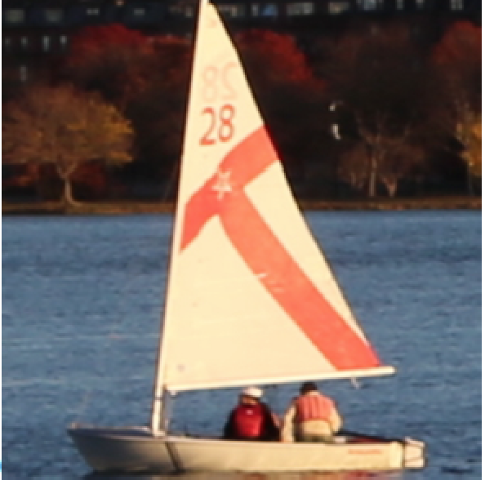
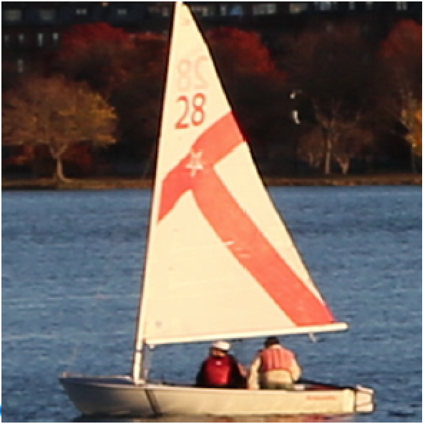
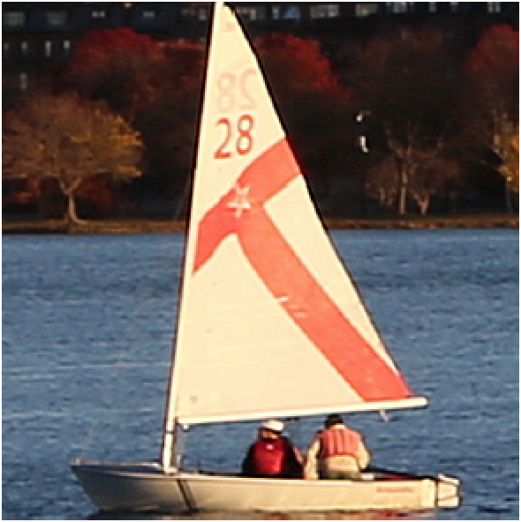
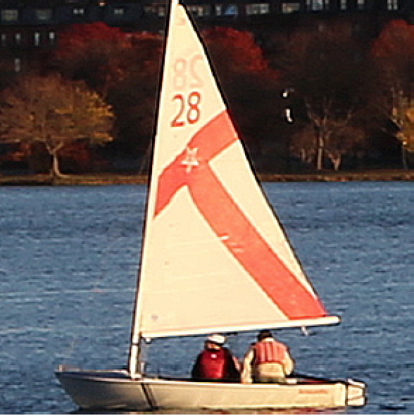
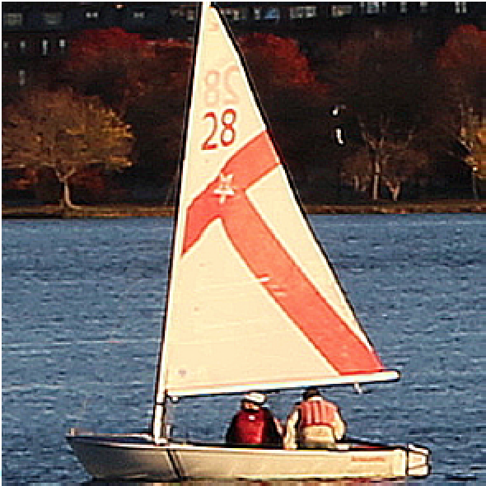
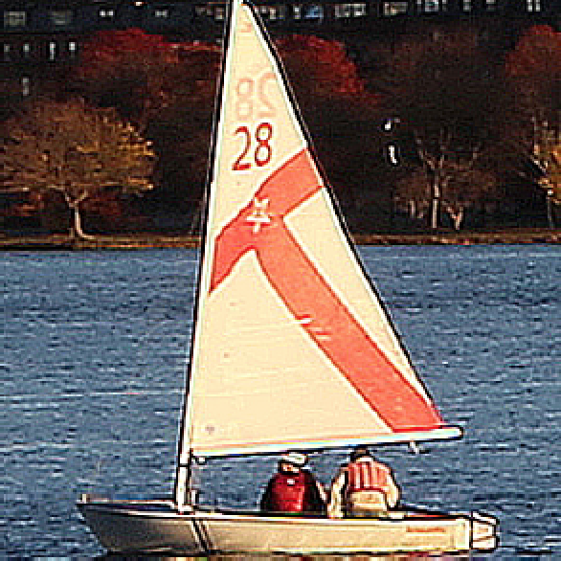
Input image

Slide 17
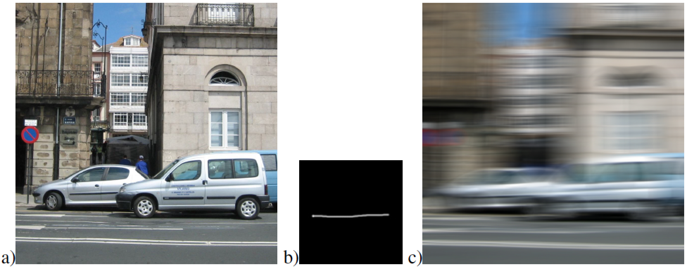
Other “naturally” occurring filters

Slide 18
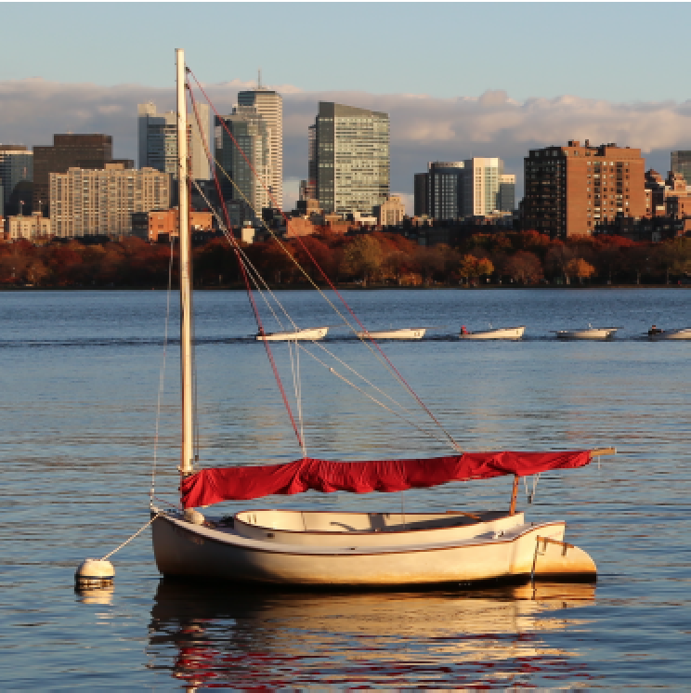
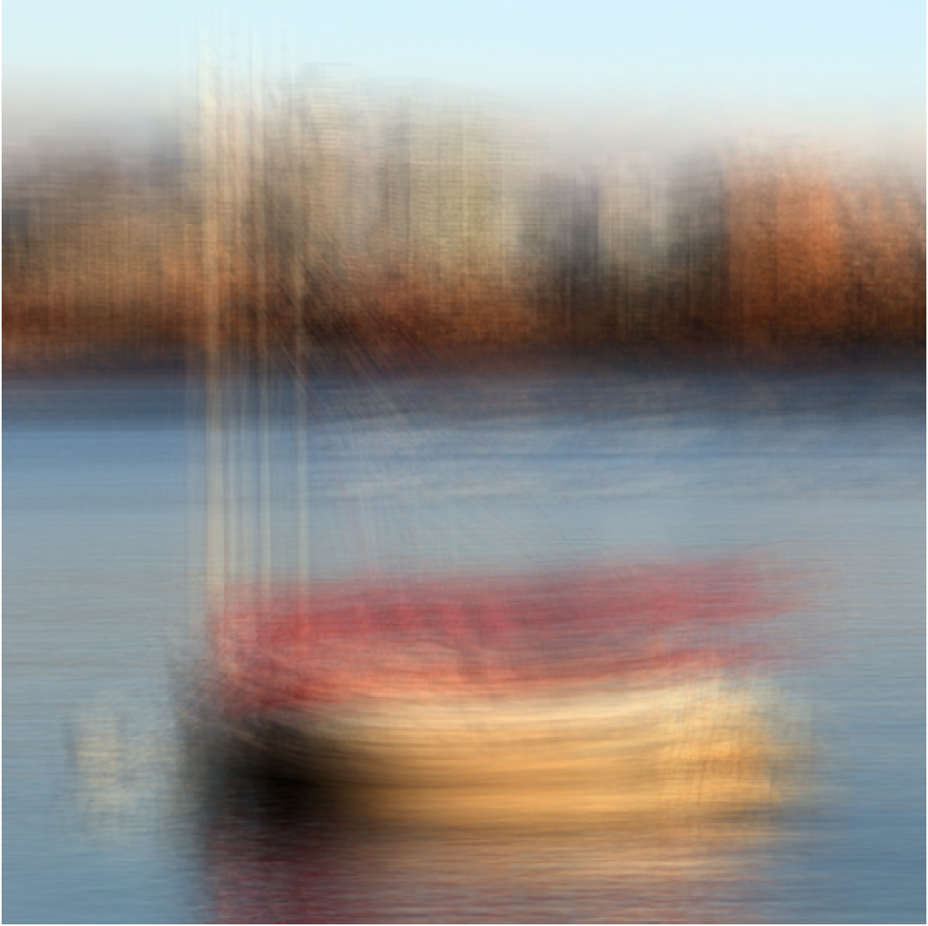
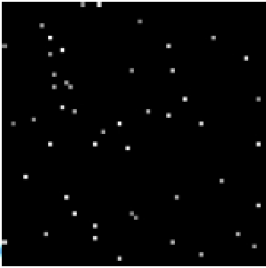
Artistic effects

Slide 19
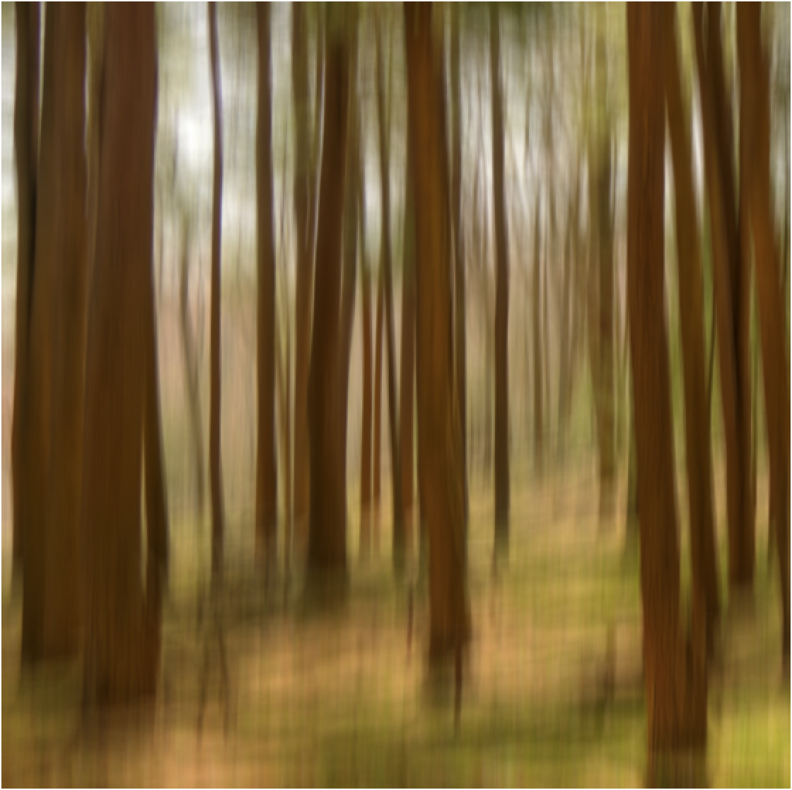
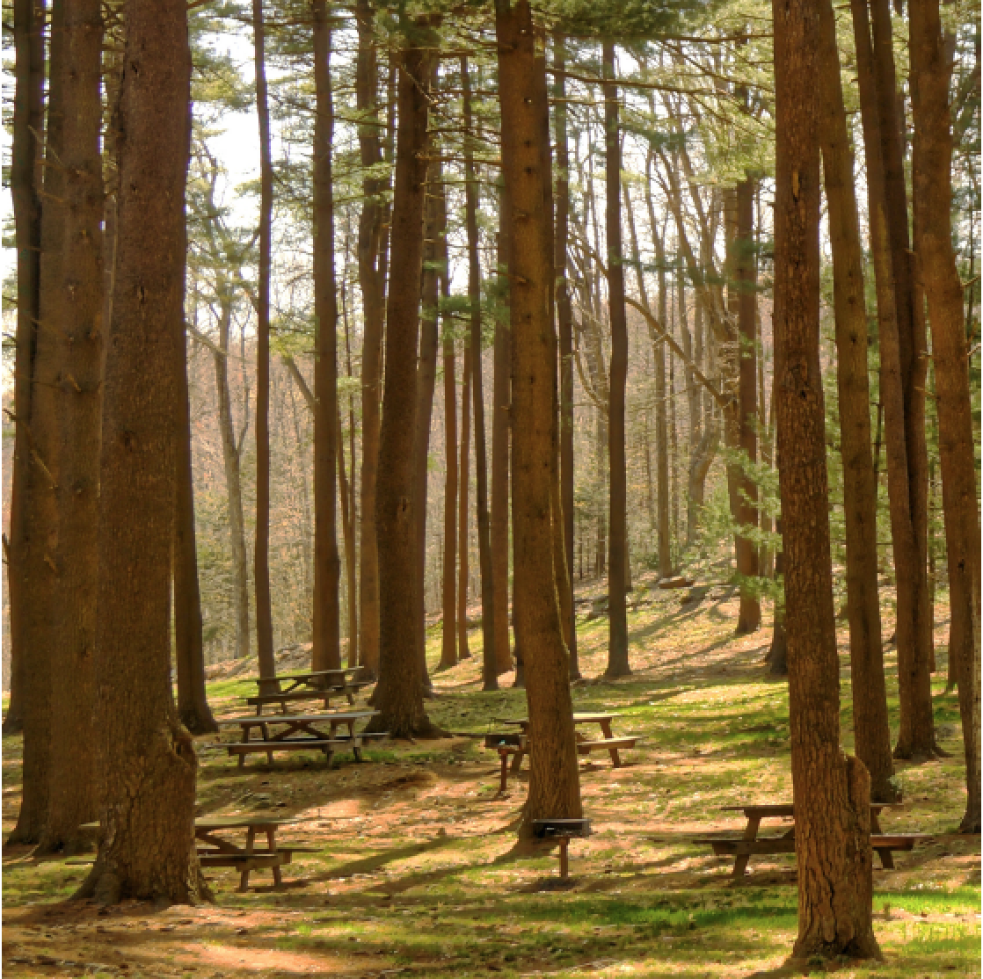

Slide 20
Sequences

Slide 21
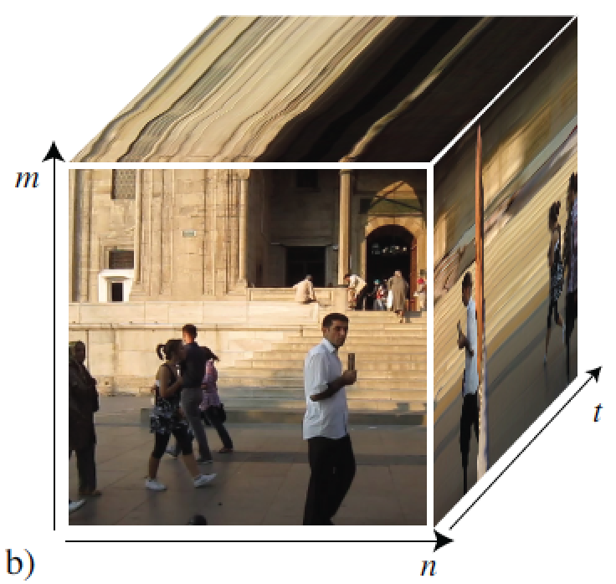
Sequences
time

Slide 22
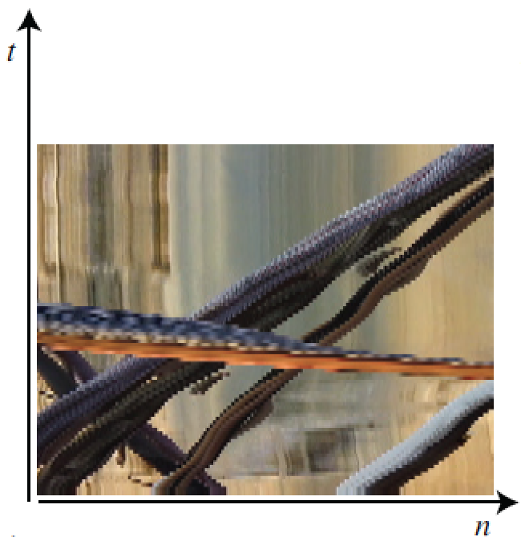
Sequences
Cube size = 128x128x90

Slide 23
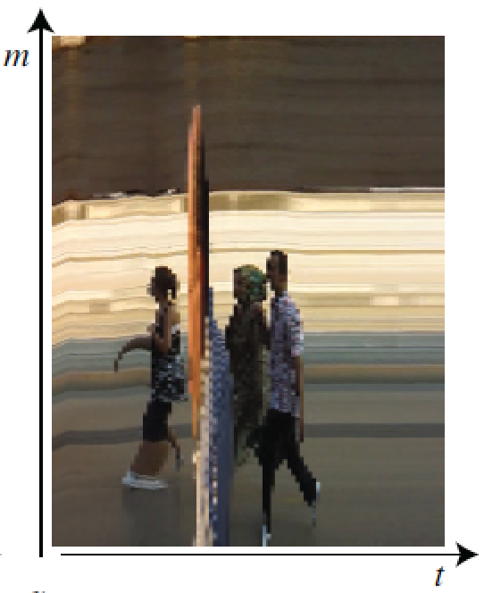
Sequences
Cube size = 128x128x90

Slide 24
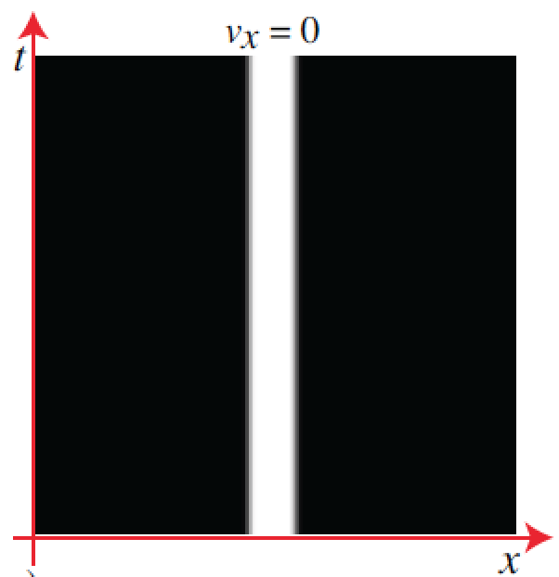
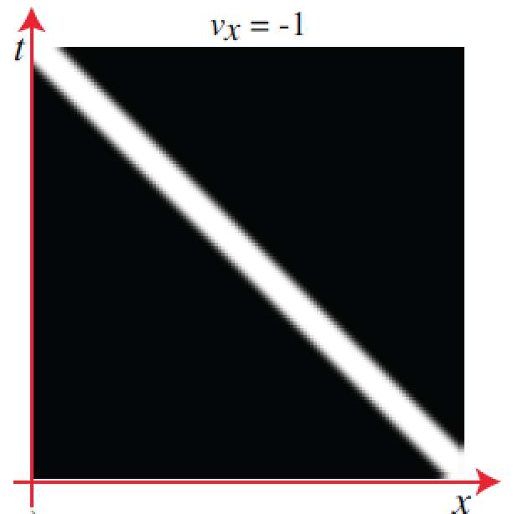
Global constant motion
Let’s work on the continuous space-time domain…
f (t)
v_{x}
t

Slide 25
Global constant motion
(v_{x},v_{y})
A global motion can be written as:
Where:

Slide 26
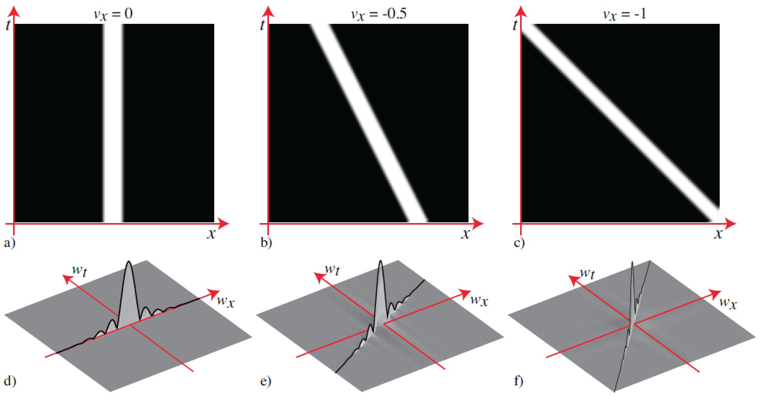

Slide 27
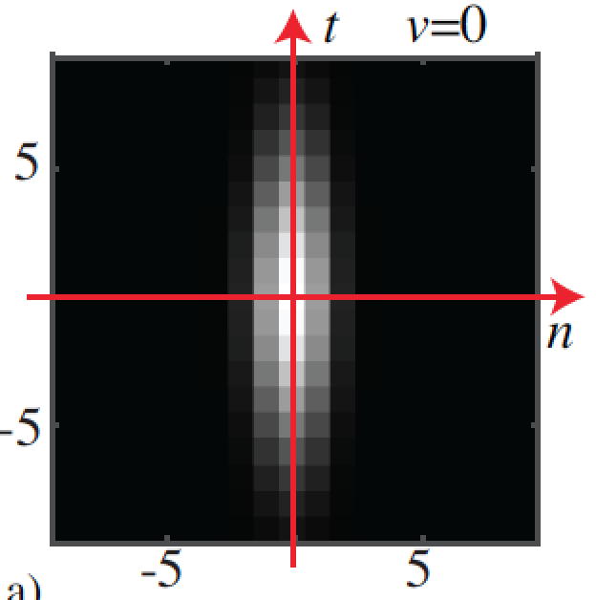
Temporal Gaussian

Slide 28
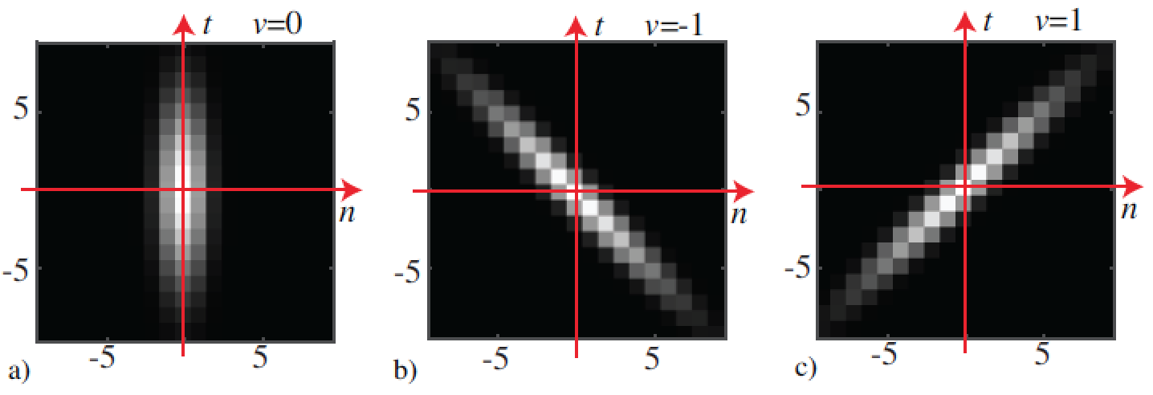
Temporal Gaussian
How could we create a filter that keeps sharp objects that move at some velocity (vx , vy) while blurring the rest?
(Note: although some of the analysis is done on continuous variables, the processing is on done on the discrete domain)

Slide 29
Temporal Gaussian
How could we create a filter that keeps sharp objects that move at some velocity (vx , vy) while blurring the rest?

Slide 30
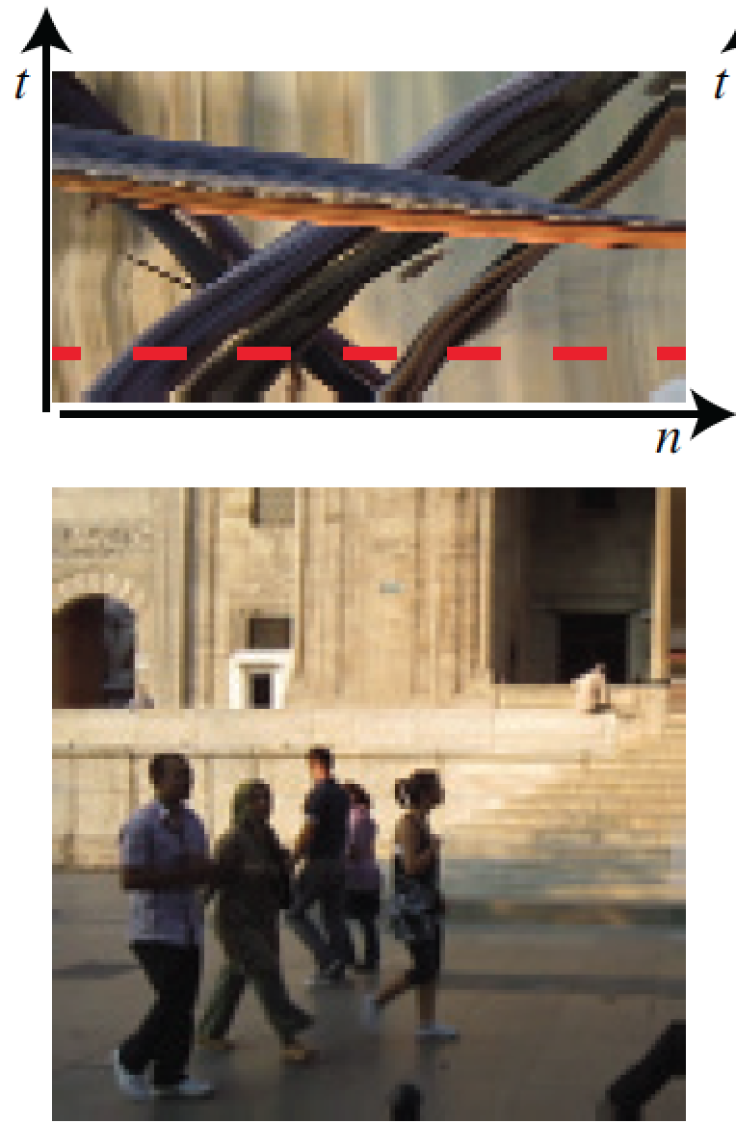
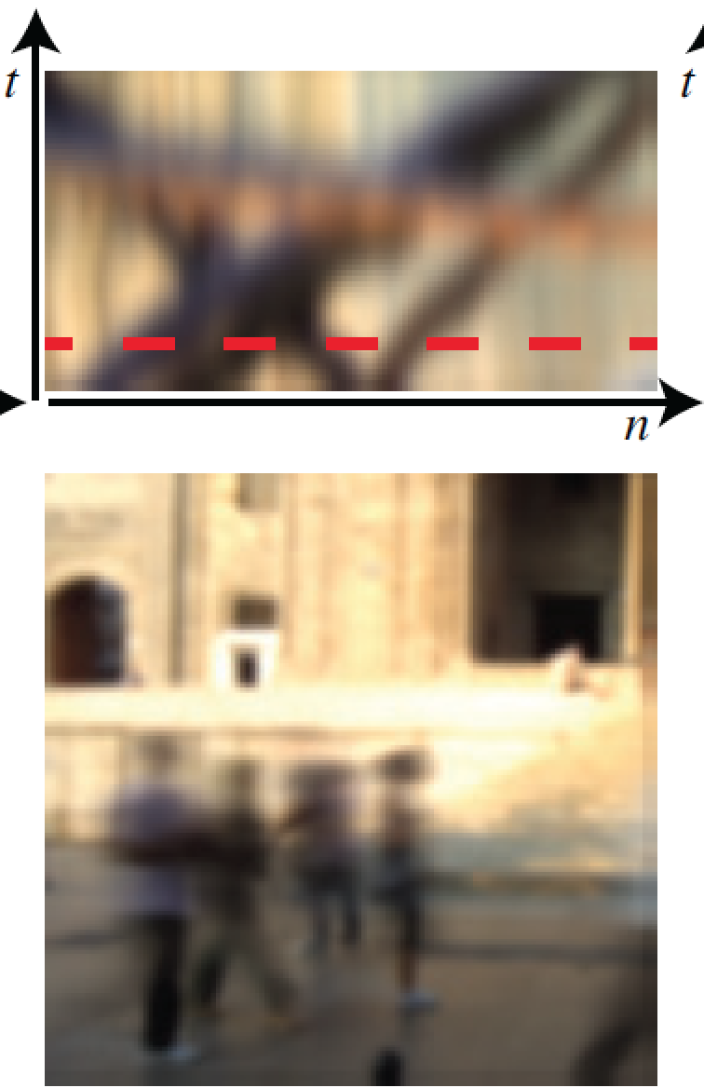

Slide 31
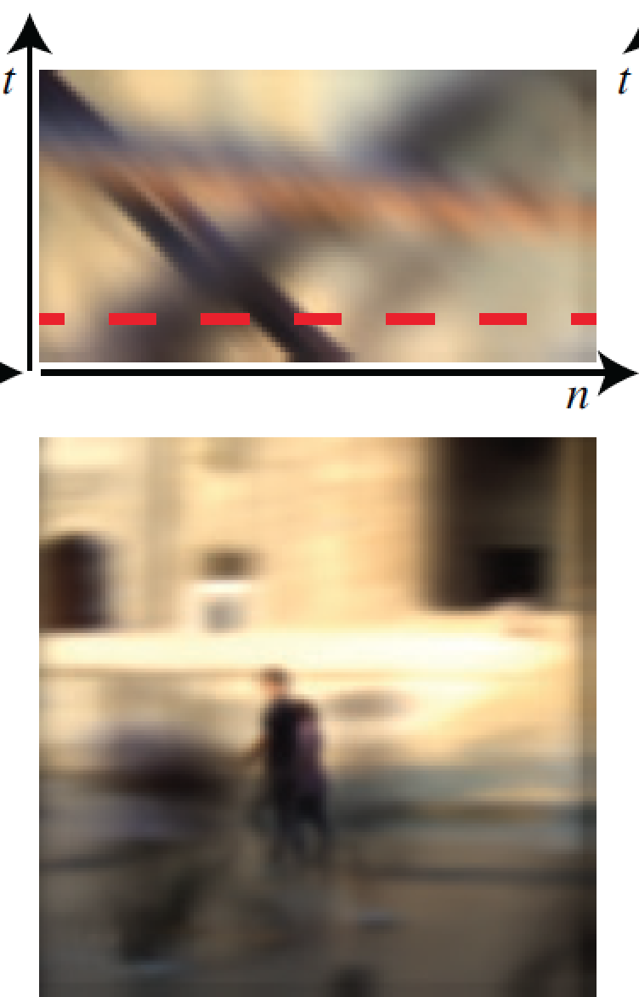

Slide 32
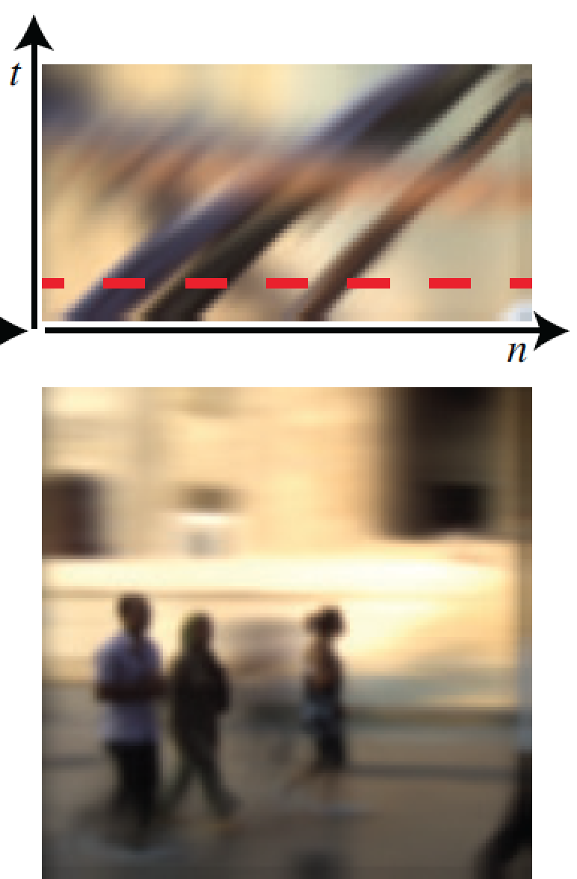

Slide 33
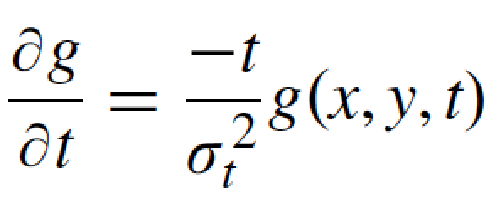
Space-time Gaussian derivatives
Note: we can discretize time derivatives in the same way we discretized spatial derivatives. For instance:

Slide 34
Cancelling moving objects
Can we create a filter that removes objects that move at some velocity (vx , vy) while keeping the rest?

Slide 35
Space-time Gaussian derivatives
For a global translation, we can write:
Therefore, we can write the temporal derivative of f as a function of the spatial derivatives of f₀ :
And from here (using derivatives of f):
+
+
=0
This relation is known as the “Brightness change constraint equation”, introduced by Horn & Schunck in 1981

Slide 36
Space-time Gaussian derivatives
Can could we create a filter that removes objects that move at some velocity (vx , vy) while keeping the rest?
Yes, we could create a filter that implements this constraint:
+
+
=0
We can create this filter as a combination of Gaussian derivatives:

Slide 37
Space-time Gaussian derivatives

Slide 38
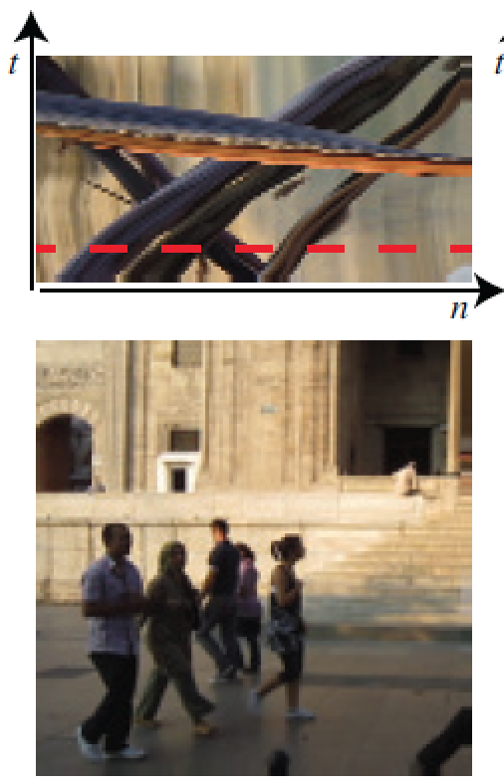
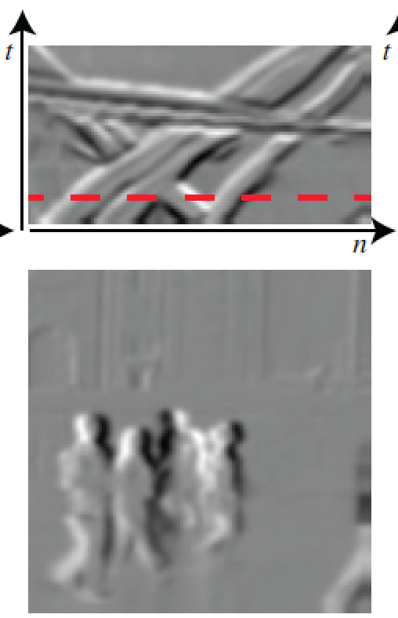

Slide 39
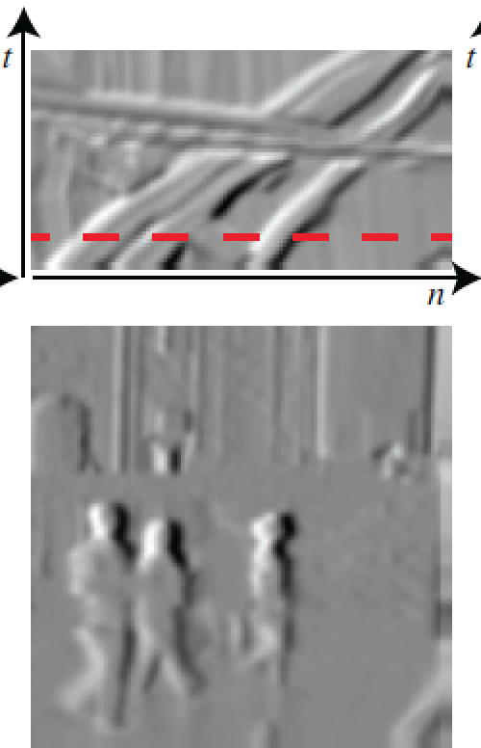

Slide 40
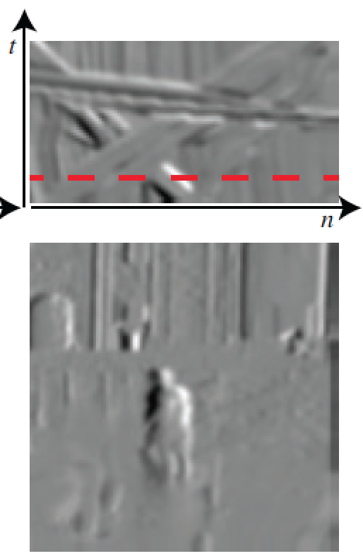

Slide 41
Gabor wavelets and quadrature filters

Slide 42
What is a good representation for image analysis?
Fourier transform domain tells you “what” (textural properties), but not “where”.
Pixel domain representation tells you “where” (pixel location), but not “what”.
Want an image representation that gives you a local description of image events—what is happening where.

Slide 43
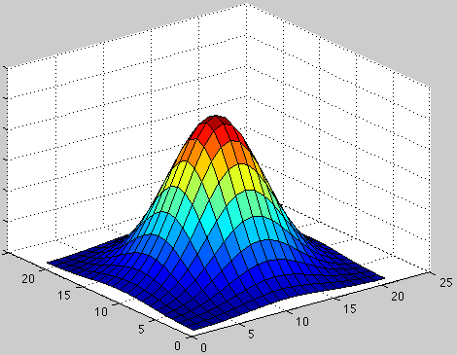
Analysis of local frequency
Fourier basis:
(x₀, y₀)
Gabor wavelet:
We can look at the real and imaginary parts:

Slide 44
Gabor wavelets
u₀=0
U₀=0.1
U₀=0.2

Slide 45
Gabor filters at different
scales and spatial frequencies
Top row shows anti-symmetric
(or odd) filters; these are good for detecting odd-phase structures like edges.
Bottom row shows the
symmetric (or even) filters, good for detecting line phase contours.
Notes:
Gabor filters are just another way to generate spots and bars.

Slide 46
Fourier transform of a Gabor wavelet
U₀=0.1
w_{y}
w_{y}
w_{x}
w_{x}
-u₀
+u₀

Slide 47
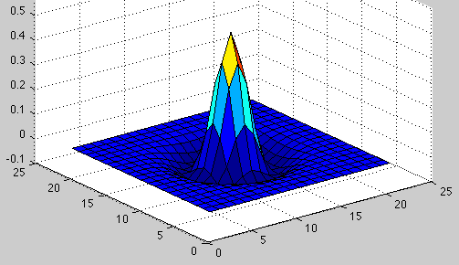
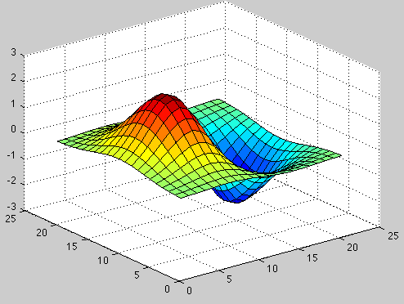
Comparing Human and Machine Perception

Slide 48
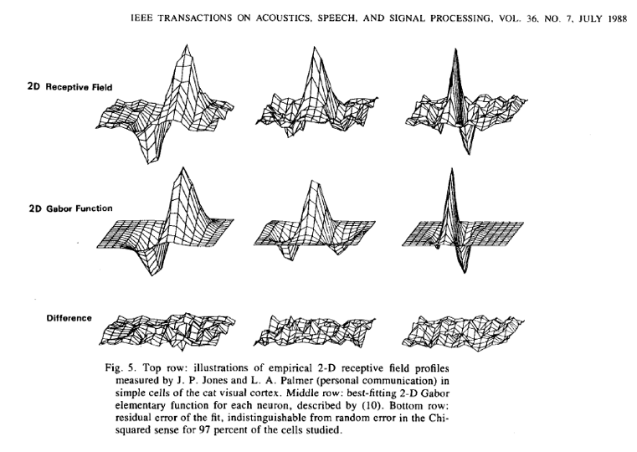
John Daugman, 1988
48

Slide 50
Quadrature filter pairs
A quadrature filter is a complex filter whose real part is related to its imaginary part via a Hilbert transform along a particular axis through origin of the frequency domain.
(.)²
+
(.)²

Slide 51
(.)²
squared magnitude
+
(.)²
Contrast invariance! ! (same energy response for white dot on black background as for a black dot on a white background).

Slide 52
energy response to an edge
edge

Slide 53
line
energy response to a line

Slide 54
A contour detector
edge detector output
Local energy
Phase ~ 90
Phase ~ 0
54

Slide 55
Iris code
Real
Imaginary
Iris codes are compared using Hamming distance
John Daugman
Images from http://cnx.org/content/m12493/latest/

Slide 56
John Daugman, http://www.cl.cam.ac.uk/~jgd1000/

Slide 57
Gabor filter measurements for iris recognition code
John Daugman, http://www.cl.cam.ac.uk/~jgd1000/
57

Slide 58
Gabor wavelet:
Tuning filter orientation:
Real
Space
Imag
Real
Fourier domain
Imag

Slide 59
Second directional derivative of a Gaussian and its quadrature pair

Slide 60
Orientation analysis
High resolution in orientation requires many oriented filters as basis (high order gaussian derivatives
or fine-tuned Gabor wavelets).

Slide 61
Orientation analysis

Slide 63
Image pyramids

Slide 64
Image information occurs at all spatial scales
64

Slide 65
Gaussian filter

Slide 66
The Gaussian pyramid
For each level
Blur input image with a Gaussian filter
Downsample by a factor of 2
Output downsampled image
66

Slide 67
The Gaussian pyramid
512×512
256×256
128×128
64×64
32×32
(original image)
67

Slide 68
The Gaussian pyramid
For each level
1. Blur input image with a Gaussian filter
[1, 4, 6, 4, 1]

Slide 69
The Gaussian pyramid
For each level
1. Blur input image with a Gaussian filter
2. Downsample image

Slide 70
Downsampling
⬇2
Blur
(no frequency content is lost)

Slide 71
In 1D, one step of the Gaussian pyramid is:
http://www-bcs.mit.edu/people/adelson/pub_pdfs/pyramid83.pdf

Slide 72
72

Slide 73
Convolution and subsampling as a matrix multiply (1D case)
1 4 6 4 1 0 0 0 0 0 0 0 0 0 0 0 0 0 0 0
0 0 1 4 6 4 1 0 0 0 0 0 0 0 0 0 0 0 0 0
0 0 0 0 1 4 6 4 1 0 0 0 0 0 0 0 0 0 0 0
0 0 0 0 0 0 1 4 6 4 1 0 0 0 0 0 0 0 0 0
0 0 0 0 0 0 0 0 1 4 6 4 1 0 0 0 0 0 0 0
0 0 0 0 0 0 0 0 0 0 1 4 6 4 1 0 0 0 0 0
0 0 0 0 0 0 0 0 0 0 0 0 1 4 6 4 1 0 0 0
0 0 0 0 0 0 0 0 0 0 0 0 0 0 1 4 6 4 1 0
(Normalization constant of 1/16 omitted for visual clarity.)

Slide 74
Next pyramid level
1 4 6 4 1 0 0 0
0 0 1 4 6 4 1 0
0 0 0 0 1 4 6 4
0 0 0 0 0 0 1 4

Slide 75
The combined effect of the two pyramid levels
1 4 10 20 31 40 44 40 31 20 10 4 1 0 0 0 0 0 0 0
0 0 0 0 1 4 10 20 31 40 44 40 31 20 10 4 1 0 0 0
0 0 0 0 0 0 0 0 1 4 10 20 31 40 44 40 30 16 4 0
0 0 0 0 0 0 0 0 0 0 0 0 1 4 10 20 25 16 4 0

Slide 76
1D Gaussian pyramid matrix, for [1 4 6 4 1] low-pass filter
full-band image, highest resolution
lower-resolution image
lowest resolution image

Slide 77
Gaussian pyramids used for
up- or down- sampling images.
Multi-resolution image analysis
Look for an object over various spatial scales
Coarse-to-fine image processing: form blur estimate or the motion analysis on very low-resolution image, upsample and repeat. Often a successful strategy for avoiding local minima in complicated estimation tasks.
77

Slide 78
Image down-sampling
⬇2
Blur
Image up-sampling
⬆2

Slide 79
Image up-sampling
1 2 1 2 4 2 1 2 1
=
64×64
Start by inserting zeros
128×128

Slide 80
Image up-sampling
1 2 1 2 4 2 1 2 1
=
64×64
=

Slide 81
Convolution and up-sampling as a matrix multiply (1D case)
Insert zeros between pixels, then apply a low-pass filter, [1 4 6 4 1]
6 1 0 0
4 4 0 0
1 6 1 0
0 4 4 0
0 1 6 1
0 0 4 4
0 0 1 6
0 0 0 4
81

Slide 82
The Laplacian Pyramid
Synthesis
Compute the difference between upsampled Gaussian pyramid level and Gaussian pyramid level.
band pass filter - each level represents spatial frequencies (largely) unrepresented at other level.
82

Slide 83
Laplacian pyramid algorithm
83

Slide 84
Showing, at full resolution, the information captured at each level of a Gaussian (top) and Laplacian (bottom) pyramid.
84
http://www-bcs.mit.edu/people/adelson/pub_pdfs/pyramid83.pdf

Slide 85
Laplacian pyramid reconstruction algorithm: recover x₁ from L₁, L₂, L₃ and x₄
G# is the blur-and-downsample operator at pyramid level #
F# is the blur-and-upsample operator at pyramid level #
Laplacian pyramid elements:
L1 = (I – F1 G1) x1
L2 = (I – F2 G2) x2
L3 = (I – F3 G3) x3
x2 = G1 x1
x3 = G2 x2
x4 = G3 x3
Reconstruction of original image (x1) from Laplacian pyramid elements:
x3 = L3 + F3 x4
x2 = L2 + F2 x3
x1 = L1 + F1 x2
85

Slide 86
Laplacian pyramid reconstruction algorithm: recover x₁ from L₁, L₂, L₃ and g₃
+
+
+
86

Slide 87
Gaussian pyramid
Notes:
This is a Gaussian pyramid

Slide 88
(Low-pass residual)
Laplacian pyramid
Notes:
And this a Laplacian pyramid. Notice that the lowest layer is the same in each case,
and that if I upsample the lowest layer and add to the next, I get the Gauss layer.
Notice also that each layer shows detail at a particular scale --- these are, basically, bandpass filtered versions of the image.

Slide 89
1-d Laplacian pyramid matrix, for [1 4 6 4 1] low-pass filter
high frequencies
mid-band frequencies
low frequencies
89

Slide 90
Laplacian pyramid applications
Texture synthesis
Image compression
Noise removal
Also related to SIFT
90

Slide 91
Image blending

Slide 92
Szeliski, Computer Vision, 2010

Slide 93
Image blending
Build Laplacian pyramid for both images: LA, LB
Build Gaussian pyramid for mask: G
Build a combined Laplacian pyramid: L(j) = G(j) LA(j) + (1-G(j)) LB(j)
Collapse L to obtain the blended image
93

Slide 94
Sampling

Slide 95
Sampling
Pixels
Continuous world

Slide 96
Sampling

Slide 97
Sampling

Slide 98
Sampling

Slide 99
What will be the best sampling pattern in 2D?
Retinal fovea
Retina periphery
Hexagonal
Random
Images from: http://www.cns.nyu.edu/~david/courses/perception/lecturenotes/retina/retina.html

Slide 100
Sampling
Continuous image f (x, y)
We can sample it using a rectangular grid as
T_{y}
T_{x}

Slide 101
Aliasing
Let’s start with this continuous image (it is not really continuous…)

Slide 102
Aliasing

Slide 103
Modeling the sampling process
Continuous image f (x, y)
We can sample it using a rectangular grid as
Or a more general sampling pattern
If a = T , b = 0, c = 0, d = T then we will have a rectangular sampling

Slide 104
Modeling the sampling process
f (t)
t
A convenient writing:
Delta train
T_{s}
t
t
Sampled signal

Slide 105
Modeling the sampling process
f (t)
Delta train
*
t
t
T_{s}
The Fourier transform is a convolution…
Interesting property of the delta train: the Fourier transform of a delta train of period T is another delta train with period 2π/T

Slide 106
Modeling the sampling process
=
1
T_{s}
t
w
Interesting property of the delta train: the Fourier transform of a delta train of period T is another delta train with period 2π/T. Demo in the class notes.

Slide 107
Modeling the sampling process
f (t)
×
=
t
t
t
T_{s}
F (w)
=
w
w
What happens when the repetitions overlap?

Slide 108
Aliasing

Slide 109
Aliasing
Both waves fit the same samples. Aliasing consists in “perceiving” the red wave when the actual input was the blue wave.

Slide 110
Sampling theorem
The sampling theorem (also known as Nyquist theorem) states that for a signal to be perfectly reconstructed from it samples, the sampling period T_{s} has to be T_{s} > T_{min}/2 where T_{min} is the period of the highest frequency present in the input signal.
F (w)
w
2π/T_{min}

Slide 111
Antialising filtering
Before sampling, apply a low pass-filter to remove all the frequencies that will produce aliasing.
Without antialising filter.
With antialising filter.

Slide 112
Modeling the 2D sampling process
Rectangular sampling
Hexagonal sampling

Slide 113
2D sampling
Retinal fovea
Retina periphery
Hexagonal
Random
Images from: http://www.cns.nyu.edu/~david/courses/perception/lecturenotes/retina/retina.html

