Slide 1

Lecture 6
Statistical Image Models

Slide 2
The visual system seems to be tuned to a set of images:
Demo inspired from D. Field

Slide 3
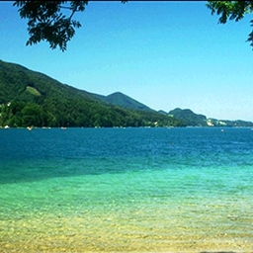
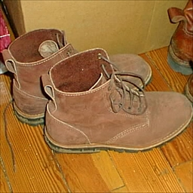
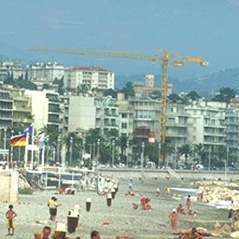
Remember these images

Slide 4
Did you saw this image?

Slide 5
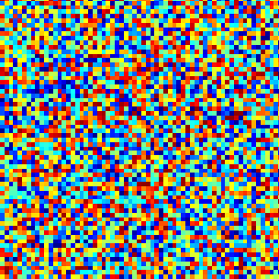
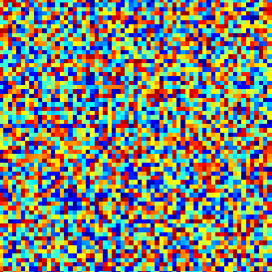
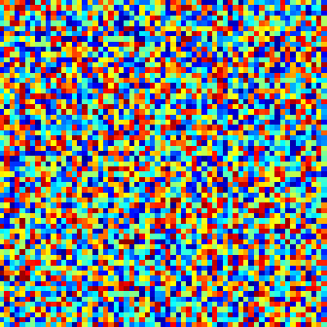
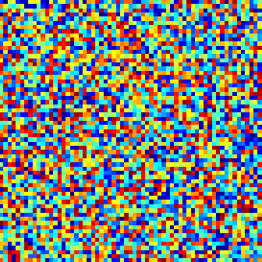
Remember these images
Test 2

Slide 6
Did you saw this image?

Slide 7
The visual system is tuned to process structures typically found in the world.

Slide 8
But why are we tuned to anything?

Slide 9
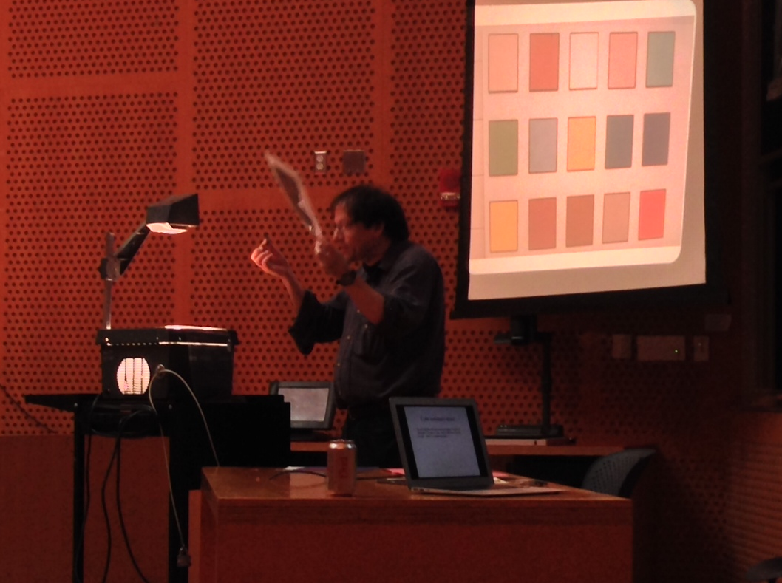

Slide 10

Separating images into components
=
*

Slide 11
Prototypical vision problem
Observe some product of two numbers, say 1.0
What were those two numbers?
Ie, 1 = ab. Find a and b.
Compare this with the prototypical graphics problem: here are two numbers; what is their product?

Slide 12

Separating images into components

Slide 13
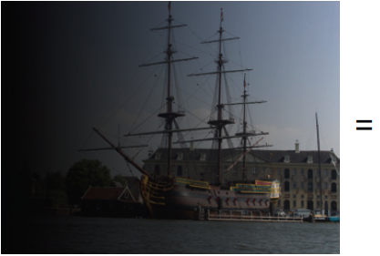
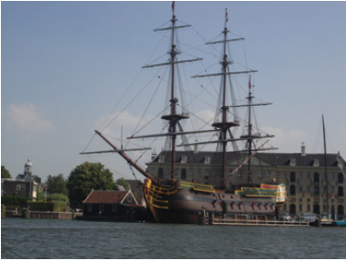

X

Slide 14
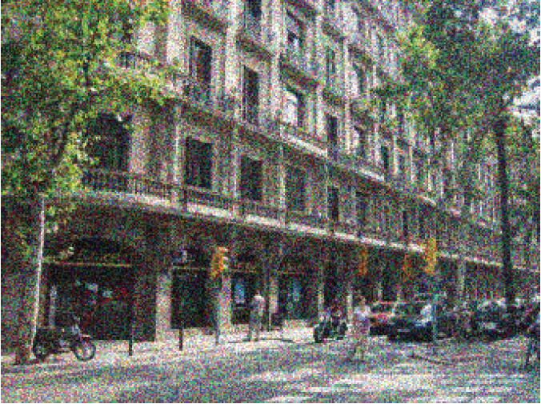
Separating images into components

Slide 15
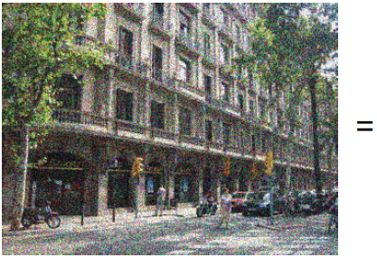
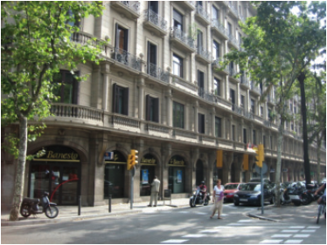

Separating images into components
+

Slide 16
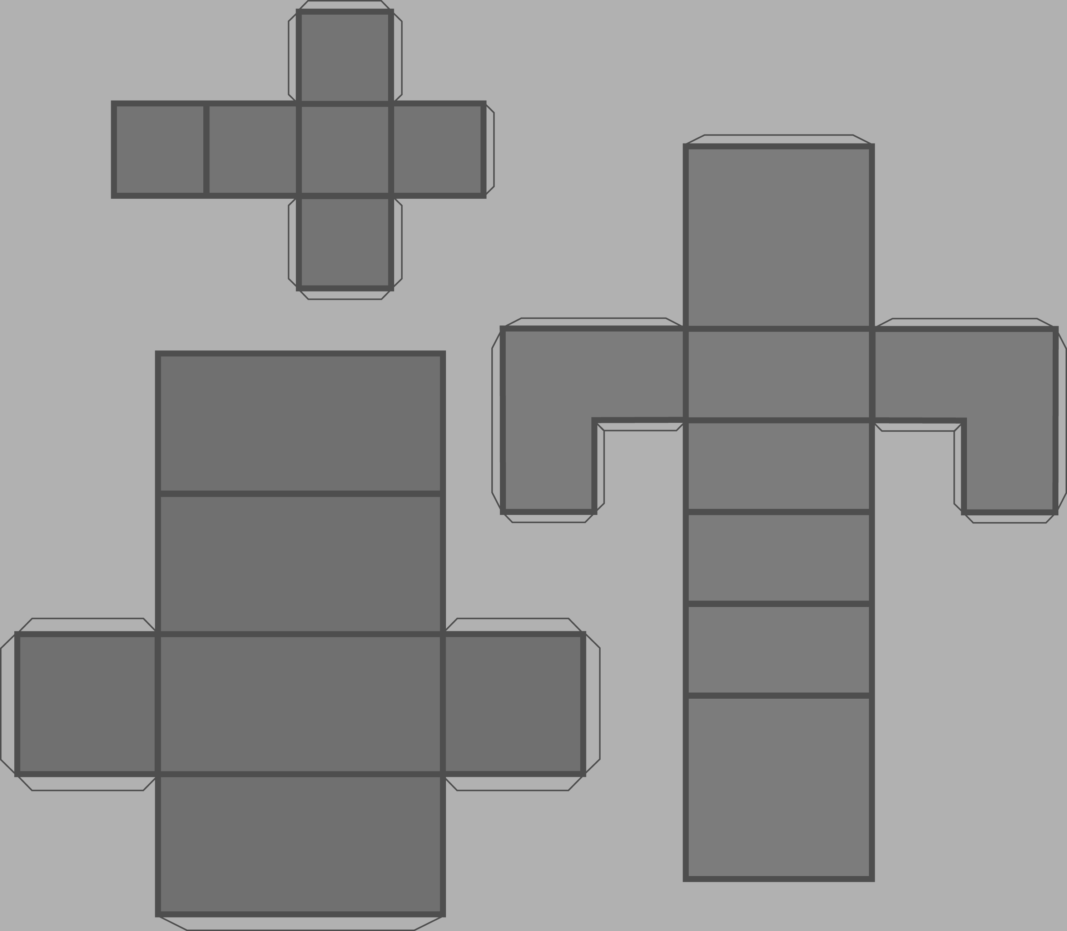
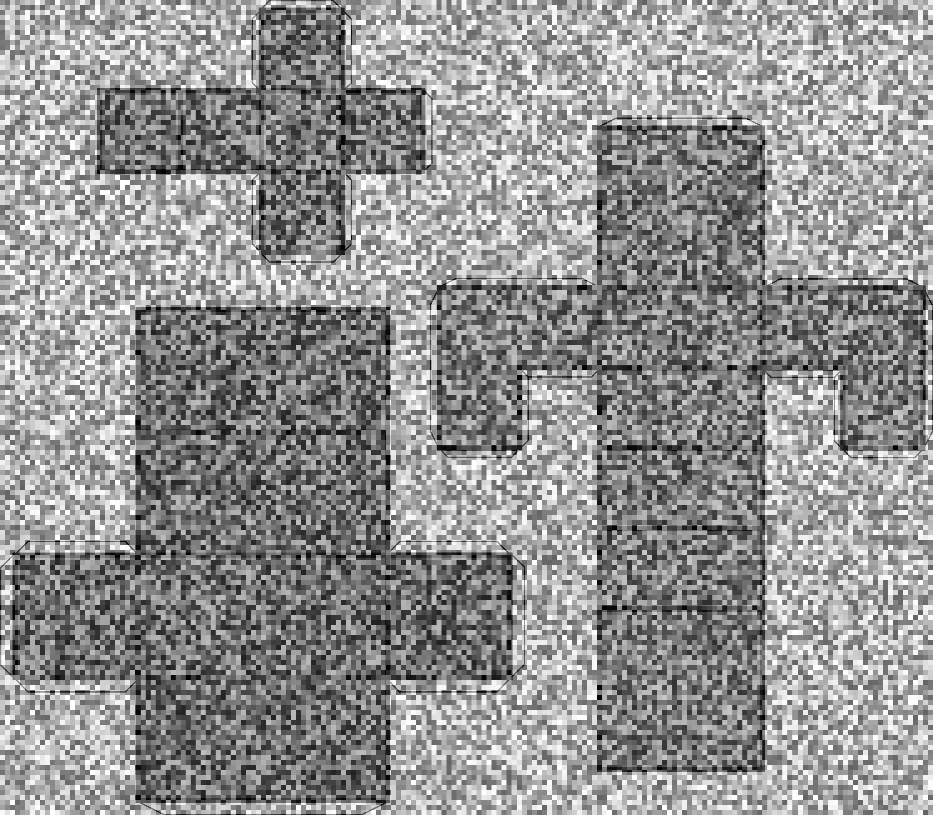
Noise on the image vs. noise in the world
The noise in the world, it is called texture by its friends

Slide 17
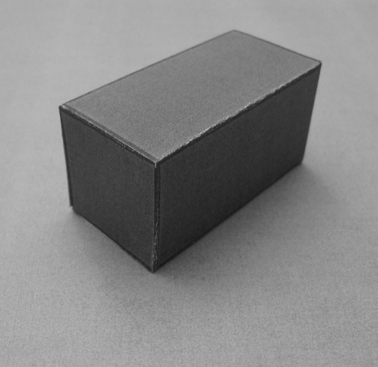
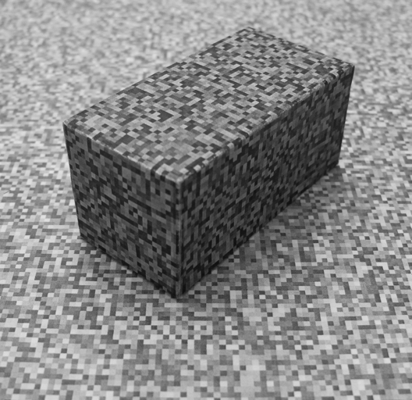
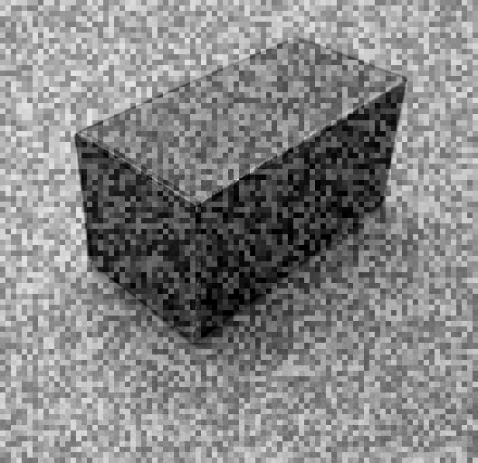
Noise or texture?

Slide 18

Separating images into components

Slide 19
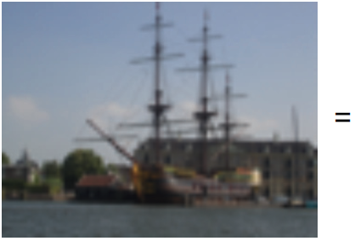
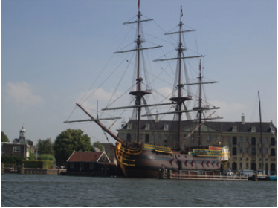
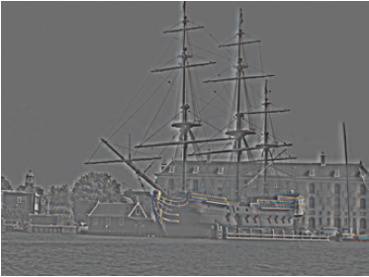
-

Slide 20
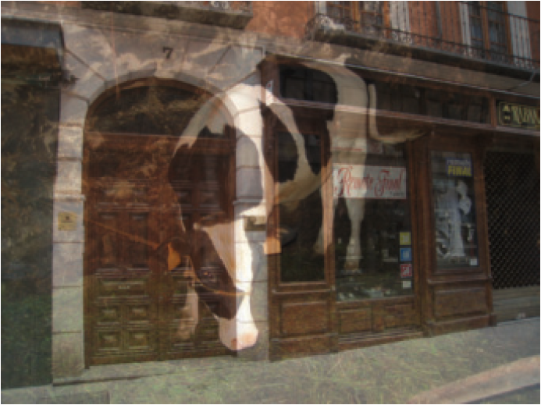
Separating images into components

Slide 21
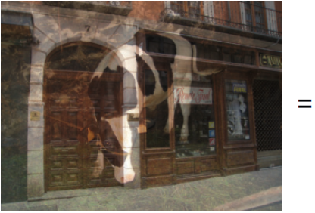
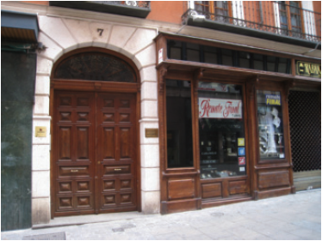
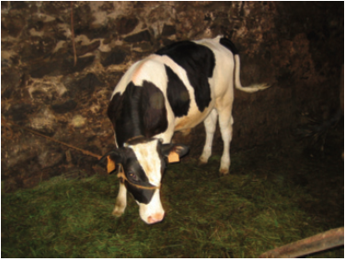
+

Slide 22

Taking a picture…
What the camera give us…

Slide 23
Why does picture appear blurry?

Slide 24
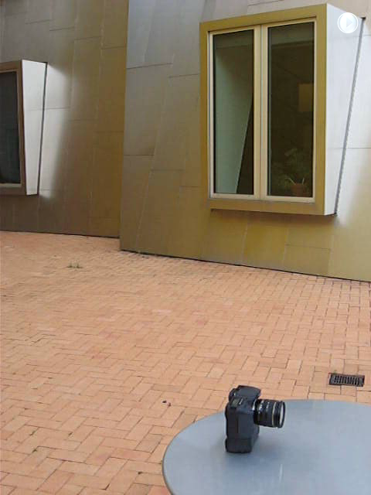
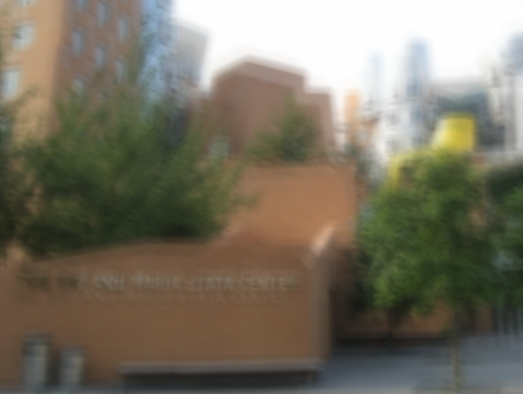
Let’s take a photo
Blurry result
Slides R. Fergus

Slide 25
Even though you thought the camera was still, in fact lots of things happened while the shutter was open.

Slide 26
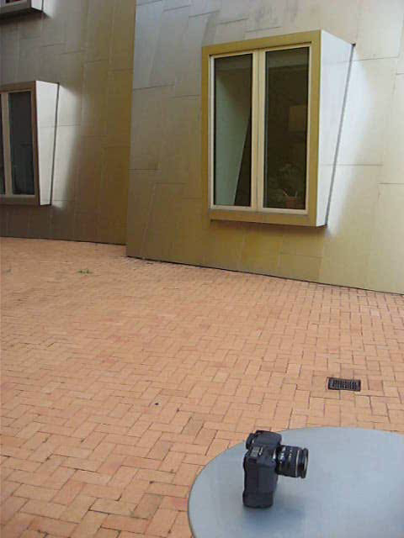
Slow-motion replay
Slides R. Fergus

Slide 27
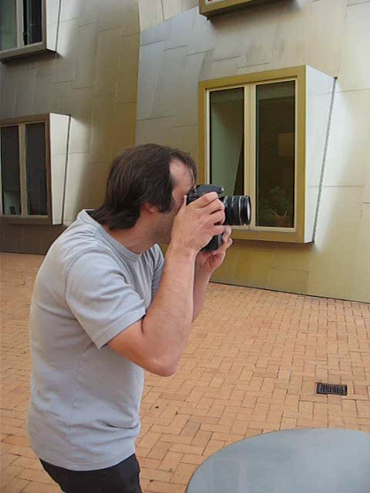

Slow-motion replay
Motion of camera
Notes:
Even though you thought the camera was still, in fact lots of things happening while the shutter is open.

Slide 28
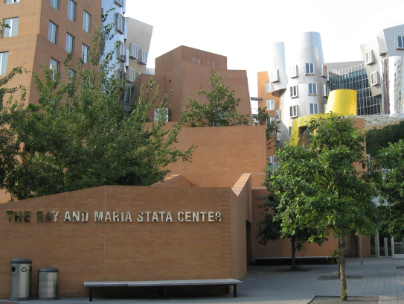
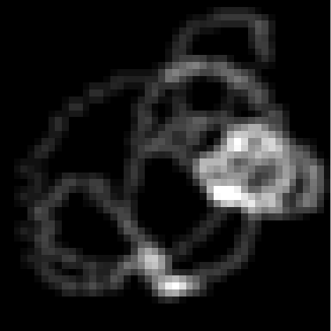
Image formation process
=
⊗
Blur
kernel
Blurry image
Sharp image
Convolution
operator
Notes:
Start with: we use the following model. …….
Approximation since there are lots of effects we don’t model.

Slide 29
Why is this hard?

Slide 30
Multiple possible solutions
Sharp image
Blur kernel
=
⊗
=
⊗
Blurry image
=
⊗
Notes:
Say middle one does convolve back to blurry. Goal to get true image.

Slide 31
Even the simplest question might be harder that one might think

Slide 32
How do your tell black from white?

Slide 33
I = L R
L
R
R
There are multiple solutions:
R
R
R
I
I
I

Slide 34

Despite the challenge, our visual system will try to measure the actual reflectance
discounting illumination effects up to some degree…

Slide 35
Same gray level

Slide 37
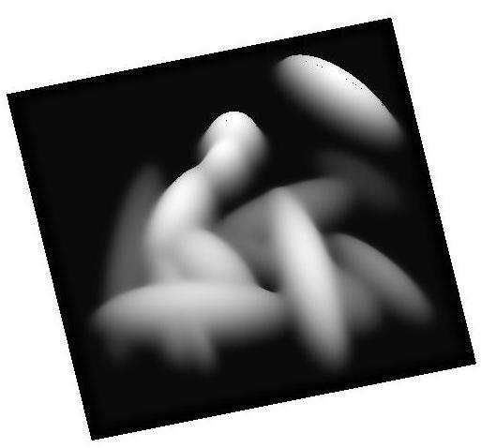
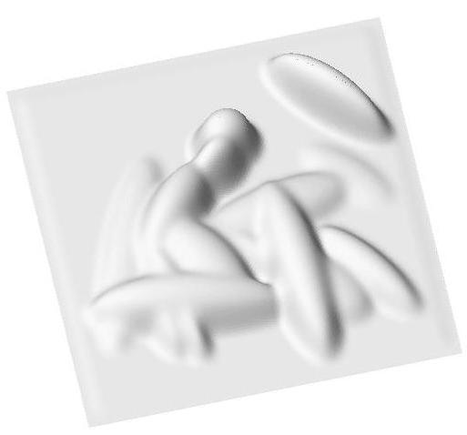
Forming an Image
Illuminate the surface to get:
Surface (Height Map)
Shading Image
The shading image is the interaction of the shape
of the surface and the illumination
Slide: Marshal Tappen

Slide 38
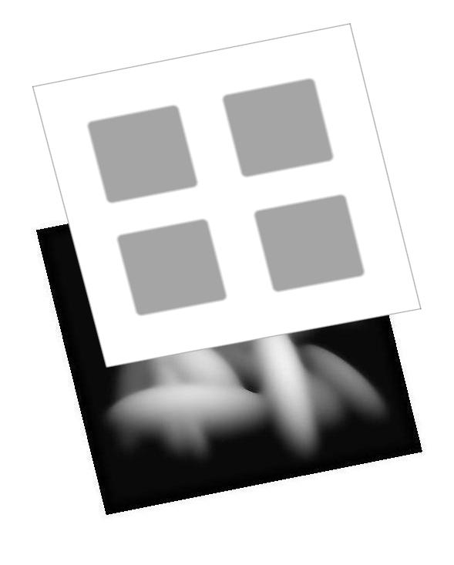
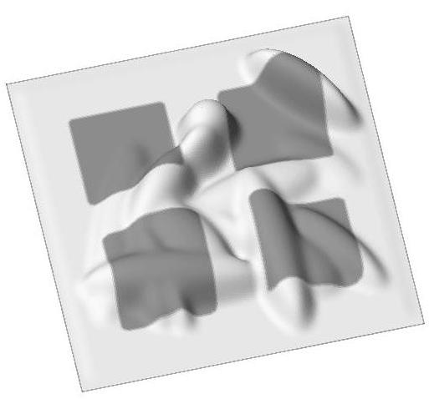
Painting the Surface
Scene
Image
Add a reflectance pattern to the surface. Points inside the squares should reflect less light
Slide: Marshal Tappen

Slide 39

Goal
Image
Shading Image
Reflectance Image
Slide: Marshal Tappen

Slide 40
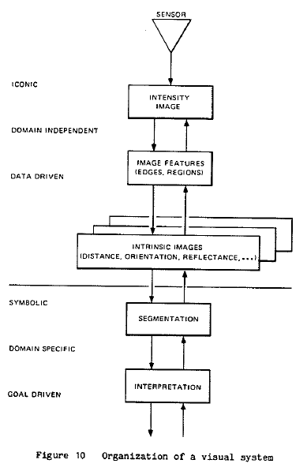
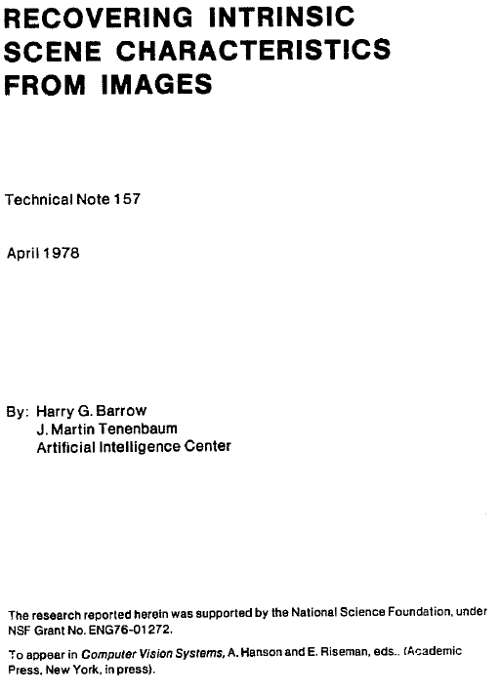

Slide 41
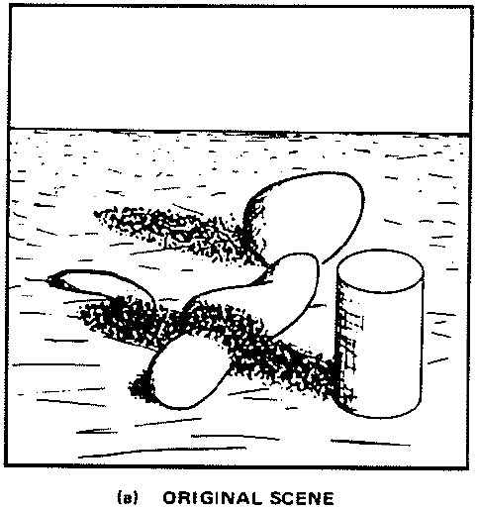
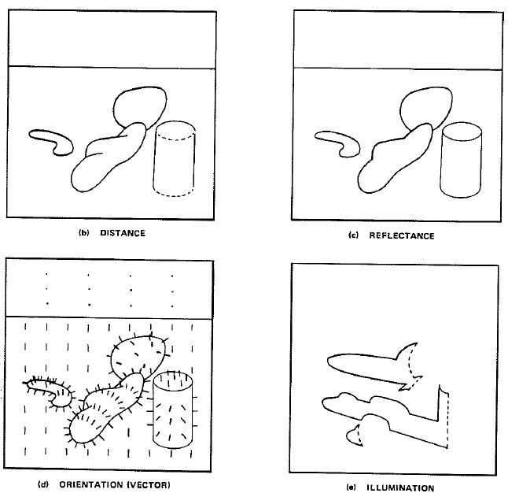
Intrinsic images

Slide 42
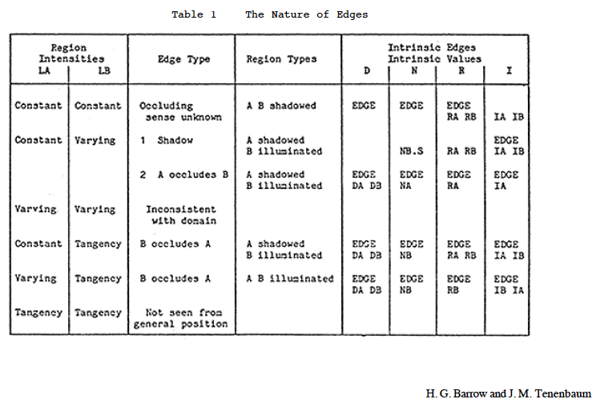


Slide 43
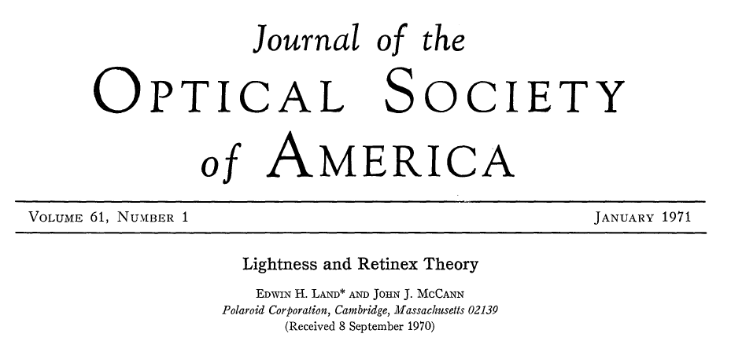
Retinex
E.H. Land, J.J. McCANN - Journal of the Optical society of America, 1971
The reflectance tends to be constant across space except for abrupt changes at the transitions between objects or pigments. Thus a reflectance change shows itself as step edge in an image, while illuminance changes gradually over space. By this argument one can separate reflectance change from illuminance change by taking spatial derivatives: High derivatives are due to reflectance and low ones are due to illuminance.

Slide 44
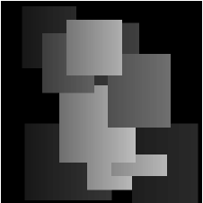
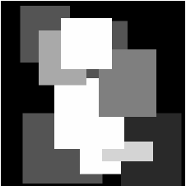

Retinex
=
x
Again, we are trying to solve an ill-posed problem:
24 = ? x ?
From M. Tappen, PhD

Slide 45
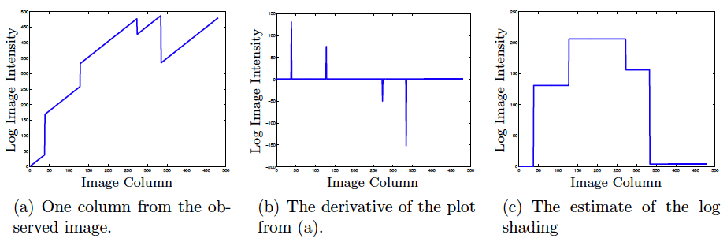
Retinex
log
[1 -1] =
Assumption:
Large derivatives correspond to changes in reflectance
Small derivatives correspond to changes in illumination
[1 -1]
log
?
[1 -1]^{T}

Slide 46
Retinex
From M. Tappen, PhD
[1 -1]
log
[1 -1]^{T}
From M. Tappen, PhD

Slide 47
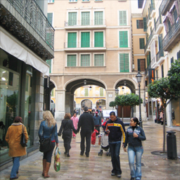
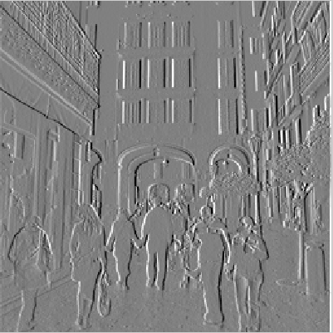
[-1 1]
[-1, 1]
=
h[m,n]
f[m,n]
g[m,n]

Slide 48
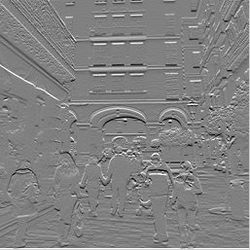
[-1 1]^{T}
[-1, 1]^{T}
=
h[m,n]
f[m,n]
g[m,n]

Slide 49
Back to the image
?

Slide 50
Reconstruction from derivatives
F = H G
c
1 | -1
 | 1 | -1
 |  | 1 | -1
 |  |  | 1 | -1
 |  |  |  | 1 | -1
 |  |  |  |  | 1 | -1
 |  |  |  |  |  | 1 | -1
 |  |  |  |  |  |  | 1
c
=
If we have multiple filter outputs:
c
c
=
[-1 1]
c
[-1 1]^{T}
If the transformation H is not invertible, we can compute the pseudo-inverse:
^
G = (H^{T}H)⁻¹ H^{T} F

Slide 51
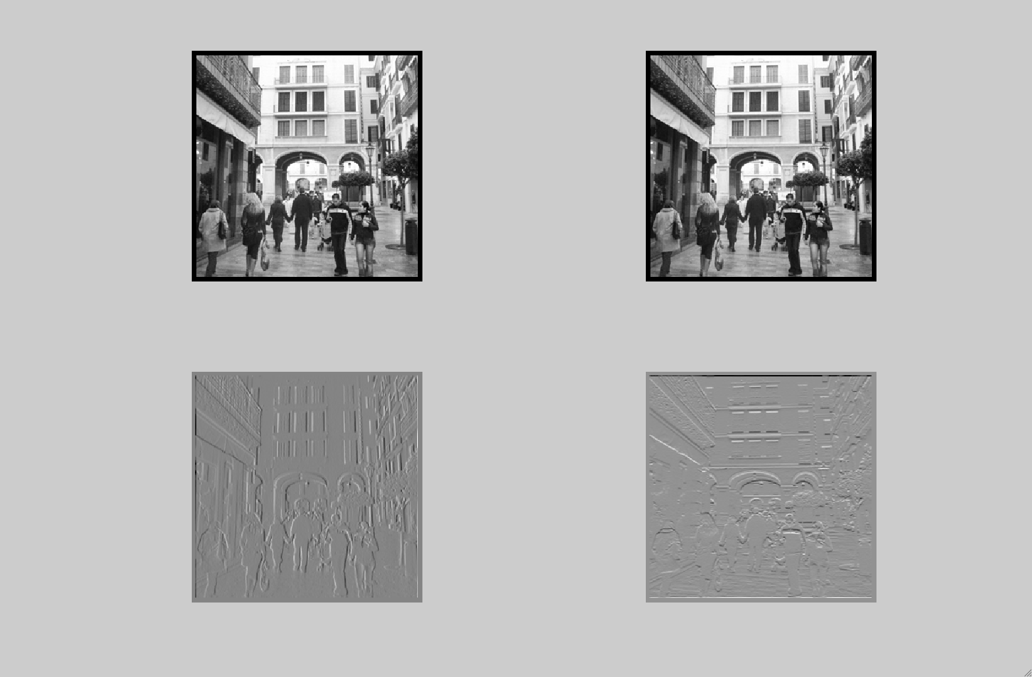
Reconstruction
[1 -1]
[1 -1]^{T}

Slide 52
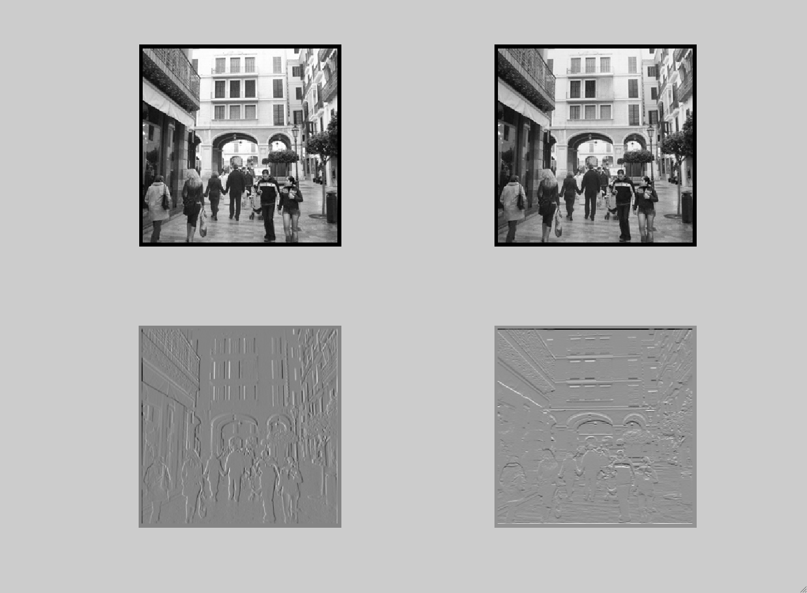
Editing the edge image
[1 -1]
[1 -1]^{T}

Slide 53
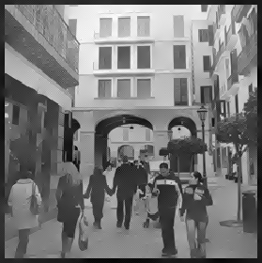


Thresholding edges

Slide 54
Retinex
log
[1 -1] =
Assumption:
Large derivatives correspond to changes in reflectance
Small derivatives correspond to changes in illumination
[1 -1]
log
?
[1 -1]^{T}

Slide 55
Same gray level

Slide 56






>
[1 -1]
<
>
[1 -1]^{T}
<

Slide 57


c
[-1 1]
c
=
c
[-1 1]^{T}
c
[-1 1]
c
=
c
[-1 1]^{T}

Slide 58


Slide 59


Slide 60
Craik-O'Brien-Cornsweet effect

Slide 61


Slide 62
Knill and Kersten's illusion

Slide 63
This illusion highlights
the importance of
scene interpretation.
The effect is gone
Knill and Kersten's illusion
and it comes back when
the gradient is not explained
by the shape.

Slide 64

Rendering synthetic objects into legacy photographs
Karsch, K.; Hedau, V.; Forsyth, D.; Hoiem, D.
ACM Transactions on Graphics (Proceedings of SIGGRAPH Asia), 30(6), 2011

Slide 65
Rendering synthetic objects into legacy photographs
Karsch, K.; Hedau, V.; Forsyth, D.; Hoiem, D.
ACM Transactions on Graphics (Proceedings of SIGGRAPH Asia), 30(6), 2011

Slide 66
Prototypical vision problem
Observe some product of two numbers, say 1.0
What were those two numbers?
Ie, 1 = ab. Find a and b.

Slide 68
Bayesian approach
Want to calculate: max P(a, b | y = 1)
a,b
Bayes rule
Use P(a, b | y = 1) = k P(y=1|a, b) P(a, b)
Posterior probability
Likelihood function
Prior probability

Slide 69



Bayesian approach
Use P(a, b | y = 1) = k P(y=1|a, b) P(a, b)
Likelihood function
P(a, b | y = 1)
a=b=1
b
a
Prior probability
b
If a>0, b>0
a
0 otherwise
b
a

Slide 70


Statistical modeling of images

Slide 71
Visual Worlds

Slide 72

Visual Worlds

Slide 73

Visual Worlds

Slide 74

Visual Worlds

Slide 75

Visual Worlds

Slide 76

Visual Worlds

Slide 77

Visual Worlds

Slide 78

Visual Worlds

Slide 79

Visual Worlds

Slide 80


Slide 81

Statistical modeling of images
The pixel

Slide 82
Statistical modeling of images
Assumptions:
Independence: All pixels are independent.
Stationarity: The distribution of pixel intensities does not depend on image location.

Slide 83


Fitting the model
Counts
Pixel intensity

Slide 84

Sampling new images
Sample

Slide 85



Sampling new images
Sample

Slide 86




The importance of distribution of intensities

Slide 87
Statistical modeling of images
The pixel

Slide 88
Statistical modeling of images
The pixel
Another pixel

Slide 89






Δ = 1
Δ = 2
C
Δ = 10
Δ = 40
horizontal
vertical
Δ

Slide 90


Dead leaves models
Introduced in the 60’s by Matheron (67) and popularized by Ruderman (97)
From Lee, Mumford and Huang 2001

Slide 91



A remarkable property of natural images
Power spectra
fall off as
Spectra
Low spatial frequencies
1/vª
High
spatial
frequencies
Vertical
v_{y}
Horizontal
v_{x}
High SF
Low SF
D. J. Field, "Relations between the statistics of natural images and
the response properties of cortical cells," J. Opt. Soc. Am. A 4, 2379- (1987)

Slide 92



A remarkable property of natural images
v_{y}
Spectra
v_{y}
v_{x}
v_{x}
Field (87)
Natural scenes
(6000 images)
1/fª
v_{y}
v_{x}
v_{y}
v_{y}
v_{x}
v_{x}
Man-made scenes
(6000 images)
  Torralba and Oliva, Statistics of Natural Image Categories. Network: Computation in Neural Systems 14 (2003) 391-412.
Notes:
Each scene category is made with different building blocks. Different scene categories show different spectral signatures.

Slide 93

Contrast Sensitivity Function
Blackmore & Campbell (1969)
Maximum sensitivity
~ 6 cycles / degree of visual angle
Invisible
visible
Contrast sensitivity
0.1
1
10
100
Low
Spatial frequency (cycles/degree)
High

Slide 94

Laplacian
An illusion by Vasarely, left, and a bandpass filtered version, right.
http://web.mit.edu/persci/people/adelson/publications/gazzan.dir/vasarely.html

Slide 95


Gaussian model
We want a distribution that captures the correlation structure typical of natural images.
Let C be the covariance matrix of the image:
Stationarity assumption: Symmetrical circulant matrix
Diagonalization of circulant matrices: C = EDE^{T}
The eigenvectors are the Fourier basis
The eigenvalues are the squared magnitude of the Fourier coefficients
 |  |  | …
D=
2
2

Slide 96



Sampling new images
Sample

Slide 97


Sampling new images
Note: The average of many hair images will not give a distribution for hair images.
I believe we will get clouds again…
This representation does not encode other correlations like:
“all hairs should follow a similar orientation”

Slide 98






Randomizing the phase

Slide 99









Denoising
Decomposition of a noisy image
=
+

Slide 100




Denoising
Decomposition of a noisy image
=
+
White Gaussian noise:
N(0, σ_{n}²)
Natural image
Find I(x,y) that maximizes the posterior (maximum a posteriory, MAP):
x
likelihood
prior

Slide 101


Denoising
Decomposition of a noisy image
=
+
White Gaussian noise:
N(0, σ_{n}²)
Natural image
Find I(x,y) that maximizes the posterior (maximum a posteriory, MAP):
x
likelihood
prior
x

Slide 102



Denoising
x
likelihood
prior
x
The solution is:
(note this is a linear operation)
This can also be written in the Fourier domain, with C = EDE^{T}:

Slide 103


Decomposition of a noisy image
=
+

Slide 104


Slide 105

x
=

Slide 106


=
+
=
+

Slide 107
Statistical modeling of images
A small neighborhood

Slide 108
Edges

Slide 109
[-1 1]

Slide 110
[-1 1]
[-1, 1]
=
h[m,n]
f[m,n]
g[m,n]

Slide 111
[-1 1]^{T}
[-1, 1]^{T}
=
h[m,n]
f[m,n]
g[m,n]

Slide 112



Observation: Sparse filter response

