Slide 1

Lecture 9
Statistical Image Models III

Slide 2
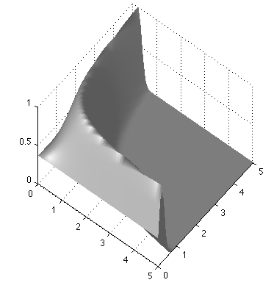
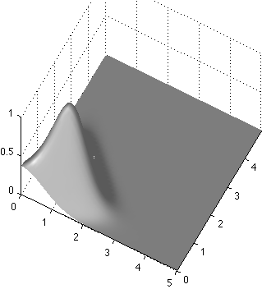
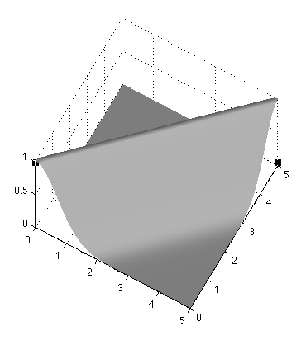
Bayesian approach
Use P(a, b | y = 1) = k P(y=1|a, b) P(a, b)
Likelihood function
P(a, b | y = 1)
a=b=1
b
a
Prior probability
b
If a>0, b>0
a
= 0 otherwise
b
a

Slide 3
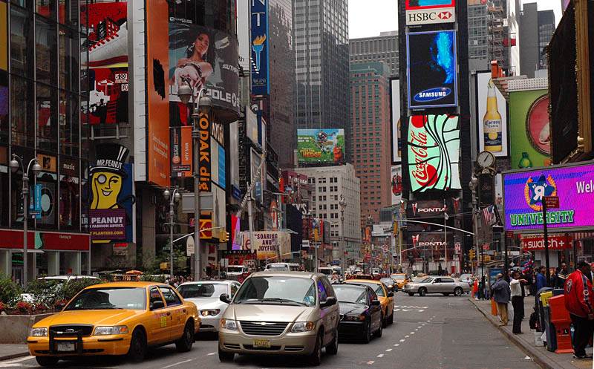
Statistical modeling of images
The pixel
Another pixel

Slide 4
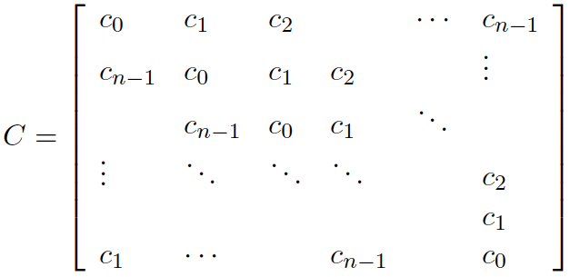
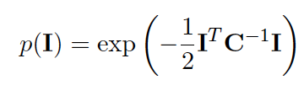
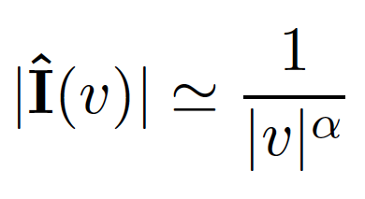
Gaussian model
We want a distribution that captures the correlation structure typical of natural images.
Let C be the covariance matrix of the image:
Stationarity assumption: Symmetrical circulant matrix
Diagonalization of circulant matrices: C = EDE^{T}
The eigenvectors are the Fourier basis
The eigenvalues are the squared magnitude of the Fourier coefficients
 |  |  | …
D=
2
2

Slide 5



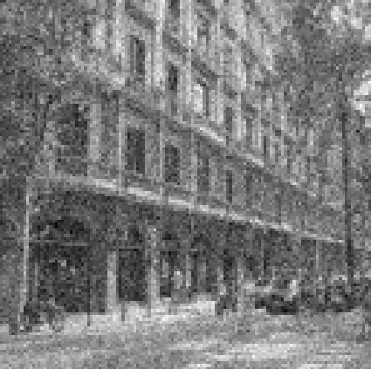
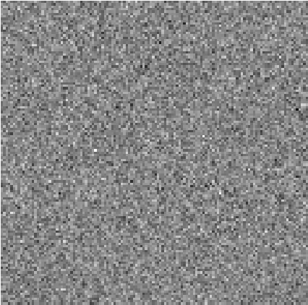
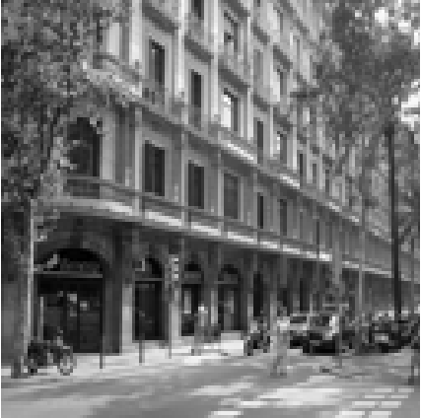
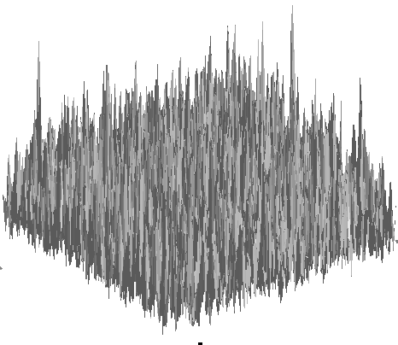
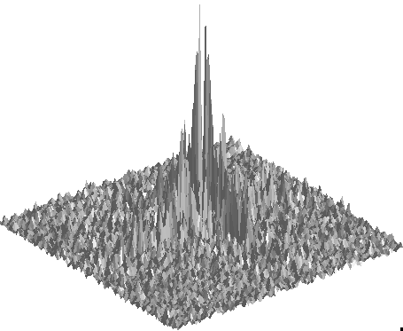
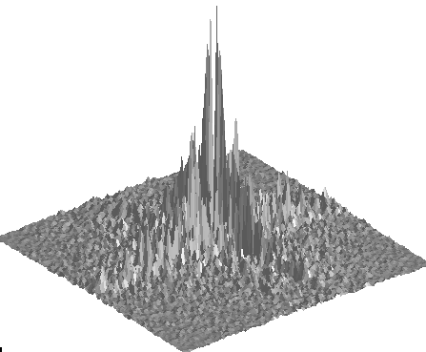
Denoising
Decomposition of a noisy image
=
+

Slide 6
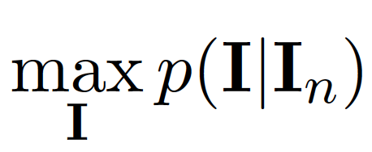
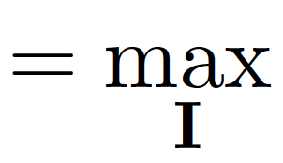
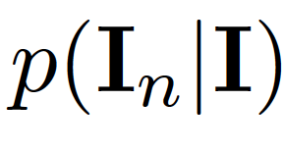
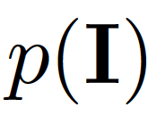
Denoising
Decomposition of a noisy image
=
+
White Gaussian noise:
N(0, σ_{n}²)
Natural image
Find I(x,y) that maximizes the posterior (maximum a posteriory, MAP):
x
likelihood
prior

Slide 7
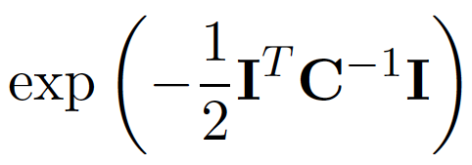

Denoising
Decomposition of a noisy image
=
+
White Gaussian noise:
N(0, σ_{n}²)
Natural image
Find I(x,y) that maximizes the posterior (maximum a posteriory, MAP):
x
likelihood
prior
x

Slide 8

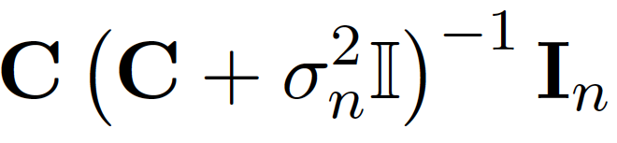
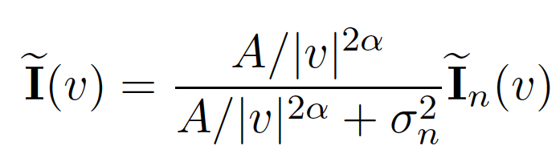
Denoising
x
likelihood
prior
x
The solution is:
(note this is a linear operation)
This can also be written in the Fourier domain, with C = EDE^{T}:

Slide 9
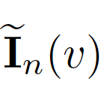
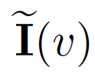
Decomposition of a noisy image
=
+

Slide 10
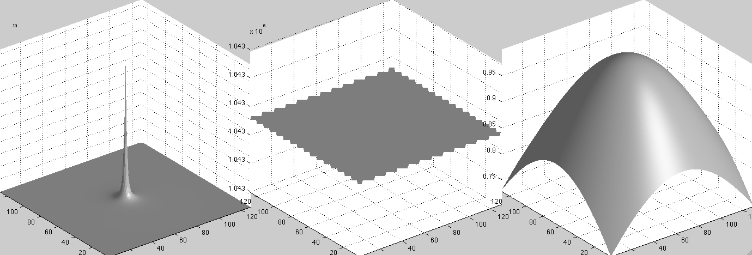

Slide 11
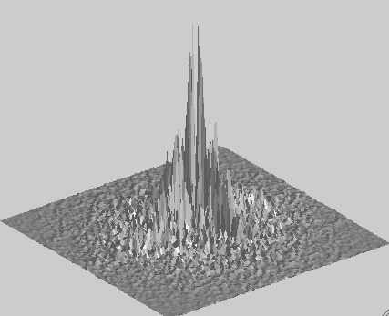
x
=

Slide 14
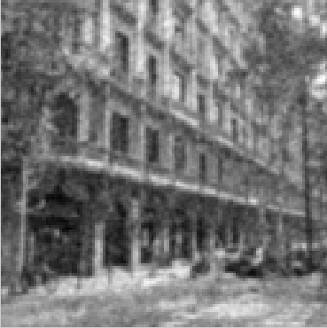
x
=

Slide 15
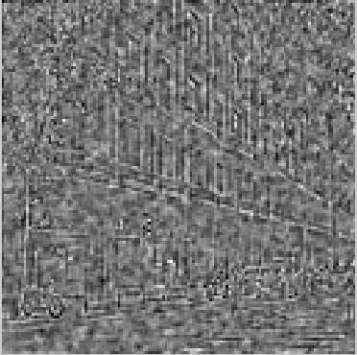
The truth:
=
+
The estimated decomposition:
=
+

Slide 16
And we got all this from just modeling the correlation between pairs of pixels!

Slide 17
Statistical modeling of images
A small neighborhood

Slide 18
[-1 1]

Slide 19
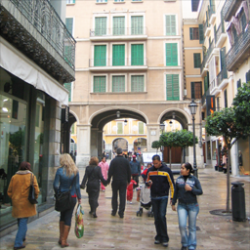
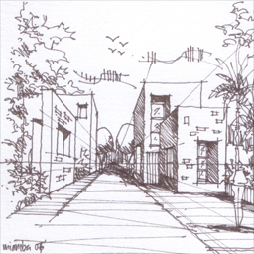
Edges

Slide 20
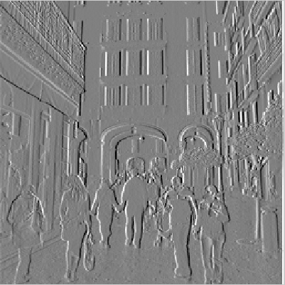
[-1 1]
[-1, 1]
=
h[m,n]
f[m,n]
g[m,n]

Slide 21
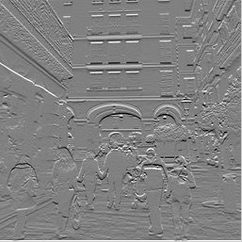
[-1 1]^{T}
[-1, 1]^{T}
=
h[m,n]
f[m,n]
g[m,n]

Slide 22
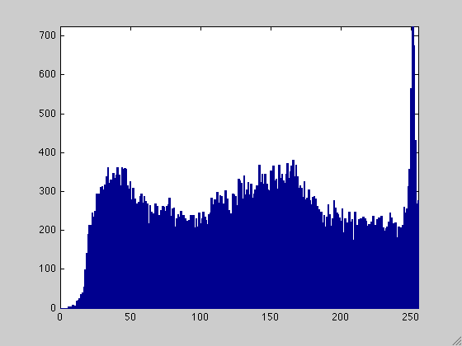
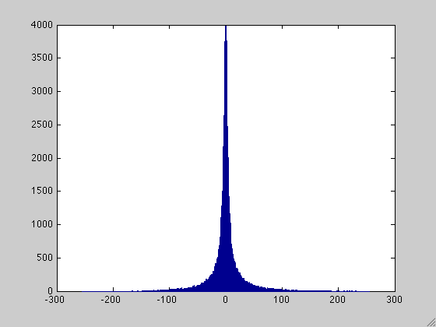
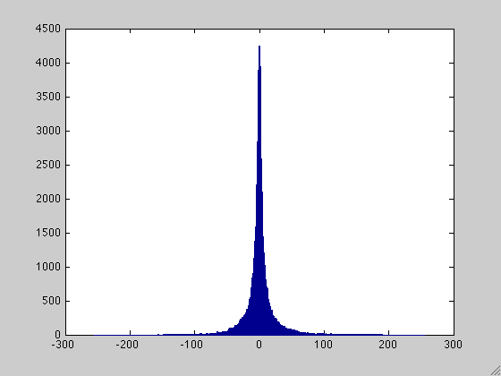
Observation: Sparse filter response
Counts
Counts
Counts
Pixel intensity
Pixel intensity
Pixel intensity

Slide 23
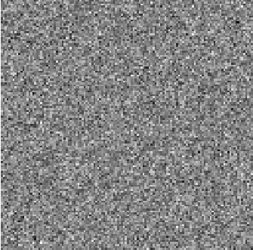
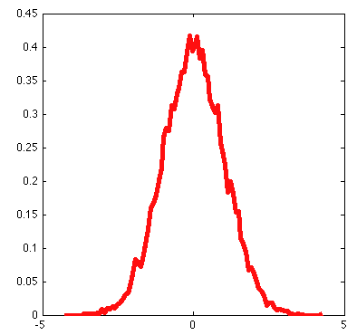

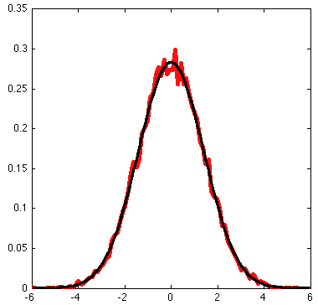
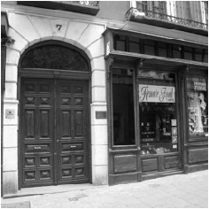
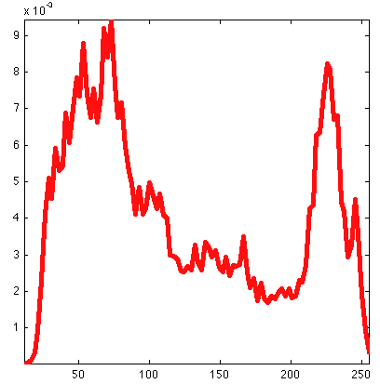
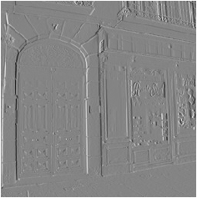
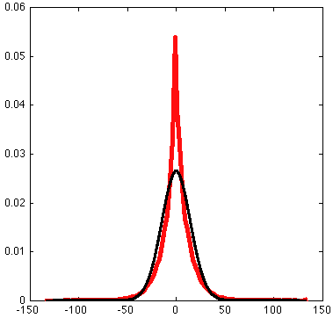
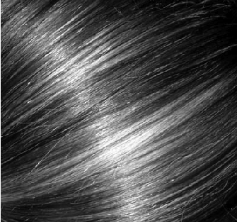
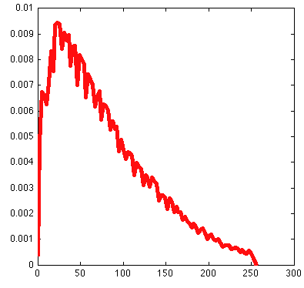
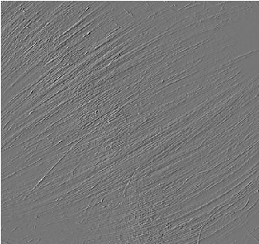
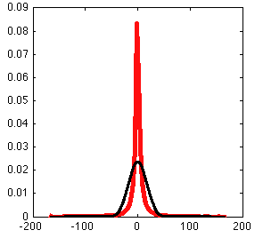
Image
Intensity histogram
[1 -1] filter output
[1 -1] output histogram
Red – true pdf
Black – best Gaussian fit

Slide 24
A model for the distribution of filter outputs
Red – true pdf
Black – best Gaussian fit
exp(-x²/2σ²)
p(x) =
2πσ²
exp(-|x/s|^{r})
p(x) =
2s/rΓ(1/r)
r ~ 0.8 (< 2)
Note: this is not a good model for ALL filter outputs

Slide 25
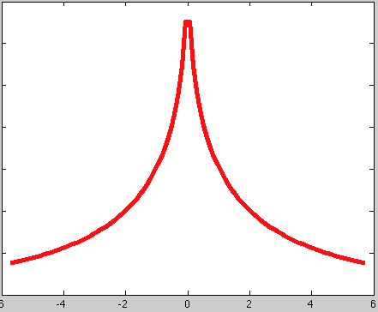
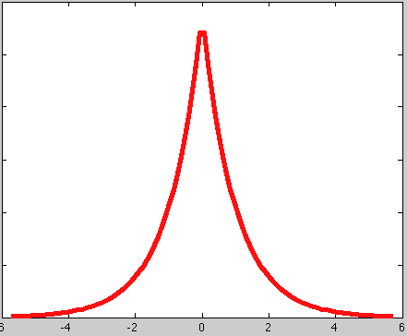
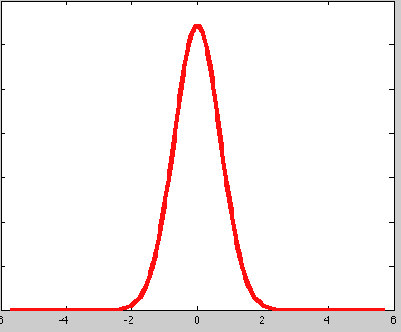
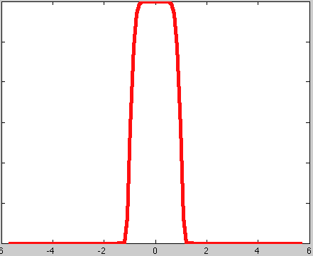
Generalized Gaussian
exp(-|x/s|^{r})
p(x) =
2s/rΓ(1/r)
r = 1
r = 2
r = 0.5
Laplacian distribution
Gaussian distribution
r = 10
Uniform distribution
r -> infinite

Slide 26
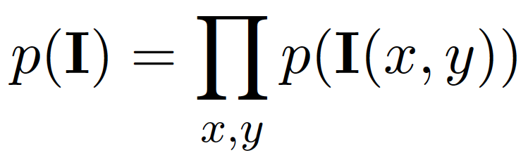
The wavelet marginal model
A small neighborhood
p(h_{k}(x,y))
k
All pixels and all outputs are independent
Filter outputs

Slide 27
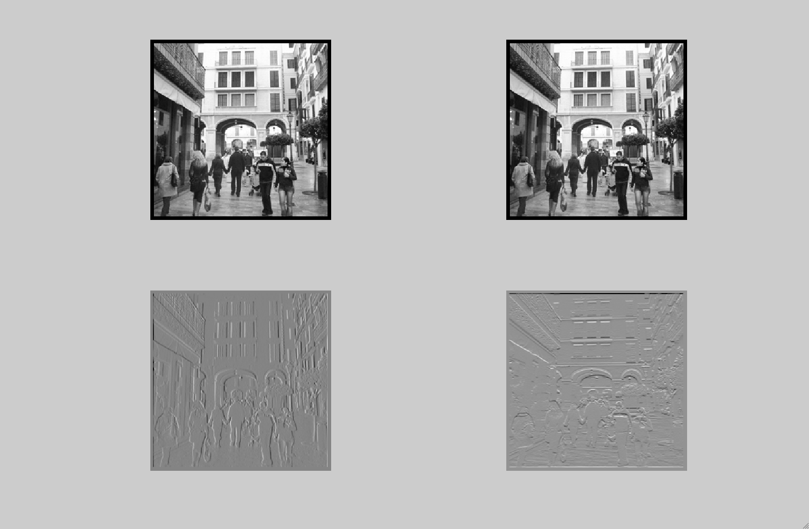
The wavelet marginal model
[1 -1]
[1 -1]^{T}
p(h_{k}(x,y))
k

Slide 28
What is the most typical image under the wavelet marginal model?
[1 -1]
p(h_{k}(x,y))
k
[1 -1]^{T}
exp(-|x/s|^{r})
p(x) =
2s/rΓ(1/r)

Slide 29


Sampling images
Gaussian model
Wavelet marginal model

Slide 30
1D example
a?
I = [1, 1, 1, a, 0, 0, 0]
Let’s start by defining a prior model:
The output to the filter [-1,1] produces independent
values each following the distribution:
exp(-|x/s|^{r})
p(x) =
2s/rΓ(1/r)

Slide 31


1D example
a?
I = [1, 1, 1, a, 0, 0, 0]
1. First, let’s compute the [-1,1] filter output:
h = I [-1,1] = [0, 0, 0, 1-a, a, 0, 0]
*
2. Let’s write the probability of the output as a function of a
p(h(x))=
=
x
exp(-|x/s|^{r})
=
p(x) =
2s/rΓ(1/r)

Slide 32
What is the preferred value of a as we change r?
a?
I = [1, 1, 1, a, 0, 0, 0]
exp(-|x/s|^{r})
p(x) =
2s/rΓ(1/r)
r = 1
r = 2
r = 10
r = 0.5
Laplacian distribution
Gaussian distribution

Slide 33

1D example
For different values of r we get different maximum

Slide 34
r=2
Gaussian model
a=0.5
I = [1, 1, 1, 0.5, 0, 0, 0]
r=0.8
~ Natural image model
a=0 or 1
I = [1, 1, 1, 0, 0, 0, 0]
I = [1, 1, 1, 1, 0, 0, 0]

Slide 35


Steerable Pyramid
Decomposition
Reconstruction
…
…
Images from: http://www.cis.upenn.edu/~eero/steerpyr.html

Slide 36
Steerable Pyramid
Decomposition
Reconstruction
p(h_{k}(x,y))
k

Slide 37

Olshausen BA, and Field DJ. (1996). "Emergence of Simple-Cell Receptive Field Properties by Learning a Sparse Code for Natural Images." Nature, 381: 607-609.

Slide 38

Learned with a convNet
1st layer
Krizhevsky, A., Sutskever, I. and Hinton, G. E.
ImageNet Classification with Deep Convolutional Neural Networks
NIPS 2012: Neural Information Processing Systems
http://papers.nips.cc/paper/4824-imagenet-classification-with-deep-convolutional-neural-networks

Slide 39





Denoising
+
+
*
White
Gaussian
noise
=
=
=
Noisy
image

Slide 40
Denoising with the marginal wavelet model
Let y = noise-corrupted observation: y = x+n, with n ~ gaussian.
Let x = bandpassed image value before adding noise.
By Bayes theorem
P(x)
y = 25
P(x|y) ~ P(y|x) P(x)
y
P(y|x)
P(x|y)

Slide 41
Denoising with the marginal wavelet model
Let x = bandpassed image value before adding noise.
Let y = noise-corrupted observation.
By Bayes theorem
y = 50
P(x|y) ~ P(y|x) P(x)
y
P(y|x)
P(x|y)

Slide 42
Denoising with the marginal wavelet model
Let x = bandpassed image value before adding noise.
Let y = noise-corrupted observation.
By Bayes theorem
y = 115
P(x|y) ~ P(y|x) P(x)
y
P(y|x)
P(x|y)

Slide 43
Denoising with the marginal wavelet model
y = 25
y = 115
P(x)
y
P(x)
P(y|x)
P(y|x)
P(x|y)
y
P(x|y)
For small y: probably it is due to noise and y should be set to 0
For large y: probably it is due to an image edge and it should be kept untouched

Slide 44
MAP estimate, , as function of observed coefficient value, y
Simoncelli and Adelson, Noise Removal via Bayesian Wavelet Coring
http://www-bcs.mit.edu/people/adelson/pub_pdfs/simoncelli_noise.pdf

Slide 45

r = 0.5
r = 1
r = 2
Laplacian distribution
Gaussian distribution

Slide 46

With Gaussian noise of std. dev. 21.4 added, giving PSNR=22.06
(1) Denoised with Gaussian model, PSNR=27.87
original
(2) Denoised with wavelet marginal model, PSNR=29.24
http://www.cns.nyu.edu/pub/eero/simoncelli05a-preprint.pdf

Slide 47

Gaussian scale mixtures
Note correlations between the amplitudes of each wavelet subband.
http://www.cns.nyu.edu/pub/eero/simoncelli05a-preprint.pdf

Slide 48

Statistics of pairs of wavelet coefficients
Contour plots of the joint histogram of various wavelet coefficient pairs
Conditional distributions of the corresponding wavelet pairs
http://www.cns.nyu.edu/pub/eero/simoncelli05a-preprint.pdf

Slide 49

Gaussian scale mixtures
Gaussian scale mixture model simulation
observed
Wavelet coefficient probability
A mixture of Gaussians of scaled covariances
z is a spatially varying hidden variable that can be used to
(a) Create the non-gaussian histograms from a mixture of Gaussian densities, and (b) model correlations between the neighboring wavelet coefficients.

Slide 50
With Gaussian noise of std. dev. 21.4 added, giving PSNR=22.06
(1) Denoised with Gaussian model, PSNR=27.87
original
(3) Denoised with Gaussian scale mixture model, PSNR=30.86
(2) Denoised with wavelet marginal model, PSNR=29.24
http://www.cns.nyu.edu/pub/eero/simoncelli05a-preprint.pdf

Slide 51





Slide 52


Applications
Detecting fake images
Camera shake removal

Slide 53



Visual Worlds
Prof. Hany Farid,
Dartmouth University

Slide 54


Taking a picture…
What the camera give us…
How do we correct this?
Slides R. Fergus
Notes:
Here is a photo blurred by camera shake. Our algorithm takes this image and removes the camera shake, giving a sharp image, like the one on the right.

Slide 55


Close-up
Original
Naïve Sharpening
Our algorithm
Slides R. Fergus
Notes:
Double image in eyes

Slide 56


Image formation process
=
⊗
Blur
kernel
Blurry image
Sharp image
Input to algorithm
Desired output
Convolution
operator
Model is approximation
Notes:
Start with: we use the following model. …….
Approximation since there are lots of effects we don’t model.

Slide 57
Multiple possible solutions
Sharp image
Blur kernel
=
⊗
=
⊗
Blurry image
=
⊗
Notes:
Say middle one does convolve back to blurry. Goal to get true image.

Slide 58


Natural image statistics
Characteristic distribution with heavy tails
Histogram of image gradients
Slides R. Fergus

Slide 59


Blury images have different statistics
Histogram of image gradients
Slides R. Fergus

Slide 60


Parametric distribution
Histogram of image gradients
Use parametric model of sharp image statistics
Slides R. Fergus
Notes:
We use green curve which was fit to the red curve. We use this distribution for all examples in the paper. Remove blur curve

Slide 61
Existing work on image deblurring
Software algorithms:
  Extensive literature in signal processing community
  Mainly Fourier and/or Wavelet based
  Strong assumptions about blur
  → not true for camera shake
Assumed forms of blur kernels
  Image constraints are frequency-domain power-laws
Slides R. Fergus
Notes:
Previous methods have used image statistics in the form of FD power-laws but these a weak constraints that do not preserve local image structure.

Slide 62




Hardware approaches
Existing work on image deblurring
Image stabilizers
Dual cameras
Coded shutter
Ben-Ezra and
Nayar 2004
Raskar et al. SIGGRAPH 2006
Our approach can be combined with these hardware methods
Notes:
There are a variety of hardware approaches, for example, image stabilizers move the light path to correct for camera motion. Ben-ezra and nayar propose adding a second, video camera to estimate the camera motion. Also the next paper in the session proposes to flutter the shutter to remove blur when the camera or object motion within the scene is known.
These methods all require you to modify the camera, while our approach works with any blurry image.

Slide 63

Three sources of information
1. Reconstruction constraint:
⊗
=
Estimated
blur kernel
Estimated sharp image
Input blurry image
2. Image prior:
3. Blur prior:
Positive
&
Sparse
Distribution of gradients
Notes:
Add in + noise
Three things we know.
Reconstruct to the blurry image plus noise.

Slide 64


Slide 65


Slide 66


Slide 67


Slide 68
How do we use this information?
Obvious thing to do:
  Combine 3 terms into an objective function
  Run conjugate gradient descent
  This is Maximum a-Posteriori (MAP)

Slide 69


Results from MAP estimation
Input blurry image
Maximum a-Posteriori (MAP)
Our method: Variational Bayes

Slide 70

Variational Bayesian method
Based on work of Miskin & Mackay 2000
Keeps track of uncertainty in estimates of image and blur by using a distribution instead of a single estimate
Helps avoid local maxima and over-fitting
Notes:
Go slow. 1 pixel → single variable. Way to precisely fit data even though it isn’t too stable.

Slide 71
Overview of algorithm
Input image
Pre-processing
Kernel estimation
  Multi-scale approach
Image reconstruction
  - Standard non-blind deconvolution routine

Slide 72
Preprocessing
Input image
Convert to
grayscale
Remove gamma
correction
User selects patch
from image
Bayesian inference too slow to run on whole image
Infer kernel
from this patch

Slide 73

Initialization
Input image
Convert to
grayscale
Remove gamma
correction
User selects patch
from image
Initialize 3x3
blur kernel
Blurry patch
Initial image estimate
Initial blur kernel

Slide 74

Inferring the kernel: multiscale method
Input image
Convert to
grayscale
Remove gamma
correction
User selects patch
from image
Loop over scales
Upsample
estimates
Variational
Bayes
Initialize 3x3
blur kernel
Use multi-scale approach to avoid local minima:

Slide 75

Image Reconstruction
Input image
Convert to
grayscale
Remove gamma
correction
User selects patch
from image
Loop over scales
Upsample
estimates
Variational
Bayes
Initialize 3x3
blur kernel
Full resolution
blur estimate
Non-blind deconvolution (Richardson-Lucy)
Deblurred
image
Notes:
Use different words to non-blind: “final deconvolution” maybe

Slide 76
Results on real images
Submitted by people from their own photo collections
Type of camera unknown
Output does contain artifacts
  Increased noise
  Ringing
Compares well to existing methods
Notes:
Off the shelf non-blind deconvolution. Needs improvement.

Slide 77

Original photograph

Slide 78


Our output
Blur kernel
Notes:
Kernel look like nice smooth trajectory

Slide 79
Original photograph
Matlab’s deconvblind

Slide 80
Close-up of garland
Original
Matlab’s
deconvblind
Our output
Notes:
Add matlab zoom in

Slide 81

Original photograph
Notes:
UPDATED IMAGE.

Slide 82
Matlab’s deconvblind
Notes:
UPDATED IMAGE.

Slide 83

Photoshop sharpen more
Notes:
UPDATED IMAGE.

Slide 84


Our output
Notes:
UPDATED IMAGE. Less ringing on Guiseppe (and elsewhere) than in old version. Brightness increased to increase clarity. Partially responsible for increased noise levels.

Slide 85



Notes:
UPDATED IMAGE.

Slide 86

Original photograph
Notes:
UPDATED IMAGE.

Slide 87


Our output
Notes:
UPDATED IMAGE. Nice image. Letter become razor sharp. Possible paralax with pole in foreground?

Slide 88
Original photograph

Slide 89

Our output

Slide 90
Matlab’s deconvblind

Slide 91

Original photograph

Slide 92


Our output
Blur kernel

Slide 93


Close-up of bird
Original
Unsharp mask
Our output

Slide 94

Original photograph

Slide 95


Blur kernel
output

Slide 96


Image artifacts & estimated kernels
Blur kernels
Image patterns
Note: blur kernels were inferred from large image patches,
NOT the image patterns shown
Notes:
Comment about not runnnig on yther patches themselves.
Shape important, not profile. Can’t always find these patterns in all images….

Slide 97

Bayesian methods

