Slide 1
Mini Places Challenge
Adrià Recasens, Nov 21

Slide 2
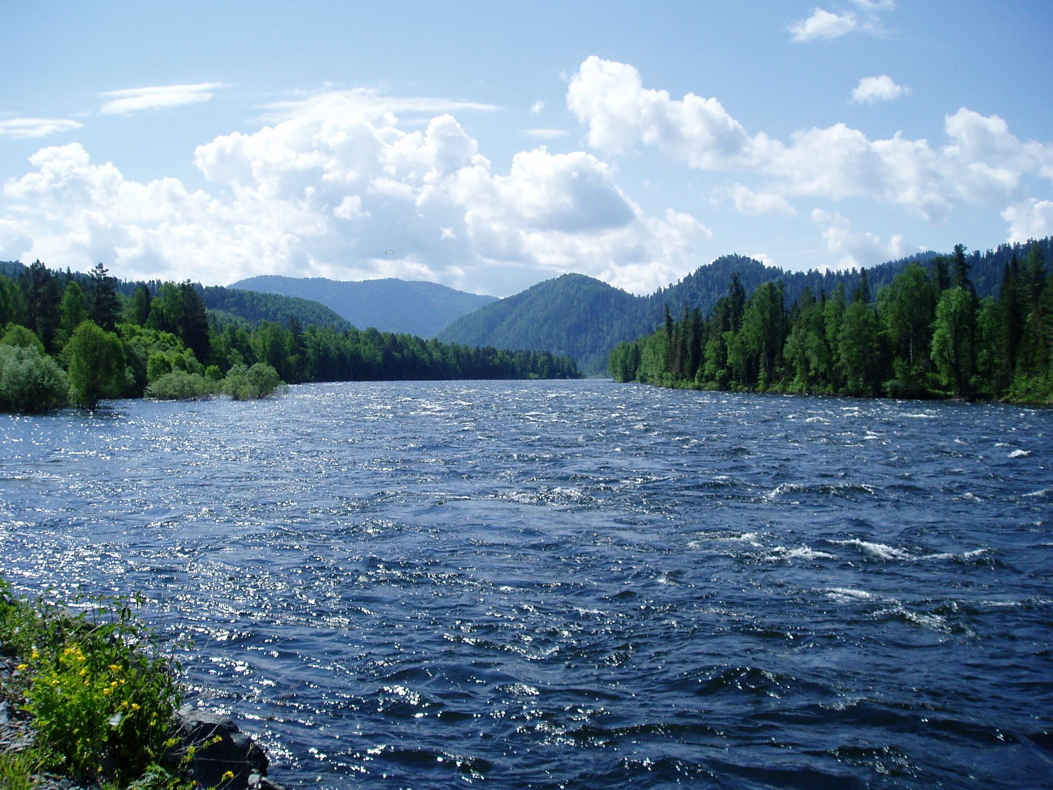
Scene classification
River

Slide 3
Scene classification
Office

Slide 4
Project: Mini Places Challenge
Goal: Build the best classiﬁer you can for scenes

Slide 5
The evolution of vision databases
COILV20
2 year old kid
Caltech 101
ObjectDcentered datasets
MNIST (1998)
(2009)
10³
CaltechV4 (2003)
10⁴
PASCAL (2005)
10⁵
10⁶
10⁷
10⁸
10⁹ # images
SceneDcentered datasets
15 scenes database (2006)
SUN database (2010)
8 scenes database (2001)
10³
10⁴
10⁵
10⁶
10⁷
10⁸
10⁹ # images

Slide 6
Computation with millions of pictures of places, scenes, environments –
Where you and objects are
Start with 60 million images

Slide 12
Amazon Mechanical Turk:
Single Image Classiﬁcation

Slide 13
Amazon Mechanical Turk:
Single Image Classiﬁcation

Slide 15
Nov 2015: Top 5 error: 25%

Slide 16
Convolution
Max pooling
Normalization
Fully connected
Convolutional Neural Network

Slide 18
More semantically meaningful

Slide 19
Challenge data
Training data: 100K, 1000 images per category.
Validation data: 10K, 100 images per category.
Test data: 10K, 100 images per category.

Slide 20
Provided code
data: categories, train/val, object categories.
evaluation: evaluation code.
util: formatting functions.

Slide 21
Challenge details
Size: 128x128. Jpeg format.
Object annotations for a subset of the images. 3503 train images and 371 validation images
Evaluation server opens Monday Nov 21. Open until Dec 7.
Errors with 5 guesses will be used to rank the results and determine the winner

Slide 22
Possible improvements
Train diﬀerent types of classiﬁers: objects and scenes to improve scene classiﬁcation
Ensemble methods: combine outputs from various networks trained with diﬀerent random seeds and/or also networks with diﬀerent architectures)
Try averaging the predictions from multiple crops

Slide 23
Possible improvements
Different architectures: numbers of units per layer, types of activation functions, supervision to intermediate layers.
Different learning parameters: learning rate, weight decay, momentum and so on.

Slide 24
Infrastructure: Amazon EC2
AWS Education project: approx. 6 days of free GPU use per member of the group (mit account).
Close the instance when you are done (time costs money!)
Instance type: g2.2xlarge
GitHub Education Pack: extra $50

Slide 25
Data loading
Torch Data Loading packages
Torch-starter: https://github.com/cvondrick/torch-starter
Torch-proj: https://github.com/nhynes/torch-proj

