Slide 1
6.869.csail.mit.edu/fa17
piazza.com/mit/fall2017/68196869
6.819 / 6.869: Advances in Computer Vision
Instructors Antonio Torralba & Bill Freeman
Lecture TR 9:30am - 11am (Room 34-101)

Slide 2
Assignments
Problem sets (60%)
Final project (40%)
No exams or quizzes

Slide 3
Problem sets (60%)
Weekly psets.
Out on Thursday each week
Due on one week after
Graded one week after due date.
The submission deadline will be 23:59 on Thursday. Late submissions are discounted 2% per minute late.
We will drop your two lowest scores. Use those two dropped problem sets wisely!
Collaboration policy
Psets are due individually
Done individually but you can talk to people
Some psets will be done in groups
Writing always individually
No hard copies. Submissions will be made electronically via Stellar.
Some problem sets will have extra problems only for those taking the graduate version of the course.

Slide 4
Projects (40%)
We will provide a list of ~10 projects to pick from. List will be made public around Oct 15.
Individually or pairs (recommended)
Due on Dec 9
Presentation on Dec 12 (2-5 minutes each)
Everybody presents.

Slide 5
Materials
http://6.869.csail.mit.edu/fa17/materials.html
Office hours (place and times to be announced on web site)
Piazza: to ask questions to other students, send your questions using Piazza (avoid emails). Everybody welcome to participate.
Stellar: turn in Psets electronically. We will release class notes on Stellar.
Readings: from Szeliski book and
Class notes
Class Web site

Slide 6
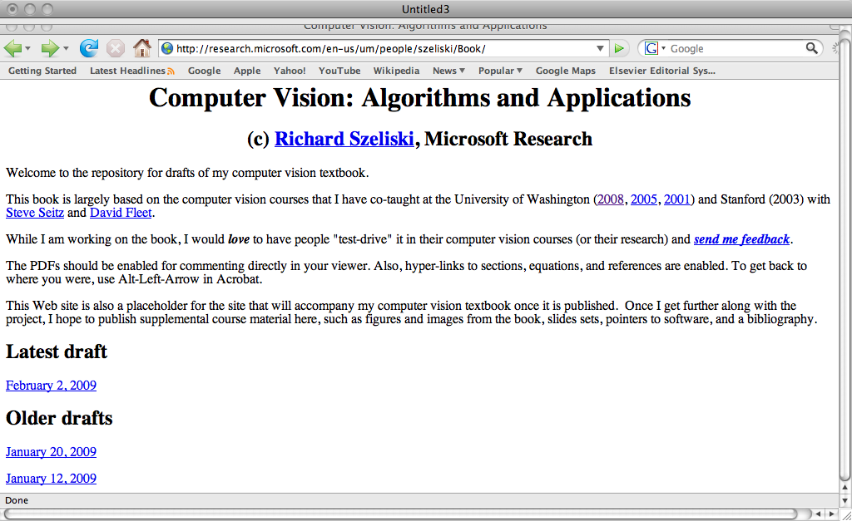
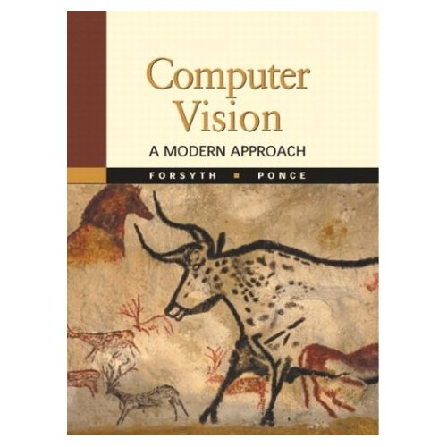
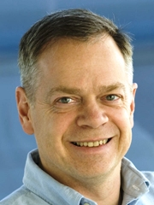
Readings
http://6.869.csail.mit.edu/fa17/materials.html
Available online
Not required

Slide 7
Readings
http://6.869.csail.mit.edu/fa17/materials.html
Class notes

Slide 8
Matlab Tutorial Sep. 13 & Sep. 14
Intended for people with no Matlab exposure.

