Slide 1

Antonio Torralba & William T. Freeman
Lecture 15
Edges and segmentation

Slide 2
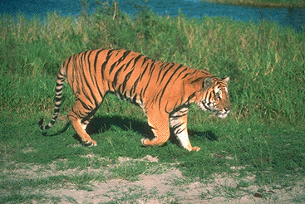
From Pixels to Perception:
Mid-level operations of Segmentation and Grouping
Water
outdoor
wildlife
Grass
Tiger
Sand
back
Tiger
head
eye
tail
legs
mouth
shadow

Slide 3
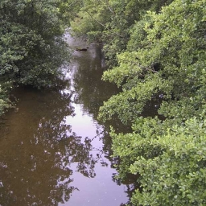


Figure / Ground
Finding groups of pixels that go together
(parts, objects, textures, holes)

Slide 4
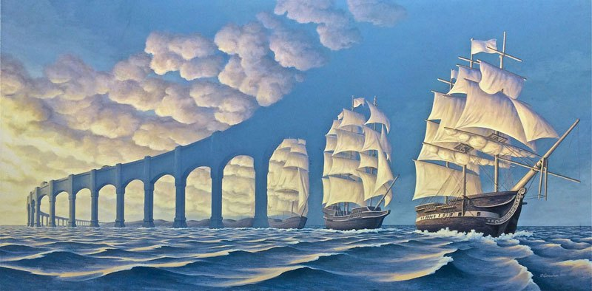
Figure / Ground
http://twistedsifter.com/2015/03/mind-bending-optical-illusion-paintings-by-rob-gonsalves/

Slide 5
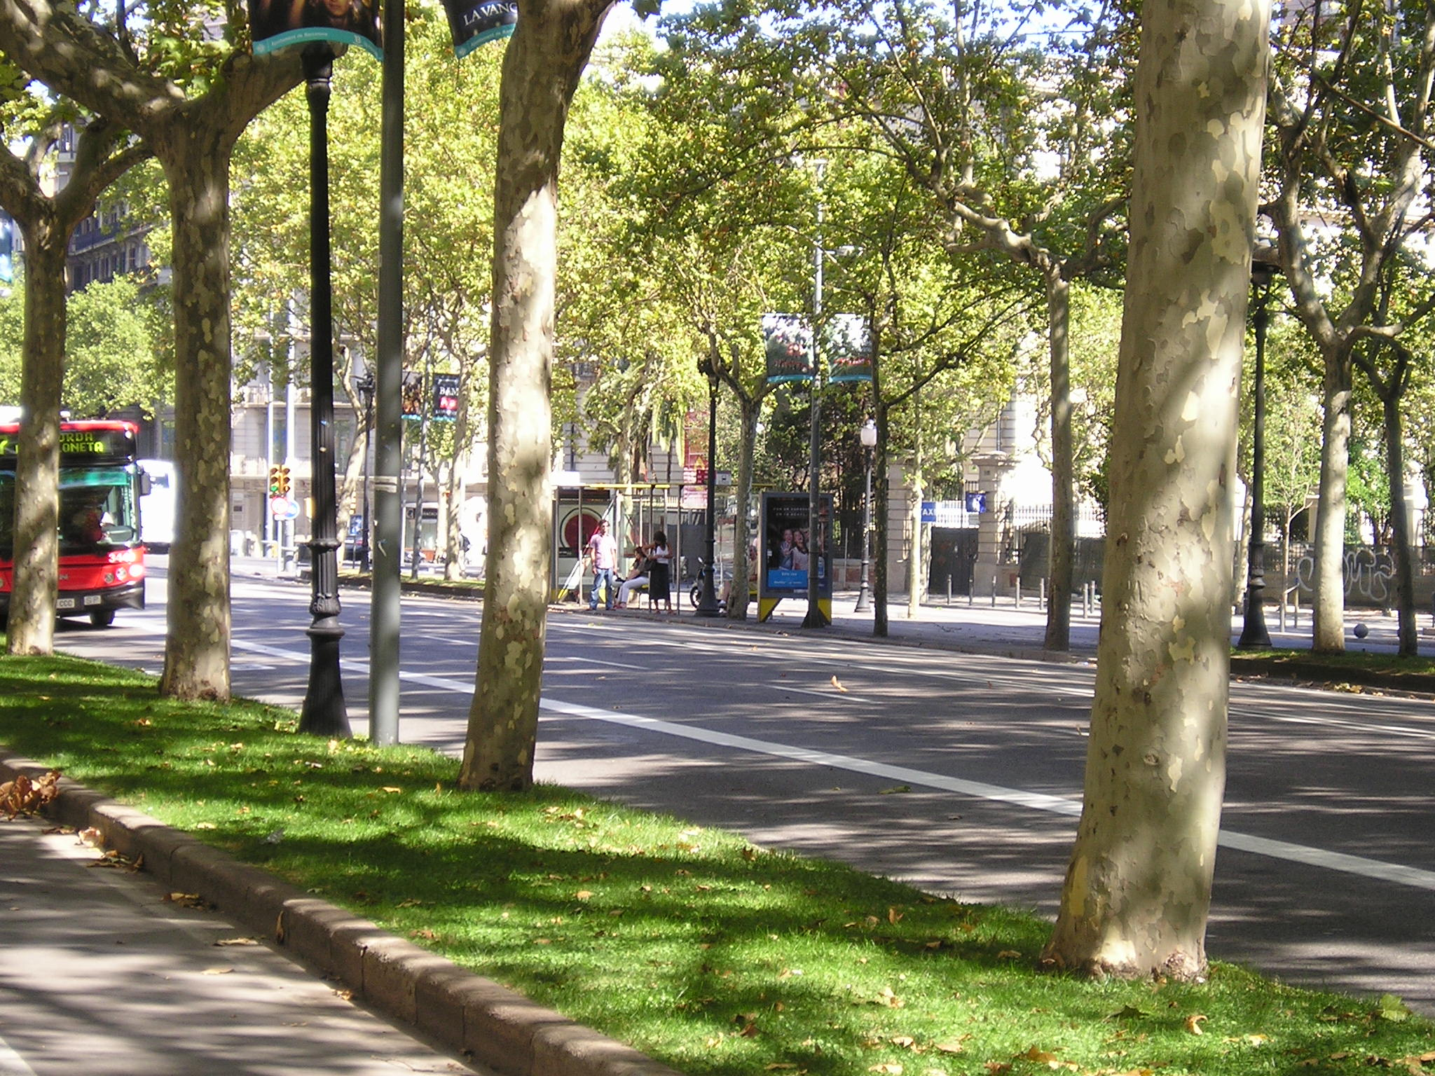
A “simple” segmentation problem

Slide 6
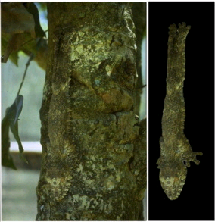
It can get a lot harder
Brady, M. J., & Kersten, D. (2003). Bootstrapped learning of novel objects. J Vis, 3(6), 413-422

Slide 7
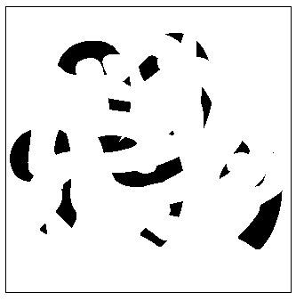
Segmentation is a global process
What are the occluded numbers?
Notes:
Occlusion cues seem to be very important in grouping. Most people find it hard to read the 5 numerals in
this picture

Slide 8
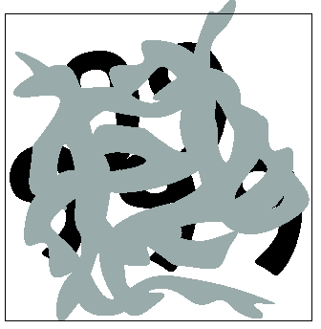
Segmentation is a global process
What are the occluded numbers?
Occlusion is an important cue in grouping.
Notes:
but easy in this

Slide 9
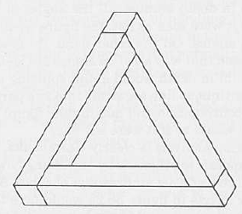
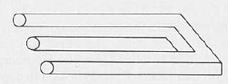
… but not too global

Slide 10
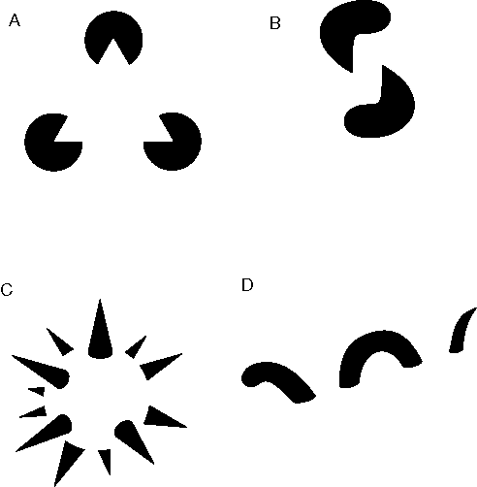
Groupings by Invisible Completions
* Images from Steve Lehar’s Gestalt papers

Slide 11
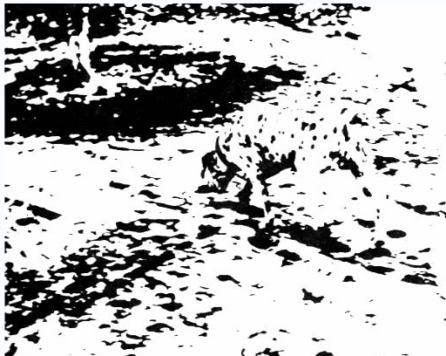
Emergence
http://en.wikipedia.org/wiki/Gestalt_psychology

Slide 12
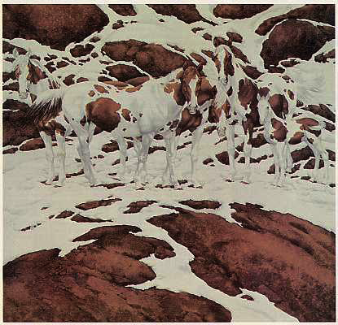
Perceptual organization
“…the processes by which the bits and pieces of visual information that are available in the retinal image are structured into the larger units of perceived objects and their interrelations”
Stephen E. Palmer, Vision Science, 1999

Slide 13
Gestalt principles
There are hundreds of different grouping laws

Slide 14
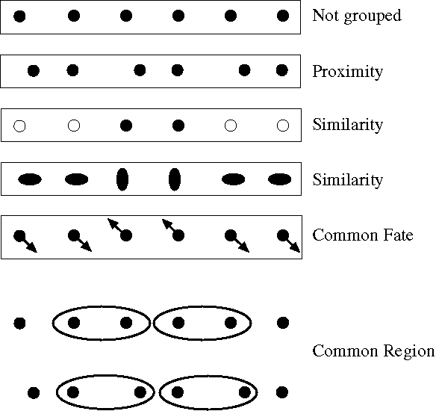
Notes:
Some criteria that tend to cause tokens to be grouped.

Slide 15
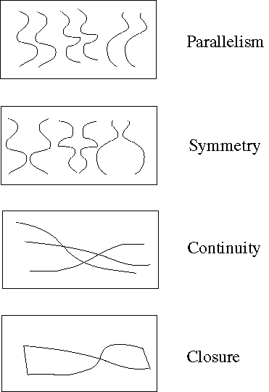
Familiar configuration
Notes:
More such

Slide 16
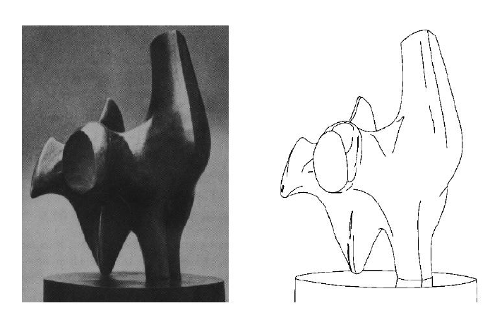
I. Edges

Slide 17
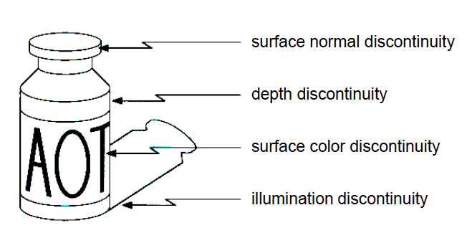
What is an edge?
Paint
Depth
discontinuity
Material change
Texture boundary

Slide 18
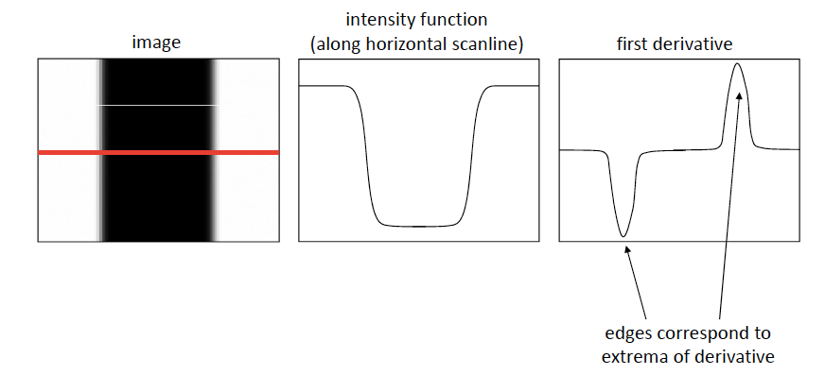
Finding edges: Computing derivatives

Slide 19
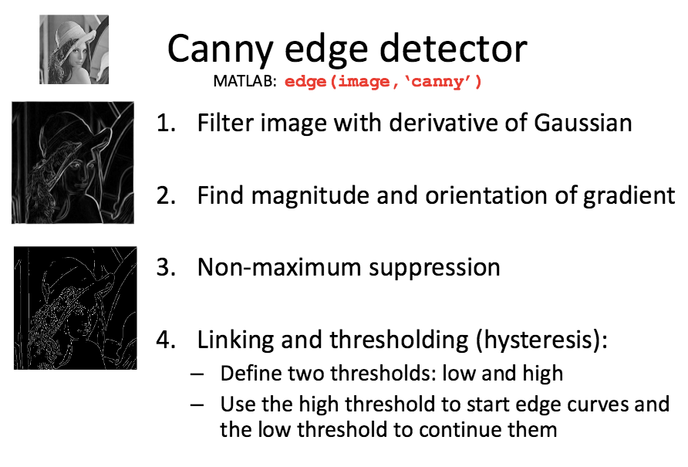

Canny edge detector
edge(image,’canny’)

Slide 20
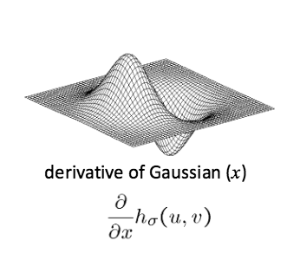
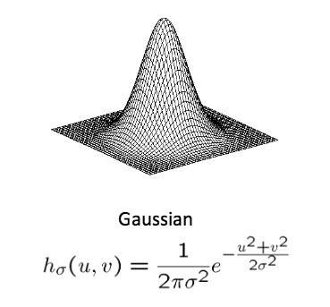
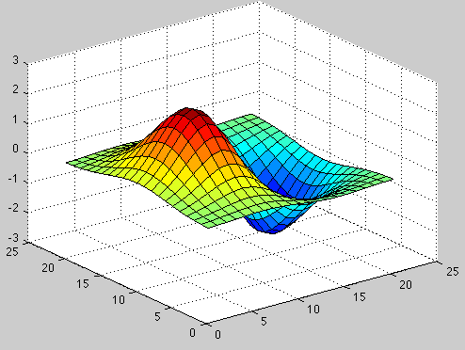
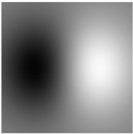
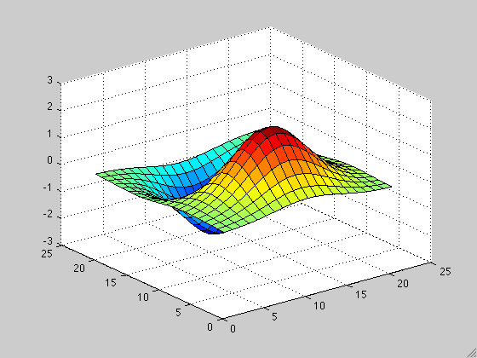

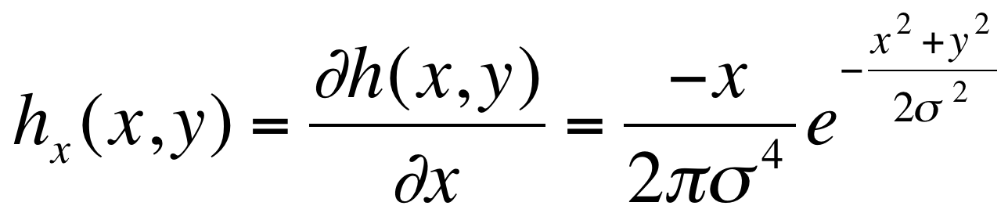
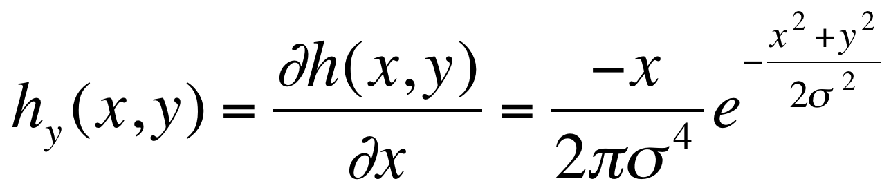
1: Filter Image with derivatives of Gaussian
2D edge detection filters
Scale

Slide 21
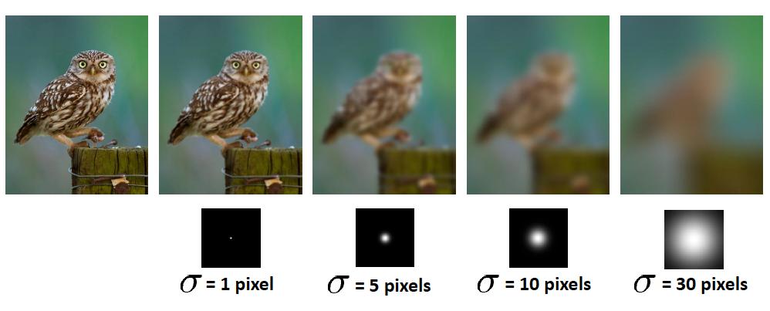
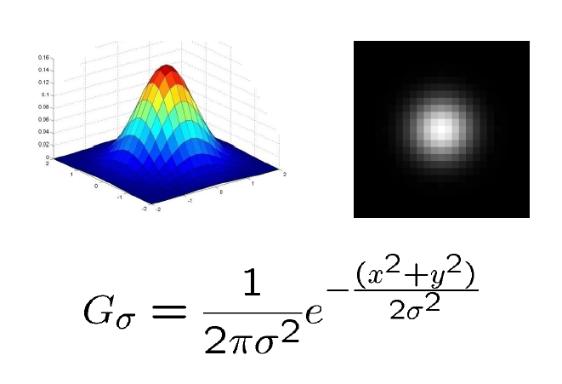
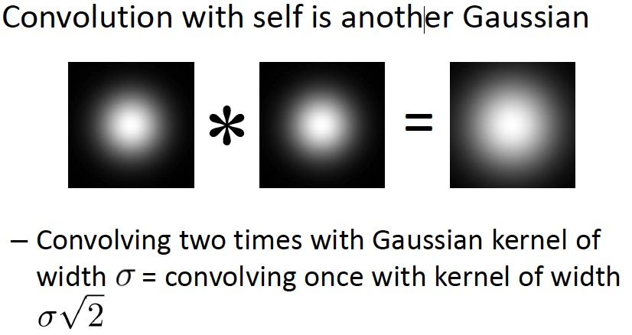
Gaussian filters

Slide 22
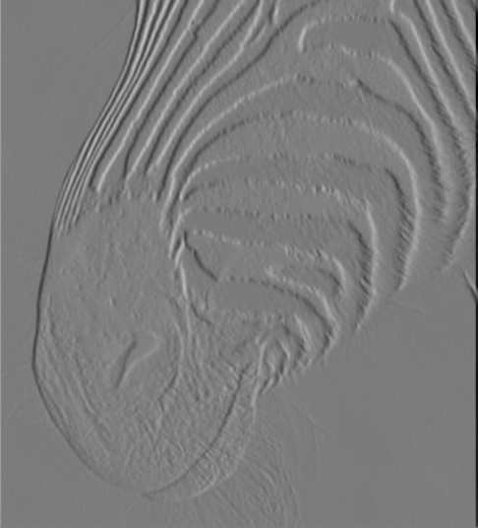
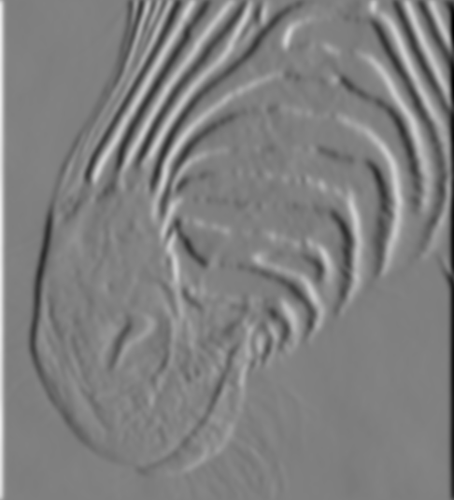
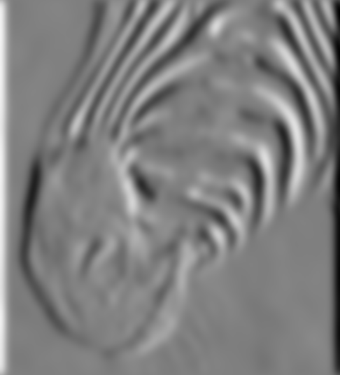
1: Filter Image with derivatives of Gaussian
2D edge detection filters
1 pixel
3 pixels
7 pixels
Smoothing filters with different scales
Notes:
See forsyth ponce chapter

Slide 23
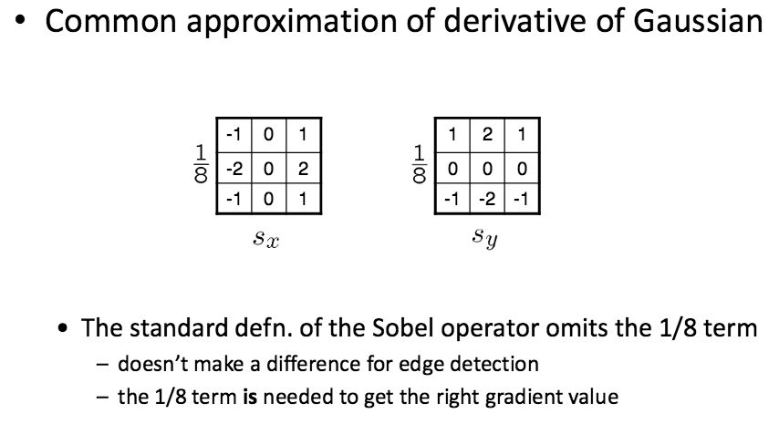
The Sobel Operator: A common approximation of derivative of gaussian

Slide 24
Canny edge detector
edge(image,’canny’)

Slide 25
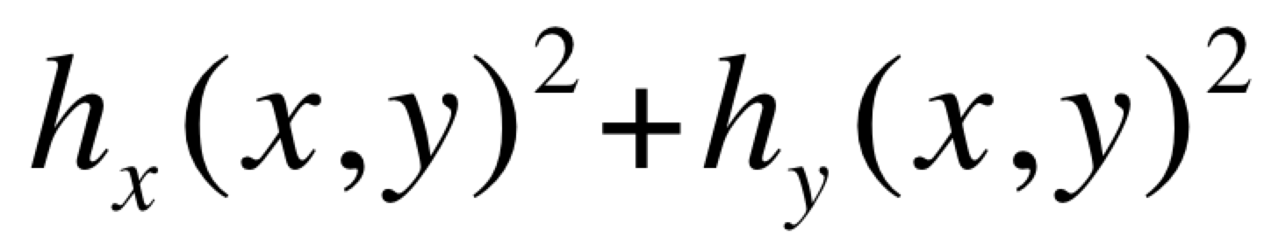
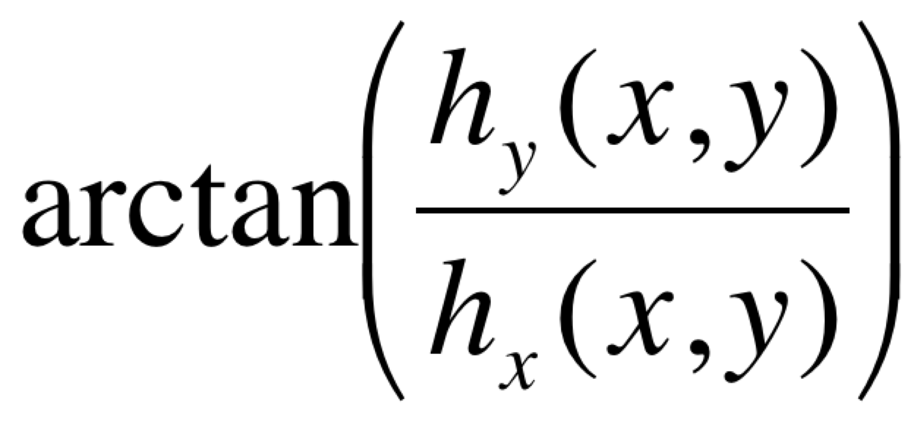
2: Gradient: Find edge strength (magnitude) and direction (angle) of gradient
Magnitude:
Edge strength
Angle:
Edge normal

Slide 26
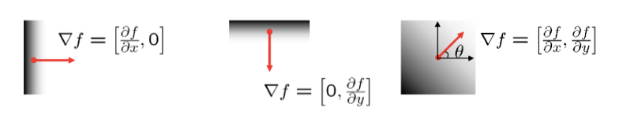
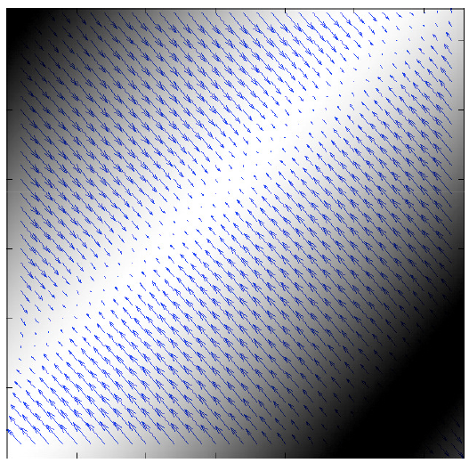
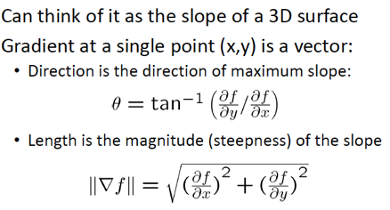
Image Gradient: gradient points in the direction of most rapid increase in intensity

Slide 27
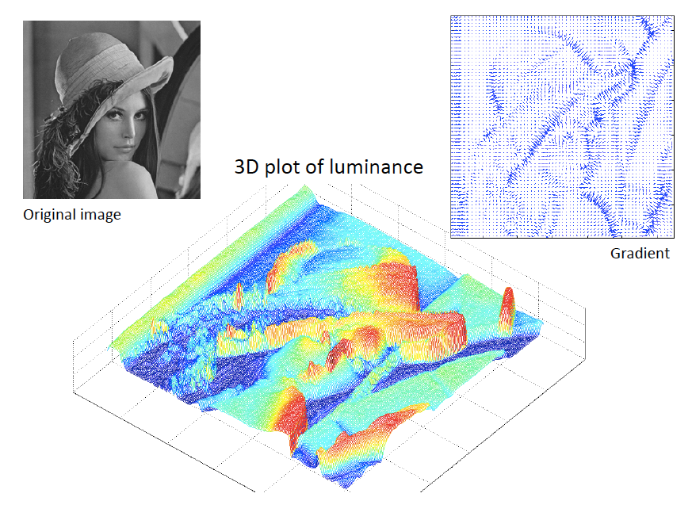

Slide 28
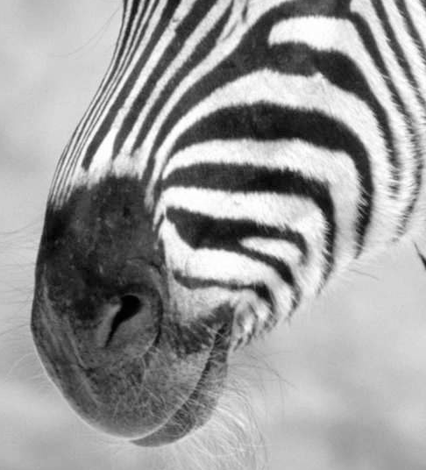
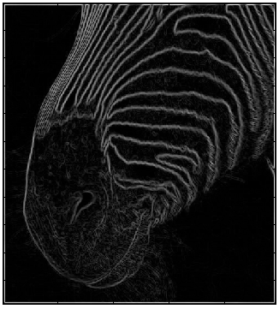
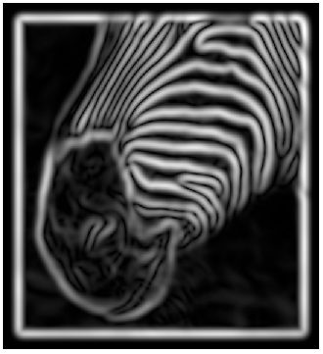
Gradient magnitudes at scale 1
Gradient magnitudes at scale 2
Issues:
1) The gradient magnitude at different scales is different; which should
we choose?
2) The gradient magnitude is large along thick trails; how do we identify the significant points?
3) How do we link the relevant points up into curves?
4) Noise.
The scale of the smoothing filter affects derivative estimates, and also
the semantics of the edges recovered.
Notes:
See forsyth ponce chapter

Slide 29
Canny edge detector
edge(image,’canny’)

Slide 30
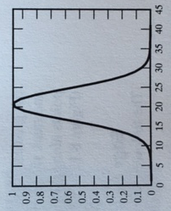


Gradient magnitude is
large
an appropriate
cutting direction
the peak in
that direction
Goal: mark points along the curve where the magnitude is biggest.
How? looking for a maximum along a slice normal to the curve
(non-maximum suppression). These points should form a curve.
There are then two algorithmic issues:
at which point is the maximum
where is the next one?
Forsyth, 2002
Notes:
See forsyth ponce chapter
The gradient magnitude tend to be large along thick trails in an image. Ideally we would like to condense these trails into curves of representative edge points. A natural way to do this is to cut the trail perpendicular to its direction and look for a peak. We use the gradient direction as an estimate of the direction in which to cut. The fig on the left shows a trail or large gradient magnitude: I the center an appropriate cutting direction, the left shows the peak in this direction

Slide 31
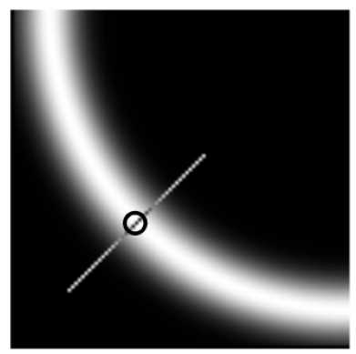
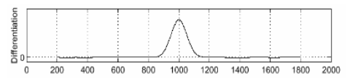
Non maximum suppression: check if pixel is local maximum along gradient direction
At q, we have a maximum (1) if the value is larger than those at both p and at r.
Interpolate between p and r to get these values.
Predicting the next edge point: Assume the marked point is an edge point. Then we construct the tangent to the edge curve (which is normal to the gradient at that point) and use this to predict the next points (here either r or s).
Notes:
See forsyth ponce chapter

Slide 32
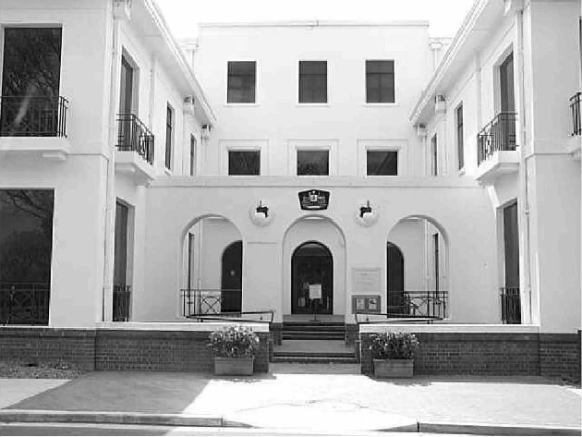
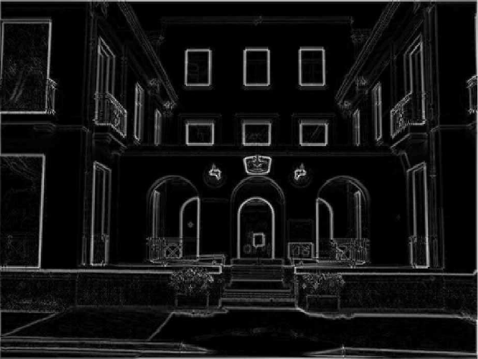
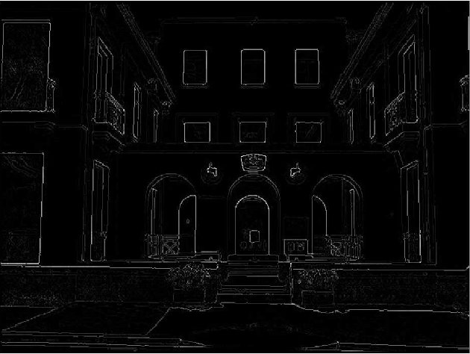
Examples:
Non-Maximum Suppression
Non-maxima
Suppressed
(remaining pixels are the local
Maximum)
Original image
Gradient magnitude
But some edges are broken

Slide 33
Canny edge detector
edge(image,’canny’)

Slide 34
Closing edge gaps
Check that maximum value of gradient value is sufficiently large
  drop-outs? use hysteresis
    use a high threshold to start edge curves and a low threshold to continue them.
t₁
Gradient magnitude
t₂
Not an edge
Labeled as edge
Pixel number in linked list along gradient maxima
Notes:
A two stage

Slide 35
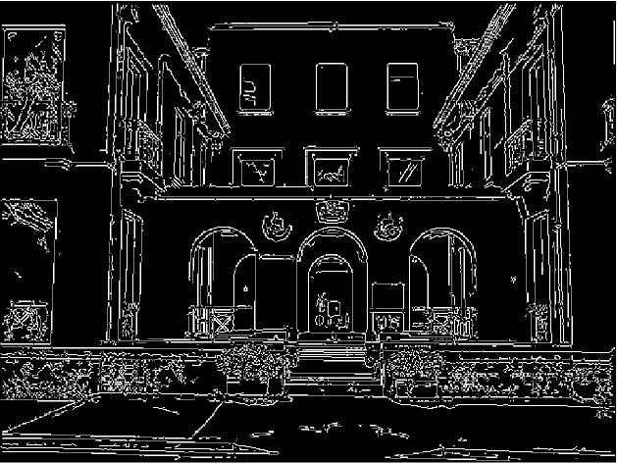
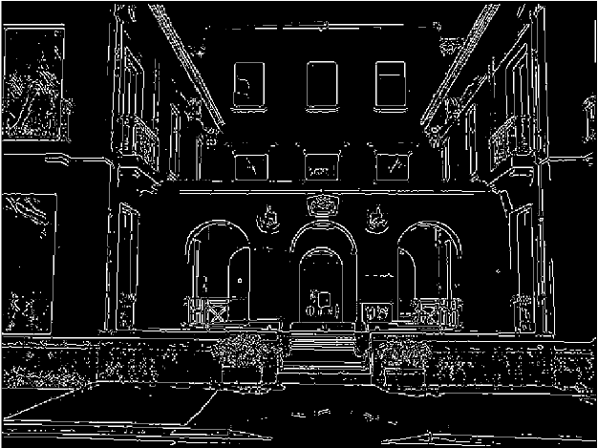
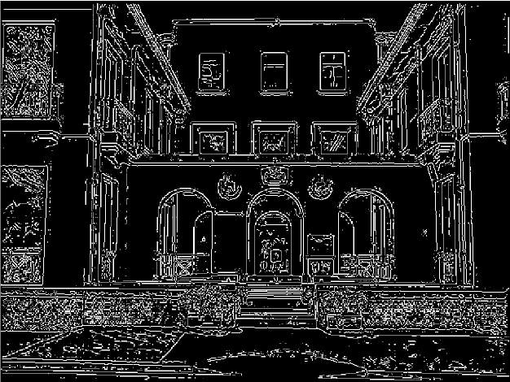
Example: Canny Edge Detection
gap is gone
Original
image
Strong +
connected
weak edges
Strong
edges
only
Weak
edges
courtesy of G. Loy

Slide 36


Example: Canny Edge Detection

Slide 37


Example: Canny Edge Detection

Slide 38

https://www2.eecs.berkeley.edu/Research/Projects/CS/vision/grouping/papers/mfm-pami-boundary.pdf

Slide 39
















Slides credit: Jitendra Malik

Slide 40
















Slides credit: Jitendra Malik

Slide 41
















Slides credit: Jitendra Malik

Slide 42



Slide 43






Color
Gray
InvNeg
Slides credit: Jitendra Malik

Slide 44


Submitted on 2 Dec 2014
Sample patches on
canny edges
https://arxiv.org/abs/1412.1123

Slide 45

Submitted on 2 Dec 2014
https://arxiv.org/abs/1412.1123

Slide 46


https://arxiv.org/pdf/1504.06375.pdf

Slide 47

https://arxiv.org/pdf/1504.06375.pdf

Slide 48


https://arxiv.org/pdf/1705.09759.pdf

Slide 49


Slide 50



II. Segmentation

Slide 51

II.1 Bottom-up segmentation
Group together similar-looking pixels
  “Bottom-up” process
  Unsupervised
Bottom-up segmentation
  Clustering
  Mean shift
  Graph-based
“superpixels”
Notes:
X. Ren and J. Malik. Learning a classification model for segmentation. ICCV 2003.

Slide 52
Issues
How do we decide that two pixels are likely to belong to the same region?
How many regions are there?

Slide 53

Method 1: Clustering
Source: K. Grauman

Slide 54
Segmentation as clustering
Cluster together (pixels, tokens, etc.) that belong together…
Agglomerative clustering
  attach closest to cluster it is closest to
  repeat
Divisive clustering
  split cluster along best boundary
  repeat
Dendrograms
  yield a picture of output as clustering process continues
Chapter – Forsyth & Ponce

Slide 55
A simple segmentation algorithm
Each pixel is described by a vector
z = [r, g, b] or [Y u v], …
Run a clustering algorithm (e.g. k-means) using some distance between pixels:
D(pixel _{i}, pixel _{j}) = || z_{i} – z_{j} ||²

Slide 56


Dendogram
Dendrogram obtained by agglomerative clustering
Data set

Slide 57
A Dendrogram Shows How the Clusters are Merged Hierarchically
  Decompose data objects into several levels of nested partitioning (tree of clusters), called a dendrogram.
  A clustering of the data objects is obtained by cutting the dendrogram at the desired level. Then each connected component forms a cluster.

Slide 58

K-Means Clustering
Given k, the k-means algorithm consists of four steps:
  Select initial centroids at random.
  Assign each object to the cluster with the nearest centroid.
  Compute each centroid as the mean of the objects assigned to it.
  Repeat previous 2 steps until no change.

Slide 59



K-means (k=5) clustering based on intensity (middle) or color (right) is essentially vector quantization of the image attributes
  Clusters don’t have to be spatially coherent
Image
Intensity-based clusters
Color-based clusters
See pdf chapter 14
each pixel is replaced with the mean value of its cluster
Notes:
I gave each pixel the mean intensity or mean color of its cluster --- this is basically just vector quantizing the image intensities/colors. Notice that there is no requirement that clusters be spatially localized and they’re not.
See forsyth ponce chapter

Slide 60




K-means using
color alone
(k=11 clusters)
Showing 4 of the
segments, (not
necessarily connected)
Some are good, some
meaningless
Notes:
Read the k mean explanation in forsyth ponce chapter

Slide 61

Including spatial relationships
Augment data to be clustered with spatial coordinates.
color coordinates
(or r,g,b)
spatial coordinates

Slide 62





Clustering based on (r,g,b,x,y) values enforces more spatial coherence
K-means using colour and
position, 20 segments
Still misses goal of perceptually
pleasing or useful segmentation
No measure of texture
Hard to pick K…
Notes:
Here I’ve represented each pixel as (r, g, b, x, y), which means that segments prefer to be spatially coherent. Here are just some of 20 segments.
See forsyth ponce chapter

Slide 63

K-Means for segmentation
Pros
  Very simple method
  Converges to a local minimum of the error function
Cons
  Memory-intensive
  Need to pick K
  Sensitive to initialization
  Sensitive to outliers
Slide credit: S. Lazebnik

Slide 64

Method 2: Mean shift clustering
An advanced and versatile technique for clustering-based segmentation
http://www.caip.rutgers.edu/~comanici/MSPAMI/msPamiResults.html
D. Comaniciu and P. Meer, Mean Shift: A Robust Approach toward Feature Space Analysis, PAMI 2002.

Slide 65

Mean shift algorithm
The mean shift algorithm seeks modes or local maxima of density in the feature space
Feature space
(L*u*v* color values)
image

Slide 66

Mean Shift Algorithm
Mean Shift Algorithm
  Choose a search window size.
  Choose the initial location of the search window.
  Compute the mean location (centroid of the data) in the search window.
  Center the search window at the mean location computed in Step 3.
  Repeat Steps 3 and 4 until convergence.
The mean shift algorithm seeks the “mode” or point of highest density of a data distribution:
Two issues:
(1) Kernel to interpolate density based on sample positions.
(2) Gradient ascent to mode.

Slide 67
Search
window
Center of
mass
Mean Shift
vector
Slide by Y. Ukrainitz & B. Sarel

Slide 68
Search
window
Center of
mass
Mean Shift
vector
Slide by Y. Ukrainitz & B. Sarel

Slide 69
Search
window
Center of
mass
Mean Shift
vector
Slide by Y. Ukrainitz & B. Sarel

Slide 70
Search
window
Center of
mass
Mean Shift
vector
Slide by Y. Ukrainitz & B. Sarel

Slide 71
Search
window
Center of
mass
Mean Shift
vector
Slide by Y. Ukrainitz & B. Sarel

Slide 72
Search
window
Center of
mass
Mean Shift
vector
Slide by Y. Ukrainitz & B. Sarel

Slide 73
Search
window
Center of
mass
Slide by Y. Ukrainitz & B. Sarel

Slide 74

Mean shift clustering
Cluster: all data points in the attraction basin of a mode
Attraction basin: the region for which all trajectories lead to the same mode
Slide by Y. Ukrainitz & B. Sarel

Slide 75

Mean Shift Segmentation
  Convert the image into tokens (via color, gradients, texture measures etc).
  Choose initial search window locations uniformly in the data.
  Compute the mean shift window location for each initial position.
  Merge windows that end up on the same “peak” or mode.
  The data these merged windows traversed are clustered together.
Pixels in L*u* space
Clustering results after
~160 mean shift procedures
Corresponding trajectories with peaks marked as red dots
Szeliski – Chapter 5 – Segmentation, 5.3 Mean shift

Slide 76

Window in image domain
Apply mean shift jointly in the image (left col.) and range (right col.) domains
1
Intensities of pixels within image domain window
2
0 1
Center of mass of pixels within both image and range domain windows
3
0 1
Window in range domain
4
Center of mass of pixels within both image and range domain windows
5
6
0 1
7
0 1

Slide 77




Mean Shift color & spatial Segmentation Results:
Notes:
http://www.caip.rutgers.edu/~comanici/MSPAMI/msPamiResults.html

Slide 78
Mean shift pros and cons
Pros
  Clusters are places where data points tend to be close together
  Just a single parameter (window size)
  Finds variable number of modes
  Robust to outliers
Cons
  Output depends on window size
  Computationally expensive
  Does not scale well with dimension of feature space
Slide credit: S. Lazebnik
Notes:
clusters are places where data points tend to be close together

Slide 79

Method 3: Graph-Theoretic Image Segmentation
Build a weighted graph G=(V,E) from image
V: image pixels
E: connections between pairs of nearby pixels
A different way of thinking about segmentation…
Segmentation = graph partition

Slide 80

Segmentation by graph cut
q
j
C_{pq}
w_{ij}
p
i
Fully connected graph (node for every pixel i,j)
  Edge/link between every pair of pixels: p,q
  Each edge is weighted by the affinity or similarity of the two nodes:
  cost c_{pq} for each link: c_{pq} measures similarity (or affinity)
  similarity is inversely proportional to difference in color and position

Slide 81
Segmentation by graph cut
j
w_{ij}
i
A
B
C
Break Graph into Segments
  Delete links that cross between segments
  Easiest to break links that have low cost (similarity or affinity)
    similar pixels should be in the same segments
    dissimilar pixels should be in different segments
Source: S. Seitz

Slide 82





Graph-based Image Segmentation
Goal: Given data points X1, …, Xn and similarities w(Xi,Xj), partition the data into groups so that points in a group are similar and points in different groups are dissimilar.
1- Get vectors of data
2a- Build a similarity graph
2b- Build a similarity/affinity matrix
3- Calculate eigenvectors
4- Cut the graph:
apply threshold to eigenvectors

Slide 83



1- Vectors of data
We represent each pixel by a feature vector x, and define a distance function appropriate for this feature representation (e.g. euclidean distance).
Features can be brightness value, color– RGB, L*u*v; texton histogram, etc- and calculate distances between vectors (e.g. Euclidean distance)
Textons
Notes:
You want to choose a vector of data that will give good result of similarities

Slide 84
Computing distance
We represent each pixel by a feature vector x, and define a distance function appropriate for this feature representation
Then we can convert the distance between two feature vectors into an affinity/similarity measure with the help of a generalized Gaussian kernel:
Slide credit: S. Lazebnik

Slide 85
Affinity between pixels
Similarities among pixel descriptors
W_{ij} = exp(-|| z_{i} – z_{j} ||² / σ²)
σ = Scale factor…
it will hunt us later

Slide 86
Affinity between pixels
Similarities among pixel descriptors
W_{ij} = exp(-|| z_{i} – z_{j} ||² / σ²)
σ = Scale factor…
it will hunt us later
Interleaving edges
W_{ij} = 1 - max Pb
Line between i and j
With Pb = probability of boundary

Slide 87
Graph-based Image Segmentation
Goal: Given data points X1, …, Xn and similarities w(Xi,Xj), partition the data into groups so that points in a group are similar and points in different groups are dissimilar.
1- Get vectors of data
2a- Build a similarity graph
2b- Build a similarity/affinity matrix
3- Calculate eigenvectors
4- Cut the graph:
apply threshold to eigenvectors

Slide 88
2a- What is a graph?
a
b
c
d
e
a
a
- - - - -
b
b
- - - - -
c
- - - - -
c
e
d
- - - - -
e
- - - - -
d
Adjacency Matrix
* From Khurram Hassan-Shafique CAP5415 Computer Vision 2003

Slide 89
2a- What is a graph?
a
b
c
d
e
a
a
0 - - - -
b
b
- 0 - - -
c
- - 0 - -
c
e
d
- - - 0 -
e
- - - - 0
d
Adjacency Matrix
* From Khurram Hassan-Shafique CAP5415 Computer Vision 2003

Slide 90
2a- What is a graph?
a
b
c
d
e
a
a
0 1 - - -
b
b
1 0 - - -
c
- - 0 - -
c
e
d
- - - 0 -
e
- - - - 0
d
Adjacency Matrix
* From Khurram Hassan-Shafique CAP5415 Computer Vision 2003

Slide 91
2a- What is a graph?
a
b
c
d
e
a
a
0 1 - - 1
b
b
1 0 - - -
c
- - 0 - -
c
e
d
- - - 0 -
e
1 - - - 0
d
Adjacency Matrix
* From Khurram Hassan-Shafique CAP5415 Computer Vision 2003

Slide 92
2a- What is a graph?
a
b
c
d
e
a
a
b
b
c
c
e
d
d
e
Adjacency Matrix
* From Khurram Hassan-Shafique CAP5415 Computer Vision 2003

Slide 93

2a- What is a weighted graph?
Affinity Matrix represents the weighted links
a
b
a
b
c
d
e
1 .1 .3 0 0
a
0 1 .4 0 .2
b
c
e
.3 .4 1 .6 .7
c
6
W =
0 0 .6 1 1
d
d
0 .2 .7 1 1
e
Diagonal: each point with itself is 1
Strong links/edges
Weak links/edges
No links/edges connected
i,j are the pixels in the image
See Forsyth-Ponce chapter

Slide 94




Similarity graph construction
Similarity Graphs: Model local neighborhood relations between data points
E.g. Gaussian kernel similarity function
Controls size of neighborhood
See Forsyth-Ponce chapter

Slide 95

2b- Building Affinity Matrix
A weighted graph
Weight matrix associated with the graph
(larger values are lighter)
0.1
1
2
3
2
2
4
5
7
1
2
0.1
1
2
3
2
A cut of the graph: two tightly linked components. This cut decomposes
the graph’s matrix into two main blocks on the diagonal
2
4
5
7
1
2
We can do segmentation by finding the minimum cut in a graph.

Slide 96

Graph terminology
Similarity matrix:
Weight matrix associated with the graph
(larger values are lighter)
Slides from Jianbo Shi

Slide 97


Scale affects affinity
W_{ij} = exp(-|| z_{i} – z_{j} ||² / σ²)
Small σ: group only nearby points
Large σ: group far-away points
Dataset of 4 groups of 10 points drawn
from a normal distribution with four different means
σ=.2
σ=.1
σ=.2
σ=1
See Forsyth-Ponce chapter

Slide 98
Affinity matrix of a natural image
N pixels
Similarity of image pixels to selected pixel
Brighter means more similar
M pixels
N*M pixels
N*M pixels

Slide 99
Graph terminology
Degree of node:
…
…
Slides from Jianbo Shi

Slide 100

Graph terminology
Volume of set:
Slides from Jianbo Shi

Slide 101
Graph terminology
Cuts in a graph:
Slides from Jianbo Shi

Slide 102
Graph-based Image Segmentation
Goal: Given data points X1, …, Xn and similarities w(Xi,Xj), partition the data into groups so that points in a group are similar and points in different groups are dissimilar.
1- Get vectors of data
2a- Build a similarity graph
2b- Build a similarity matrix
3- Calculate eigenvectors
4- Cut the graph:
apply threshold to eigenvectors

Slide 103
Spectral Clustering
cluster
Data
Similarities
Affinity Matrix
* Slides from Dan Klein, Sep Kamvar, Chris Manning, Natural Language Group Stanford University
Notes:
Methods that use the spectrum of the affinity matrix to cluster are known as spectral clustering.
Normalized cuts, Average cuts, Average association make use of the eigenvectors of the affinity matrix.
What is an Affinity? It is a metric that determines how close, or Similar, two points our in our space. We have to guess the metric, or we have to learn the metric. For now, we will guess the metric. Notice it is not the standard Euclidean metric. The next simplest thing is, of course, a Gaussian Kernel.
Given 2 data pts we define an Affinity that is positive, symmetric, and depends on the Euclidian distance between the data points

Slide 104
Spectral clustering: Using Eigenvalues of the matrix
spectral clustering uses the eigenvalues of the similarity/affinity matrix of the data to perform dimensionality reduction before clustering in fewer dimensions
Affinity matrix
Reorganized Affinity matrix
Compute eigenvectors
w(i,j)→ distance node i to node j
Notes:
We expect clusters to show up in the matrix depending how we organize the row and columns. We can shuffle the row and columns to form a matrix that is roughly blocked diagonal (the blocks being the clusters). Shuffling the matrix simply shuffle the elements of its eigenvectors so that we can reason about the eigenvectors by thinking about a shuffle version of M.
The eigenvectors of block diagonal matrices consist of eigenvectors of the blocked padded out with zeros. We expect each block to have an eigenvector corresponding to rather large eigenvalue – corresponding to the cluster – and then a series of small eigen values of no particular significance. We expect they are C significant cluster the eigenvector corresponding to the C largest values each represented a cluster

Slide 105
An ideal case
1 | 1 | 1 | 1 | 0 | 0
1 | 1 | 1 | 1 | 0 | 0
1 | 1 | 1 | 1 | 0 | 0
1 | 1 | 1 | 1 | 0 | 0
0 | 0 | 0 | 0 | 1 | 1
0 | 0 | 0 | 0 | 1 | 1
W=
Affinity Matrix
What are the eigenvectors of this matrix?
On Spectral Clustering: Analysis and an algorithm. Andrew Y. Ng, Michael I. Jordan, Yair Weiss, NIPS 2001

Slide 106
An ideal case
Eigenvectors:
1 | 1 | 1 | 1 | 0 | 0
1 | 1 | 1 | 1 | 0 | 0
1 | 1 | 1 | 1 | 0 | 0
1 | 1 | 1 | 1 | 0 | 0
0 | 0 | 0 | 0 | 1 | 1
0 | 0 | 0 | 0 | 1 | 1
1
1
1
1
0
0
0
0
0
0
1
1
W=
…
Affinity Matrix
λ =4
λ =2
On Spectral Clustering: Analysis and an algorithm. Andrew Y. Ng, Michael I. Jordan, Yair Weiss, NIPS 2001

Slide 107
An ideal case
But we do not know the ordering, so W with have some random permutation:
On Spectral Clustering: Analysis and an algorithm. Andrew Y. Ng, Michael I. Jordan, Yair Weiss, NIPS 2001

Slide 108
An ideal case
But we do not know the ordering, so W with have some random permutation:
Eigenvectors:
1 | 0 | 1 | 0 | 1 | 1
0 | 1 | 0 | 1 | 0 | 0
1 | 0 | 1 | 0 | 1 | 1
0 | 1 | 0 | 1 | 0 | 0
1 | 0 | 1 | 0 | 1 | 1
1 | 0 | 1 | 0 | 1 | 1
1
0
1
0
1
1
0
1
0
1
0
0
W=
Affinity Matrix
λ =4
λ =2
On Spectral Clustering: Analysis and an algorithm. Andrew Y. Ng, Michael I. Jordan, Yair Weiss, NIPS 2001

Slide 109





What are eigenvectors?
Eigenvectors represent the dimensions of data
Eigenvalues are the length of eigenvectors
No relationship between variables
In a case of two variables,
Eigenvectors are the two lines
drawn in the scatterplot
A linear relationship between variables
Notes:
spectral clustering techniques make use of the spectrum (eigenvalues) of the similarity matrix of the data to perform dimensionality reduction before clustering in fewer dimensions. The similarity matrix is provided as an input and consists of a quantitative assessment of the relative similarity of each pair of points in the dataset.
In application to image segmentation, spectral clustering is known as segmentation-based object categorization.

Slide 110


Eigenvectors example
1st Eigenvector is the all ones vector 1 (if graph is connected)
•2nd Eigenvector thresholded at 0 separates first two clusters from last two
• k-means clustering of the 4 eigenvectors identifies all 4 clusters

Slide 111


Spectral Clustering pipeline
Matrix V after Spectral Clustering
Affinity matrix M
Wij
Data are projected into a lower-dimensional space (spectral/eigenvector domain)
where they are easily separable
Given number k of clusters, compute the first k eigenvectors, V1, …, Vk of the affinity matrix M
Build the matrix V with the eigenvectors as columns
Interpret the rows of V as new data points Zi
Cluster the points Zi with the k-means algorithms
Dimensionality reduction
n x n → n x k
Notes:
This is an exemple where good clusters can be identified

Slide 112
Eigenvectors and blocks
Block weight matrices have block eigenvectors:
Near-block matrices have near-block eigenvectors:
λ₁= 2
λ₂= 2
λ₃= 0
1 | 1 | 0 | 0
1 | 1 | 0 | 0
0 | 0 | 1 | 1
0 | 0 | 1 | 1
.71
.71
0
0
0
0
.71
.71
λ₄= 0
eigensolver
λ₁= 2.02
λ₂= 2.02
λ₃= -0.02
1 | 1 | .2 | 0
1 | 1 | 0 | -.2
.2 | 0 | 1 | 1
0 | -.2 | 1 | 1
.71
.69
.14
0
0
-.14
.69
.71
λ₄= -0.02
eigensolver
e1
e2
* Slides from Dan Klein, Sep Kamvar, Chris Manning, Natural Language Group Stanford University

Slide 113
Spectral Space
Can put items into blocks by eigenvectors:
e₁
1 | 1 | .2 | 0
1 | 1 | 0 | -.2
.2 | 0 | 1 | 1
0 | -.2 | 1 | 1
.71
.69
.14
0
0
-.14
.69
.71
e₂
e₁
e₂
Clusters clear regardless of row ordering:
e₁
1 | .2 | 1 | 0
.2 | 1 | 0 | 1
1 | 0 | 1 | -.2
0 | 1 | -.2 | 1
.71
.14
.69
0
0
.69
-.14
.71
e₂
e₁
e₂
* Slides from Dan Klein, Sep Kamvar, Chris Manning, Natural Language Group Stanford University

Slide 114




Example eigenvector
Eigenvector (largest)
points
The eigenvector corresponding to the largest eigenvalue
of the affinity matrix. Most values are small, but some,
corresponding to the elements of the main cluster, are large
Affinity matrix
The 3 next eigenvectors corresponding to the next 3 largest eigenvalues
of the affinity matrix. Most values are small but for (disjoint) sets of elements
the values are large. This follows from the block structure of the affinity matrix
See Forsyth Ponce, Chapter 14 given

Slide 115
Graph-based Image Segmentation
Goal: Given data points X1, …, Xn and similarities w(Xi,Xj), partition the data into groups so that points in a group are similar and points in different groups are dissimilar.
1- Get vectors of data
2a- Build a similarity graph
2b- Build a similarity matrix
3- Calculate eigenvectors
4- Cut the graph:
apply threshold to eigenvectors

Slide 116

Clustering – How many groups are there?
Out of the various possible partitions, which is the correct one?

Slide 117

Clustering – 5 groups
Optimal?

Slide 118

Clustering – 5 groups
Looks optimal

Slide 119

What does the Affinity Matrix Look Like?
Notes:
With the right sigma in the gaussian to get distances

Slide 120



The Eigenvectors and the Clusters
Step-Function like behavior preferred!
Makes Clustering Easier.

Slide 121





The Eigenvectors and the Clusters

Slide 122





The Eigenvectors and the Clusters
#1
#2
#3
#4
#5
Eigenvector #2
Eigenvector #3
Eigenvector #5
Eigenvector #4
Eigenvector #1

Slide 123

Clustering – Example 2
Dense Square Cluster
Sparse Square Cluster
Sparse Circle Cluster

Slide 124


The Affinity Matrix

Slide 125







1st Eigenvector
2nd Eigenvector
3rd Eigenvector

Slide 126

The eigenvectors correspond the 2nd smallest to the 9th smallest eigenvalues

Slide 127









Issue: Number of Clusters ?
k = 3
k = 4
k = 6
Issue: choice of kernel, for Gaussian kernels, choice of σ
σ = 3
σ = 13
σ = 25

Slide 128
Graph-based Image Segmentation
Goal: Given data points X1, …, Xn and similarities w(Xi,Xj), partition the data into groups so that points in a group are similar and points in different groups are dissimilar.
1- Get vectors of data
2a- Build a similarity graph
2b- Build a similarity matrix
3- Calculate eigenvectors
4- Cut the graph:
apply threshold to eigenvectors

Slide 129

Graph cut
Set of edges whose removal makes a graph disconnected
Cost of a cut: sum of weights of cut edges
A graph cut gives us a segmentation

Slide 130


Partition a graph with minimum cut
Cut: sum of the weight of the cut edges:
Minimum cut is the cut of minimum weight

Slide 131
Drawbacks of Minimum Cut
Weight of cut is directly proportional to the number of edges in the cut.
Cuts with
lesser weight
than the
ideal cut
Ideal Cut
* Slide from Khurram Hassan-Shafique CAP5415 Computer Vision 2003

Slide 132


Normalized Cut is a better measure ..
We normalize by the total volume of connections

Slide 133

Normalized Cut As Generalized Eigenvalue problem
after simplification, Shi and Malik derive
W = affinity matrix
For detailed derivation: http://www.cs.berkeley.edu/~malik/papers/SM-ncut.pdf

Slide 134

Normalized cuts
Minimize:
Binary
Binary
Instead, solve the generalized eigenvalue problem
They show that the 2nd smallest eigenvector solution y is a good real-valued approx to the original normalized cuts problem. Then you look for a quantization threshold that maximizes the criterion --- i.e all components of y above that threshold go to one, all below go to -b
http://www.cs.berkeley.edu/~malik/papers/SM-ncut.pdf

Slide 135
Many different methods…
Goal: Given data points X1, …, Xn and similarities w(Xi,Xj), partition the data into groups so that points in a group are similar and points in different groups are dissimilar.
1- Get vectors of data
1- Get vectors of data
2- Build a similarity graph
2- Build normalized cost matrix
3- Calculate eigenvectors
3- Get eigenvectors with
smallest eigenvalues
4- Apply threshold to largest eigenvectors
4- Apply threshold
Shi & Malik
… etc
Notes:
Pros of n cut
Generic framework, can be used with many different features and affinity formulations
Cons
High storage requirement and time complexity

Slide 136
Global optimization
In this formulation, the segmentation becomes a global process.
Decisions about what is a boundary are not local (as in Canny edge detector)

Slide 137

Graph-based Image Segmentation
Image (I)
Eigenvector
X(W)
Discretization/Thresholding
Intensity
Color
Edges
Texture
Affinity matrix
(W)
Slide from Timothee Cour
Notes:
Start with the baby face and background: How many clusters?

Slide 138


Slide 139







The Eigenvectors

Slide 140

Normalized cut

Slide 141


Normalized cut

Slide 142


Normalized cut

Slide 143








Slide 144





Slide 145



