Slide 1
Lecture 16
Textures

Slide 2
What is a texture?

Slide 5
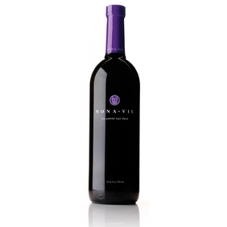
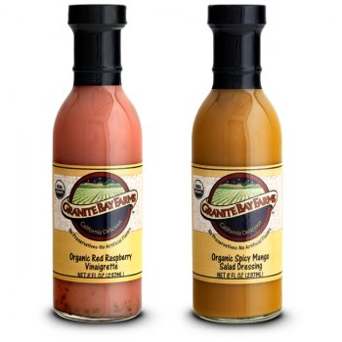
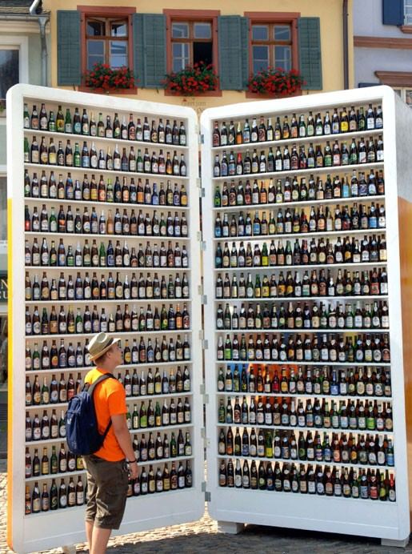
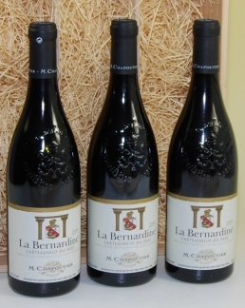
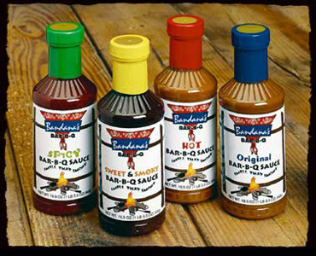
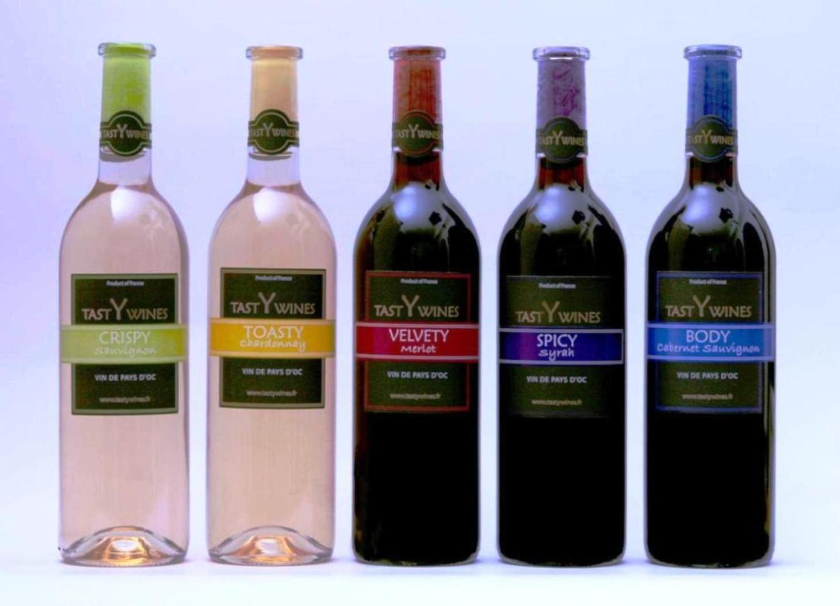
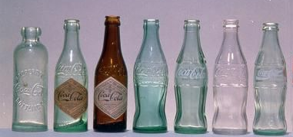

Slide 6
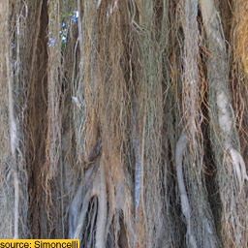
Which textures are we going to talk about in this lecture?
Stationary
Stochastic

Slide 7
When are two textures similar?
All these images are different instances of the same texture
We can differentiate between them, but they seem generated
by the same process

Slide 8
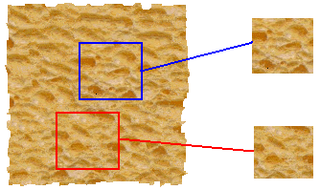
Texture Analysis
input image
ANALYSIS
“Same” or “different”
True (infinite) texture
generated image
Compare textures and decide if they’re made of the same “stuff”.

Slide 9
Texture Synthesis
input image
SYNTHESIS
True (infinite) texture
generated image
Given a finite sample of some texture, the goal is to synthesize other samples from that same texture
The sample needs to be "large enough“

Slide 10
Let’s get a feeling of the mechanisms for texture perception

Slide 11
What is special about texture perception?
Pre-attentive texture discrimination
Perception of sets and summary statistics
Crowding

Slide 12
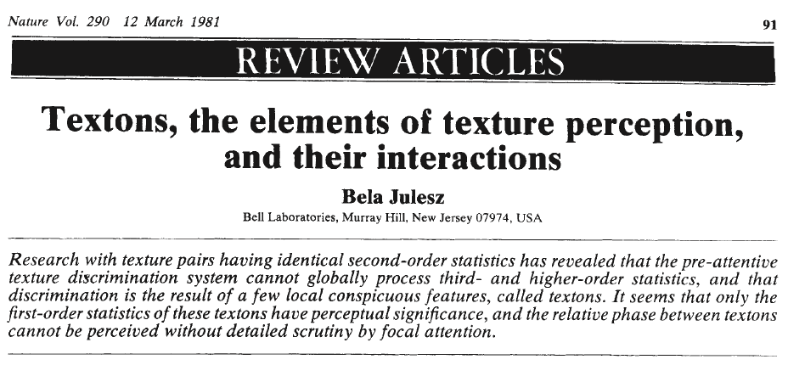
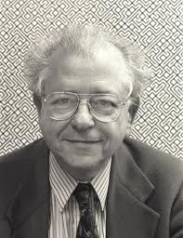
Pre-attentive texture discrimination
Bela Julesz, "Textons, the Elements of Texture Perception, and their Interactions". Nature 290: 91-97. March, 1981.

Slide 13
Pre-attentive texture discrimination
Bela Julesz, "Textons, the Elements of Texture Perception, and their Interactions". Nature 290: 91-97. March, 1981.

Slide 14
Pre-attentive texture discrimination
Bela Julesz, "Textons, the Elements of Texture Perception, and their Interactions". Nature 290: 91-97. March, 1981.

Slide 15
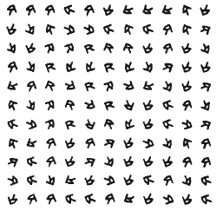
Pre-attentive texture discrimination
This texture pair is pre-attentively indistinguishable. Why?
Bela Julesz, "Textons, the Elements of Texture Perception, and their Interactions". Nature 290: 91-97. March, 1981.

Slide 16
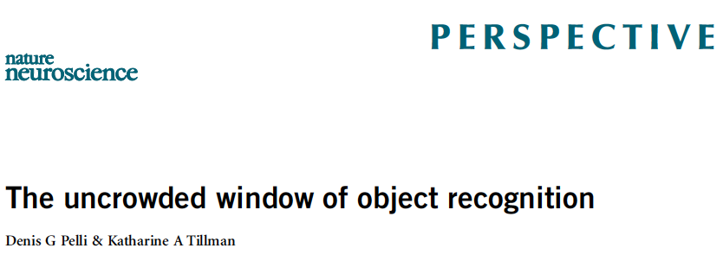

Slide 17
Crowding
KBW
+
R
Pelli, D. G., Cavanagh, P., Desimone, R., Tjan, B., & Treisman, A. (2007). Crowding: Including illusory conjunctions, surround suppression, and attention. Journal of Vision, 7(2):i, 1, http://journalofvision.org/7/2/i/

Slide 18
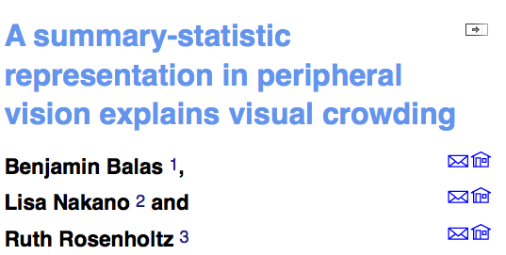
Journal of Vision November 19, 2009 vol. 9 no. 12

Slide 19
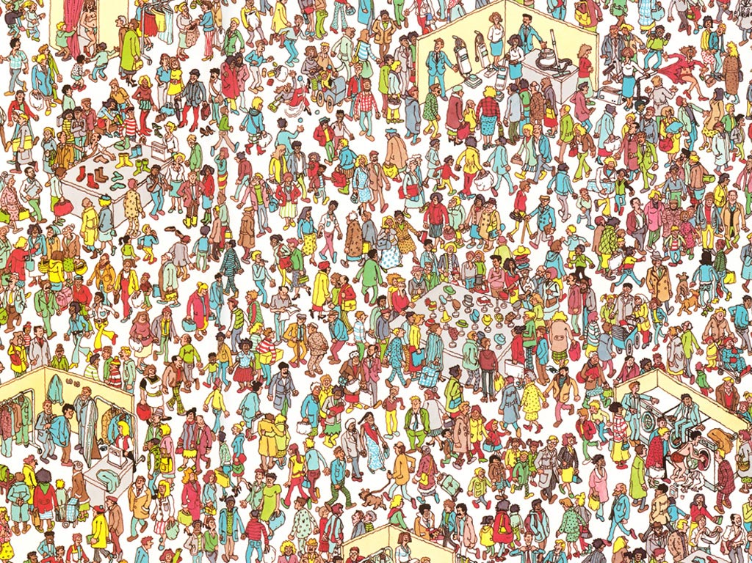
Where’s waldo?

Slide 21
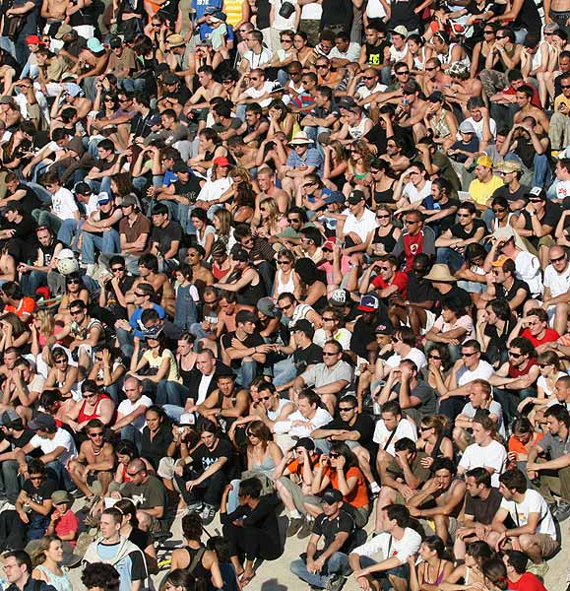
Representation of sets

Slide 22
Set
Is this element a member of the set?

Slide 23
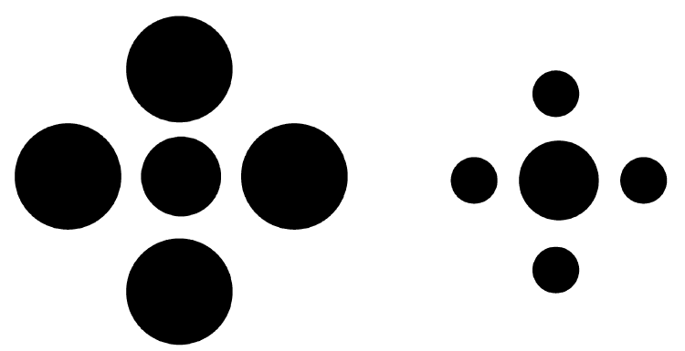
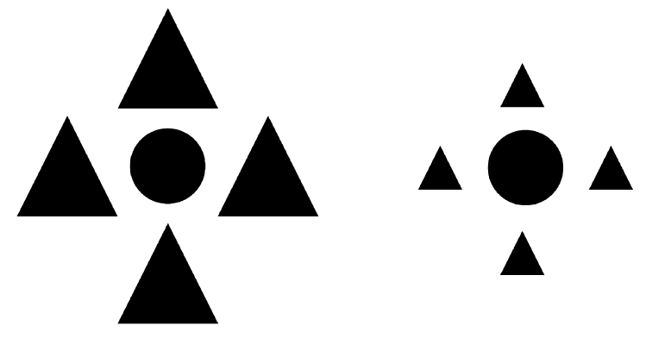
Ebbinghaus illusion
The central circle is judged relative to the set properties of the circles surrounding it
Attenuated by reducing the set grouping.

Slide 24
Representation

Slide 25
What a model should account for:
Biological plausibility: The stages of the model should be motivated by, and be consistent with, known physiological mechanisms of early vision.
2. Generality: The model should be general enough that it can be tested on any arbitrary gray-scale image.
3. Quantitative match with psychophysical data: The model should make a quantitative prediction about the salience of the boundary between any two textured regions. Rank ordering of the discriminability of different texture pairs should agree with that measured psychophysically.
From Malik & Perona, 1990

Slide 26
Julesz - Textons

Slide 27
Julesz - Textons
Textons: fundamental texture elements.
Textons might be represented by features such as terminators, corners, and intersections within the patterns…

Slide 28
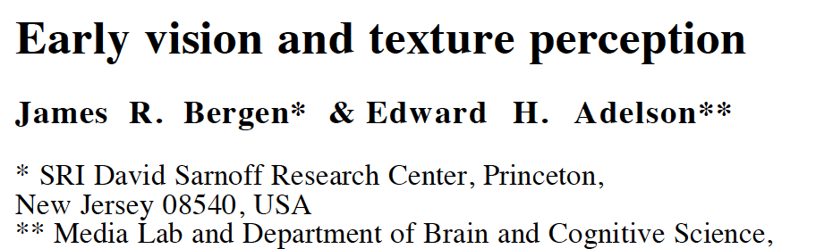
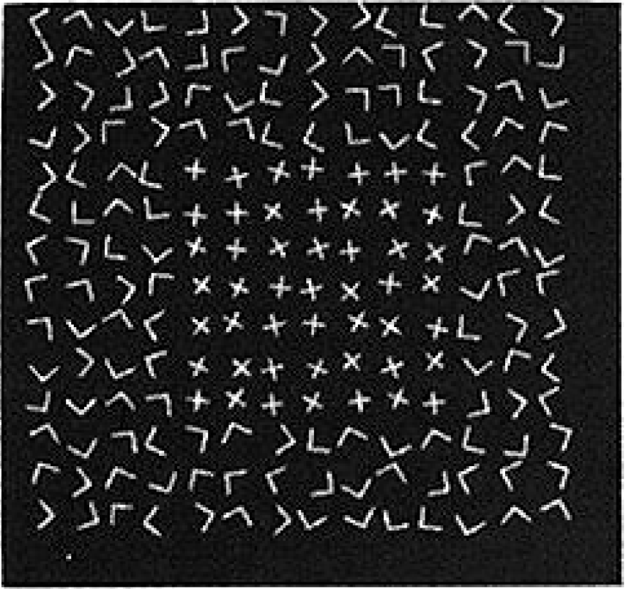
Observation: the Xs look smaller than the Ls.
“We note here that simpler, lower-level mechanisms tuned for size may be sufficient to explain this discrimination.”

Slide 29
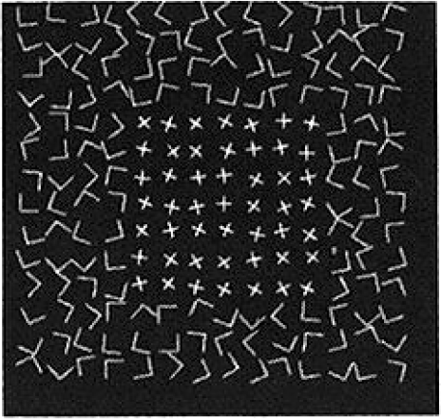
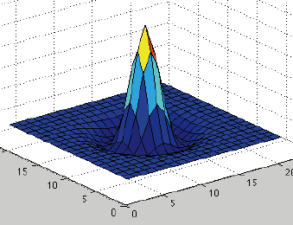
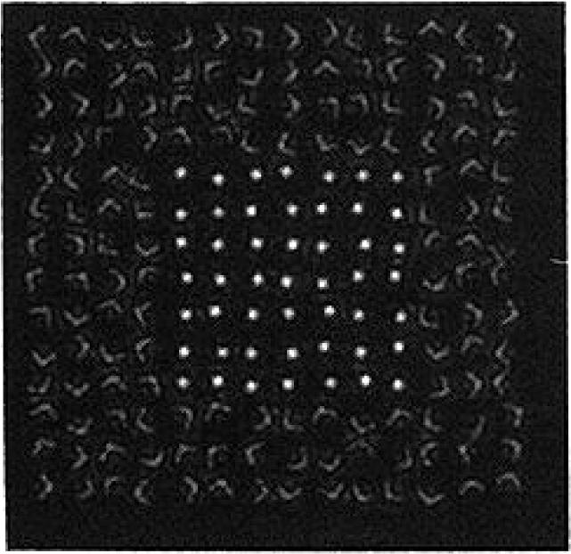
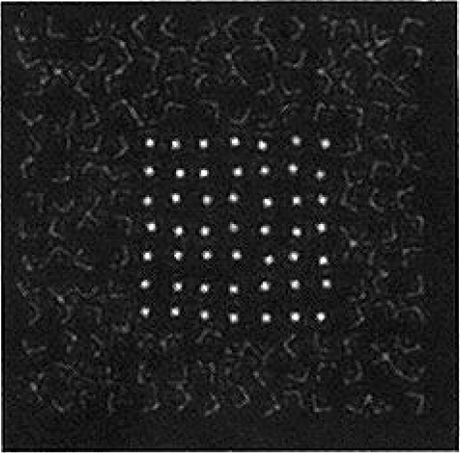
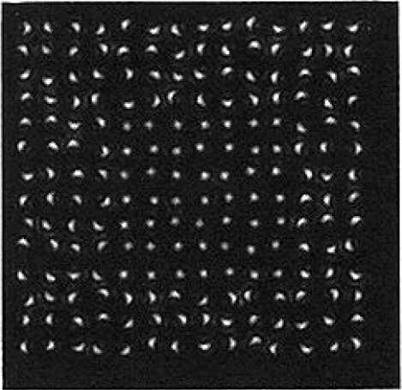
Ls 25% larger contrast adjusted to keep mean constant
Ls 25% shorter

Slide 30
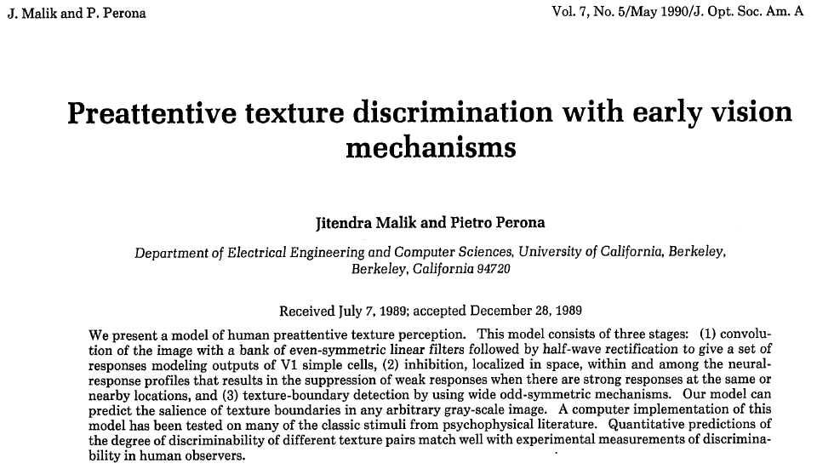

Slide 31
Squared responses
Spatially blurred
vertical filter
image
Threshold squared, blurred responses, then categorize texture based on those two bits
horizontal filter

Slide 32
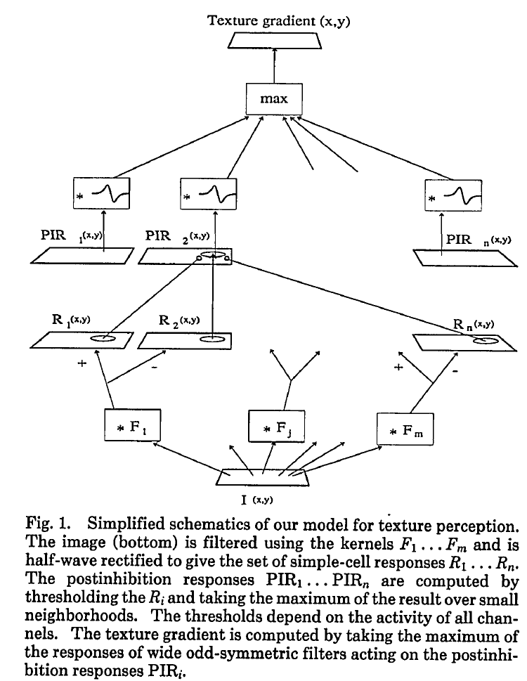
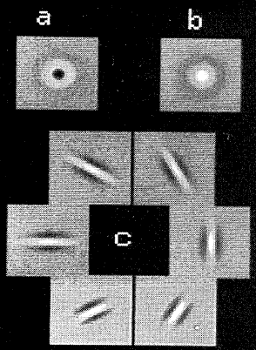
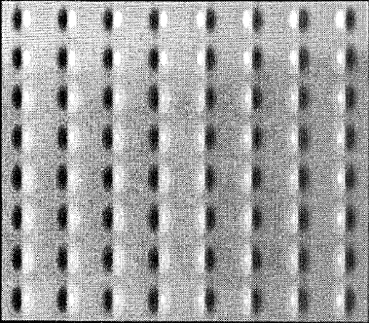

Slide 33
Two big families of models
1- Parametric models of filter outputs
2- Example-based non-parametric models

Slide 34
The trivial texture synthesis algorithm
Notes:
If you want to create images of walls, you can start with a huge picture of a very large wall and crop at random locations. The issue is that this requires having a huge wall (but, is this truly a problem?)

Slide 35
Texture synthesis and representation
Set of equivalent textures
Space of all images
Set of equivalent textures: generated by exactly the same physical process

Slide 36
Texture synthesis and representation
Set of equivalent textures
Set of perceptually
equivalent textures
Space of all images
Set of equivalent textures: generated by exactly the same physical process
Set of perceptually equivalent textures: “well, they just look the same to me”

Slide 37
If matching the averaged squared filter values is a good way to match a given texture, then maybe matching the entire marginal distribution (eg, the histogram) of a filter’s response would be even better.
Jim Bergen proposed this…

Slide 38
SIGGRAPH 1994

Slide 39
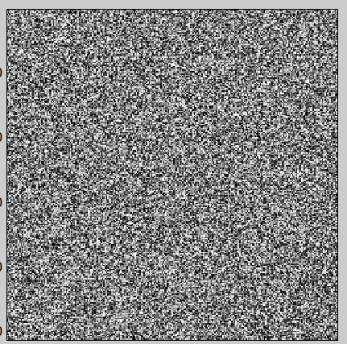
The main idea: it works by ‘kind of’ projecting a random image into the set of equivalent textures
Set of equivalent textures
Set of perceptually
equivalent textures
Space of all images

Slide 40
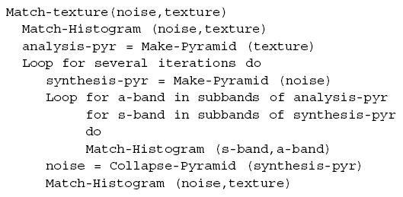
Overview of the algorithm
Two main tools:
1- steerable pyramid
2- matching histograms

Slide 41
1-The steerable pyramid
Low-pass residual
+

Slide 42
1-The steerable pyramid
But why do I want to represent images like this?

Slide 43
1-The steerable pyramid
Argument used by H & B: Statistical measures in the subband representation seem to provide a “distance” between textures that correlates with human perception better than pixel-based representations.

Slide 44
1-The steerable pyramid
In general seems a good idea to have a representation that:
Preserves all image information (we can go back to the image)
Provides more independent channels of information than pixel values (we can mess with each band independently)
But all this is just indirectly related to the texture synthesis task. But let assume is good enough…

Slide 45
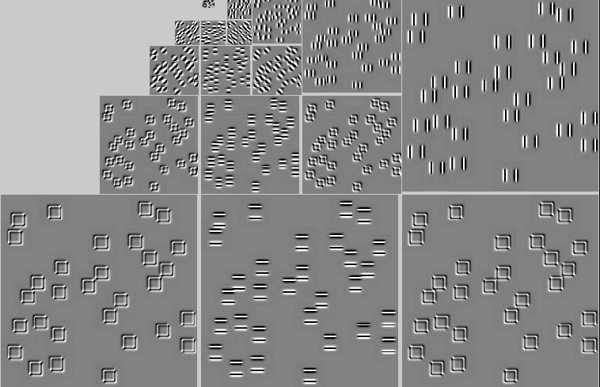
1-The steerable pyramid
Steerable pyr
Input texture

Slide 46
Overview of the algorithm
Two main tools:
1- steerable pyramid
2- matching histograms

Slide 47
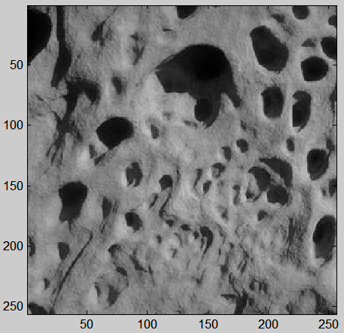
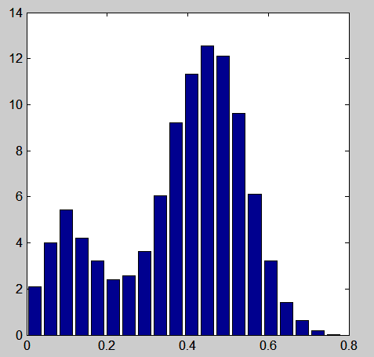
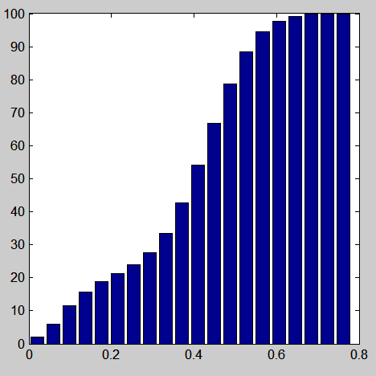
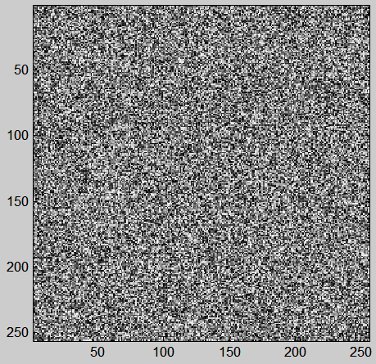
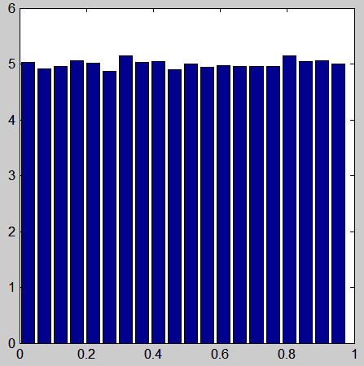
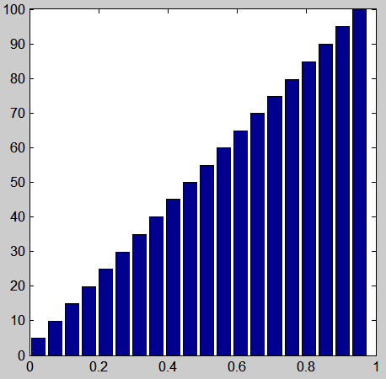
2-Matching histograms
9% of pixels have an intensity value
within the range[0.37, 0.41]
75% of pixels have an intensity value
smaller than 0.5
5% of pixels have an intensity value
within the range[0.37, 0.41]

Slide 48
2-Matching histograms
Z(x,y)
We look for a transformation
of the image Y
Y’ = f (Y)
Such that
Hist(Y) = Hist(f(Z))
Problem: there are infinitely many functions
that can do this transformation.
A natural choice is to use f being:
pointwise non linearity
stationary
monotonic (most of the time invertible)
?
Y(x,y)

Slide 49
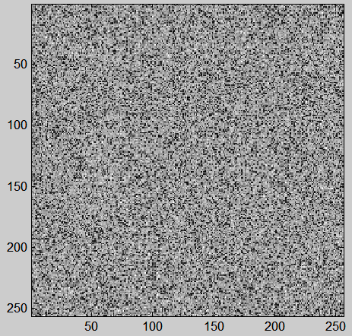
2-Matching histograms
The function f is just a look up table: it says, change all the pixels of
value Y into a value f(Y).
Y’ = f (Y)
Y(x,y)
Y= 0.8
Y’= 0.5
Original
intensity
New
intensity

Slide 50
2-Matching histograms
Y’ = f (Y)

Slide 51
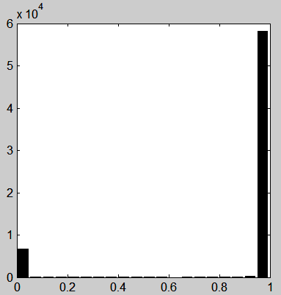
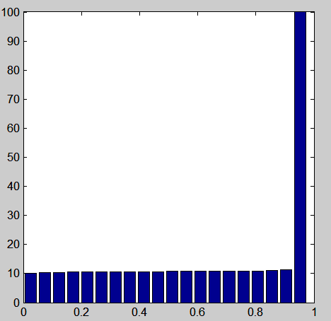
Another example: Matching histograms
10% of pixels are black
and 90% are white
?
?
5% of pixels have an intensity value
within the range[0.37, 0.41]

Slide 52
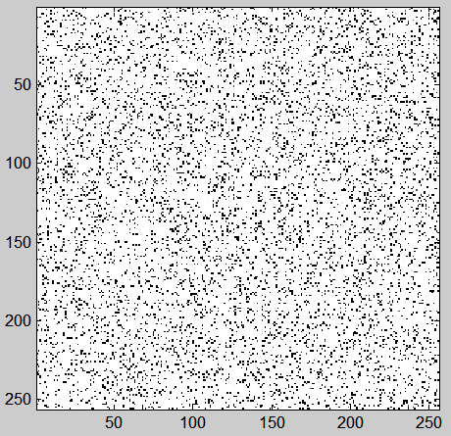
Another example: Matching histograms
The function f is just a look up table: it says, change all the pixels of
value Y into a value f(Y).
Y’ = f (Y)
Y(x,y)
Y= 0.8
Y’= 1
Original
intensity
New
intensity

Slide 53
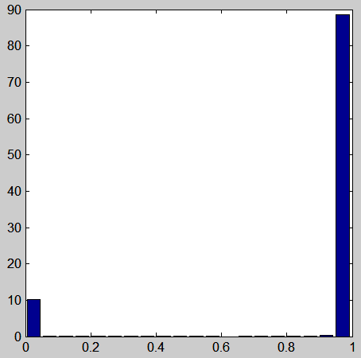
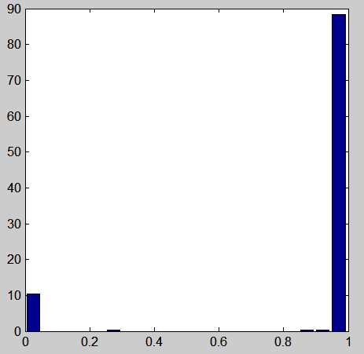
Another example: Matching histograms
Y’ = f (Y)
In this example, f is a step function.

Slide 54
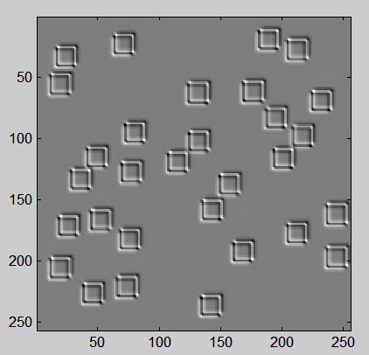
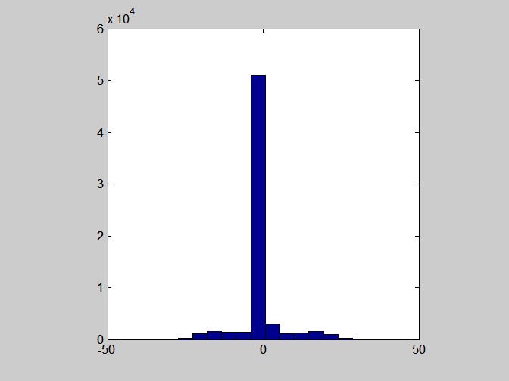
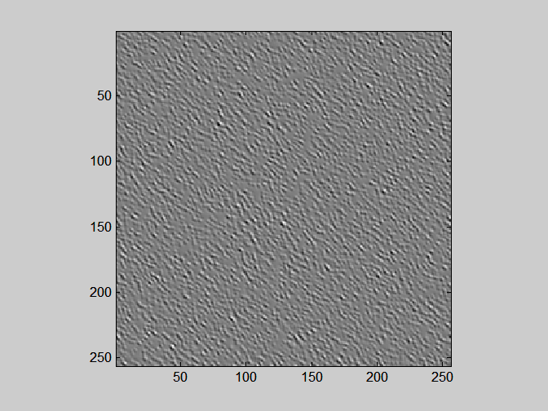
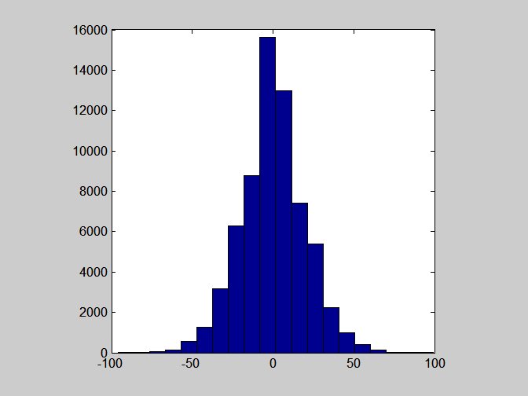
Matching histograms of a subband

Slide 55
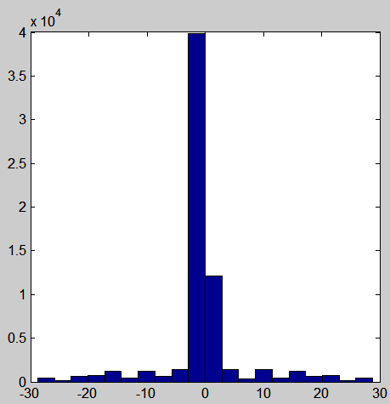
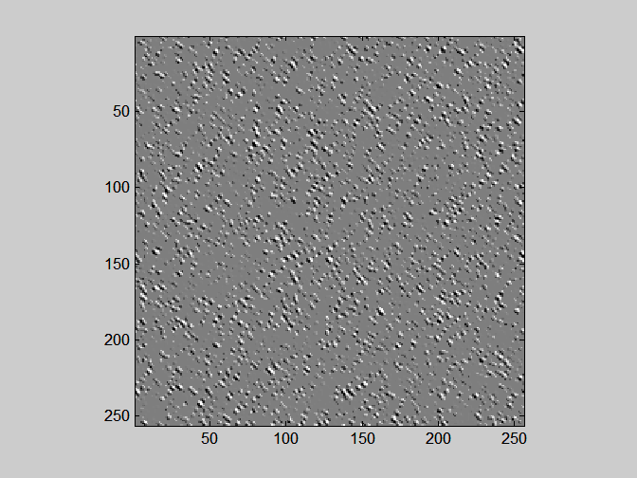
Matching histograms of a subband
Y’ = f (Y)

Slide 56
Texture analysis
Wavelet decomposition (steerable pyr)
(histogram)
Input texture
(histogram)
(Steerable pyr; Freeman & Adelson, 91)
The texture is represented as a collection of
marginal histograms.

Slide 57
Texture synthesis
Heeger and Bergen, 1995
(histogram)
Input texture
(histogram)

Slide 58
Why does it work? (sort of)

Slide 59
Why does it work? (sort of)
The black and white
blocks appear by
thresholding (f) a
blobby image
Iteration 0
Filter bank
…

Slide 60
Why does it work? (sort of)
The black and white blocks appear by
thresholding (f) a blobby image

Slide 61
Why does it work? (sort of)
After 6 iterations
Histograms match ok
red = target histogram, blue = current iteration

Slide 62
Color textures
R
G
Three textures
B

Slide 63
Color textures
R
G
B

Slide 64
Color textures
R
This does not work
G
B

Slide 65
Color textures
Problem: we create new colors not present in the original image.
Why? Color channels are not independent.
R
G
B

Slide 66
PCA and decorrelation
R
G
B
In the original image, R and G are correlated, but, after synthesis,…
G
G
R
R

Slide 67
PCA and decorrelation
The texture synthesis algorithm assumes that the channels
are independent.
What we want to do is some rotation
G
U2
Rotation
U1
R
See that in this rotated space,
if I specify one coordinate the
other remains unconstrained.

Slide 68
PCA and decorrelation
G
correlation(R,G)
1.0000 0.9303 0.6034
0.9303 0.9438 0.6620
0.6034 0.6620 0.5569
C =
R
PCA finds the principal directions of variation of the data.
It gives a decomposition of the covariance matrix as:
0.6347 0.6072 0.4779
0.6306 -0.0496 -0.7745
0.4466 -0.7930 0.4144
C = D D’
D =
By transforming the original data (RGB) using D we get:
U1
U2
U3
=
D’
R
G
B
U2
3 x Npixels
3 x 3
3 x Npixels
U1
The new components (U1,U2,U3) are decorrelated.

Slide 69
Color textures
R
G
Rotation
Matrix
(3x3)
B
D’
These three textures
look similar
(high dependency)
These three textures
Look less similar
(lower dependency)

Slide 70
Color textures
R
Inverse
Rotation
Matrix
G
D
B

Slide 71
Color textures
R
R
G
Inverse
Rotation
G
Rotation
Matrix
D
B
D’
B
These three textures
look similar
(high dependency)
These three textures
Look less similar
(lower dependency)

Slide 72
Color channels
Without PCA
With PCA

Slide 73
Color channels

Slide 74
Color channels

Slide 75
Examples from the paper
Heeger and Bergen, 1995

Slide 76
Examples from the paper

Slide 77
Examples not from the paper
Input
texture
Synthetic
texture
But, does it really work even when it seems to work?

Slide 78
But, does it really work??? How to measure how well the representation constraints the set of equivalent textures?
?
All the textures in this
set have the same
parameters.
?
?
?
?

Slide 79
How to identify the set of equivalent textures?
?
This does not reveal how poor
the representation actually is.

Slide 80
We need a space that is more perceptual
In a perceptual space
all these noise images
are very close. But in
pixel space, they are
very far away.
How big is this set
in a pixels space?

Slide 81
We need a space that is more perceptual
In a perceptual space
all these noise images
are very close. But in
pixel space, they are
very far away.
How big is this set
in a pixels space?
How big is this set
in a perceptual space?

Slide 82
How to identify the set of equivalent textures?
These trajectories are
more perceptually
salient
This set is huge

Slide 83
How to identify the set of equivalent textures?

Slide 84
How to identify the set of equivalent textures?
These trajectories are
more perceptually
salient

Slide 85
Portilla and Simoncelli
Parametric representation, based on Gaussian scale mixture prior model for images.
About 1000 numbers to describe a texture.
Ok results; maybe as good as DeBonet.

Slide 86
Portilla and Simoncelli

Slide 87
Portilla & Simoncelli
Heeger & Bergen
Portilla & Simoncelli

Slide 88
How to identify the set of equivalent textures?
Now they look good, but maybe
they look too good…
Portilla & Simoncelli

Slide 89
Journal of Vision November 19, 2009 vol. 9 no. 12

Slide 90
Zhu, Wu, & Mumford, 1998
Principled approach. Based on an assumption of heavy-tailed distributions for an over-complete set of filters.
Synthesis quality not great, but ok.

Slide 91
Zhu, Wu, & Mumford
Cheetah Synthetic

Slide 92
De Bonet (and Viola)
SIGGRAPH 1997

Slide 93
DeBonet
Learn: use filter conditional statistics across scale.

Slide 94
DeBonet

Slide 95
DeBonet

Slide 96
Two big families of models
1- Parametric models of filter outputs
2- Example-based non-parametric models

Slide 98
Efros & Leung Algorithm
non-parametric
sampling
p
Input image
Synthesizing a pixel
Assuming Markov property, compute P(p|N(p))
Building explicit probability tables infeasible
Instead, we search the input image for all similar neighborhoods — that’s our pdf for p
To sample from this pdf, just pick one match at random

Slide 99
Neighborhood Window
input

Slide 100
Varying Window Size
Increasing window size

Slide 101
Synthesis Results
french canvas
rafia weave

Slide 102
More Results
white bread
brick wall

Slide 103
Homage to Shannon

Slide 104
Hole Filling

Slide 105
Extrapolation

Slide 106
Image Quilting [Efros & Freeman]
non-parametric
sampling
p
B
Input image
Synthesizing a block
Observation: neighbor pixels are highly correlated
Idea: unit of synthesis = block
Exactly the same but now we want P(B|N(B))
Much faster: synthesize all pixels in a block at once
Not the same as multi-scale!

Slide 107
block
Input texture
B1
B2
B1
B2
B1
B2
Random placement
of blocks
Neighboring blocks
constrained by overlap
Minimal error
boundary cut

Slide 108
Minimal error boundary
overlapping blocks
vertical boundary
2
_
=
overlap error
min. error boundary

Slide 109
Texture Transfer
Take the texture from one object and “paint” it onto another object
This requires separating texture and shape
That’s HARD, but we can cheat
Assume we can capture shape by boundary and rough shading
Then, just add another constraint when sampling: similarity to underlying image at that spot

Slide 110
parmesan
+
=
rice
+
=

Slide 111
+
=

Slide 112
+
=

Slide 113
Source
texture
Target image
Source
correspondence
image
Target
correspondence image

Slide 114
+
=

Slide 115
https://arxiv.org/pdf/1601.06759.pdf

Slide 118
Generator
Random uniform vector (100 numbers)

Slide 119
Generator
Discriminator
Random
vector
Real or generated?
Multilayer perceptron
Multilayer perceptron

Slide 120
Generated images
Trained with CIFAR-10

Slide 121
Introduced a form of ConvNet more stable under adversarial training than previous attempts.

Slide 122
Generator
Random uniform vector (100 numbers)

Slide 124
Two components
Generator
Network to visualize
car
Classification
layer
conv4
conv5
fc6
fc7
conv3
conv2
conv1

Slide 125
Two components
Generator
Network to visualize
Table lamp
Classification
layer
conv4
conv5
fc6
fc7
conv3
conv2
conv1

Slide 126
Two components
Table lamp
fc6
Classification
layer
conv4
conv5
fc7
conv3
Generator
conv2
conv1
Unit to visualize

Slide 127
Synthesizing Images Preferred by CNN
ImageNet-Alexnet-final units (class units)
Nguyen A, Dosovitskiy A, Yosinski J, Brox T, Clune J. (2016). "Synthesizing the preferred inputs for neurons in neural networks via deep generator networks.". arXiv:1605.09304.

Slide 128
https://arxiv.org/pdf/1703.10593.pdf

Slide 129
https://arxiv.org/pdf/1703.10593.pdf

