Slide 1
MIT CSAIL
6.869/6.819 Advances in Computer Vision
Lecture 1
A Simple Vision System

Slide 2
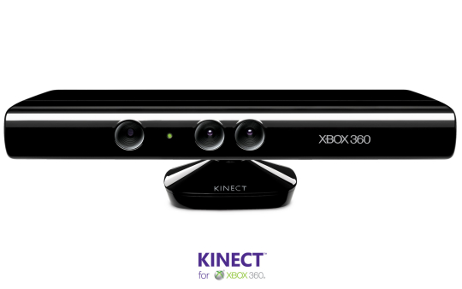
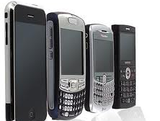
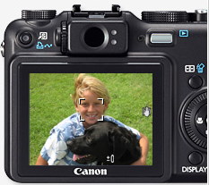
Exciting times for computer vision

Slide 3
What is vision?
What does it mean, to see?
“to know what is where by looking”.
To discover from images what is present in the world, where things are, what actions are taking place.
from Marr, 1982

Slide 4
A bit of history…

Slide 5
50 years ago…

Slide 6
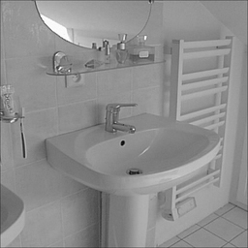
30 years ago…

Slide 7
But 15 years ago…

Slide 8
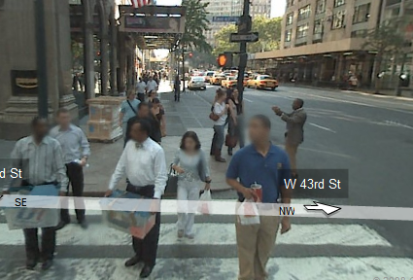
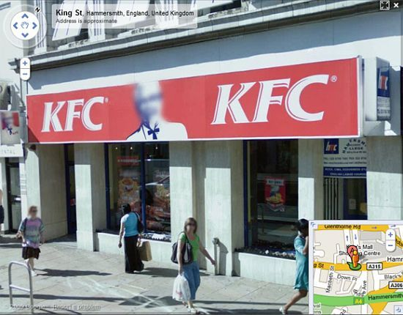
The representation and matching of pictorial structures Fischler, Elschlager (1973).
Face recognition using eigenfaces M. Turk and A. Pentland (1991).
Human Face Detection in Visual Scenes - Rowley, Baluja, Kanade (1995)
Graded Learning for Object Detection - Fleuret, Geman (1999)
Robust Real-time Object Detection - Viola, Jones (2001)
Feature Reduction and Hierarchy of Classifiers for Fast Object Detection in Video Images - Heisele, Serre, Mukherjee, Poggio (2001)
….
Notes:
The way it works is by breaking the image into lots of pieces and asking for each piece if it is a face. It is a very local process. There is no scene reasoning. It is sophisticated template matching. But it works great.

Slide 9
Why is vision hard?

Slide 10
The structure of ambient light
Notes:
100 million miles

Slide 11
The structure of ambient light

Slide 15
Why is vision hard?

Slide 16
Measuring light vs. measuring scene properties
We perceive two squares, one on top of each other.

Slide 17
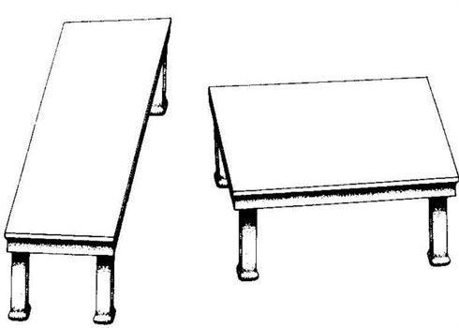
Measuring light vs. measuring scene properties
by Roger Shepard (”Turning the Tables”)
Depth processing is automatic, and we can not shut it down…

Slide 18
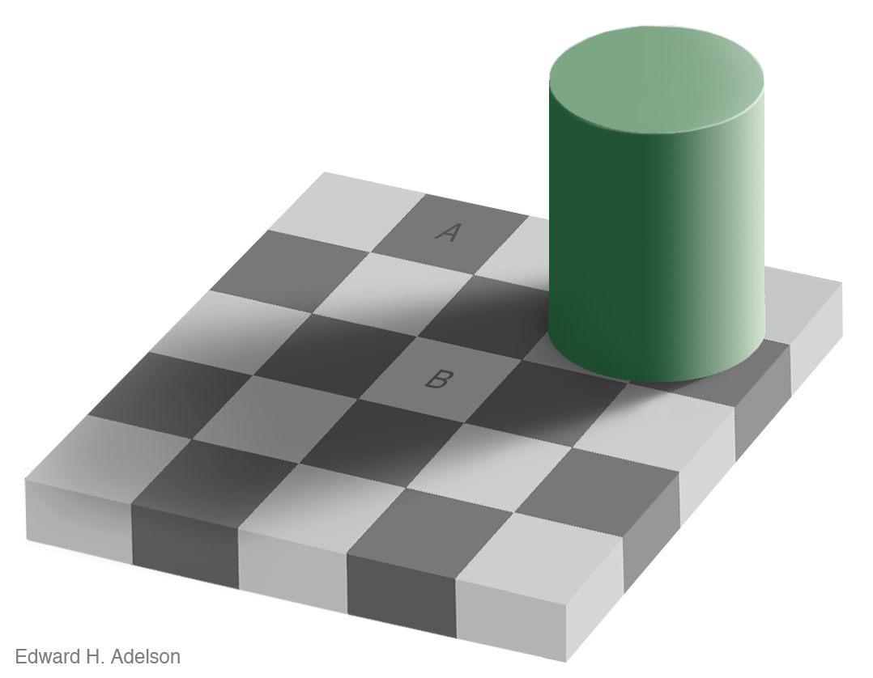
Measuring light vs. measuring scene properties

Slide 19
Measuring light vs. measuring scene properties

Slide 20
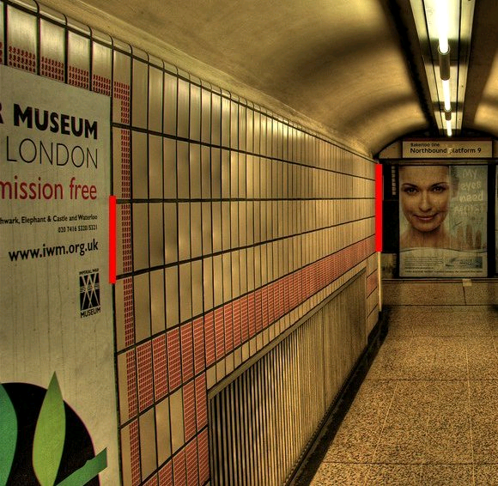
Measuring light vs. measuring scene properties
(c) 2006 Walt Anthony

Slide 21
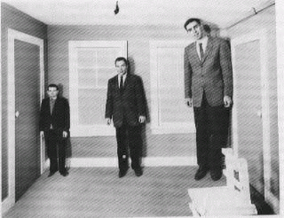
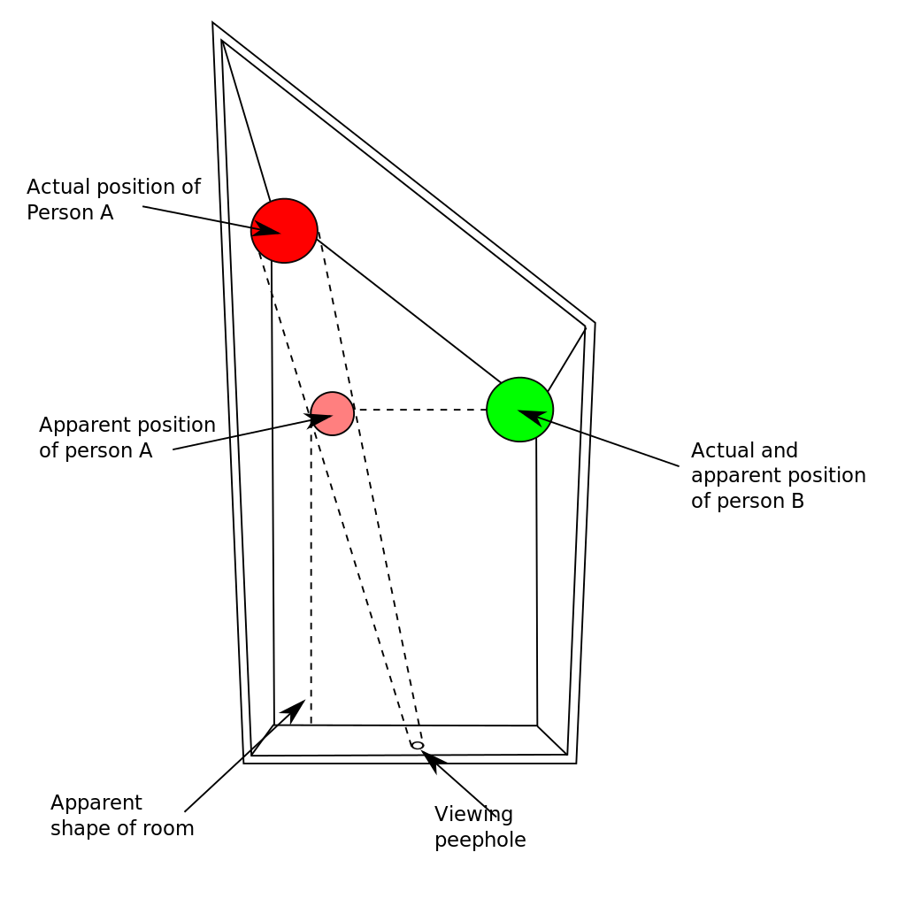
Assumptions can be wrong
Ames room (1934)

Slide 22
Why is vision hard?

Slide 23
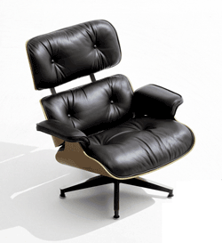
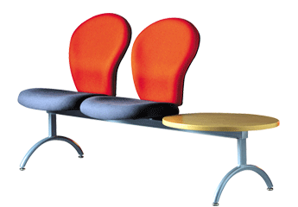
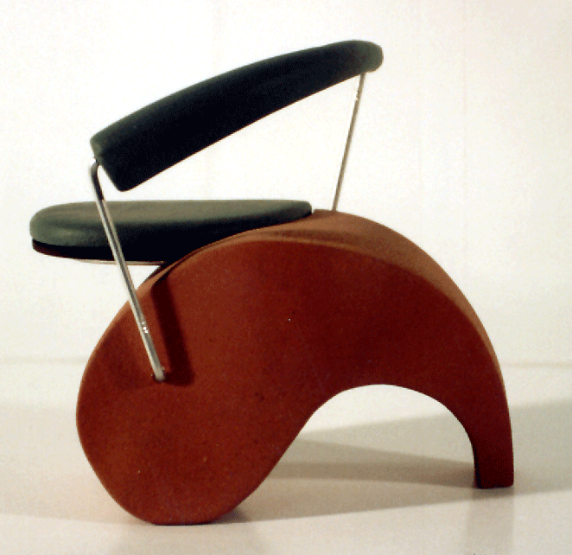
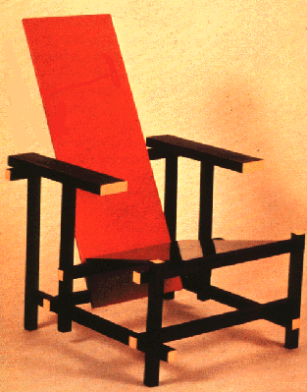
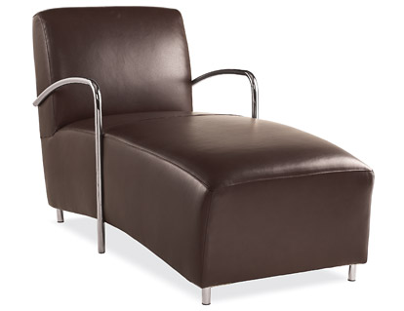
Some things have strong variations in appearance

Slide 24
Some things know that you have eyes
Brady, M. J., & Kersten, D. (2003). Bootstrapped learning of novel objects. J Vis, 3(6), 413-422

Slide 25
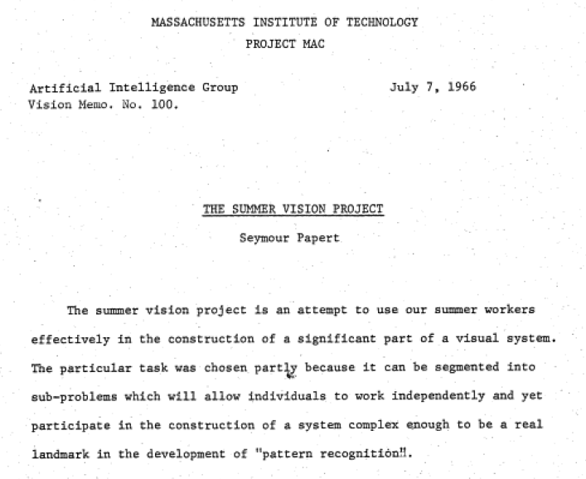

Slide 26
Problem set 1 The “one week” vision project
The goal of the first problem set is to solve vision

Slide 27
A Simple Visual System
A simple world
A simple image formation model
A simple goal

Slide 28
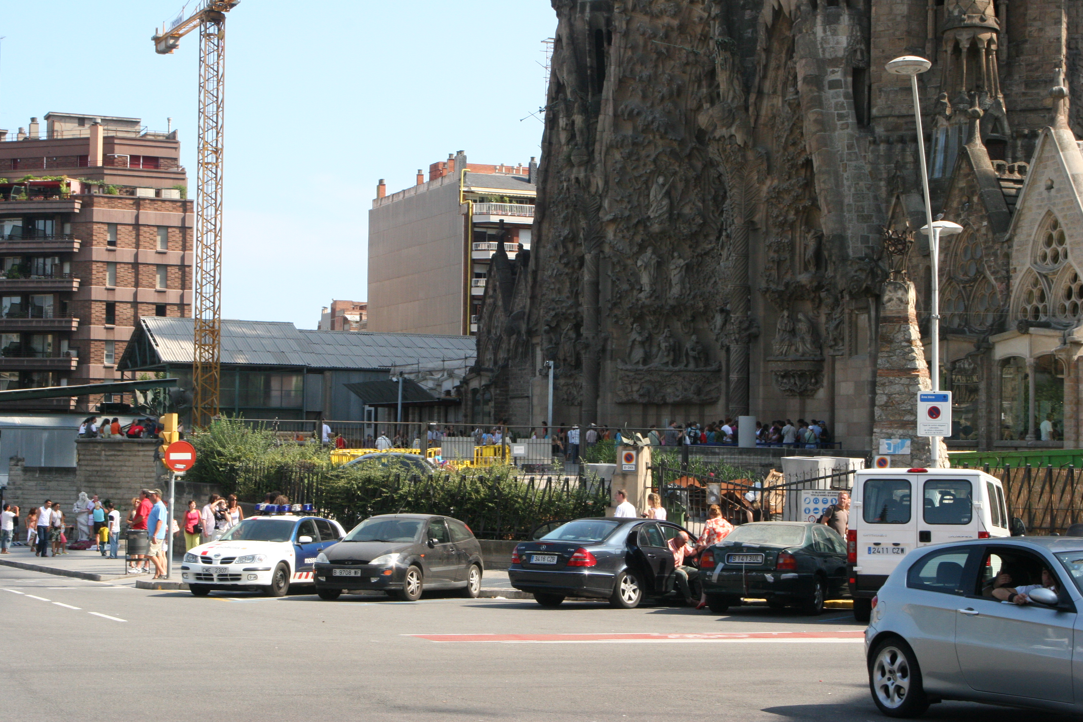
A Simple World

Slide 29
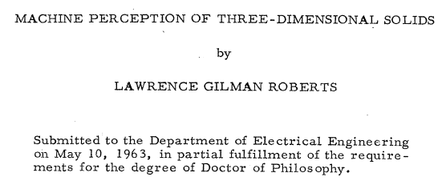
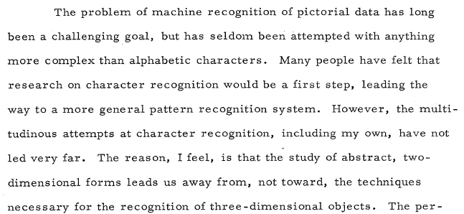
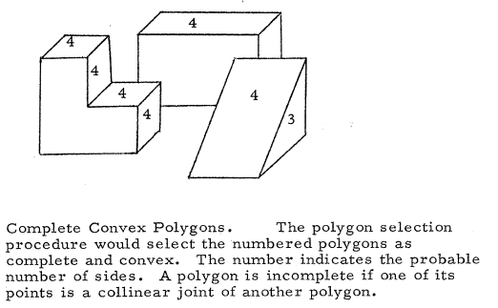
A Simple World
http://www.packet.cc/files/mach-per-3D-solids.html

Slide 30
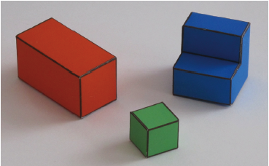
A Simple World

Slide 31
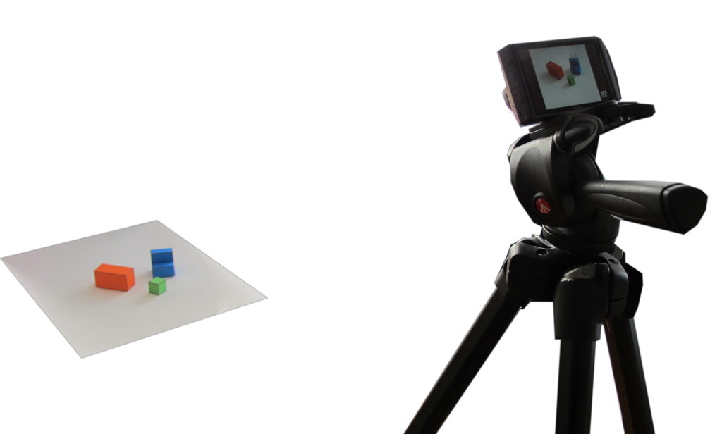
A simple image formation model
Simple world rules:
Surfaces can be horizontal or vertical.
Objects will be resting on a white horizontal ground plane

Slide 32
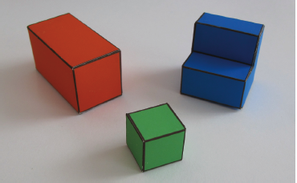
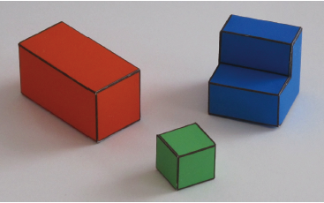
A simple image formation model
Perspective projection
Parallel (orthographic) projection

Slide 33
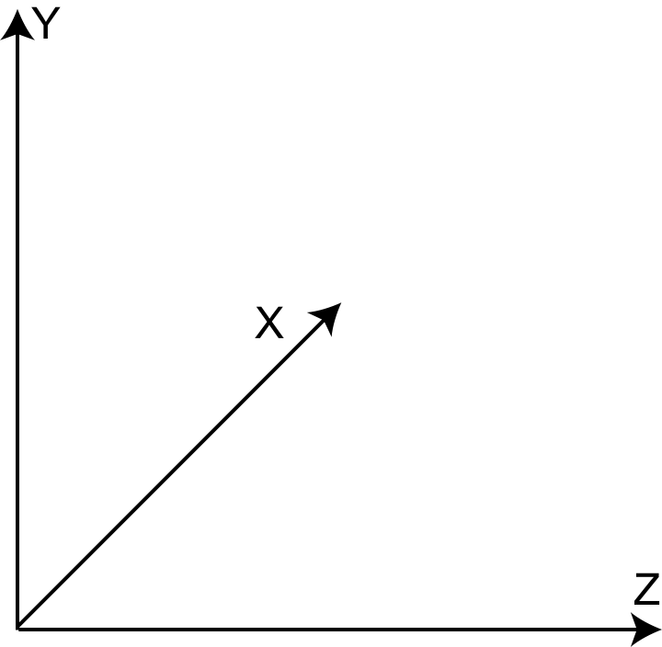
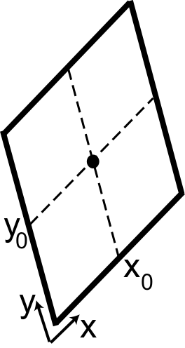
A simple image formation model
World reference system
Camera plane
(right-handed reference system)

Slide 34
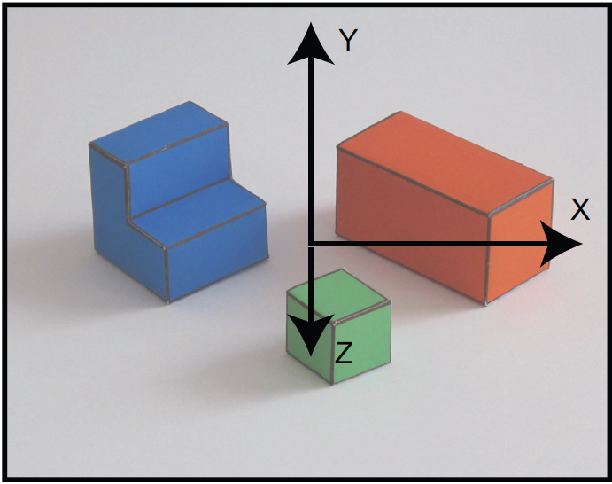
A simple image formation model
Image and projection of the world coordinate axes into the image plane
World coordinates
image coordinates
World coordinates
x =
X + x₀
y =
cos(θ) Y – sin(θ) Z + y₀
image coordinates

Slide 35
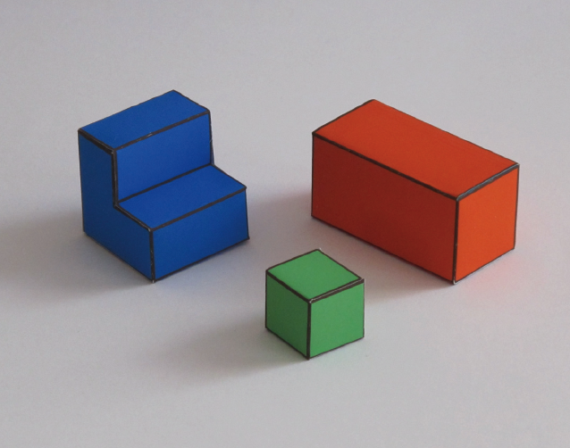
A simple goal
To recover the 3D structure of the world
We want to recover X(x,y), Y(x,y), Z(x,y) using as input I(x,y)

Slide 36
Why is this hard?
Sinha & Adelson 93

Slide 37
Why is this hard?
Sinha & Adelson 93

Slide 38
Why is this hard?
Sinha & Adelson 93

Slide 39
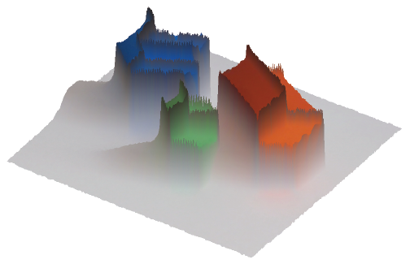
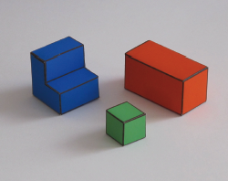
A simple visual system The input image
I(x,y)
0
y
255
x

Slide 40
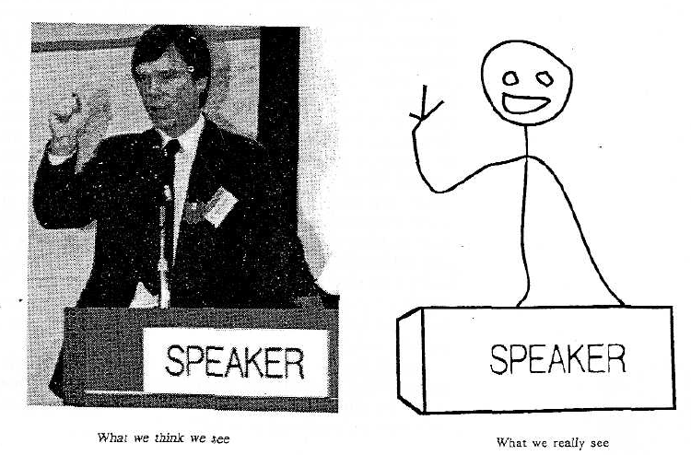
Proposition 1. The primary task of early vision is to deliver a small set of useful measurements about each observable location.
Proposition 2. The elemental operations of early vision involve the measurement of local change along various directions.
Goal: to transform the image into other representations (rather than pixel values) that makes scene information more explicit
Adelson, Bergen. 91
Cavanagh, Perception 95

Slide 41
Edges
Occlusion
Horizontal 3D edge
Change of
Surface orientation
Vertical 3D edge
Contact edge
Shadow boundary

Slide 42
Finding edges in the image
Image gradient:
Approximation image derivative:
I(x,y)
Edge strength
Edge orientation:
Edge normal:

Slide 43
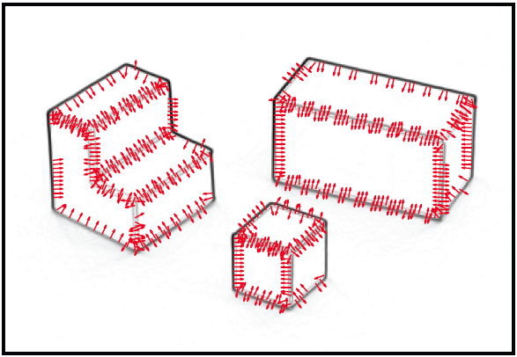
Finding edges in the image
I(x,y)
E(x,y)
and
n(x,y)

Slide 44
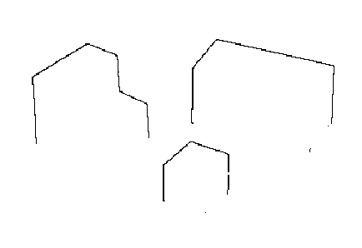
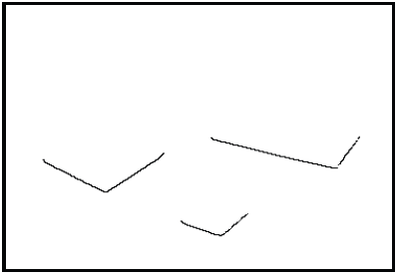
Edge classification
Figure/ground segmentation
Using the fact that objects have color
Occlusion edges
Occlusion edges are owned by the foreground
Contact edges

Slide 45
From edges to surface constraints
X(x,y)
Y(x,y)
?
Z(x,y)

Slide 46
From edges to surface constraints
Ground
Y(x,y) = 0 if (x,y) belongs to a ground pixel
Contact edge
Y(x,y) = 0 if (x,y) belongs to foreground and is a contact edge
What happens inside the objects?
… now things get a bit more complicated.

Slide 47
Generic view assumption
3D world
3D world
Image
3D world
Generic view assumption: the observer should not assume that he has a special position in the world… The most generic interpretation is to see a vertical line as a vertical line in 3D.
Freeman, 93

Slide 48
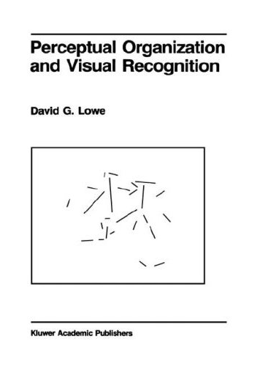
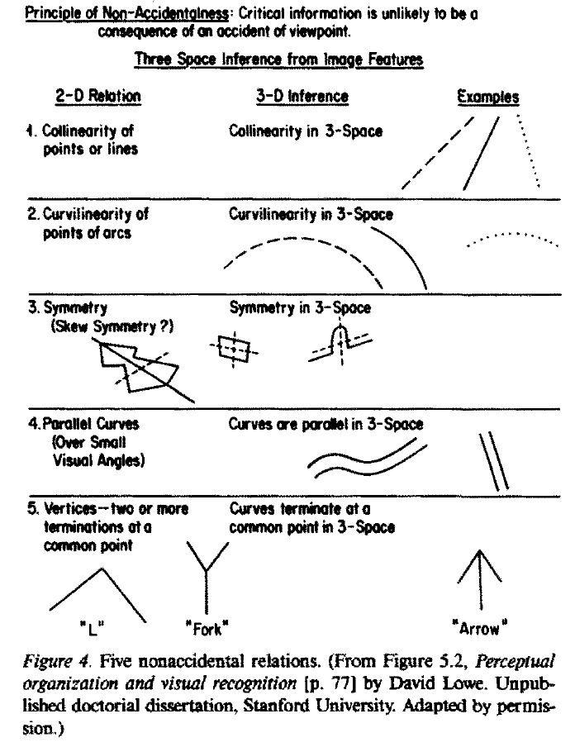
Non-accidental properties
D. Lowe, 1985
Biederman_RBC_1987

Slide 49
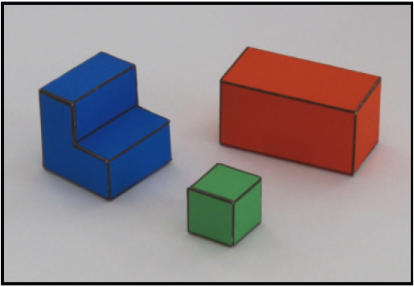
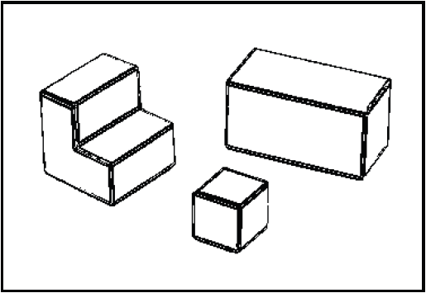
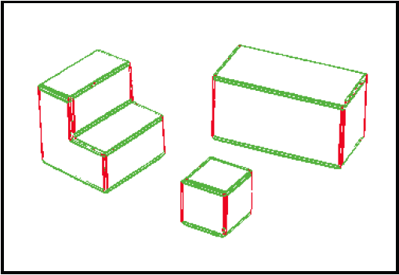
Non-accidental properties in the simple world
generic
generic
generic
accidental
generic
generic
generic
Using E(x,y)
Using θ(x,y)

Slide 50
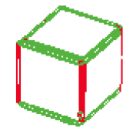
From edges to surface constraints
How can we relate the information in the pixels with 3D surfaces in the world?
Vertical edges
World coordinates
x =
X + x₀
y =
cos(θ) Y – sin(θ) Z + y₀
image coordinates
Given the image, what can we say about X, Y and Z in the pixels that belong to a vertical edge?
Z = constant along the edge

Slide 51
From edges to surface constraints
Horizontal edges
World coordinates
x =
X + x₀
y =
cos(θ) Y – sin(θ) Z + y₀
image coordinates
Given the image, what can we say about X, Y and Z in the pixels that belong to an horizontal 3D edge?
Y = constant along the edge
Where t is the vector parallel to the edge

Slide 52
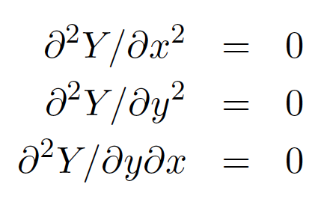
From edges to surface constraints
What happens where there are no edges?
?
Assumption of planar faces:
Information has to be propagated from the edges

Slide 53
A simple inference scheme
All the constraints are linear
Y(x,y) = 0
if (x,y) belongs to a ground pixel
if (x,y) belongs to a vertical edge
if (x,y) belongs to an horizontal edge
if (x,y) is not on an edge
A similar set of constraints could be derived for Z

Slide 54
Discrete approximation
We can transform every differential constrain into a discrete linear constraint on Y(x,y)
Y(x,y)
111 | 115 | 113 | 111 | 112 | 111 | 112 | 111
135 | 138 | 137 | 139 | 145 | 146 | 149 | 147
163 | 168 | 188 | 196 | 206 | 202 | 206 | 207
180 | 184 | 206 | 219 | 202 | 200 | 195 | 193
189 | 193 | 214 | 216 | 104 | 79 | 83 | 77
191 | 201 | 217 | 220 | 103 | 59 | 60 | 68
195 | 205 | 216 | 222 | 113 | 68 | 69 | 83
199 | 203 | 223 | 228 | 108 | 68 | 71 | 77
dY
dx
≈ Y(x,y) – Y(x-1,y)
-1 | 1
A slightly better approximation
(it is symmetric, and it averages horizontal derivatives over 3 vertical locations)
-1 | 0 | 1
-2 | 0 | 2
-1 | 0 | 1

Slide 55
Discrete approximation
Transform the “image” Y(x,y) into a column vector:
x=2, y=2
dY
Y(x,y)
dx
≈ Y(x,y) – Y(x-1,y) = Y(2,2) – Y(1,2)=
0 | 0 | 0 | 0 | 0 | -1 | 0 | 0 | 0 | 1 | 0 | 0 | 0 | 0 | 0 | 0
x=0 y=0

Slide 56
A simple inference scheme
Y
b
=
Constraint weights
A Y = b
Y = (A^{T}A)⁻¹ A^{T}b

Slide 57
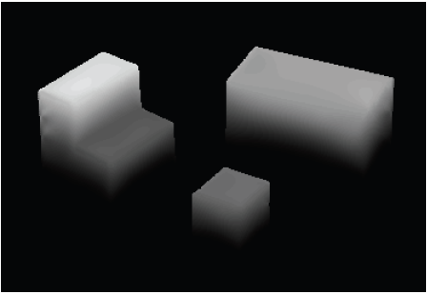
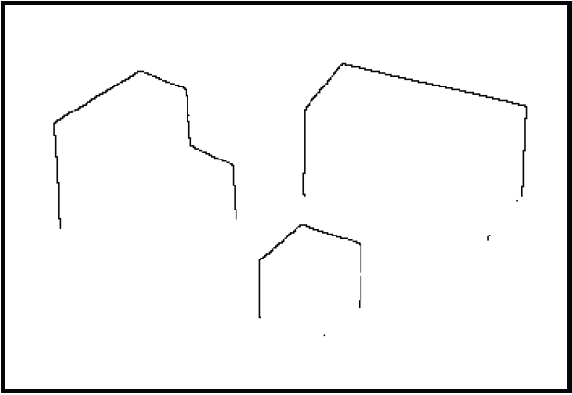
Results
X
Edge strength
3D orientation
Y
Edge normals
Contact edges
Z
Depth discontinuities

Slide 58
Changing view point
Input
New view points:

Slide 59
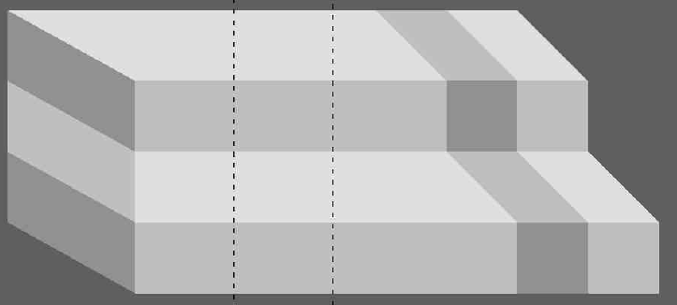
Violations of simple world assumptions

Slide 60
Violations of simple world assumptions
Shading is due to painted stripes

Slide 61
Violations of simple world assumptions
Shading is due to illumination

Slide 62
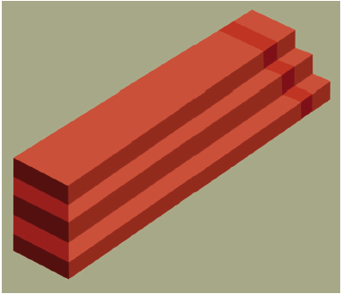
Impossible steps

Slide 63
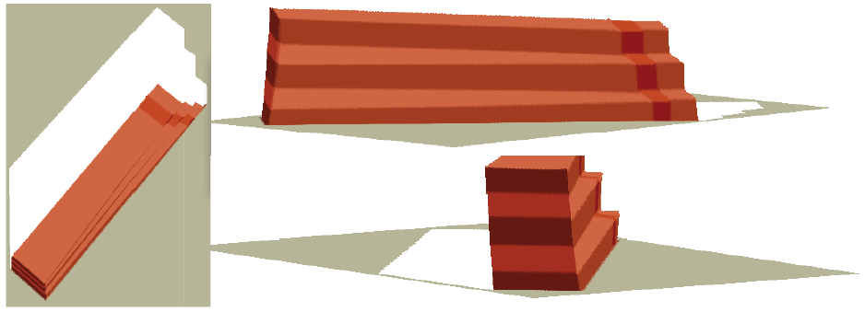
Impossible steps

Slide 64
Problem set 1 The “one week” vision project

