Slide 1

Antonio Torralba and Bill Freeman, 2017
Lecture 2
Linear filters

Slide 2
Class web page
http://6.869.csail.mit.edu/fa17/

Slide 3
About me…
Bill Freeman
Thomas and Gerd Perkins Professor,
Electrical Engineering and Computer Science
MIT CSAIL
Stata Center, 32-D476
Cambridge, MA 02139
e-mail: billf@mit.edu
web: http://www.ai.mit.edu/people/wtf

Slide 4
Polaroid

Slide 8
Taiyuan, China, 1987

Slide 9

In my office at the Computer Center, 1987

Slide 10
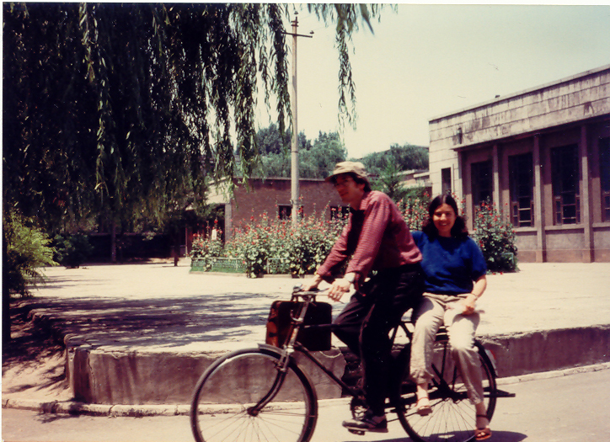

Slide 13
Polaroid
MIT Media Lab

Slide 15
Image interpretation from local cues
Image
Oriented energy
Contours
Occluding contour

Slide 16
MERL
Polaroid
MIT Media Lab

Slide 18
Comdex 1994
Decathlete 100m hurdles

Slide 19
MERL
Polaroid
MIT AI Lab
MIT Media Lab

Slide 20
MERL
MIT AI Lab
Polaroid
MIT AI Lab
MIT Media Lab

Slide 21
MERL
MIT AI Lab
Polaroid
MIT AI Lab
MIT CSAIL
MIT Media Lab

Slide 22


Slide 23



Slide 24
MERL
MIT AI Lab
Polaroid
MIT AI Lab
MIT CSAIL
Google
MIT Media Lab

Slide 25


Slide 26
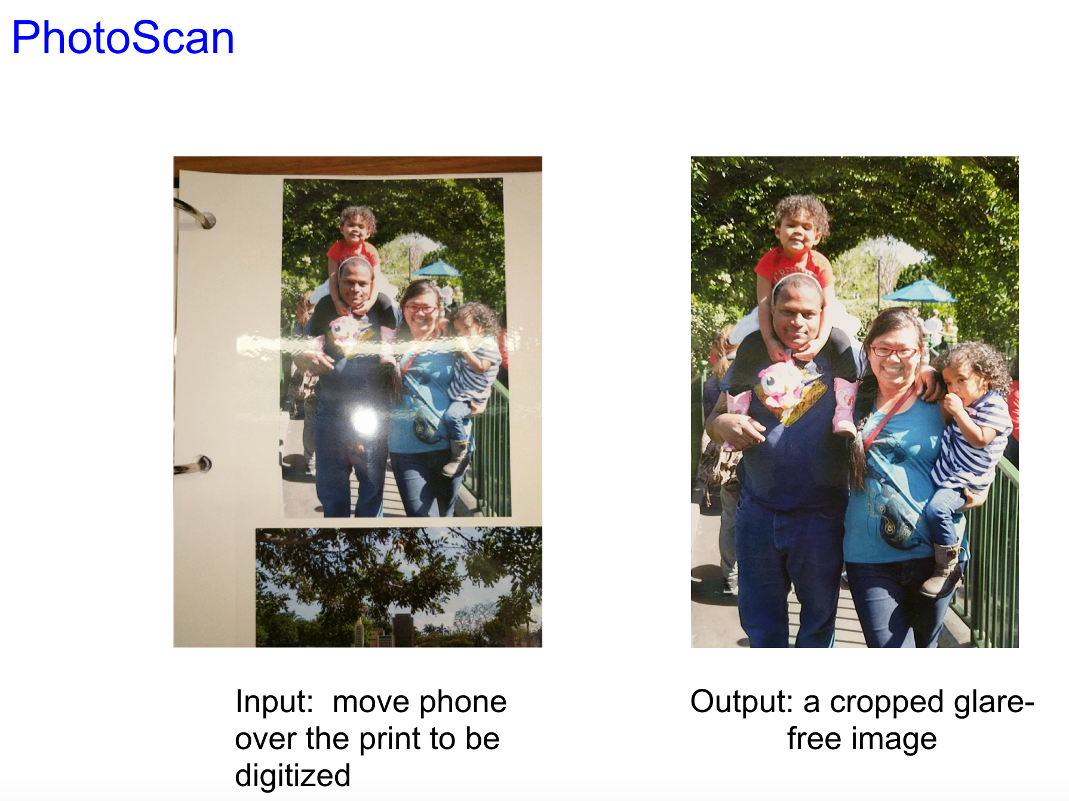

Slide 27
MERL
MIT AI Lab
Polaroid
MIT AI Lab
MIT CSAIL
Google
MIT Media Lab

Slide 28
Two offerings of a Matlab tutorial
Sep. 13 & Sep. 14
Intended for people with no Matlab exposure.
Weds 9/13/2017 11:00 am 32-D507 Zhoutong
Thurs 9/14/2017 3:00 pm 32-D507 Jiajun

Slide 29
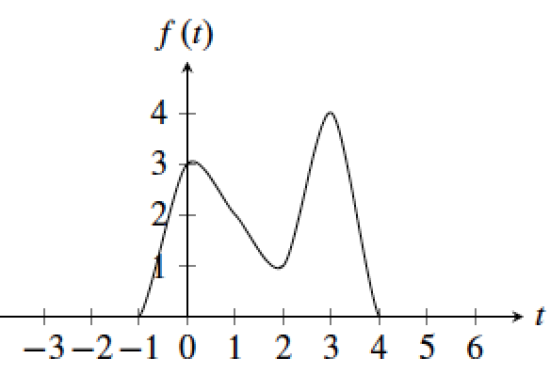
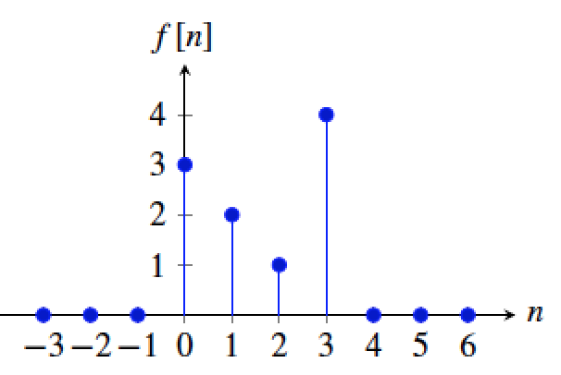
Signals and systems
Time continuous signal
Time discrete signal

Slide 30
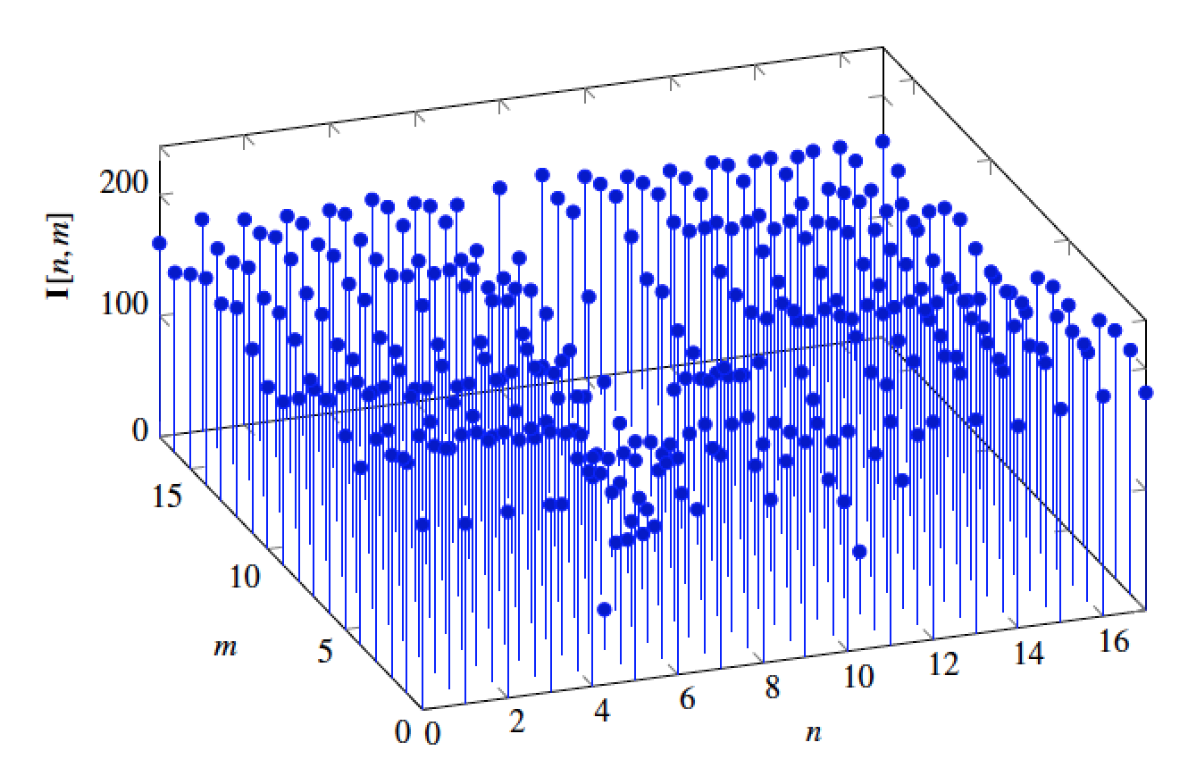
A 2D discrete signal

Slide 31
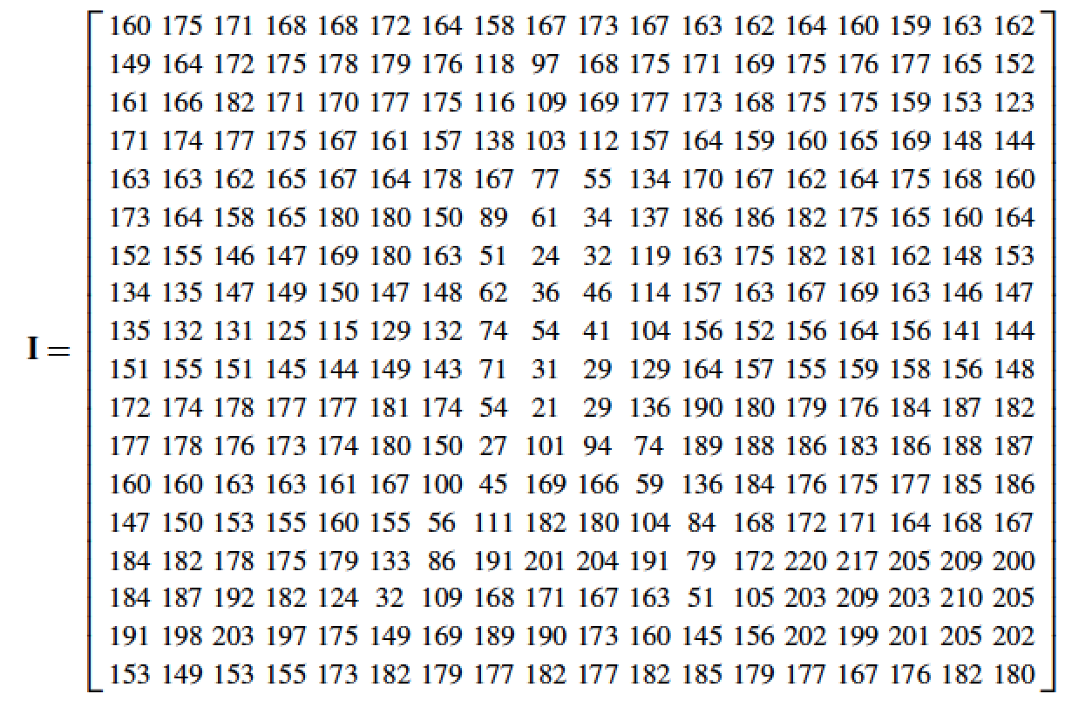

Slide 32
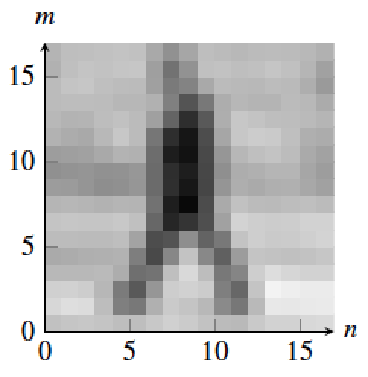
A tiny person of 18 x 18 pixels

Slide 33
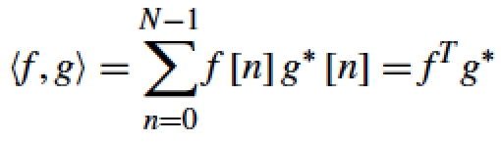
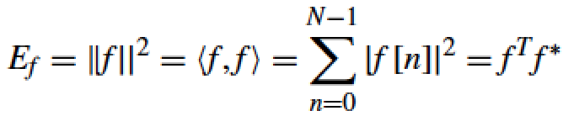
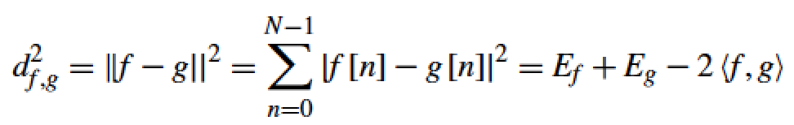
Signal / image space
Scalar product between two signals f, g :
L2 norm of f :
Distance between two signals f, g :

Slide 34

Filtering
Image in
Image out
We want to remove unwanted sources of variation, and keep the information relevant for whatever task we need to solve

Slide 35
Linear filtering
g [m,n]
f [m,n] = H(g [m,n])
For a filter to be linear, it has to verify:
f [m,n] = H(a [m,n] + b [m,n]) = H(a [m,n]) + H(b [m,n])
f [m,n] = H(C a [m,n]) = C H(a [m,n])

Slide 36
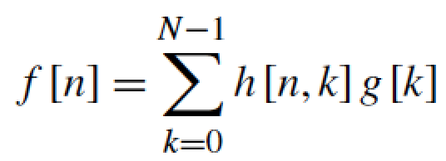
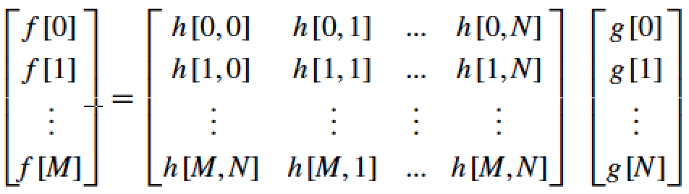
Linear filtering, 1D
g [n]
f [n] = H(g [n])
A linear filter in its most general form can be written as,
in 1D for a signal of length N:
It is useful to make it more explicit by writing:

Slide 37
Linear filtering, 1D
g [n]
f [n] = H(g [n])
A linear filter in its most general form can be written as,
in 1D for a signal of length N:
It is useful to make it more explicit by writing:

Slide 38
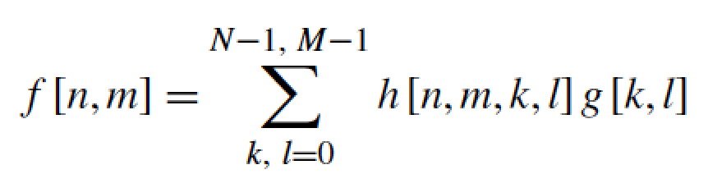
Linear filtering
g [m,n]
f [m,n] = H(g [m,n])
In 2D:
Which can also be written in matrix form as in the 1D case:
=

Slide 39

Why should one pixel be treated differently than any another?
Credit picture: Fredo Durand

Slide 40
Why should one pixel be treated differently than any another?
Credit picture: Fredo Durand

Slide 41
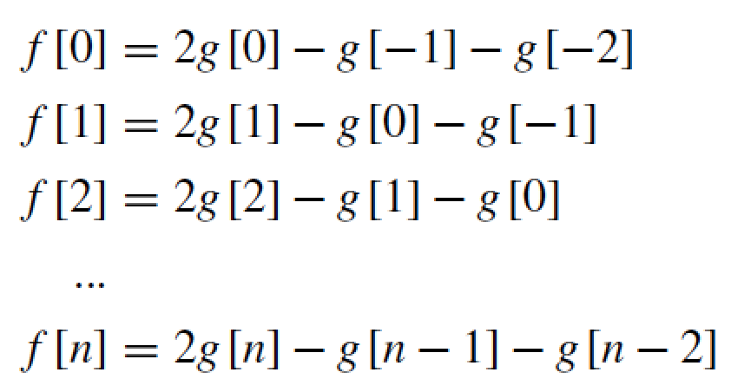
A translation invariant filter
Example: The output for the sample n is twice the value of the
input at that same time minus the sum of the two previous time steps
A filter is linear translation invariant (LTI) if it is linear and when we translate the input signal by m samples, the output is also translated by m samples.

Slide 42

A translation invariant filter
=
The same weighting occurs within each window

Slide 43
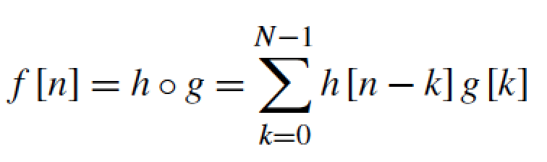
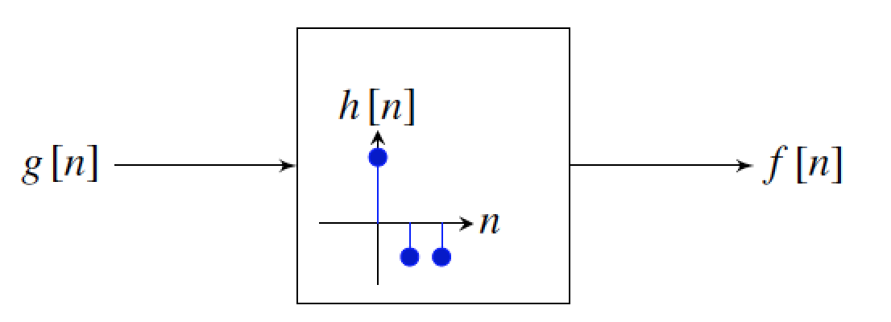
Convolution
For the previous example: h = [2, -1, -1]

Slide 44
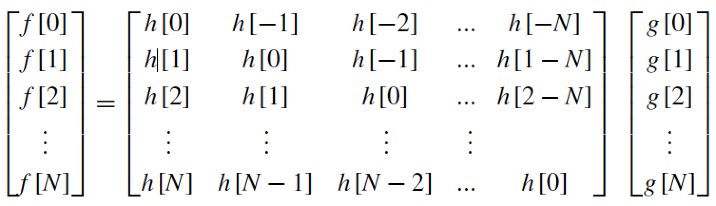
Convolution
In the 1D case, it helps to make explicit the structure of the matrix:

Slide 45
Convolution
In the 1D case, it helps to make explicit the structure of the matrix:

Slide 46
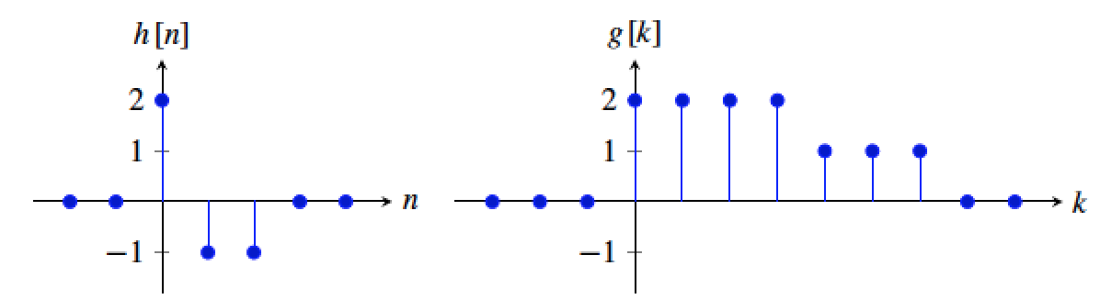
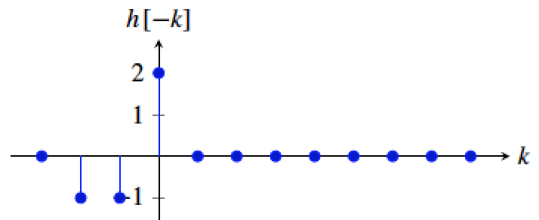

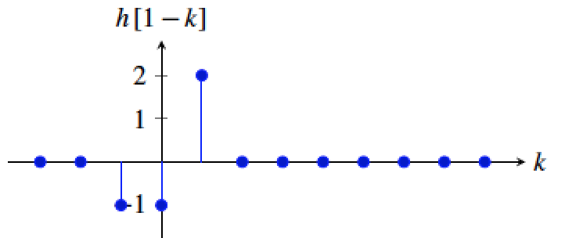

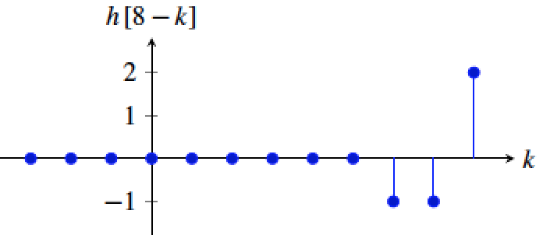

Convolution
f [0] = 4
f [1] = 2
.
.
.
.
.
.
f [8] = -1

Slide 47
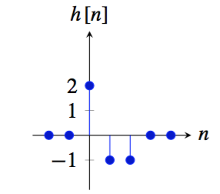
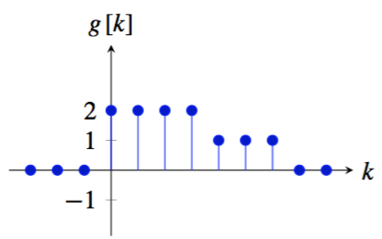
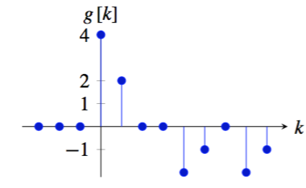
Convolution
○
=

Slide 48


Properties of the convolution
Commutative
Associative
Distributive with respect to the sum
Shift property

Slide 49
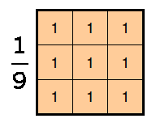
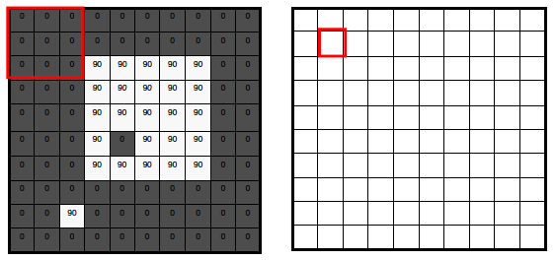
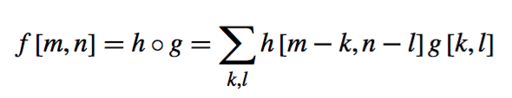
2D convolution

Slide 50
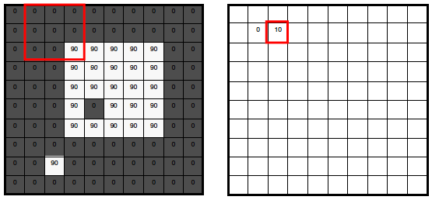

Slide 51
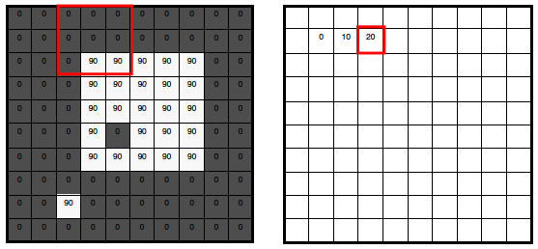

Slide 52
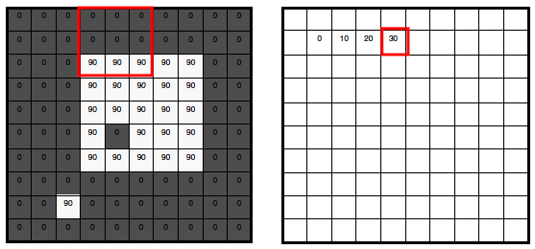

Slide 53
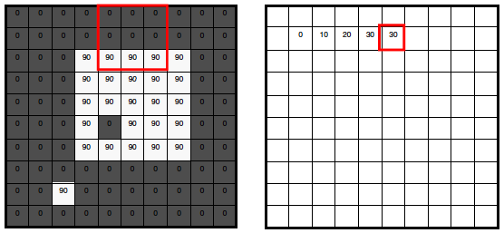

Slide 54
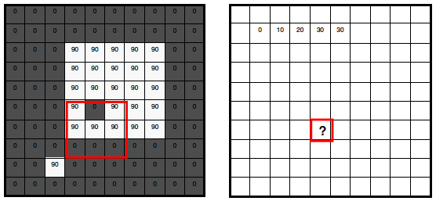

Slide 55
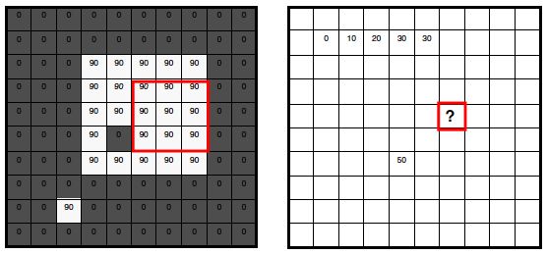

Slide 56
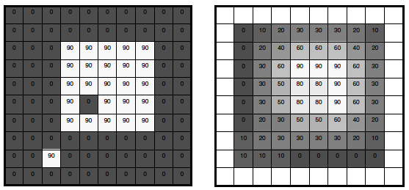
What does it do?
• Replaces each pixel with an average of its neighborhood
• Achieve smoothing effect (remove sharp features)

Slide 57


2D convolution
m=0 1 2 …
111 | 115 | 113 | 111 | 112 | 111 | 112 | 111
135 | 138 | 137 | 139 | 145 | 146 | 149 | 147
163 | 168 | 188 | 196 | 206 | 202 | 206 | 207
180 | 184 | 206 | 219 | 202 | 200 | 195 | 193
189 | 193 | 214 | 216 | 104 | 79 | 83 | 77
191 | 201 | 217 | 220 | 103 | 59 | 60 | 68
195 | 205 | 216 | 222 | 113 | 68 | 69 | 83
199 | 203 | 223 | 228 | 108 | 68 | 71 | 77
? | ? | ? | ? | ? | ? | ? | ?
? | -5 | 9 | -9 | 21 | -12 | 10 | ?
? | -29 | 18 | 24 | 4 | -7 | 5 | ?
? | -50 | 40 | 142 | -88 | -34 | 10 | ?
? | -41 | 41 | 264 | -175 | -71 | 0 | ?
? | -24 | 37 | 349 | -224 | -120 | -10 | ?
? | -23 | 33 | 360 | -217 | -134 | -23 | ?
? | ? | ? | ? | ? | ? | ? | ?
-1 | 2 | -1
-1 | 2 | -1
-1 | 2 | -1
=
h[m,n]
f[m,n]
g[m,n]

Slide 58

Handling boundaries

Slide 59
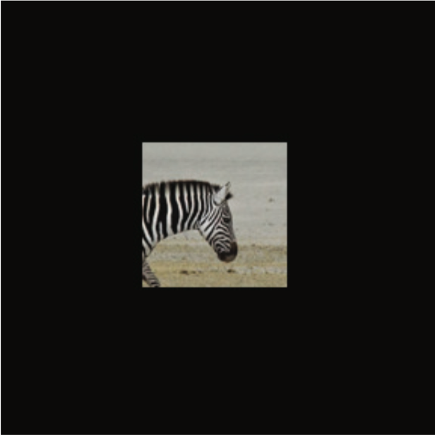
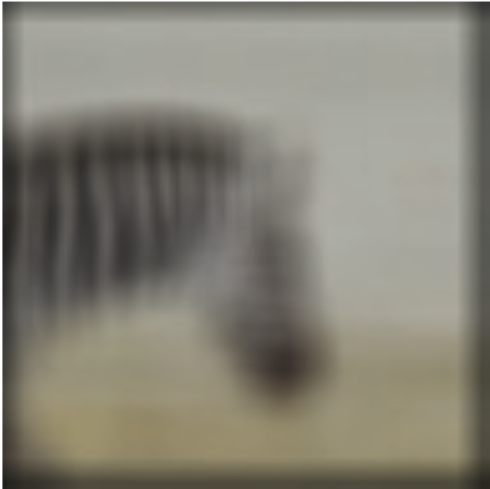
Handling boundaries
Zero padding
=
11x11 ones

Slide 60
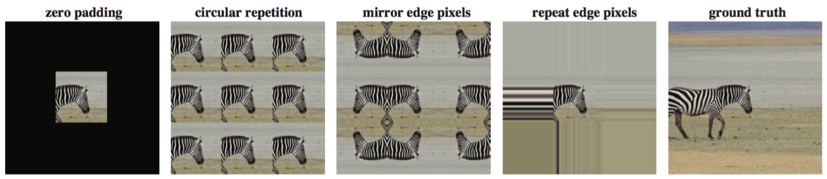


Handling boundaries
Input
Output
Error
Notes:
Circular repetition is useful because of the DFT

Slide 61
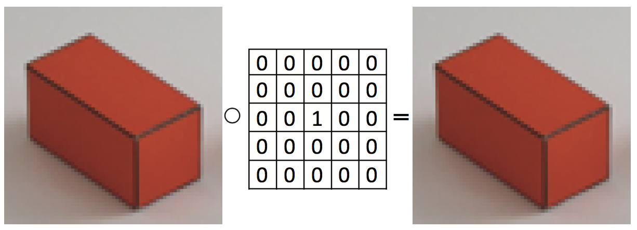
Examples

Slide 62

Examples
2 pixels
(using zero padding)

Slide 63

Examples

Slide 64

Examples

Slide 65
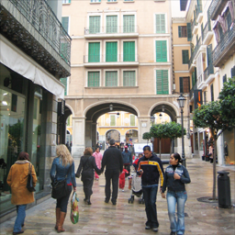

Rectangular filter
=
h[m,n]
f[m,n]
g[m,n]

Slide 66

Rectangular filter
=
h[m,n]
f[m,n]
g[m,n]

Slide 67

Rectangular filter
=
h[m,n]
f[m,n]
g[m,n]

Slide 68
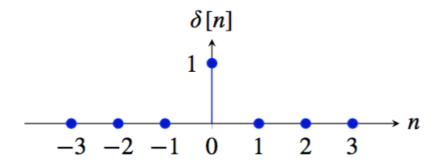
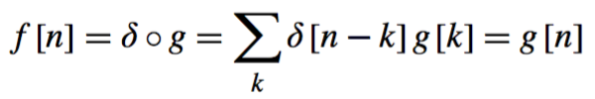

Important signals
The impulse
The result of convolving a signal g[n] with the impulse signal is the same signal:
Convolving a signal f with a translated impulse δ [n − n0] results in a translated signal:

Slide 69
Why the impulse is so important
Write the input signal as a sum of impulses
δ [n]
h [n]
LTI system

Slide 70
Why the impulse is so important
δ [n]
h [n]
LTI system
Passing f[n] through the LTI system, replace every δ[n] in f[n] with h[n]
f [n]
g [n]
LTI system
Then the output of an LTI system is the corresponding sum of impulse responses.

Slide 71

Why the impulse is so important

Slide 72
Why the impulse is so important

Slide 73

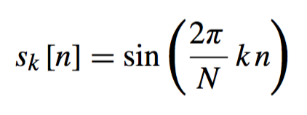
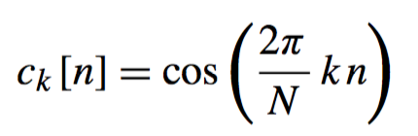
Important signals
Cosine and sine waves
A discrete signal f [n] is periodic, if there exists T ∈ integers such that f [n] = f [n + mT] for all m ∈ integers. For the discrete sine (and cosine) wave to be periodic the frequency has to be w = 2πK/N for K,N ∈ integers. If K/N is an irreducible fraction, then the period of the wave will be T = N samples.
k ∈ [1, N /2] denotes the number of wave cycles that will occur within the region of support

Slide 74
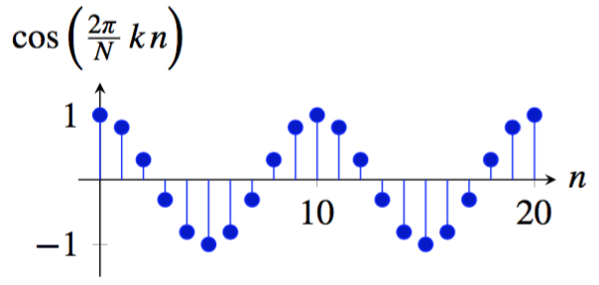
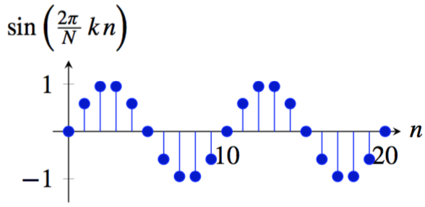
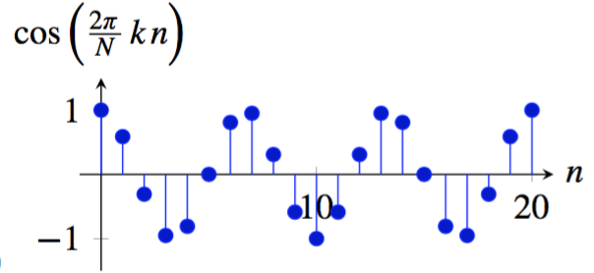
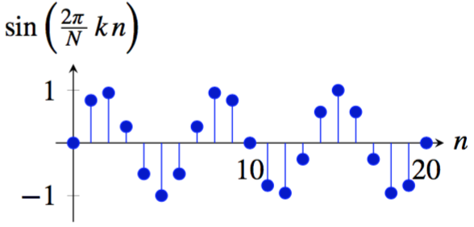
Important signals
Cosine and sine waves, N=20
k=2
k=2
k=3
k=3

Slide 75


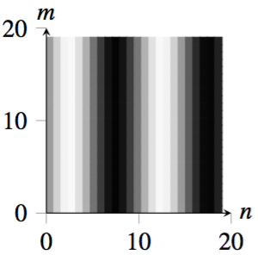
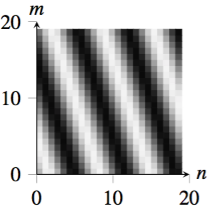
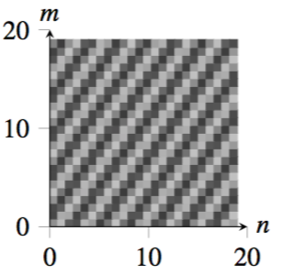
Waves in 2D
^{u = 2, v = 0}
^{u = 3, v = 1}
^{u = 7, v = −5}

Slide 76



Important signals
Complex exponential
In discrete time (setting A = 1), we can write:
And in 2D, the complex exponential wave is:

Slide 77

Important signals
Complex exponential
N = 40, k = 1
N = 40, k = 4

Slide 78
Each of impulses, sine and cosine waves or complex exponentials can form an orthogonal basis for signals of length N

Slide 79


Linear image transformations
In analyzing images, it’s often useful to make a change of basis.
Transformed image
Vectorized image
Fourier transform, or
Wavelet transform, or
Steerable pyramid transform
=

Slide 80
Self-inverting transforms
Same basis functions are used for the inverse transform
U transpose and complex conjugate

Slide 81


The Discrete Fourier transform
Discrete Fourier Transform (DFT) transforms an image
f [m, m] into the complex image Fourier transform F [u, v] as:
The inverse Fourier transform is:

Slide 82

Discrete Fourier transform visualization
Notes:
Cellbots

Slide 83
Fourier transform visualization

Slide 84




Some useful transforms
Fourier transform of an impulse, the Delta function δ[n ,m]:
If we apply the inverse DFT to both sides, we have:

Slide 85





Some useful transforms
The Fourier transform of the cosine wave
is:
Same for the sine wave:

Slide 86


Bracewell’s pictorial dictionary of Fourier transform pairs
Bracewell, The Fourier Transform and its Applications, McGraw Hill 1978

Slide 87

Szeliski, Computer Vision, 2010

Slide 88
2D Discrete Fourier Transform
Note that 2D (and higher-D) DFT’s are separable:
This is a 1D DFT over m, followed by 1D DFT over n.

Slide 89

2D Discrete Fourier Transform
Using the real and imaginary components:
Or using a polar decomposition:

Slide 90




2D Discrete Fourier Transform

Slide 91
Properties for the DFT
Linearity
Symmetry: Fourier transform of a real signal has coefficients that come in pairs, with F [u, v] being the complex conjugate of F [-u, -v].

Slide 92
Properties for the DFT
Both the DFT and its inverse are periodic
As F [u, v] is obtained as a sum of complex exponential with a common period of N , M samples, the function F [u, v] is also periodic: F [u + aN, v + bM] = f [u, v] for any a, b ∈ Z. Also the result of the inverse DFT is a periodic image: f [n + aN, m + bM] = f [n, m] for any a, b ∈ Z.

Slide 93

Properties for the DFT
Shift in space

Slide 94







Properties for the DFT
Only the phase changes! The magnitude is translation invariant.

Slide 95


Properties for the DFT
Modulation
Multiplying by a complex exponential results in a translation of the DFT

Slide 96


Frequencies
Image
(assuming zero phase)
DFT amplitude
Images are 64x64 pixels. The wave is a cosine (if phase is zero).

Slide 97

Frequencies
Images are 64x64 pixels. The wave is a cosine (if phase is zero).

Slide 98






+
=

Slide 99



Some important Fourier transforms
Image
Magnitude DFT
Phase DFT
Images are 64x64 pixels.

Slide 100



Some important Fourier transforms
Image
Magnitude DFT
Phase DFT

Slide 101



Some important Fourier transforms
Image
Magnitude DFT
Phase DFT

Slide 102



Some important Fourier transforms
Image
Magnitude DFT
Phase DFT

Slide 103
Image
Magnitude DFT
Scale
Small image
details produce content in high spatial frequencies

Slide 104



Some important Fourier transforms
Image
Magnitude DFT
Phase DFT

Slide 105



Some important Fourier transforms
Image
Magnitude DFT
Phase DFT

Slide 106
Image
Magnitude DFT
Orientation
A line transforms to a line oriented perpendicularly to the first.

Slide 107


The Fourier Transform of some important images
Image
Log(1+Magnitude FT)

Slide 108
More properties for the DFT

Slide 109





DFT of the convolution

Slide 110
Linear filtering
g [m,n]
f [m,n]
h [m,n]
In the spatial domain:
In the frequency domain:

Slide 111


Product of images
The Fourier transform of the product of two images
is the convolution of their DFTs:

Slide 112


*
=

Slide 113






Game: find the right pairs
Images
A
B
C
DFT
magnitude
1
2
3
fx(cycles/image pixel size)
fx(cycles/image pixel size)
fx(cycles/image pixel size)

