Slide 1
Antonio Torralba and Bill Freeman, 2017
Lecture 3
Linear filters

Slide 2
Pset1 due tonight midnight
Pset2 out after class

Slide 3
Outline for today’s class
Fourier transform properties
Practice taking Fourier transforms
The importance of phase
Our perception of Fourier components
Hybrid images
Filtering tricks
Blur
Derivatives
Orientation

Slide 4
2D Discrete Fourier Transform
Note that 2D (and higher-D) DFT’s are separable:
Do this sum first
Then do this sum

Slide 5
Properties for the DFT
Linearity
Symmetry: Fourier transform of a real signal has coefficients that come in pairs, with F [u, v] being the complex conjugate of F [-u, -v].

Slide 6
Properties for the DFT
Both the DFT and its inverse are periodic
As F [u, v] is obtained as a sum of complex exponential with a common period of N , M samples, the function F [u, v] is also periodic: F [u + aN, v + bM] = f [u, v] for any a, b ∈ Z. Also the result of the inverse DFT is a periodic image: f [n + aN, m + bM] = f [n, m] for any a, b ∈ Z.

Slide 7
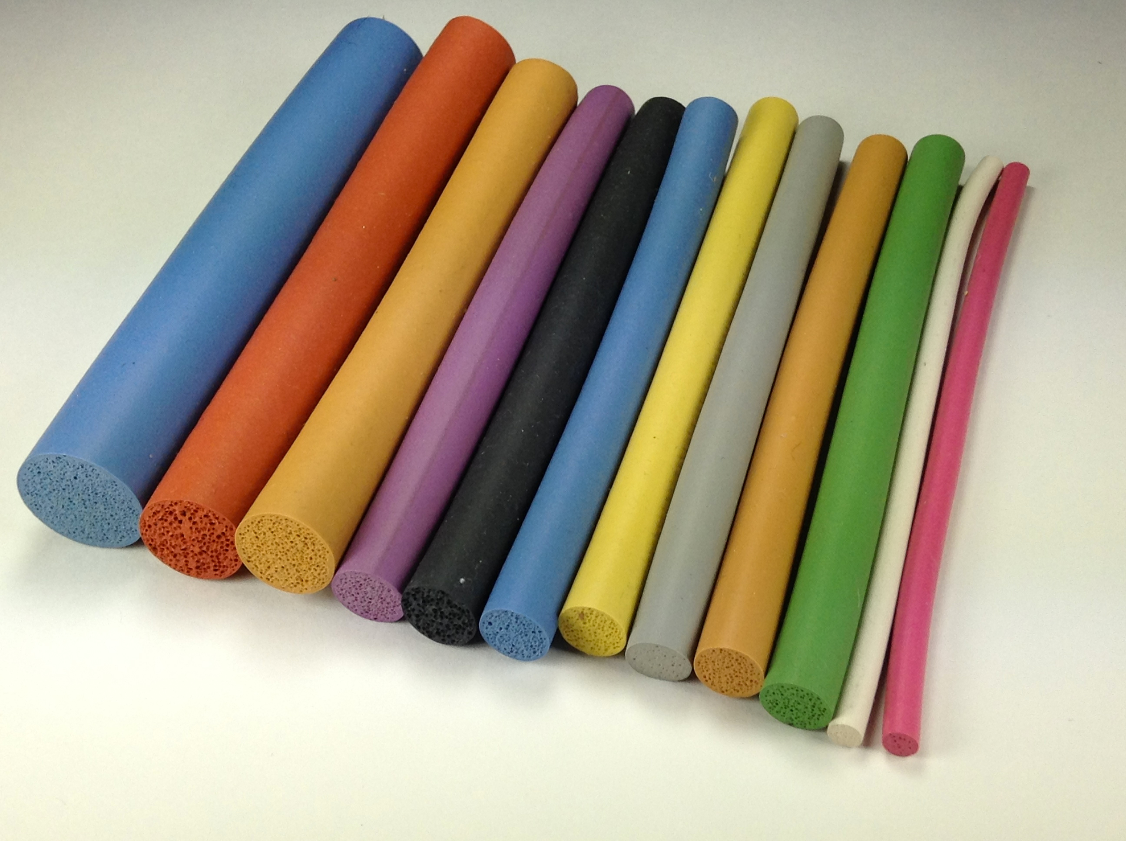
What will the FT of this look like?
https://www.marshbellofram.com/bellofram-silicones/products/bellofram-closed-cell-silicone-sponge-extrusion-products/

Slide 8
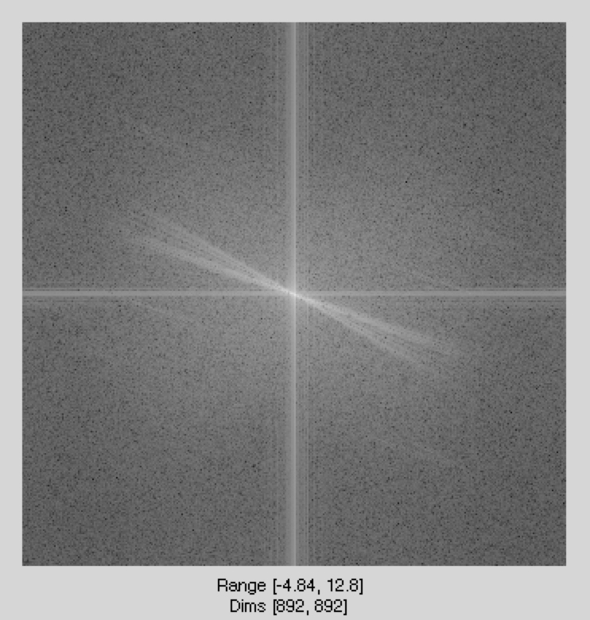
The DFT of this image:
Dft of luminance
image

Slide 9
What will the FT of this look like?
What the DFT sees

Slide 10
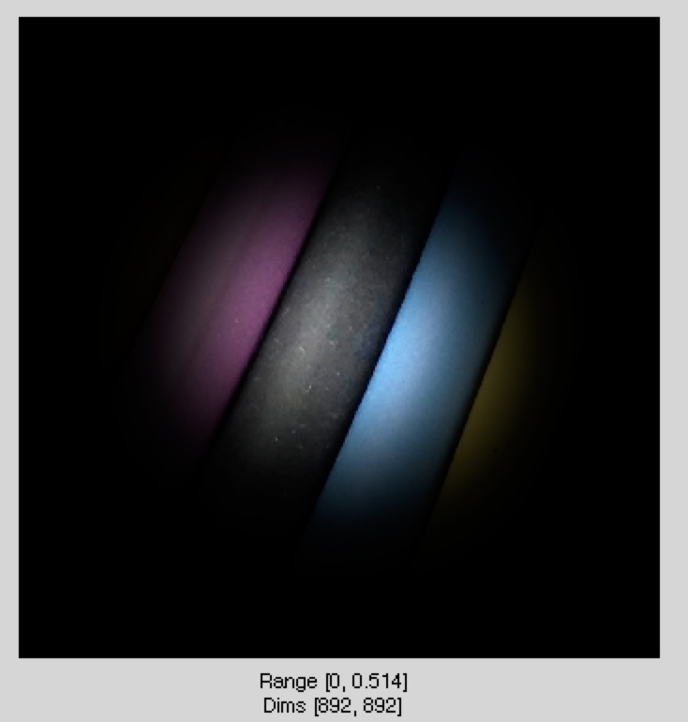
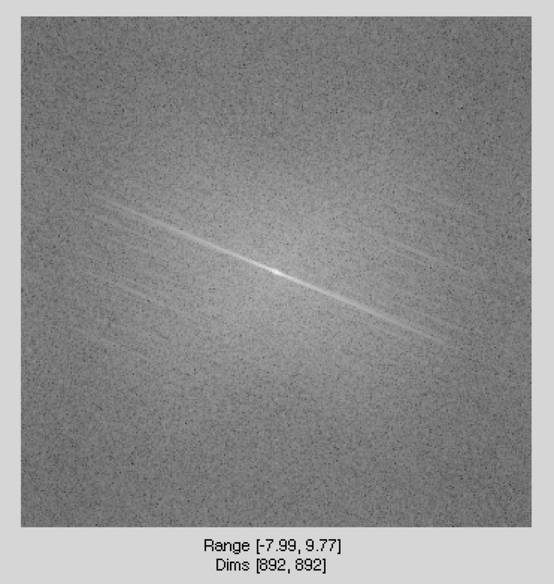
To remove any edge effects, let’s takd the DFT of this image:

Slide 11
Properties for the DFT
Shift in space corresponds to a phase shift in the frequency domain.

Slide 12
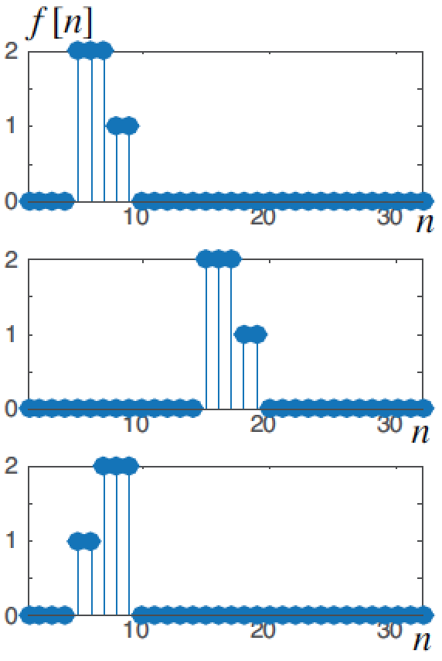
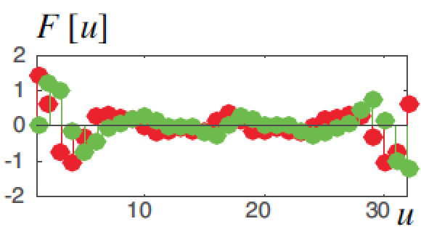
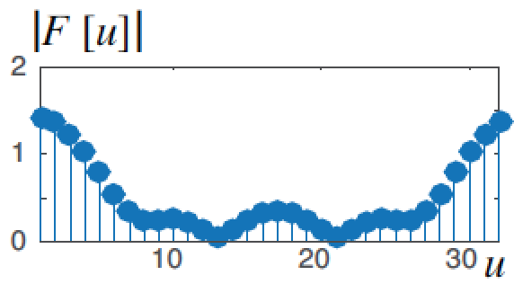
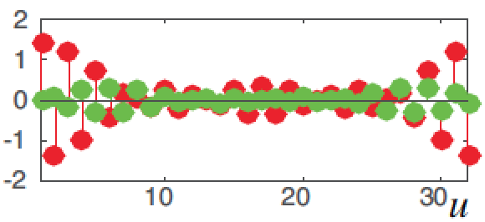
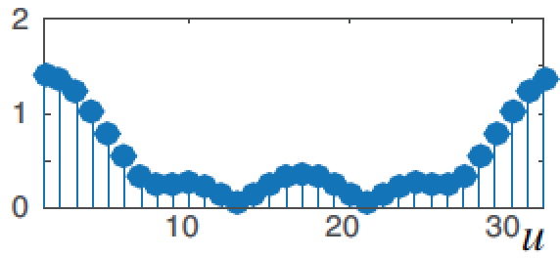
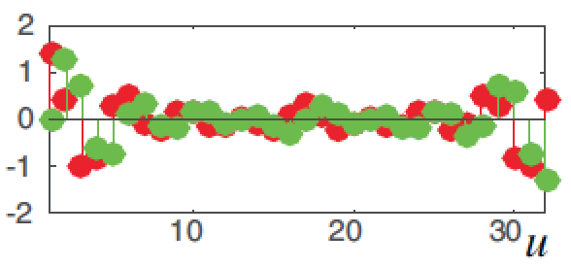
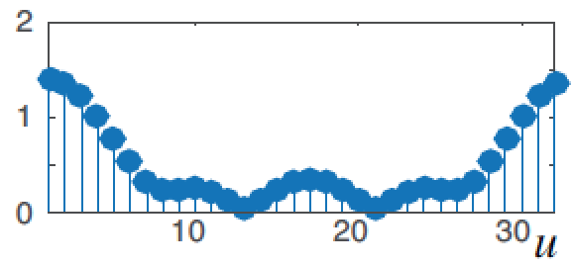
Properties for the DFT
Only the phase changes! The magnitude is translation invariant.

Slide 13
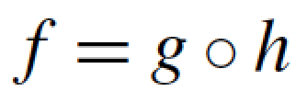
DFT of a convolution is the product of the DFT’s of the multiplicands

Slide 14
Outline for today’s class
Fourier transform properties
Practice taking Fourier transforms
The importance of phase
Our perception of Fourier components
Hybrid images
Filtering tricks
Blur
Derivatives
Orientation

Slide 15
2D Discrete Fourier Transform
Using the real and imaginary components:
Or using a polar decomposition:

Slide 16
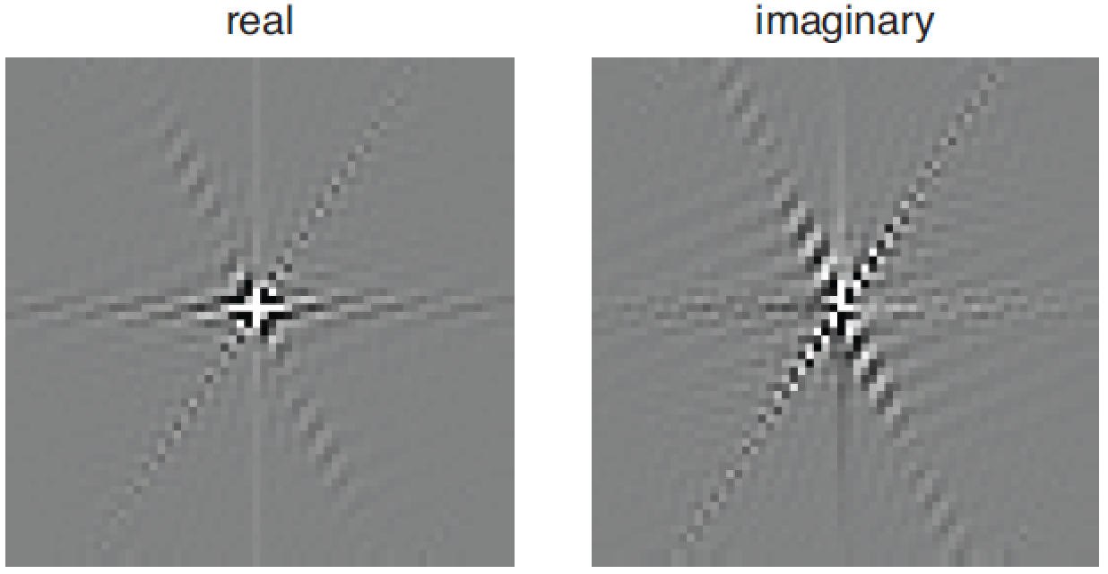
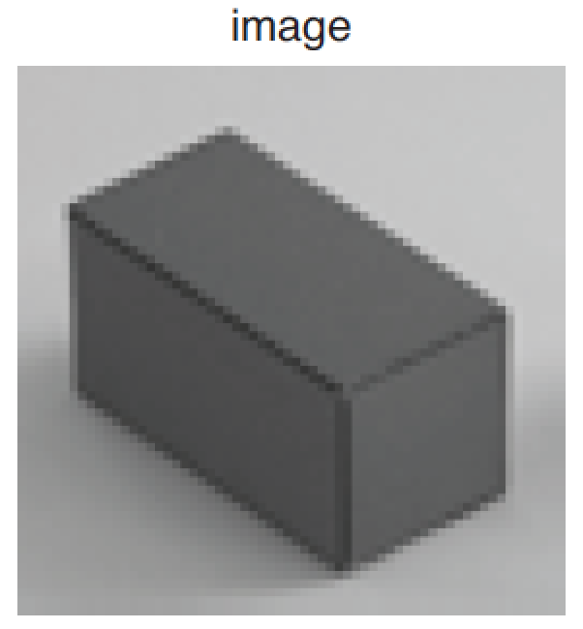
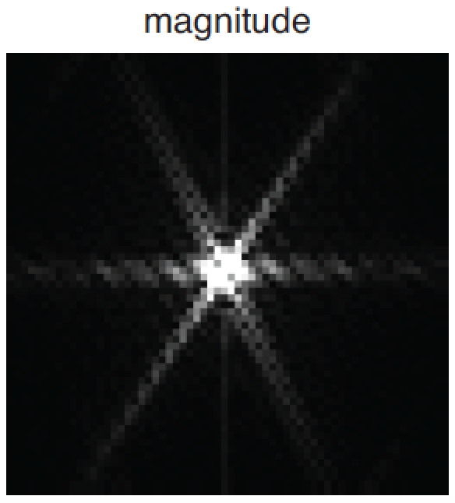
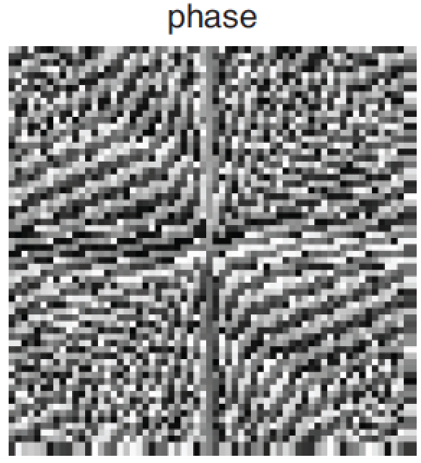
2D Discrete Fourier Transform

Slide 17
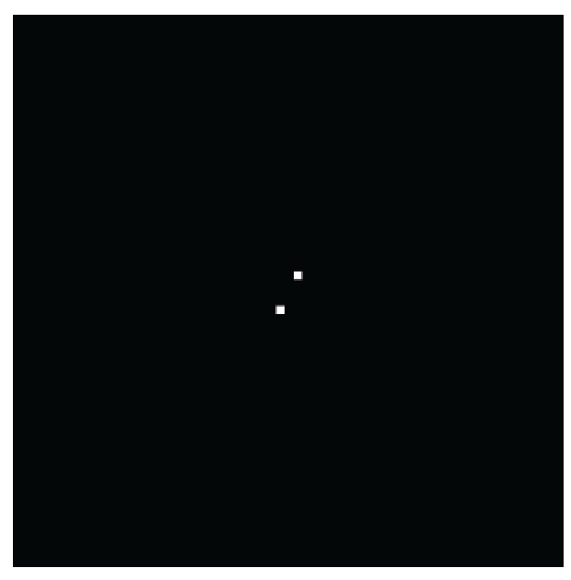
Frequencies
Image (assuming zero phase)
DFT amplitude
Images are 64x64 pixels. The wave is a cosine (if phase is zero).

Slide 18
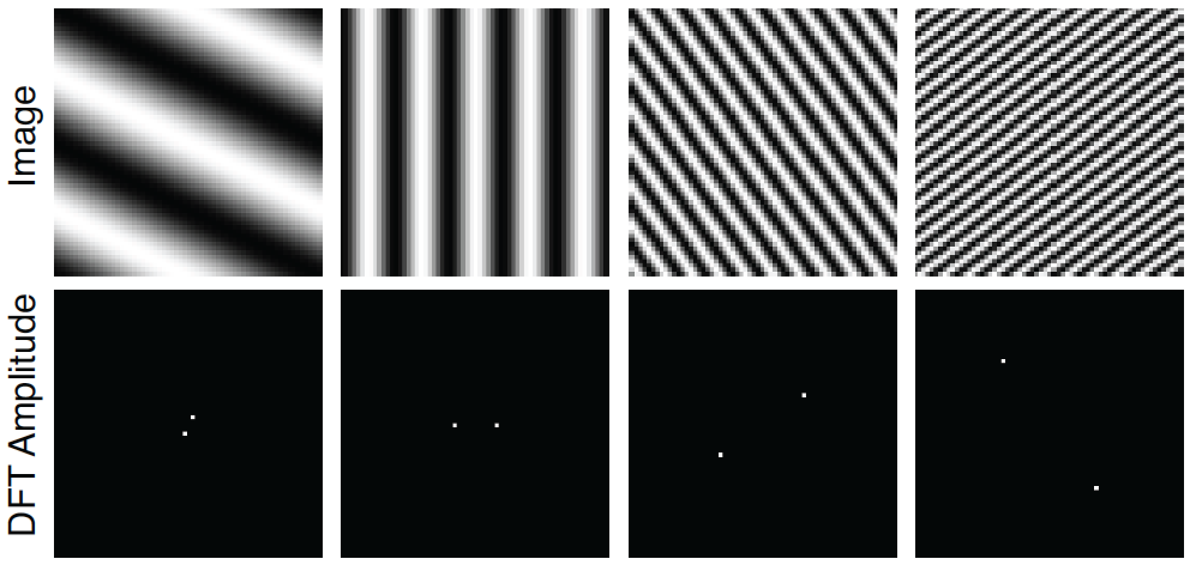
Frequencies
Images are 64x64 pixels. The wave is a cosine (if phase is zero).

Slide 19
Some important Fourier transforms
Image
Magnitude DFT
Phase DFT
Images are 64x64 pixels.

Slide 20
Some important Fourier transforms
Image
Magnitude DFT
Phase DFT

Slide 21
Some important Fourier transforms
Image
Magnitude DFT
Phase DFT

Slide 22
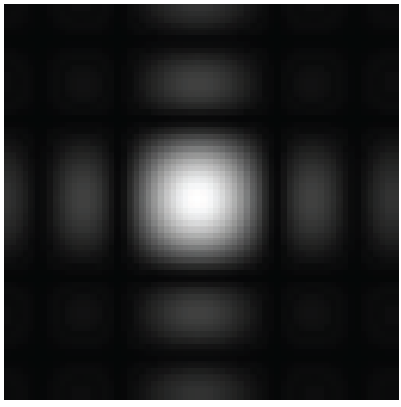
Some important Fourier transforms
Image
Magnitude DFT
Phase DFT

Slide 23
Image
Magnitude DFT
Scale
Small image details produce content in high spatial frequencies

Slide 24
Some important Fourier transforms
Image
Magnitude DFT
Phase DFT

Slide 25
Some important Fourier transforms
Image
Magnitude DFT
Phase DFT

Slide 26
Image
Magnitude DFT
Orientation
A line transforms to a line oriented perpendicularly to the first.

Slide 27
Linear filtering
g [m,n]
f [m,n]
h [m,n]
In the spatial domain:
In the frequency domain:

Slide 28
Product of images
The Fourier transform of the product of two images
is the convolution of their DFTs:

Slide 29
*
=

Slide 30
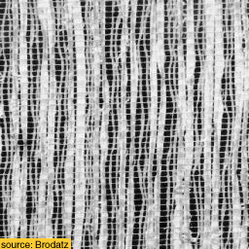
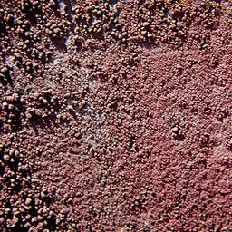
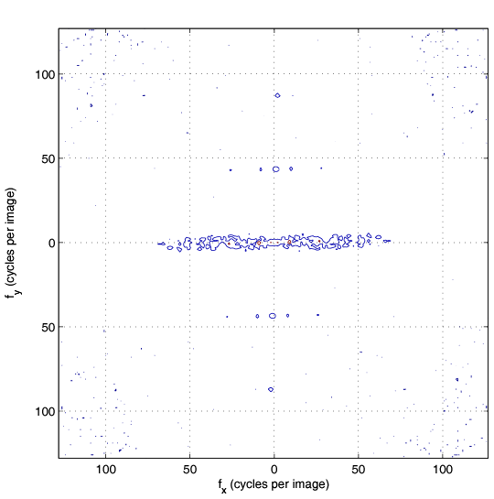
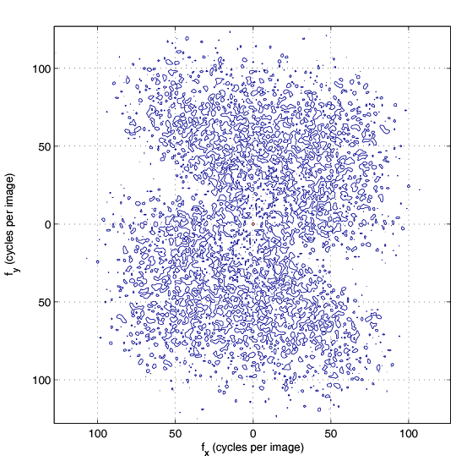
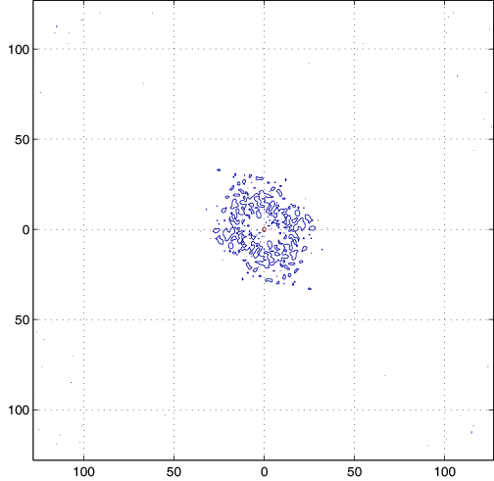
Game: find the right pairs
Images
A
B
C
DFT magnitude
1
2
3
fx(cycles/image pixel size)
fx(cycles/image pixel size)
fx(cycles/image pixel size)

Slide 31
Outline for today’s class
Fourier transform properties
Practice taking Fourier transforms
The importance of phase
Our perception of Fourier components
Hybrid images
Filtering tricks
Blur
Derivatives
Orientation

Slide 32
Phase and Magnitude
Curious fact
all natural images have about the same magnitude transform
hence, phase seems to matter, but magnitude largely doesn’t
Demonstration
Take two pictures, swap the phase transforms, compute the inverse - what does the result look like?

Slide 33
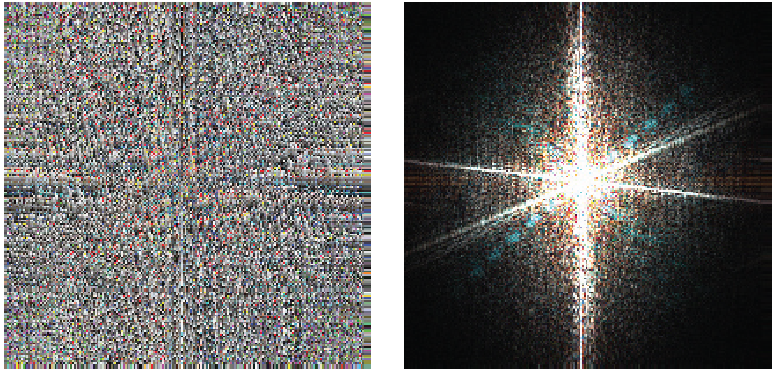
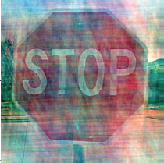
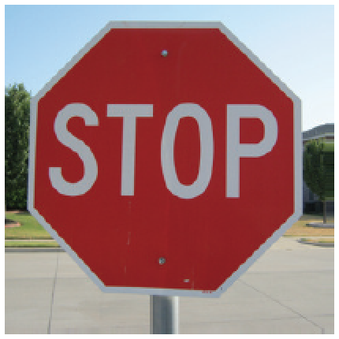
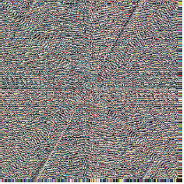
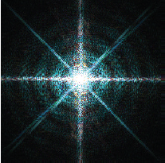
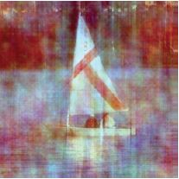
Phase and Magnitude
Each color channel is processed in the same way.

Slide 34
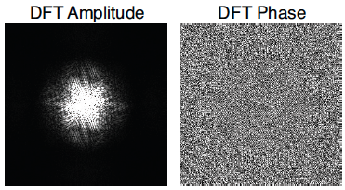
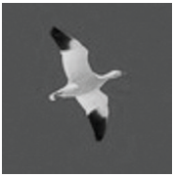
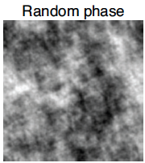
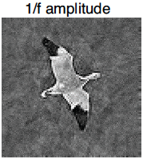
Phase and magnitude
Using random amplitude does not look good.

Slide 35
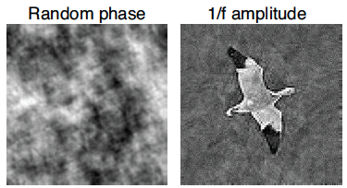
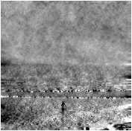
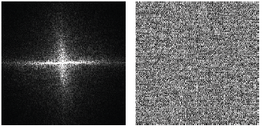
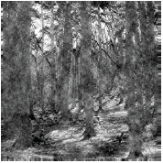
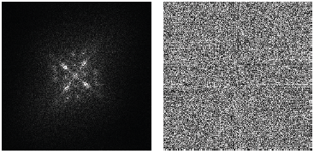
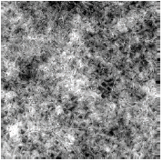
Does phase always win?

Slide 36
Outline for today’s class
Fourier transform properties
Practice taking Fourier transforms
The importance of phase
Our perception of Fourier components
Hybrid images
Filtering tricks
Blur
Derivatives
Orientation

Slide 37
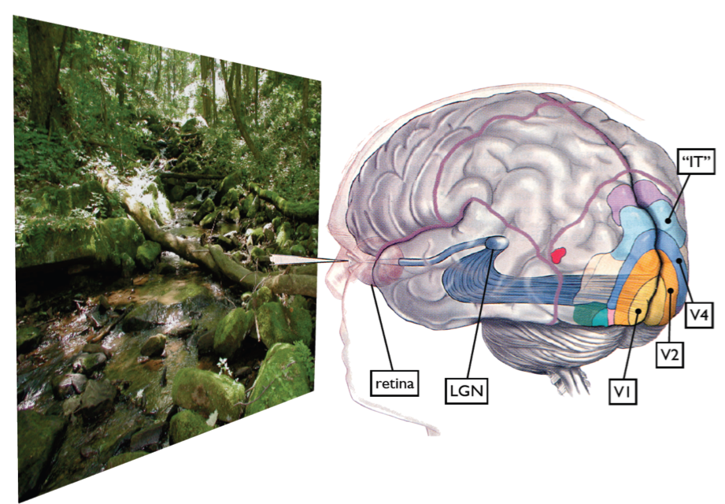
Some visual areas…
From M. Lewicky
Notes:
Slides from lewicki

Slide 38
Campbell & Robson chart
Let’s define the following image:
With:
What do you think you should see when looking at this image?

Slide 41
Contrast Sensitivity Function
Blackmore & Campbell (1969)
Maximum sensitivity
~ 6 cycles / degree of visual angle
Invisible
visible
Contrast sensitivity
0.1
1
10
100
Low
Spatial frequency (cycles/degree)
High

Slide 42
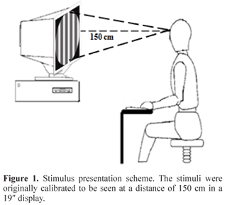

Slide 43
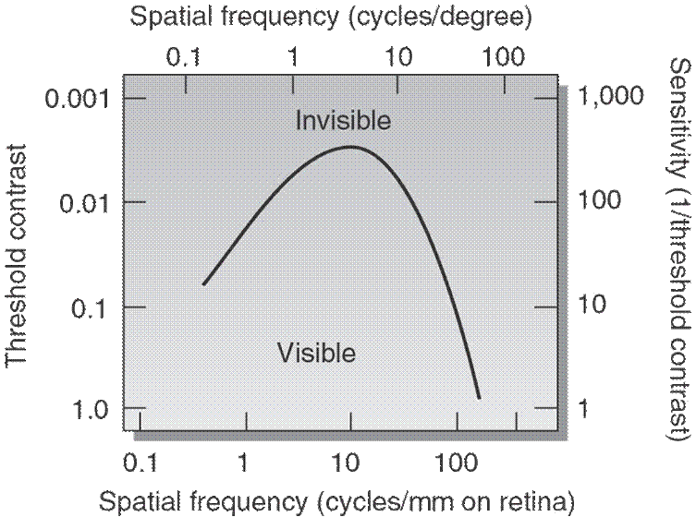
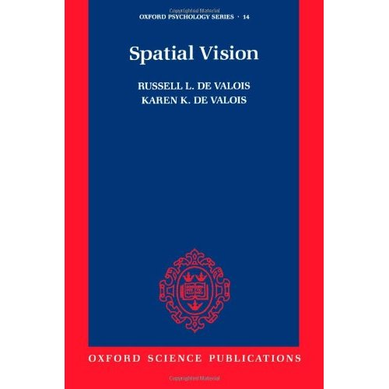
Contrast Sensitivity Function
From:
http://www.cns.nyu.edu/~david/courses/perception/lecturenotes/channels/channels.html

Slide 44
Human Visual Perception
Low spatial frequency
Blur image
Sharp image
Medium spatial frequency
High spatial frequency
Spatial frequency channels
Notes:
The most important principle subtening the working of hybrid images is the mechanism of human perception: The observer is seeing the world through a collection of spatial frequency channels: studies in human vision have precisely established the way our brain decomposes an image. From a low spatial frequency image (blur image, out of focus) to a high spatial frequency image, represented by sharp contours, details, edges, looking like a drawing. This decomposition is hard wired: this is how our brain reads the world.

Slide 45
Hybrid Images
Oliva & Schyns
Notes:
We start by taking two pictures, we isolate the details and contours in one, here the woman, and we blur the second face. as you can see, the man seems to go out of focus and the details of the woman are superposed.

Slide 46
Hybrid Images

Slide 47
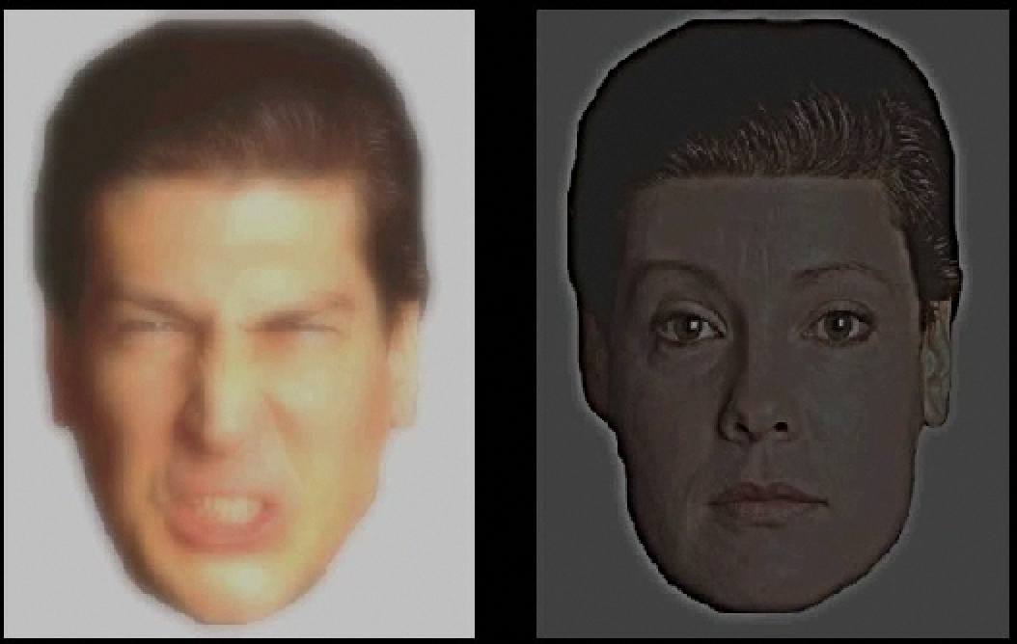
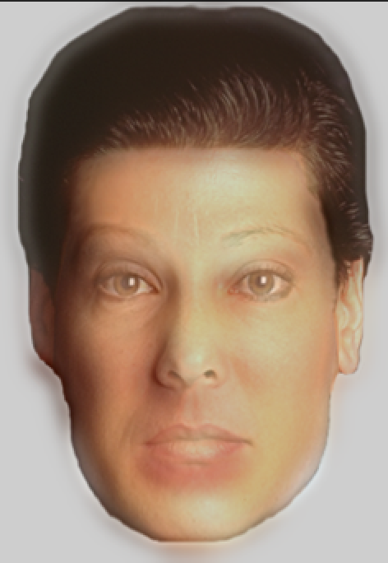
+
=

Slide 48
Hybrid Images

Slide 49
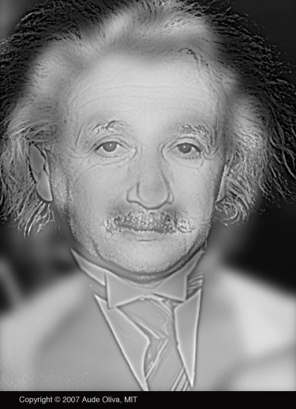

Slide 50
http://cvcl.mit.edu/hybrid_gallery/gallery.html

Slide 51
Outline for today’s class
Fourier transform properties
Practice taking Fourier transforms
The importance of phase
Our perception of Fourier components
Hybrid images
Filtering tricks
Blur
Derivatives
Orientation

Slide 52
A collection of useful filters

Slide 53
Low pass-filters

Slide 54
Box filter
2N+1
1 1 1 1 1 … 1
1 1 1 1 1 1
2M+1
…
…
…
…
…
…
1 1 1 1 1 1

Slide 55
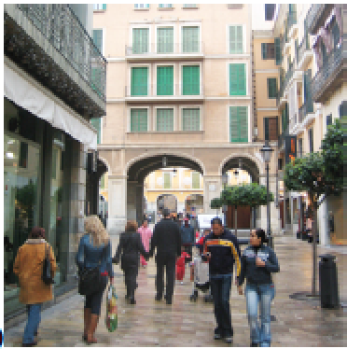
Box filter
=

Slide 56
Box filter
The box filter is separable as a 2-d box can be written as the convolution of two 1D kernels
1
1
1
1 1 1 1 1 1
1 1
=

Slide 57
Box filter
But if you convolve two boxes along the same dimension:
1 1 1
1 1 1
=
1 2 3 2 1
=
The convolution of two box filters is not another box filter.
It is a triangular filter.

Slide 58
Box filter
=
It produces a blurry version of the input. But it is not a perfect blur.

Slide 59
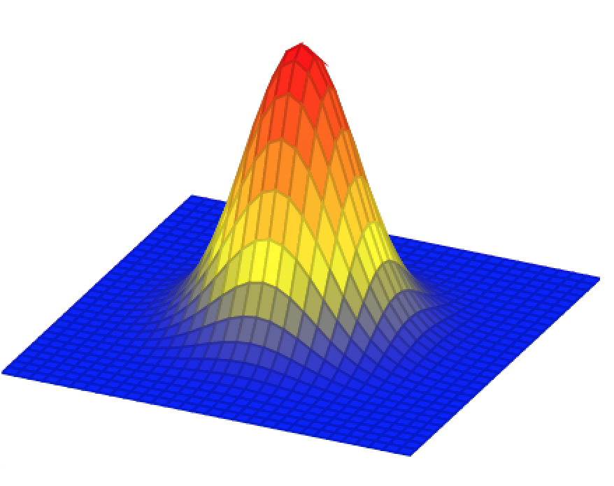
Gaussian filter
In the continuous domain:

Slide 60
Gaussian filter
Discretization of the Gaussian:
At 3σ the amplitude of the Gaussian is around 1% of its central value

Slide 61
Blur occurs under many natural situations

Slide 62
Blur occurs under many natural situations

Slide 63
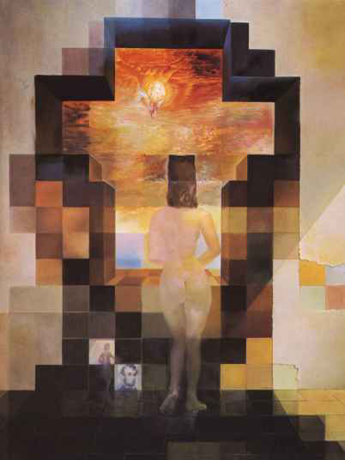
Gaussian filter
Dali

Slide 64
Scale

Slide 65
Properties of the Gaussian filter
The n-dimensional Gaussian is the only completely circularly symmetric operator that is separable.
The (continuous) Fourier transform is a gaussian

Slide 66
Properties of the Gaussian filter
The convolution of two n-dimensional gaussians is an n-dimensional gaussian.
where the variance of the result is the sum
(it is easy to prove this using the FT of the gaussian)

Slide 67
Properties of the Gaussian filter
Repeated convolutions of any function concentrated in the origin result in a gaussian (central limit theorem).

Slide 68
Discretization of the Gaussian
There are very efficient approximations to the Gaussian filter for certain values of σ with nicer properties than when working with discretized gaussians.

Slide 69
Binomial filter
Binomial coefficients provide a compact approximation of the gaussian coefficients using only integers.
The simplest blur filter (low pass) is
[1 1]
Binomial filters in the family of filters obtained as
successive convolutions of [1 1]

Slide 70
Binomial filter
b₁ = [1 1]
b₂ =
[1 1] [1 1] = [1 2 1]
b₃ =
[1 1] [1 1] [1 1] = [1 3 3 1]

Slide 71
Binomial filter

Slide 72
Properties of binomial filters
Sum of the values is 2^{n}
The variance of b_{n} is
The convolution of two binomial filters is also a binomial filter
With a variance:
These properties are analogous to the gaussian property in the continuous domain (but the binomial filter is different than a discretization of a gaussian)

Slide 73
B2[n]
The simplest approximation to the Gaussian filter is the 3-tap kernel:

Slide 74
B2[n] versus the 3-tap box filter
[1 2 1]
[1 1 1]
Which one is better?

Slide 75
B2[n] versus the 3-tap box filter
(with N=20, and assuming periodic boundary extension)
B₂(u) = 2 + exp(-2πj u/N) + exp(2πj u/N) =
= 2 + 2 cos(2π u/N)
H₁(u) = 1 + exp(-2πj u/N) + exp(2πj u/N) =
= 1 + 2 cos(2π u/N)

Slide 76
2 + 2 cos(2π u/20)
1 + 2 cos(2π u/20)

Slide 77
B2[n]
[1, 2, 1] […, 1, -1, 1, -1, 1, -1, …] =
[…, 0, 0, 0, 0, 0, 0, …]
This does not happen with the sampled version of a Gaussian.
[1, 1, 1] […, 1, -1, 1, -1, 1, -1, …] =
[…, -1, 1, -1, 1, -1, 1, …]

Slide 78
B2[n]

Slide 79
Linear blur occurs under many natural situations
(from Fergus et al, 2007)
This is not a Gaussian kernel...
Notes:
UPDATED IMAGE.

Slide 80
Contrast Sensitivity Function
Blackmore & Campbell (1969)
Maximum sensitivity
~ 6 cycles / degree of visual angle
Invisible
visible
Contrast sensitivity
0.1
1
10
100
Low
Spatial frequency (cycles/degree)
High
Things that are very close and large are hard to see
Things far away are hard to see

Slide 81
Vasarely visual illusion

Slide 82
?

Slide 85
Finding edges in the image
Image gradient:
Approximation image derivative:
Edge strength
Edge orientation:
Edge normal:

Slide 86
[-1 1]
[-1, 1]
=
h[m,n]
f[m,n]
g[m,n]

Slide 87
[-1 1]^{T}
[-1, 1]^{T}
=
h[m,n]
f[m,n]
g[m,n]

Slide 88
Differential Geometry Descriptors

Slide 89
Discrete derivatives

Slide 90
Discrete derivatives
=
=

Slide 91
Discrete derivatives
=
=

Slide 92
[-1 1]
[-1, 1]
=
h[m,n]
f[m,n]
g[m,n]

Slide 93
[-1 1]^{T}
[-1, 1]^{T}
=
h[m,n]
f[m,n]
g[m,n]

Slide 94
Back to the image
?

Slide 95
Reconstruction from 1D derivatives
f = D g
c
c
=
Can we compute the inverse?

Slide 96
Reconstruction from 1D derivatives
f = D g
c
c
=

Slide 97
Reconstruction from 1D derivatives
What happens if we remove the output pixels affected by the boundary?

Slide 98
Reconstruction from 1D derivatives
What happens if we remove the output pixels affected by the boundary?
1
1
2
2
0
0
-1
0
2
=
Can we still recover the input?
If the derivative D is not invertible, we can compute the pseudo-inverse:
^
D = (D^{T}D)⁻¹ D^{T}

Slide 99
Reconstruction from 1D derivatives
^
D =
D =
Pseudo-inverse of derivative matrix
Derivative matrix (without boundary)

Slide 100
Reconstruction from derivatives
Derivative:
Input
Derivative
1
1
2
2
0
0
-1
0
2
=
Reconstruction:
Derivative
-0.2
-0.2
0.8
0.8
-1.2
0
-1
0
2
=
Reconstruction input
Did it work?

Slide 101
Reconstruction from 2D derivatives
In 2D, we have multiple derivatives (along n and m)
c
c
=
[-1 1]
c
[-1 1]^{T}
and we compute the pseudo-inverse of the full matrix.

Slide 102
Reconstruction from 2D derivatives
[1 -1]
[1 -1]^{T}

Slide 103
Editing the edge image
[1 -1]
[1 -1]^{T}

Slide 104
Thresholding edges

Slide 105
2D derivatives
There are several ways in which 2D derivatives can be approximated.
Robert-Cross operator:
And many more…

Slide 106
Issues with image derivatives
Derivatives are sensitive to noise
If we consider continuous image derivatives, they might not be define in some regions (e.g., object boundaries, …)

Slide 107
Derivatives
We want to compute the image derivative:
If there is noise, we might want to “smooth” it with a blurring filter
But derivatives and convolutions are linear and we can move them around:

Slide 108
Gaussian derivatives
The continuous derivative is:

Slide 109
Gaussian derivatives
g_{x}(x,y)
In general:

Slide 110
n-th order Gaussian derivatives

Slide 111
Orientation
What about other orientations not axis aligned?

Slide 112
Orientation
The smoothed directional gradient is a linear combination of two kernels
Any orientation can be computed as a linear combination of two filtered images
= cos(α)
+sin(α)
=
Steereability of gaussian derivatives, Freeman & Adelson 92

Slide 113
Gaussian Scale
σ=2
σ=4
σ=8

Slide 114
Derivatives of Gaussians: Scale
σ=2
σ=4
σ=8

Slide 115
Discretization Gaussian derivatives
There are many discrete approximations. For instance, we can take samples of the continuous functions. In practice it is common to use the discrete approximation given by the binomial filters.
Convolving the binomial coefficients with [1, -1]
[1, -1]

Slide 116
Discretization 2D Gaussian derivatives
As Gaussians are separable, we can approximate two 1D derivatives and then convolve them.
One example is the Sobel-Feldman operator:

Slide 117
Effect of different approximations

Slide 118
Effect of different approximations
[1,-1]
[1,0,-1]/2

Slide 119
Laplacian filter
Made popular by Marr and Hildreth in 1980 in the search for
operators that locate the boundaries between objects.
The Laplacian operator is defined as the sum of the second order partial derivatives of a function:
To reduce noise and undefined derivatives, we use the same trick:
Where:

Slide 120
dx
dy
laplacian

Slide 121
Comparison derivative and laplacian
Zero crossings

Slide 122
Image sharpening filter
Subtract away the blurred components of the image:
This filter has an overall DC component of 1. It de-emphasizes the blur component of the image (low spatial frequencies).

Slide 123
Input image

Slide 124
Other “naturally” occurring filters

Slide 125
Camera shake
(from Fergus et al, 2007)
This is not a Gaussian kernel...
Notes:
UPDATED IMAGE.

