Slide 1
Antonio Torralba and Bill Freeman, 2017
Lecture 4
Filters Spatial pyramids

Slide 2
General class comments
New TA: Daniel Moon.
The TA’s will have their office hours in pairs, to address congestion.
Antonio and my office hours: best used for questions about the lectures or the material.
For problem set detail questions, better to use the TA’s office hours.
Pset2 due Thursday midnight

Slide 3
Outline
Low-pass filtering
Band-pass filtering and oriented filters
Motion and phase
Pyramids

Slide 4
Outline
Low-pass filtering
Band-pass filtering and oriented filters
Motion and phase
Pyramids

Slide 5
Blur occurs under many natural situations

Slide 6
Blur occurs under many natural situations

Slide 7
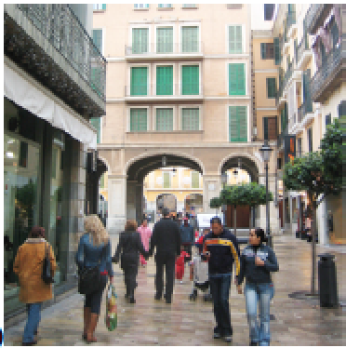
Box filter
=
It produces a blurry version of the input. But it is not a perfect blur.

Slide 8
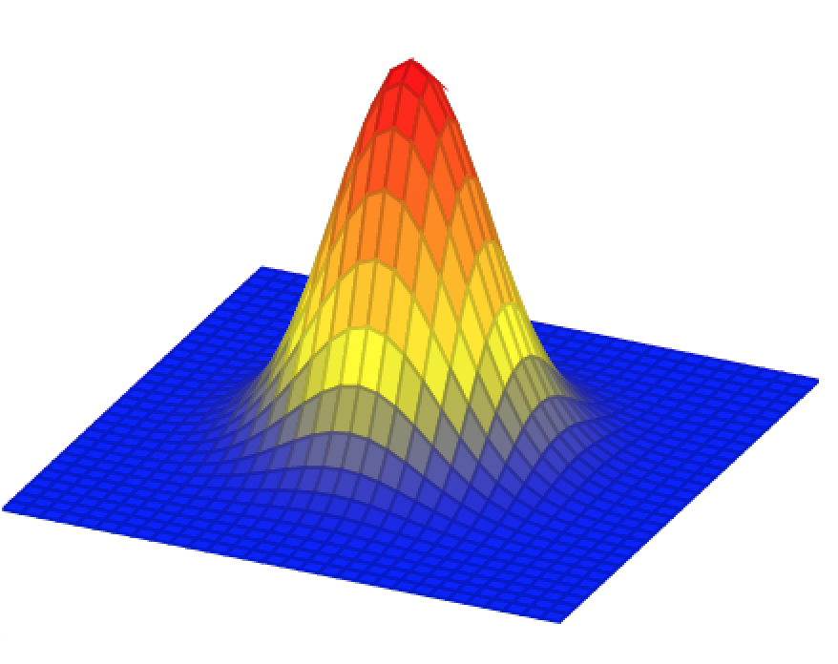
Gaussian filter
In the continuous domain:

Slide 9
Gaussian filter
Discretization of the Gaussian:
At 3σ the amplitude of the Gaussian is around 1% of its central value

Slide 10
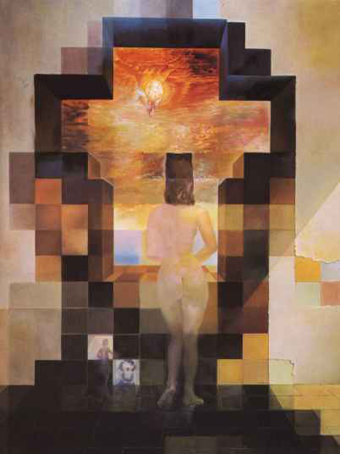
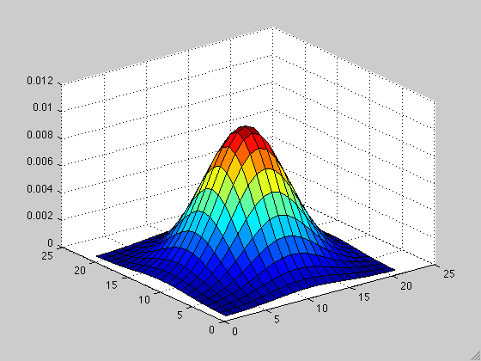
Gaussian filter
Dali

Slide 11
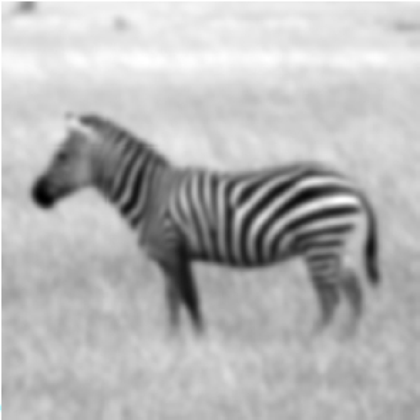
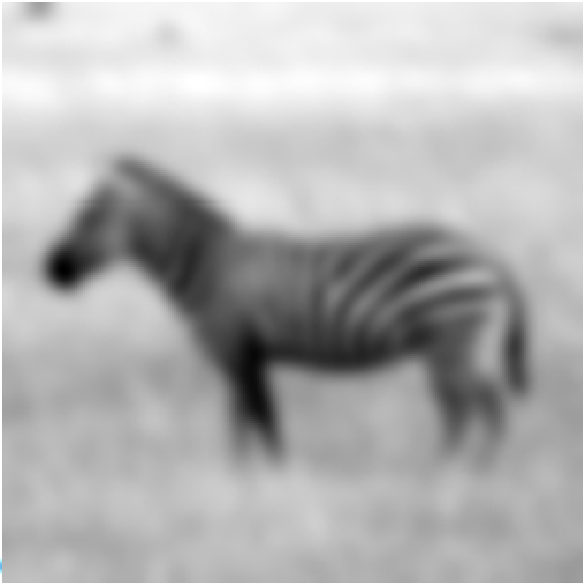
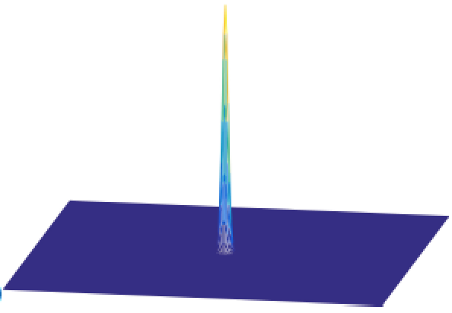
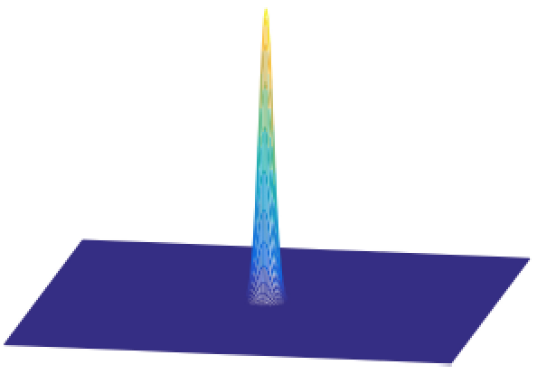
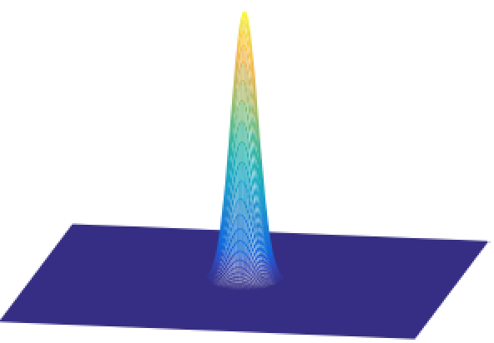
Gaussian low-pass filters allow for selection of scale

Slide 12
Properties of the Gaussian filter
The convolution of two n-dimensional gaussians is an n-dimensional gaussian.
where the variance of the result is the sum
(it is easy to prove this using the FT of the gaussian)

Slide 13
Binomial filter
Binomial coefficients provide a compact approximation of the gaussian coefficients using only integers.
The simplest blur filter (low pass) is
[1 1]
Binomial filters in the family of filters obtained as
successive convolutions of [1 1]

Slide 14
Binomial filter
b₁ = [1 1]
b₂ =
[1 1] [1 1] = [1 2 1]
b₃ =
[1 1] [1 1] [1 1] = [1 3 3 1]

Slide 15
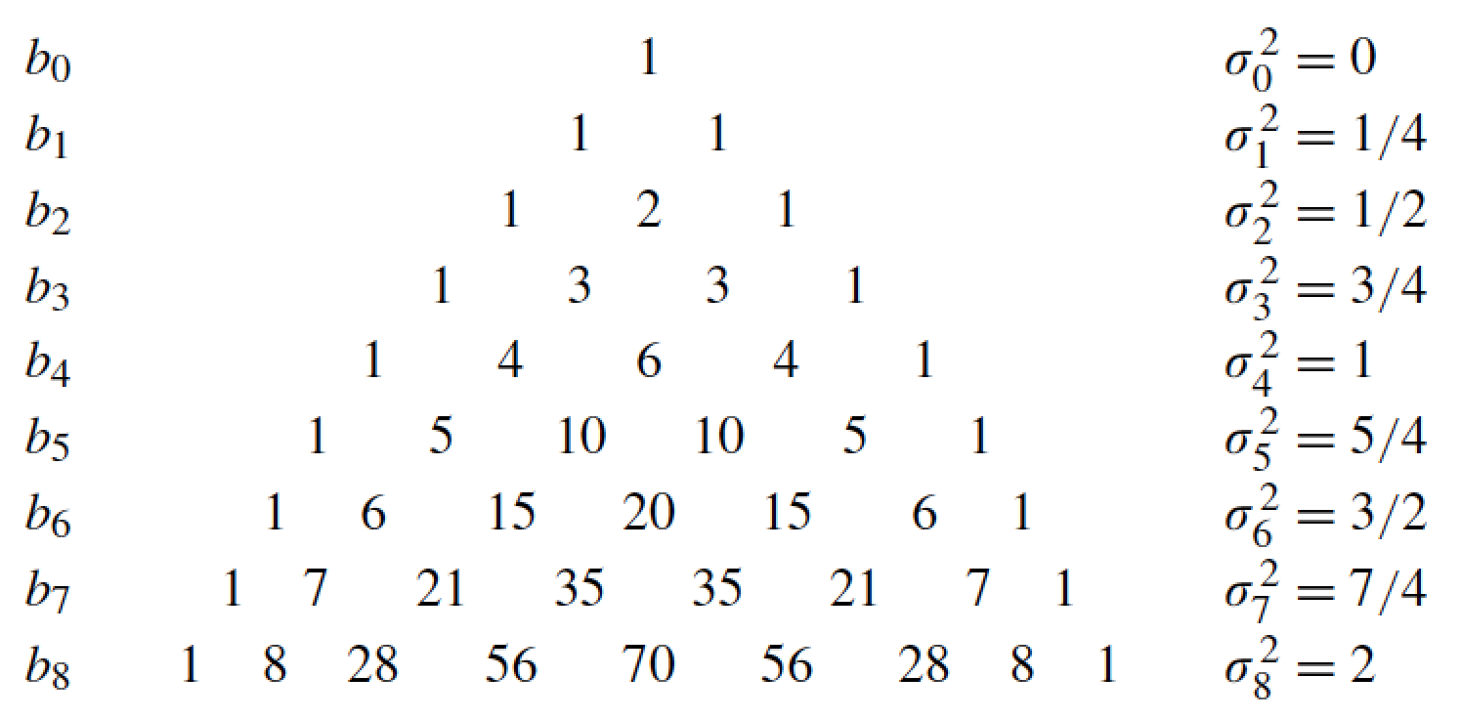
Binomial filter

Slide 16
Properties of binomial filters
Sum of the values is 2^{n}
The variance of b_{n} is
The convolution of two binomial filters is also a binomial filter
With a variance:
These properties are analogous to the gaussian property in the continuous domain (but the binomial filter is different than a discretization of a gaussian)

Slide 17
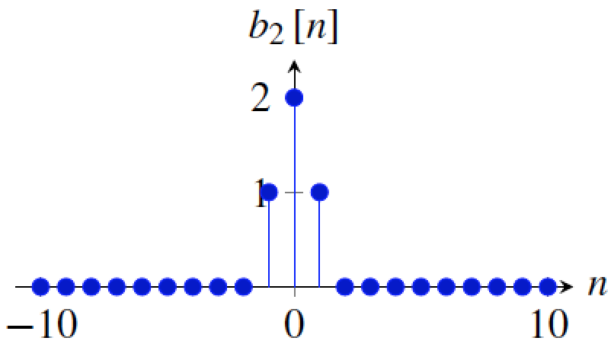
B2[n]
The simplest binomial is the 3-tap kernel:

Slide 18
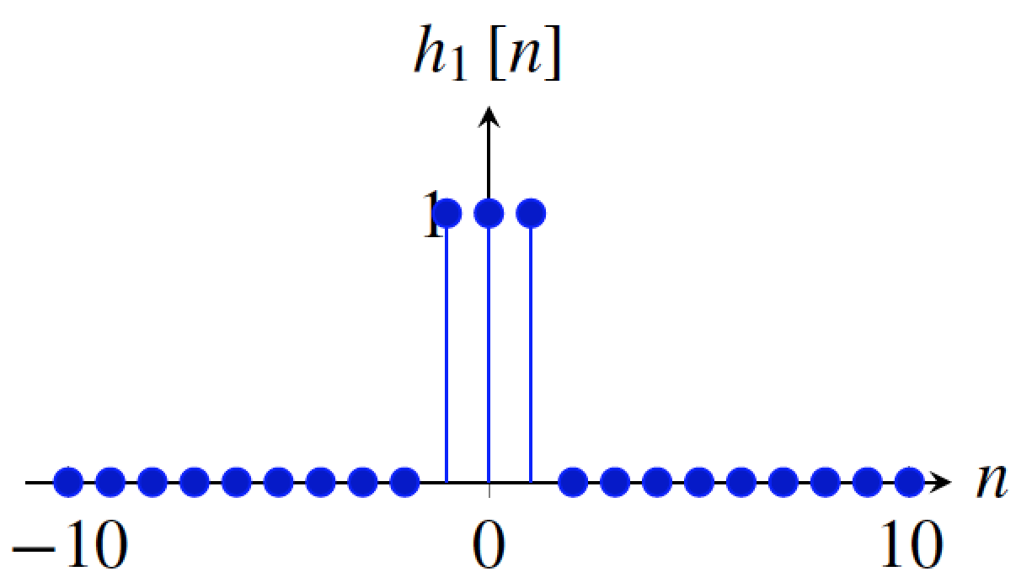
B2[n] versus the 3-tap box filter
[1 2 1]
[1 1 1]
Which one is better?

Slide 19
B2[n] versus the 3-tap box filter
(with N=20, and assuming periodic boundary extension)
B₂(u) = 2 + exp(-2πj u/N) + exp(2πj u/N) =
= 2 + 2 cos(2π u/N)
H₁(u) = 1 + exp(-2πj u/N) + exp(2πj u/N) =
= 1 + 2 cos(2π u/N)

Slide 20
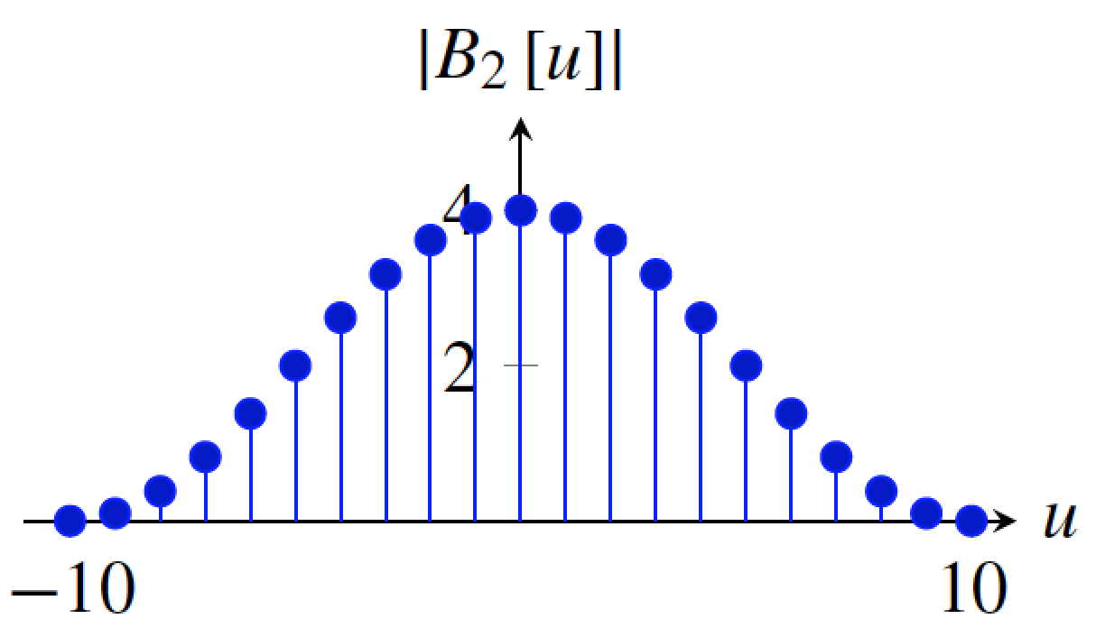
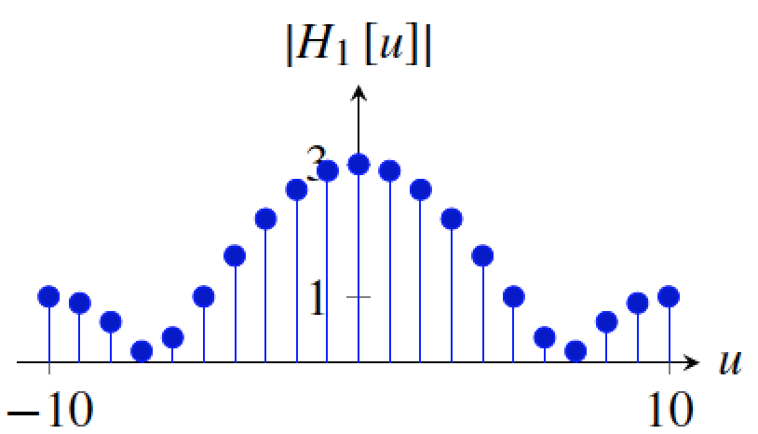
2 + 2 cos(2π u/20)
1 + 2 cos(2π u/20)

Slide 21
Outline
Low-pass filtering
Band-pass filtering and oriented filters
Motion and phase
Pyramids

Slide 22
What is a good representation for image analysis?
Fourier transform domain tells you “what” (textural properties), but not “where”.
Pixel domain representation tells you “where” (pixel location), but not “what”.
Want an image representation that gives you a local description of image events—what is happening where.

Slide 23
Gabor wavelets and quadrature filters

Slide 24
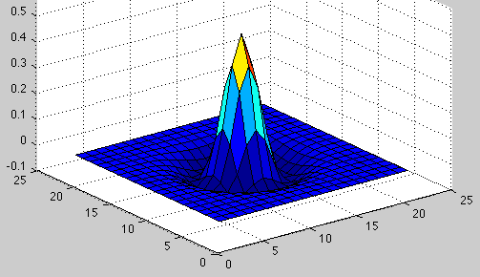
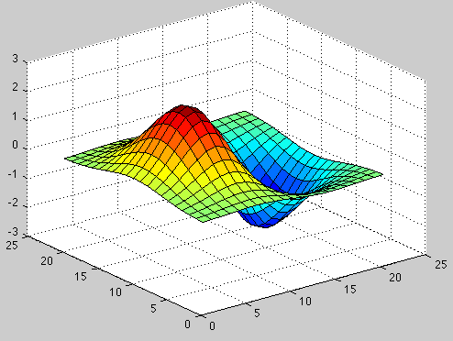
Comparing Human and Machine Perception

Slide 25
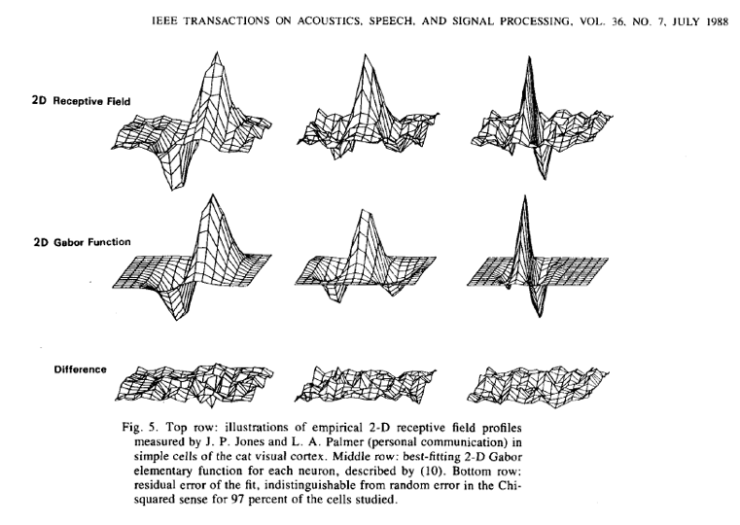
John Daugman, 1988
25

Slide 26
Analysis of local frequency
Fourier basis:
(x₀, y₀)
Gabor wavelet:
We can look at the real and imaginary parts:

Slide 27
Gabor wavelets
u₀=0
U₀=0.1
U₀=0.2

Slide 28
Gabor filters at different
scales and spatial frequencies
Top row shows anti-symmetric
(or odd) filters; these are good for detecting odd-phase structures like edges.
Bottom row shows the
symmetric (or even) filters, good for detecting line phase contours.
Notes:
Gabor filters are just another way to generate spots and bars.

Slide 29
Fourier transform of a Gabor wavelet
U₀=0.1
w_{y}
w_{y}
w_{x}
w_{x}
-u₀
+u₀

Slide 31
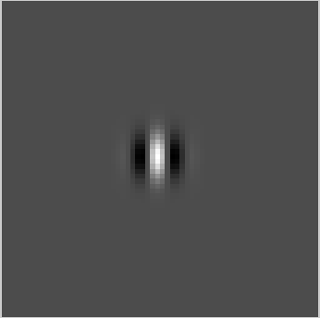
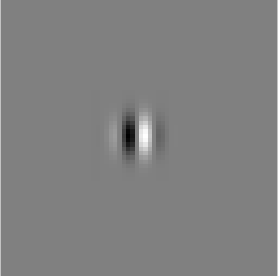
Quadrature filter pairs
A quadrature filter is a complex filter whose real part is related to its imaginary part via a Hilbert transform along a particular axis through origin of the frequency domain.
(.)²
+
(.)²

Slide 32
(.)²
squared magnitude
+
(.)²
Contrast invariance! ! (same energy response for white dot on black background as for a black dot on a white background).

Slide 33
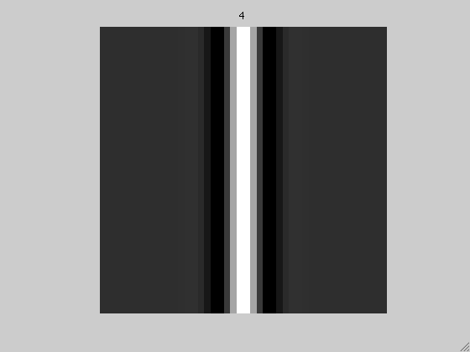
energy response to an edge
edge

Slide 34
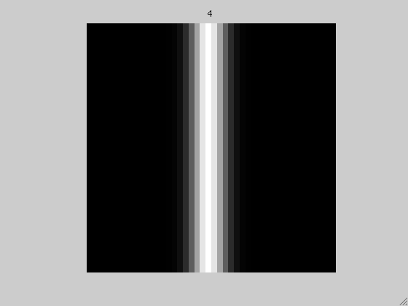
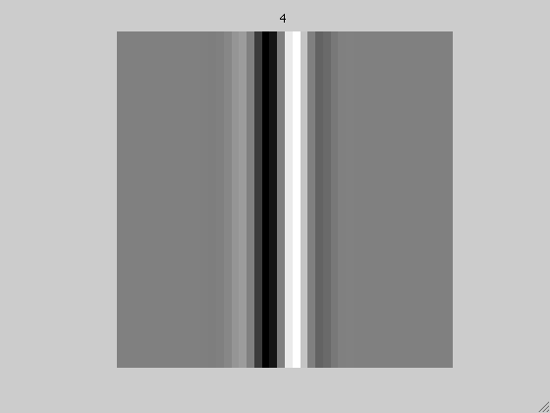
line
energy response to a line

Slide 35
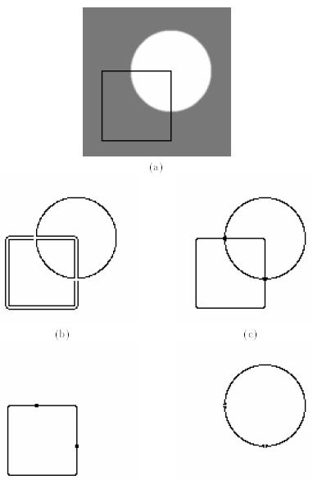
A contour detector
edge detector output
Local energy
Phase ~ 90
Phase ~ 0
35

Slide 36
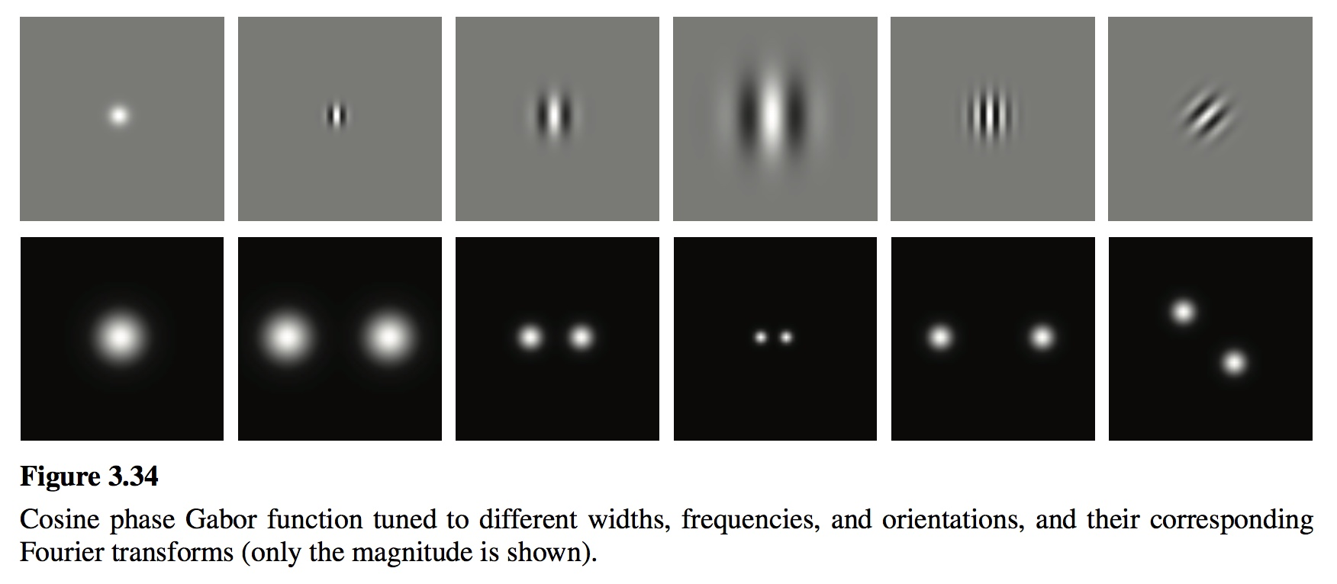

Slide 37
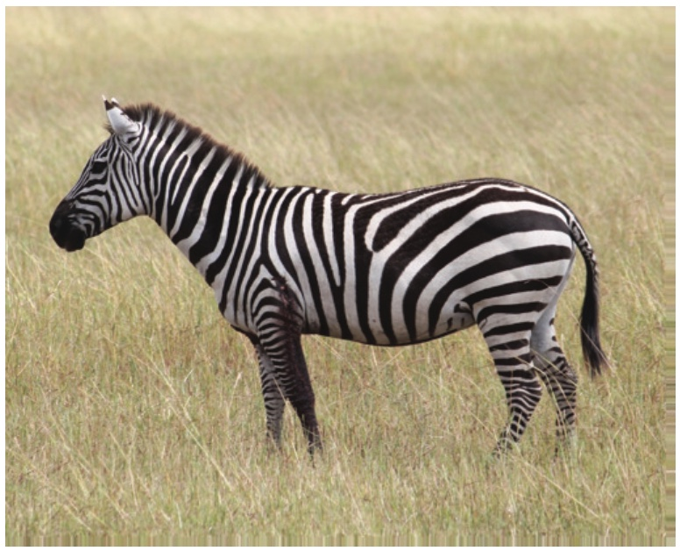

Slide 38
[-1 1]
[-1, 1]
=
h[m,n]
f[m,n]
g[m,n]

Slide 39
Derivatives
We want to compute the image derivative:
If there is noise, we might want to “smooth” it with a blurring filter
But derivatives and convolutions are linear and we can move them around:

Slide 40
Gaussian derivatives
The continuous derivative is:

Slide 41
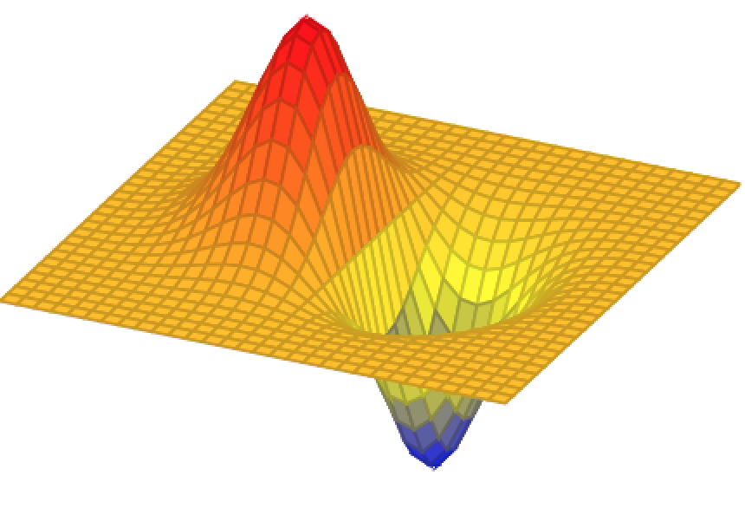
Gaussian derivatives
g_{x}(x,y)
In general:

Slide 42
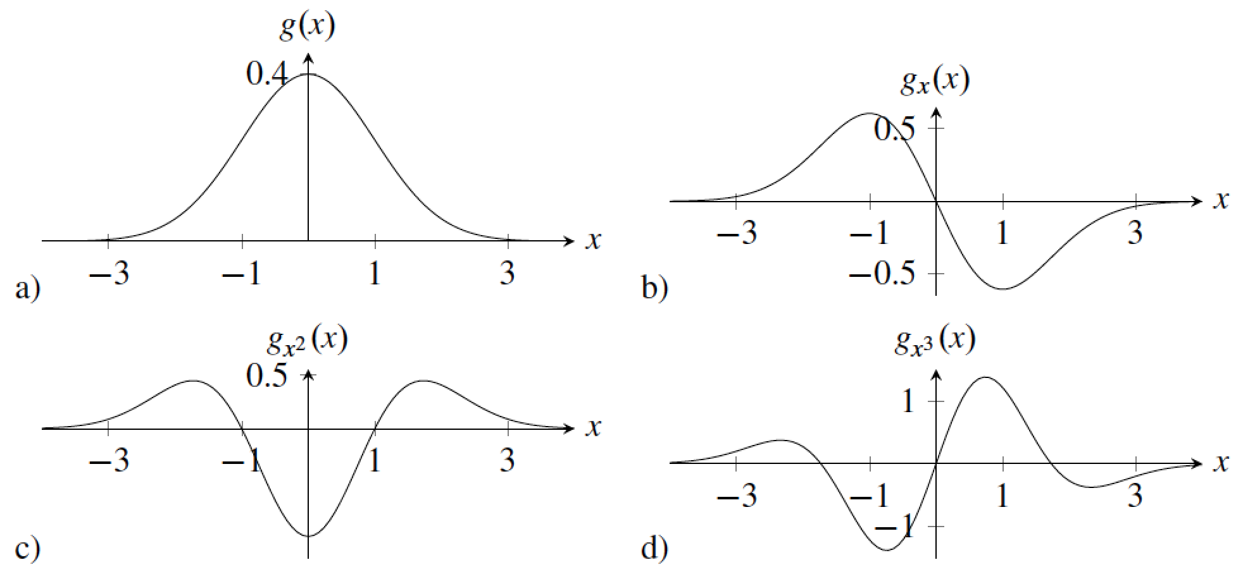
n-th order Gaussian derivatives

Slide 43
Gaussian Scale
σ=2
σ=4
σ=8

Slide 44
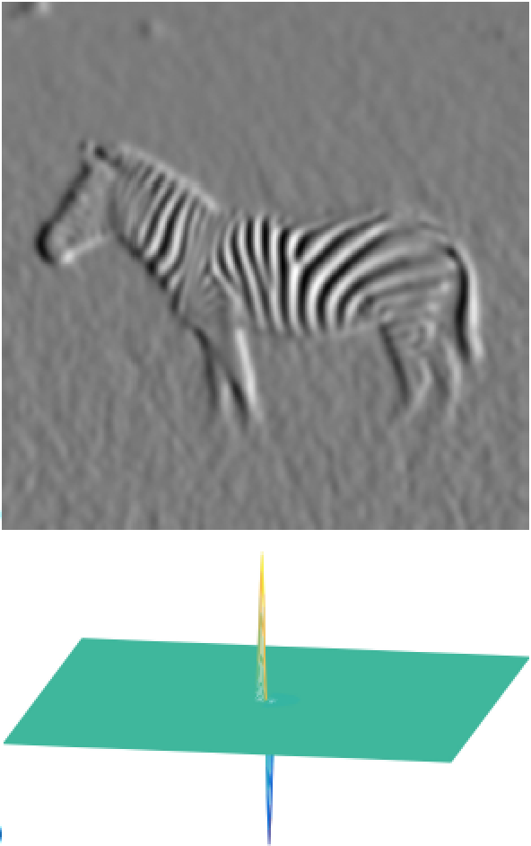
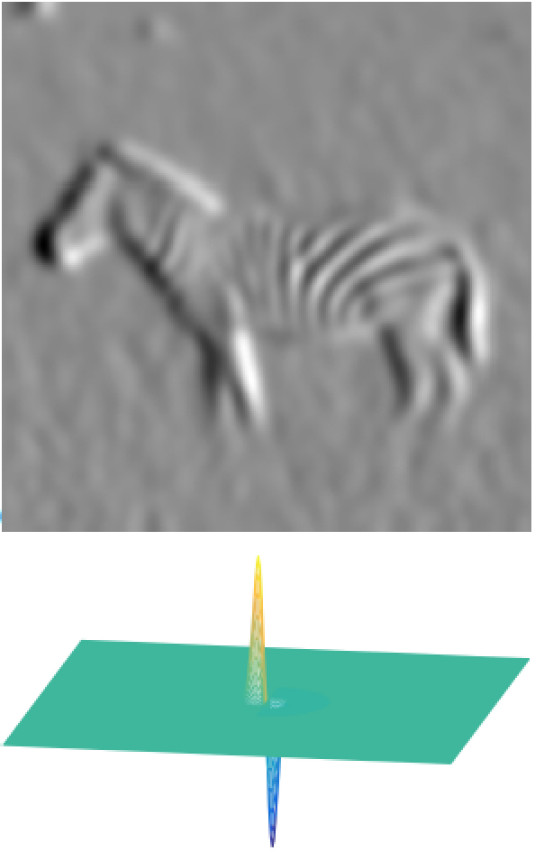
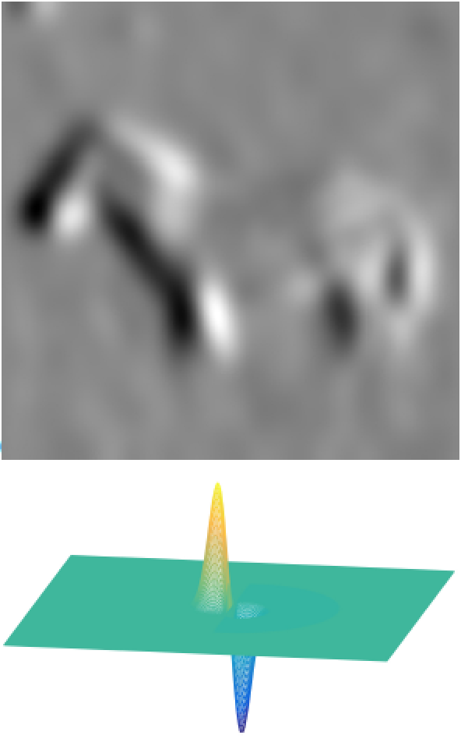
Derivatives of Gaussians: Scale
σ=2
σ=4
σ=8

Slide 45
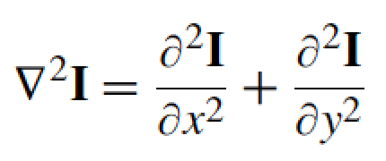
Laplacian filter
Made popular by Marr and Hildreth in 1980 in the search for
operators that locate the boundaries between objects.
The Laplacian operator is defined as the sum of the second order partial derivatives of a function:
To reduce noise and undefined derivatives, we use the same trick:
Where:

Slide 46
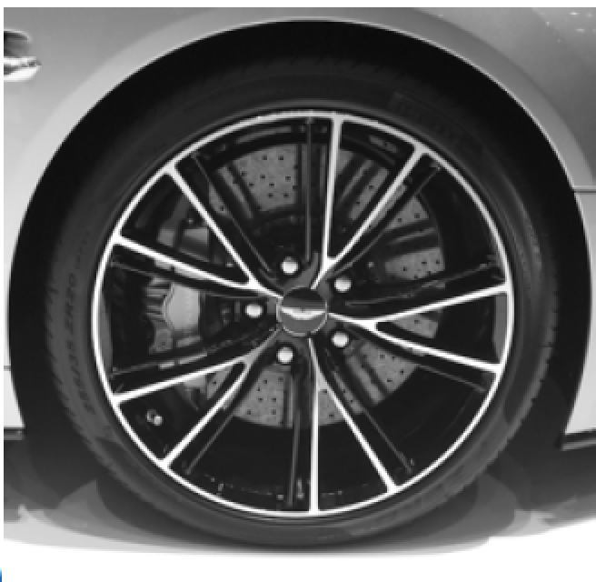
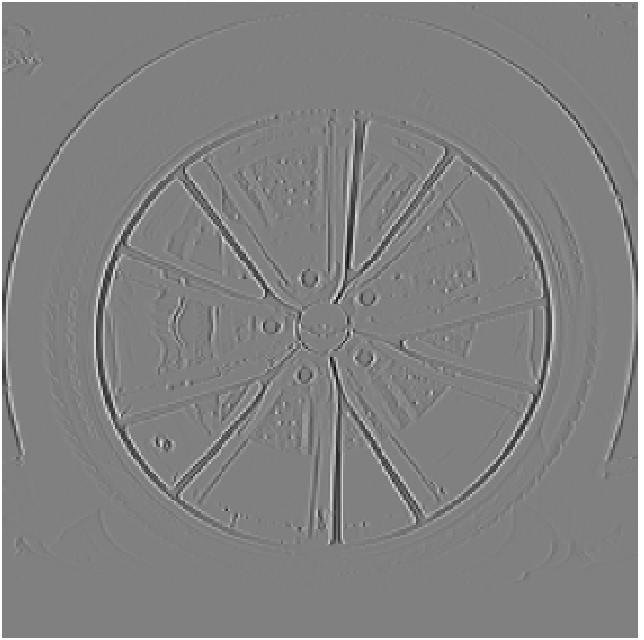
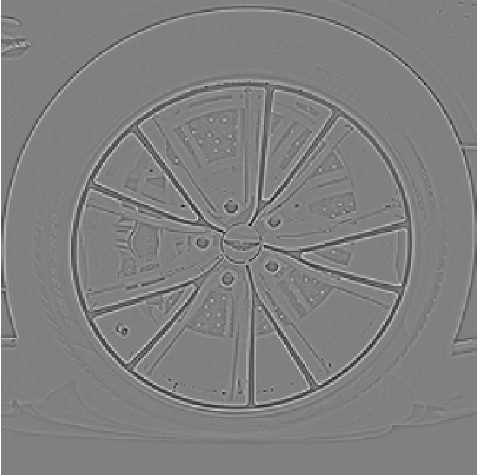
dx
dy
laplacian

Slide 47
Contrast Sensitivity Function
Blackmore & Campbell (1969)
Maximum sensitivity
~ 6 cycles / degree of visual angle
Invisible
visible
Contrast sensitivity
0.1
1
10
100
Low
Spatial frequency (cycles/degree)
High
Things that are very close and large are hard to see
Things far away are hard to see

Slide 48
Vasarely visual illusion

Slide 49
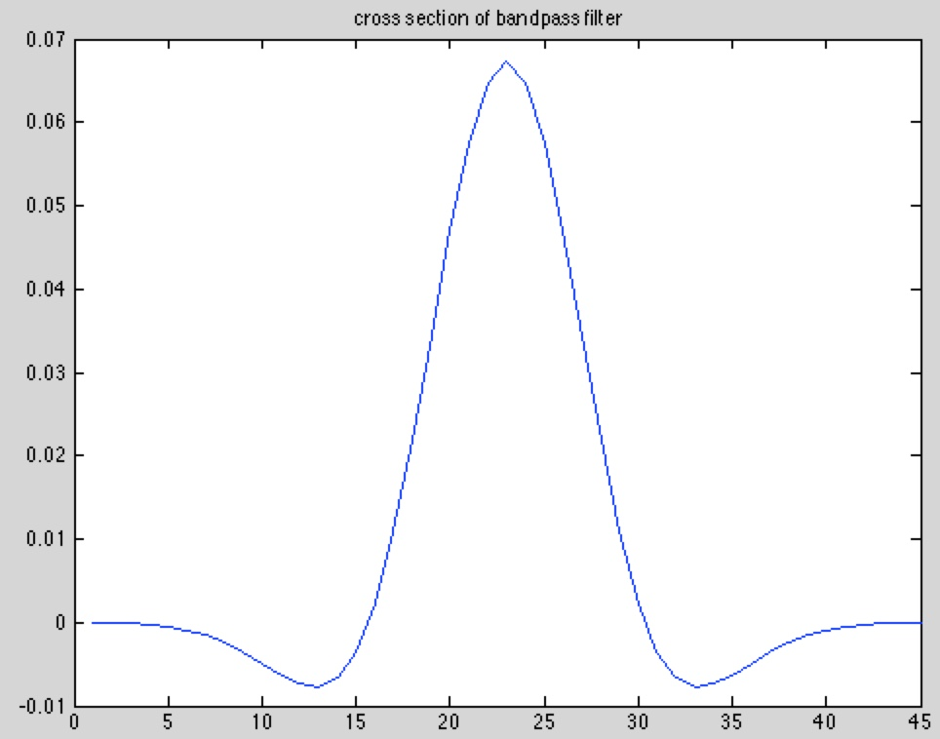
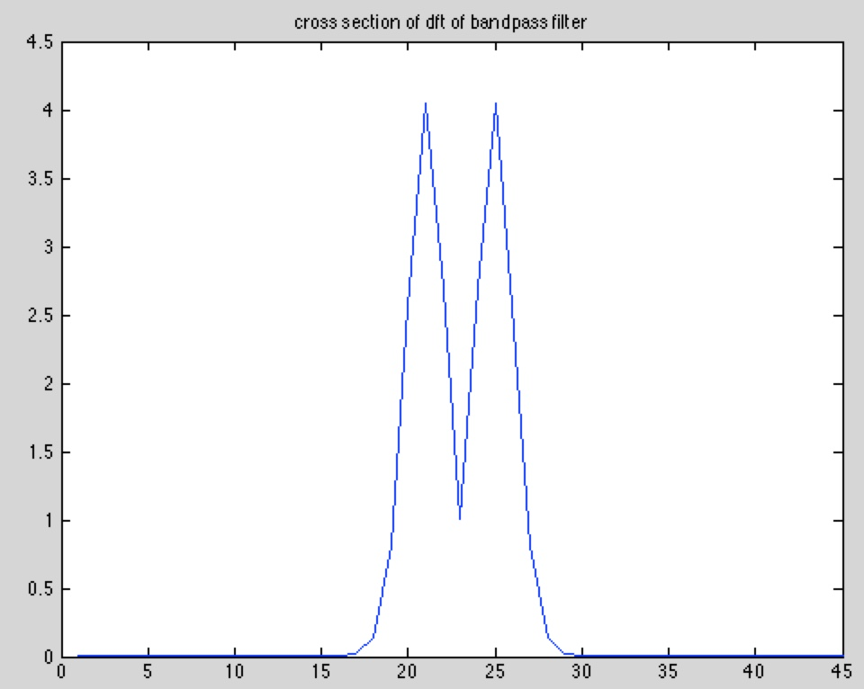
?
Bandpass filter amplitude, in frequency
Bandpass filter, in space

Slide 50
Input
Output
One row of the output

Slide 51
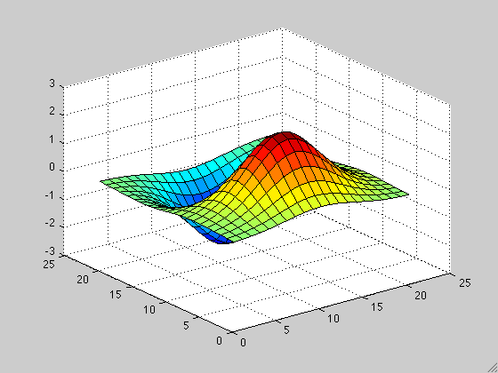
Orientation
What about other orientations not axis aligned?

Slide 52
Orientation
The smoothed directional gradient is a linear combination of two kernels
Any orientation can be computed as a linear combination of two filtered images
= cos(α)
+sin(α)
=
Steereability of gaussian derivatives, Freeman & Adelson 92

Slide 53
Simple example of steerable filter
“Steerability”-- the ability to synthesize a filter of any orientation from a linear combination of filters at fixed orientations.
0º
90º
Synthesized 30º
Filter Set:
Response:
Taken from:
W. Freeman, T. Adelson, “The Design
and Use of Sterrable Filters”, IEEE
Trans. Patt, Anal. and Machine Intell.,
vol 13, #9, pp 891-900, Sept 1991
Raw Image

Slide 54
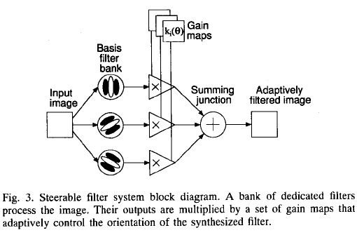

Slide 55
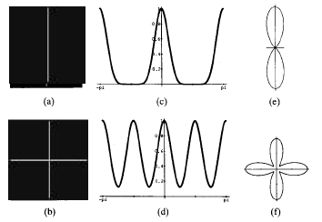
Orientation analysis
High resolution in orientation requires many oriented filters as basis (high order gaussian derivatives
or fine-tuned Gabor wavelets).

Slide 56
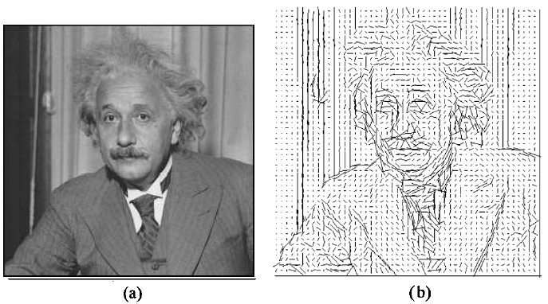
Orientation analysis

Slide 57
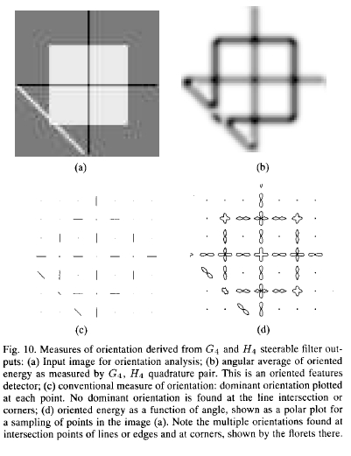

Slide 58
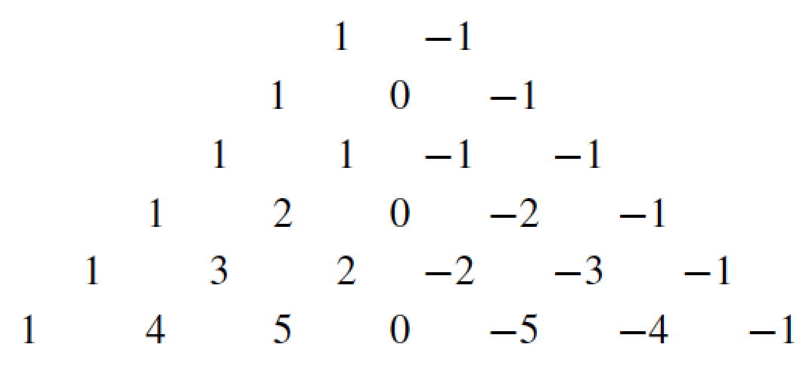
Discretization Gaussian derivatives
There are many discrete approximations. For instance, we can take samples of the continuous functions. In practice it is common to use the discrete approximation given by the binomial filters.
Convolving the binomial coefficients with [1, -1]
[1, -1]

Slide 59
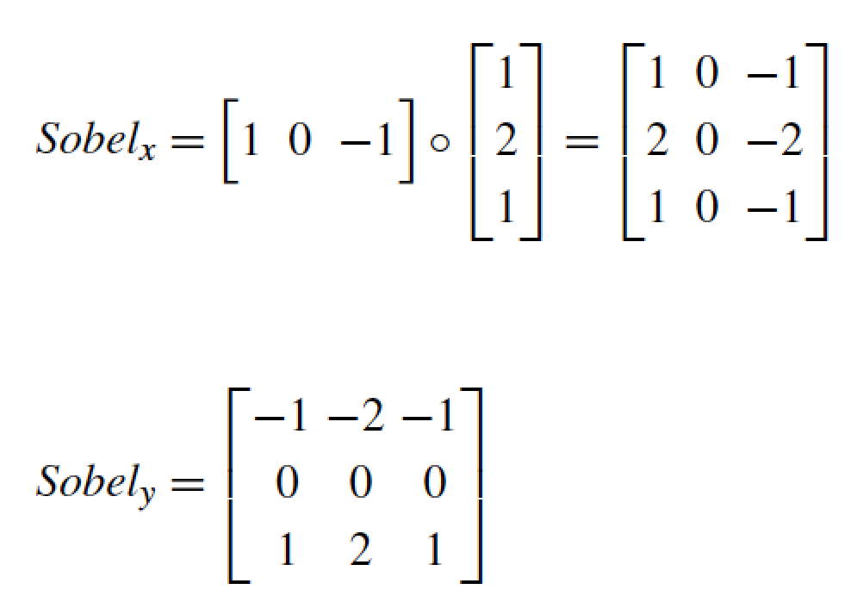
Discretization 2D Gaussian derivatives
As Gaussians are separable, we can approximate two 1D derivatives and then convolve them.
One example is the Sobel-Feldman operator:

Slide 60
Image sharpening filter
Subtract away the blurred components of the image:
This filter has an overall DC component of 1. It de-emphasizes the blur component of the image (low spatial frequencies).
The DC component is the mean value of the image

Slide 61
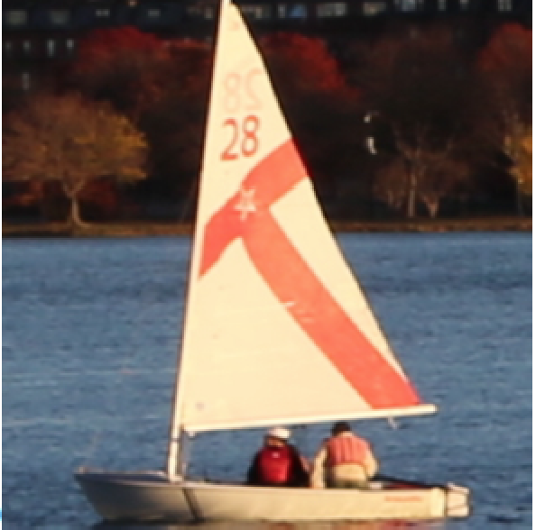
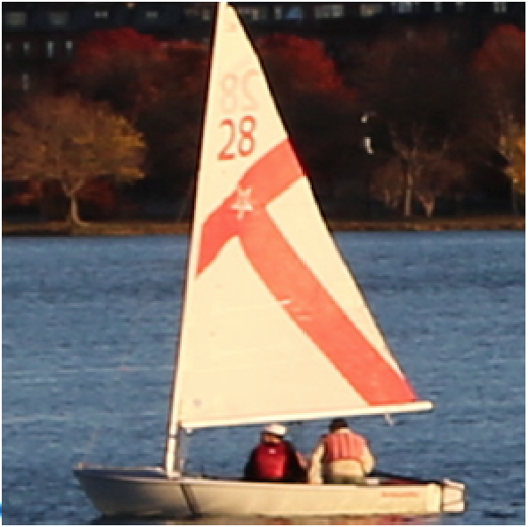
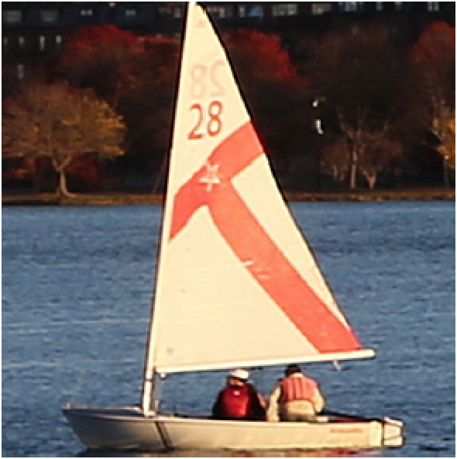
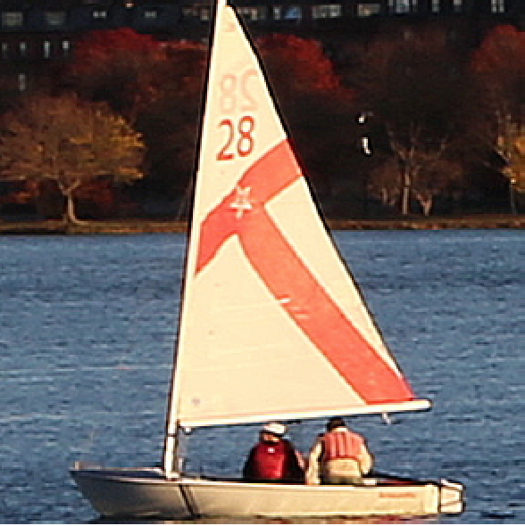
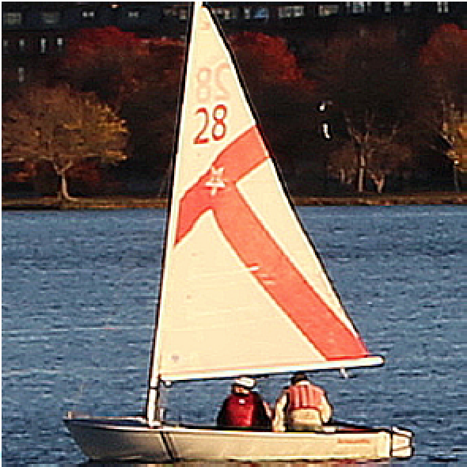
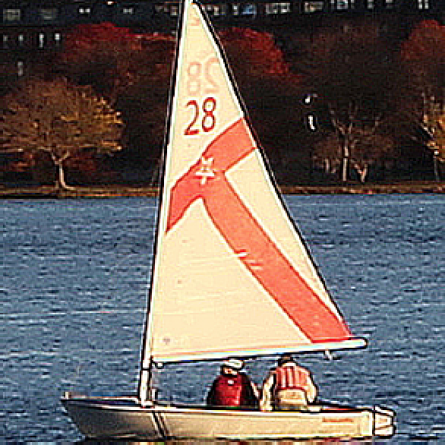
Input image

Slide 62
Outline
Low-pass filtering
Band-pass filtering and oriented filters
Motion and phase
Pyramids

Slide 63
original
motion magnified

Slide 64
original
motion magnified

Slide 65
Showing the relationship between positional offset and DFT phase
Impulse at 0,0
Impulse at 0,1
Impulse at 0,3

Slide 66
Properties for the DFT
Shift in space corresponds to a phase shift in the frequency domain.

Slide 67
Showing the relationship between positional offset and DFT phase
Phase (complex angle) of dft of impulse at (0,0)
Phase of dft of impulse at (0,1)
Phase of dft of impulse at (0,3)
0 everywhere
pi -pi
3pi -3pi

Slide 68
Outline
Low-pass filtering
Band-pass filtering and oriented filters
Motion and phase
Pyramids

Slide 69
Image pyramids

Slide 70
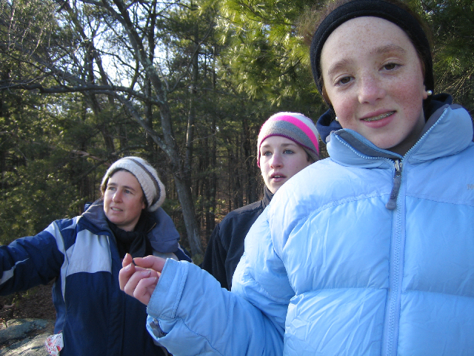
Image information occurs at all spatial scales
70

Slide 71
Gaussian filter

Slide 72
The Gaussian pyramid
For each level
Blur input image with a Gaussian filter
Downsample by a factor of 2
Output downsampled image
72

Slide 73
The Gaussian pyramid
512×512
256×256
128×128
64×64
32×32
(original image)
73

Slide 74
The Gaussian pyramid
For each level
1. Blur input image with a Gaussian filter
[1, 4, 6, 4, 1]

Slide 75
The Gaussian pyramid
For each level
1. Blur input image with a Gaussian filter
2. Downsample image

Slide 76
Downsampling
⬇2
Blur
(no frequency content is lost)

Slide 77
In 1D, one step of the Gaussian pyramid is:
http://www-bcs.mit.edu/people/adelson/pub_pdfs/pyramid83.pdf

Slide 78
78

Slide 79
Convolution and subsampling as a matrix multiply (1D case)
1 4 6 4 1 0 0 0 0 0 0 0 0 0 0 0 0 0 0 0
0 0 1 4 6 4 1 0 0 0 0 0 0 0 0 0 0 0 0 0
0 0 0 0 1 4 6 4 1 0 0 0 0 0 0 0 0 0 0 0
0 0 0 0 0 0 1 4 6 4 1 0 0 0 0 0 0 0 0 0
0 0 0 0 0 0 0 0 1 4 6 4 1 0 0 0 0 0 0 0
0 0 0 0 0 0 0 0 0 0 1 4 6 4 1 0 0 0 0 0
0 0 0 0 0 0 0 0 0 0 0 0 1 4 6 4 1 0 0 0
0 0 0 0 0 0 0 0 0 0 0 0 0 0 1 4 6 4 1 0
(Normalization constant of 1/16 omitted for visual clarity.)

Slide 80
Next pyramid level
1 4 6 4 1 0 0 0
0 0 1 4 6 4 1 0
0 0 0 0 1 4 6 4
0 0 0 0 0 0 1 4

Slide 81
The combined effect of the two pyramid levels
1 4 10 20 31 40 44 40 31 20 10 4 1 0 0 0 0 0 0 0
0 0 0 0 1 4 10 20 31 40 44 40 31 20 10 4 1 0 0 0
0 0 0 0 0 0 0 0 1 4 10 20 31 40 44 40 30 16 4 0
0 0 0 0 0 0 0 0 0 0 0 0 1 4 10 20 25 16 4 0

Slide 82
1D Gaussian pyramid matrix, for [1 4 6 4 1] low-pass filter
full-band image, highest resolution
lower-resolution image
lowest resolution image

Slide 83
Gaussian pyramids used for
up- or down- sampling images.
Multi-resolution image analysis
Look for an object over various spatial scales
Coarse-to-fine image processing: form blur estimate or the motion analysis on very low-resolution image, upsample and repeat. Often a successful strategy for avoiding local minima in complicated estimation tasks.
83

Slide 84
The Laplacian Pyramid
Synthesis
Compute the difference between upsampled Gaussian pyramid level and Gaussian pyramid level.
band pass filter - each level represents spatial frequencies (largely) unrepresented at other level.
84

Slide 85
Image down-sampling
⬇2
Blur
Image up-sampling
⬆2

Slide 86
Image up-sampling
1 2 1 2 4 2 1 2 1
=
64×64
Start by inserting zeros
128×128

Slide 87
Image up-sampling
1 2 1 2 4 2 1 2 1
=
64×64
=

Slide 88
Convolution and up-sampling as a matrix multiply (1D case)
Insert zeros between pixels, then apply a low-pass filter, [1 4 6 4 1]
6 1 0 0
4 4 0 0
1 6 1 0
0 4 4 0
0 1 6 1
0 0 4 4
0 0 1 6
0 0 0 4
88

Slide 89
Down-sampling
Original
Blurred
Downsampled

Slide 90
Down-sampling and Up-sampling
Original
Blurred
Downsampled
Blurred
Upsampled

Slide 91
Laplacian pyramid algorithm
91

Slide 92
Showing, at full resolution, the information captured at each level of a Gaussian (top) and Laplacian (bottom) pyramid.
92
http://www-bcs.mit.edu/people/adelson/pub_pdfs/pyramid83.pdf

Slide 93
Laplacian pyramid reconstruction algorithm: recover x₁ from L₁, L₂, L₃ and x₄
G# is the blur-and-downsample operator at pyramid level #
F# is the blur-and-upsample operator at pyramid level #
Laplacian pyramid elements:
L1 = (I – F1 G1) x1
L2 = (I – F2 G2) x2
L3 = (I – F3 G3) x3
x2 = G1 x1
x3 = G2 x2
x4 = G3 x3
Reconstruction of original image (x1) from Laplacian pyramid elements:
x3 = L3 + F3 x4
x2 = L2 + F2 x3
x1 = L1 + F1 x2
93

Slide 94
Laplacian pyramid reconstruction algorithm: recover x₁ from L₁, L₂, L₃ and g₃
+
+
+
94

Slide 95
Gaussian pyramid
Notes:
This is a Gaussian pyramid

Slide 96
(Low-pass residual)
Laplacian pyramid
Notes:
And this a Laplacian pyramid. Notice that the lowest layer is the same in each case,
and that if I upsample the lowest layer and add to the next, I get the Gauss layer.
Notice also that each layer shows detail at a particular scale --- these are, basically, bandpass filtered versions of the image.

Slide 97
1-d Laplacian pyramid matrix, for [1 4 6 4 1] low-pass filter
high frequencies
mid-band frequencies
low frequencies
97

Slide 98
Laplacian pyramid applications
Texture synthesis
Image compression
Noise removal
98

Slide 99
end

Slide 100
Gabor wavelet:
Tuning filter orientation:
Real
Space
Imag
Real
Fourier domain
Imag

Slide 101
Second directional derivative of a Gaussian and its quadrature pair

