Slide 1
William T. Freeman, Antonio Torralba, 2017
Lecture 6
Learned feedforward visual processing Neural Networks, Deep learning, ConvNets
Some slides modified from R. Fergus

Slide 2
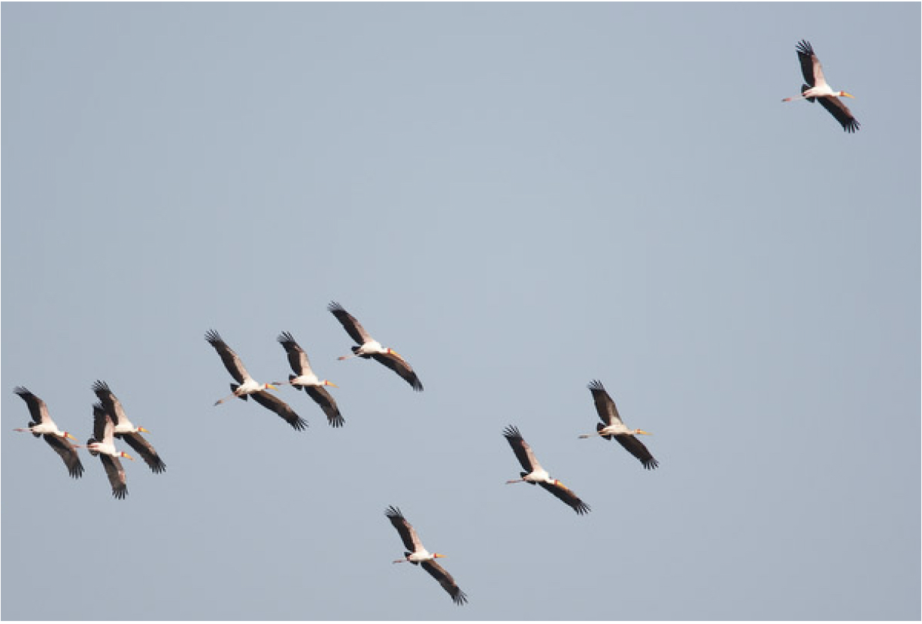
We need translation invariance

Slide 3
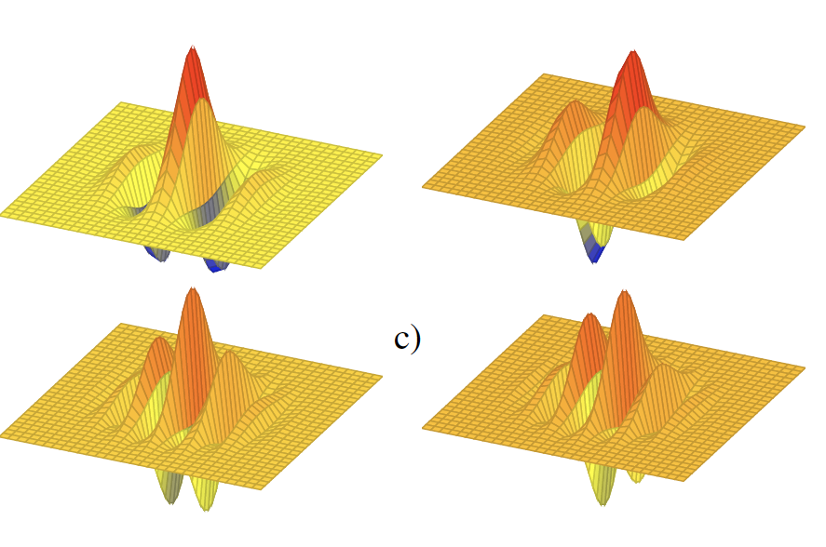
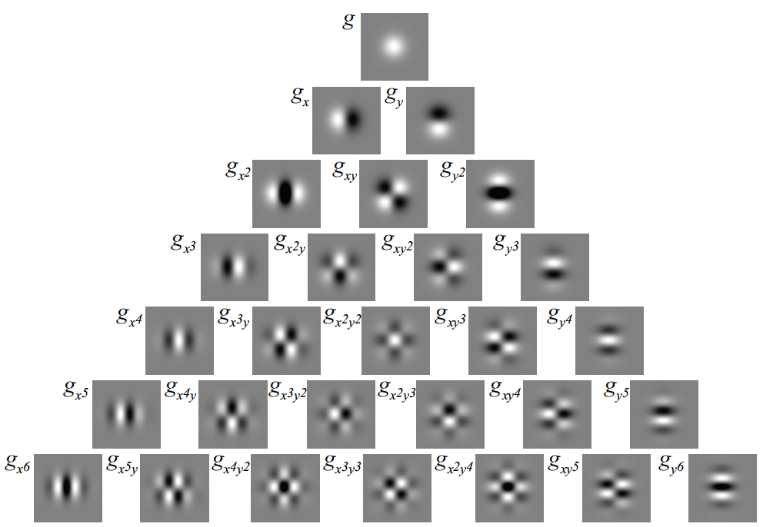
Lots of useful linear filters…
Laplacian
Gaussian derivative
Gaussian
Gabor
And many more…
High order Gaussian derivatives

Slide 4
We need translation and scale invariance

Slide 5
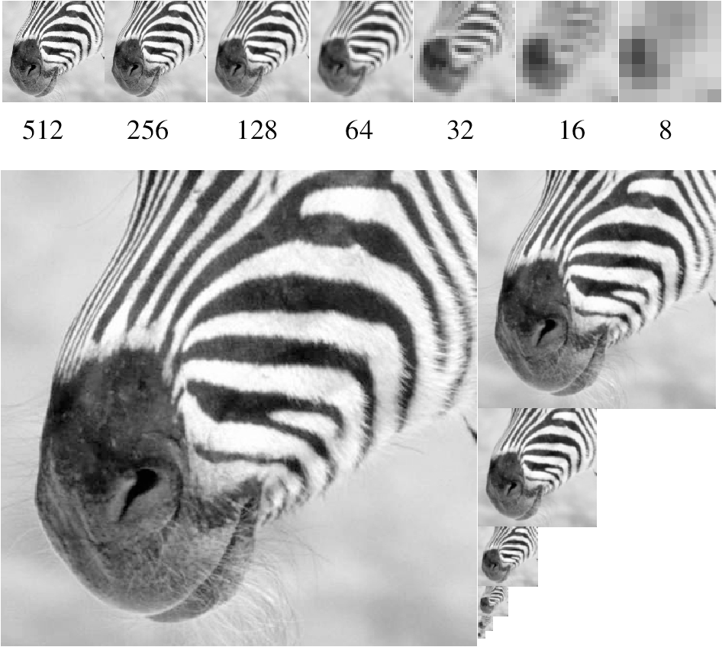
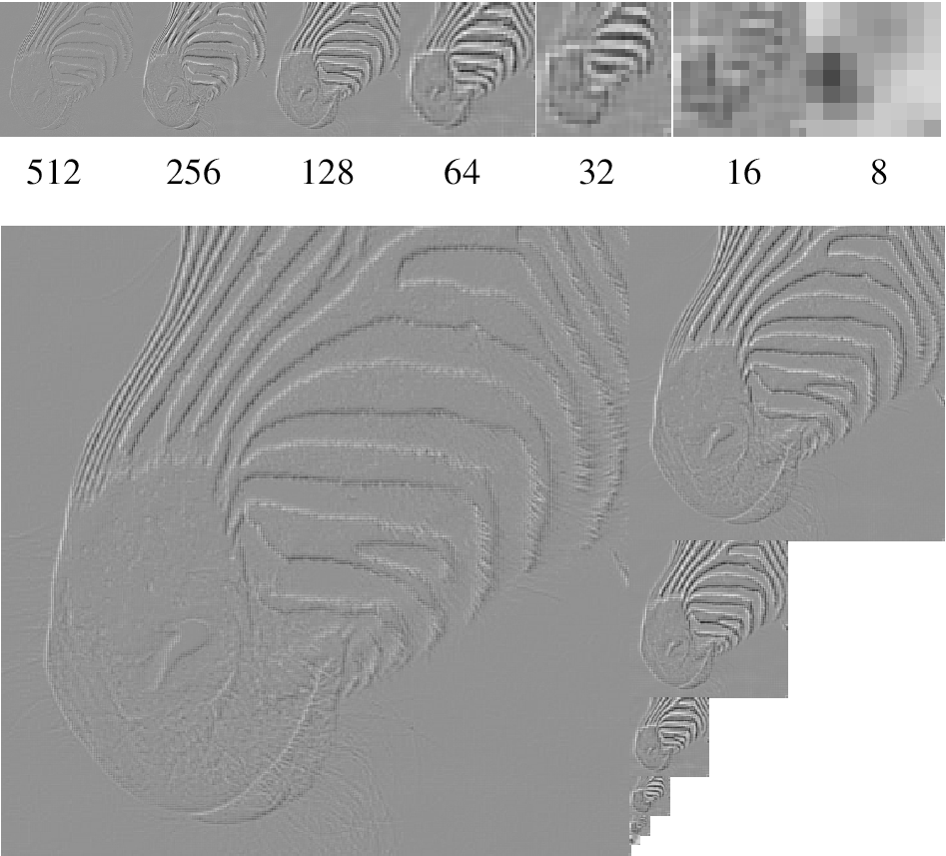
Lots of image pyramids…
Gaussian Pyr
Laplacian Pyr
And many more: QMF, steerable, …

Slide 6
We need …

Slide 7
What is the best representation?
All the previous representation are manually constructed.
Could they be learnt from data?

Slide 8
A brief history of Neural Networks
enthusiasm
time

Slide 9
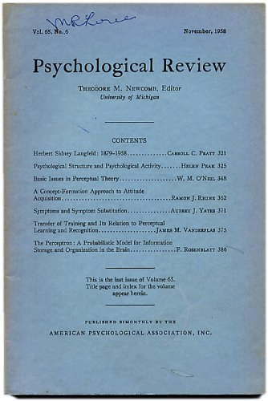
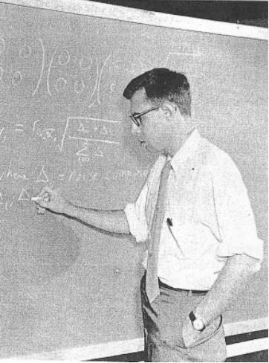
Perceptrons, 1958
Rosenblatt
http://www.ecse.rpi.edu/homepages/nagy/PDF_chrono/2011_Nagy_Pace_FR.pdf. Photo by George Nagy
9
http://www.manhattanrarebooks-science.com/rosenblatt.htm

Slide 10
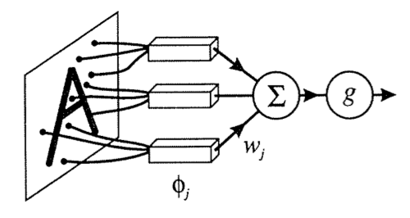
Perceptrons, 1958
10

Slide 11
Perceptrons,
1958
enthusiasm
time

Slide 12
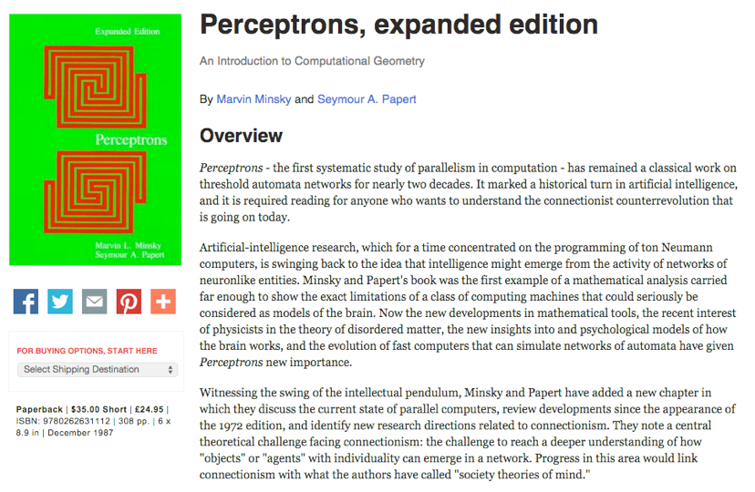
Minsky and Papert, Perceptrons, 1972
12

Slide 13
Perceptrons,
1958
enthusiasm
Minsky and Papert,
1972
time

Slide 14
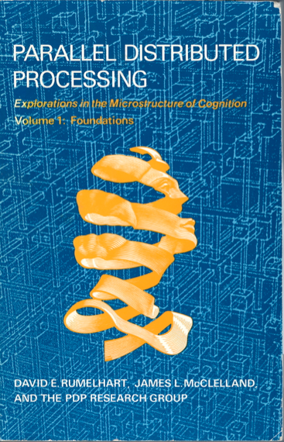
Parallel Distributed Processing (PDP), 1986
14

Slide 15
XOR problem
Inputs
Output
0 0 0
1 0 1
0 1 1
1 1 0
0 1
0 1
PDP authors pointed to the backpropagation algorithm
as a breakthrough, allowing multi-layer neural networks to be
trained. Among the functions that a multi-layer network can represent but a single-layer network cannot: the XOR function.
15

Slide 16
Perceptrons,
1958
PDP book,
1986
enthusiasm
Minsky and Papert,
1972
time

Slide 17
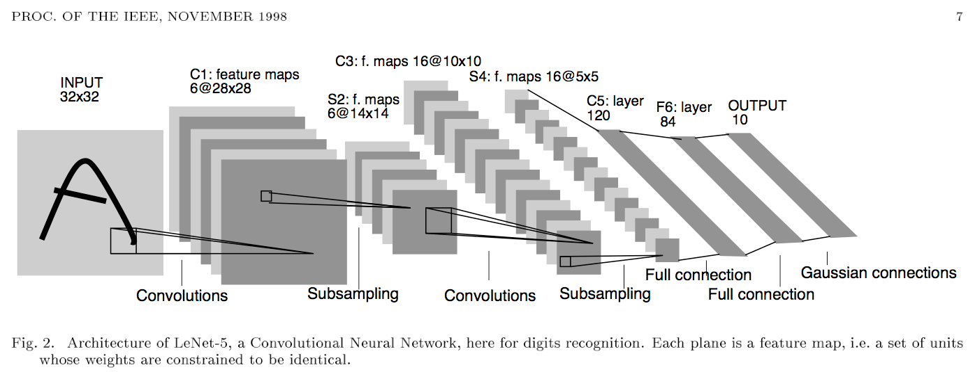
LeCun conv nets, 1998
Demos:
http://yann.lecun.com/exdb/lenet/index.html
17

Slide 18
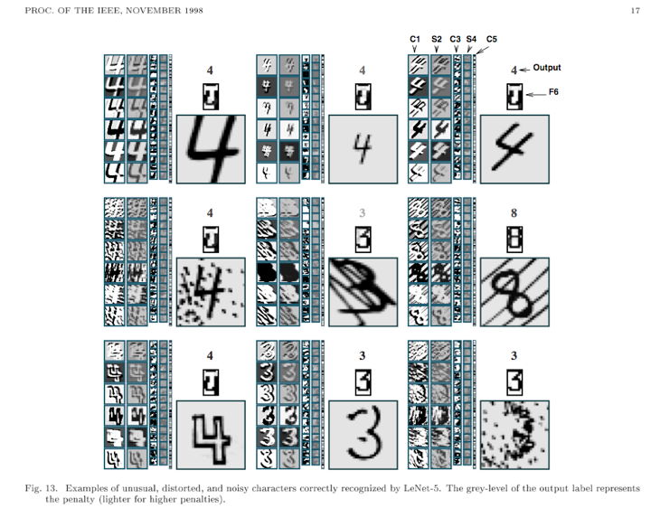
18

Slide 19
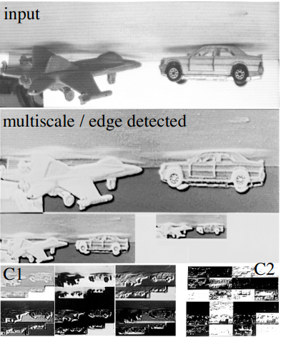
Neural networks to recognize handwritten digits? yes
Neural networks for tougher problems? not really
http://pub.clement.farabet.net/ecvw09.pdf
19

Slide 20
NIPS 2000
NIPS, Neural Information Processing Systems, is the premier conference on machine learning. Evolved from an interdisciplinary conference to a machine learning conference.
For the NIPS 2000 conference:
title words predictive of paper acceptance: “Belief Propagation” and “Gaussian”.
title words predictive of paper rejection: “Neural” and “Network”.
20

Slide 21
Perceptrons,
1958
PDP book,
1986
enthusiasm
Minsky and Papert,
1972
AI winter,
2000
time

Slide 22
Krizhevsky, Sutskever, and Hinton, NIPS 2012
22

Slide 23
Slide from Rob Fergus, NYU

Slide 24
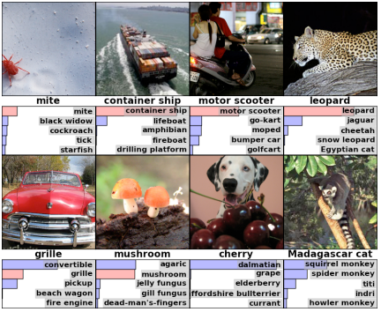
Krizhevsky, Sutskever, and Hinton, NIPS 2012
24

Slide 25
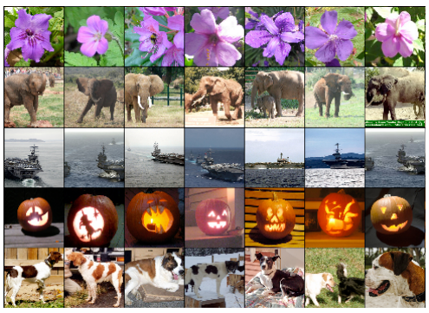
Krizhevsky, Sutskever, and Hinton, NIPS 2012
Test
Nearby images, according to NN features
25

Slide 26
Krizhevsky, Sutskever,
Hinton, 2012
Perceptrons,
1958
PDP book,
1986
enthusiasm
Minsky and Papert,
1972
AI winter,
2000
time

Slide 27
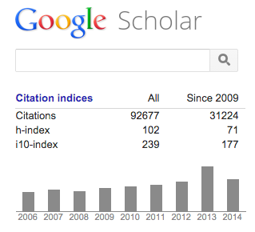
28 years
28 years
Krizhevsky, Sutskever,
Hinton, 2012
Perceptrons,
1958
PDP book,
1986
enthusiasm
Minsky and Papert,
1972
AI winter,
2000
time
Geoff Hinton’s citations

Slide 28
What comes next?
Krizhevsky, Sutskever,
Hinton, 2012
Perceptrons,
1958
PDP book,
1986
enthusiasm
Minsky and Papert,
1972
AI winter,
2000
2028 ?
time
28 years
28 years

Slide 29
What comes next?
Krizhevsky, Sutskever,
Hinton, 2012
Perceptrons,
1958
PDP book,
1986
enthusiasm
Minsky and Papert,
1972
AI winter,
2000
2028 ?
time
28 years
28 years

Slide 30
http://www.deeplearningbook.org/
By Ian Goodfellow, Yoshua Bengio and Aaron Courville
November 2016

Slide 31
Tutorials for Deep Learning Frameworks
TensorFlow Sessions:
5-6pm, Tue 10/3, 3-270, by Hunter
2-3pm, Thu 10/5, 3-270, by Jimmy
PyTorch Sessions:
4-5pm, Thu 10/5, 4-370, by Xiuming
6-7pm, Thu 10/5, 4-270, by Daniel
Information available on the class website

Slide 32
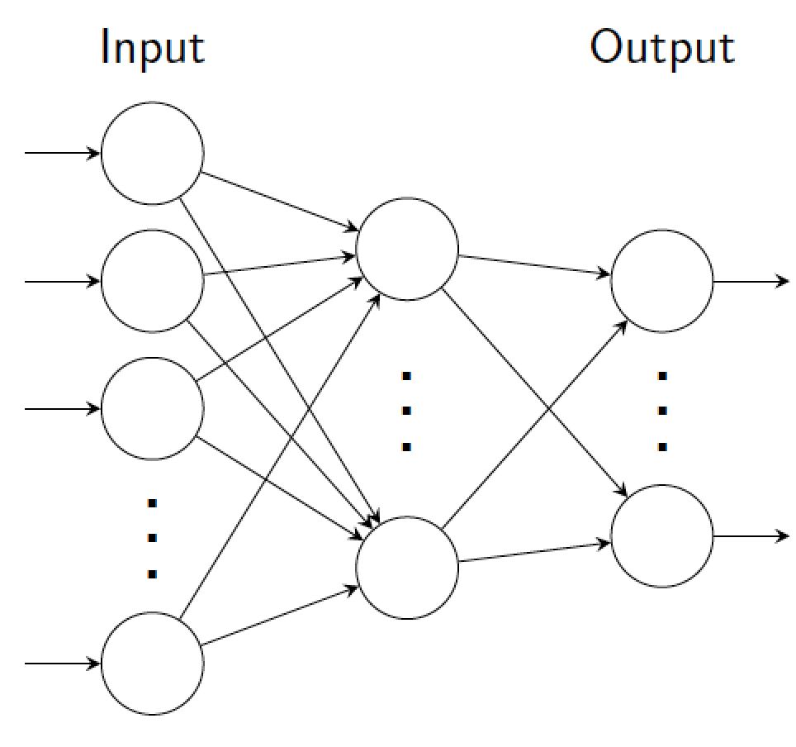
Neural networks
Neural nets composed of layers of artificial neurons.
Each layer computes some function of layer beneath.
Inputs mapped in feed-forward fashion to output.
Consider only feed-forward neural models at the moment, i.e. no cycles

Slide 33
An individual neuron (unit)
x1
Input: vector x (size n×1)
w1
Unit parameters: vector w (size n×1) bias b (scalar)
x2
w2
a
y=f(a)
x3
w3
+
Unit activation:
…
xn
wn
Output:
b
1
f(.) is a point-wise non-linear function. E.g.:
Can think of bias as weight w₀, connected to constant input 1: y = f ([w₀, w]^{T} [1; x ]).

Slide 34
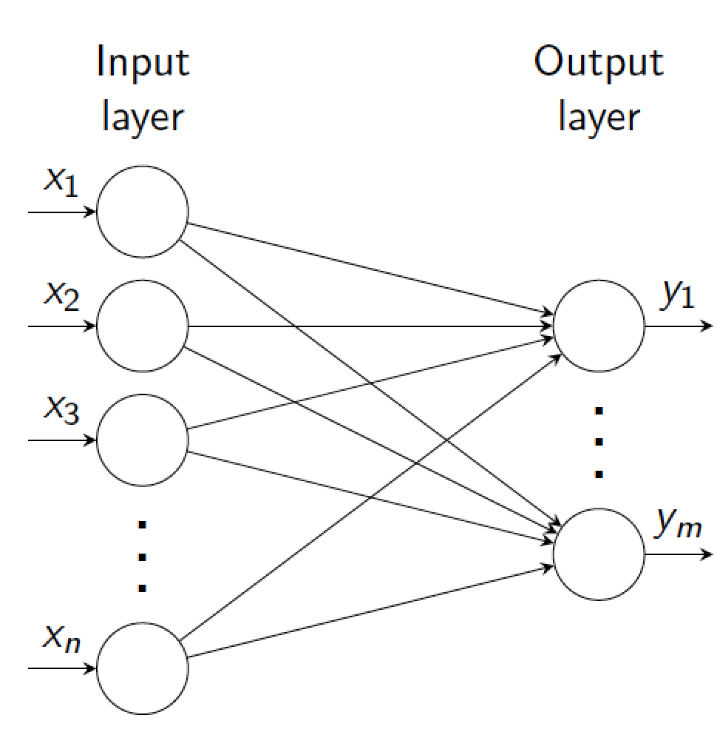
Single layer network
Input: column vector x (size n×1)
Output: column vector y (size m×1)
Layer parameters: weight matrix W (size n×m)
bias vector b (m×1)
w1,m
w1,1
Units activation:
wn,m

Slide 35
Single layer network
Input: column vector x (size n×1)
Output: column vector y (size m×1)
Layer parameters: weight matrix W (size n×m)
bias vector b (m×1)
w1,m
w1,1
Units activation:
ex. 4 inputs, 3 outputs
wn,m
y₁
=
w_{1,1}
x₁
+
b₁
y₂
x₂
b₂
y₃
w_{3,1}
w_{4,3}
x₃
b₃
x₄
b₄
Output:

Slide 36
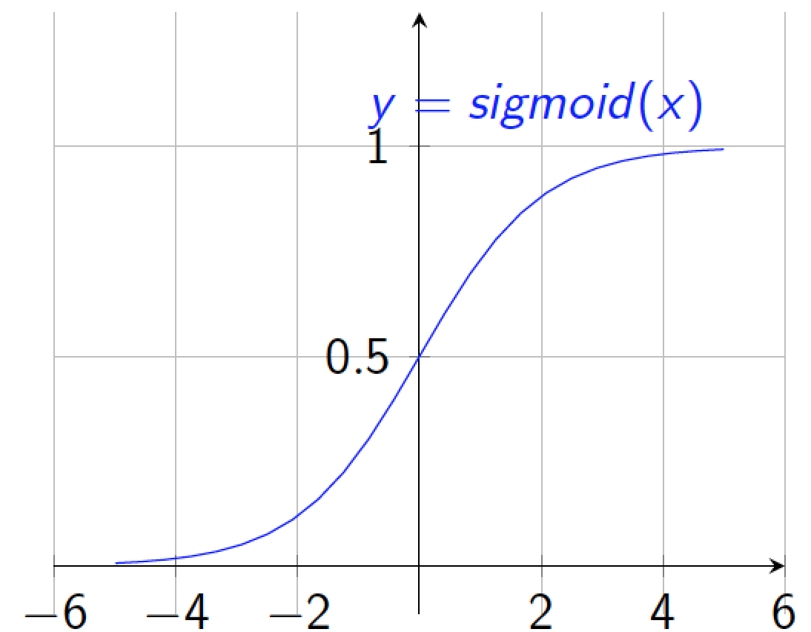
Non-linearities: sigmoid
Interpretation as firing rate of neuron
Bounded between [0,1]
Saturation for large +ve,-ve inputs
Gradients go to zero
Outputs centered at 0.5 (poor conditioning)
Not used in practice

Slide 37
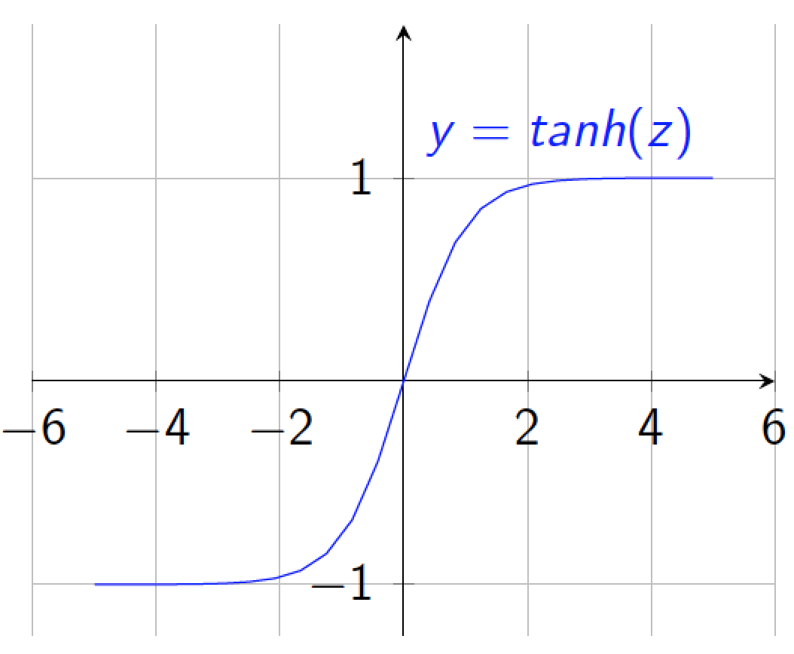
Non-linearities: tanh
Bounded between [-1,+1]
Saturation for large +ve,-ve inputs
Gradients go to zero
Outputs centered at 0
Preferable to sigmoid
tanh(x) = 2 sigmoid(2x) −1

Slide 38
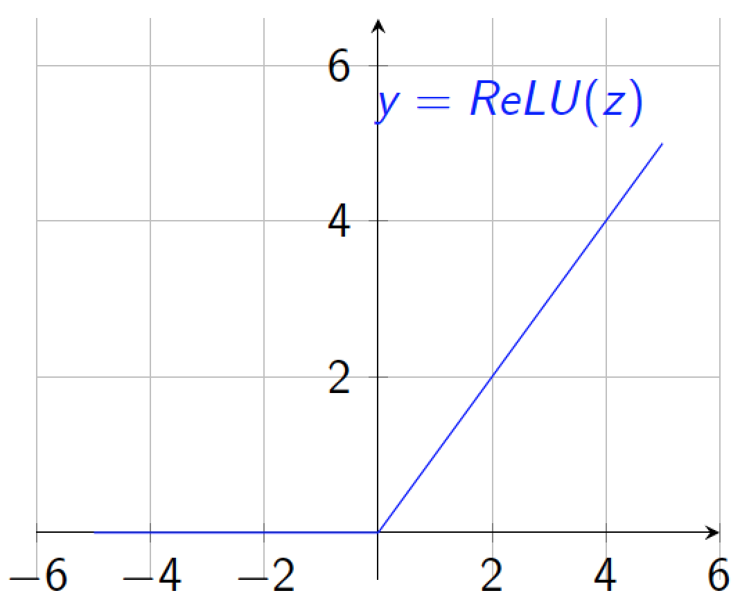
Non-linearities: rectified linear (ReLU)
Unbounded output (on positive side)
Efficient to implement:
Also seems to help convergence (see 6x speedup vs tanh in [Krizhevsky et al.])
Drawback: if strongly in negative region, unit is dead forever (no gradient).
Default choice: widely used in current models.

Slide 39
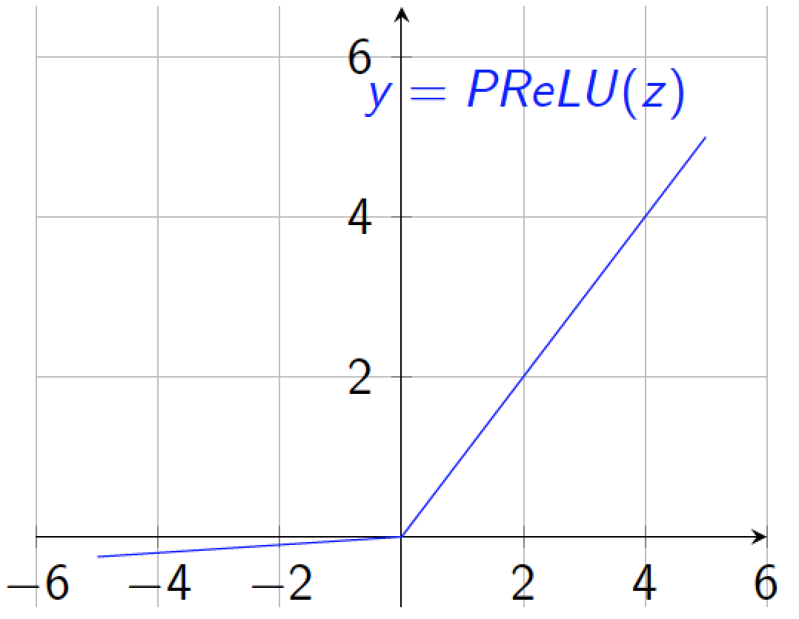
Non-linearities: Leaky ReLU
where α is small (e.g. 0.02)
Efficient to implement:
Also known as probabilistic ReLU (PReLU)
Has non-zero gradients everywhere (unlike ReLU)
α can also be learned (see
Kaiming He et al. 2015).

Slide 40
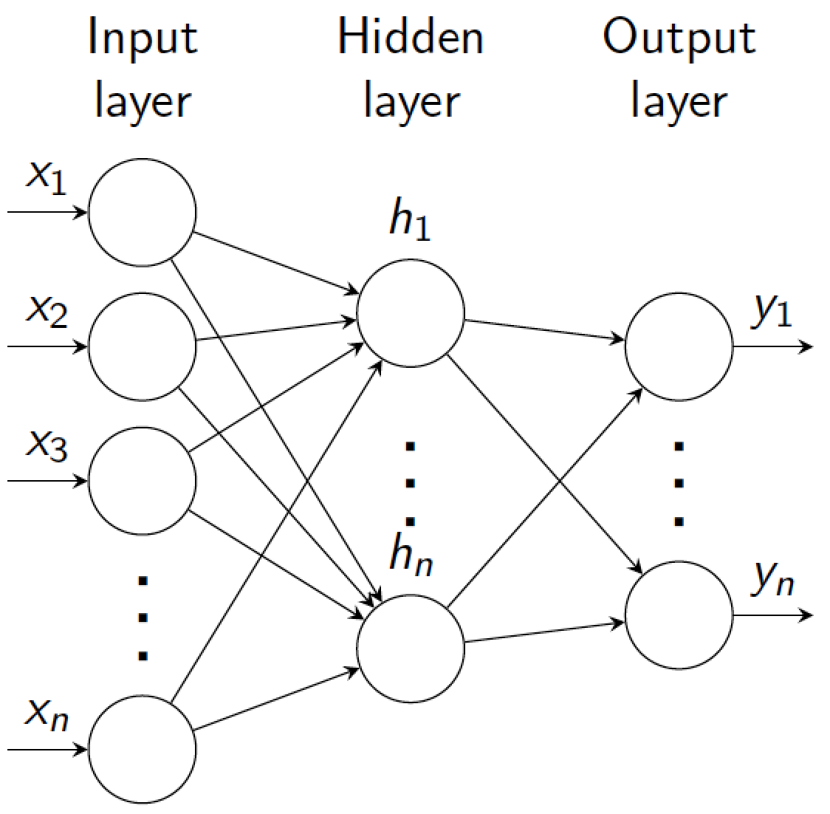
Multiple layers
Neural networks are composed of multiple layers of neurons.
Acyclic structure. Basic model assumes full connections between layers.
Layers between input and output are called hidden.
Various names used:
Artificial Neural Nets (ANN)
Multi-layer Perceptron (MLP)
Fully-connected network
Neurons typically called units.

Slide 41
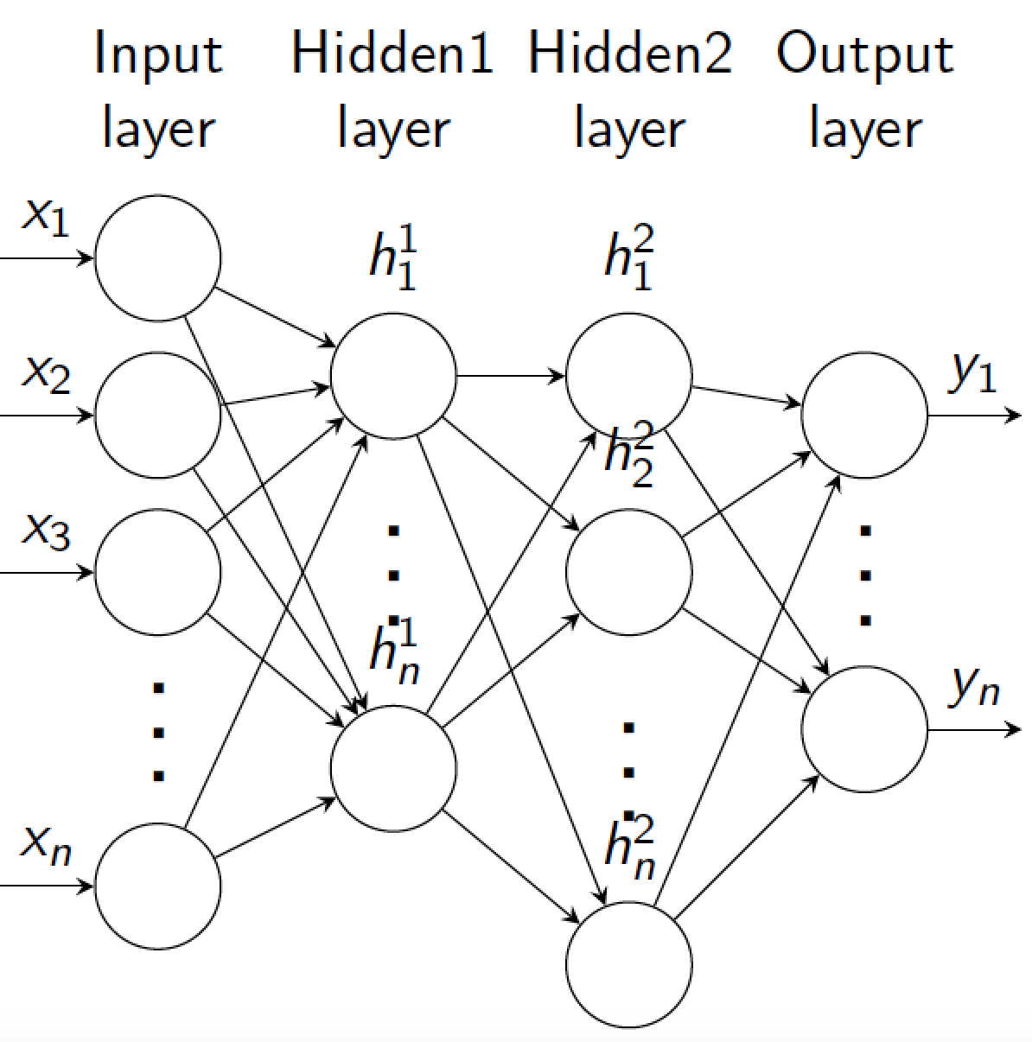
Example: 3 layer MLP
By convention, number of layers is hidden + output (i.e. does not include input).
So 3-layer model has 2 hidden layers.
Parameters: weight matrices W₁;W₂;W₃ bias vectors b₁; b₂; b₃.

Slide 42
Multiple layers
(output)
x_{n}
Output layer n
F_{n}(x_{n-1}, W_{n})
x_{n-1}
…
…
x_{i}
Hidden layer i
F_{i}(x_{i-1}, W_{i})
…
x_{i-1}
…
…
x₁
Hidden layer 1
F₁(x₀, W₁)
Input layer
(input)
x₀

Slide 43
Architecture selection
How to pick number of layers and units/layer?
Active area of research
For fully connected models 2 or 3 layers seems the most that can be effectively trained.
Regarding number of units/layer:
Parameters grows with (units/layer)² .
With large units/layer, can easily overfit.

Slide 44
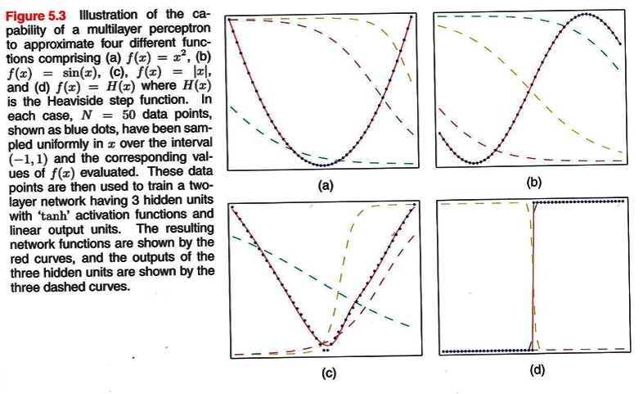
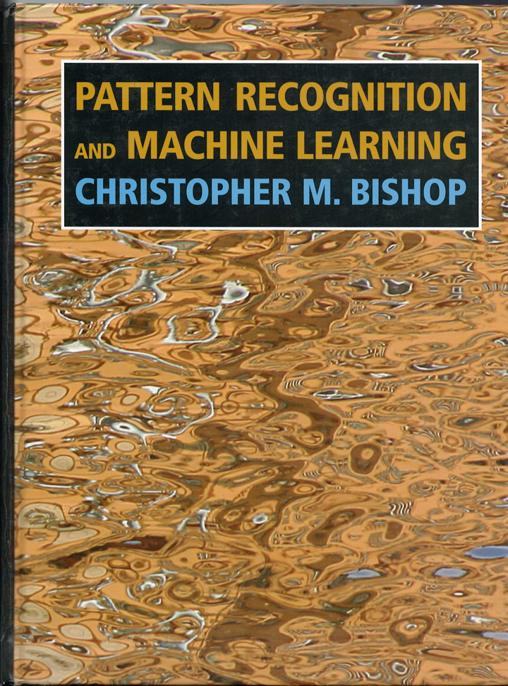
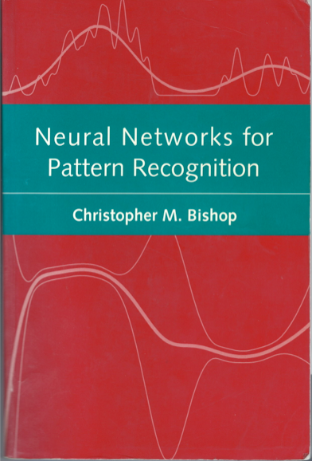
Representational power of two-layer network
2
1
3
5
bias
In
Out
44
4

Slide 45
Representational power
1 layer? Linear decision surface.
2+ layers? In theory, can represent any function. Assuming non-trivial non-linearity.
Bengio 2009,
http://www.iro.umontreal.ca/~bengioy/papers/ftml.pdf
Bengio, Courville, Goodfellow book
http://www.deeplearningbook.org/contents/mlp.html
Simple proof by M. Neilsen
http://neuralnetworksanddeeplearning.com/chap4.html
D. Mackay book
http://www.inference.phy.cam.ac.uk/mackay/itprnn/ps/482.491.pdf
But issue is efficiency: very wide two layers vs narrow deep model? In practice, more layers helps.

Slide 46
Training a model: overview
Given dataset {x; y}, pick appropriate cost function C.
Forward-pass (f-prop) training examples through the model to get network output.
Get error using cost function C to compare output to targets y
Use Stochastic Gradient Descent (SGD) to update weights adjusting parameters to minimize loss/energy E (sum of the costs for each training example)

Slide 47
(

Slide 48
Object detection

Slide 50
Discriminative methods
Object detection and recognition is formulated as a classification problem.
The image is partitioned into a set of overlapping windows
… and a decision is taken at each window about if it contains a target object or not.
Decision boundary
Background
Where are the screens?
Bag of image patches
Computer screen
In some feature space
Notes:
Object detection and recognition is formulated as a classification problem. The image is partitioned into a set of overlapping windows, and a decision is taken at each window about if it contains a target object or not.
Each window is represented by extracting a large number of features that encode information such as boundaries, textures, color, spatial structure.
The classification function, that maps an image window into a binary decision, is learnt using methods such as SVMs, boosting or neural networks.

Slide 51
Formulation
Formulation: binary classification
…
x₁
x₂
x₃
…
x_{N}
x_{N+1}
x_{N+2}
…
x_{N+M}
Features x =
Labels
y =
-1
+1
-1
-1
?
?
?
Training data: each image patch is labeled
as containing the object or background
Test data
Classification function
Where belongs to some family of functions
Minimize misclassification error
(Not that simple: we need some guarantees that there will be generalization)
Notes:
In many cases, F(x) will give a real value and the classification is perform with a Threshold. If F(x)>0 then y =+1

Slide 52
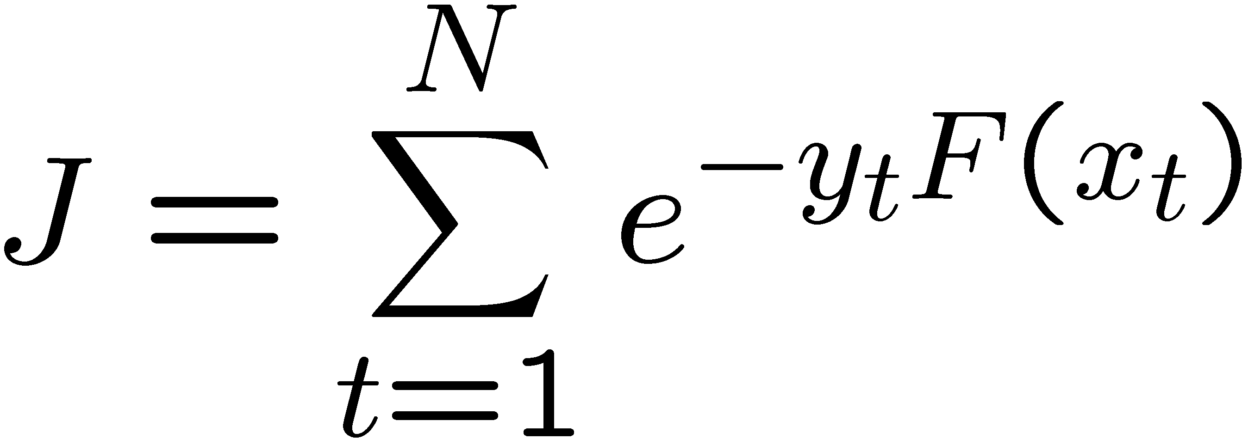
Cost functions
Loss
Squared error
4
Misclassification error
3.5
Squared error
3
Exponential loss
2.5
2
1.5
Exponential loss
1
0.5
0
-1.5
-1
-0.5
0
0.5
1
1.5
2
yF(x) = margin

Slide 53
MiniPlaces Challenge
Goal: identify the scene category depicted in a photograph.
Data
100,000 images for training, 10,000 for validation and 10,000 for testing
100 scene categories
Task: produce up to 5 categories in descending order of confidence

Slide 54
MiniPlaces Challenge
Steps:
Students have to sign up with a team name and the team members to receive a team code and instructions for submitting to the leaderboard. This can be done here.
After sign-up, upload the prediction results here. Each team is allowed to upload a submission at most every 4 hours.
The leaderboard is here.

Slide 55
MiniPlaces Challenge
Suggestions:
Computation: Amazon's EC2
Students can receive free $100 credit through the AWS Educate program.
Model: It is very helpful to go through the examples of training convolutional neural nets in Caffe, TensorFlow, or PyTorch.
Algorithm: Use data augmentation, deeper layers, or object annotation etc, to boost the classification accuracy.

Slide 57
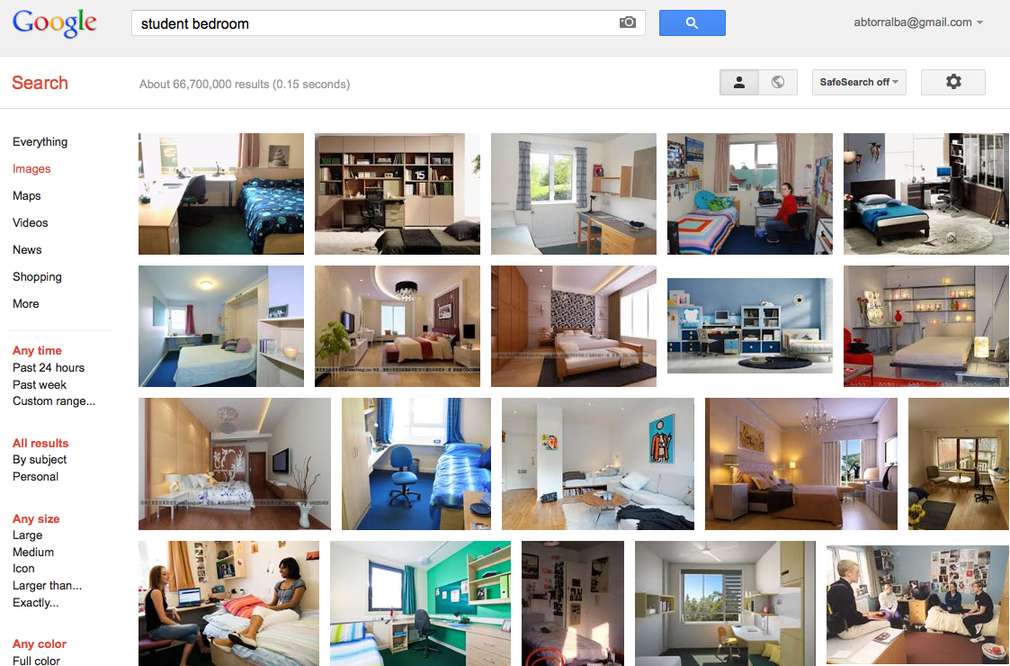

Slide 58
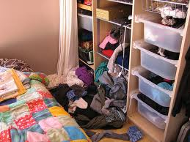

Slide 59
)

Slide 60
Cost function
Consider model with N layers. Layer i has vector of weights Wi.
Forward pass: takes input x and passes it through each layer F_{i}: x_{i} = F_{i} (x_{i-1}, W_{i})
Output of layer i is x_{i}.
Network output (top layer) is x_{n}.
(output)
x_{n}
F_{n}(x_{n-1}, W_{n})
x_{n-1}
…
x_{i}
F_{i}(x_{i-1}, W_{i})
x_{i-1}
…
x₂
F₂(x₁, W₂)
x₁
F₁(x₀, W₁)
(input)
x₀

Slide 61
Cost function
E
C(x_{n}, y)
Consider model with N layers. Layer i has vector of weights Wi.
Forward pass: takes input x and passes it through each layer F_{i}: x_{i} = F_{i} (x_{i-1}, W_{i})
Output of layer i is x_{i}.
Network output (top layer) is x_{n}.
Cost function C compares x_{n} to y
Overall energy is the sum of the cost over all training examples:
(output)
x_{n}
F_{n}(x_{n-1}, W_{n})
x_{n-1}
…
x_{i}
F_{i}(x_{i-1}, W_{i})
x_{i-1}
…
x₂
F₂(x₁, W₂)
x₁
F₁(x₀, W₁)
(input)
x₀
y

Slide 62
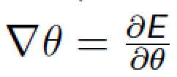
Stochastic gradient descend
Want to minimize overall loss function E. Loss is sum of individual losses over each example.
In gradient descent, we start with some initial set of parameters θ
Update parameters:
k is iteration index, η is learning rate (scalar; set semi-manually).
Gradients computed by b-prop.
In Stochastic gradient descent, compute gradient on sub-set (batch) of data.
If batchsize=1 then θ is updated after each example.
If batchsize=N (full set) then this is standard gradient descent.
Gradient direction is noisy, relative to average over all examples (standard gradient descent).

Slide 63
Stochastic gradient descend
We need to compute gradients of the cost with respect to model parameters w_{i}
Back-propagation is essentially chain rule of derivatives back through the model.
By dessign, each layer is differentiable with respect to parameters and input.

Slide 64
Computing gradients
Training will be an iterative procedure, and at each iteration we will update the network parameters
We want to compute the gradients
Where
…

Slide 65
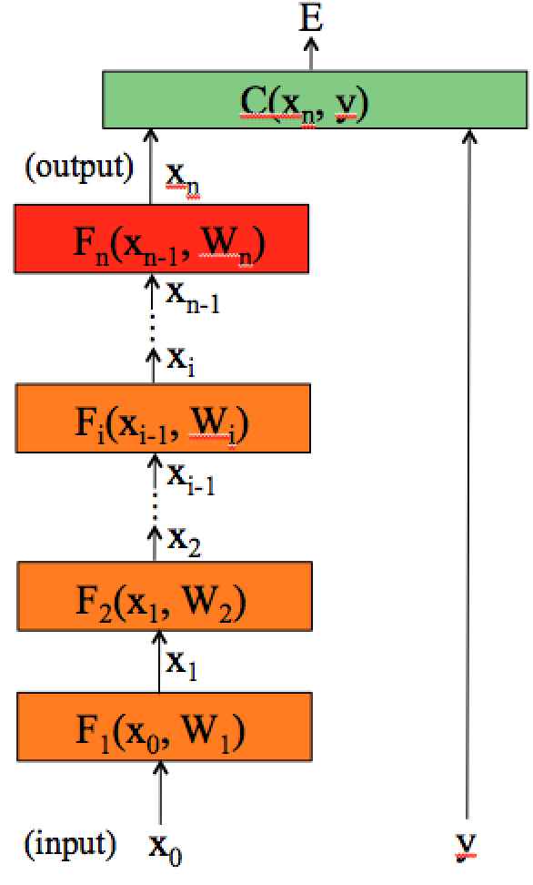
Computing gradients
To compute the gradients, we could start by wring the full energy E as a function of the network parameters.
And then compute the partial derivatives… instead, we can use the chain rule to derive a compact algorithm: back-propagation

Slide 66
(

Slide 67
Matrix calculus
x column vector of size [n×1]
We now define a function on vector x: y = F(x)
If y is a scalar, then
The derivative of y is a row vector of size [1×n]
If y is a vector [m×1], then (Jacobian formulation):
The derivative of y is a matrix of size [m×n]
(m rows and n columns)

Slide 68
Matrix calculus
If y is a scalar and X is a matrix of size [n×m], then
The output is a matrix of size [m×n]

Slide 69
Matrix calculus
Chain rule:
For the function: z = h(x) = f (g(x))
Its derivative is:
h’(x) = f’ (g(x)) g’(x)
and writing z=f(u), and u=g(x):
[m×n]
[m×p]
[p×n]
with p = length vector u = |u|, m = |z|, and n = |x|
Example, if |z|=1, |u| = 2, |x|=4
h’(x) =
=

Slide 70
Matrix calculus
Chain rule:
For the function: h(x) = f_{n}(f_{n-1}(…(f₁(x)) ))
With u₁= f₁(x)
u_{i} = f_{i}(u_{i-1})
z = u_{n}= f_{n}(u_{n-1})
The derivative becomes a product of matrices:
(exercise: check that all the matrix dimensions work fine)

Slide 71
)

Slide 72
Computing gradients
To compute the gradients, we could start by wring the full energy E as a function of the network parameters.
And then compute the partial derivatives… instead, we can use the chain rule to derive a compact algorithm: back-propagation

Slide 73
Computing gradients
The energy E is the sum of the costs associated to each training example x^{m}, y^{m}
θ
θ

Slide 74
Computing gradients
The energy E is the sum of the costs associated to each training example x^{m}, y^{m}
Its gradient with respect to the networks parameters θ is:
θ
θ
θ
∂θ_{i}
∂θ_{i}
is how much E varies when the parameter θ_{i} is varied.

Slide 75
Computing gradients
We could write the cost function to get the gradients:
θ
with
θ
If we compute the gradient with respect to the parameters of the last layer (output layer) w_{n}, using the chain rule:
(how much the cost changes when we change w_{n}: is the product between how much the cost changes when we change the output of the last layer and how much the output changes when we change the layer parameters.)

Slide 76
Computing gradients: cost layer
If we compute the gradient with respect to the parameters of the last layer (output layer) w_{n}, using the chain rule:
Will depend on the layer structure and non-linearity.
For example, for an Euclidean loss:
The gradient is:

Slide 77
Computing gradients: layer i
We could write the full cost function to get the gradients:
θ
If we compute the gradient with respect to w_{i}, using the chain rule:
And this can be computed iteratively!
This is easy.

Slide 78
Backpropagation
If we have the value of we can compute the gradient at the layer bellow as:
Gradient layer i-1
Gradient layer i

Slide 79
Backpropagation: layer i
Layer i has two inputs (during training)
x_{i-1}
F_{i+1}
For layer i, we need the derivatives:
x_{i}
Hidden layer i
F_{i}(x_{i-1}, W_{i})
x_{i-1}
We compute the outputs
F_{i-1}
Forward pass
Backward pass
The weight update equation is:
(sum over all training examples to get E)
Notes:
During training, each layer will have three outputs:
the forward pass. To compute the operating point for each layer and training example
the backwards pass to propagate the energy derivative with respect to the input of the layer
- and the derivative of the energy with respect to the weights.

Slide 80
Backpropagation: summary
E
Forward pass: for each training example. Compute the outputs for all layers
Backwards pass: compute cost derivatives iteratively from top to bottom:
Compute gradients and update weights.
C(X_{n},Y)
(output)
x_{n}
F_{n}(x_{n-1}, W_{n})
x_{n-1}
…
x_{i}
F_{i}(x_{i-1}, W_{i})
x_{i-1}
…
x₂
F₂(x₁, W₂)
x₁
F₁(x₀, W₁)
(input)
x₀
y

Slide 81
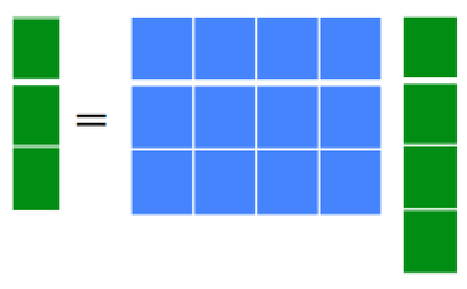
Linear Module
x_{out}
Forward propagation:
F(x_{in}, W)
x_{in}
With W being a matrix of size |x_{out}|×|x_{in}|
Backprop to input:
If we look at the j component of output x_{out}, with respect to the i component of the input, x_{in}:
Therefore:

Slide 82
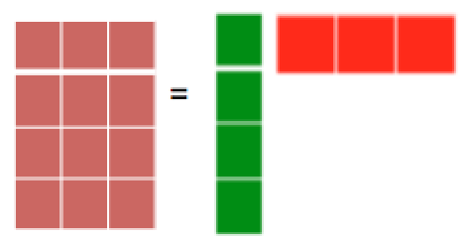
Linear Module
x_{out}
Forward propagation:
F(x_{in}, W)
x_{in}
Backprop to weights:
If we look at how the parameter W_{ij} changes the cost, only the i component of the output will change, therefore:
And now we can update the weights (by summing over all the training examples):
(sum over all training examples to get E)
Notes:
Things to notice: dC/dW is the derivative of a scalar by a matrix. So it is well defined.
If there is a single training example, then E = C.

Slide 83
Linear Module
x_{out}
Weight updates
x_{in}

Slide 84
Pointwise function
x_{out}
Forward propagation:
F(x_{in}, W)
x_{in}
h = an arbitrary function, b_{i} is a bias term.
Backprop to input:
Backprop to bias:
We use this last expression to update the bias.
Some useful derivatives:
For hyperbolic tangent:
For ReLU: h(x) = max(0,x) h’(x) = 1 [x>0]

Slide 85
Pointwise function
x_{out}
Weight updates
x_{in}

Slide 86
Euclidean cost module
C
x_{in}
y

Slide 87
Back propagation example
node 1
w13=1
node 3
1
0.2
tanh
node 5
input
output
-3
linear
node 2
node 4
-1
1
tanh
Learning rate = -0.2 (because we used positive increments)
Euclidean loss
Training data:
input
desired output
node 1
node 2
node 5
1.0 0.1 0.5
Exercise: run one iteration of back propagation

Slide 88
Back propagation example
node 1
w13=1
node 3
1
0.2
tanh
node 5
input
output
-3
linear
node 2
node 4
-1
1
tanh
After one iteration (rounding to two digits):
node 1
w13=1.02
node 3
1.02
0.17
tanh
node 5
input
output
-3
linear
node 2
node 4
-0.99
1
tanh

