Slide 1
Notes on research, giving talks and writing papers
Antonio Torralba

Slide 2
Doing research
Collaborators
Doing original work
Finding the right story (you might have not solved the problem you wanted to solve, but maybe you solved a different one). Sometimes discoveries are made by accident. Learn to identify the “accidental” discoveries within your work

Slide 3
Doing research
Finding your own vision. It might become visible after several years. even if your work seems disconected, there is a reason why you worked in all of those projects.

Slide 4
Knowing when things do not “work”
Bugs vs fundamental problems
Pushing vs giving up
Do not hide issues, admit when things do not work
Sometimes helps reformulating what you are doing (change the story or change the approach)

Slide 5
Knowing when things “work”
In research “work” means something different depending on the context. For a well defined problem, does it work better than previous work? For a new problem, does it show promise?
Do not get scared by failures in your method. Do not hide them. Failures can be interesting, fun, and pedagogical. Failures can help you to better explain what your method is really doing.

Slide 6
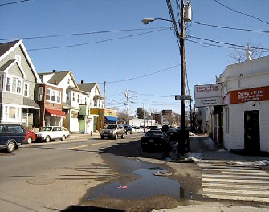
Event prediction
What can happen here?
Liu, Yuen, Torralba. CVPR 2009. Yuen, Torralba. ECCV 2010

Slide 7
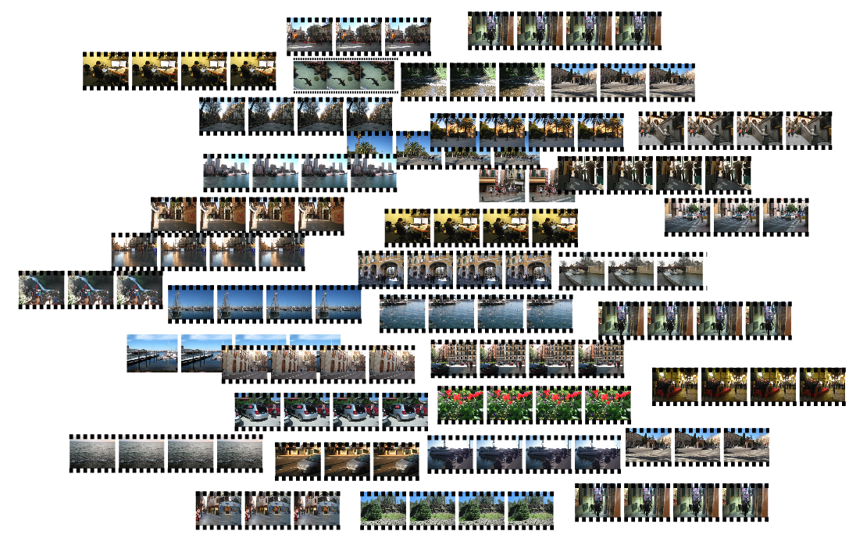
Event prediction
What can happen here?
Video database
Liu, Yuen, Torralba. CVPR 2009. Yuen, Torralba. ECCV 2010

Slide 8
Event prediction
What can happen here?
Video database
Liu, Yuen, Torralba. CVPR 2009; Yuen, Torralba. ECCV 2010

Slide 9
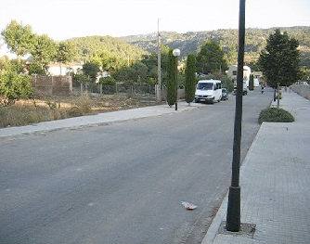
What can happen here?
Prediction
Nearest neighbor
Liu, Yuen, Torralba. CVPR 2009. Yuen, Torralba. ECCV 2010
Liu, Yuen, Torralba. CVPR 2009; Yuen, Torralba. ECCV 2010
Notes:
9

Slide 10
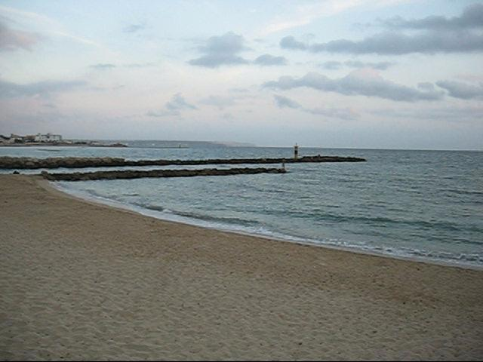
What can happen here?
Liu, Yuen, Torralba. CVPR 2009. Yuen, Torralba. ECCV 2010
Liu, Yuen, Torralba. CVPR 2009; Yuen, Torralba. ECCV 2010
Notes:
10

Slide 11
What can happen here?
Prediction
Liu, Yuen, Torralba. CVPR 2009. Yuen, Torralba. ECCV 2010
Liu, Yuen, Torralba. CVPR 2009; Yuen, Torralba. ECCV 2010
Notes:
11

Slide 12
VirtualHome: Simulating Household Activities via Programs. Xavier Puig, Kevin Ra, Marko Boben, Jiaman Li, Tingwu Wang, Sanja Fidler, Antonio Torralba. Computer Vision and Pattern Recognition (CVPR) 2018
Notes:
TODO: better align

Slide 13
Notes:
Of course animaitng our environment took some effort

Slide 15
Talking
Bad news first:
The more you work on a talk, the better it gets…
But the good news:
People usually forget bad talks (unless it is a job talk), and remember only the best talks...

Slide 16
All talks are important
There are no unimportant talks.
There are no big or small audiences.
Prepare each talk with the same enthusiasm.
If you are giving the same talk multiple times, it is helpful to do minor changes. This way you engage with the content again.

Slide 17
How to give a talk
Delivering:
Look at the audience! Try not to talk to your laptop or to the screen. Instead, look at the other humans in the room.
You have to believe in what you present, be confident… even if it only lasts for the time of your presentation.
Do not be afraid to acknowledge limitations of whatever you are presenting. Limitations are good. They leave job for the people to come. Trying to hide the problems in your work will make the preparation of the talk a lot harder and your self confidence will be hurt.

Slide 18
How to give a talk
Talk organization: here there are as many theories as there are talks. Here there are some extreme advices:
Go into details / only big picture
Go in depth on a single topic / cover as many things as you can
Be serious (never make jokes, maybe only one) / be funny (it is just another form of theater)
Corollary: ask people for advice, but at the end, if will be just you and the audience. Chose what fits best your style.
What everybody agree on is that you have to practice in advance (the less your experience, the more you have to practice). Do it with an audience or without, but practice.
The best advice I got came from Yair Weiss while preparing my job talk:
“just give a good talk”

Slide 19
How to give the project class talk
Initial conditions:
I started with a great idea
It did not work
The day before the presentation I found 40 papers that already did this work
Then I also realized that the idea was not so great
How do I present?
Just give a good talk

Slide 20
Writing
Writing is difficult. You learn to write by writing and reading (a lot).
Leave enough time to write your paper.
Clarity of ideas...
Clarity of vocabulary (use the same words to refer to the same concept, ...)
The reader is educated but not familiar with your work and ideas. Do not make strong assumptions about what they understand, but do not review all the basic material.

