Slide 1
6.819 / 6.869: Advances in Computer Vision
William T. Freeman, Phillip Isola, Antonio Torralba, 2018
Lecture 4
Stereo

Slide 2
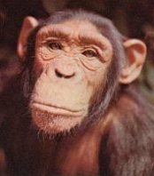
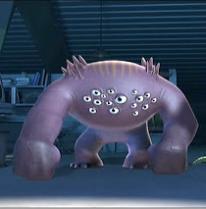
Vision systems
Two cameras
N cameras
One camera

Slide 3
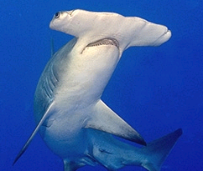
Stereo vision
~6cm
~50cm

Slide 4
1, 2, N eyes

Slide 5
1, 2, N eyes

Slide 6
1, 2, N eyes

Slide 7
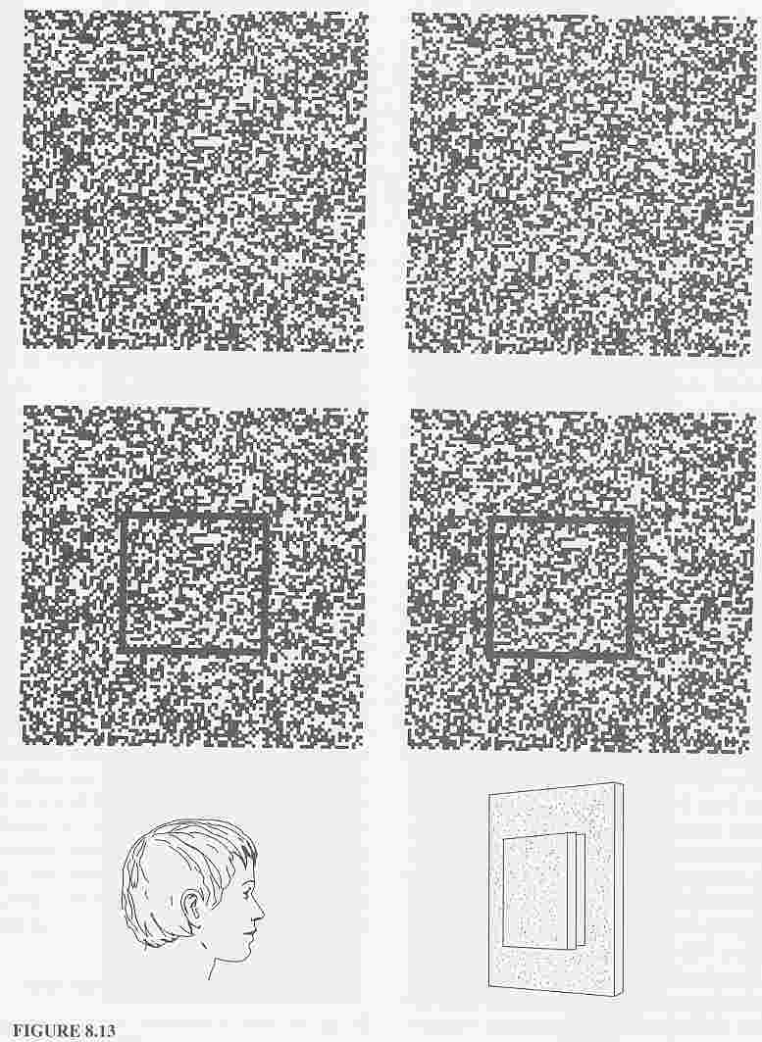
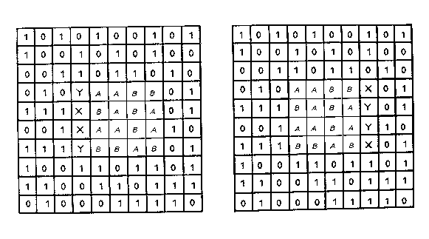
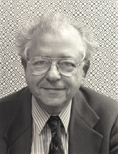
Depth without objects
Random dot stereograms (Bela Julesz)
Julesz, 1971

Slide 8
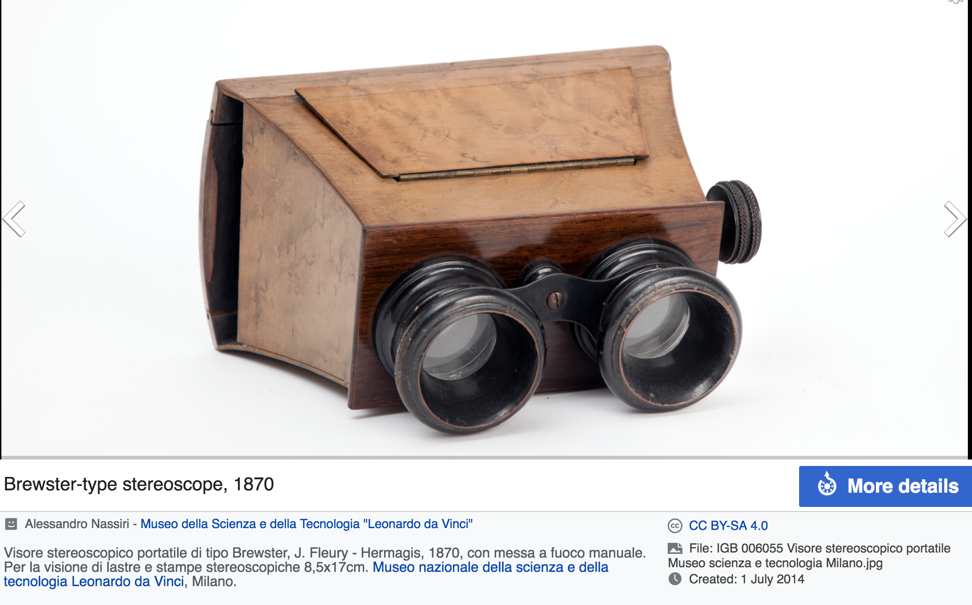
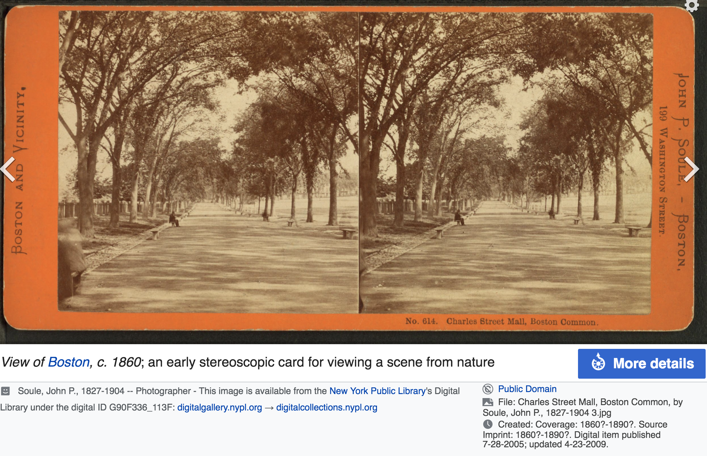

Slide 9
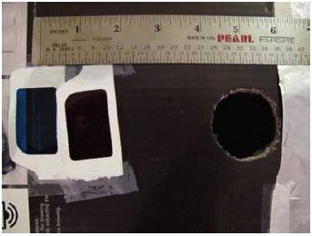
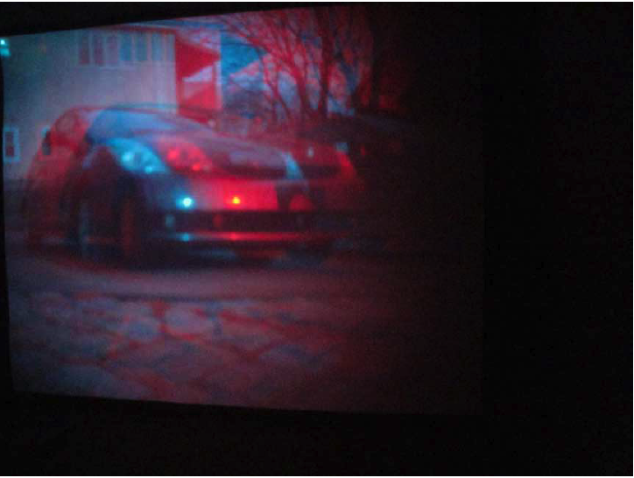
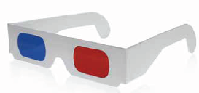
Anaglyph pinhole camera

Slide 10
Geometry for a simple stereo system
Z₁
x_{L}
f
X₁

Slide 11
Geometry for a simple stereo system
Z₁
Z?
x_{L}
f
X₁

Slide 12
Geometry for a simple stereo system
Z₁
Z₂
Z?
x_{L}
x_{R}
f
f
X₁
X₂
T

Slide 13
Geometry for a simple stereo system
Z₁
Z₂
Z?
x_{L}
x_{R}
f
f
X₁
X₂
T
Similar triangles

Slide 14
Geometry for a simple stereo system
Z₁
Z₂
Z?
x_{L}
x_{R}
f
f
X₁
X₂
T
Similar triangles

Slide 15
Geometry for a simple stereo system
Z₁
Z₂
Similar triangles:
Z?
T+X_{L}-X_{R}
=
x_{L}
x_{R}
Z-f
f
f
X₁
X₂
T

Slide 16
Geometry for a simple stereo system
Z₁
Z₂
Similar triangles:
Z?
T+X_{L}-X_{R}
T
=
x_{L}
x_{R}
Z-f
Z
f
f
X₁
X₂
T

Slide 17
Geometry for a simple stereo system
Z₁
Z₂
Similar triangles:
Z?
T+X_{L}-X_{R}
T
=
x_{L}
x_{R}
Z-f
Z
f
f
X₁
X₂
Solving for Z:
T
T
Z = f
X_{L} - X_{R}
Disparity

Slide 18
In 3D
camera 1
camera 2
T

Slide 19
Disparity map
Left image
Right image
I took one picture, then I moved ~1m to the right and took a second picture.

Slide 20
Disparity map
Left image
Right image

Slide 21
Disparity map
Left image
Right image

Slide 22
Disparity map
I’(x,y)
I(x,y)
I’(x,y) = I(x+D(x,y), y)
a
D(x,y)
Z(x,y) =
D(x,y)

Slide 23
Finding correspondences
We only need to search for matches along horizontal lines.

Slide 24
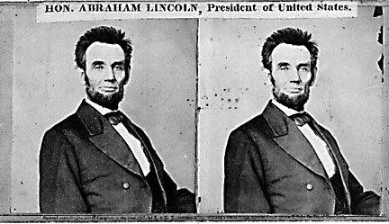
Your basic stereo algorithm
For each epipolar line
For each pixel in the left image
compare with every pixel on same epipolar line in right image
pick pixel with minimum match cost
CSE 576, Spring 2008
Stereo matching
Slide credit: Rick Szeliski

Slide 25
Computing disparity

Slide 26
Computing disparity
Opencv (3.4.1) and python 3.6.5
import cv2
from matplotlib import pyplot as plt
imgL = cv2.imread('input1.jpg', 0)
imgR = cv2.imread('input2.jpg', 0)
stereo = cv2.StereoSGBM_create(numDisparities=80, blockSize=15)
disparity = stereo.compute(imgL, imgR)
plt.imshow(disparity, 'gray')
plt.show()

Slide 27
Computing disparity
import numpy as np
from sklearn.preprocessing import normalize
import cv2
from matplotlib import pyplot as plt
imgL = cv2.imread('img_0.JPG',0)
imgR = cv2.imread('img_1.JPG',0)
# SGBM Parameters -----------------
window_size = 3 # wsize default 3; 5; 7 for SGBM reduced size image; 15 for SGBM full size image (1300px and above); 5 Works nicely
left_matcher = cv2.StereoSGBM_create(
minDisparity=0,
numDisparities=160, # max_disp has to be dividable by 16 f. E. HH 192, 256
blockSize=5,
P1=8 * 3 * window_size ** 2, # wsize default 3; 5; 7 for SGBM reduced size image; 15 for SGBM full size image (1300px and above); 5 Works nicely
P2=32 * 3 * window_size ** 2,
disp12MaxDiff=1,
uniquenessRatio=15,
speckleWindowSize=0,
speckleRange=2,
preFilterCap=63,
mode=cv2.STEREO_SGBM_MODE_SGBM_3WAY
)
right_matcher = cv2.ximgproc.createRightMatcher(left_matcher)
# FILTER Parameters
lmbda = 80000
sigma = 1.2
visual_multiplier = 1.0
wls_filter = cv2.ximgproc.createDisparityWLSFilter(matcher_left=left_matcher)
wls_filter.setLambda(lmbda)
wls_filter.setSigmaColor(sigma)
print('computing disparity...')
displ = left_matcher.compute(imgL, imgR) # .astype(np.float32)/16
dispr = right_matcher.compute(imgR, imgL) # .astype(np.float32)/16
displ = np.int16(displ)
dispr = np.int16(dispr)
filteredImg = wls_filter.filter(displ, imgL, None, dispr) # important to put "imgL" here!!!
filteredImg = cv2.normalize(src=filteredImg, dst=filteredImg, beta=0, alpha=255, norm_type=cv2.NORM_MINMAX);
filteredImg = np.uint8(filteredImg)
cv2.imwrite("disparity_l.png", filteredImg)
http://timosam.com/python_opencv_depthimage

Slide 28
Do we really need two images?

Slide 29
Manually adjusting the focal length, to something that looks reasonable...

Slide 30
General case, with calibrated cameras
The two cameras need not have parallel optical axes.

Slide 32
We only need to search for matches along horizontal lines?

Slide 33
We only need to search for matches along horizontal lines?

Slide 34
We only need to search for matches along horizontal lines.
It looks like we need to search everywhere... are there any constraints that can guide the search?

Slide 35
Stereo correspondence constraints
Camera 1
Camera 2
p’ ?
p
O
O’
If we see a point in camera 1, are there any constraints on where we will find it on camera 2?

Slide 36
Epipolar constraint
p’ ?
p
O
O’

Slide 37
Some terminology
p’ ?
p
O
O’

Slide 38
Some terminology
p’ ?
p
Baseline
O
O’
Baseline: the line connecting the two camera centers
Epipole: point of intersection of baseline with the image plane

Slide 39
Some terminology
p’ ?
p
epipole
Baseline
epipole
O
O’
Baseline: the line connecting the two camera centers
Epipole: point of intersection of baseline with the image plane

Slide 40
Some terminology
epipolar plane
p’ ?
p
O
O’
Baseline: the line connecting the two camera centers
Epipole: point of intersection of baseline with the image plane
Epipolar plane: the plane that contains the two camera centers and a 3D point in the world

Slide 41
Some terminology
epipolar line
epipolar line
p’ ?
p
O
O’
Baseline: the line connecting the two camera centers
Epipole: point of intersection of baseline with the image plane
Epipolar plane: the plane that contains the two camera centers and a 3D point in the world
Epipolar line: intersection of the epipolar plane with each image plane

Slide 42
Epipolar constraint
epipolar line
p’ ?
p
O
O’
We can search for matches across epipolar lines
All epipolar lines intersect at the epipoles

Slide 43
The essential matrix
p’
p
O
O’
If we observe a point in one image, its position in the other image is constrained to lie on line defined by above.
p^{T} E p’ = 0
E: essential matrix
p, p’: image points in homogeneous coordinates

Slide 44
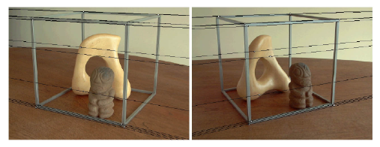
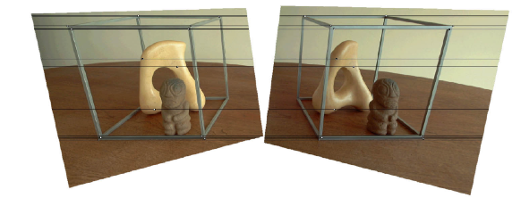
Image rectification
Source: Alyosha Efros

Slide 45
Active stereo with structured light
Li Zhang’s one-shot stereo
camera 1
camera 1
projector
projector
camera 2
Li Zhang, Brian Curless, and Steven M. Seitz. Rapid Shape Acquisition Using Color Structured Light and Multi-pass Dynamic Programming. In Proceedings of the 1st International Symposium on 3D Data Processing, Visualization, and Transmission (3DPVT), Padova, Italy, June 19-21, 2002, pp. 24-36.
CSE 576, Spring 2008
Stereo matching
Slide credit: Rick Szeliski

Slide 46
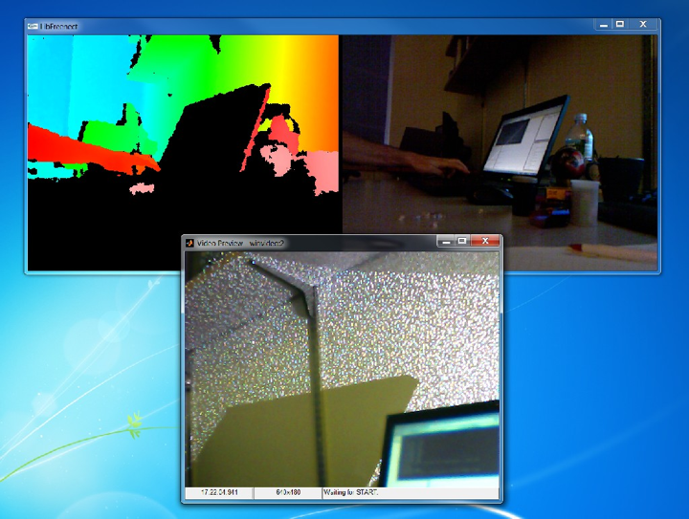
CSE 576, Spring 2008
Stereo matching

Slide 47
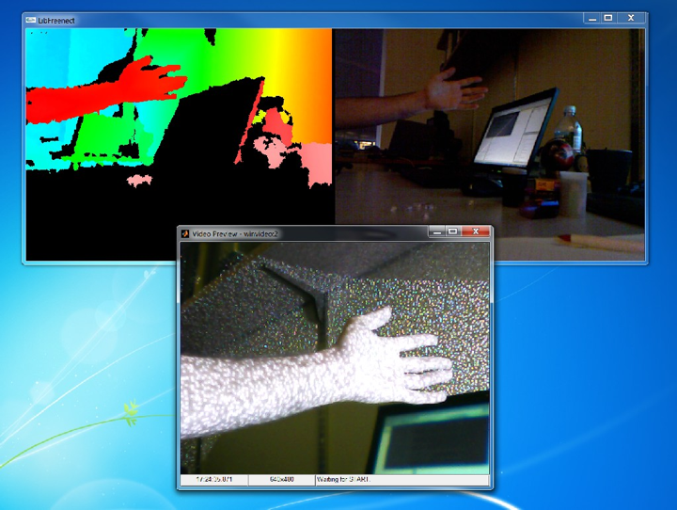

Slide 48
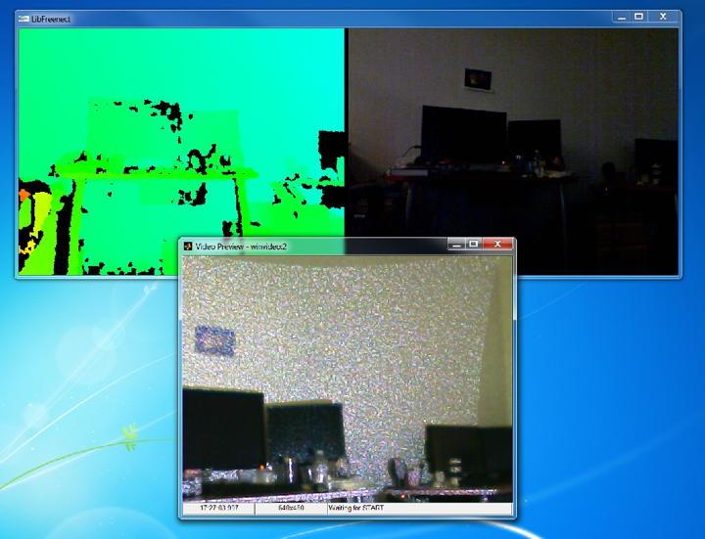

Slide 49
