Slide 1

William T. Freeman, Phillip Isola, Antonio Torralba, 2018
Lecture 5
Linear filters

Slide 2
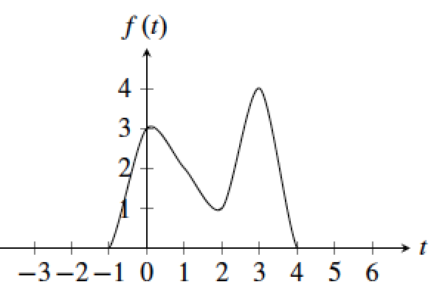
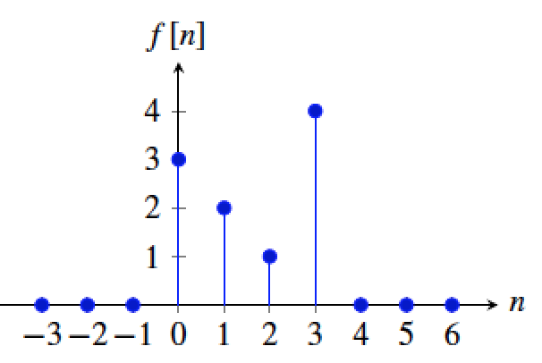
Signals and systems
Time continuous signal
Time discrete signal

Slide 3
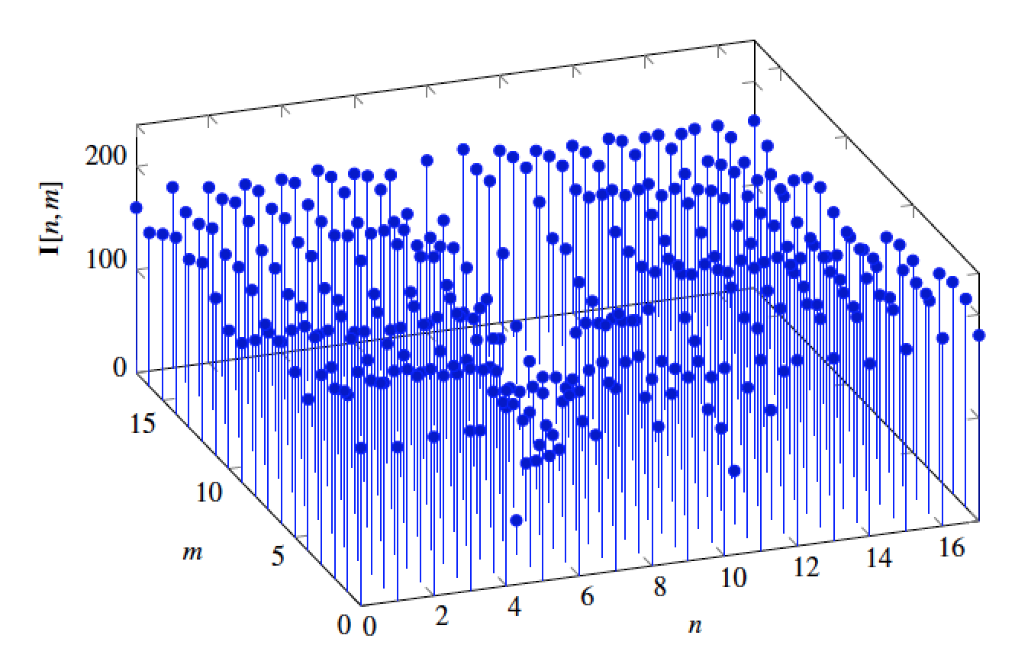
A 2D discrete signal

Slide 4
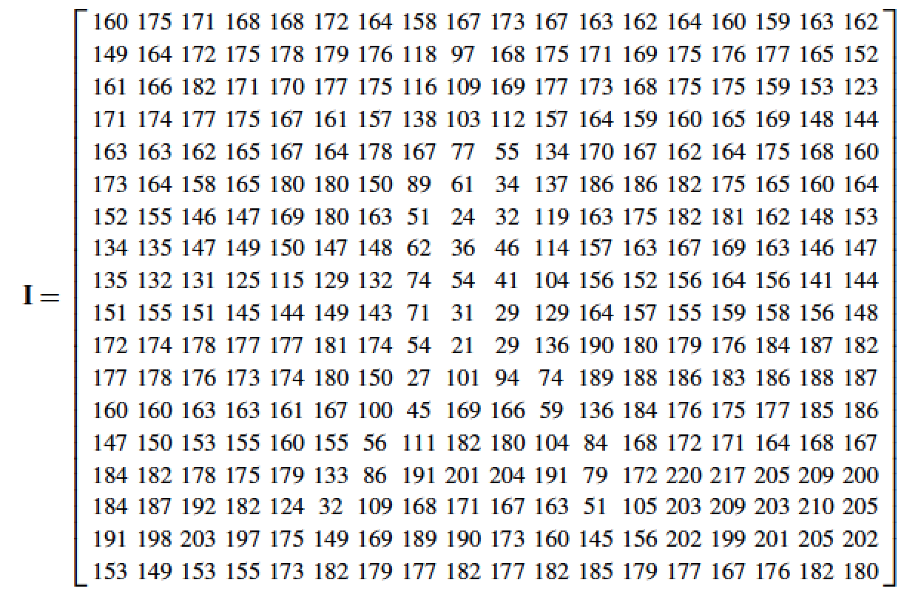

Slide 5
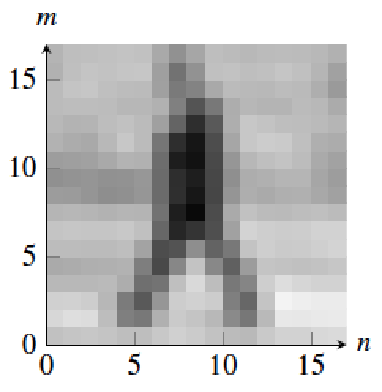
A tiny person of 18 x 18 pixels

Slide 6
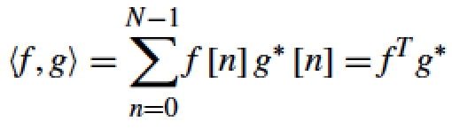
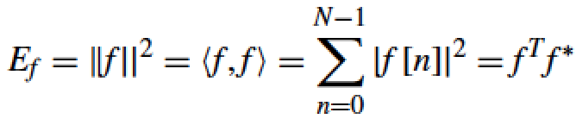
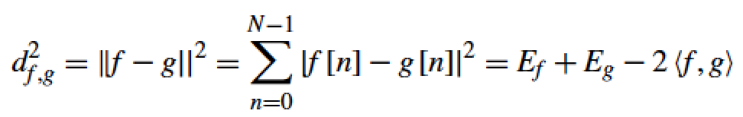
Signal / image space
Scalar product between two signals f, g :
L2 norm of f :
Distance between two signals f, g :

Slide 7

Filtering
Image in
Image out
We want to remove unwanted sources of variation, and keep the information relevant for whatever task we need to solve

Slide 8
Linear filtering
g [m,n]
f [m,n] = H(g [m,n])
For a filter to be linear, it has to verify:
f [m,n] = H(a [m,n] + b [m,n]) = H(a [m,n]) + H(b [m,n])
f [m,n] = H(C a [m,n]) = C H(a [m,n])

Slide 9
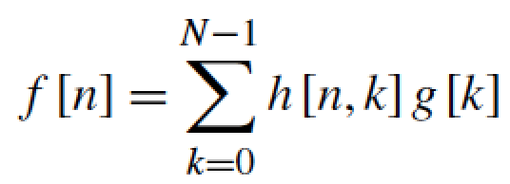
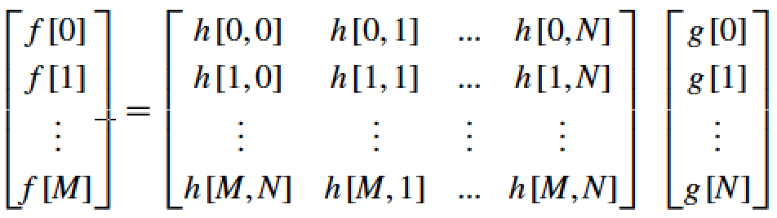
Linear filtering
g [n]
f [n] = H(g [n])
A linear filter in its most general form can be written as,
in 1D for a signal of length N:
It is useful to make it more explicit by writing:

Slide 10
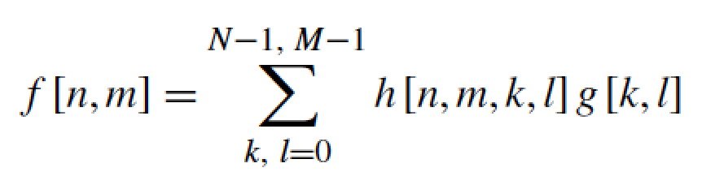
Linear filtering
g [m,n]
f [m,n] = H(g [m,n])
In 2D:
Which can also be written in matrix form as in the 1D case:
=

Slide 11
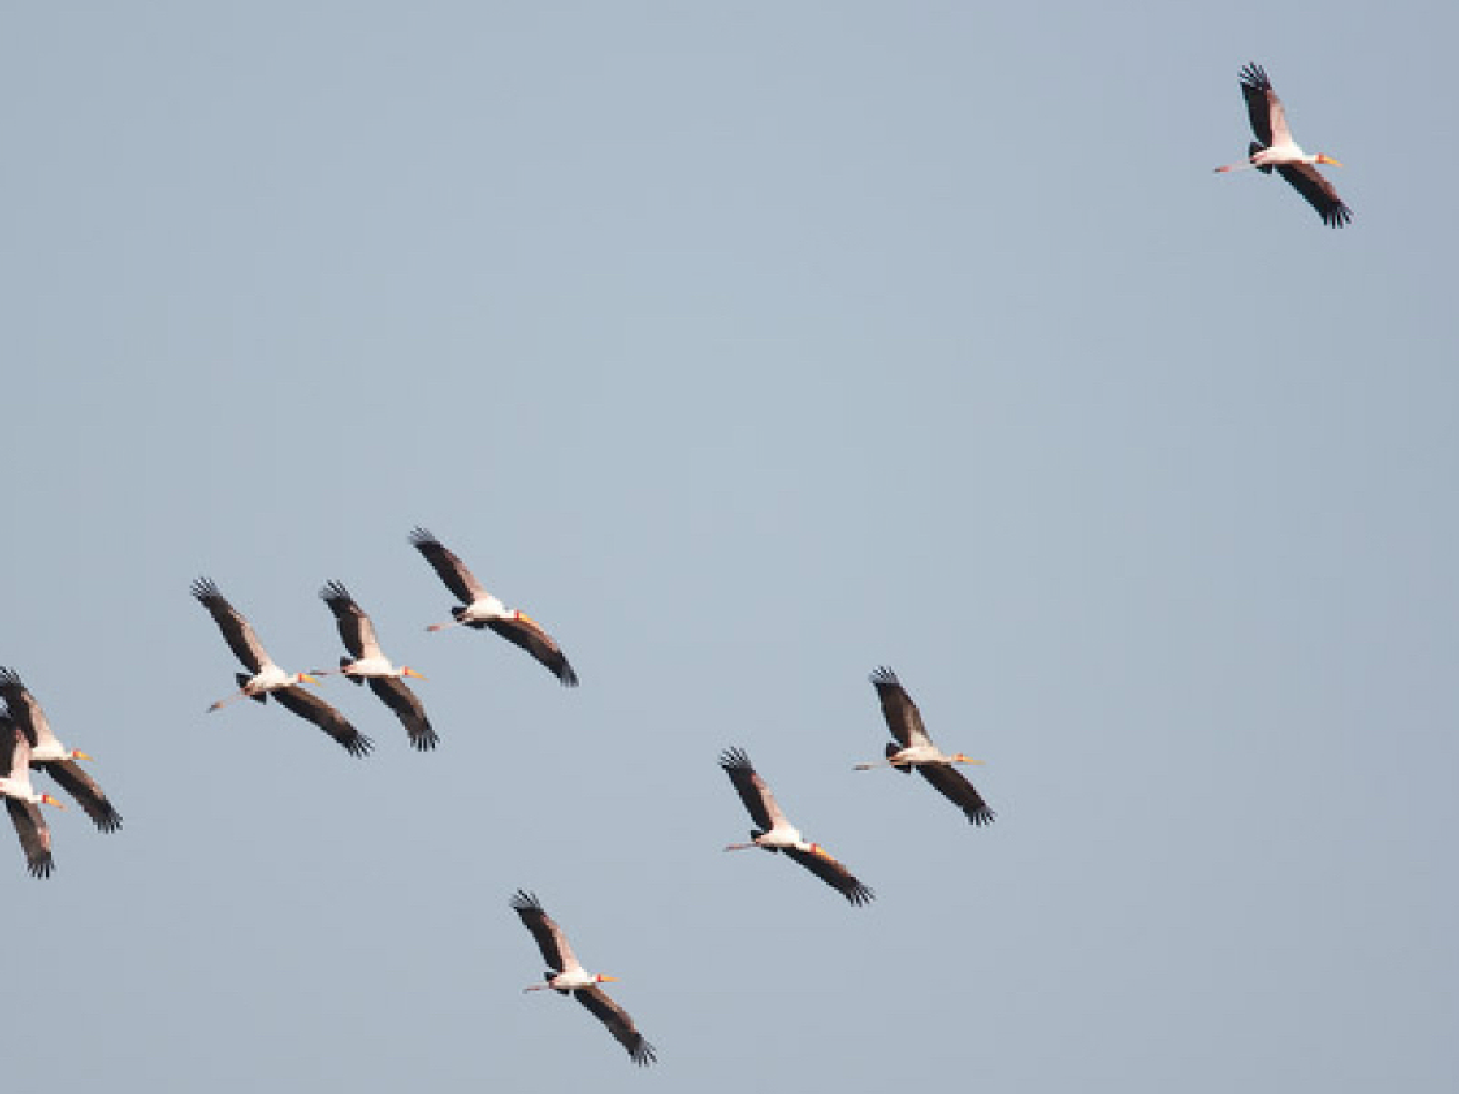
Credit picture: Fredo Durand

Slide 12
Why should one pixel be treated differently than any another?
Credit picture: Fredo Durand

Slide 13

A translation invariant filter
=
The same weighting occurs within each window

Slide 14
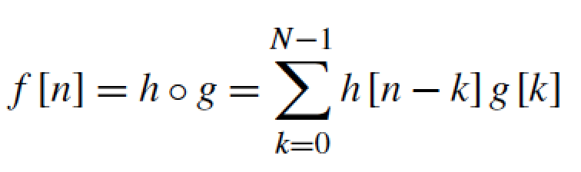
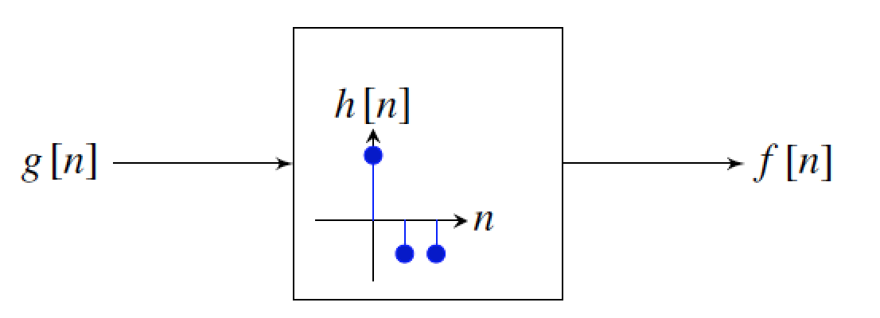
Convolution
For example: h = [2, -1, -1]

Slide 15
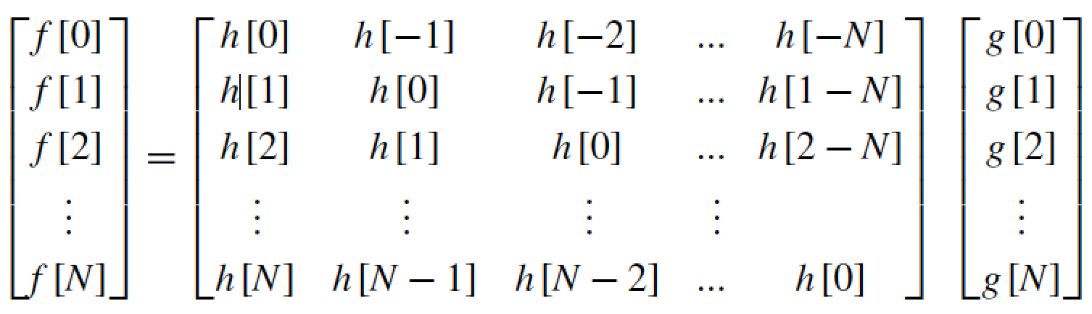
Convolution
In the 1D case, it helps to make explicit the structure of the matrix:

Slide 16
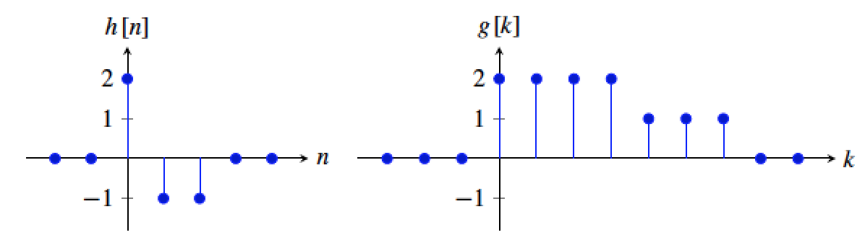
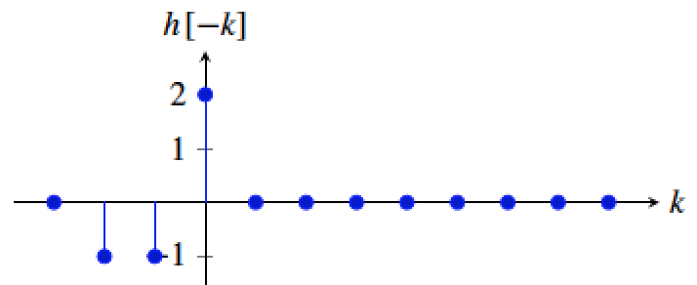

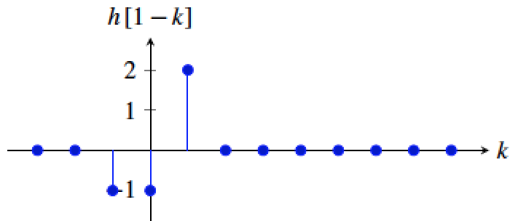

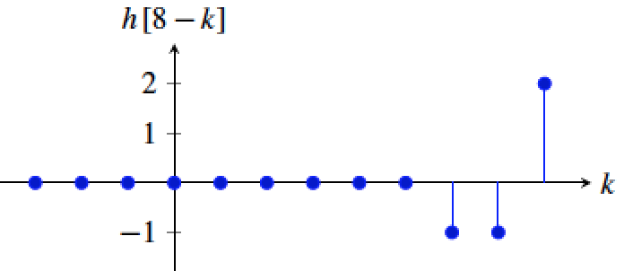

Convolution
f [0] = 4
f [1] = 2
.
.
.
.
.
.
f [8] = -1

Slide 17
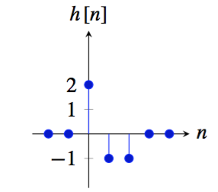
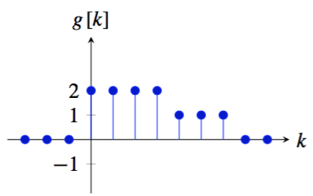
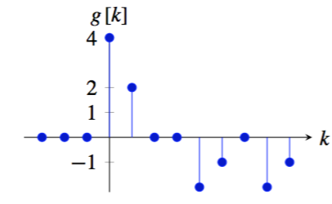
Convolution
=

Slide 18
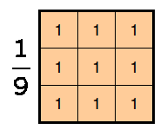
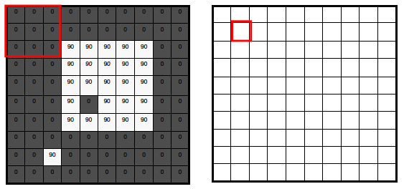
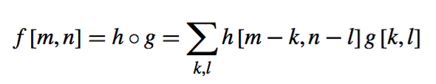
2D convolution

Slide 19
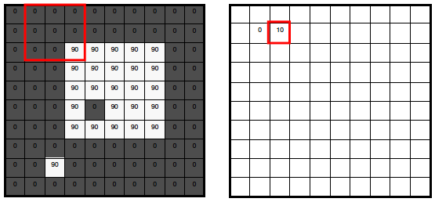

Slide 20
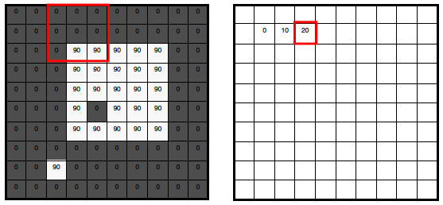

Slide 21
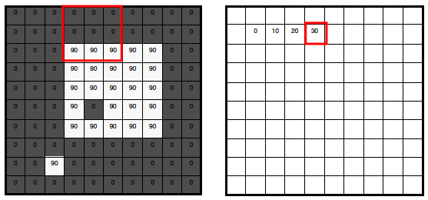

Slide 22
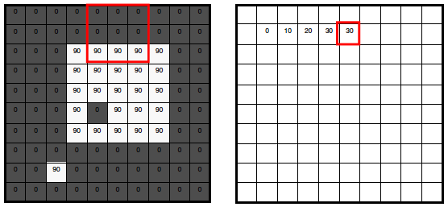

Slide 23
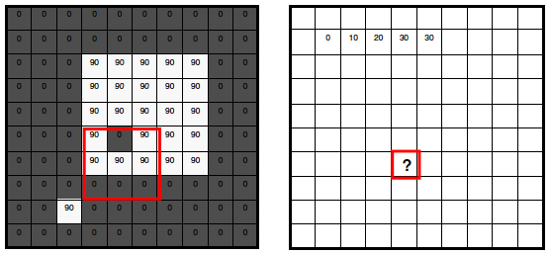

Slide 24
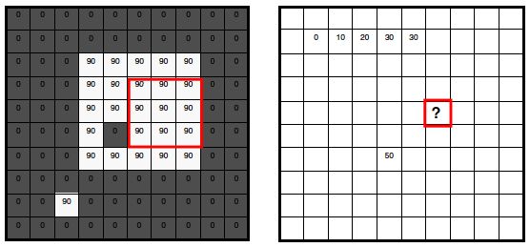

Slide 25
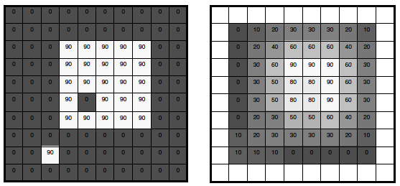
What does it do?
• Replaces each pixel with an average of its neighborhood
• Achieve smoothing effect (remove sharp features)

Slide 26


2D convolution
m=0 1 2 …
111 | 115 | 113 | 111 | 112 | 111 | 112 | 111
135 | 138 | 137 | 139 | 145 | 146 | 149 | 147
163 | 168 | 188 | 196 | 206 | 202 | 206 | 207
180 | 184 | 206 | 219 | 202 | 200 | 195 | 193
189 | 193 | 214 | 216 | 104 | 79 | 83 | 77
191 | 201 | 217 | 220 | 103 | 59 | 60 | 68
195 | 205 | 216 | 222 | 113 | 68 | 69 | 83
199 | 203 | 223 | 228 | 108 | 68 | 71 | 77
? | ? | ? | ? | ? | ? | ? | ?
? | -5 | 9 | -9 | 21 | -12 | 10 | ?
? | -29 | 18 | 24 | 4 | -7 | 5 | ?
? | -50 | 40 | 142 | -88 | -34 | 10 | ?
? | -41 | 41 | 264 | -175 | -71 | 0 | ?
? | -24 | 37 | 349 | -224 | -120 | -10 | ?
? | -23 | 33 | 360 | -217 | -134 | -23 | ?
? | ? | ? | ? | ? | ? | ? | ?
-1 | 2 | -1
-1 | 2 | -1
-1 | 2 | -1
=
h[m,n]
f[m,n]
g[m,n]

Slide 27


Properties of the convolution
Commutative
Associative
Distributive with respect to the sum
Shift property

Slide 28

Handling boundaries

Slide 29
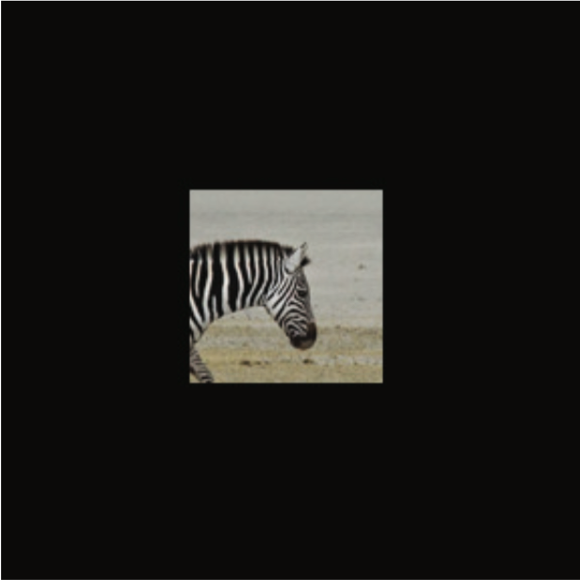
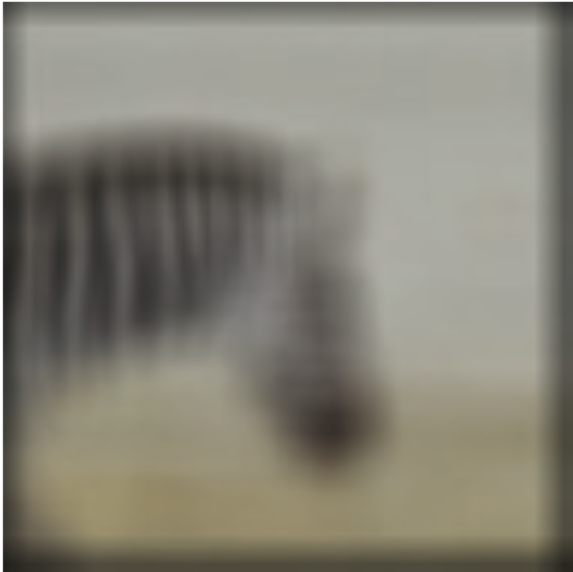
Handling boundaries
Zero padding
=
11x11 ones

Slide 30
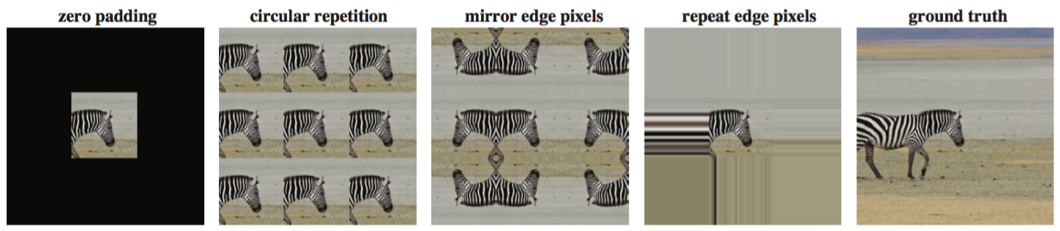


Handling boundaries
Input
Output
Error

Slide 31
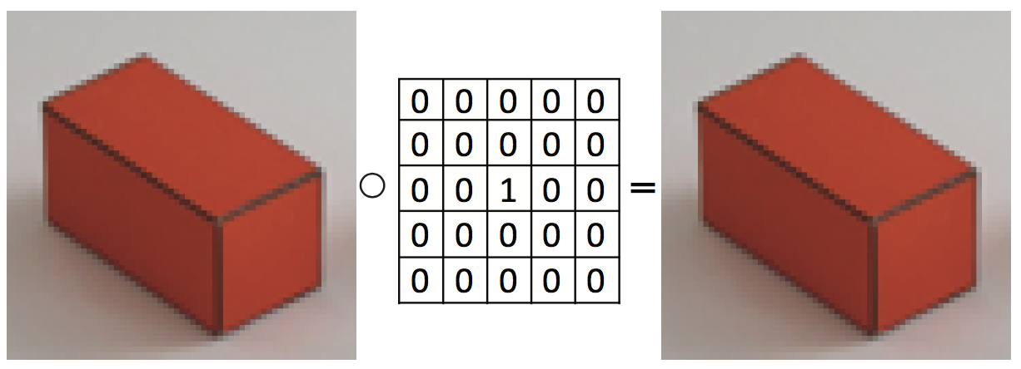
Examples

Slide 32
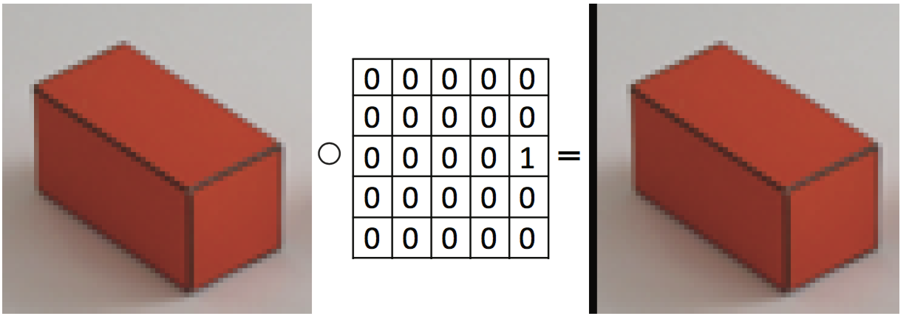
Examples
2 pixels
(using zero padding)

Slide 33

Examples

Slide 34

Examples

Slide 35
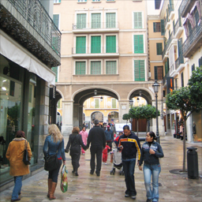

Rectangular filter
=
h[m,n]
f[m,n]
g[m,n]

Slide 36

Rectangular filter
=
h[m,n]
f[m,n]
g[m,n]

Slide 37

Rectangular filter
=
h[m,n]
f[m,n]
g[m,n]

Slide 38
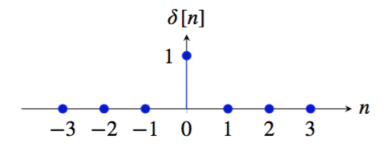
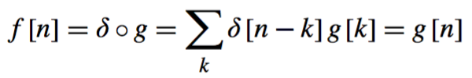

Important signals
The impulse
The result of convolving a signal g[n] with the impulse signal is the same signal:
Convolving a signal f with a translated impulse δ [n − n0] results in a translated signal:

Slide 39

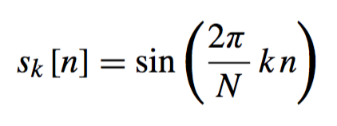
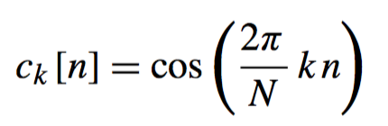
Important signals
Cosine and sine waves
k ∈ [1, N /2] denotes the number of wave cycles that will occur within the region of support

Slide 40
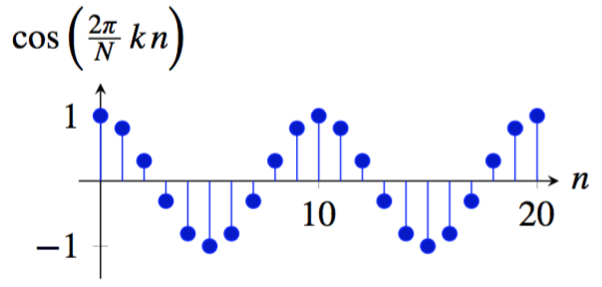
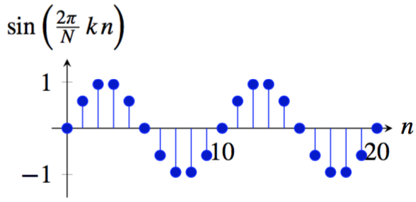
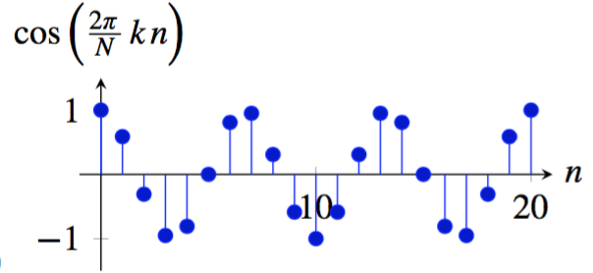
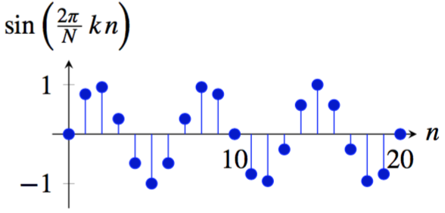
Important signals
Cosine and sine waves
k=2
k=2
k=3
k=3

Slide 41


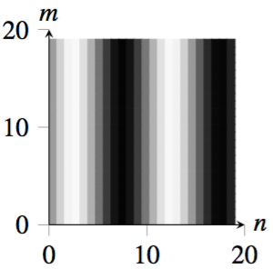
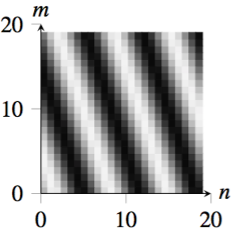
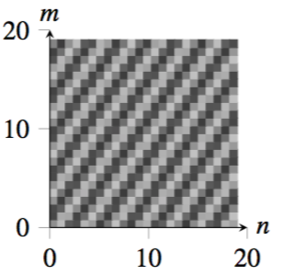
Waves in 2D
^{u = 2, v = 0}
^{u = 3, v = 1}
^{u = 7, v = −5}

Slide 42
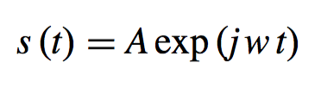


Important signals
Complex exponential
In discrete time (setting A = 1), we can write:
And in 2D, the complex exponential wave is:

Slide 43

Important signals
Complex exponential
N = 40, k = 1
N = 40, k = 3

Slide 44
Impulses, sine and cosine waves or complex exponentials form each an orthogonal basis for signals of length N

Slide 45


Linear image transformations
In analyzing images, it’s often useful to make a change of basis.
Transformed image
Vectorized image
Fourier transform, or
Wavelet transform, or
Steerable pyramid transform
=

Slide 46
Self-inverting transforms
Same basis functions are used for the inverse transform
U transpose and complex conjugate

Slide 47


The Discrete Fourier transform
Discrete Fourier Transform (DFT) transforms an image
f [m, m] into the complex image Fourier transform F [u, v] as:
The inverse Fourier transform is:

Slide 48

Discrete Fourier transform visualization
Notes:
Cellbots

Slide 49
Fourier transform visualization

Slide 50




Some useful transforms
Fourier transform of the Delta function δ[n ,m]:
Observation: if we think in terms of the inverse DFT, this means that:

Slide 51





Some useful transforms
The Fourier transform of the cosine wave
is:
Same for the sine wave:

Slide 52


Bracewell’s pictorial dictionary of Fourier transform pairs
Bracewell, The Fourier Transform and its Applications, McGraw Hill 1978

Slide 53

Szeliski, Computer Vision, 2010

Slide 54

2D Discrete Fourier Transform
Using the real and imaginary components:
Or using a polar decomposition:

Slide 55




2D Discrete Fourier Transform

Slide 56
Properties for the DFT
Linearity
Symmetry: Fourier transform of a real signal has coefficients that come in pairs, with F [u, v] being the complex conjugate of F [-u, -v].

Slide 57

Properties for the DFT
Shift in space

Slide 58







Properties for the DFT
Only the phase changes! The magnitude is translation invariant.

Slide 59



Properties for the DFT
Modulation
Multiplying by a complex exponential results in a translation of the DFT

Slide 60


Frequencies
Image
(assuming zero phase)
DFT amplitude
Images are 64x64 pixels. The wave is a cosine (if phase is zero).

Slide 61

Frequencies
Images are 64x64 pixels. The wave is a cosine (if phase is zero).

Slide 62






+
=

Slide 63



Some important Fourier transforms
Image
Magnitude DFT
Phase DFT
Images are 64x64 pixels.

Slide 64



Some important Fourier transforms
Image
Magnitude DFT
Phase DFT

Slide 65



Some important Fourier transforms
Image
Magnitude DFT
Phase DFT

Slide 66



Some important Fourier transforms
Image
Magnitude DFT
Phase DFT

Slide 67
Image
Magnitude DFT
Scale
Small image
details produce content in high spatial frequencies

Slide 68



Some important Fourier transforms
Image
Magnitude DFT
Phase DFT

Slide 69



Some important Fourier transforms
Image
Magnitude DFT
Phase DFT

Slide 70
Image
Magnitude DFT
Orientation
A line transforms to a line oriented perpendicularly to the first.

Slide 71


The Fourier Transform of some important images
Image
Log(1+Magnitude FT)

Slide 72
More properties for the DFT

Slide 73





DFT of the convolution

Slide 74
Linear filtering
g [m,n]
f [m,n]
h [m,n]
In the spatial domain:
In the frequency domain:

Slide 75


Product of images
The Fourier transform of the product of two images
is the convolution of their DFTs:

Slide 76


*
=

Slide 77






Game: find the right pairs
Images
A
B
C
DFT
magnitude
1
2
3
fx(cycles/image pixel size)
fx(cycles/image pixel size)
fx(cycles/image pixel size)

Slide 78
The inverse Discrete Fourier transform
How does summing waves ends up giving back a picture?

Slide 79

2

Slide 80

6

Slide 81

18

Slide 82

50

Slide 83

82

Slide 84

136

Slide 85

282

Slide 86

538

Slide 87

1088

Slide 88

2094

Slide 89

4052.
4052

Slide 90

8056.

Slide 91

15366

Slide 92

28743

Slide 93

49190.

Slide 94

65536.

Slide 95

3
Now, an analogous sequence of images, but selecting Fourier components in descending order of magnitude.

Slide 96

5

Slide 97

9

Slide 98

17

Slide 99

33

Slide 100

65

Slide 101

129

Slide 102

257

Slide 103

513

Slide 104

1025

Slide 105

2049

Slide 106

4097

Slide 107

8193

Slide 108

16385

Slide 109

32769

Slide 110

65536

Slide 111


Fourier transform magnitude

Slide 112


Masking out the fundamental and harmonics from periodic pillars

Slide 113


Slide 114
2D Discrete Fourier Transform
Using the real and imaginary components:
Or using a polar decomposition:

Slide 115
2D Discrete Fourier Transform

Slide 116
Phase and Magnitude
Curious fact
  all natural images have about the same magnitude transform
  hence, phase seems to matter, but magnitude largely doesn’t
Demonstration
  Take two pictures, swap the phase transforms, compute the inverse - what does the result look like?

Slide 117







Phase and Magnitude
Each color channel is processed in the same way.

Slide 118




Phase and magnitude
Using random
amplitude does not
look good.

Slide 119











Does phase always win?

Slide 120






Randomizing the phase

Slide 121



Fourier Transform types
Discrete (finite and discrete sequences):
Continuous (infinite and continuous signals):

