Slide 1
William T. Freeman, Phillip Isola, Antonio Torralba, 2018
Lecture 6
Spatial filters

Slide 2
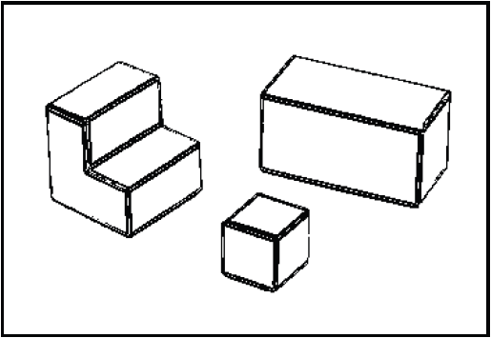
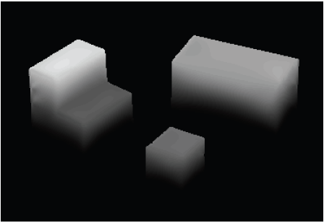
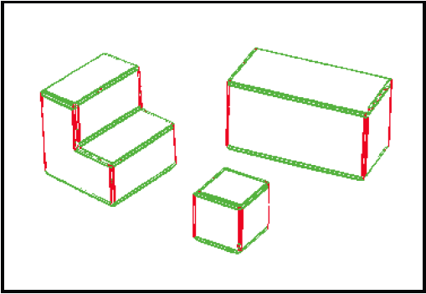
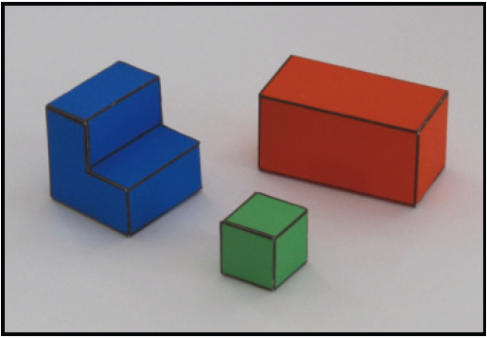
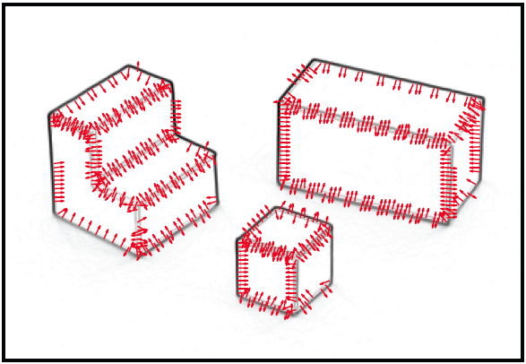
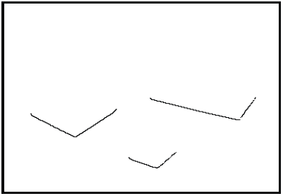
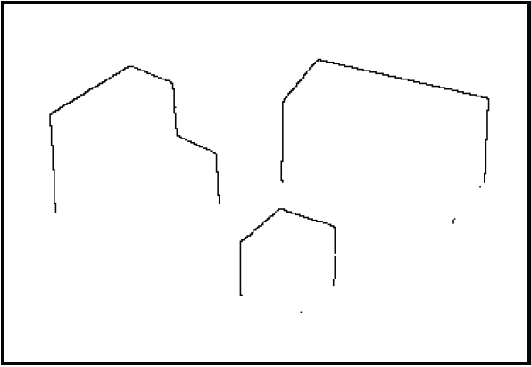
Image transformations
X
Edge strength
3D orientation
Input image
Y
Edge normals
Contact edges
1. From pixels to edges
Z
Depth discontinuities
2. From edges to geometric primitives

Slide 3
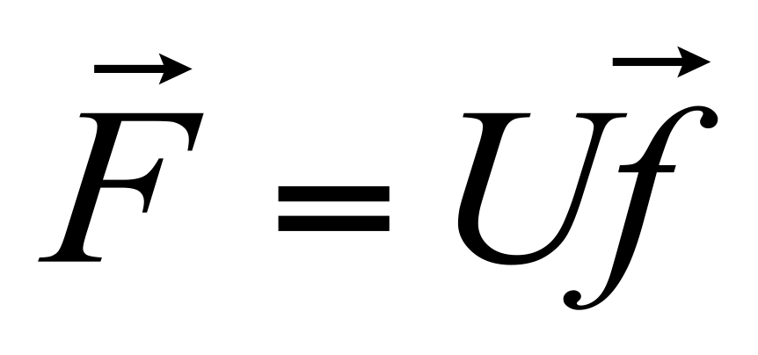
Linear image transformations
In analyzing images, it’s often useful to make a change of basis.
Transformed image
Vectorized image
Fourier transform, or
Wavelet transform, or
Steerable pyramid transform
=

Slide 4
Self-inverting transforms
Same basis functions are used for the inverse transform
U transpose and complex conjugate

Slide 5
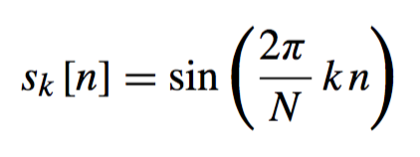
Important signals
Cosine and sine waves
k ∈ [1, N /2] denotes the number of wave cycles that will occur within the region of support

Slide 6
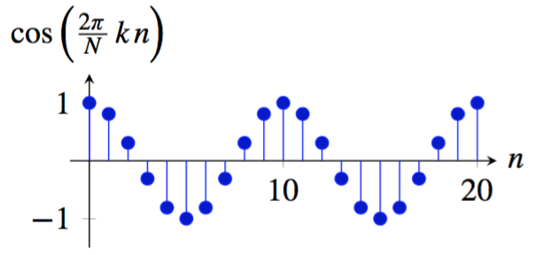
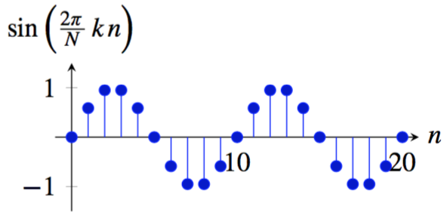
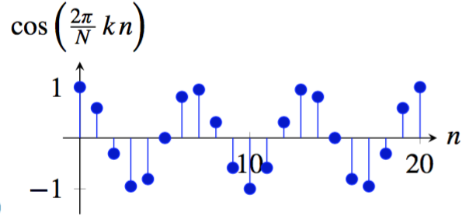
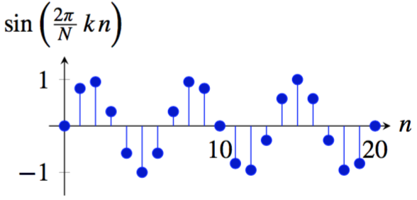
Important signals
Cosine and sine waves
k=2
k=2
k=3
k=3

Slide 7
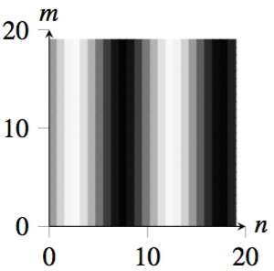
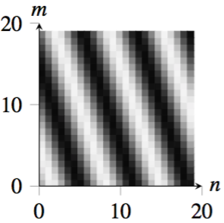
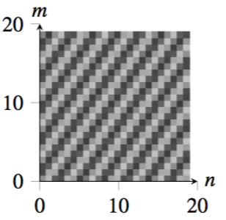
Waves in 2D
^{u = 2, v = 0}
^{u = 3, v = 1}
^{u = 7, v = −5}

Slide 8
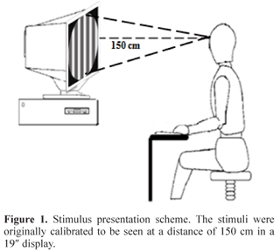

Slide 9
The Discrete Fourier transform
Discrete Fourier Transform (DFT) transforms an image
f [m, m] into the complex image Fourier transform F [u, v] as:
The inverse Fourier transform is:

Slide 10
Complex exponential
Remember: exp (α j) = cos(α) + j sin(α)
Visualization complex exponential for two different frequencies u
N = 40, u = 1
N = 40, u = 3

Slide 11
2D Discrete Fourier Transform
The values of F [u,v] are complex.
Using the real and imaginary components:
Or using a polar decomposition:
Amplitude
Phase

Slide 12
Discrete Fourier transform visualization
Notes:
Cellbots

Slide 13
Fourier transform visualization

Slide 14
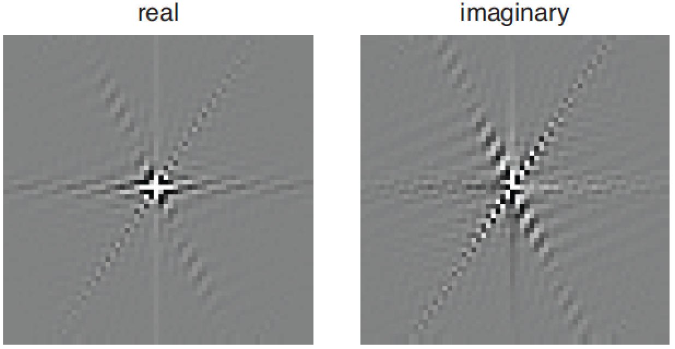
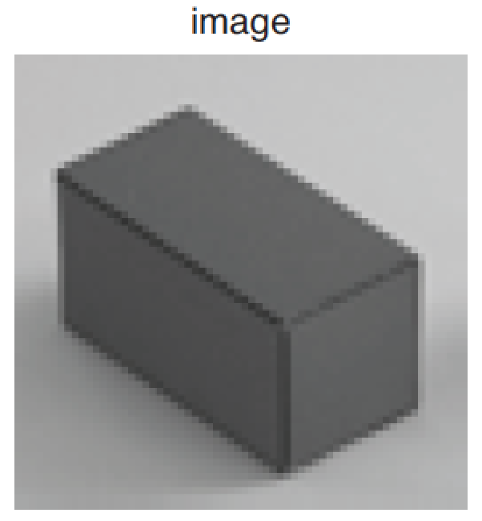
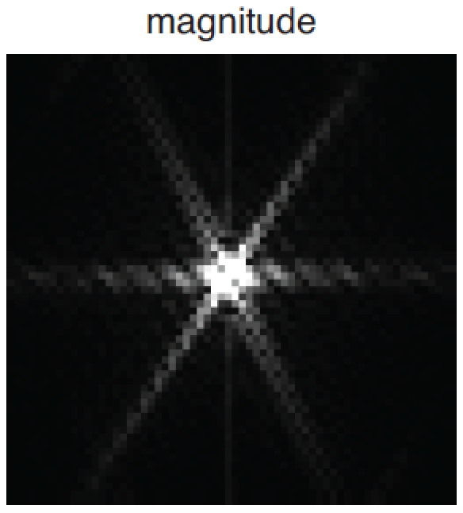
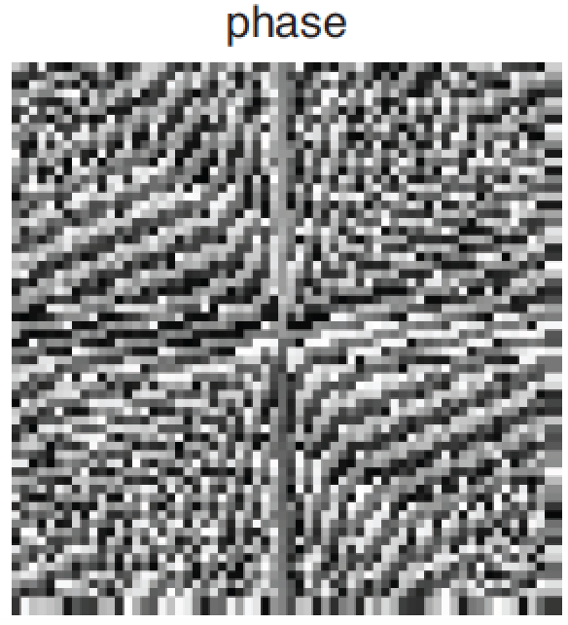
2D Discrete Fourier Transform
v
v
m
u
u
n
v
v
u
u

Slide 15
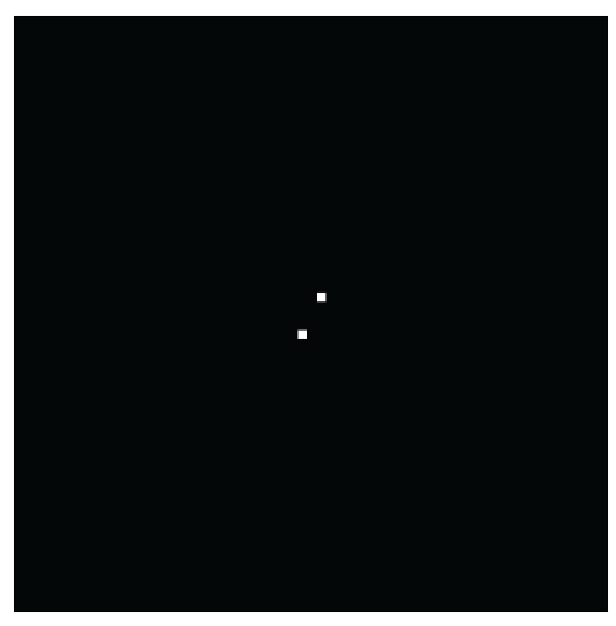
Frequencies
Image (assuming zero phase)
DFT amplitude
Images are 64x64 pixels. The wave is a cosine (if phase is zero).

Slide 16
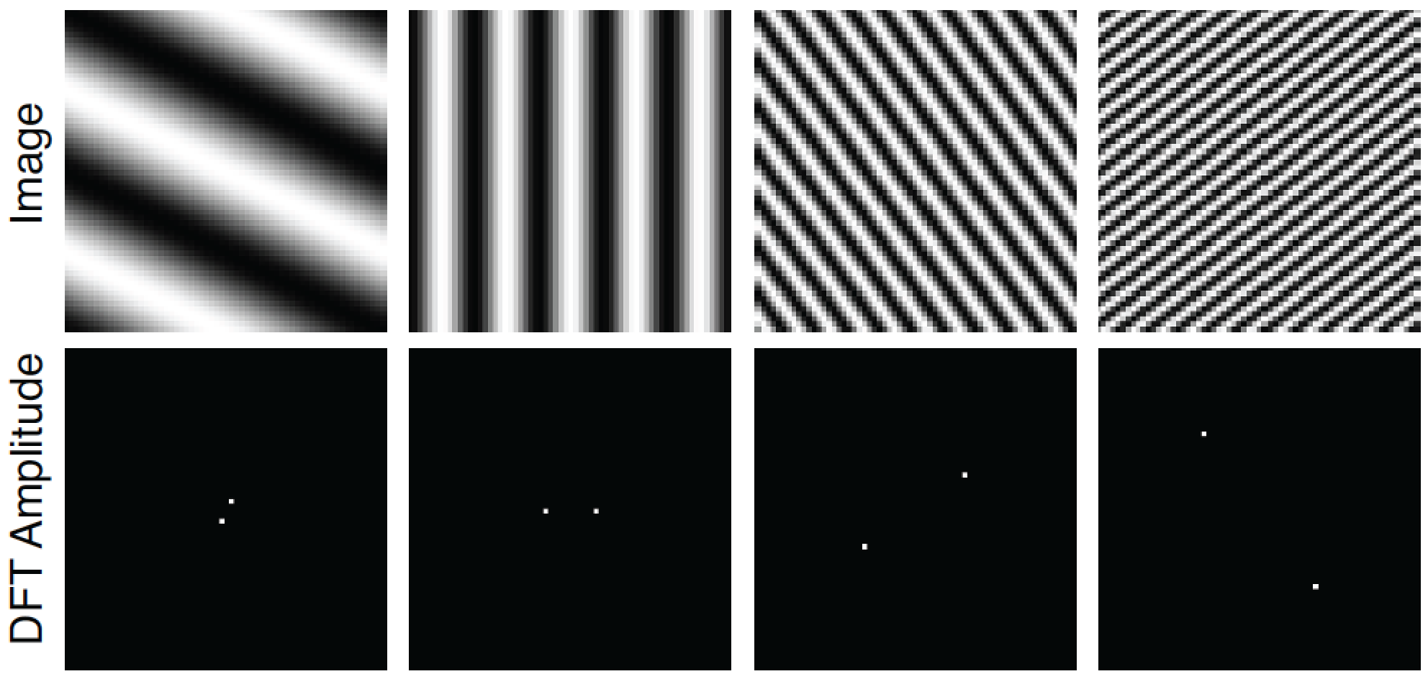
Frequencies
Images are 64x64 pixels. The wave is a cosine (if phase is zero).

Slide 17
Some important Fourier transforms
Image
Magnitude DFT
Phase DFT
Images are 64x64 pixels.

Slide 18
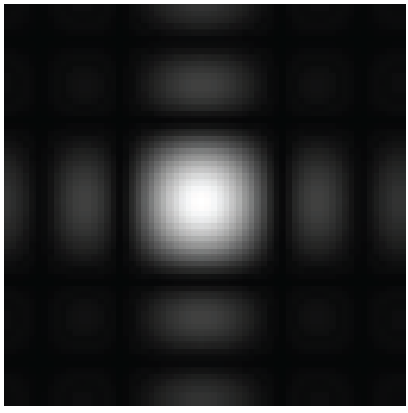
Some important Fourier transforms
Image
Magnitude DFT
Phase DFT

Slide 19
Image
Magnitude DFT
Scale
Small image details produce content in high spatial frequencies

Slide 20
Some important Fourier transforms
Image
Magnitude DFT
Phase DFT

Slide 21
Some important Fourier transforms
Image
Magnitude DFT
Phase DFT

Slide 22
Image
Magnitude DFT
Orientation
A line transforms to a line oriented perpendicularly to the first.

Slide 23
The Fourier Transform of some important images
Image
Log(1+Magnitude FT)

Slide 24
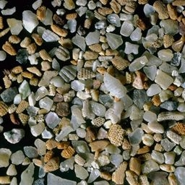
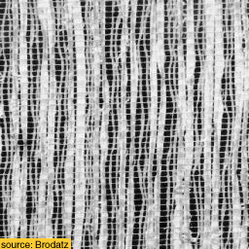
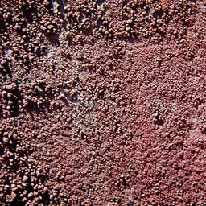
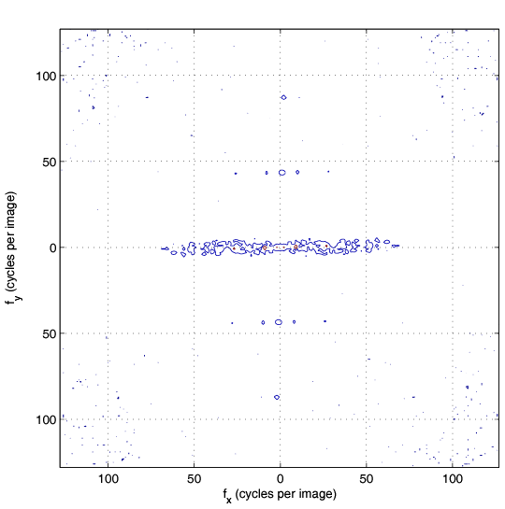
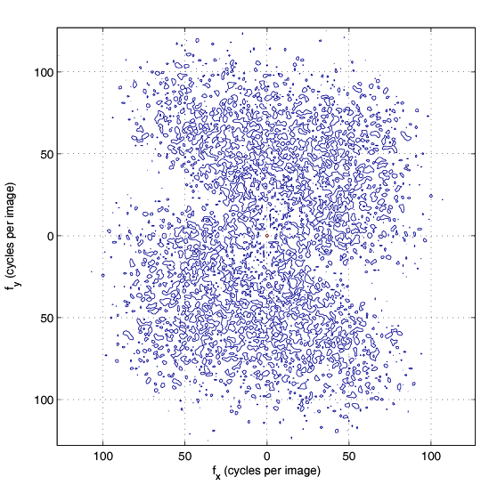
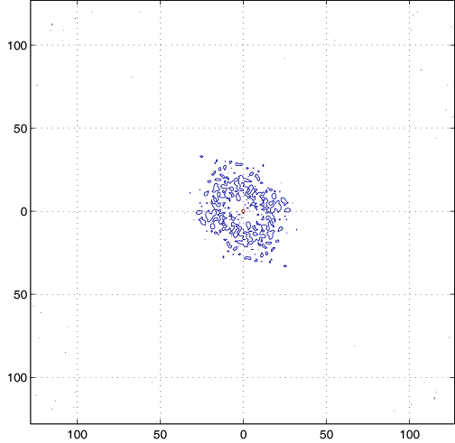
Game: find the right pairs
Images
A
B
C
DFT magnitude
1
2
3
fx(cycles/image pixel size)
fx(cycles/image pixel size)
fx(cycles/image pixel size)

Slide 25
The inverse Discrete Fourier transform
How does summing waves ends up giving back a picture?

Slide 26
2

Slide 27
6

Slide 28
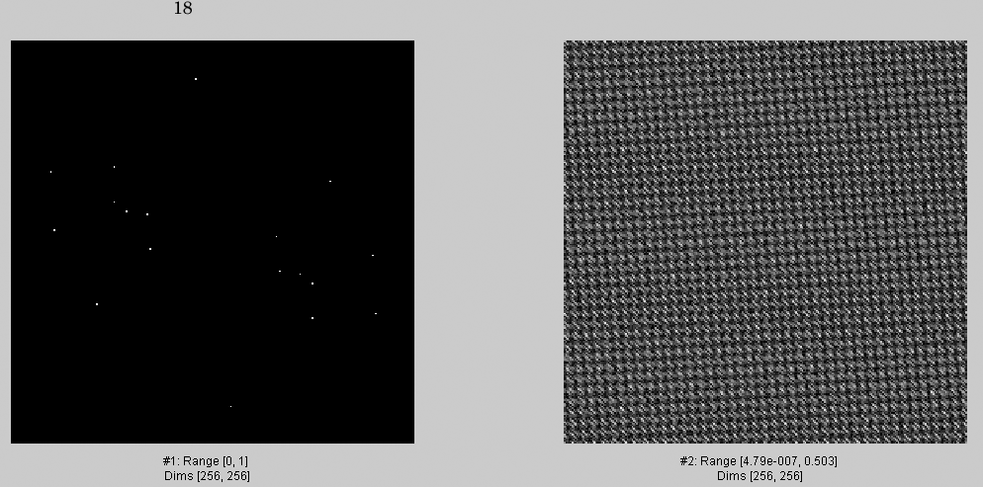
18

Slide 29
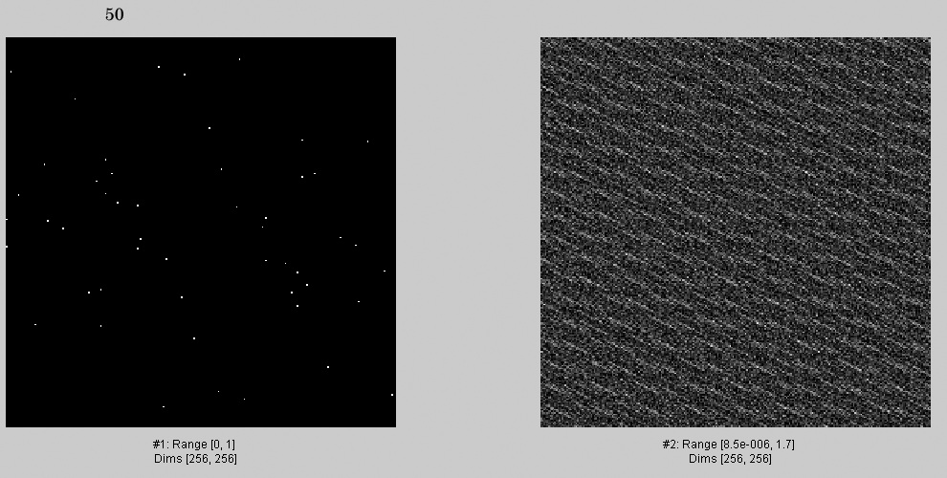
50

Slide 30
82

Slide 31
136

Slide 32
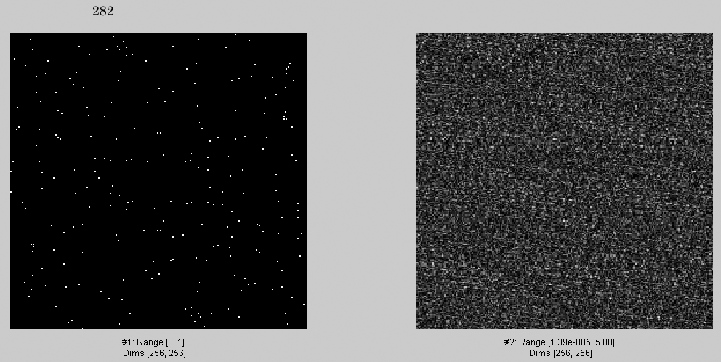
282

Slide 33
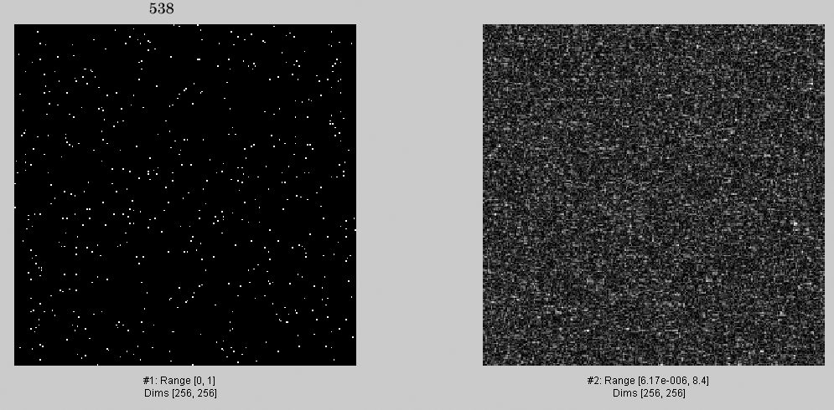
538

Slide 34
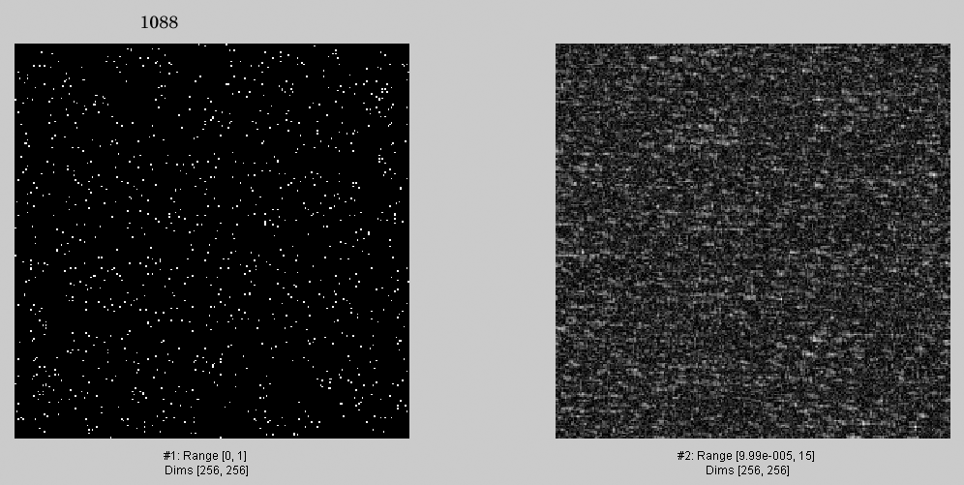
1088

Slide 35
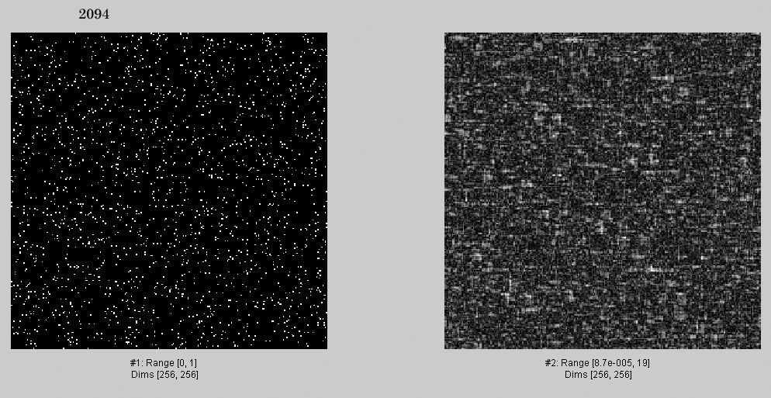
2094

Slide 36
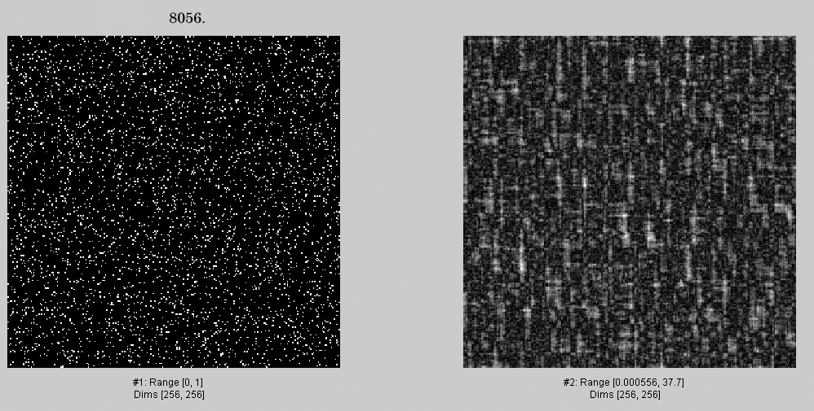
4052.
4052

Slide 37
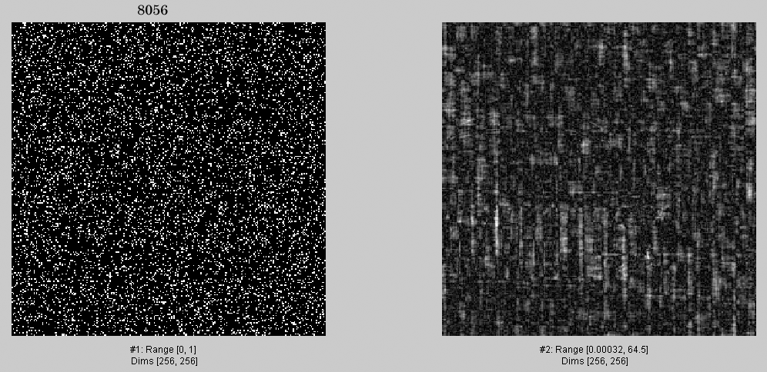
8056.

Slide 38
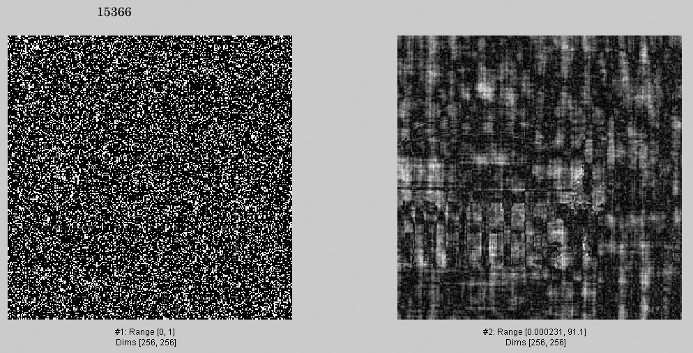
15366

Slide 39
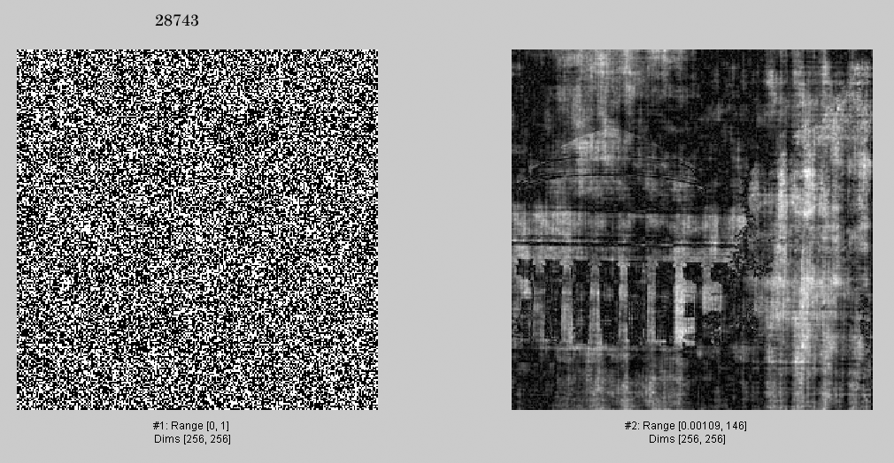
28743

Slide 40
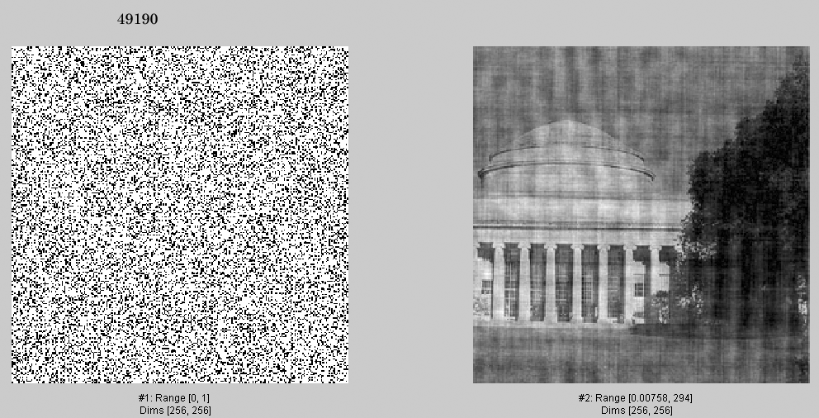
49190.

Slide 41
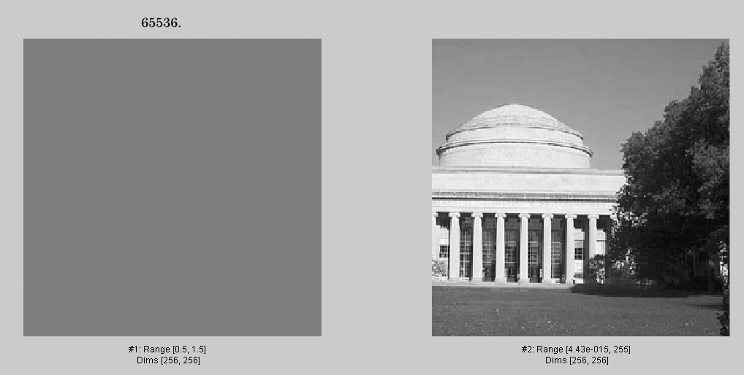
65536.

Slide 42
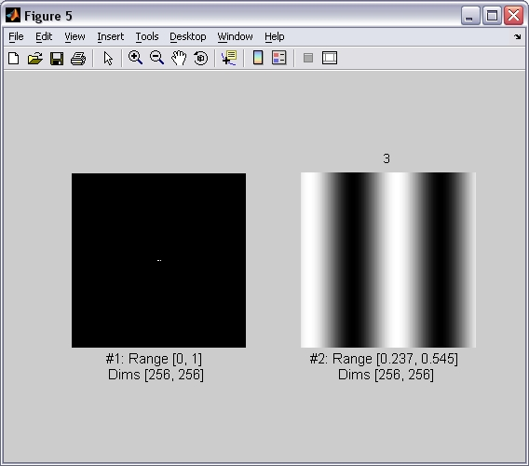
3
Now, an analogous sequence of images, but selecting Fourier components in descending order of magnitude.

Slide 43
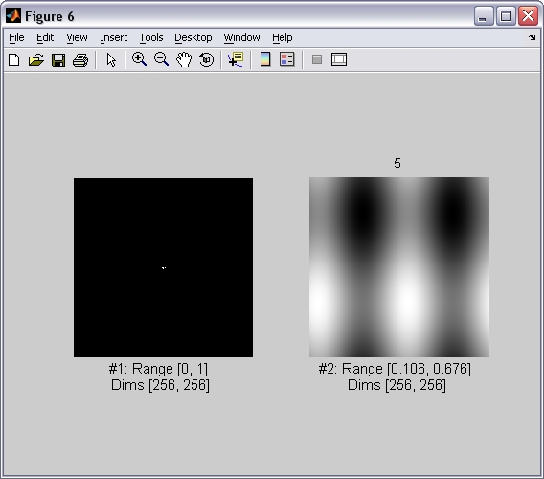
5

Slide 44
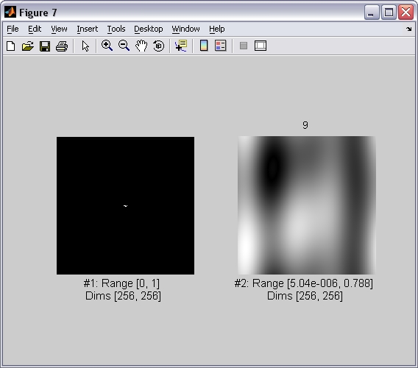
9

Slide 45
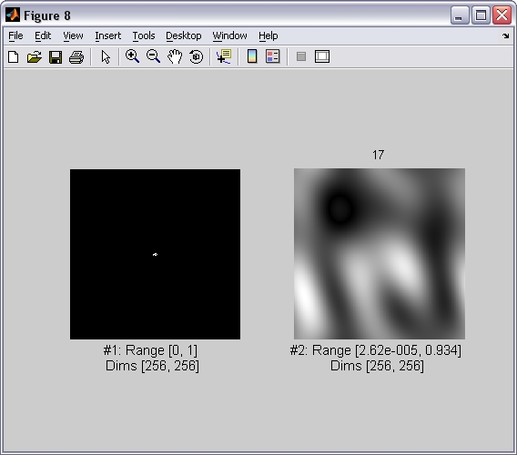
17

Slide 46
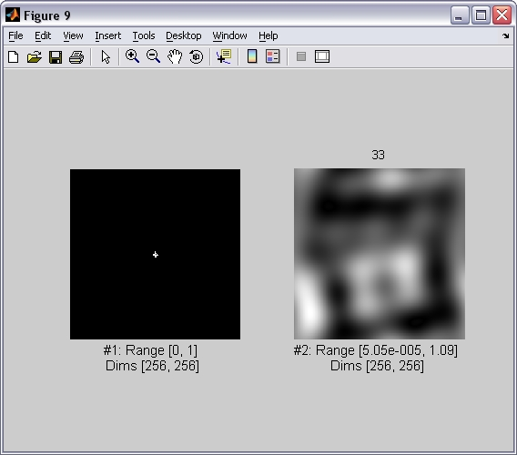
33

Slide 47
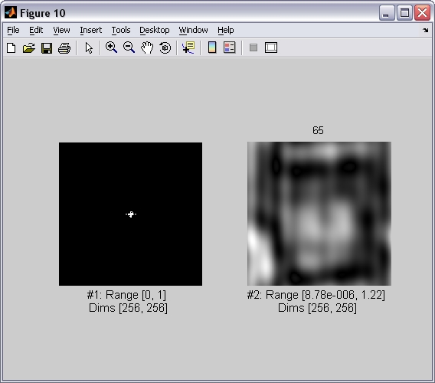
65

Slide 48
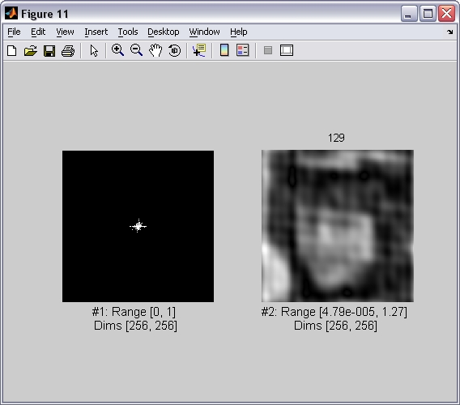
129

Slide 49
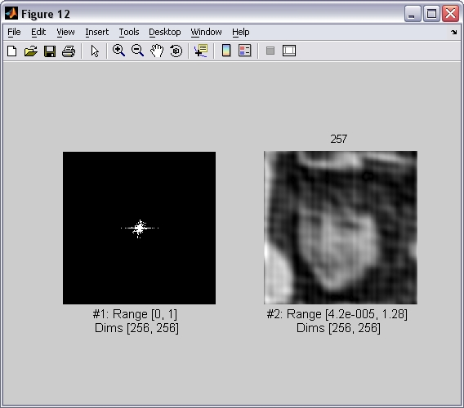
257

Slide 50
513

Slide 51
1025

Slide 52
2049

Slide 53
4097

Slide 54
8193

Slide 55
16385

Slide 56
32769

Slide 57
65536

Slide 58
2D Discrete Fourier Transform
Using the real and imaginary components:
Or using a polar decomposition:

Slide 59
2D Discrete Fourier Transform

Slide 60
Phase and Magnitude
Curious fact
all natural images have about the same magnitude transform
hence, phase seems to matter, but magnitude largely doesn’t
Demonstration
Take two pictures, swap the phase transforms, compute the inverse - what does the result look like?

Slide 61
Phase and Magnitude
Each color channel is processed in the same way.

Slide 62
Linear filtering
g [m,n]
f [m,n]
h [m,n]
In the spatial domain:
In the frequency domain:
Terminology:
Impulse response:
h [m,n]
Transfer function:

Slide 63
Fourier transform magnitude

Slide 64
Masking out the fundamental and harmonics from periodic pillars

Slide 66
Keeping only the fundamental and harmonics from periodic pillars

Slide 68
Some visual areas…
From M. Lewicky
Notes:
Slides from lewicki

Slide 69
Campbell & Robson chart
Let’s define the following image:
With:
What do you think you should see when looking at this image?

Slide 72
Contrast Sensitivity Function
Blackmore & Campbell (1969)
Maximum sensitivity
~ 6 cycles / degree of visual angle
Invisible
visible
Contrast sensitivity
0.1
1
10
100
Low
Spatial frequency (cycles/degree)
High
Things that are very close and/or large are hard to see
Things far away are hard to see

Slide 73
Vasarely visual illusion

Slide 74
?

Slide 76
Receptive field
of a cell in the cat’s cortex
Responses to an oriented bar

Slide 77
A collection of useful filters

Slide 78
Low pass-filters

Slide 79
Box filter
2N+1
1 1 1 1 1 … 1
1 1 1 1 1 1
2M+1
…
…
…
…
…
…
1 1 1 1 1 1

Slide 80
Box filter
=
It produces a blurry version of the input. But it is not a perfect blur.
(it has “square-like” artifacts)

Slide 81
Gaussian filter
In the continuous domain:

Slide 82
Gaussian filter
Discretization of the Gaussian:
At 3σ the amplitude of the Gaussian is around 1% of its central value

Slide 83
Scale

Slide 84
Gaussian filter
Dali

Slide 85
Properties of the Gaussian filter
The n-dimensional Gaussian is the only completely circularly symmetric operator that is separable.
The (continuous) Fourier transform is a gaussian

Slide 86
Properties of the Gaussian filter
The convolution of two n-dimensional gaussians is an n-dimensional gaussian.
where the variance of the result is the sum
(it is easy to prove this using the FT of the gaussian)

Slide 87
Properties of the Gaussian filter
Repeated convolutions of any function concentrated in the origin result in a gaussian (central limit theorem).

Slide 88
Discretization of the Gaussian
There are very efficient approximations to the Gaussian filter for certain values of σ with nicer properties than when working with discretized gaussians.

Slide 89
Binomial filter
Binomial coefficients provide a compact approximation of the gaussian coefficients using only integers.
The simplest blur filter (low pass) is
[1 1]
Binomial filters in the family of filters obtained as
successive convolutions of [1 1]

Slide 90
Binomial filter
b₁ = [1 1]
b₂ =
[1 1] [1 1] = [1 2 1]
b₃ =
[1 1] [1 1] [1 1] = [1 3 3 1]

Slide 91
Binomial filter
1
Pascal’s triangle

Slide 92
Binomial vs. gaussian
>> x = -4:4;
>> y = exp(-x.^2/(2*2))
>> plot(x,y)
>> plot([1 8 28 56 70 56 28 8 1]/70)

Slide 93
Binomial vs. gaussian
Gaussian
Binomial

Slide 94
Properties of binomial filters
Sum of the values is 2^{n}
The variance of b_{n} is
The convolution of two binomial filters is also a binomial filter
With a variance:
These properties are analogous to the gaussian property in the continuous domain (but the binomial filter is different than a discretization of a gaussian)

Slide 95
Some applications

Slide 96
Hybrid Images
Oliva & Schyns
Low pass filter: I(x,y) o G(x,y)
High pass filter: I(x,y) - I(x,y) o G(x,y)
Note: the gaussian filter is normalized so that sum G(x,y) = 1
Notes:
We start by taking two pictures, we isolate the details and contours in one, here the woman, and we blur the second face. as you can see, the man seems to go out of focus and the details of the woman are superposed.

Slide 97
Hybrid Images
Oliva & Schyns
Notes:
We start by taking two pictures, we isolate the details and contours in one, here the woman, and we blur the second face. as you can see, the man seems to go out of focus and the details of the woman are superposed.

Slide 98
Hybrid Images

Slide 99
+
=

Slide 100
Hybrid Images

Slide 102
http://cvcl.mit.edu/hybrid_gallery/gallery.html

Slide 103
Image sharpening filter
?
Subtract away the blurred components of the image:
This filter has an overall DC component of 1. It de-emphasizes the blur component of the image (low spatial frequencies).

Slide 104
Input image

Slide 105
High pass-filters

Slide 106
Finding edges in the image
Image gradient:
Approximation image derivative:
Edge strength
Edge orientation:
Edge normal:

Slide 107
[-1 1]
[-1, 1]
=
h[m,n]
f[m,n]
g[m,n]

Slide 108
[-1 1]^{T}
[-1, 1]^{T}
=
h[m,n]
f[m,n]
g[m,n]

Slide 109
[-1 1]
[-1, 1]
=
h[m,n]
f[m,n]
g[m,n]

Slide 110
[-1 1]^{T}
[-1, 1]^{T}
=
h[m,n]
f[m,n]
g[m,n]

Slide 111
Back to the image
?

Slide 112
Reconstruction from 2D derivatives
In 2D, we have multiple derivatives (along n and m)
c
c
=
[-1 1]
c
[-1 1]^{T}
and we compute the pseudo-inverse of the full matrix.

Slide 113
Reconstruction from 2D derivatives
[1 -1]
[1 -1]^{T}

Slide 114
Editing the edge image
[1 -1]
[1 -1]^{T}

Slide 115
Thresholding edges

Slide 116
2D derivatives
There are several ways in which 2D derivatives can be approximated.
Robert-Cross operator:
And many more…

Slide 117
Issues with image derivatives
Derivatives are sensitive to noise
If we consider continuous image derivatives, they might not be define in some regions (e.g., object boundaries, …)

Slide 118
Differential Geometry Descriptors

Slide 119
Derivatives
We want to compute the image derivative:
If there is noise, we might want to “smooth” it with a blurring filter
But derivatives and convolutions are linear and we can move them around:

Slide 120
Gaussian derivatives
The continuous derivative is:

Slide 121
Gaussian derivatives
g_{x}(x,y)
In general:

Slide 122
Gaussian Scale
σ=2
σ=4
σ=8

Slide 123
Derivatives of Gaussians: Scale
σ=2
σ=4
σ=8

Slide 124
Orientation
What about other orientations not axis aligned?

Slide 125
Orientation
The smoothed directional gradient is a linear combination of two kernels
Any orientation can be computed as a linear combination of two filtered images
= cos(α)
+sin(α)
=
Steereability of gaussian derivatives, Freeman & Adelson 92

