Slide 1
Lecture 10
Backpropagation

Slide 2
2. Backprop and Differentiable Programming
Review of gradient descent, SGD
Forward propagation
Computing gradients
Backward propagation
Computation graphs and differentiable programming

Slide 3
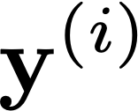
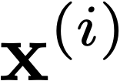
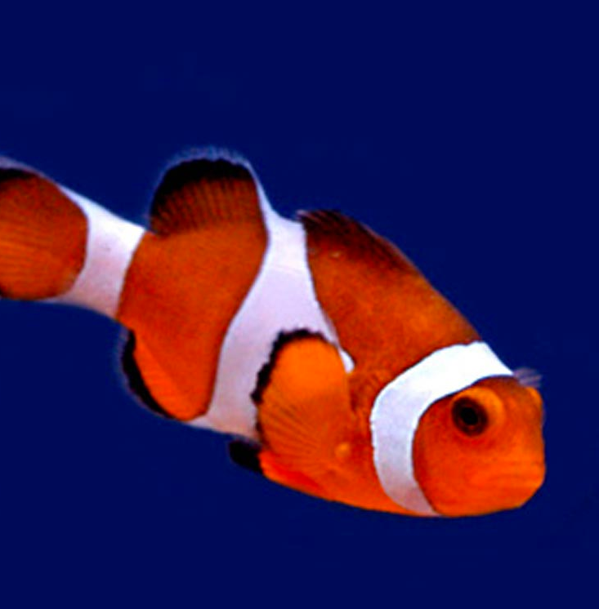
Deep learning
Learned
“clown fish”
Loss
Notes:
The basic idea is that you fiddle all the weights until you match the desired output.
\mathbf{\theta}^* = \argmin_{\theta} \sum_{i=1}^N \mathcal{L}(f_{\theta}(\mathbf{x}^{(i)}), \mathbf{y}^{(i)})
\mathcal{L}(f_{\theta}(\mathbf{x}^{(i)}), \mathbf{y}^{(i)})

Slide 4
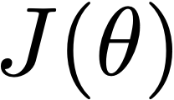
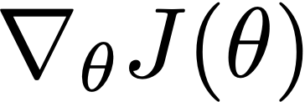
Optimization
Params
What’s the knowledge we have about J?
We can evaluate
We can evaluate and
We can evaluate , , and
Gradient
Black box optimization
First order optimization
Second order optimization
Hessian

Slide 5
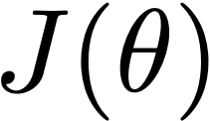
Gradient descent
x

Slide 6
Gradient descent
One iteration of gradient descent:
learning rate
Notes:
\theta^{t+1} = \theta^t - \eta_t \frac{\partial J(\theta)}{\partial \theta}\bigg\rvert_{\theta = \theta^t}

Slide 7
Stochastic gradient descent (SGD)
Want to minimize overall loss function J, which is sum of individual losses over each example.
In Stochastic gradient descent, compute gradient on sub-set (batch) of data.
If batchsize=1 then θ is updated after each example.
If batchsize=N (full set) then this is standard gradient descent.
Gradient direction is noisy, relative to average over all examples (standard gradient descent).
Advantages
Faster: approximate total gradient with small sample
Implicit regularizer
Disadvantages
High variance, unstable updates

Slide 8
Forward pass
Consider model with layers. Layer has vector of weights
Forward pass: takes input and passes it through each layer :
Output of layer is .
Network output (top layer) is .
(output)
…
…
(input)
Notes:
\mathbf{x}_l = f_l(\mathbf{x}_{l-1}, \mathbf{W}_l)

Slide 9
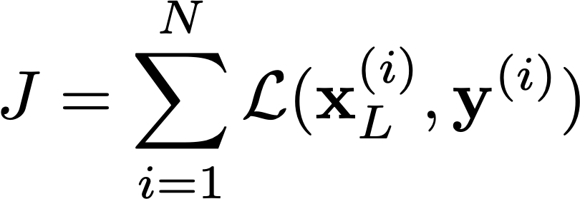
Forward pass
Consider model with layers. Layer has vector of weights
Forward pass: takes input and passes it through each layer :
Output of layer is .
Network output (top layer) is .
(output)
…
…
Loss function compares to .
Overall cost is the sum of the losses over all training examples:
(input)
Notes:
J = \sum_{i=1}^N \mathcal{L}(\mathbf{x}^{(i)}_L, \mathbf{y}^{(i)})
\mathcal{L}(\mathbf{x}_L, \mathbf{y})

Slide 10
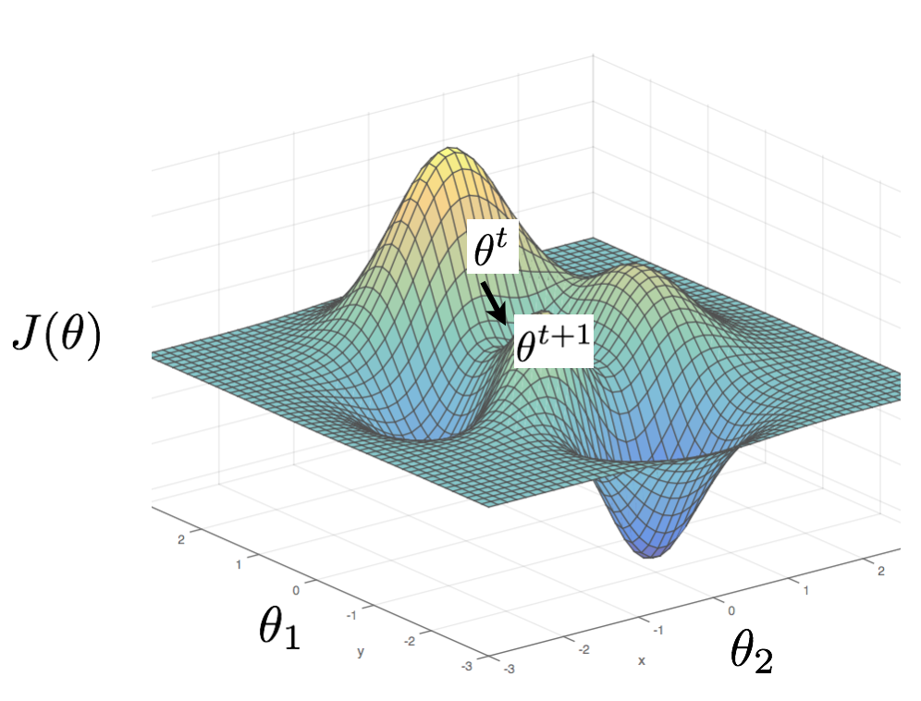
Gradient descent
W^{t}
J(W)
W^{t+1}
w₁
w₂
We need to compute gradients of the cost with respect to model parameters .
By design, each layer is differentiable with respect to its parameters and input.
…
…

Slide 11
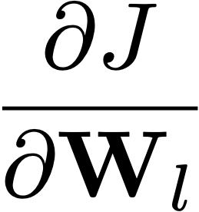
Computing gradients
To compute the gradients, we could start by writing the full energy J as a function of the network parameters.
…
…
And then compute the partial derivatives…
instead, we can use the chain rule to derive a compact algorithm: backpropagation
Notes:
\frac{\partial J}{\partial \mathbf{W}_l}
J(\mathbf{W}) = \sum_{i=1} \mathcal{L}(f_L(\ldots f_2(f_1(\mathbf{x}_0^{(i)}, \mathbf{W}_1), \mathbf{W}_2), \ldots \mathbf{W}_L), \mathbf{y}^{(i)})

Slide 12
(

Slide 13
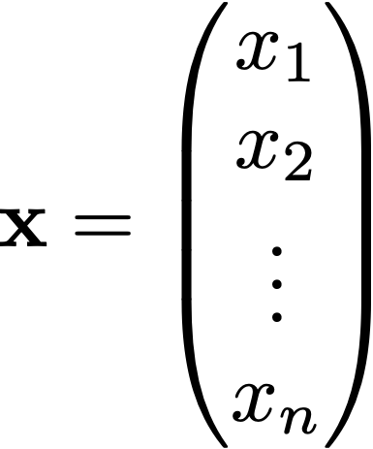
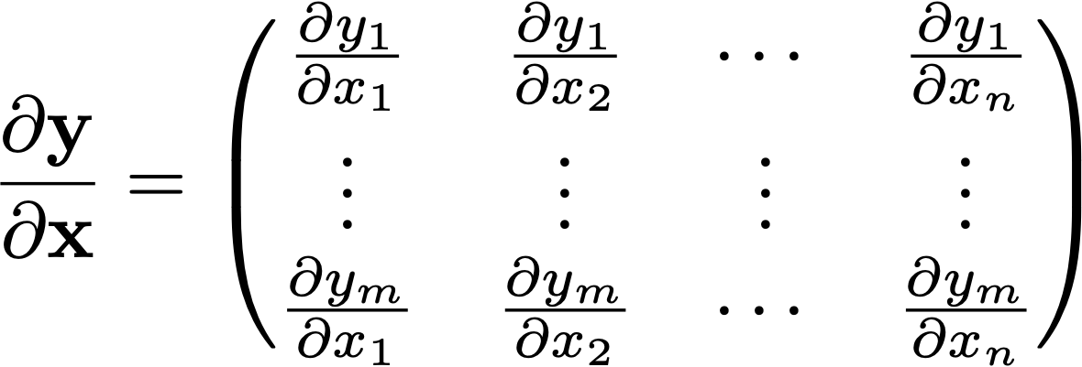
Matrix calculus
column vector of size :
We now define a function on vector :
If is a scalar, then
The derivative of y is a row vector of size
If is a vector , then (Jacobian formulation):
The derivative of y is a matrix of size
(m rows and n columns)
Notes:
\mathbf{x} =
\begin{pmatrix}
x_1 \\
x_2 \\
\vdots \\
x_n \\
\end{pmatrix}
\frac{\partial y}{\partial \mathbf{x}} =
\begin{pmatrix}
\frac{\partial y}{\partial x_1} & \frac{\partial y}{\partial x_2} & \cdots & \frac{\partial y}{\partial x_n}
\end{pmatrix}
\frac{\partial \mathbf{y}}{\partial \mathbf{x}} =
\begin{pmatrix}
\frac{\partial y_1}{\partial x_1} & \frac{\partial y_1}{\partial x_2} & \cdots & \frac{\partial y_1}{\partial x_n} \\
\vdots & \vdots & \vdots & \vdots \\
\frac{\partial y_m}{\partial x_1} & \frac{\partial y_m}{\partial x_2} & \cdots & \frac{\partial y_m}{\partial x_n}
\end{pmatrix}

Slide 14
Matrix calculus
If is a scalar and is a matrix of size , then
The output is a matrix of size
Wikipedia: The three types of derivatives that have not been considered are those involving vectors-by-matrices, matrices-by-vectors, and matrices-by-matrices. These are not as widely considered and a notation is not widely agreed upon.
Notes:
\frac{\partial y}{\partial \mathbf{X}} =
\begin{pmatrix}
\frac{\partial y}{\partial x_{11}} & \frac{\partial y}{\partial x_{21}} & \cdots & \frac{\partial y}{\partial x_{n1}} \\
\vdots & \vdots & \vdots & \vdots \\
\frac{\partial y}{\partial x_{1m}} & \frac{\partial y}{\partial x_{2m}} & \cdots & \frac{\partial y}{\partial x_{nm}}
\end{pmatrix}

Slide 15
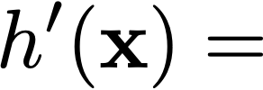
Matrix calculus
Chain rule:
For the function:
Its derivative is:
and writing , and :
with length of vector , , and
Example, if , ,
Notes:
h^{\prime}(\mathbf{x}) = f^{\prime}(g(\mathbf{x})) g^{\prime}(\mathbf{x})
\frac{\partial \mathbf{z}}{\partial \mathbf{x}}\bigg\rvert_{\mathbf{x} = \mathbf{a}} = \frac{\partial \mathbf{z}}{\partial \mathbf{u}}\bigg\rvert_{\mathbf{u} = g(\mathbf{a})} \cdot \frac{\partial \mathbf{u}}{\partial \mathbf{x}}\bigg\rvert_{\mathbf{x} = \mathbf{a}}

Slide 16
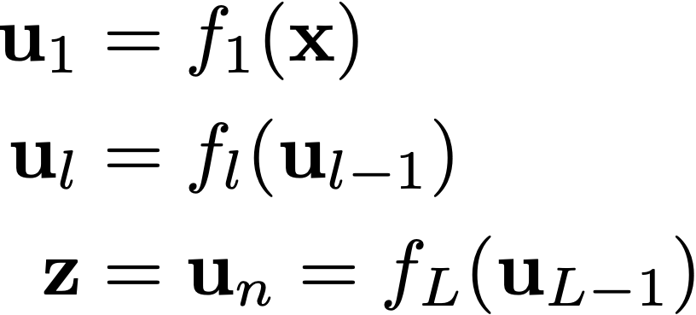
Matrix calculus
Chain rule:
For the function:
With
The derivative becomes a product of matrices:
(exercise: check that all the matrix dimensions work out fine)
Notes:
h(\mathbf{x}) = f_L(f_{L-1}(\ldots f_1(\mathbf{x})))
\mathbf{u}_1 &= f_1(\mathbf{x})\\
\mathbf{u}_l &= f_l(\mathbf{u}_{l-1})\\
\mathbf{z} &= \mathbf{u}_n = f_L(\mathbf{u}_{L-1})
\frac{\partial \mathbf{z}}{\partial \mathbf{x}}\bigg\rvert_{\mathbf{x} = \mathbf{a}} = \frac{\partial \mathbf{z}}{\partial \mathbf{u}_{L-1}}\bigg\rvert_{\mathbf{u}_{L-1} = f_{L-1}(\mathbf{u}_{L-2})} \cdot \frac{\partial \mathbf{u}^{L-1}}{\partial \mathbf{u}_{L-2}}\bigg\rvert_{\mathbf{u}_{L-2} = f_{L-2}(\mathbf{u}_{L-3})} \cdots \frac{\partial \mathbf{u}_{2}}{\partial \mathbf{u}_{1}}\bigg\rvert_{\mathbf{u}_{1} = f_{1}(\mathbf{a})} \cdot \frac{\partial \mathbf{u}_{1}}{\partial \mathbf{x}}\bigg\rvert_{\mathbf{x} = \mathbf{a}}

Slide 17
)

Slide 18
Computing gradients
To compute the gradients, we could start by writing the full energy J as a function of the network parameters.
…
…
And then compute the partial derivatives… instead, we can use the chain rule to derive a compact algorithm: backpropagation
Notes:
J(\mathbf{W}) = \sum_{i=1} \mathcal{L}(f^{(L)}(\ldots f^{(2)}(f^{(1)}(\mathbf{x}^{(0)}_i, \mathbf{W}^{(1)}), \mathbf{W}^{(2)}), \ldots \mathbf{W}^{(L)}), \mathbf{y}_i)

Slide 19
Computing gradients
The loss J is the sum of the losses associated with each training example
…
Its gradient with respect to each of the network’s parameters w is:
…
is how much J varies when the parameter w is varied.
Notes:
\{\mathbf{x}_0^{(i)}, \mathbf{y}^{(i)}\}
J(\mathbf{W}) = \sum_{i=1}^N \mathcal{L}(\mathbf{x}_L^{(i)}, \mathbf{y}^{(i)}; \mathbf{W})
\frac{\partial J(\mathbf{W})}{\partial w} = \sum_{i=1}^N \frac{\partial \mathcal{L}(\mathbf{x}^{(L)}_i, \mathbf{y}_i; \mathbf{W})}{\partial w}

Slide 20
Computing gradients
We could write the loss function to get the gradients as:
If we compute the gradient with respect to the parameters of the last layer (output layer) WL, using the chain rule:
…
…
How much the loss changes when we change WL? The change is the product between how much the loss changes when we change the output of the last layer and how much the output changes when we change the layer parameters.
Notes:
\mathcal{L}(\mathbf{x}_L, \mathbf{y}; \mathbf{W}) = \mathcal{L}(f_L(\mathbf{x}_{L-1}, \mathbf{W}_L), \mathbf{y})
\frac{\partial \mathcal{L}}{\partial \mathbf{W}_L} = \frac{\partial \mathcal{L}}{\partial \mathbf{x}_L} \cdot \frac{\partial \mathbf{x}_L}{\partial \mathbf{W}_L} = \frac{\partial \mathcal{L}}{\partial \mathbf{x}_L} \cdot \frac{\partial f_L(\mathbf{x}_{L-1}, \mathbf{W}_L)}{\partial \mathbf{W}_L}

Slide 21
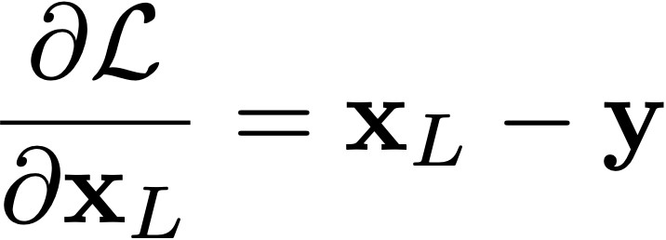
Computing gradients: loss layer
If we compute the gradient with respect to the parameters of the last layer (output layer) WL, using the chain rule:
For example, for an Euclidean loss:
Will depend on the layer structure and non-linearity.
The gradient is:
Notes:
\mathcal{L}(\mathbf{x}_L, \mathbf{y}) = \frac{1}{2} \norm{\mathbf{x}_L - \mathbf{y}}_2^2
\frac{\partial \mathcal{L}}{\partial \mathbf{x}_L} = \mathbf{x}_L - \mathbf{y}

Slide 22
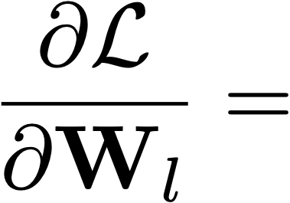
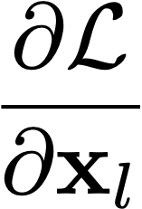
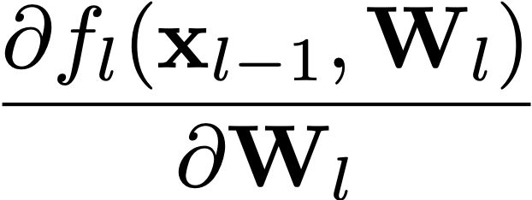
Computing gradients: layer
We could write the full loss function to get the gradients:
If we compute the gradient with respect to , using the chain rule:
…
…
And this can be computed iteratively!
This is easy.
Notes:
\mathcal{L}(\mathbf{x}_L, \mathbf{y}; \mathbf{W}) = \mathcal{L}(f_L(\ldots f_2(f_1(\mathbf{x}_0, \mathbf{W}_1), \mathbf{W}_2), \ldots \mathbf{W}_L), \mathbf{y})
\frac{\partial \mathcal{L}}{\partial \mathbf{W}_l} = \frac{\partial \mathcal{L}}{\partial \mathbf{x}_L} \cdot \frac{\partial \mathbf{x}_L}{\partial \mathbf{x}_{L-1}} \cdot \frac{\partial \mathbf{x}_{L-1}}{\partial \mathbf{x}_{L-2}} \cdots \frac{\partial \mathbf{x}_{l+1}}{\partial \mathbf{x}_{l}} \cdot \frac{\partial \mathbf{x}_{l}}{\partial \mathbf{W}_{l}}
\frac{\partial \mathcal{L}}{\partial \mathbf{x}_l}
\frac{\partial f_l(\mathbf{x}_{l-1}, \mathbf{W}_l)}{\partial \mathbf{W}_l}

Slide 23
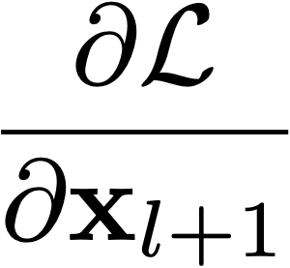
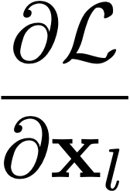
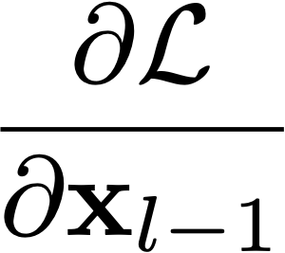
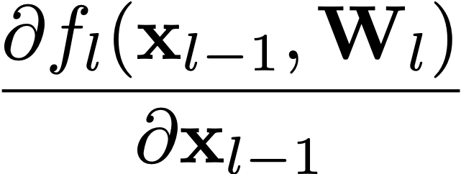
Backpropagation
And this can be computed iteratively. We start at the top (L) and we can compute the gradient at layer l-1
If we have the value of we can compute the gradient at the layer below as:
Gradient layer l-1
Gradient layer l
Notes:
\frac{\partial \mathcal{L}}{\partial \mathbf{x}_{l-1}} = \frac{\partial \mathcal{L}}{\partial \mathbf{x}_l} \cdot \frac{\partial \mathbf{x}_l}{\partial \mathbf{x}_{l-1}}
\frac{\partial f_l(\mathbf{x}_{l-1}, \mathbf{W}_l)}{\partial \mathbf{x}_{l-1}}

Slide 24
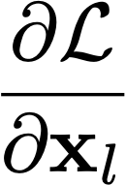
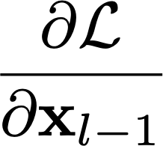
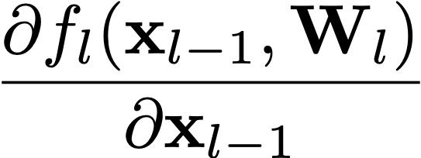
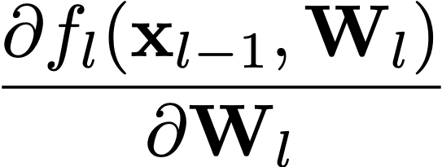
Backpropagation — Goal: to update parameters of layer
Layer has two inputs (during training)
We compute the outputs
Hidden layer
To compute the output, we need:
Forward pass
Backward pass
To compute the weight update, we need:
Notes:
During training, each layer will have three outputs:
the forward pass. To compute the operating point for each layer and training example
the backwards pass to propagate the energy derivative with respect to the input of the layer
and the derivative of the energy with respect to the weights.
\mathbf{x}_l = f_l(\mathbf{x}_{l-1}, \mathbf{W}_l)
\frac{\partial \mathcal{L}}{\partial \mathbf{x}_{l-1}} = \frac{\partial \mathcal{L}}{\partial \mathbf{x}_l} \cdot
\frac{\partial f_l(\mathbf{x}_{l-1}, \mathbf{W}_l)}{\partial \mathbf{x}_{l-1}}

Slide 25
Backpropagation — Goal: to update parameters of layer
Layer has two inputs (during training)
We compute the outputs
Hidden layer
The weight update equation is:
Forward pass
Backward pass
(sum over all training examples to get J)
Notes:
\frac{\partial \mathcal{L}}{\partial \mathbf{W}_l} = \frac{\partial \mathcal{L}}{\partial \mathbf{x}_l} \cdot \frac{\partial f_l(\mathbf{x}_{l-1}, \mathbf{W}_l)}{\partial \mathbf{W}_l}
\mathbf{W}_l \leftarrow \mathbf{W}_l + \eta \bigg(\frac{\partial J}{\partial \mathbf{W}_l}\bigg)^T

Slide 26
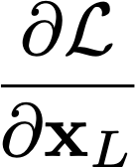
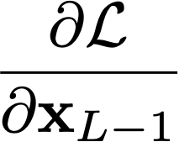
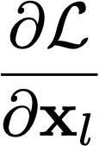
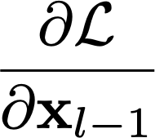
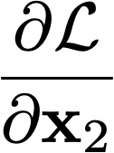
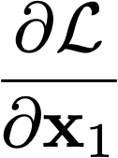
Backpropagation Summary
Forward pass: for each training example, compute the outputs for all layers:
Backwards pass: compute loss derivatives iteratively from top to bottom:
Compute gradients w.r.t. weights, and update weights:
(output)
…
…
…
…
(input)

Slide 27
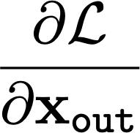
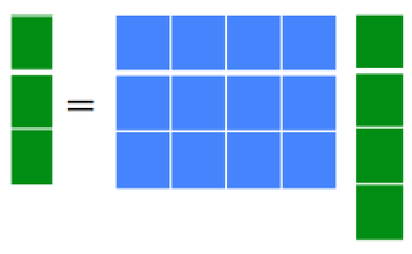
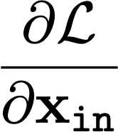
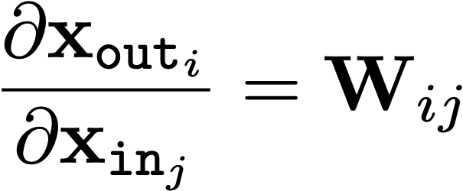
Linear Module
Forward propagation:
With W being a matrix of size |x_{out}|×|x_{in}|
Backprop to input:
If we look at the j component of output x_{out}, with respect to the i component of the input, x_{in}:
Therefore:
Notes:
f(\mathbf{x}_{\texttt{in}}, \mathbf{W})
\frac{\partial \mathcal{L}}{\partial \mathbf{x}_{\texttt{in}}}
\mathbf{x}_{\texttt{out}} = f(\mathbf{x}_{\texttt{in}}, \mathbf{W}) = \mathbf{W}\mathbf{x}_{\texttt{in}}
\frac{\partial \mathcal{L}}{\partial \mathbf{x}_{\texttt{in}}} = \frac{\partial \mathcal{L}}{\partial \mathbf{x}_{\texttt{out}}} \cdot \frac{\partial f(\mathbf{x}_{\texttt{in}}, \mathbf{W})}{\partial \mathbf{x}_{\texttt{in}}} = \frac{\partial \mathcal{L}}{\partial \mathbf{x}_{\texttt{out}}} \cdot \frac{\partial \mathbf{x}_{\texttt{out}}}{\partial \mathbf{x}_{\texttt{in}}}
\frac{\partial \mathbf{x}_{\texttt{out}_i}}{\partial \mathbf{x}_{\texttt{in}_j}} = \mathbf{W}_{ij}
\frac{\partial f(\mathbf{x}_{\texttt{in}}, \mathbf{W})}{\partial \mathbf{x}_{\texttt{in}}} = \mathbf{W}

Slide 28
Linear Module
Forward propagation:
Backprop to input:
Now let’s see how we use the set of outputs to compute the weights update equation (backprop to the weights).

Slide 29
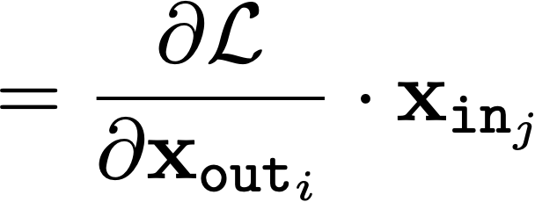
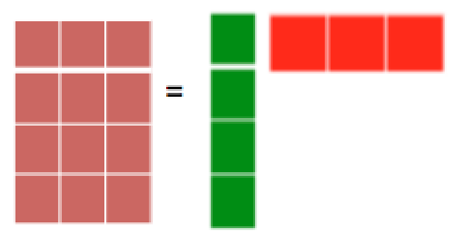
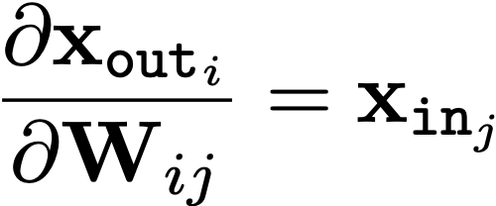
Linear Module
Forward propagation:
Backprop to weights:
If we look at how the parameter W_{ij} changes the cost, only the i component of the output will change, therefore:
And now we can update the weights (by summing over all the training examples):
(sum over all training examples to get J)
Notes:
Things to notice: dC/dW is the derivative of a scalar by a matrix. So it is well defined.
If there is a single training example, then E = C.
\frac{\partial \mathcal{L}}{\partial \mathbf{W}} = \frac{\partial \mathcal{L}}{\partial \mathbf{x}_{\texttt{out}}} \cdot \frac{\partial f(\mathbf{x}_{\texttt{in}}, \mathbf{W})}{\partial \mathbf{W}} = \frac{\partial \mathcal{L}}{\partial \mathbf{x}_{\texttt{out}}} \cdot \frac{\partial \mathbf{x}_{\texttt{out}}}{\partial \mathbf{W}}
\frac{\partial \mathcal{L}}{\partial \mathbf{W}_{ij}} = \frac{\partial \mathcal{L}}{\partial \mathbf{x}_{\texttt{out}_i}} \cdot \frac{\partial \mathbf{x}_{\texttt{out}_i}}{\partial \mathbf{W}_{ij}}
\frac{\partial \mathbf{x}_{\texttt{out}_i}}{\partial \mathbf{W}_{ij}} = \mathbf{x}_{\texttt{in}_j}
\frac{\partial \mathcal{L}}{\partial \mathbf{W}} = \mathbf{x}_{\texttt{in}} \cdot \frac{\partial \mathcal{L}}{\partial \mathbf{x}_{\texttt{out}}}
\mathbf{W}^{k+1} \leftarrow \mathbf{W}^{k} + \eta \bigg(\frac{\partial J}{\partial \mathbf{W}}\bigg)^T

Slide 30
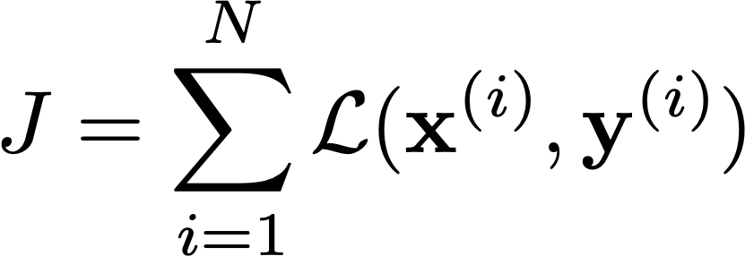
Linear Module
Weight updates:
Sum over N training pairs
Notes:
\mathbf{x}_{\texttt{out}} = \mathbf{W}\mathbf{x}_{\texttt{in}}
\mathbf{W}^{k+1} \leftarrow \mathbf{W}^{k} + \eta \bigg(\frac{\partial J}{\partial \mathbf{W}}\bigg)^T
J = \sum_{i=1}^N \mathcal{L}(\mathbf{x}^{(i)}, \mathbf{y}^{(i)})
\frac{\partial J}{\partial \mathbf{W}} = \sum_{i=1}^N \mathbf{x}_{\texttt{in}} \cdot \frac{\partial \mathcal{L}}{\partial \mathbf{x}_{\texttt{out}}}\bigg\rvert_{\mathbf{x}_i, \mathbf{y}_i}

Slide 31
Pointwise function
Forward propagation:
h = an arbitrary function, b_{i} is a bias term.
Backprop to input:
Backprop to bias:
We use this last expression to update the bias.
Notes:
\mathbf{x}_{\texttt{out}_i} = h(\mathbf{x}_{\texttt{in}_i} + b_i)
\frac{\partial \mathcal{L}}{\partial \mathbf{x}_{\texttt{in}_i}} = \frac{\partial \mathcal{L}}{\partial \mathbf{x}_{\texttt{out}_i}} \cdot \frac{\partial \mathbf{x}_{\texttt{out}_i}}{\partial \mathbf{x}_{\texttt{in}_i}} = \frac{\partial \mathcal{L}}{\partial \mathbf{x}_{\texttt{out}_i}} \cdot \frac{\partial h(\mathbf{x}_{\texttt{in}_i} + b_i)}{\partial \mathbf{x}_{\texttt{in}_i}}
\frac{\partial \mathcal{L}}{\partial b_i} = \frac{\partial \mathcal{L}}{\partial \mathbf{x}_{\texttt{out}_i}} \cdot \frac{\partial \mathbf{x}_{\texttt{out}_i}}{\partial b_i} = \frac{\partial \mathcal{L}}{\partial \mathbf{x}_{\texttt{out}_i}} \cdot \frac{\partial h(\mathbf{x}_{\texttt{in}_i} + b_i)}{\partial b_i}

Slide 32
Pointwise function
Forward propagation:
h = an arbitrary function, b_{i} is a bias term.
Backprop to input:
Backprop to bias:
We use this last expression to update the bias.
Some useful derivatives:
For hyperbolic tangent:
For ReLU:
Notes:
\mathbf{x}_{\texttt{out}_i} = h(\mathbf{x}_{\texttt{in}_i} + b_i)
\frac{\partial \mathcal{L}}{\partial \mathbf{x}_{\texttt{in}_i}} = \frac{\partial \mathcal{L}}{\partial \mathbf{x}_{\texttt{out}_i}} \cdot \frac{\partial \mathbf{x}_{\texttt{out}_i}}{\partial \mathbf{x}_{\texttt{in}_i}} = \frac{\partial \mathcal{L}}{\partial \mathbf{x}_{\texttt{out}_i}} \cdot h^{\prime}(\mathbf{x}_{\texttt{in}_i} + b_i)
\frac{\partial \mathcal{L}}{\partial b_i} = \frac{\partial \mathcal{L}}{\partial \mathbf{x}_{\texttt{out}_i}} \cdot \frac{\partial \mathbf{x}_{\texttt{out}_i}}{\partial b_i} = \frac{\partial \mathcal{L}}{\partial \mathbf{x}_{\texttt{out}_i}} \cdot h^{\prime}(\mathbf{x}_{\texttt{in}_i} + b_i)

Slide 33
Pointwise function
Bias updates:
Notes:
b_i^{k+1} \leftarrow b_i^{k} + \eta \frac{\partial J}{\partial b_i}

Slide 34
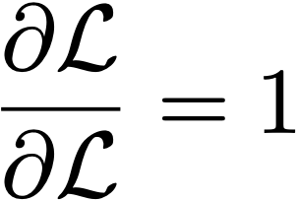
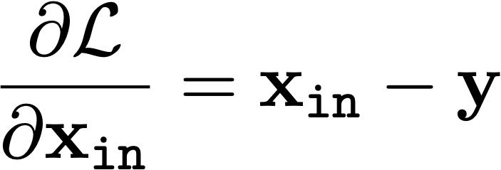
Euclidean loss module
Notes:
\mathcal{L} = \frac{1}{2} \norm{\mathbf{x}_{\texttt{in}} - \mathbf{y}}_2^2
\frac{\partial \mathcal{L}}{\partial \mathbf{x}_{\texttt{in}}} = \mathbf{x}_{\texttt{in}} - \mathbf{y}

Slide 35
Homework: Convolution Module
Assume the input x_{in} and output x_{out} are 1D signals of the same length N. The convolution kernel is W, and has length k < N
Weight updates:
Derive the equations that go inside each box.
Discuss how you handle the boundaries.
Notes:
Things to notice: dC/dW is the derivative of a scalar by a matrix. So it is well defined.
If there is a single training example, then E = C.

Slide 36
Homework: max pooling module
Assume the input x_{in} and output x_{out} are 1D signals of different lengths.
Weight updates:
Derive the equations that go inside each box.
Discuss how you handle the boundaries.
Notes:
Things to notice: dC/dW is the derivative of a scalar by a matrix. So it is well defined.
If there is a single training example, then E = C.

Slide 37
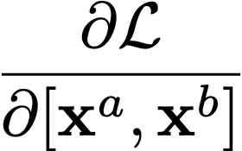
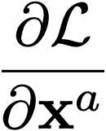
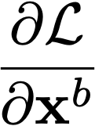
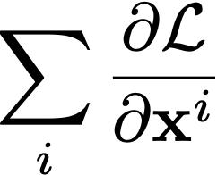
Branching and Merging
merge
branch
Notes:
\frac{\partial \mathcal{L}}{\partial \mathbf{x}^a}
\frac{\partial \mathcal{L}}{\partial [\mathbf{x}^a, \mathbf{x}^b]}
\sum_i \frac{\partial \mathcal{L}}{\partial \mathbf{x}^i}

Slide 38
Computation Graphs
If all the modules ( ) are differentiable, and they are connected to form a Directed Acyclic Graph (DAG), then you can use backprop to train this whole system!
This is an example of a computation graph.
Many programs can be represented with differentiable DAGs, not just “neural nets”.

Slide 39
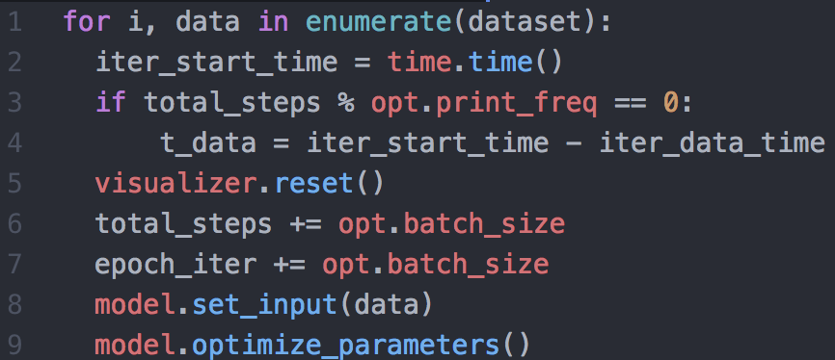
Differentiable programming
Deep learning
Differentiable programming

Slide 40
Differentiable programming
Deep nets are popular for a few reasons:
Easy to optimize (differentiable)
Compositional “block based programming”
An emerging term for general models with these properties is differentiable programming.

Slide 41
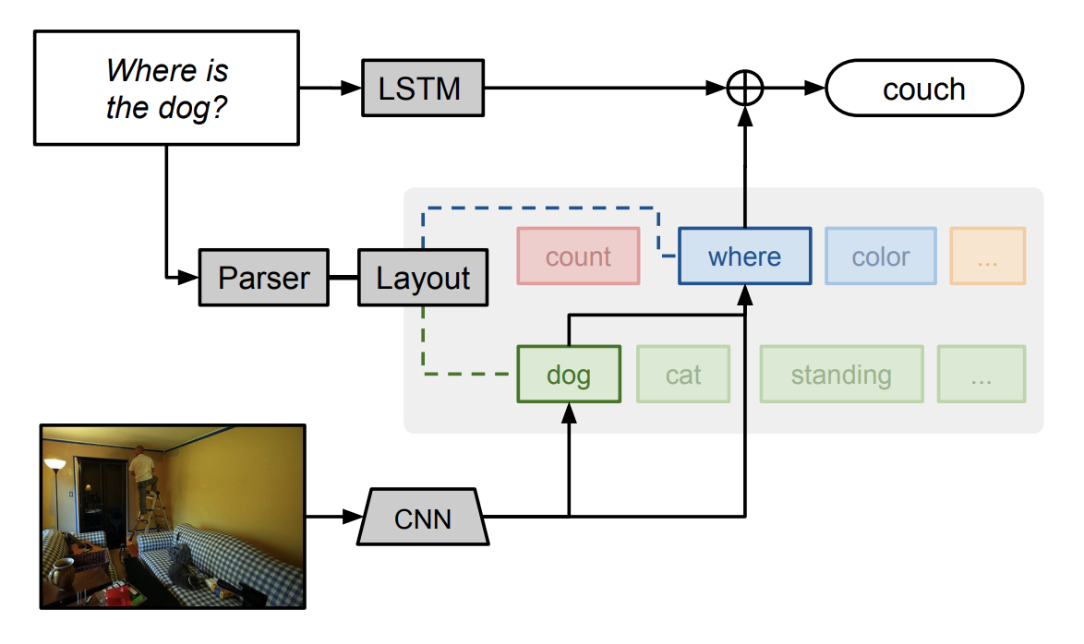
Differentiable programming
[Figure from “Neural Module Networks”, Andreas et al. 2017]

Slide 42
Software 2.0
[Andrej Karpathy: https://karpathy.medium.com/software-2-0-a64152b37c35]

Slide 43
Programmed by a human
Programmed by backprop
e.g., programmed by tuning behavior to match training examples

Slide 44
Backprop lets you optimize any node (function) or edge (variable) in your computation graph w.r.t. to any scalar cost

Slide 45
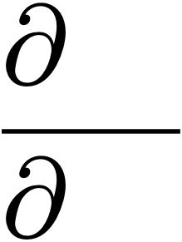
Backprop lets you optimize any node (function) or edge (variable) in your computation graph w.r.t. to any scalar cost
How the loss changes when the functional node highlighted changes

Slide 46
Backprop lets you optimize any node (function) or edge (variable) in your computation graph w.r.t. to any scalar cost
How the loss changes when the functional node highlighted changes
How the cost changes when the input data changes

Slide 47
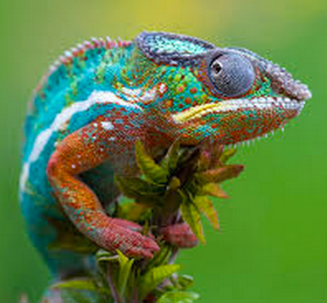
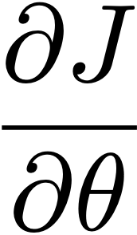
Optimizing parameters versus optimizing inputs
dolphin
cat
grizzly bear
angel fish
chameleon
clown fish
iguana
elephant
…
How much the total cost is increased or decreased by changing the parameters.
Notes:
\frac{\partial J}{\partial \theta}

Slide 48
Optimizing parameters versus optimizing inputs
dolphin
cat
grizzly bear
angel fish
chameleon
clown fish
iguana
elephant
…
How much the “chameleon” score is increased or decreased by changing the image pixels.
Notes:
\frac{\partial y_j}{\partial \mathbf{x}}
= \frac{\partial x^{(L)}_j}{\partial \mathbf{x}^{(L-1)}} \cdot \frac{\partial \mathbf{x}^{(L-1)}}{\partial \mathbf{x}^{(L-2)}} \cdots \frac{\partial \mathbf{x}^{(2)}}{\partial \mathbf{x}^{(1)}} \cdot \frac{\partial \mathbf{x}^{(1)}}{\partial \mathbf{x}^{(0)}}

Slide 49
Unit visualization via backprop

Slide 50
Unit visualization
Make an image that maximizes the “cat”
output neuron:
[https://distill.pub/2017/feature-visualization/]
Notes:
\argmax_{\mathbf{x}} y_j + \lambda R(\mathbf{x})
\mathbf{x}^{k+1} \leftarrow \mathbf{x}^k + \eta\frac{\partial (y_j(\mathbf{x}) + \lambda R(\mathbf{x}))}{\partial \mathbf{x}}\bigg\rvert_{\mathbf{x} = \mathbf{x}^k}

Slide 51
Unit visualization
Make an image that maximizes the value of neuron j on layer l of the network:
[https://distill.pub/2017/feature-visualization/]
Notes:
\argmax_{\mathbf{x}} h_{l_j} + \lambda R(\mathbf{x})
\mathbf{x}^{k+1} \leftarrow \mathbf{x}^k + \eta\frac{\partial (h_{l_j}(\mathbf{x}) + \lambda R(\mathbf{x}))}{\partial \mathbf{x}}\bigg\rvert_{\mathbf{x} = \mathbf{x}^k}

Slide 52
“Deep dream” [https://ai.googleblog.com/2015/06/inceptionism-going-deeper-into-neural.html]

Slide 53
CLIP
[https://openai.com/blog/clip/]

Slide 54
CLIP+GAN
INPUT:
"What is the answer to the ultimate question of life, the universe, and everything?”
To maximize this
OUTPUT:
Optimize this
Image
Generator
Code: https://colab.research.google.com/drive/1_4PQqzM_0KKytCzWtn-ZPi4cCa5bwK2F?usp=sharing

Slide 55
CLIP+GAN
Differentiable program that measures the similarity between text and images
What is the answer to the ultimate question of life,
the universe, and everything?
To maximize this
Optimize this
Code: https://colab.research.google.com/drive/1_4PQqzM_0KKytCzWtn-ZPi4cCa5bwK2F?usp=sharing

Slide 56
2. Backprop and Differentiable Programming
Review of gradient descent, SGD
Forward propagation
Computing gradients
Backward propagation
Computation graphs and differentiable programming

Slide 57
Backpropagation example
node 1
w13=1
node 3
1
0.2
tanh
node 5
input
output
-3
linear
node 2
node 4
-1
1
tanh
Learning rate η = -0.2 (because we used positive increments)
Euclidean loss
Training data:
input
desired output
node 1
node 2
node 5
1.0
0.1
0.5
Exercise: run one iteration of back propagation

Slide 58
Backpropagation example
node 1
w13=1.02
node 3
1.02
0.17
tanh
node 5
input
output
-3.0
linear
node 2
node 4
-0.99
1.0
tanh
After one iteration (rounding to two digits)

Slide 59
Step by step solution

Slide 60
First, let’s rewrite the network using the modular block notation:
We need to compute all these terms simply so we can find the weight updates at the bottom.

Slide 61
Our goal is to perform the following two updates:
where W^{k} are the weights at some iteration k of gradient descent given by the first slide:
Notes:
\W^{k+1}_1 = \W^{k}_1 + \eta \bigg( \frac{\partial \Loss}{\partial \W_1} \bigg)^T
\W^k_0 =
\begin{pmatrix}
1 & -3 \\
0.2 & 1 \\
\end{pmatrix}

Slide 62
First we compute the derivative of the loss with respect to the output:
Now, by the chain rule, we can derive equations, working backwards, for each remaining term we need:
ending up with our two gradients needed for the weight update:
Notice the ordering of the two terms being multiplied here. The notation hides the details but you can write out all the indices to see that this is the correct ordering — or just check that the dimensions work out.
Notes:
\frac{\partial \Loss}{\partial \x_3} = \x_3 - \y
\frac{\partial \Loss}{\partial \W_0} = \frac{\partial \Loss}{\partial \x_1}\frac{\partial \x_1}{\partial \W_0} = \x_0 \frac{\partial \Loss}{\partial \x_1}
\frac{\partial \Loss}{\partial \x_2} = \frac{\partial \Loss}{\partial \x_3}\frac{\partial \x_3}{\partial \x_2} = \frac{\partial \Loss}{\partial \x_3}\W_1
\frac{\partial \Loss}{\partial \x_1} = \frac{\partial \Loss}{\partial \x_2}\frac{\partial \x_2}{\partial \x_1} = \frac{\partial \Loss}{\partial \x_2}\frac{\partial \tanh(\x_1)}{\partial \x_1} = \frac{\partial \Loss}{\partial \x_2}(1-\tanh^2(\x_1))

Slide 63
The values for input vector x0 and target y are also given by the first slide:
Finally, we simply plug these values into our equations and compute the numerical updates:
Forward pass:
Notes:
\x_1 = \W_0\x_0 =
\begin{pmatrix}
1 & -3 \\
0.2 & 1 \\
\end{pmatrix}
\begin{pmatrix}
1 \\
0.1 \\
\end{pmatrix}
=
\begin{pmatrix}
0.7 \\
0.3 \\
\end{pmatrix}
\x_2 = \tanh(\x_1) = \begin{pmatrix}
0.604 \\
0.291 \\
\end{pmatrix}
\x_3 = \W_1\x_2 =
\begin{pmatrix}
1 & -1 \\
\end{pmatrix}
\begin{pmatrix}
0.604 \\
0.291 \\
\end{pmatrix}
=
0.313
\Loss = \frac{1}{2}(\x_3 - \y)^2 = 0.017

Slide 64
Backward pass:
diagonal matrix because tanh is a pointwise operation
Notes:
\frac{\partial \Loss}{\partial \x_2} = \frac{\partial \Loss}{\partial \x_3}\W_1 = -0.1869 \begin{pmatrix}
1 & -1
\end{pmatrix}
=
\begin{pmatrix}
-0.1869 & 0.1869
\end{pmatrix}
\frac{\partial \Loss}{\partial \x_1} = \frac{\partial \Loss}{\partial \x_2}(1-\tanh^2(\x_1)) =
\begin{pmatrix}
-0.1869 & 0.1869
\end{pmatrix}
\begin{pmatrix}
1-\tanh^2(0.7) & 0 \\
0 & 1-\tanh^2(0.3)
\end{pmatrix}
=
\begin{pmatrix}
-0.1186 & 0.171
\end{pmatrix}
\frac{\partial \Loss}{\partial \W_0} = \x_0 \frac{\partial \Loss}{\partial \x_1} =
\begin{pmatrix}
1.0 \\
0.1
\end{pmatrix}
\begin{pmatrix}
-0.1186 & 0.171
\end{pmatrix} =
\begin{pmatrix}
-0.1186 & 0.171 \\
-0.01186 & 0.0171
\end{pmatrix}
= \W^k_0 =
\begin{pmatrix}
1 & -3 \\
0.2 & 1 \\
\end{pmatrix} - 0.2

Slide 65
Gradient updates:
Notes:
&=
\begin{pmatrix}
1 & -3 \\
0.2 & 1 \\
\end{pmatrix} - 0.2
\begin{pmatrix}
-0.1186 & 0.171 \\
-0.01186 & 0.0171
\end{pmatrix}
\\
&= \begin{pmatrix}
1.02 & -3.0 \\
0.17 & 1.0
\end{pmatrix}

