Slide 1
Lecture 11
CNNs and Spatial Processing

Slide 2
Announcements
Review lectures 4 through 8 for background on signal processing, convolution, and multiscale image processing — this is the technology that underlies convnets!

Slide 3
10. CNNs and Spatial Processing
How to use deep nets for images
New layer types: convolutional, pooling
Feature maps and multichannel representations
Popular architectures: Alexnet, VGG, Resnets
Getting to know learned filters
Unit visualization

Slide 4
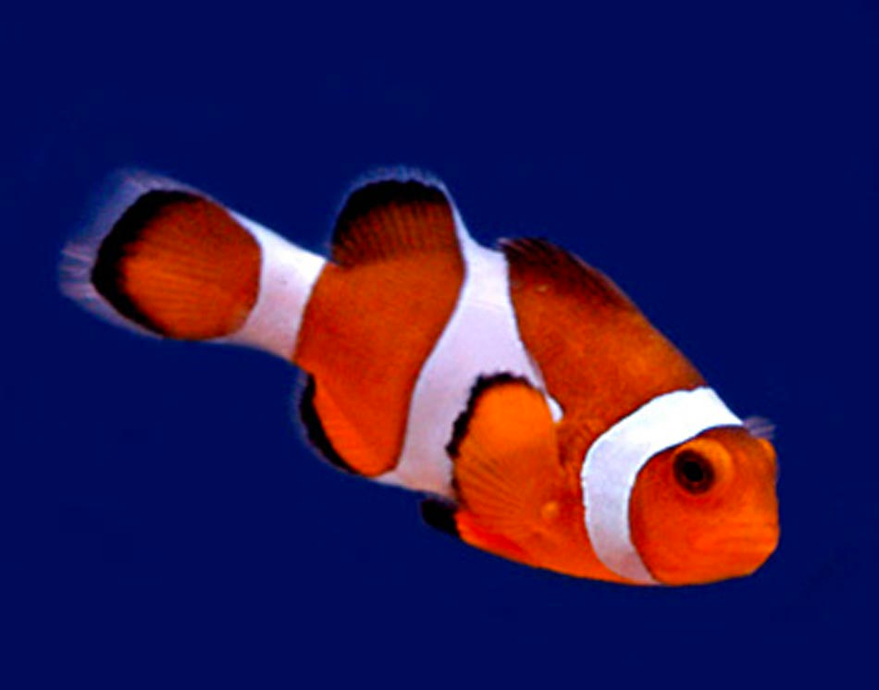
Image classification
Classifier
“Fish”
image x
label y
Notes:
What we have seen so far is a situation like this.
We have an image with a single object, and want to estimate the class of this image.
So we take the image, pass it through our classifier, and out comes a single label.

Slide 5
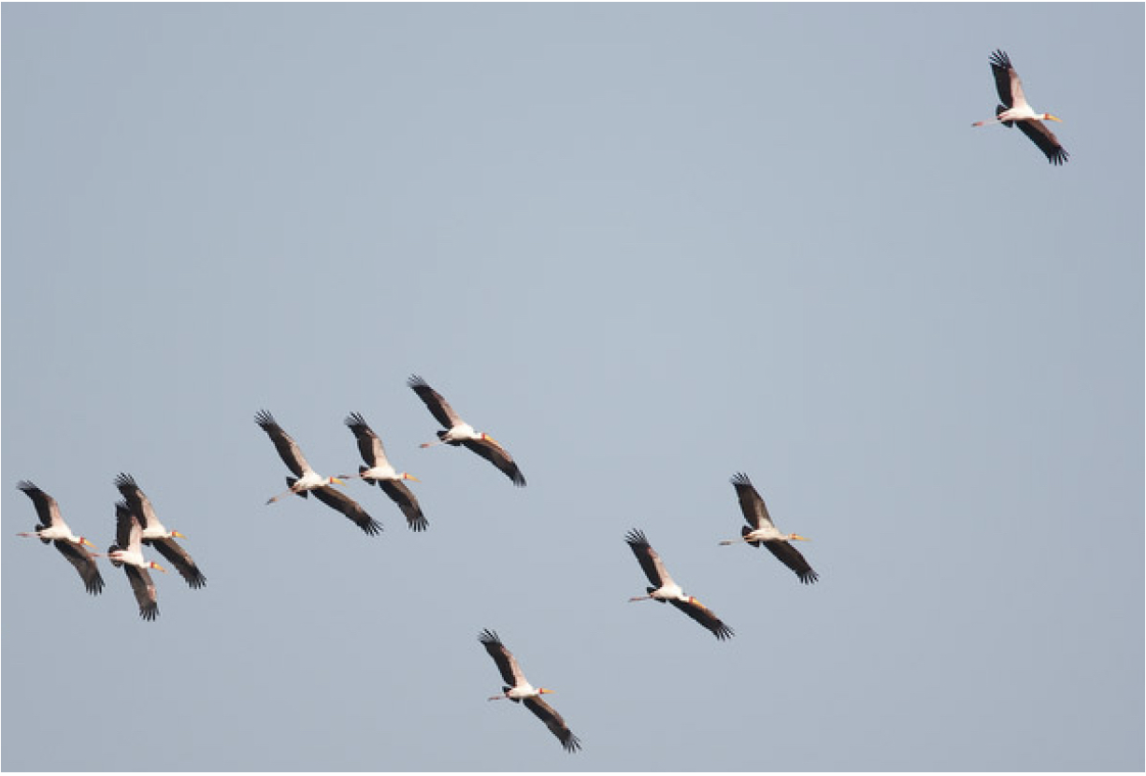
Photo credit: Fredo Durand
Notes:
What do we do in a situation like this? We have multiple objects, but we also have a large part of the image that is just the sky.
Do we want this image to be classified as “bird”? “flock of birds”? “sky”?
A single label is usually not enough!
If you would take a photo from where you sit, how would you classify the image? Lecture hall? Students? Projector? MIT?
It is all of these things.

Slide 6
Notes:
One thing we can do is to subdivide the image into patches, and classify each patch separately.

Slide 7
Classifier
“Bird”

Slide 8
Classifier
“Bird”
Bird

Slide 9
Bird
Classifier
“Sky”
Sky

Slide 10
Sky
Sky
Sky
Sky
Sky
Sky
Sky
Bird
Sky
Sky
Sky
Sky
Sky
Sky
Sky
Sky
Sky
Sky
Sky
Sky
Sky
Sky
Sky
Sky
Bird
Bird
Bird
Sky
Bird
Sky
Sky
Sky
Sky
Sky
Sky
Bird
Sky
Sky
Sky
Sky

Slide 11
Problem: What happens to objects that are bigger?
What if an object crosses multiple cells?

Slide 12
“Cell”-based approach is limited.
What can we do instead?
Notes:
If we break up the grid to be too small, then we don’t have enough context to tell what is going on in each patch, we can’t recognize objects in a tiny patch!

Slide 13
What’s the object class of the center pixel?
“Bird”
“Bird”
“Sky”
“Sky”

Slide 14
What’s the object class of the center pixel?
Training data
“Bird”
“Bird”
“Bird”
“Sky”
“Bird”
“Sky”
“Sky”
…

Slide 15
(Colors represent one-hot codes)
This problem is called semantic segmentation

Slide 16
What’s the object class of the center pixel?
“Bird”
“Bird”
“Sky”
“Sky”
Translation invariance: process each patch in the same way.
An equivariant mapping:

Slide 17
W computes a weighted sum of all pixels in the patch
W is a convolutional kernel applied to the full image!

Slide 18
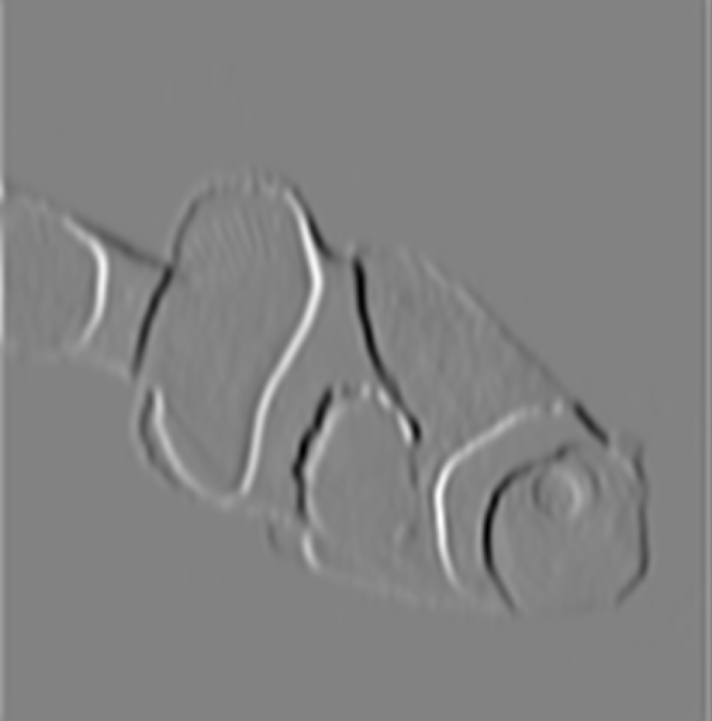
Convolution
filter
Notes:
The advantage of convolution is that parameters are shared. All spatial windows are treated the same way during each filtering operation. This means there are far fewer parameters, weights, to learn. So we can learn more efficiently and avoid overfitting.
This works because stuff in the world is mostly translation invariant. For example, a clown fish looks the same no matter where it is in the image. (Technically, a clown fish on the left looks like a clown fish on the right, except translated to the left, which means the clown fish semantic labels are equivariant with translation.)

Slide 19
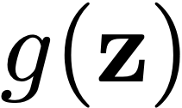
Fully-connected network
Fully-connected (fc) layer

Slide 20
Locally connected network
Often, we assume output is a local function of input.
If we use the same weights (weight sharing) to compute each local function, we get a convolutional neural network.
Notes:
z_k = \frac{1}{|\mathcal{N}|} \sum_{j \in \mathcal{N}(j)} g(y_j)

Slide 21
Convolutional neural network
Conv layer
Often, we assume output is a local function of input.
If we use the same weights (weight sharing) to compute each local function, we get a convolutional neural network.
Notes:
\mathbf{z} = \mathbf{w} \circ \mathbf{x} + \mathbf{b}

Slide 22
Weight sharing
Conv layer
Often, we assume output is a local function of input.
If we use the same weights (weight sharing) to compute each local function, we get a convolutional neural network.
Notes:
z_k = \frac{1}{|\mathcal{N}|} \sum_{j \in \mathcal{N}(j)} g(y_j)

Slide 23
Linear system:
$$y=f(x)$$
A linear function f can be written as a matrix multiplication:
It can also be represented as a fully connected linear neural network
y
x
…
$$h\left[n,k\right]$$
$$y\left[n\right]=\overset{N-1}{\underset{k=0}{∑}}h\left[n,k\right]x\left[k\right]$$
$$h\left[n,k\right]$$
…
n indexes rows, k indexes columns
$$h\left[n,k\right]$$
Is the strength of the connection between x[k] and y[n]

Slide 24
Convolution
A linear shift invariant (LSI) function f can be written as a matrix multiplication:
It can also be represented as a convolutional layer of neural net:
y
x
$$h\left[1\right]$$
$$h\left[0\right]$$
$$h\left[-1\right]$$
$$h\left[-1\right]$$
$$y\left[n\right]=\overset{1}{\underset{k=-1}{∑}}h\left[k\right]x\left[n-k\right]$$
$$h\left[0\right]$$
$$h\left[1\right]$$
$$h\left[1\right]$$
$$h\left[0\right]$$
$$h\left[-1\right]$$
$$h\left[n-k\right]$$
n indexes rows, k indexes columns
$$h\left[n-k\right]$$
Is the strength of the connection between x[k] and y[n]

Slide 25
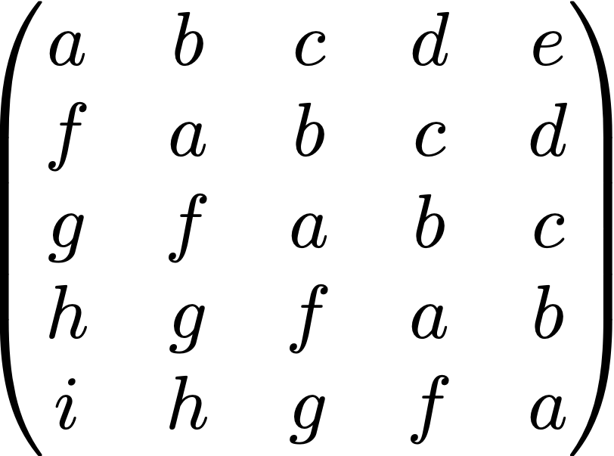
Toeplitz matrix
e.g., pixel image
Constrained linear layer
Fewer parameters —> easier to learn, less overfitting
Notes:
\begin{pmatrix}
a & b & c & d & e \\
f & a & b & c & d \\
g & f & a & b & c \\
h & g & f & a & b \\
i & h & g & f & a \\
\end{pmatrix}

Slide 26
Notes:
\begin{pmatrix}
a & b & c & d & e \\
f & a & b & c & d \\
g & f & a & b & c \\
h & g & f & a & b \\
i & h & g & f & a \\
\end{pmatrix}

Slide 27
Notes:
\begin{pmatrix}
a & b & c & d & e \\
f & a & b & c & d \\
g & f & a & b & c \\
h & g & f & a & b \\
i & h & g & f & a \\
\end{pmatrix}

Slide 28
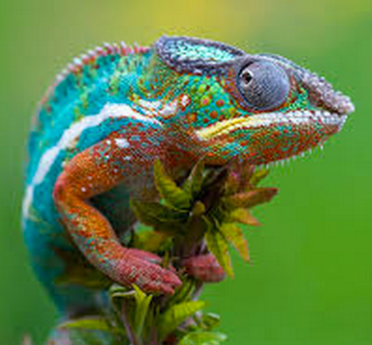
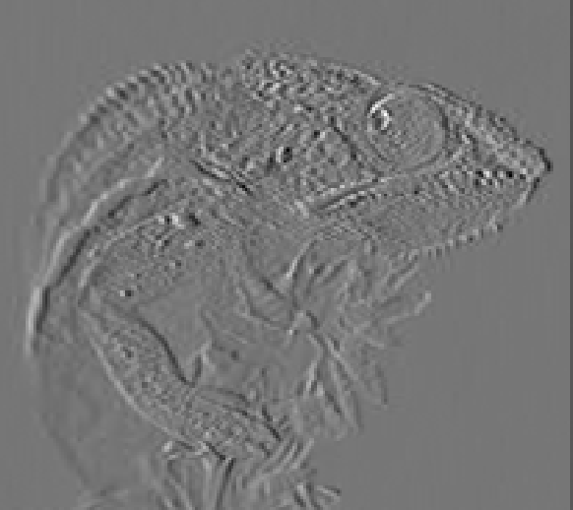
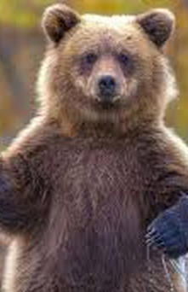
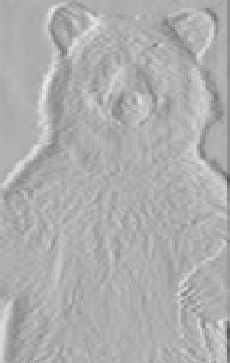
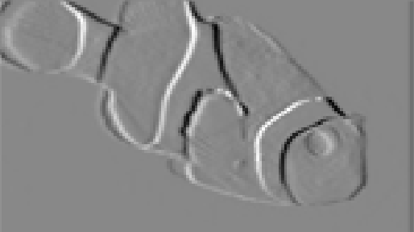
Conv layers can be applied to arbitrarily-sized inputs

Slide 29
Five views on convolutional layers
Equivariant with translation
Patch processing
Image filter
Parameter sharing
A way to process variable-sized tensors

Slide 30
What if we have color?
(aka multiple input channels?)

Slide 31
Multiple channel inputs
Conv layer
Notes:
\mathbf{y} = \sum_c \mathbf{w}_c \circ \mathbf{x}_c + \mathbf{b}

Slide 32
Multiple channel outputs
Conv layer
Notes:
\mathbb{R}^{N \times C_1} \rightarrow \mathbb{R}^{N \times C_2}

Slide 33
Multiple channels
Conv layer
…
…
…
Notes:
\mathbf{y}_k = \sum_c \mathbf{w}_{k_c} \circ \mathbf{x}_c
\mathbb{R}^{N \times C} \rightarrow \mathbb{R}^{N \times K}

Slide 34
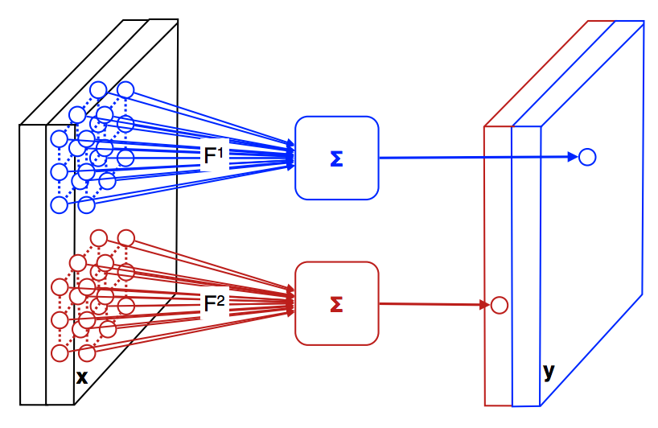
2-dimensional output feature maps
Input features
A bank of 2 filters
[Figure modified from Andrea Vedaldi]
Notes:
\mathbb{R}^{H \times W \times C_1} \rightarrow \mathbb{R}^{H \times W \times C_{2}}

Slide 35
Feature maps
Each layer can be thought of as a set of C feature maps aka channels
Each feature map is an NxM image
Image source: https://stackoverflow.com/questions/45678473/convolution-neural-networks-all-feature-maps-are-blackpixel-value-is-0

Slide 36
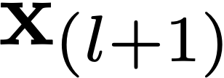
Multiple channels: Example
128
…
128
Filter Bank with 3x3 filters
128
…
128
3
96
How many parameters does each filter have?
(a) 9 (b) 27 (c) 96 (d) 864
Notes:
\mathbb{R}^{N \times C^{(0)}} \rightarrow \mathbb{R}^{N \times C^{(1)}}

Slide 37
Multiple channels: Example
128
…
128
Filter Bank with 3x3 filters
128
…
128
3
96
How many filters are in the bank?
(a) 3 (b) 27 (c) 96 (d) can’t say
Notes:
\mathbb{R}^{N \times C^{(0)}} \rightarrow \mathbb{R}^{N \times C^{(1)}}

Slide 38
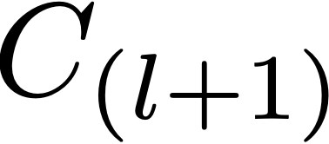
Filter sizes
When mapping from
using an filter of spatial extent Number of parameters per filter:
Number of filters:
Notes:
\mathbf{x}_l \in \mathbb{R}^{H \times W \times C_l}

Slide 39
“Tensor flow”
Notes:
\mathbf{h}_1 \in \mathbb{R}^{N_{\texttt{batch}} \times C_1}
\mathbf{h}_2 \in \mathbb{R}^{N_{\texttt{batch}} \times C_2}

Slide 40
Each layer of data processing in CNNs is typically 4D tensor —> 4D tensor
Notes:
\mathbf{h}_1 \in \mathbb{R}^{N_{\texttt{batch}} \times H_1 \times W_1 \times C_1}

Slide 41
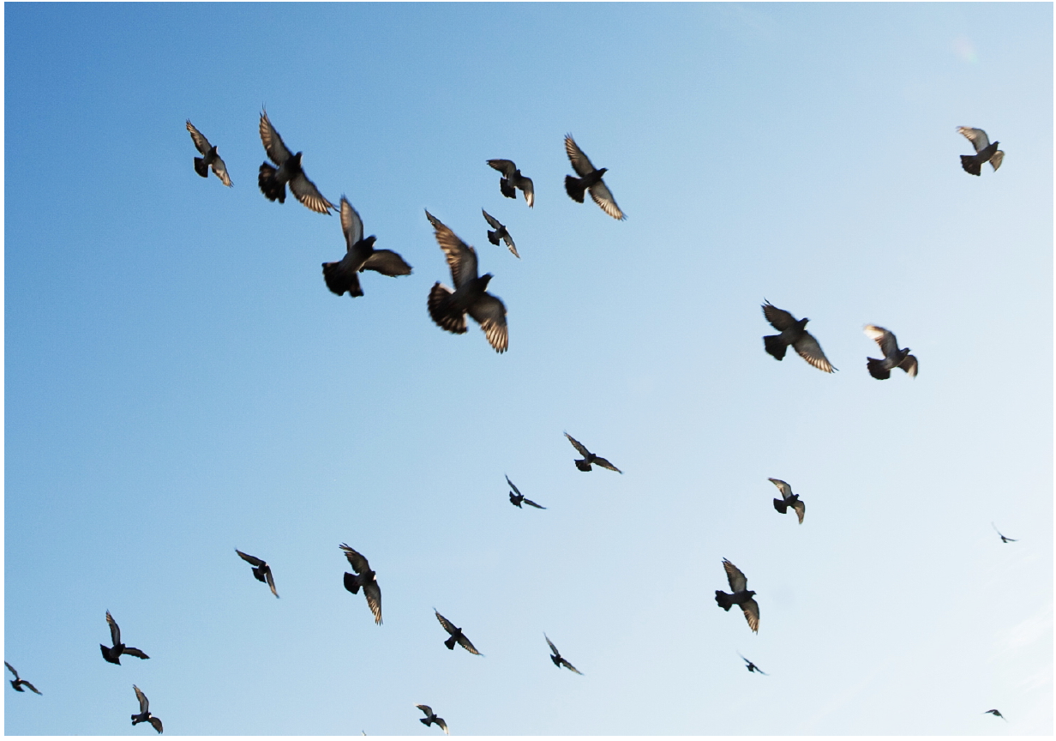
Pooling and downsampling
We need translation and scale invariance

Slide 42
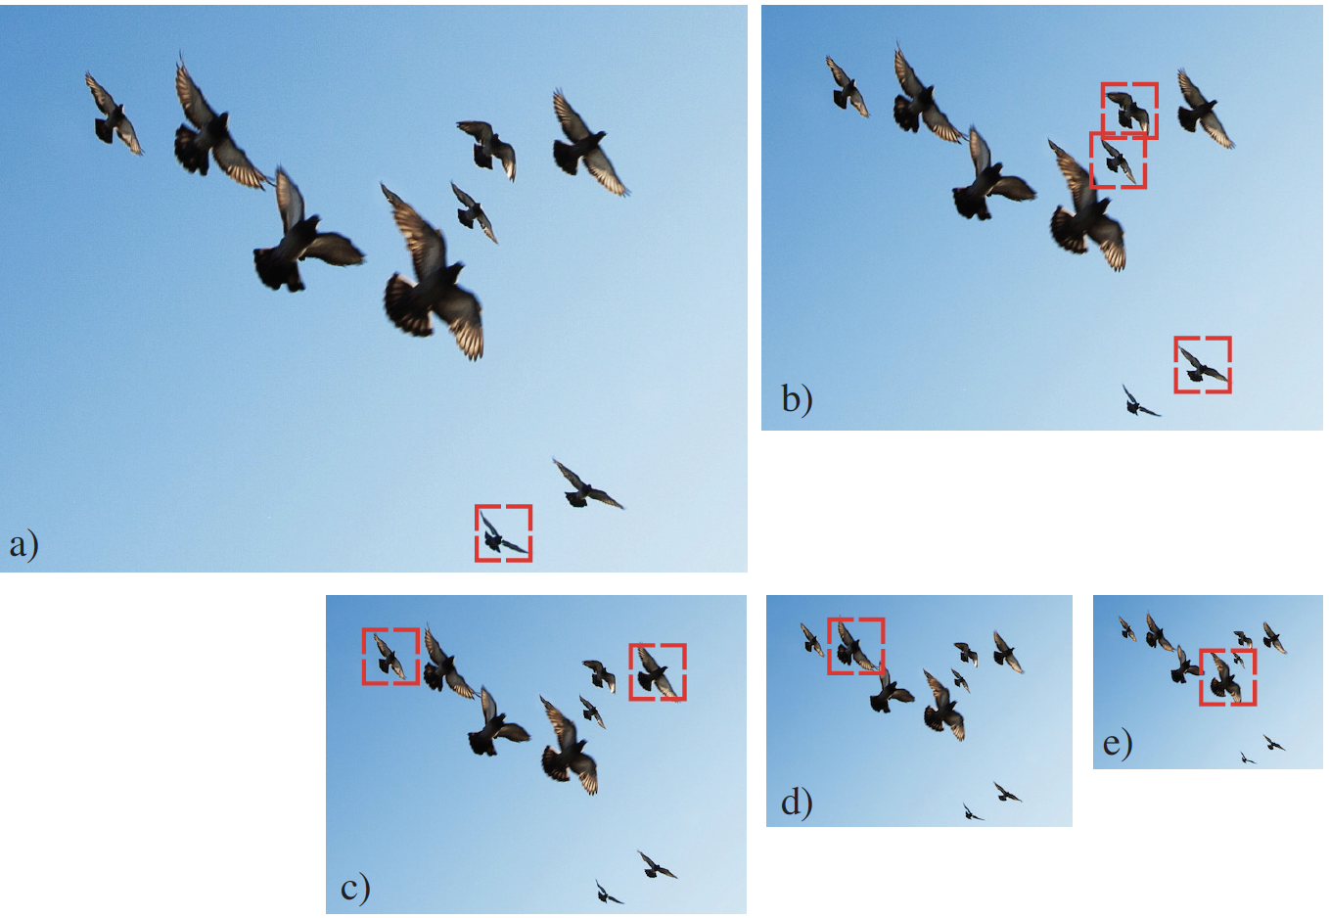
Image pyramids

Slide 43
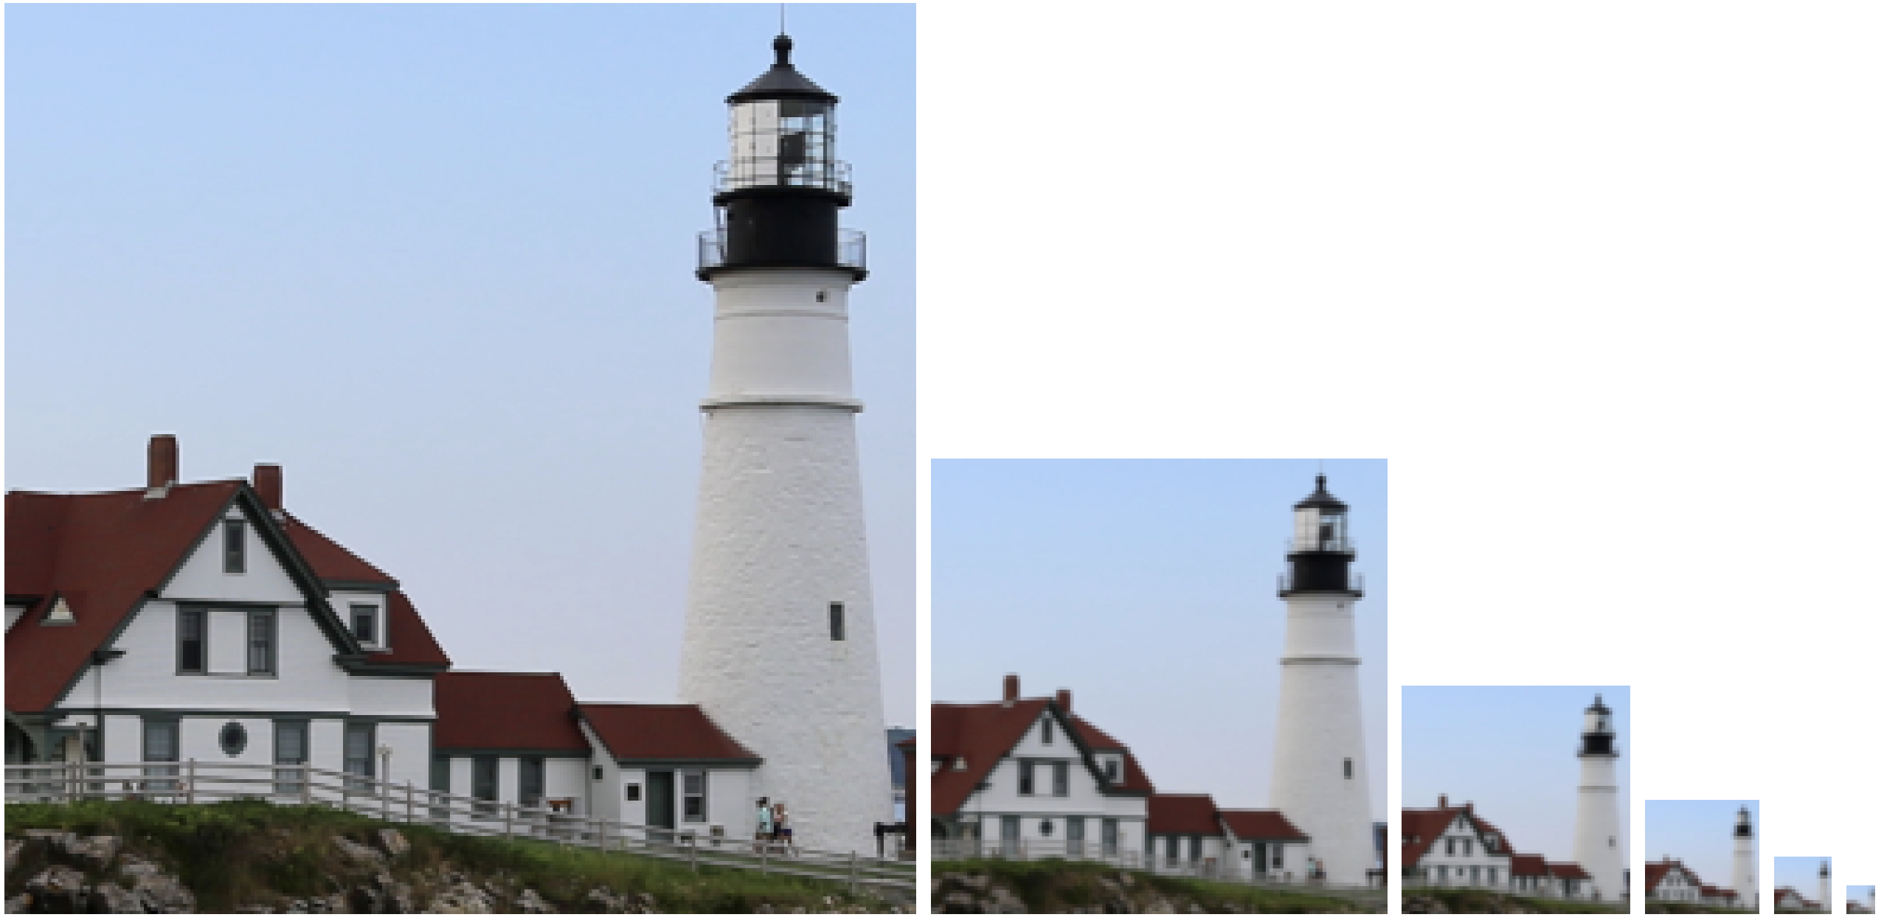
Gaussian Pyramid
1/2
1/2
1/2
1/2

Slide 44
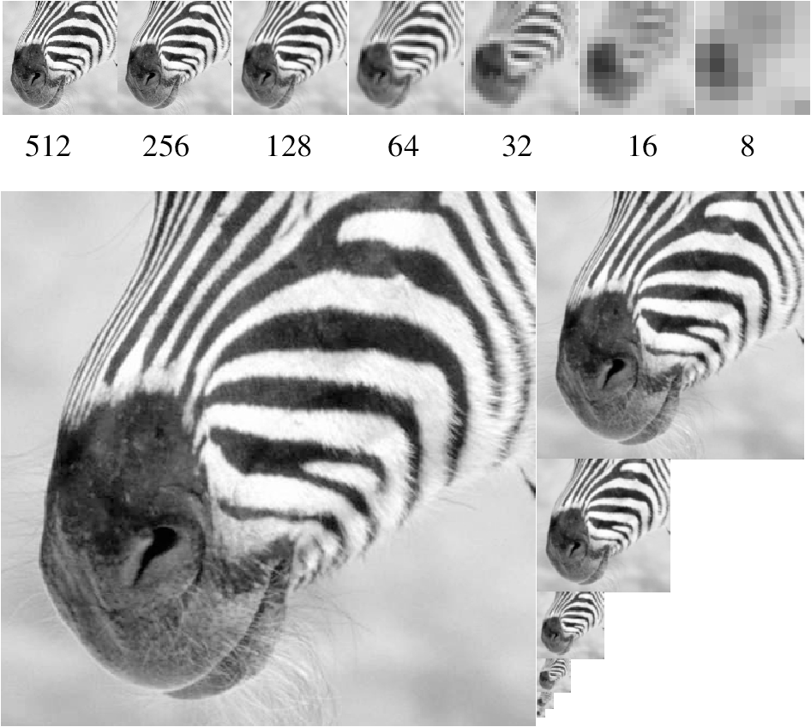
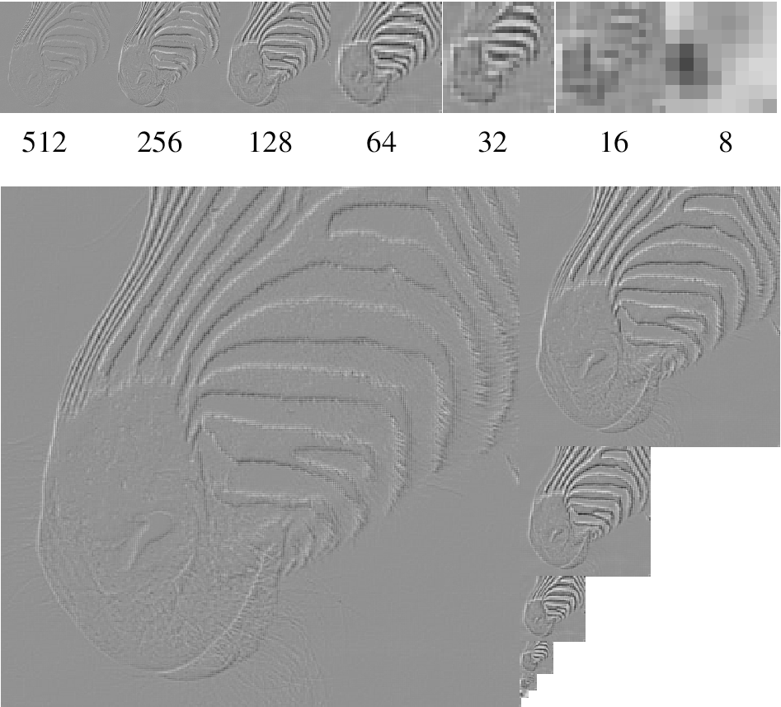
Multiscale representations are great!
Gaussian Pyr
Laplacian Pyr
How can we use multi-scale modeling in Convnets?
Notes:
How can we use multi-scale modeling in convnets?
There are two operations to do so, pooling and downsampling.

Slide 45
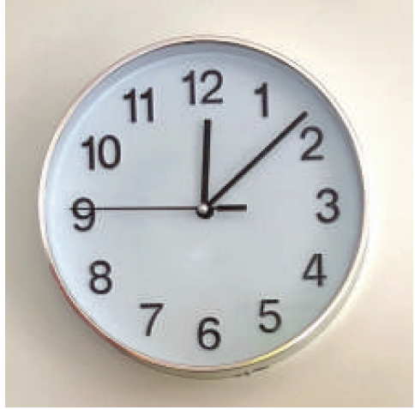
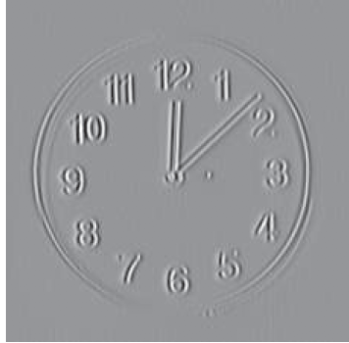
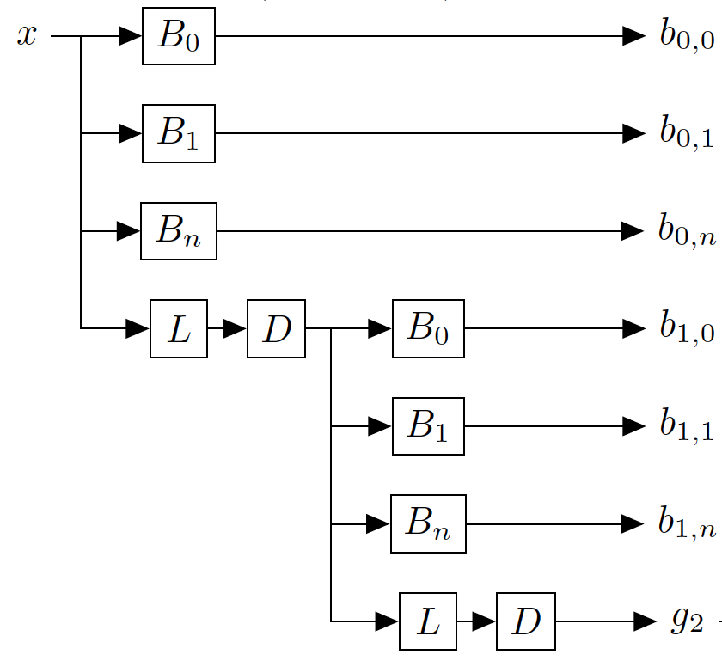
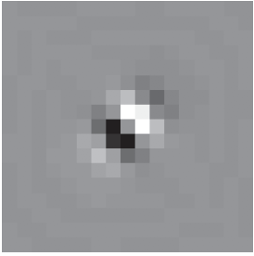
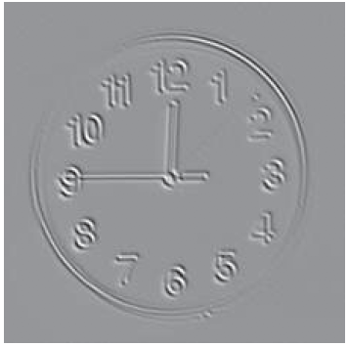
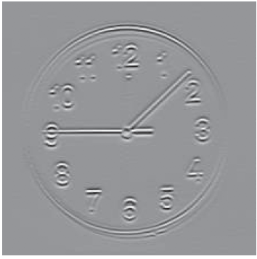
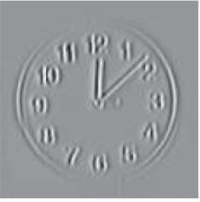
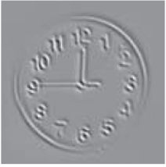
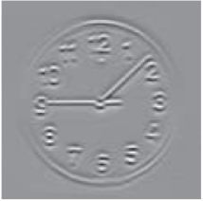
Steerable Pyramid
=
$$x$$

Slide 46
Pooling
Filter
Pool
Max pooling
Notes:
y_j =\max_{j \in \mathcal{N}(j)} h_j

Slide 47
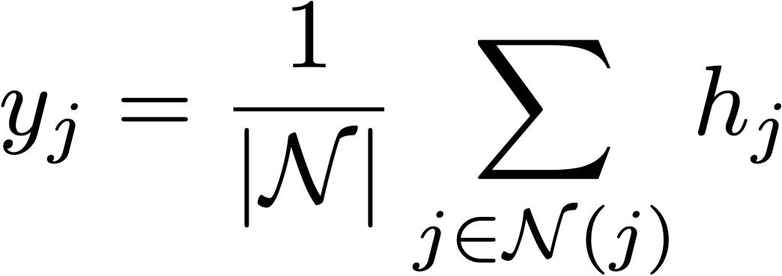
Pooling
Filter
Pool
Max pooling
Mean pooling
Notes:
y_j = \frac{1}{|\mathcal{N}|} \sum_{j \in \mathcal{N}(j)} h_j

Slide 48
Pooling — Why?
Pooling across spatial locations achieves stability w.r.t. small translations:

Slide 49
Pooling — Why?
Pooling across spatial locations achieves stability w.r.t. small translations:
large response regardless of exact position of edge

Slide 50
Pooling — Why?
Pooling across spatial locations achieves stability w.r.t. small translations:

Slide 51
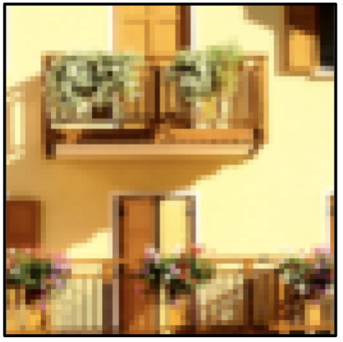
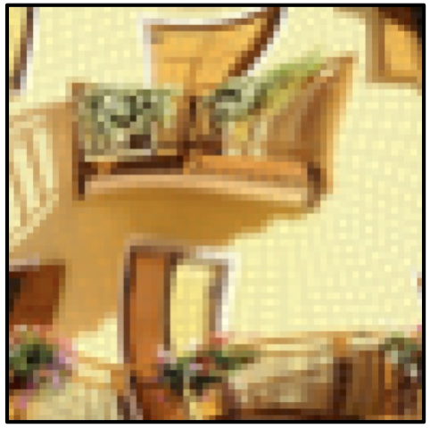
CNNs are stable w.r.t. diffeomorphisms
[“Unreasonable effectiveness of Deep Features as a Perceptual Metric”, Zhang et al. 2018]

Slide 52
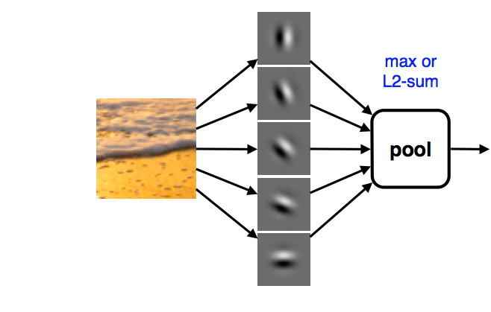
Pooling across channels — Why?
Pooling across feature channels (filter outputs) can achieve other kinds of invariances:
large response for any edge, regardless of its orientation
[Derived from slide by Andrea Vedaldi]

Slide 53
Computation in a neural net
Filter
ReLU
Classify
Pool
“clown fish”
…
Notes:
Cascade of repeated simple computations. With each increasing layer we get more abstracted representations, we get a higher capacity model. This means it can perform more complex and abstract calculations. A shallow network can only efficiently compute simple things, like finding edges. A deep network can efficiently compute harder things like recognizing a clown fish or translating English to Chinese.

Slide 54
Downsampling
Filter
Pool
and downsample

Slide 55
Downsampling
Filter
Downsample
Notes:
\mathbb{R}^{H_l \times W_l \times C_l} \rightarrow \mathbb{R}^{H_{l+1} \times W_{l+1} \times C_{l+1}}

Slide 56
Strided operations
Conv layer
Stride 2
Strided operations combine a given operation (convolution or pooling) and downsampling into a single operation.

Slide 57
Computation in a neural net
Filter
ReLU
Downsample
Classify
“clown fish”
…
Notes:
Cascade of repeated simple computations. With each increasing layer we get more abstracted representations, we get a higher capacity model. This means it can perform more complex and abstract calculations. A shallow network can only efficiently compute simple things, like finding edges. A deep network can efficiently compute harder things like recognizing a clown fish or translating English to Chinese.

Slide 58
Receptive fields

Slide 59
Receptive fields
Pool and downsample by 2
Pool and downsample by 2
3x1 Filter
Sky
Sky
Bird
Sky
RF = RF*2
RF = RF + floor(3/2)*2
RF = RF*2
kernel size
downsample factor

Slide 60
[http://fomoro.com/tools/receptive-fields/index.html]

Slide 61
Local vs. global processing
Across all images, which is higher:
(1) correlation between points with distance
(2) correlation between points with distance
(3) can’t say
$$ΔA$$
$$ΔB$$
$$ΔA$$
$$ΔB$$

Slide 62
Local vs. global processing
Across all images, which is higher:
(1) correlation between points with distance
(2) correlation between points with distance
(3) can’t say
$$ΔA$$
$$ΔB$$
$$ΔA$$
$$ΔB$$

Slide 63
Local vs. global processing
$$ΔA$$
$$ΔB$$
[Simoncelli: Statistical Modelling of Photographic Images, 2005]

Slide 64
CNNs — Why?
Statistical dependences between pixels decay as a power law of distance between the pixels.
It is therefore often sufficient to model local dependences only. —> Convolution
More generally, we should allocate parameters that model dependencies in proportion to the strength of those dependences. —> Multiscale, hierarchical representations
[For more discussion, see “Why does Deep and Cheap Learning Work So Well?”, Lin et al. 2017]

Slide 65
Some networks
… and what makes them work

Slide 66
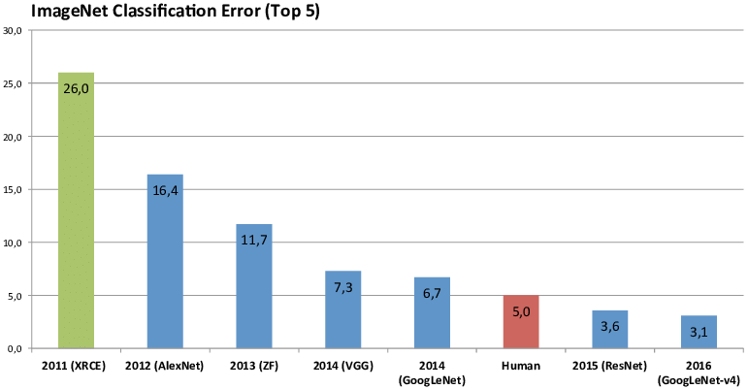

Slide 67
2012: AlexNet
5 conv. layers
Error: 16.4%
[Krizhevsky et al: ImageNet Classification with Deep Convolutional Neural Networks, NIPS 2012]

Slide 68
Alexnet — [Krizhevsky et al. NIPS 2012]
[227x227x3] INPUT
[55x55x96] CONV1: 96 11x11 filters at stride 4, pad 0
[27x27x96] MAX POOL1: 3x3 filters at stride 2
[27x27x96] NORM1: Normalization layer
[27x27x256] CONV2: 256 5x5 filters at stride 1, pad 2 [13x13x256] MAX POOL2: 3x3 filters at stride 2
[13x13x256] NORM2: Normalization layer
[13x13x384] CONV3: 384 3x3 filters at stride 1, pad 1
[13x13x384] CONV4: 384 3x3 filters at stride 1, pad 1
[13x13x256] CONV5: 256 3x3 filters at stride 1, pad 1
[6x6x256] MAX POOL3: 3x3 filters at stride 2
[4096] FC6: 4096 neurons
[4096] FC7: 4096 neurons
[1000] FC8: 1000 neurons (class scores)

Slide 69
What filters are learned?

Slide 70
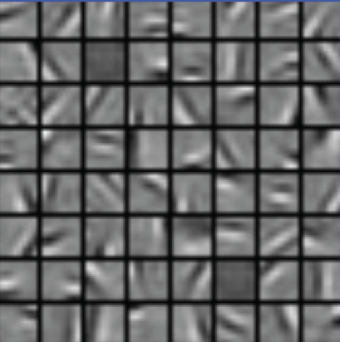
What filters are learned?
A
B
C
D

Slide 71
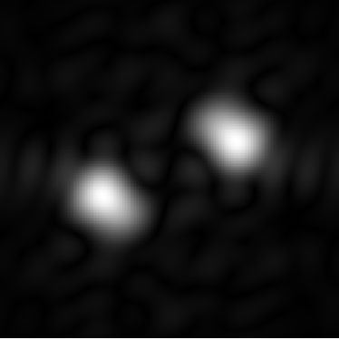
Get to know your units
fy
fx
11x11 convolution kernel
(3 color channels)

Slide 72
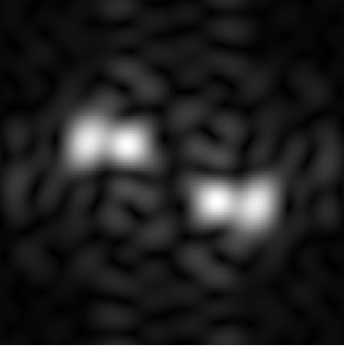
Get to know your units
fy
fx

Slide 73
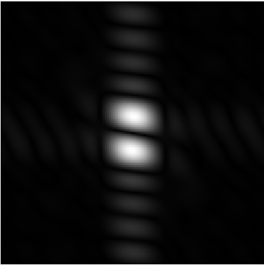
Get to know your units
fy
fx

Slide 74
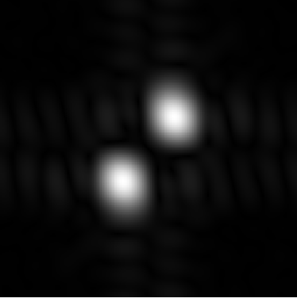
Get to know your units
fy
fx

Slide 75
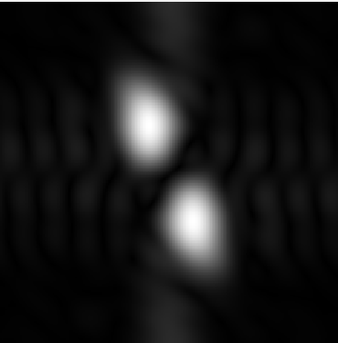
Get to know your units
fy
fx

Slide 76
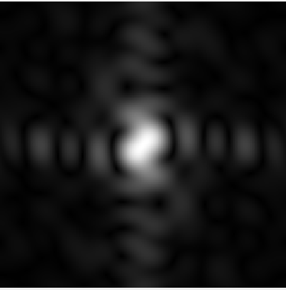
Get to know your units
fy
fx

Slide 77
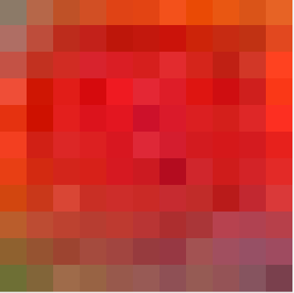
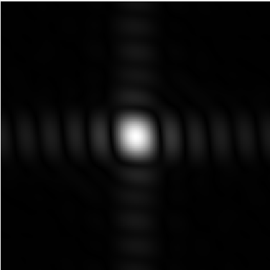
Get to know your units
fy
fx

Slide 78
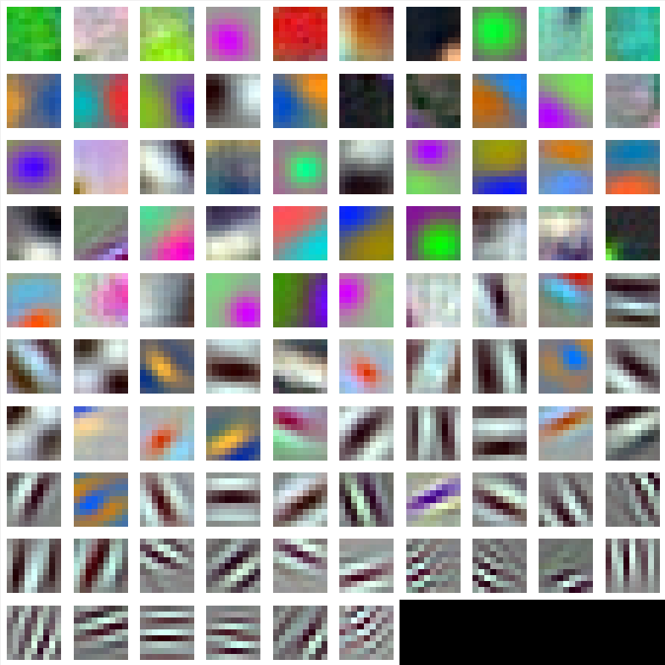
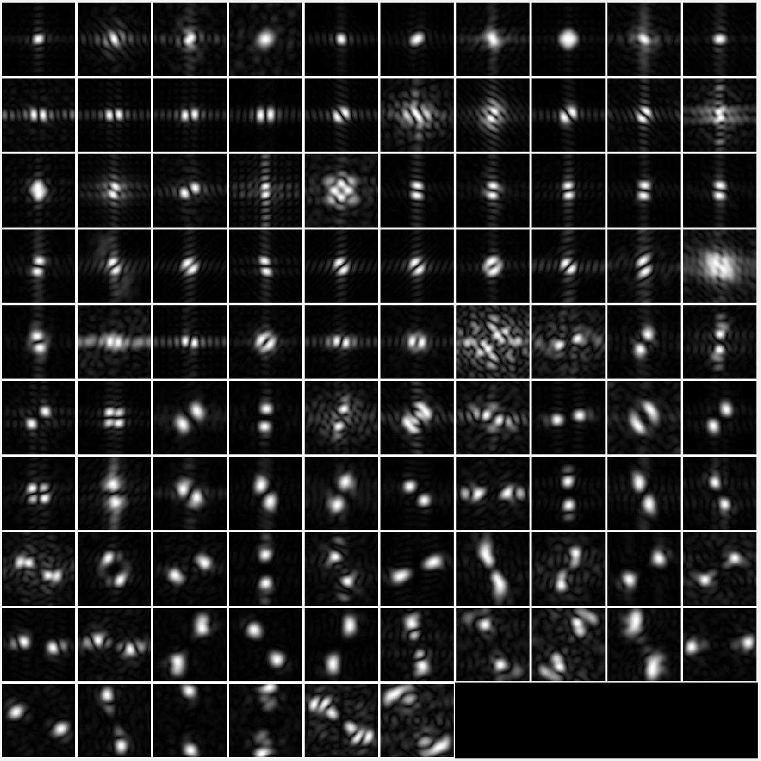
Get to know your units
96 Units in conv1

Slide 79
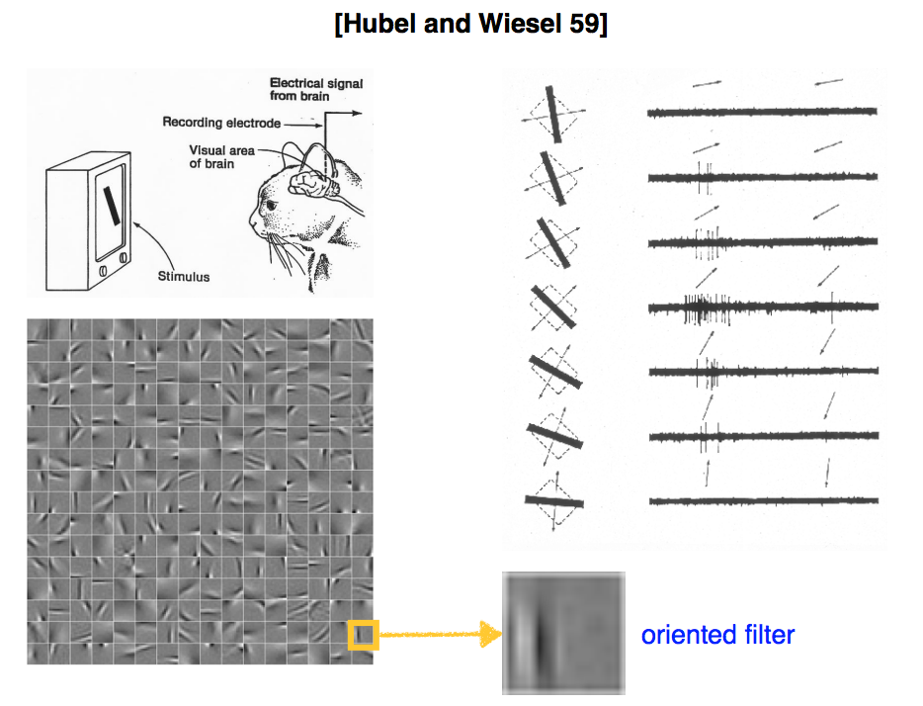
[Slide from Andrea Vedaldi]

Slide 81
2014: VGG
16 conv. layers
Error: 7.3%
[Simonyan & Zisserman: Very Deep Convolutional Networks for Large-Scale Image Recognition, ICLR 2015]

Slide 82
VGG-Net [Simonyan & Zisserman, 2015]
2014: VGG
16 conv. layers
Main developments
Small convolutional kernels: only 3x3
Increased depth (5 -> 16/19 layers)
Error: 7.3%

Slide 83
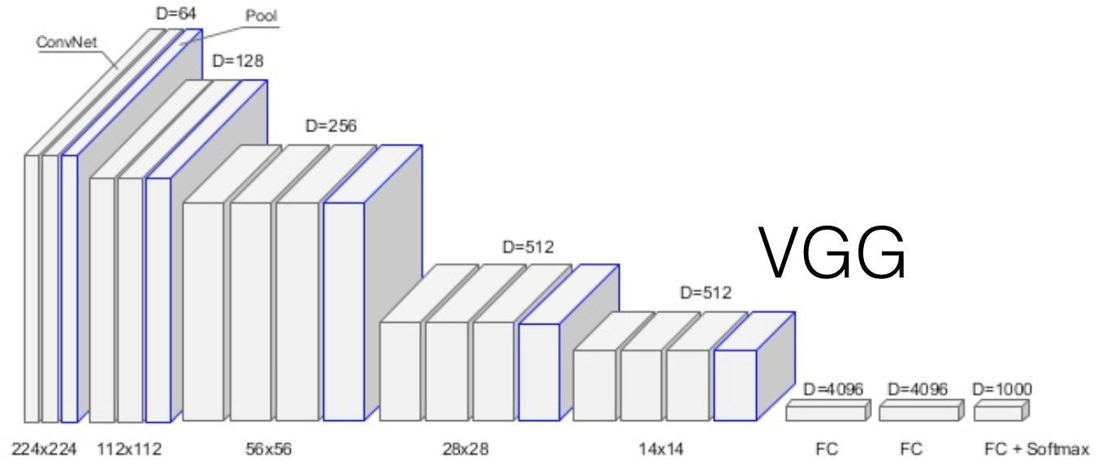
2014: VGG
16 conv. layers
https://arxiv.org/pdf/1409.1556.pdf
Small convolutional kernels: 3x3
ReLu non-linearities
>100 million parameters.
Softmax
Error: 8.5%

Slide 84
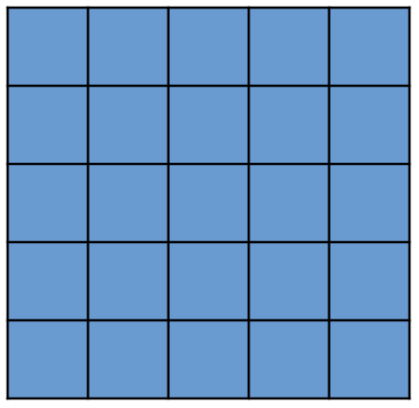
Chaining convolutions
3x3
3x3
5x5
=
25 coefficients, but only
18 degrees of freedom
=
9 coefficients, but only
6 degrees of freedom. Only separable filters… would this be enough?

Slide 85
Dilated convolutions
5x5
7x7
3x3
a | 0 | b | 0 | c
0 | 0 | 0 | 0 | 0
d | 0 | e | 0 | f
0 | 0 | 0 | 0 | 0
g | 0 | h | 0 | i
=
25 coefficients
9 degrees of freedom
49 coefficients
18 degrees of freedom
What is lost?
[https://arxiv.org/pdf/1511.07122.pdf]

Slide 86
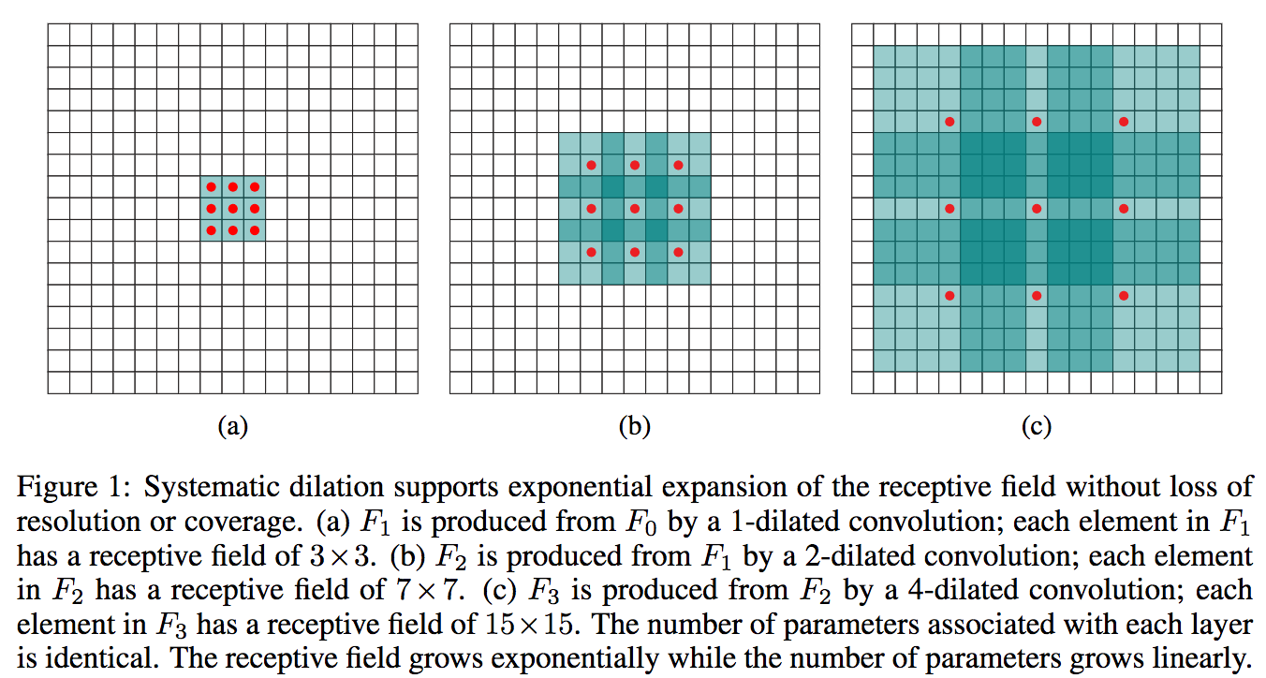
[https://arxiv.org/pdf/1511.07122.pdf]

Slide 88
2016: ResNet
>100 conv. layers
Error: 3.6%
[He et al: Deep Residual Learning for Image Recognition, CVPR 2016]

Slide 89
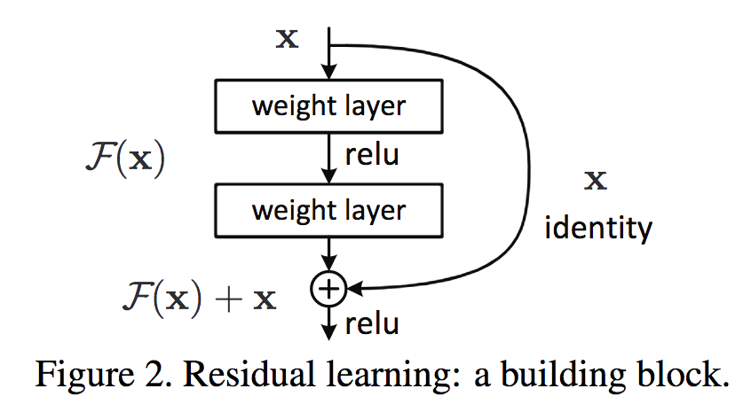
ResNet [He et al, 2016]
2016: ResNet
>100 conv. layers
Main developments
Increased depth possible through residual blocks
Error: 3.6%

Slide 90
Residual Blocks

Slide 91
Residual Blocks
Why do they work?
Gradients can propagate faster (via the identity mapping)
Within each block, only small residuals have to be learned

Slide 92
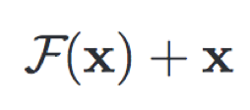
If output has same size as input:
If output has a different size:
Projects into the right dimensionality:
dim(F(x)) = dim(Wx)
Wx

Slide 93
Make them bigger
ResNet
>100 conv. layers
GoogLeNet
22 conv. layers
VGG
16 conv. layers
AlexNet
5 conv. layers
2012
2013
2014
2015
2016
Notes:
Start: as you know, over the years, deep neural networks have been widely used in computer vision, specifically for visual recognition. In 2012, the AlexNet is firstly proposed to initialize the revolution of deep convlutional neural networks. AlexNet has 5 conv layer, with extra 3 fully connected layers. It has been applied to the large-scale image classification benchmark ImageNet,
Final output is just one part of the story, the other half of the story is the internal representations.
Key:
-------------------
A lot of work has been done to improve the final output, such as achieving higher classification accuracy and make the network converge faster.
Emphasize that people all focus on the final output, the classification layer. (repeat the important points several times in different sentences). Make a story about this motivation slide. Accent (replace word with longer and simpler words).
Maybe this is one slide. Show all the networks at once. Then emphasize green bbox (
Diagram should be accuracy.

Slide 94
Some debugging advice

Slide 95
Other good things to know
Check gradients numerically by finite differences
Visualize hidden activations — should be uncorrelated and high variance
Good training: hidden units are sparse across samples and across features.
[Derived from slide by Marc’Aurelio Ranzato]

Slide 96
Other good things to know
Check gradients numerically by finite differences
Visualize hidden activations — should be uncorrelated and high variance
Bad training: many hidden units ignore the input and/or exhibit strong correlations.
[Derived from slide by Marc’Aurelio Ranzato]

Slide 97
Other good things to know
Check gradients numerically by finite differences
Visualize hidden activations — should be uncorrelated and high variance
Visualize filters
Good training: learned filters exhibit structure and are uncorrelated.
[Derived from slide by Marc’Aurelio Ranzato]

Slide 98
Transformers
Convnets in Disguise

Slide 99
Classifier
bird
Classifier
sky
Classifier
sky
…
Enduring principles:
Chop up signal into patches (divide and conquer)
Process each patch identically (and in parallel)

Slide 100
Deep nets are data transformers
z
Layer L
Deep nets transform datapoints, layer by layer
Each layer is a different representation of the data
We call these representations embeddings
z
Input

Slide 101
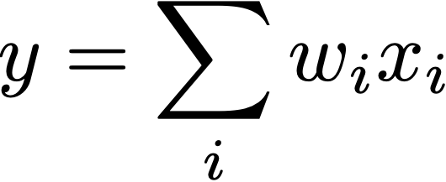
A new data structure: Tokens
A token is just transformer lingo for a vector of neurons (a.k.a. an embedding)
But the connotation is that a token is an encapsulated bundle of information; with transformers we will operate over tokens rather than over neurons
linear comb of neurons
Linear comb of tokens
Notes:
y = \sum_i w_i x_i
\mathbf{y} = \sum_i w_i \mathbf{X}_i

Slide 102
Convolution over tokens

Slide 103
Tokenizing the input data
When operating over neurons, we represent the input as an array of scalar-valued measurements (e.g., pixels)
When operating over tokens, we represent the input as an array of vector-valued measurements
tokens
…
…
wor2vec
Three guineafowl walking on ice plants.

Slide 104
Convolution over tokens
“Local MLP” == Conv
space/time

Slide 105
conv w/o overlap
conv w overlap
conv pyramid
fc layer
…
…
…
…
Notes:
So far we processed each token independently (left). There is no mixing. How to mix information across tokens? three strategies (right three columns)

Slide 106
Attention layer
…

Slide 107
Attention layer
…

Slide 108
Attention layer
…

Slide 109
Attention layer
conv
1
M
1
=
attention
sim
query
M
linear
key
N
M
M
M
N
N
M
N
N
=
N
N
=
N
linear
Z
K
Q
attention
k
q
v
z
[“Attention is All You Need”, Vaswani et al. 2017]
[“Vision Transformer”, Dosovitskiy et al. 2020]
Notes:
\mathbf{Z} = \texttt{softmax}(\frac{\mathbf{Q}\mathbf{K}^T}{d_k})\mathbf{V}
\mathbf{A} = \texttt{softmax}(\frac{\mathbf{Q}\mathbf{K}^T}{d_k})
\mathbf{A}^{\prime} = \mathbf{Q}\mathbf{K}^T
\mathbf{A} = \texttt{softmax}(\frac{\mathbf{A}^{\prime}}{d_k})
\mathbf{V} = \mathbf{w}_1^z \circ \mathbf{Z}
\mathbf{Q} = \mathbf{w}_1^q \circ \mathbf{Z}
\mathbf{K} = \mathbf{w}_1^k \circ \mathbf{Z}

Slide 110
Attention layer
…
1
M
1
=
sim
query
M
key
M
N
N
M
N
=
N
K
Q
k
q
v
N
M
M
N
N
=
N
Z
Notes:
\mathbf{Z} = \texttt{softmax}(\frac{\mathbf{Q}\mathbf{K}^T}{d_k})\mathbf{V}
\mathbf{A} = \texttt{softmax}(\frac{\mathbf{Q}\mathbf{K}^T}{d_k})
\mathbf{A}^{\prime} = \mathbf{Q}\mathbf{K}^T
\mathbf{A} = \texttt{softmax}(\frac{\mathbf{A}^{\prime}}{d_k})

Slide 111
Transformer (simplified)
…
conv
sum
…
attention
…
attention
k
q
v
conv
…
z
…
[“Attention is All You Need”, Vaswani et al. 2017]
[“Vision Transformer”, Dosovitskiy et al. 2020]

Slide 112
Attention maps in a trained transformer
[“DINO”, Caron et all. 2021]

