Slide 1
Lecture 19
Statistical Models of Images
April 12, 2022

Slide 2
The main points of this lecture
We need to make assumptions about the world in order to interpret it visually.
What are some of those assumptions?

Slide 3
The visual system seems to be tuned to a particular subset
of all possible images:
Demo inspired from D. Field

Slide 4
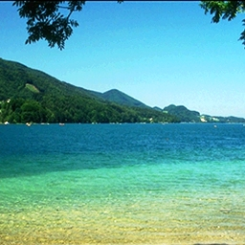
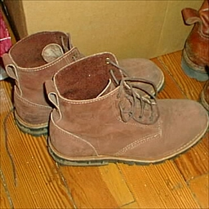
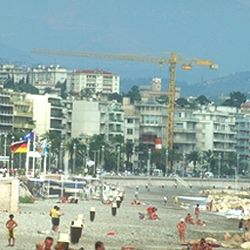
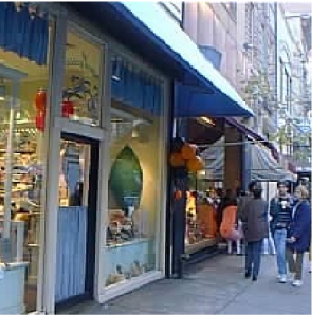
Remember each of these images

Slide 5
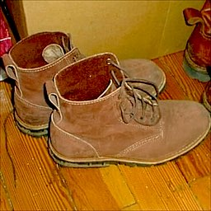
Was this one of them?

Slide 6
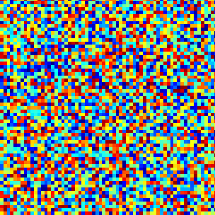
Remember each of these images
Test 2

Slide 7
Was this one of them?

Slide 8
The visual system is tuned to process structures typically found in the world.

Slide 9
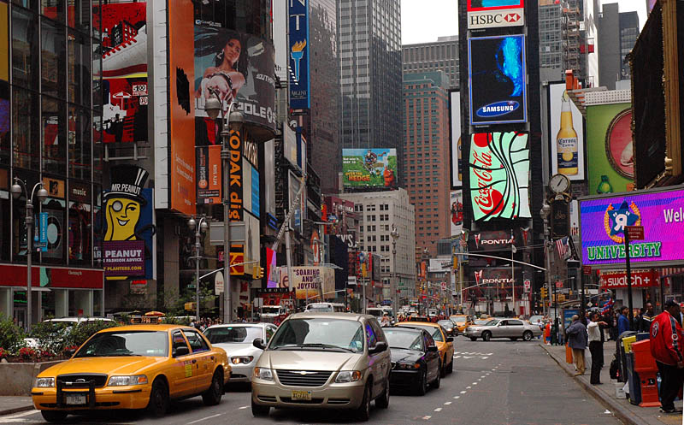
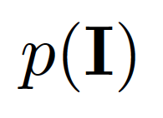
Statistical modeling of images

Slide 10
Visual Worlds

Slide 11
Visual Worlds

Slide 12
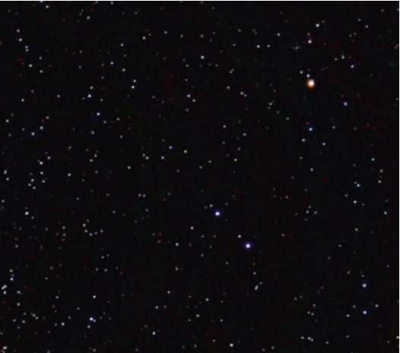
Visual Worlds

Slide 13
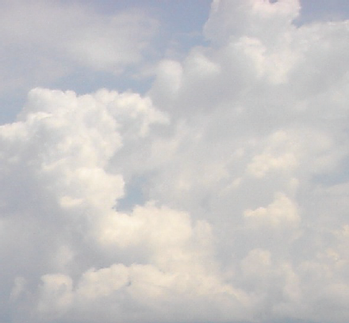
Visual Worlds

Slide 14
Visual Worlds

Slide 15
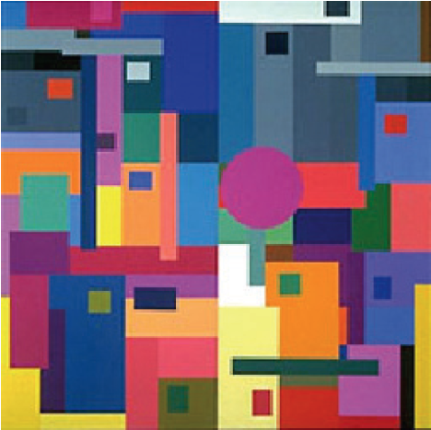
Visual Worlds

Slide 16
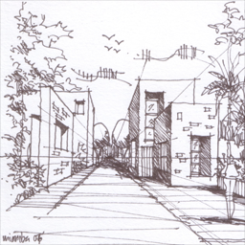
Visual Worlds

Slide 17
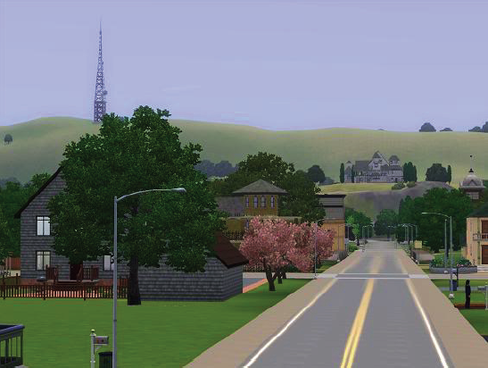
Visual Worlds

Slide 18
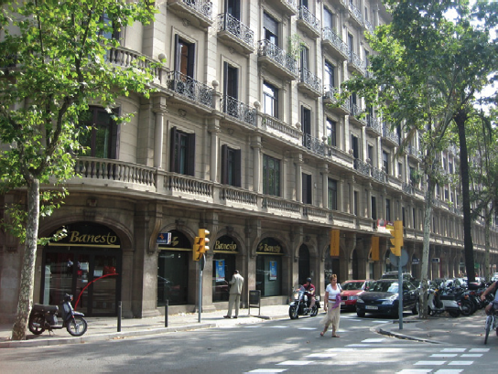
Visual Worlds

Slide 19
Statistical Image Models
Gaussian image model
image synthesis
Wiener filter denoising
Kurtotic wavelets model
image synthesis
Bayesian denoising
Non-parametric MRF model
image synthesis (Efros and Leung texture model)
Non-local means denoising

Slide 20
Statistical Image Models—Readings
Optional additions to the chapter notes.
Gaussian image model
image synthesis
Wiener filter denoising
Kurtotic wavelets model
image synthesis
Bayesian denoising
Non-parametric MRF model
image synthesis (Efros and Leung texture model)
Non-local means denoising
Simoncelli paper
https://pdfs.semanticscholar.org/ee55/814e8705f5e8cf664efb66c31c0ea6372d92.pdf
inspiration for Gatys et al image stylization
http://people.eecs.berkeley.edu/~efros/research/NPS/efros-iccv99.pdf
http://citeseerx.ist.psu.edu/viewdoc/download?doi=10.1.1.374.7899&rep=rep1&type=pdf

Slide 21
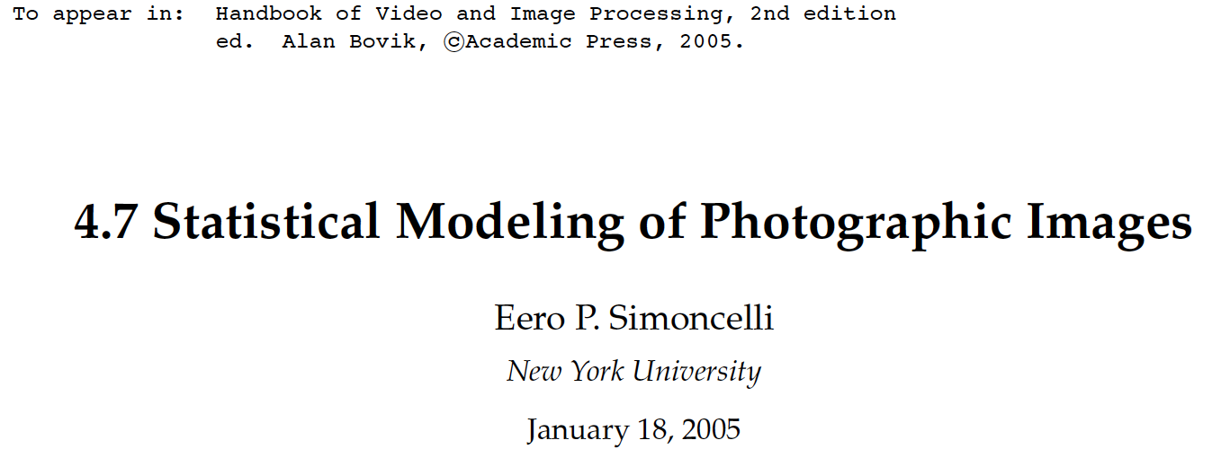
https://pdfs.semanticscholar.org/ee55/814e8705f5e8cf664efb66c31c0ea6372d92.pdf

Slide 22
Statistical Image Models
Gaussian image model
image synthesis
Wiener filter denoising
Kurtotic wavelets model
image synthesis
Bayesian denoising
Non-parametric MRF model
image synthesis (Efros and Leung texture model)
Non-local means denoising

Slide 23
Statistical modeling of images
The pixel

Slide 24
0th image model: independent pixels
Assumptions:
Independence: All pixels are independent.
Stationarity: The distribution of pixel intensities does not depend on image location.

Slide 25
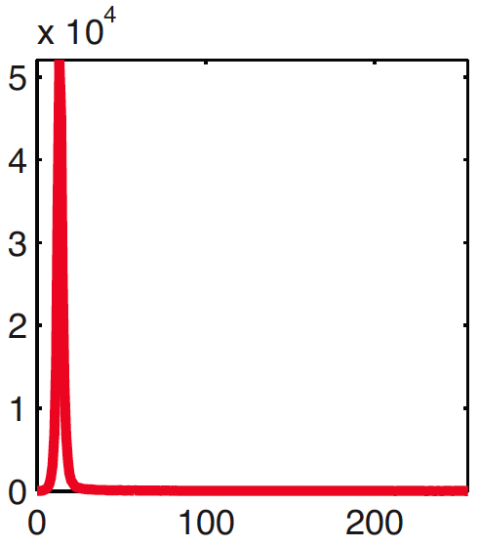
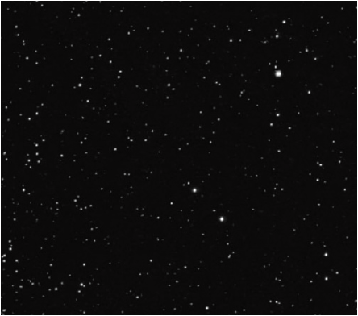
Fitting the model
Counts
Pixel intensity

Slide 26
Sampling new images
Sample

Slide 27
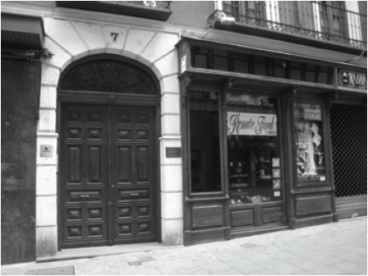
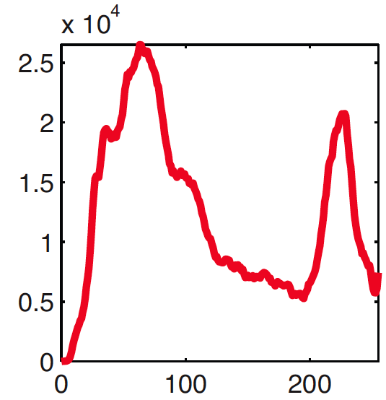
Sampling new images
Sample

Slide 28
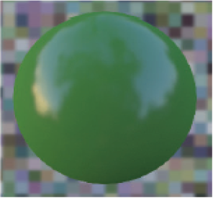
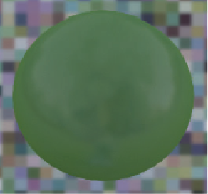
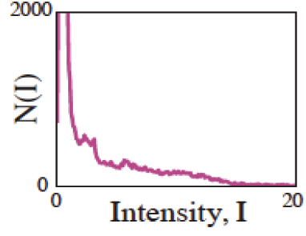
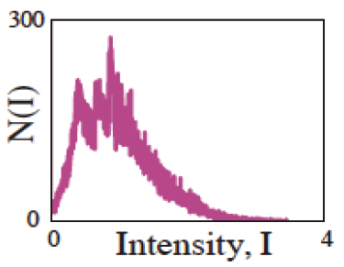
The importance of distribution of intensities

Slide 29
0th model
The pixel

Slide 30
First model: include pixel correlations
The pixel
Another pixel
E

Slide 31
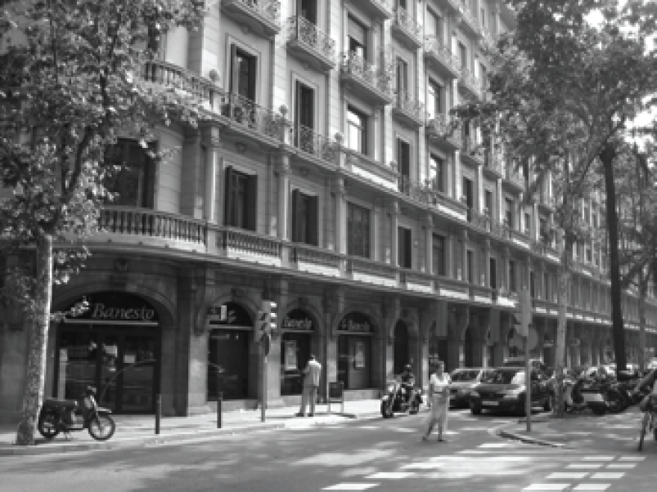
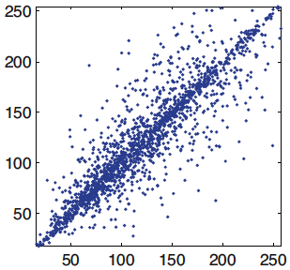
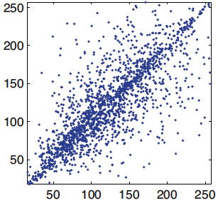
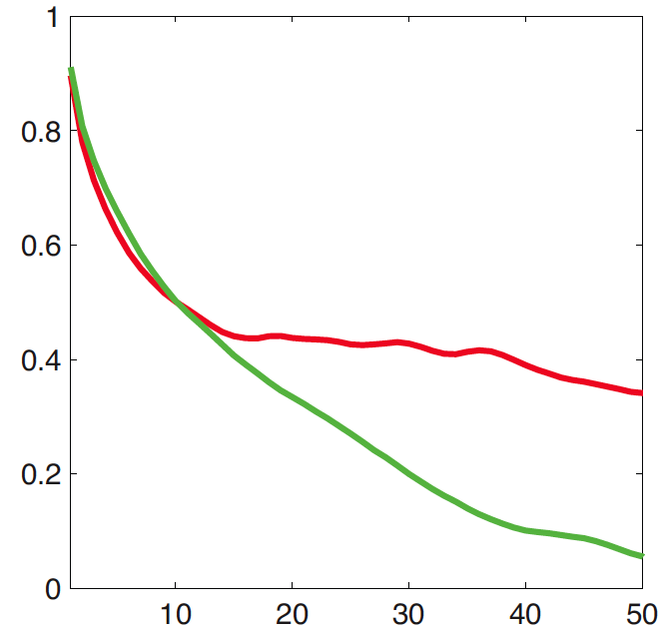
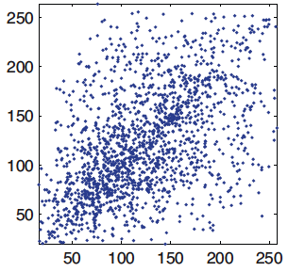
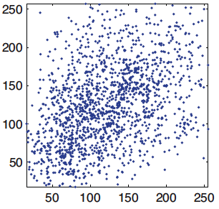
E
D = 1
D = 2
D = 10
D = 40
horizontal
vertical
D

Slide 32
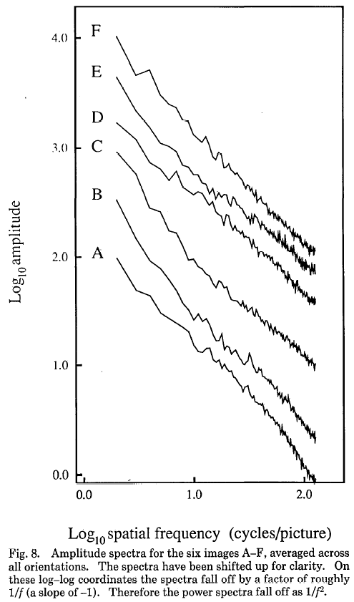
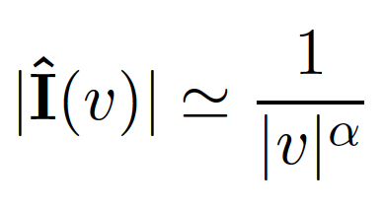
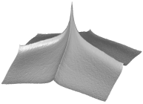
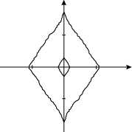
A remarkable property of natural images
By the Wiener-Khinchin theorem, the Fourier transform of the auto-correlation function of the image is the power spectrum of the image, so…
Amplitude spectrum
fall off as
Spectra
Low spatial frequencies
1/vª
$$α≈1$$
High
spatial
frequencies
Vertical
v_{y}
Horizontal
v_{x}
High SF
Low SF
D. J. Field, "Relations between the statistics of natural images and
the response properties of cortical cells," J. Opt. Soc. Am. A 4, 2379- (1987)

Slide 33
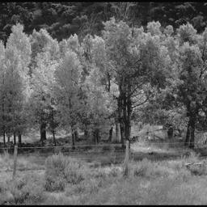
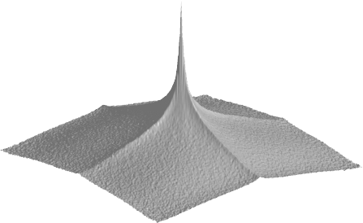
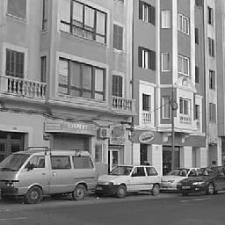
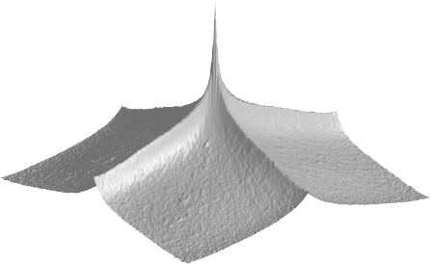
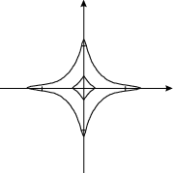
A remarkable property of natural images
v_{y}
Spectra
v_{y}
v_{x}
v_{x}
Field (87)
Natural scenes
(6000 images)
1/fª
v_{y}
v_{x}
v_{y}
v_{y}
v_{x}
v_{x}
Man-made scenes
(6000 images)
Torralba and Oliva, Statistics of Natural Image Categories. Network: Computation in Neural Systems 14 (2003) 391-412.
Notes:
Each scene category is made with different building blocks. Different scene categories show different spectral signatures.

Slide 34
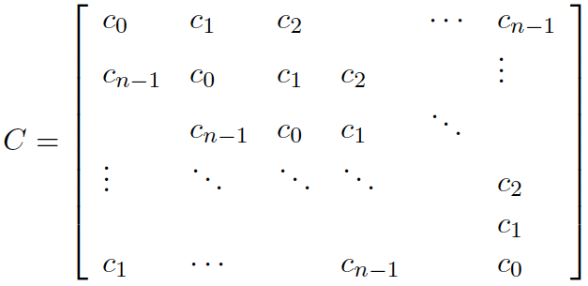
Gaussian image model:
specifies the power spectrum of the image
We want a distribution that captures the correlation structure typical of natural images.
Let C be the covariance matrix of the image:
Stationarity assumption: Symmetrical circulant matrix
Diagonalization of circulant matrices: C = EDE^{T}
The eigenvectors are the Fourier basis
The eigenvalues are the squared magnitude of the Fourier coefficients
 |  |  | …
D=
2
2

Slide 35
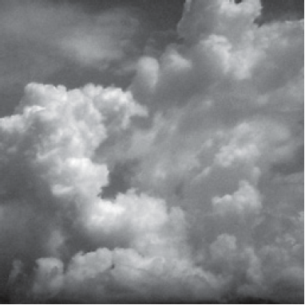
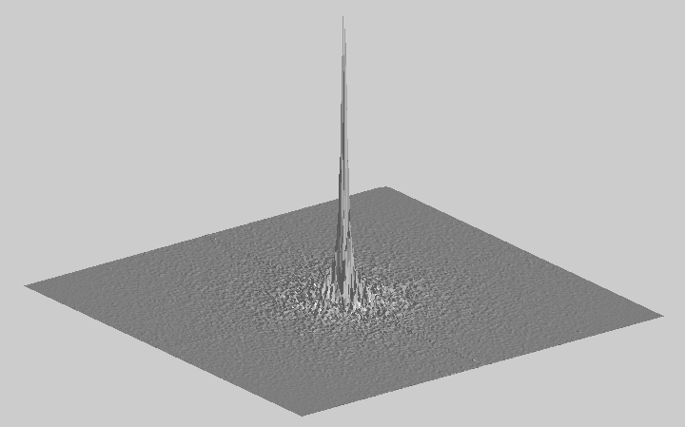
Sampling new images
Sample

Slide 36
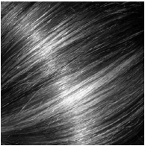
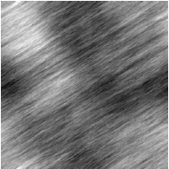
Sampling new images

Slide 37
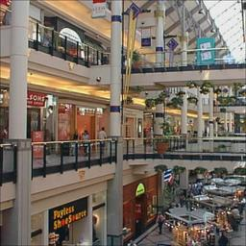
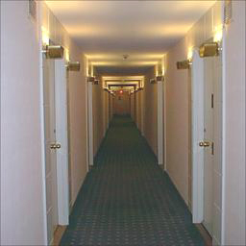
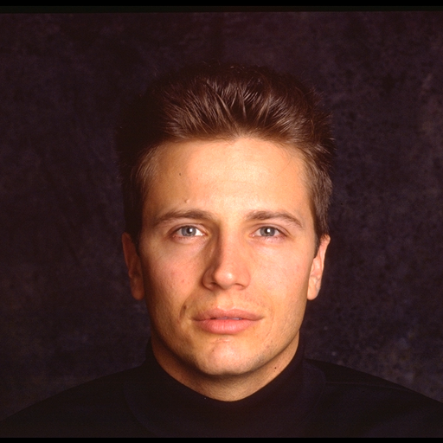
Randomizing the phase (if you fit the Gaussian image model to each of the images in the top row, then draw another random sample, you get the bottom row)

Slide 38
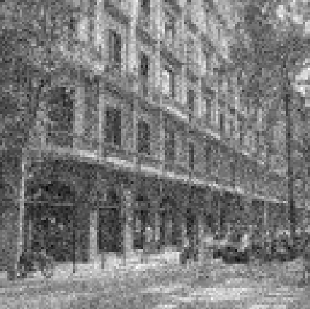
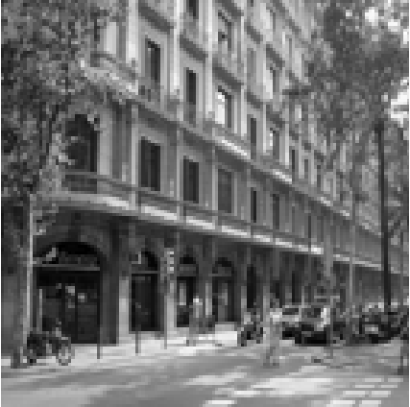
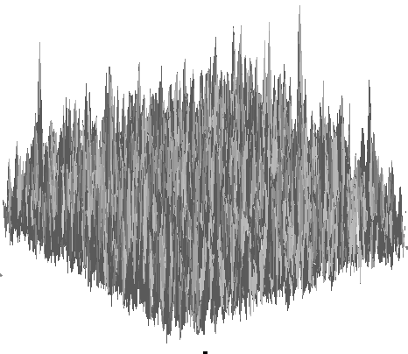
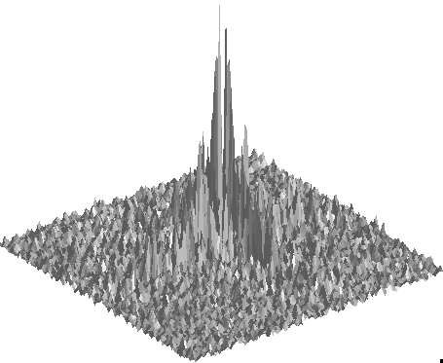
Image model application: Denoising
Decomposition of a noisy image
=
+

Slide 39
Denoising
Decomposition of a noisy image
=
+
White Gaussian noise:
N(0, σ_{n}²)
Natural image
Find I(x,y) that maximizes the posterior (maximum a posteriori, MAP):
x
likelihood
prior

Slide 40
Denoising
Decomposition of a noisy image
=
+
White Gaussian noise:
N(0, σ_{n}²)
Natural image
Find I(x,y) that maximizes the posterior (maximum a posteriori, MAP):
x
likelihood
prior
x

Slide 41
Denoising
x
likelihood
prior
x
The solution is:
(note this is a linear operation)
This can also be written in the Fourier domain, with C = EDE^{T}:

Slide 42
Decomposition of a noisy image
=
+

Slide 44
x
=

Slide 47
x
=

Slide 48
The true decomposition:
=
+
The estimated decomposition:
=
+

Slide 49
And we got all this from just modeling the correlation between pairs of pixels!

Slide 50
Dead leaves models
Introduced in the 60’s by Matheron (67) and popularized by Ruderman (97)
From Lee, Mumford and Huang 2001

Slide 51
Observation: Sparse filter response

Slide 52
Statistical modeling of images
A small neighborhood

Slide 53
[-1 1]

Slide 54
Edges

Slide 55
[-1 1]
[-1, 1]
=
h[m,n]
f[m,n]
g[m,n]

Slide 56
[-1 1]^{T}
[-1, 1]^{T}
=
h[m,n]
f[m,n]
g[m,n]

Slide 57
Statistical Image Models
Gaussian image model
image synthesis
Wiener filter denoising
Kurtotic wavelets model
image synthesis
Bayesian denoising
Non-parametric MRF model
image synthesis (Efros and Leung texture model)
Non-local means denoising
Extensions:
Instead of using basis functions with global support (Fourier basis functions), we’ll use localized filters.
Instead of looking at average power values of the basis functions, we’ll examine the full marginal distribution (the histogram of their responses), generalizing to non-Gaussian distributions.

Slide 58
Observation: Sparse filter response
Counts
Counts
Counts
Pixel intensity
Pixel intensity
Pixel intensity

Slide 59
Image
Intensity histogram
[1 -1] filter output
[1 -1] output histogram
Red – true pdf
Black – best Gaussian fit

Slide 60
A model for the distribution of filter outputs
Red – true pdf
Black – best Gaussian fit
exp(-x²/2σ²)
p(x) =
2πσ²
exp(-|x/s|^{r})
p(x) =
2s/rΓ(1/r)
r ~ 0.8 (< 2)

Slide 61
A model for the distribution of filter outputs
Red – true pdf
Black – best Gaussian fit
exp(-x²/2σ²)
p(x) =
2πσ²
exp(-|x/s|^{r})
p(x) =
2s/rΓ(1/r)
r ~ 0.8 (< 2)
Note: this is not a good model for ALL filter outputs

Slide 62
Generalized Gaussian
exp(-|x/s|^{r})
p(x) =
2s/rΓ(1/r)
r = 1
r = 2
r = 0.5
Laplacian distribution
Gaussian distribution
r = 10
Uniform distribution
r -> infinite

Slide 63
The wavelet marginal model
A small neighborhood
p(h_{k}(x,y))
k
All pixels and all outputs are independent
Filter outputs

Slide 64
The wavelet marginal model
[1 -1]
[1 -1]^{T}
p(h_{k}(x,y))
k

Slide 65
What is the most probable image under the wavelet marginal model?
[1 -1]
p(h_{k}(x,y))
k
[1 -1]^{T}
exp(-|x/s|^{r})
p(x) =
2s/rΓ(1/r)

Slide 66
Sampling images
Gaussian model
Wavelet marginal model

Slide 67
1D example
a?
I = [1, 1, 1, a, 0, 0, 0]
Let’s start by defining a prior model:
The output to the filter [-1,1] produces independent values each following the distribution:
exp(-|x/s|^{r})
p(x) =
2s/rΓ(1/r)

Slide 68
1D example
a?
I = [1, 1, 1, a, 0, 0, 0]
1. First, let’s compute the [-1,1] filter output:
h = I [-1,1] = [0, 0, 0, 1-a, a, 0, 0]
*
2. Let’s write the probability of the output as a function of a
p(h(x))=
=
x
exp(-|x/s|^{r})
=
p(x) =
2s/rΓ(1/r)

Slide 69
What is the preferred value of a as we change r?
a?
I = [1, 1, 1, a, 0, 0, 0]
exp(-|x/s|^{r})
p(x) =
2s/rΓ(1/r)
r = 1
r = 2
r = 10
r = 0.5
Laplacian distribution
Gaussian distribution

Slide 70
1D example
For different values of r we get different maximum

Slide 71
r=2
Gaussian model
a=0.5
I = [1, 1, 1, 0.5, 0, 0, 0]
r=0.8
~ Natural image model
a=0 or 1
I = [1, 1, 1, 0, 0, 0, 0]
I = [1, 1, 1, 1, 0, 0, 0]

Slide 72
Steerable Pyramid
Reminder
Decomposition
Reconstruction
…
…
Images from: http://www.cis.upenn.edu/~eero/steerpyr.html

Slide 73
Steerable Pyramid
Reminder
Decomposition
Reconstruction
p(h_{k}(x,y))
k

Slide 74
Reminder from lecture 8:
https://www.cns.nyu.edu/heegerlab/content/publications/Heeger-siggraph95.pdf
SIGGRAPH 1995

Slide 75
Texture analysis
Wavelet decomposition (steerable pyr)
Input texture
(sub-band histogram)
(Steerable pyr; Simoncelli & Freeman, ’95)

Slide 76
Texture synthesis
Heeger and Bergen, 1995
(histogram)
Random noise
Force each subband of the input random noise to have the histogram of the corresponding subband from the input texture

Slide 77
Iterate the histogram matching over the subbands and input images
Original
Synthesized

Slide 78
Overview of the algorithm: force the marginal statistics of each image subband to have the distribution of a target texture image.
Reminder
Two main tools:
1- steerable pyramid
2- matching histograms

Slide 79
Examples from the paper
Heeger and Bergen, 1995
This texture synthesis work was the inspiration for the Gatys et al approach to force neural network co-occurence statistics to agree with those of a target style image in order to stylize an image.

Slide 80
Olshausen BA, and Field DJ. (1996). "Emergence of Simple-Cell Receptive Field Properties by Learning a Sparse Code for Natural Images." Nature, 381: 607-609.

Slide 81
Learned with a convNet
1st layer
Krizhevsky, A., Sutskever, I. and Hinton, G. E.
ImageNet Classification with Deep Convolutional Neural Networks
NIPS 2012: Neural Information Processing Systems
http://papers.nips.cc/paper/4824-imagenet-classification-with-deep-convolutional-neural-networks

Slide 82
Denoising
+
+
*
convolution
White
Gaussian
noise
=
=
=
Noisy
image

Slide 83
Denoising with the marginal wavelet model
Let y = noise-corrupted observation: y = x+n, with n ~ gaussian.
Let x = bandpassed image value before adding noise.
By Bayes theorem
P(x)
y = 25
P(x|y) ~ P(y|x) P(x)
y
P(y|x)
P(x|y)

Slide 84
Denoising with the marginal wavelet model
Let x = bandpassed image value before adding noise.
Let y = noise-corrupted observation.
By Bayes theorem
y = 50
P(x|y) ~ P(y|x) P(x)
y
P(y|x)
P(x|y)

Slide 85
Denoising with the marginal wavelet model
Let x = bandpassed image value before adding noise.
Let y = noise-corrupted observation.
By Bayes theorem
y = 115
P(x|y) ~ P(y|x) P(x)
y
P(y|x)
P(x|y)

Slide 86
Denoising with the marginal wavelet model
y = 25
y = 115
P(x)
y
P(x)
P(y|x)
P(y|x)
P(x|y)
y
P(x|y)
For small y: probably it is due to noise and y should be set to 0
For large y: probably it is due to an image edge and it should be kept untouched

Slide 87
MAP estimate, , as function of observed coefficient value, y
Simoncelli and Adelson, Noise Removal via Bayesian Wavelet Coring
http://www-bcs.mit.edu/people/adelson/pub_pdfs/simoncelli_noise.pdf

Slide 88
Bayesian estimate for wavelet coefficient value, for different assumed wavelet marginal distribution values of r
optimal denoising function for wavelet coefficients
r = 0.5
r = 1
r = 2
Laplacian distribution
Gaussian distribution
assumed wavelet marginal distribution

Slide 89
With Gaussian noise of std. dev. 21.4 added, giving PSNR=22.06 dB
(1) Denoised with Gaussian model, PSNR=27.87 dB
original
(2) Denoised with wavelet marginal model, PSNR=29.24 dB
http://www.cns.nyu.edu/pub/eero/simoncelli05a-preprint.pdf

Slide 90
Gaussian scale mixtures
Note correlations between the amplitudes of each wavelet subband.
http://www.cns.nyu.edu/pub/eero/simoncelli05a-preprint.pdf

Slide 91
Statistics of pairs of wavelet coefficients
Contour plots of the joint histogram of various wavelet coefficient pairs
Conditional distributions of the corresponding wavelet pairs
http://www.cns.nyu.edu/pub/eero/simoncelli05a-preprint.pdf

Slide 92
Gaussian scale mixtures
Gaussian scale mixture model simulation
observed
Wavelet coefficient probability
A mixture of Gaussians of scaled covariances
z is a spatially varying hidden variable that can be used to
(a) Create the non-gaussian histograms from a mixture of Gaussian densities, and (b) model correlations between the neighboring wavelet coefficients.

Slide 93
With Gaussian noise of std. dev. 21.4 added, giving PSNR=22.06
(1) Denoised with Gaussian model, PSNR=27.87
original
(3) Denoised with Gaussian scale mixture model, PSNR=30.86
(2) Denoised with wavelet marginal model, PSNR=29.24
http://www.cns.nyu.edu/pub/eero/simoncelli05a-preprint.pdf

Slide 95
Applications
Detecting fake images
Camera shake removal

Slide 96
Visual Worlds
Prof. Hany Farid,
Dartmouth University

Slide 97
Statistical Image Models
Gaussian image model
image synthesis
Wiener filter denoising
Kurtotic wavelets model
image synthesis
Bayesian denoising
Non-parametric MRF model
image synthesis (Efros and Leung texture model)
Non-local means denoising
Instead of a sum of basis function samples taken independently, we’ll generate the image bit by bit, modeling the image as a set of conditional sample draws.

Slide 98
Image model: each image has a large set of “production rules”
If the local image values satisfy the conditions of one of the production rules, then you output a particular pixel value.

Slide 99
Efros & Leung Algorithm
non-parametric
sampling
p
Input image
Synthesizing a pixel
Assuming Markov property, compute P(p|N(p))
Building explicit probability tables is infeasible
Instead, we search the input image for all similar neighborhoods — that’s our pdf for p
To sample from this pdf, just pick one match at random

Slide 101
Effect of Neighborhood Window Size on Texture Generation
input
input

Slide 102
Varying Window Size
Increasing window size

Slide 103
Synthesis Results
french canvas
rafia weave

Slide 104
More Results
white bread
brick wall

Slide 105
Homage to Shannon

Slide 106
Hole Filling

Slide 107
Extrapolation

Slide 108
What denoising algorithm would result from this non-parametric model for image generation?

Slide 109
A denoising algorithm which implicitly assumes this non-parametric model for image generation

Slide 110
Non-local means

Slide 111
Non-local means
Noisy original
Wiener filter output
Total variation output
Non-local means output

Slide 112
Statistical Image Models
Gaussian image model
image synthesis
Wiener filter denoising
Kurtotic wavelets model
image synthesis
Bayesian denoising
Non-parametric MRF model
image synthesis (Efros and Leung texture model)
Non-local means denoising
subband statistics (or statistics of any linear combination of pixels)
subband statistics
production rules

Slide 113
if there’s time…

Slide 114
Image Quilting [Efros & Freeman]
non-parametric
sampling
p
B
Input image
Synthesizing a block
Observation: neighbor pixels are highly correlated
Idea: unit of synthesis = block
Exactly the same but now we want P(B|N(B))
Much faster: synthesize all pixels in a block at once
Not the same as multi-scale!

Slide 115
block
Input texture
B1
B2
B1
B2
B1
B2
Random placement
of blocks
Neighboring blocks
constrained by overlap
Minimal error
boundary cut

Slide 116
Minimal error boundary
overlapping blocks
vertical boundary
2
_
=
overlap error
min. error boundary

Slide 117
Texture Transfer
Take the texture from one object and “paint” it onto another object
This requires separating texture and shape
That’s HARD, but we can cheat
Assume we can capture shape by boundary and rough shading
Then, just add another constraint when sampling: similarity to underlying image at that spot

Slide 118
parmesan
+
=
rice
+
=

Slide 119
+
=

Slide 120
+
=

Slide 121
Source
texture
Target image
Source
correspondence
image
Target
correspondence image

Slide 122
+
=

