Slide 1
Lecture 19
Graphical Models and Belief Propagation
April 19, 2022
Only the first 10 slides will be presented in class; the rest are just included for reference. Most of the class will be on the blackboard.

Slide 4
Identical local evidence...

Slide 5
…different interpretations

Slide 6
Information must propagate over the image.
Local information...
...must propagate
Probabilistic graphical models are a powerful tool for propagating
information within an image. And these tools are used everywhere within computer vision now.

Slide 7
From a random sample of 6 papers from CVPR 2014, half had figures that look like this...
http://www.cvpapers.com/cvpr2014.html

Slide 8
Partial Optimality by Pruning for MAP-inference with General Graphical Models, Swoboda et al
http://hci.iwr.uni-heidelberg.de/Staff/bsavchyn/papers/swoboda-GraphicalModelsPersistency-with-Supplement-cvpr2014.pdf

Slide 9
Active flattening of curved document images via two structured beams, Meng et al.
file:///Users/billf/Downloads/dewarp_high.pdf

Slide 10
A Mixture of Manhattan Frames: Beyond the Manhattan World, Straub et al
http://www.jstraub.de/download/straub2014mmf.pdf

Slide 11
Undirected graphical models
A set of nodes joined by undirected edges.
The graph makes conditional independencies explicit: If two nodes are not linked, and we condition on every other node in the graph, then those two nodes are conditionally independent.
Conditionally independent, because are not connected by a line in the undirected graphical model

Slide 12
Undirected graphical models: cliques
Clique: a fully connected set of nodes
A maximal clique is a clique that can’t include more nodes of the graph w/o losing the clique property.
not a clique
clique
Non-maximal clique
Maximal clique

Slide 13
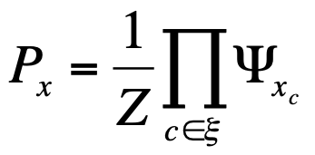
Undirected graphical models: probability factorization
Hammersley-Clifford theorem addresses the pdf factorization implied by a graph: A distribution has the Markov structure implied by an undirected graph iff it can be represented in the factored form
Potential functions of states of variables in maximal clique
Normalizing constant
set of maximal cliques

Slide 14
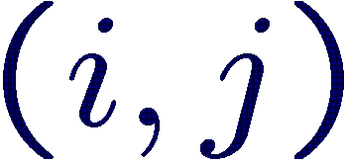
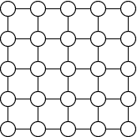
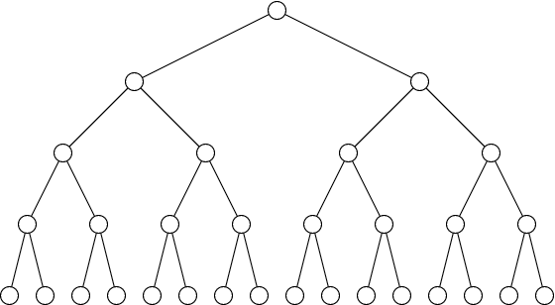
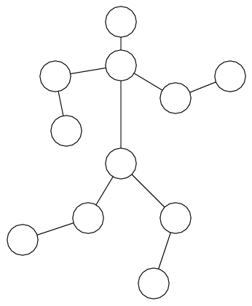
Graphical Models
Markov Random Fields
set of nodes
edges connecting nodes
Nodes are associated with hidden variables
Potential functions may depend on observations

Slide 15
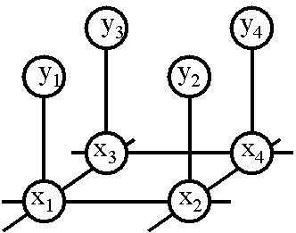
Markov Random Fields (MRF)
Oftentimes MRF’s have a regular, grid-like structure (but they don’t need to).

Slide 16
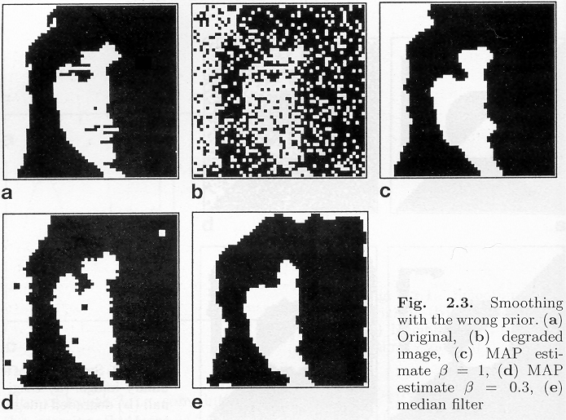
MRF nodes as pixels
Winkler, 1995, p. 32

Slide 17
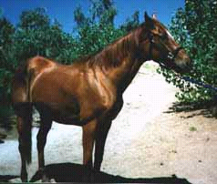
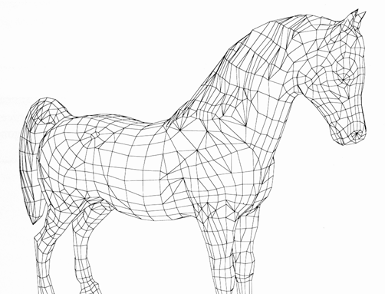
MRF nodes as patches
image patches
scene patches
image
Φ(x_{i}, y_{i})
Ψ(x_{i}, x_{j})
scene

Slide 18
Network joint probability
1
Õ
Õ
P
(
x
,
y
)
=
Y
(
x
,
x
)
F
(
x
,
y
)
Z
i
j
i
i
i
,
j
i
scene
Scene-scene
compatibility
function
Image-scene
compatibility
function
image
neighboring
scene nodes
local
observations

Slide 19
Energy formulation
E
scene
Scene-scene
compatibility
function
Image-scene
compatibility
function
image
neighboring
scene nodes
local
observations

Slide 20
In order to use MRFs:
Given observations y, and the parameters of the MRF, how infer the hidden variables, x?
How learn the parameters of the MRF?
22

Slide 21
Markov Random Fields (MRF’s)
Inference in MRF’s.
Gibbs sampling, simulated annealing
Iterated conditional modes (ICM)
Belief propagation
Application example—super-resolution
Graph cuts
Variational methods
Learning MRF parameters.
Iterative proportional fitting (IPF)
23

Slide 22
Outline of MRF section
Inference in MRF’s.
Gibbs sampling, simulated annealing
Iterated conditional modes (ICM)
Belief propagation
Application example—super-resolution
Graph cuts
Variational methods
Learning MRF parameters.
Iterative proportional fitting (IPF)
24

Slide 23
Gibbs Sampling
Gibbs sampling:
A way to generate random samples from a (potentially very complicated) probability distribution.
Fix all dimensions except one. Draw from the resulting 1-d conditional distribution. Repeat for all dimensions, and repeat many times.
Take an average of a subset of those samples to estimate the posterior mean. (Wait for a “burn in” period before including samples. And then subsample Gibbs sampler outputs to find independent draws of the joint probability).
Reference: Geman and Geman, IEEE PAMI 1984.

Slide 24
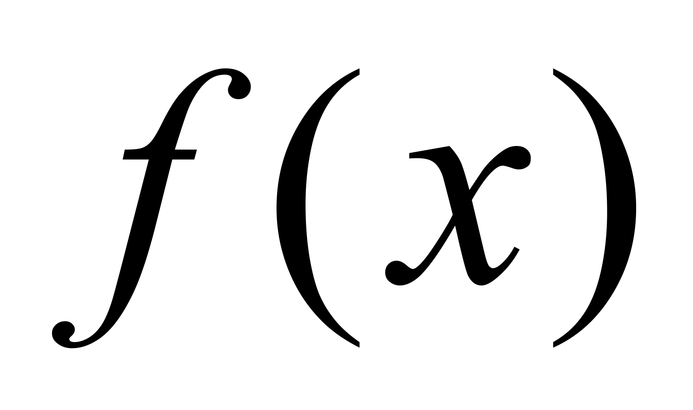
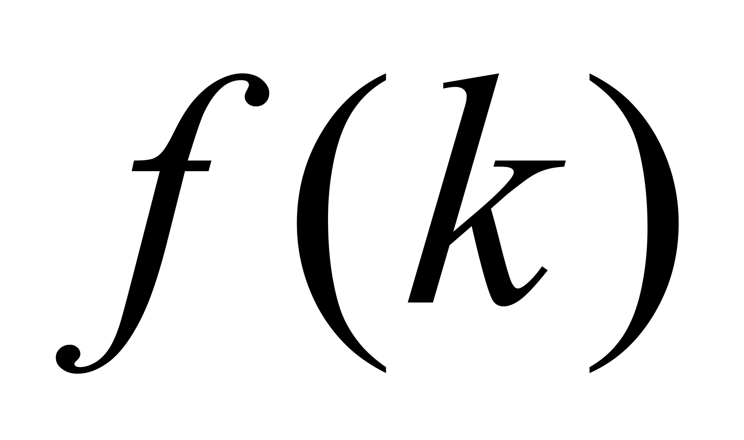
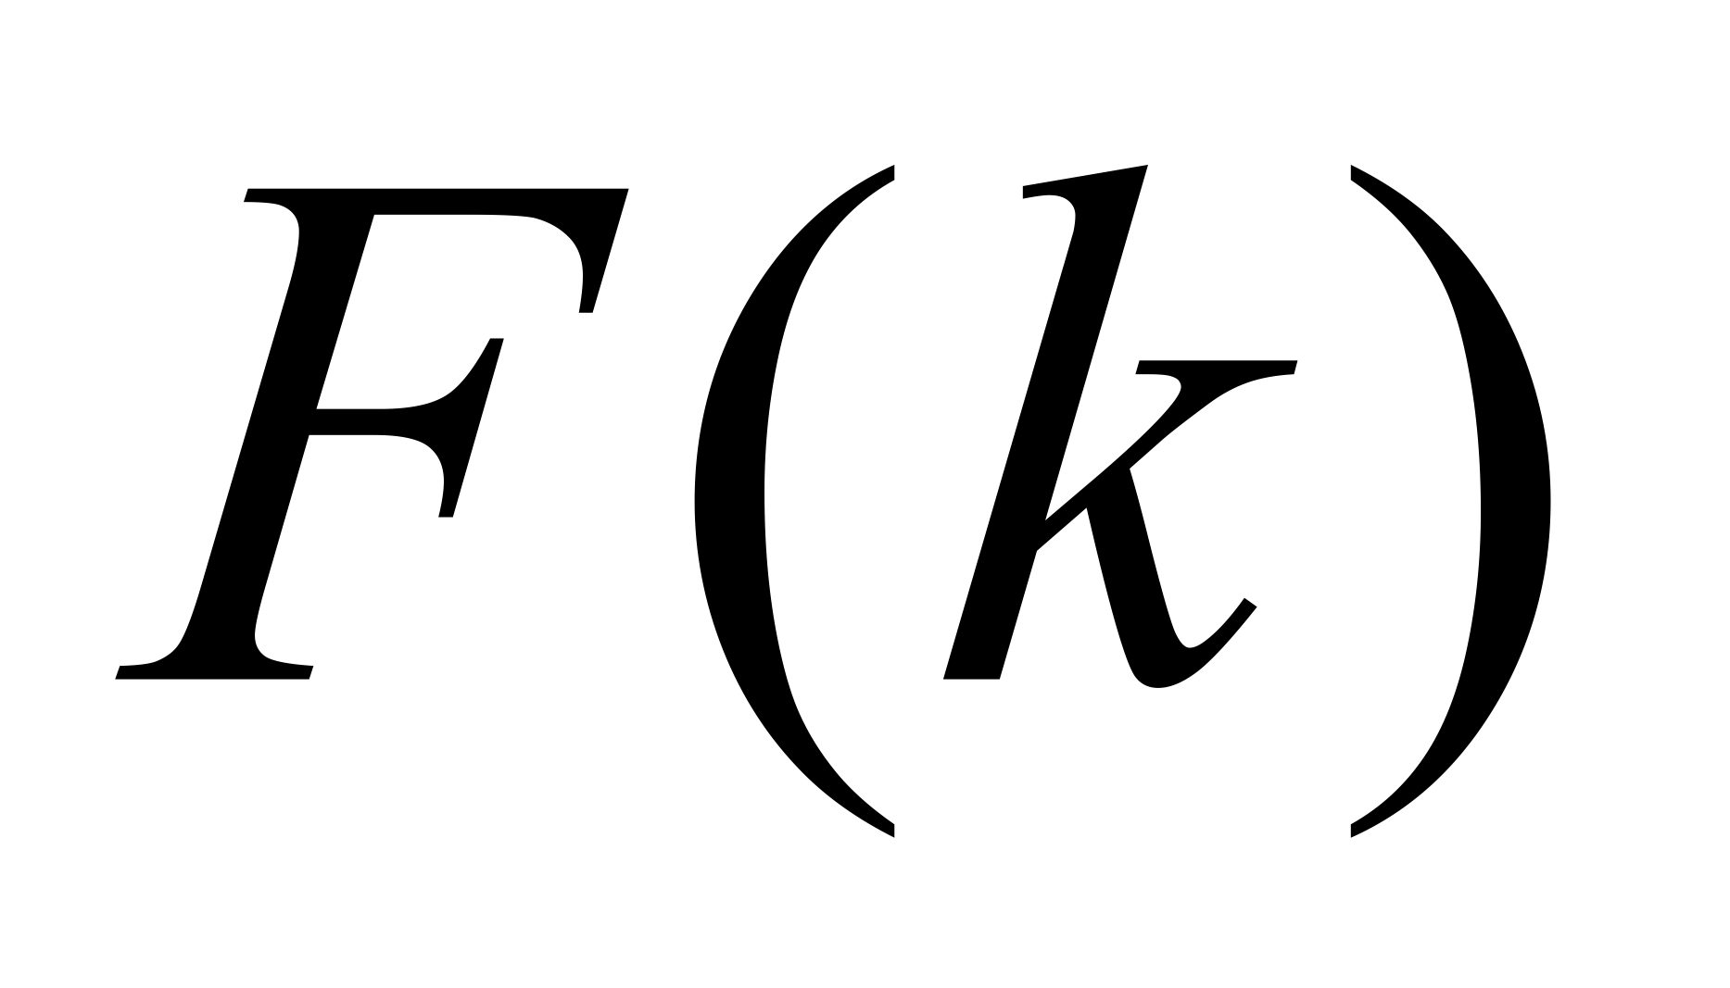
Sampling from a 1-d function
Discretize the density function
2. Compute distribution function from density function
3. Sampling
draw α ~ U(0,1);
for k = 1 to n
if
break;
;
26

Slide 25
Gibbs Sampling
x₂
x₁
Slide by Ce Liu

Slide 26
Gibbs Sampling and Simulated Annealing
Gibbs sampling:
A way to generate random samples from a (potentially very complicated) probability distribution.
Fix all dimensions except one. Draw from the resulting 1-d conditional distribution. Repeat for all dimensions, and repeat many times
Simulated annealing:
A schedule for modifying the probability distribution so that, at “zero temperature”, you draw samples only from the MAP solution.
Reference: Geman and Geman, IEEE PAMI 1984.

Slide 27
Gibbs sampling and simulated annealing
Simulated annealing as you gradually lower the “temperature” of the probability distribution ultimately giving zero probability to all but the MAP estimate.
What’s good about it: finds global MAP solution.
What’s bad about it: takes forever. Gibbs sampling is in the inner loop…

Slide 28
Gibbs sampling and simulated annealing
So you can find the mean value (MMSE estimate) of a variable by doing Gibbs sampling and averaging over the values that come out of your sampler.
You can find the MAP estimate of a variable by doing Gibbs sampling and gradually lowering the temperature parameter to zero.

Slide 29
Outline of MRF section
Inference in MRF’s.
Gibbs sampling, simulated annealing
Iterated conditional modes (ICM)
Belief propagation
Application example—super-resolution
Graph cuts
Application example--stereo
Variational methods
Application example—blind deconvolution
Learning MRF parameters.
Iterative proportional fitting (IPF)

Slide 30
Iterated conditional modes
For each node:
Condition on all the neighbors
Find the mode
Repeat.
Compare with Gibbs sampling…
Very small region over which it’s a local maximum
Described in: Winkler, 1995. Introduced by Besag in 1986.

Slide 31
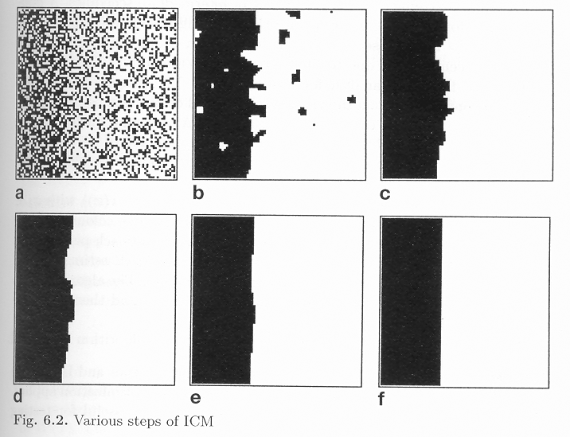
Winkler, 1995

Slide 32
Outline of MRF section
Inference in MRF’s.
Gibbs sampling, simulated annealing
Iterated conditional modes (ICM)
Loopy belief propagation
Application example—super-resolution
Graph cuts
Variational methods
Learning MRF parameters.
Iterative proportional fitting (IPF)

Slide 33
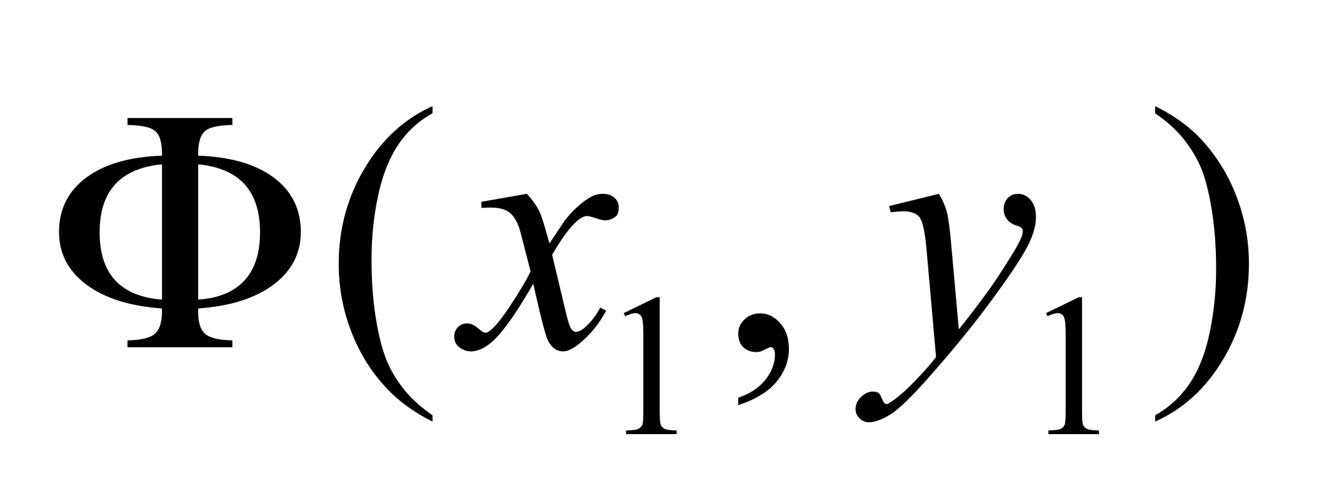
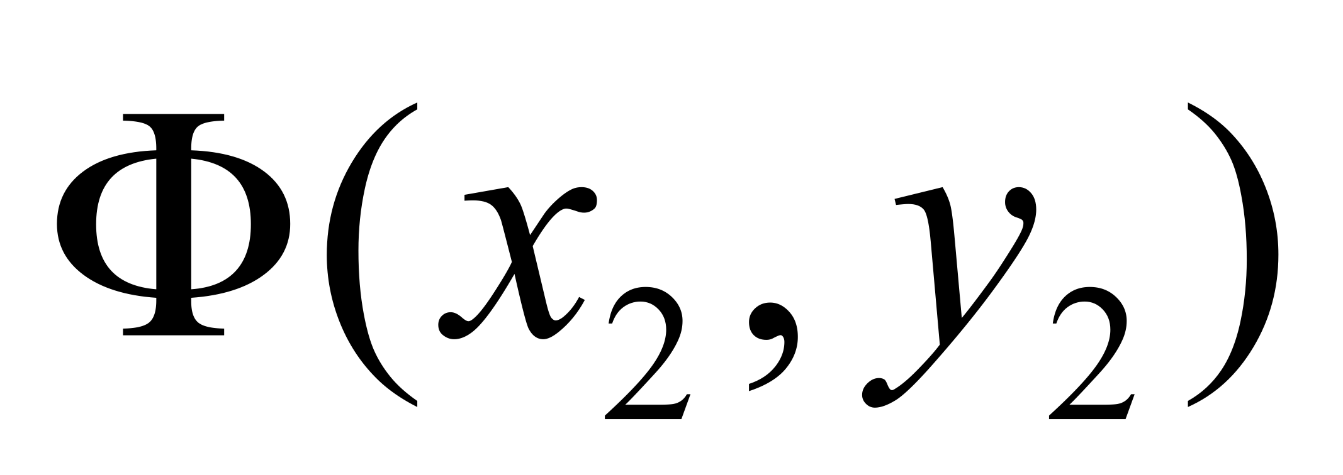
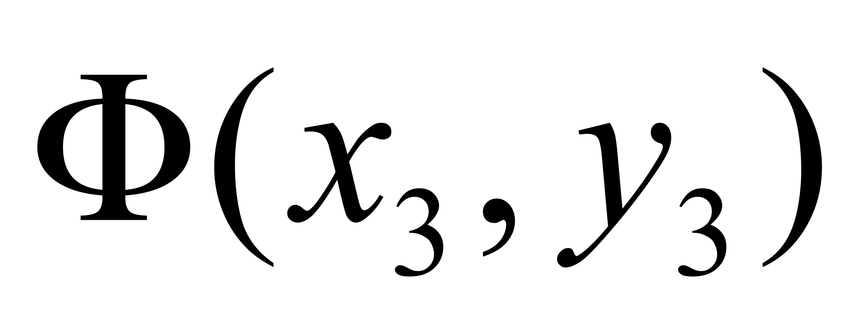
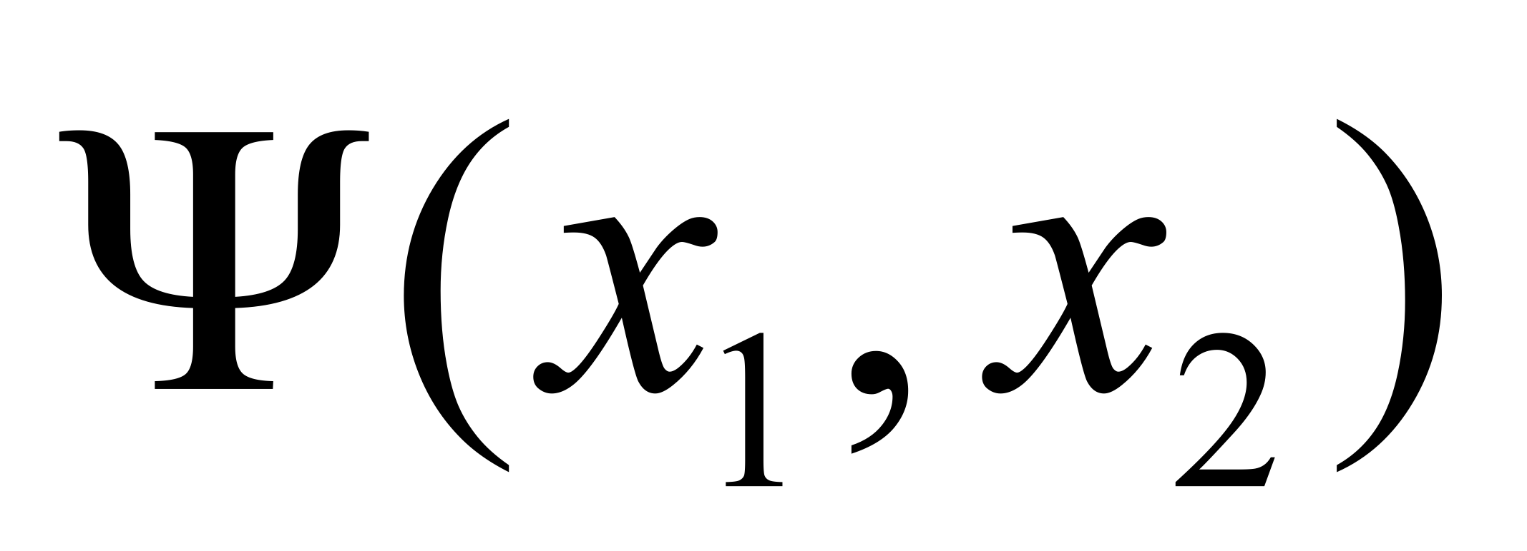
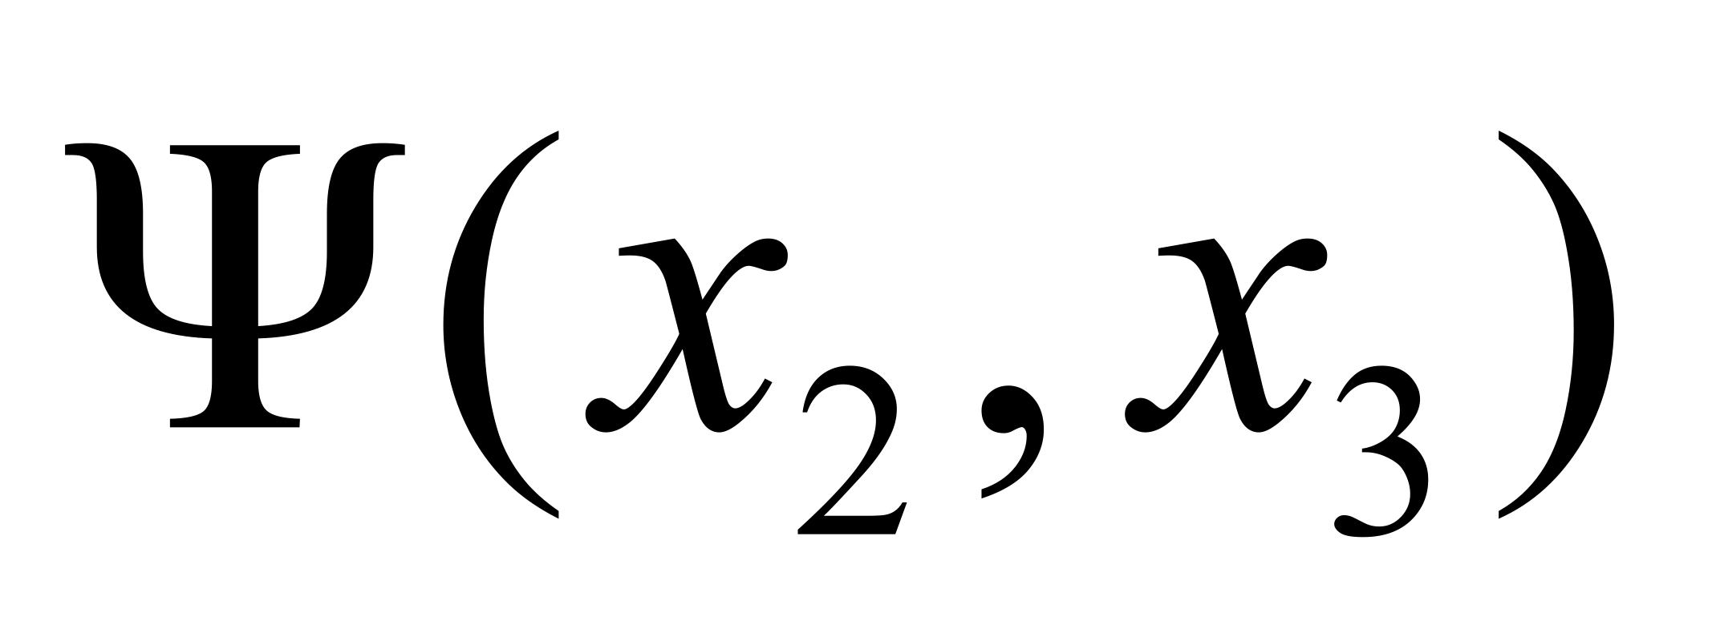
Derivation of belief propagation
y₁
y₂
y₃
x₁
x₂
x₃

Slide 34
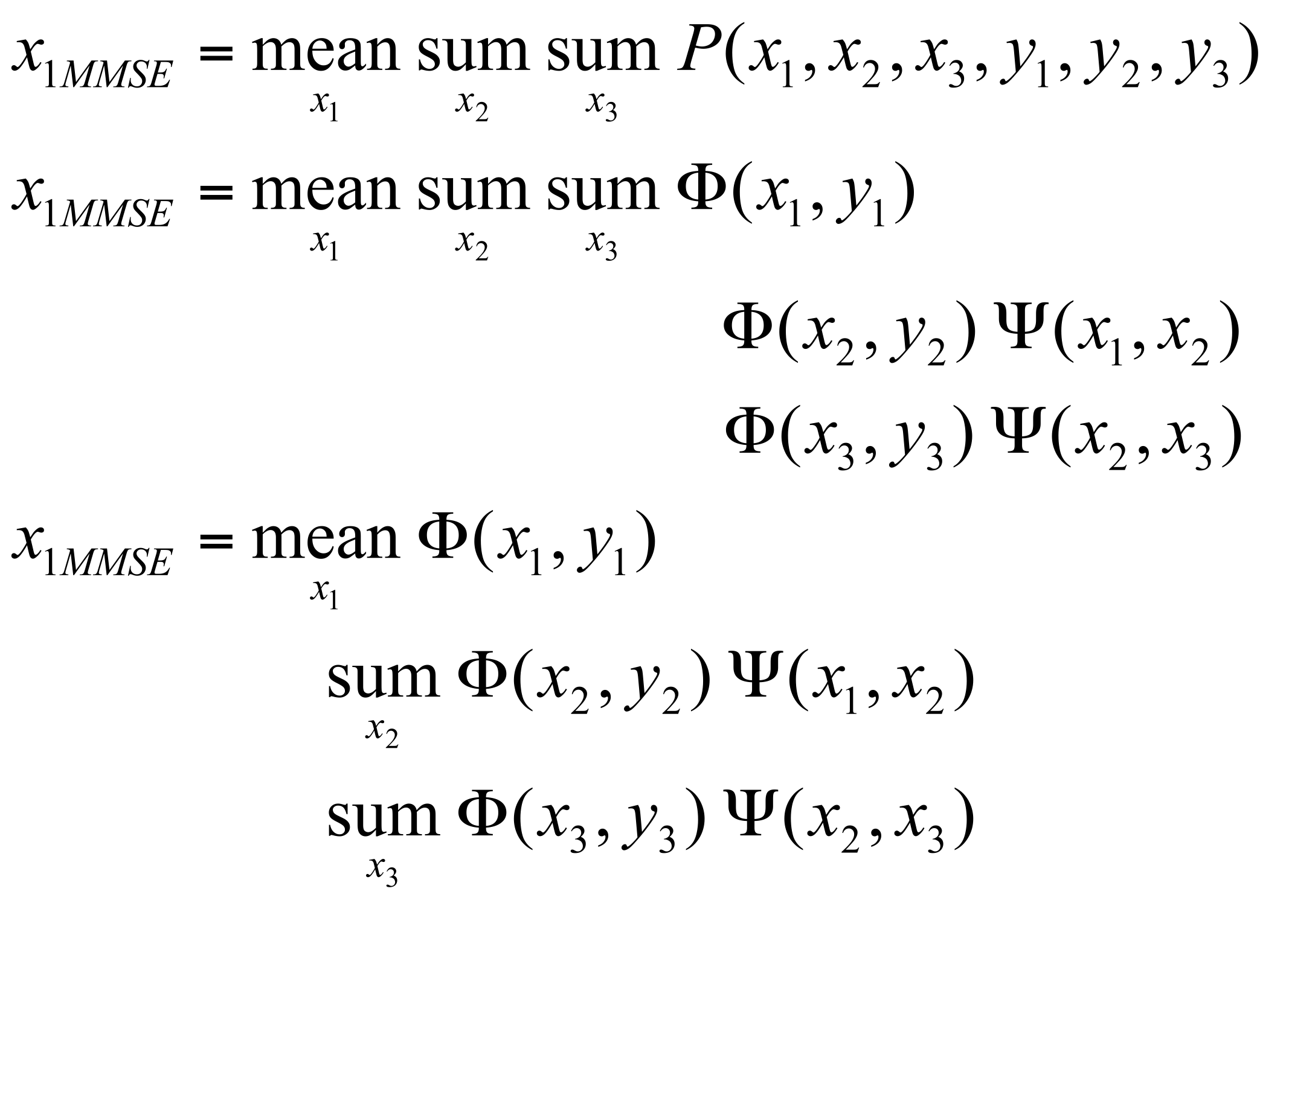
The posterior factorizes
y₁
y₂
y₃
x₁
x₂
x₃

Slide 35
Propagation rules
y₁
y₂
y₃
y₁
y₂
y₃
x₁
x₂
x₃

Slide 36
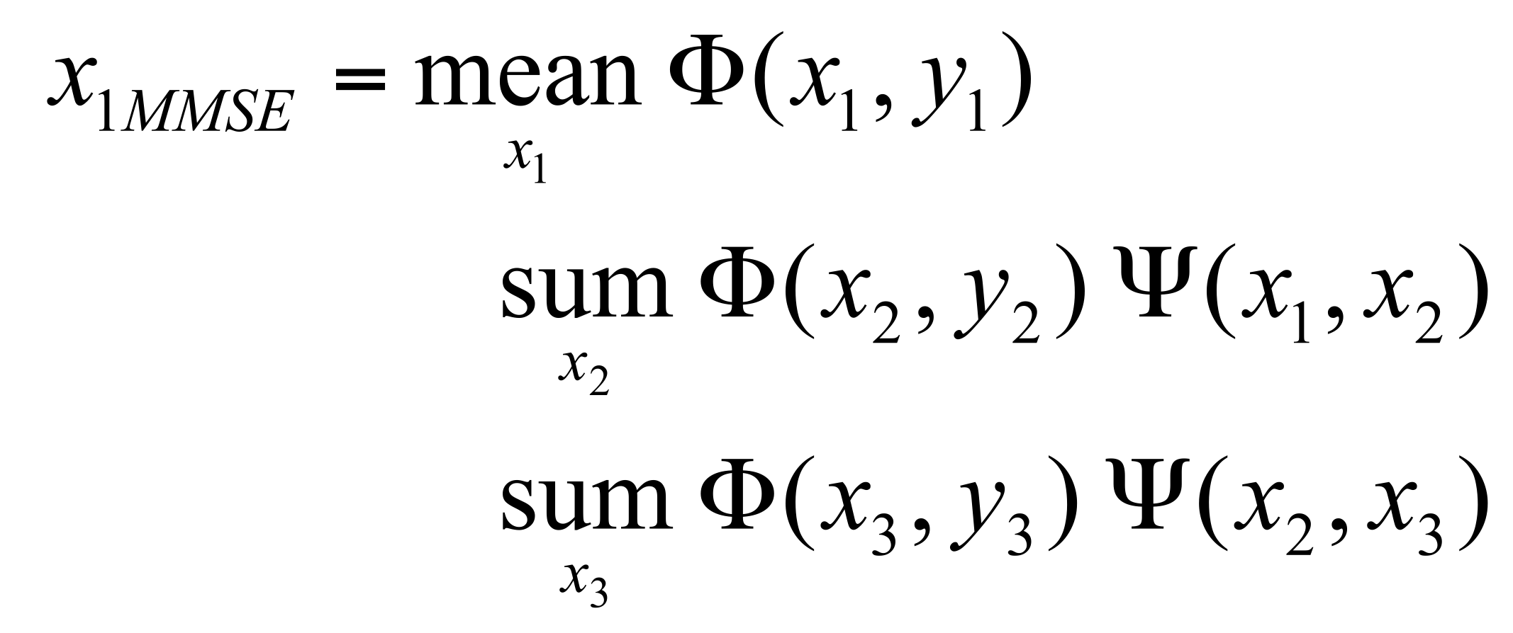
Propagation rules
y₁
y₂
y₃
y₁
y₂
y₃
x₁
x₂
x₃

Slide 37
Propagation rules
y₁
y₂
y₃
y₁
y₂
y₃
x₁
x₂
x₃

Slide 38
Belief propagation messages
A message: can be thought of as a set of weights on each of your possible states
To send a message: Multiply together all the incoming messages, except from the node you’re sending to,
then multiply by the compatibility matrix and marginalize over the sender’s states.
i
j
=
i
j

Slide 39
Beliefs
To find a node’s beliefs: Multiply together all the messages coming in to that node.
j

Slide 40
Max-product belief propagation
y₁
y₂
y₃
x₁
x₂
x₃
message update equation for sum-product algo
message update equation for max-product algo.

Slide 41
Optimal solution in a chain or tree: Belief Propagation
“Do the right thing” Bayesian algorithm.
For Gaussian random variables over time: Kalman filter.
For hidden Markov models: forward/backward algorithm (and MAP variant is Viterbi).

Slide 42
Belief, and message update rules are just local operations, and can be run whether or not the network has loops
j
i
=
i
j

Slide 43
Justification for running belief propagation in networks with loops
Experimental results:
Comparison of methods
Error-correcting codes
Vision applications
Theoretical results:
For Gaussian processes, means are correct.
Large neighborhood local maximum for MAP.
Equivalent to Bethe approx. in statistical physics.
Tree-weighted reparameterization
Szeliski et al. 2008
http://vision.middlebury.edu/MRF/
Kschischang and Frey, 1998;
McEliece et al., 1998
Freeman and Pasztor, 1999;
Frey, 2000
Weiss and Freeman, 1999
Weiss and Freeman, 2000
Yedidia, Freeman, and Weiss, 2000
Wainwright, Willsky, Jaakkola, 2001

Slide 44
Show program comparing some methods on a simple MRF
testMRF.m

Slide 45
Outline of MRF section
Inference in MRF’s.
Gibbs sampling, simulated annealing
Iterated conditional modes (ICM)
Belief propagation
Application example—super-resolution
Graph cuts
Variational methods
Learning MRF parameters.
Iterative proportional fitting (IPF)

Slide 46
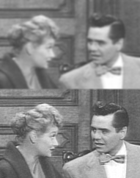
Super-resolution
Image: low resolution image
Scene: high resolution image
ultimate goal...
image
scene
53

Slide 47
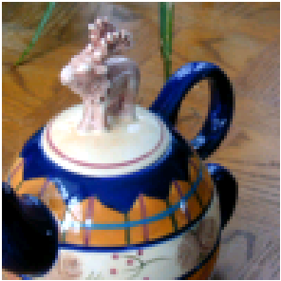
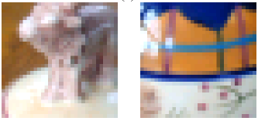
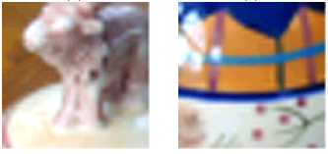
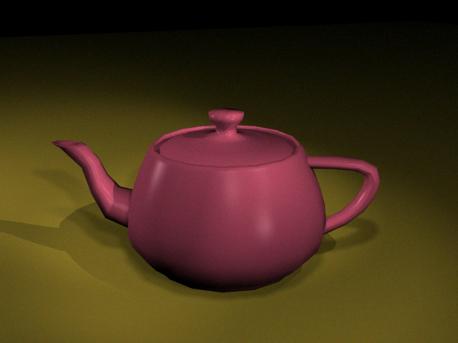
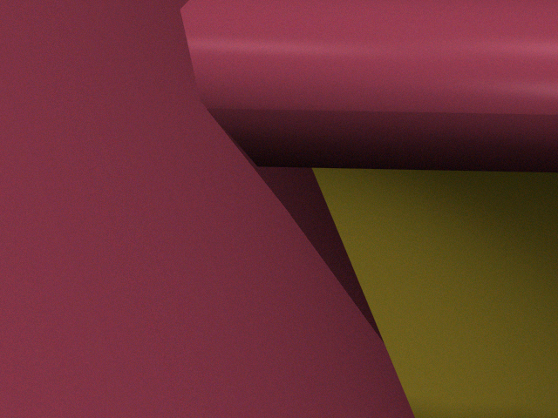
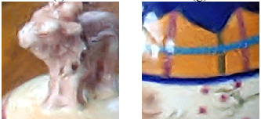
Pixel-based images are not resolution independent
Pixel replication
Cubic spline, sharpened
Cubic spline
Training-based super-resolution
Polygon-based graphics images are resolution independent

Slide 48
3 approaches to perceptual sharpening
(1) Sharpening; boost existing high frequencies.
(2) Use multiple frames to obtain higher sampling rate in a still frame.
(3) Estimate high frequencies not present in image, although implicitly defined.
amplitude
spatial frequency
amplitude
In this talk, we focus on (3), which we’ll call “super-resolution”.
spatial frequency

Slide 49
Super-resolution: other approaches
Schultz and Stevenson, 1994
Pentland and Horowitz, 1993
fractal image compression (Polvere, 1998; Iterated Systems)
astronomical image processing (eg. Gull and Daniell, 1978; “pixons” http://casswww.ucsd.edu/puetter.html)
Follow-on: Jianchao Yang, John Wright, Thomas S. Huang, Yi Ma: Image super-resolution as sparse representation of raw image patches. CVPR 2008

Slide 50
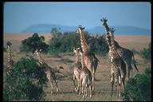
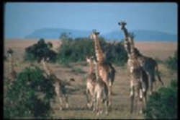
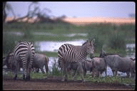
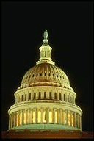
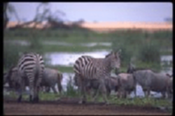
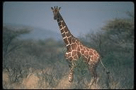
Training images, ~100,000 image/scene patch pairs
Images from two Corel database categories: “giraffes” and “urban skyline”.
57

Slide 51
Do a first interpolation
Zoomed low-resolution
Low-resolution

Slide 52
Zoomed low-resolution
Full frequency original
Low-resolution

Slide 53
Representation
Zoomed low-freq.
Full freq. original

Slide 54
Representation
Zoomed low-freq.
Full freq. original
True high freqs
Low-band input
(contrast normalized, PCA fitted)
(to minimize the complexity of the relationships we have to learn,
we remove the lowest frequencies from the input image,
and normalize the local contrast level).
61

Slide 55
Gather ~100,000 patches
...
...
high freqs.
low freqs.
Training data samples (magnified)

Slide 56
Nearest neighbor estimate
Input low freqs.
True high freqs.
Estimated high freqs.
...
...
high freqs.
low freqs.
Training data samples (magnified)

Slide 57
Nearest neighbor estimate
Input low freqs.
Estimated high freqs.
...
...
high freqs.
low freqs.
Training data samples (magnified)

Slide 58
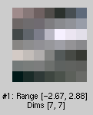
Example: input image patch, and closest matches from database
Input patch
Closest image
patches from database
Corresponding
high-resolution
patches from database

Slide 59
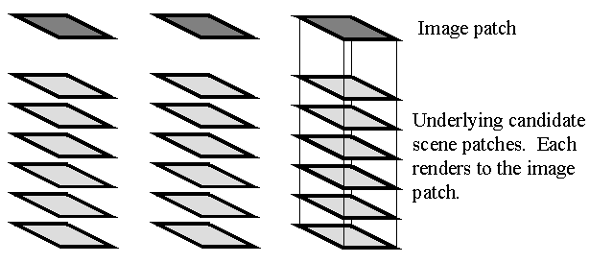

Slide 60
Scene-scene compatibility function, Ψ(x_{i}, x_{j})
Assume overlapped regions, d, of hi-res. patches differ by Gaussian observation noise:
Uniqueness constraint,
not smoothness.
d

Slide 61
Image-scene compatibility function, Φ(x_{i}, y_{i})
y
x
Assume Gaussian noise takes you from observed image patch to synthetic sample:

Slide 62
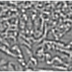
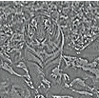
Markov network
image patches
Φ(x_{i}, y_{i})
scene patches
Ψ(x_{i}, x_{j})

Slide 63
Belief Propagation
After a few iterations of belief propagation, the algorithm selects spatially consistent high resolution interpretations for each low-resolution patch of the input image.
Input
Iter. 0
Iter. 1
Iter. 3

Slide 64
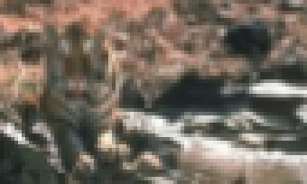
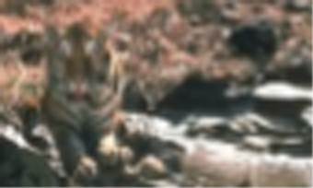
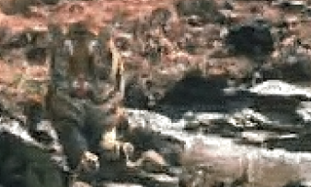
Zooming 2 octaves
We apply the super-resolution algorithm recursively, zooming up 2 powers of 2, or a factor of 4 in each dimension.
85 x 51 input
Cubic spline zoom to 340x204
Max. likelihood zoom to 340x204

Slide 65
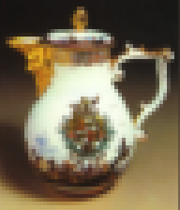
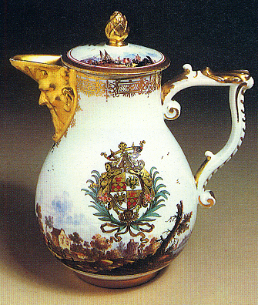
Now we examine the effect of the prior assumptions made about images on the high resolution reconstruction.
First, cubic spline interpolation.
Original
50x58
(cubic spline implies thin plate prior)
True
200x232

Slide 66
Original
50x58
(cubic spline implies thin plate prior)
True
200x232
Cubic spline

Slide 67
Next, train the Markov network algorithm on a world of random noise images.
Original
50x58
Training images
True

Slide 68
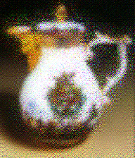
The algorithm learns that, in such a world, we add random noise when zoom to a higher resolution.
Original
50x58
Training images
Markov
network
True

Slide 69
Next, train on a world of vertically oriented rectangles.
Original
50x58
Training images
True

Slide 70
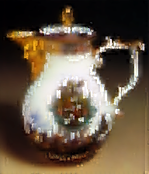
The Markov network algorithm hallucinates those vertical rectangles that it was trained on.
Original
50x58
Training images
Markov
network
True

Slide 71
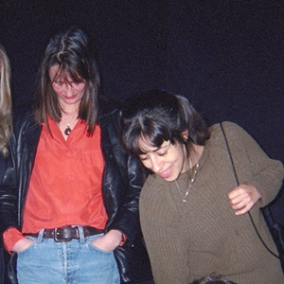
Now train on a generic collection of images.
Original
50x58
Training images
True

Slide 72
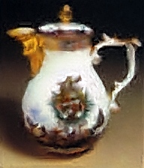
The algorithm makes a reasonable guess at the high resolution image, based on its training images.
Original
50x58
Training images
Markov
network
True

Slide 73
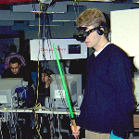
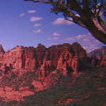
Generic training images
Next, train on a generic set of training images. Using the same camera as for the test image, but a random collection of photographs.

Slide 74
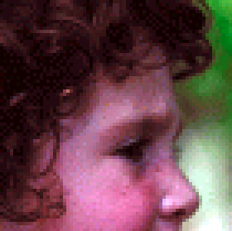
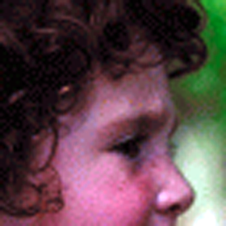
Original
70x70
Cubic Spline
Markov
net, training:
generic
True
280x280

Slide 75
Kodak Imaging Science Technology Lab test.
3 test images, 640x480, to be
zoomed up by 4 in each dimension.
8 judges, making 2-alternative, forced-choice comparisons.
82

Slide 76
Algorithms compared
Bicubic Interpolation
Mitra's Directional Filter
Fuzzy Logic Filter
Vector Quantization
VISTA

Slide 77
Bicubic spline
Altamira
VISTA
84

Slide 78
Bicubic spline
Altamira
VISTA

Slide 79
User preference test results
“The observer data indicates that six of the observers ranked
Freeman’s algorithm as the most preferred of the five tested
algorithms. However the other two observers rank Freeman’s algorithm
as the least preferred of all the algorithms….
Freeman’s algorithm produces prints which are by far the sharpest
out of the five algorithms. However, this sharpness comes at a price
of artifacts (spurious detail that is not present in the original
scene). Apparently the two observers who did not prefer Freeman’s
algorithm had strong objections to the artifacts. The other observers
apparently placed high priority on the high level of sharpness in the
images created by Freeman’s algorithm.”

Slide 80
87

Slide 81
88

Slide 82
Training images
89

Slide 83
Training image

Slide 84
Processed image

Slide 85
code available online
http://people.csail.mit.edu/billf/project%20pages/sresCode/Markov%20Random%20Fields%20for%20Super-Resolution.html

Slide 86
Motion application
image patches
image
scene patches
scene

Slide 87
What behavior should we see in a motion algorithm?
Aperture problem
Resolution through propagation of information
Figure/ground discrimination

Slide 88
The aperture problem
http://web.mit.edu/persci/demos/Motion&Form/demos/one-square/one-square.html

Slide 89
The aperture problem

Slide 90
motion program demo

Slide 91
Motion analysis: related work
Markov network
Luettgen, Karl, Willsky and collaborators.
Neural network or learning-based
Nowlan & T. J. Senjowski; Sereno.
Optical flow analysis
Weiss & Adelson; Darrell & Pentland; Ju, Black & Jepson; Simoncelli; Grzywacz & Yuille; Hildreth; Horn & Schunk; etc.
96

Slide 92
Motion estimation results
Inference:
(maxima of scene probability distributions displayed)
Image data
Iterations 0 and 1
Initial guesses only show motion at edges.

Slide 93
Motion estimation results
(maxima of scene probability distributions displayed)
Iterations 2 and 3
Figure/ground still unresolved here.

Slide 94
Motion estimation results
(maxima of scene probability distributions displayed)
Iterations 4 and 5
Final result compares well with vector quantized true (uniform) velocities.

Slide 95
Vision applications of MRF’s
Stereo
Motion estimation
Labelling shading and reflectance
Segmentation
Many others…

Slide 96
Random Fields for segmentation
I = Image pixels (observed)
h = foreground/background labels (hidden) – one label per pixel
θ = Parameters
Posterior
Joint
Likelihood
Prior
Generative approach models joint
→ Markov random field (MRF)
2. Discriminative approach models posterior directly
→ Conditional random field (CRF)

Slide 97
Generative Markov Random Field
Likelihood
MRF Prior
h (labels)
∈{foreground,background}
h_{i}
Pairwise Potential (MRF)
ψ_{ij}(h_{i}, h_{j}|θ_{ij})
h_{j}
Unary Potential
φ_{i}(I|h_{i},θ_{i})
i
I (pixels)
j
Prior has no dependency on I
Image Plane

Slide 98
Conditional Random Field
Discriminative approach
Lafferty, McCallum and Pereira 2001
Unary
Pairwise
Dependency on I allows introduction of pairwise terms that make use of image.
For example, neighboring labels should be similar only if pixel colors are similar → Contrast term
h_{i}
h_{j}
i
e.g Kumar and Hebert 2003
j
I (pixels)
Image Plane

Slide 99
OBJCUT
Kumar, Torr & Zisserman 2005
Unary
Pairwise
Color Likelihood
Distance from Ω
Label smoothness
Contrast
Ω (shape parameter)
Ω is a shape prior on the labels from a Layered Pictorial Structure (LPS) model
Segmentation by:
- Match LPS model to image (get number of samples, each with a different pose
Marginalize over the samples using a single graph cut
[Boykov & Jolly, 2001]
h_{i}
h_{j}
i
I (pixels)
j
Figure from Kumar et al., CVPR 2005
Image Plane

Slide 100
OBJCUT: Shape prior - Ω - Layered Pictorial Structures (LPS)
Generative model
Composition of parts + spatial layout
Layer 2
Spatial Layout
(Pairwise Configuration)
Layer 1
Parts in Layer 2 can occlude parts in Layer 1
Kumar, et al. 2004, 2005

Slide 101
OBJCUT: Results
Using LPS Model for Cow
In the absence of a clear boundary between object and background
Image
Segmentation

Slide 102
Outline of MRF section
Inference in MRF’s.
Gibbs sampling, simulated annealing
Iterated conditional modes (ICM)
Belief propagation
Application example—super-resolution
Graph cuts
Variational methods
Learning MRF parameters.
Iterative proportional fitting (IPF)

Slide 103
True joint probability
Observed marginal distributions

Slide 104
Initial guess at joint probability

Slide 105
IPF update equation, for maximum likelihood estimate of clique potentials
Scale the previous iteration’s estimate for the joint probability by the ratio of the true to the predicted marginals.
Gives gradient ascent in the likelihood of the joint probability, given the observations of the marginals.
See: Michael Jordan’s book on graphical models

Slide 106
Convergence to correct marginals by IPF algorithm

Slide 107
Convergence of to correct marginals by IPF algorithm

Slide 108
IPF results for this example: comparison of joint probabilities
True joint probability
Initial guess
Final maximum
entropy estimate

Slide 109
Application to MRF parameter estimation
Can show that for the ML estimate of the clique potentials, φ_{c}(x_{c}), the empirical marginals equal the model marginals,
Because the model marginals are proportional to the clique potentials, we have the IPF update rule for φ_{c}(x_{c}), which scales the model marginals to equal the observed marginals:
Performs coordinate ascent in the likelihood of the MRF parameters, given the observed data.
Reference: unpublished notes by Michael Jordan, and by Roweis: http://www.cs.toronto.edu/~roweis/csc412-2004/notes/lec11x.pdf

Slide 110
Learning MRF parameters, labeled data
Iterative proportional fitting lets you make a maximum likelihood estimate a joint distribution from observations of various marginal distributions.
Applied to learning MRF clique potentials:
(1) measure the pairwise marginal statistics (histogram state co-occurrences in labeled training data).
(2) guess the clique potentials (use measured marginals to start).
(3) do inference to calculate the model’s marginals for every node pair.
(4) scale each clique potential for each state pair by the empirical over model marginal

