Slide 1
Lecture 5
Spatial Linear Filters

Slide 2
Today’s lecture: Spatial Filtering
Problem set 1 due today. Problem set 2 out today (due Thursday of next week).
This week: Tuesday: spatial filtering. Thursday: temporal filtering
Next week: no class Tuesday, then on Thursday: image pyramids.
Today:
Fourier transforms and signal processing, continued
Fourier processing by human visual system
Spatial digital filters

Slide 3
Stereo camera
surface
light ray
Camera
Camera

Slide 4
Projector
Camera

Slide 5
Active stereo
surface
light ray
uc
up
f
f
d
Camera
Projector

Slide 6
surface
light ray
uc
up
Zc
f
f
d
If we know uc, up, f, and d, we can infer depth Zc

Slide 7
surface
laser
uc
up

Slide 12
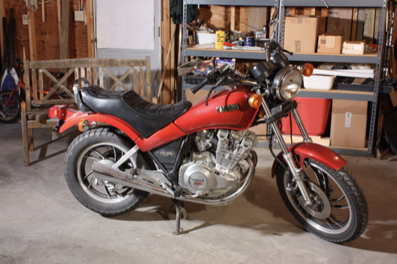
world

Slide 15
F(
) = 32
F recognizes that this is the pattern that the projector projected at up=32 pixels.

Slide 16
The Discrete Fourier transform
2D Discrete Fourier Transform (DFT) transforms an image f [n,m] into F [u,v] as:
$$F[u,v]=\overset{N-1}{\underset{n=0}{∑}}\overset{M-1}{\underset{m=0}{∑}}f[n,m]exp\left(-2πj\left(\frac{un}{N}+\frac{vm}{M}\right)\right)$$

Slide 17
The inverse Discrete Fourier transform
2D Discrete Fourier Transform (DFT) transforms an image f [n,m] into F [u,v] as:
$$F[u,v]=\overset{N-1}{\underset{n=0}{∑}}\overset{M-1}{\underset{m=0}{∑}}f[n,m]exp\left(-2πj\left(\frac{un}{N}+\frac{vm}{M}\right)\right)$$
The inverse of the 2D DFT is:
$$f[n,m]=\frac{1}{NM}\overset{N-1}{\underset{n=0}{∑}}\overset{M-1}{\underset{m=0}{∑}}F[u,v]exp\left(+2πj\left(\frac{un}{N}+\frac{vm}{M}\right)\right)$$

Slide 18
The inverse Discrete Fourier transform
2D Discrete Fourier Transform (DFT) transforms an image f [n,m] into F [u,v] as:
$$F[u,v]=\overset{N-1}{\underset{n=0}{∑}}\overset{M-1}{\underset{m=0}{∑}}f[n,m]exp\left(-2πj\left(\frac{un}{N}+\frac{vm}{M}\right)\right)$$
The inverse of the 2D DFT is:
$$f[n,m]=\frac{1}{NM}\overset{N-1}{\underset{n=0}{∑}}\overset{M-1}{\underset{m=0}{∑}}F[u,v]exp\left(+2πj\left(\frac{un}{N}+\frac{vm}{M}\right)\right)$$
How does summing waves end up giving back a picture?

Slide 19
Visualizing the image Fourier transform
$$F[u,v]=\overset{N-1}{\underset{n=0}{∑}}\overset{M-1}{\underset{m=0}{∑}}f[n,m]exp\left(-2πj\left(\frac{un}{N}+\frac{vm}{M}\right)\right)$$
The values of F [u,v] are complex.
Using the real and imaginary components:
Or using a polar decomposition:
Amplitude
Phase

Slide 20
Simple Fourier transforms
Image
DFT (amplitude)
m
v
v₀
-u₀
n
u
-v₀
u₀
64x64 pixels

Slide 21
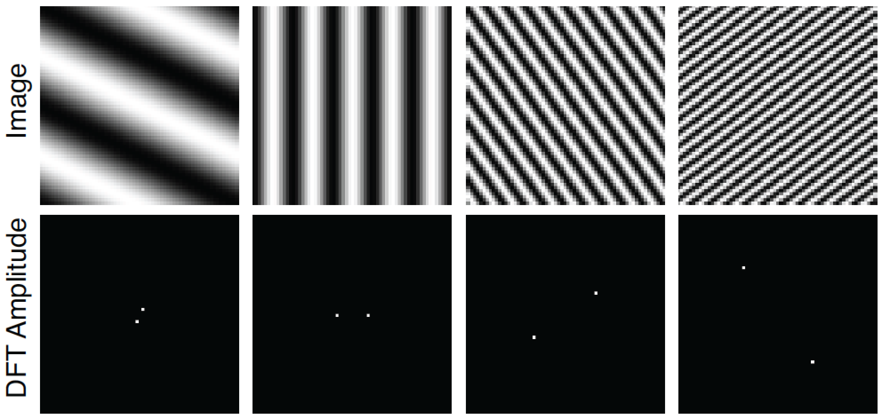
Simple Fourier transforms
Images are 64x64 pixels. The wave is a cosine, therefore DFT phase is zero.

Slide 22
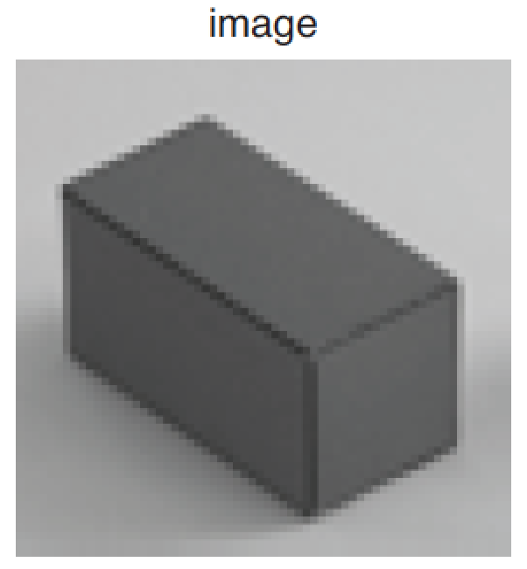
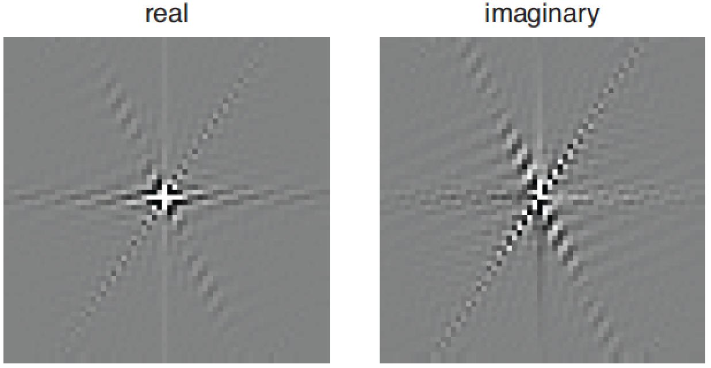
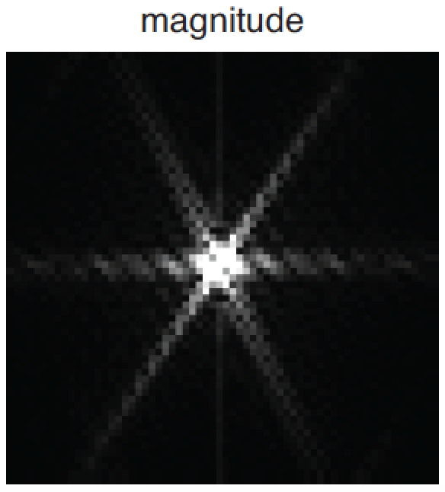
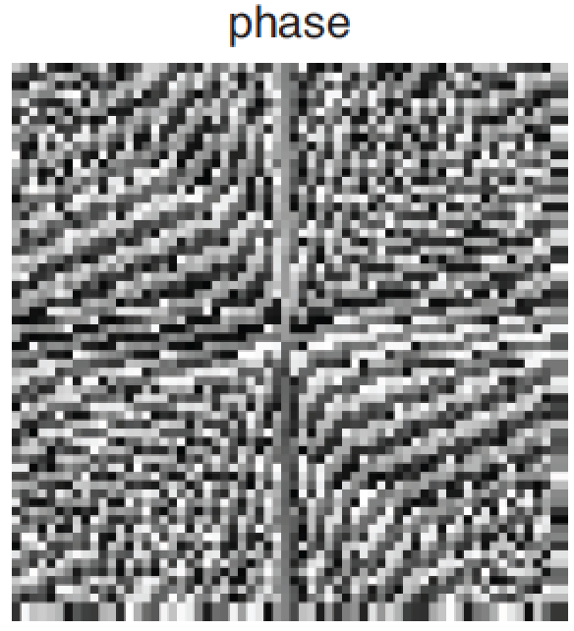
Visualizing the image Fourier transform
$$f[n,m]$$
m
$$F[u,v]$$
v
v
n
u
u
v
v
u
u

Slide 23
2

Slide 24
6

Slide 25
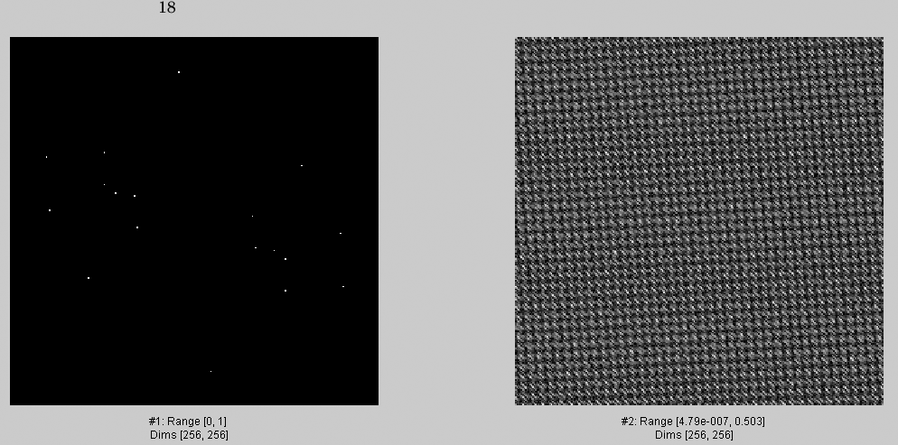
18

Slide 26
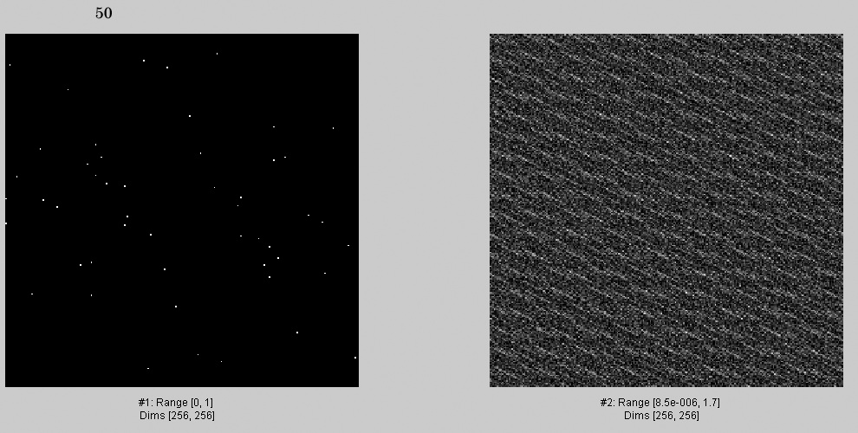
50

Slide 27
82

Slide 28
136

Slide 29
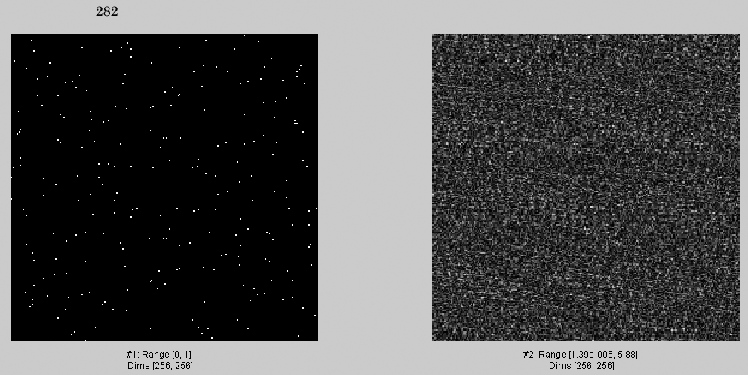
282

Slide 30
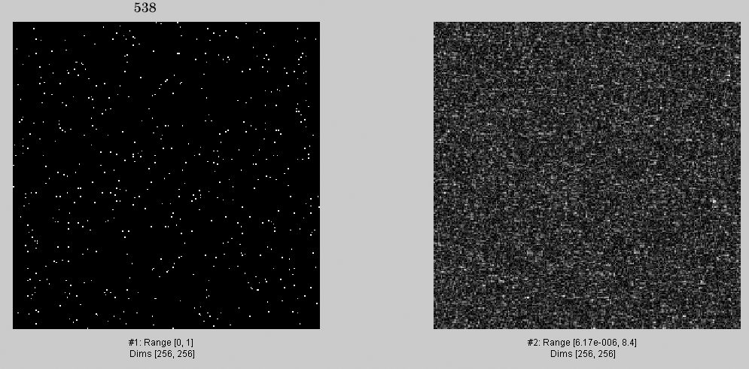
538

Slide 31
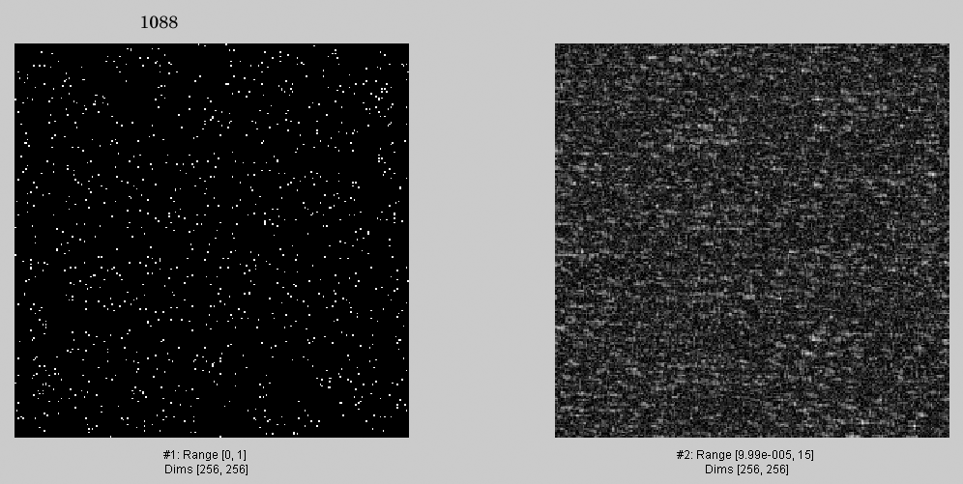
1088

Slide 32
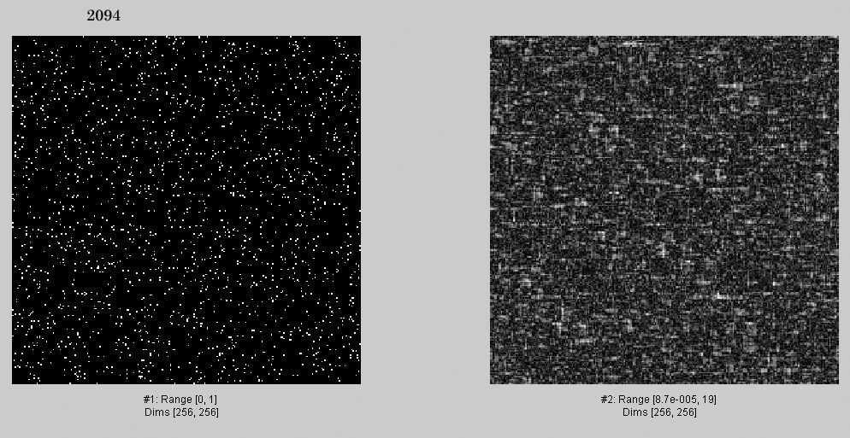
2094

Slide 33
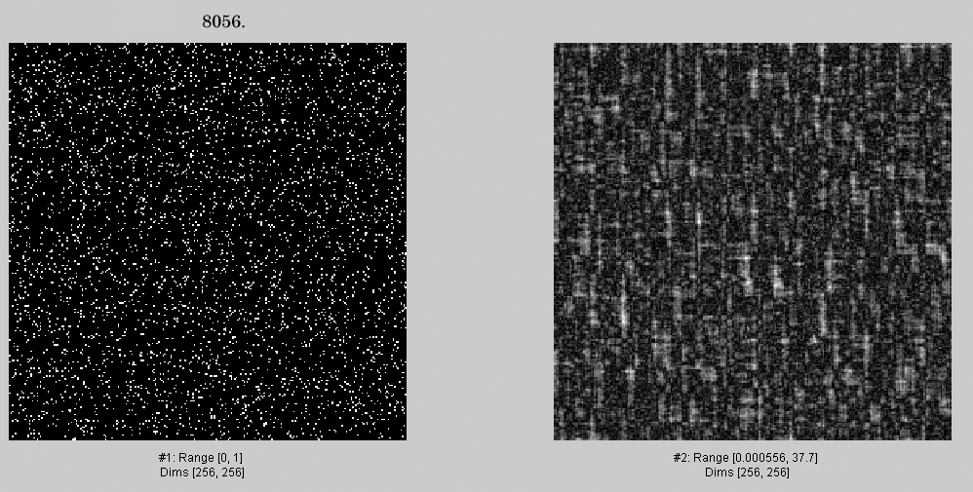
4052.
4052

Slide 34
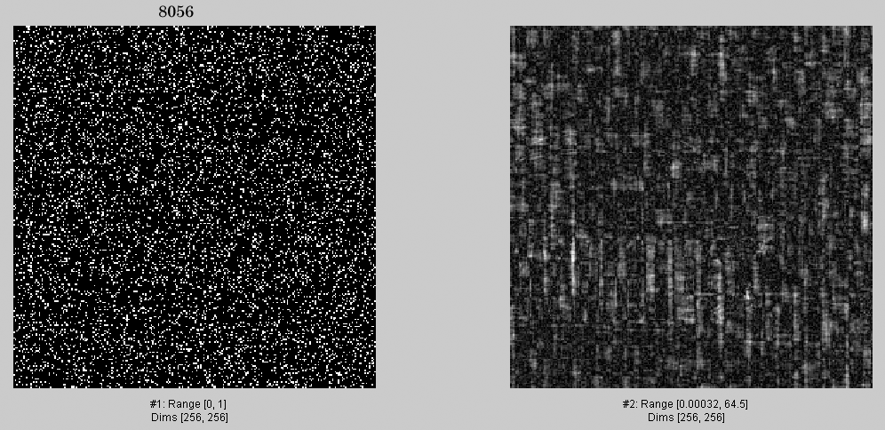
8056.

Slide 35
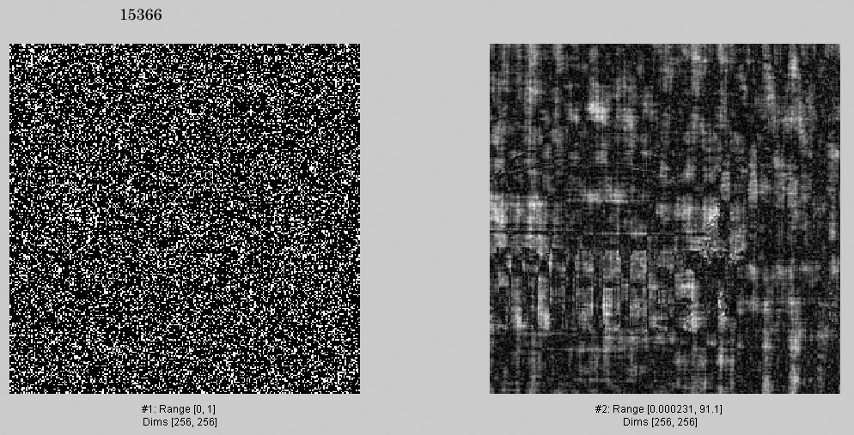
15366

Slide 36
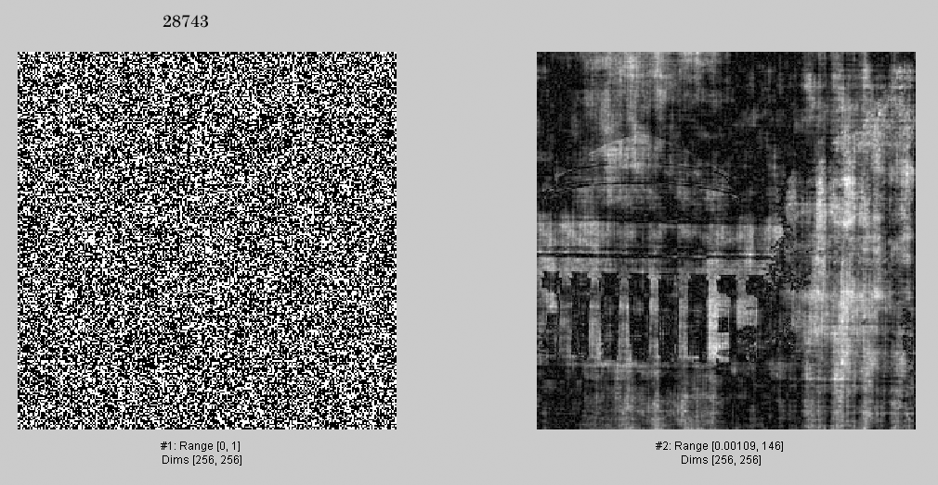
28743

Slide 37
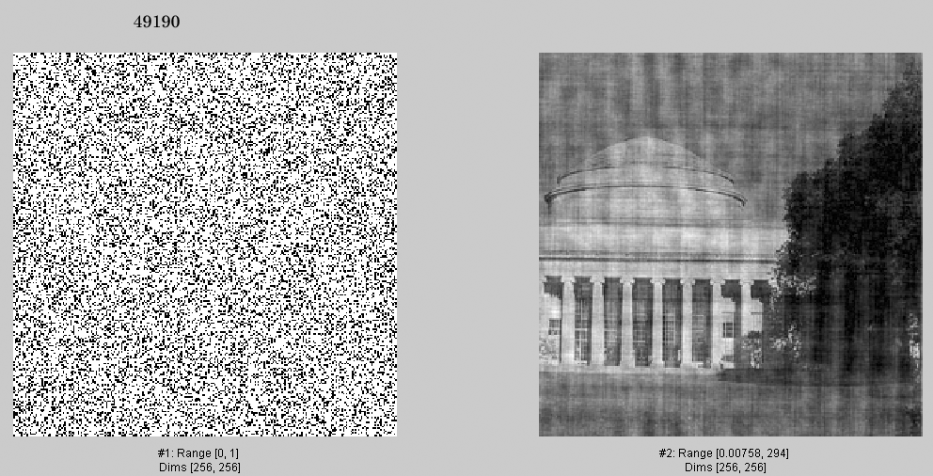
49190.

Slide 38
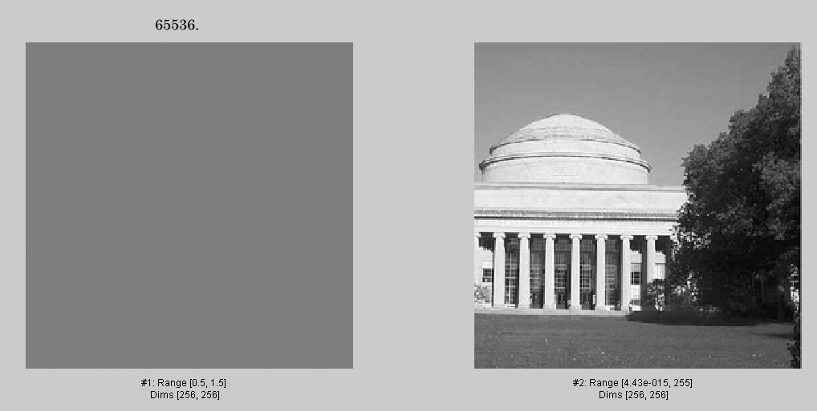
65536.

Slide 39
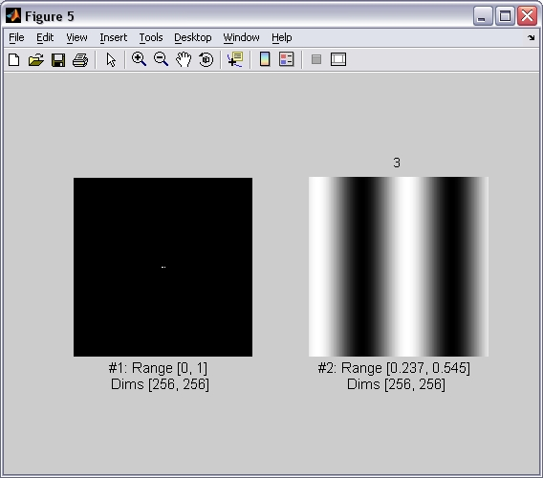
3
Now, an analogous sequence of images, but selecting Fourier components in descending order of magnitude.

Slide 40
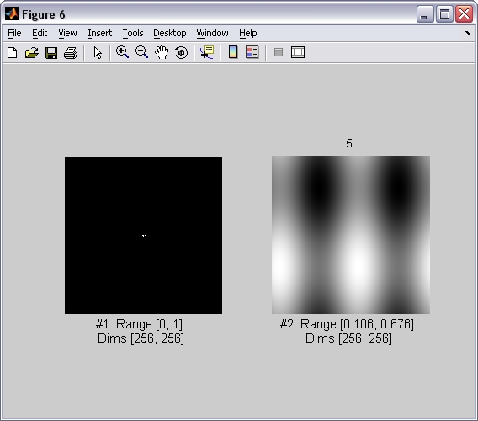
5

Slide 41
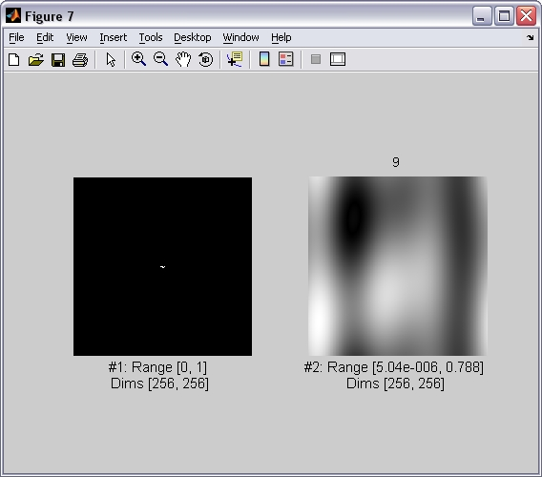
9

Slide 42
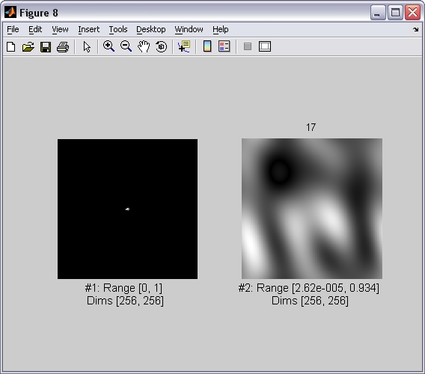
17

Slide 43
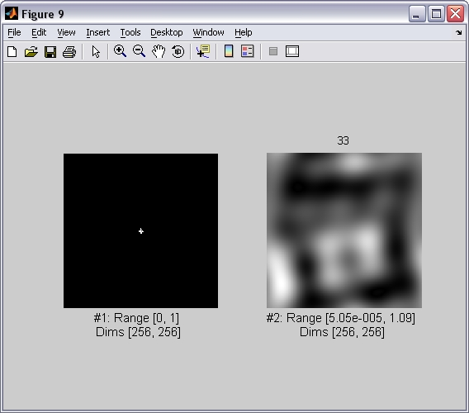
33

Slide 44
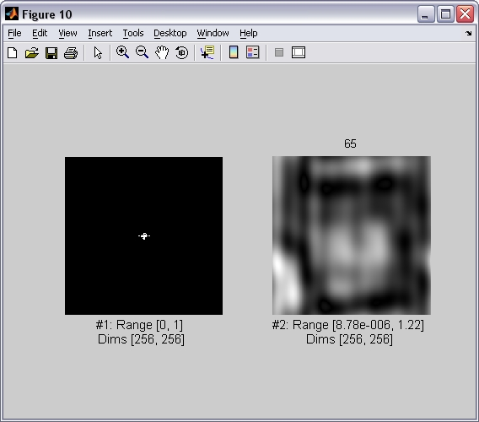
65

Slide 45
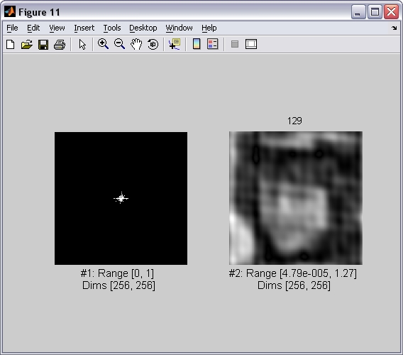
129

Slide 46
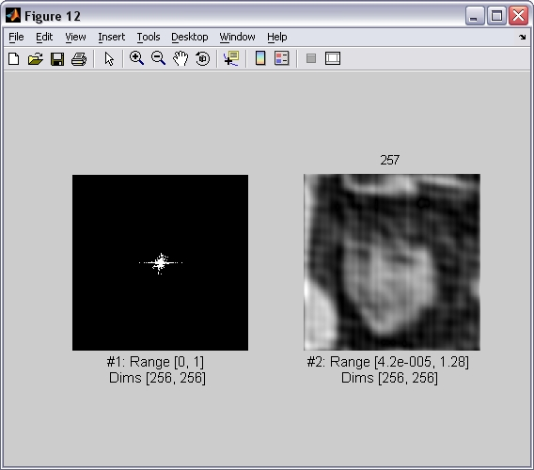
257

Slide 47
513

Slide 48
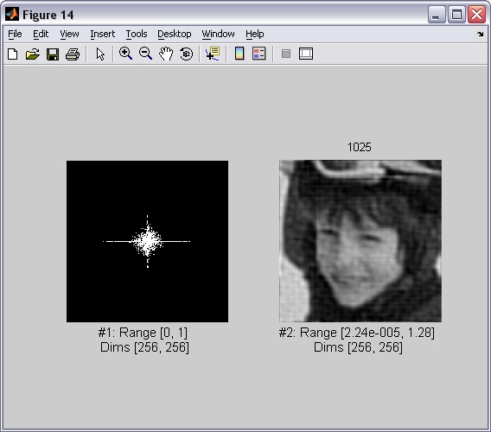
1025

Slide 49
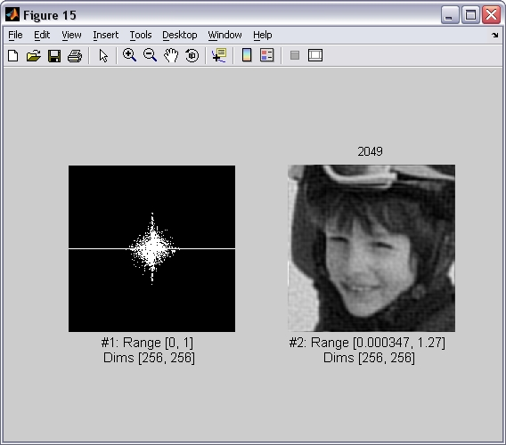
2049

Slide 50
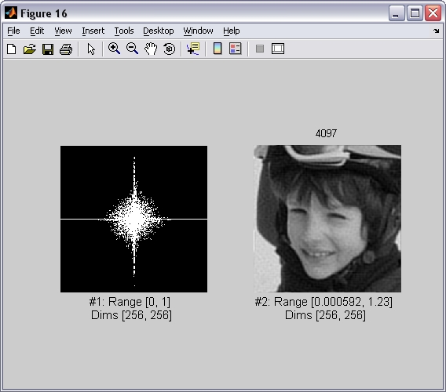
4097

Slide 51
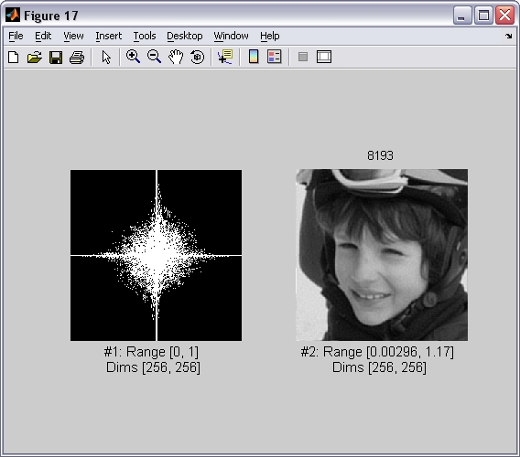
8193

Slide 52
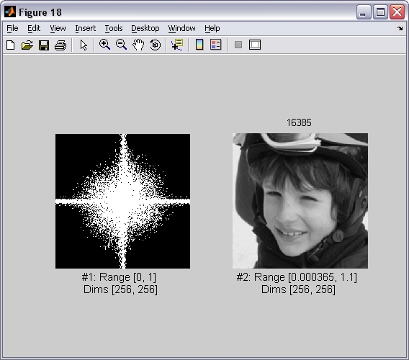
16385

Slide 53
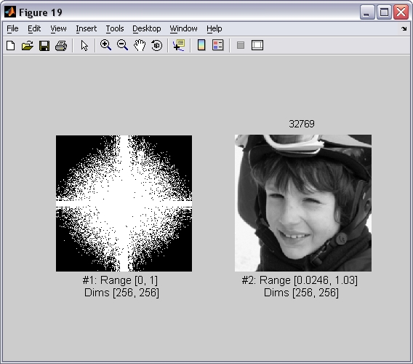
32769

Slide 54
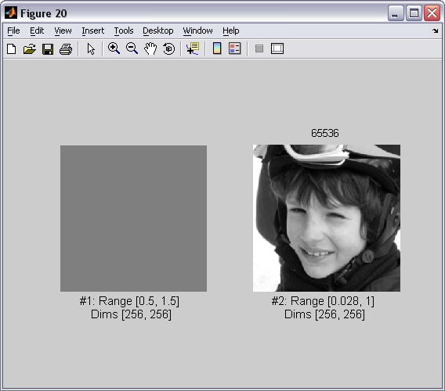
65536

Slide 55
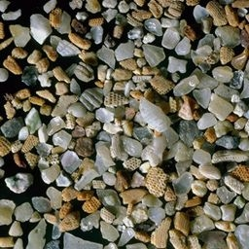
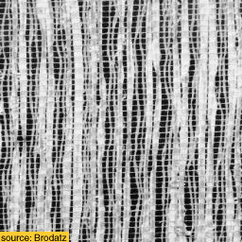
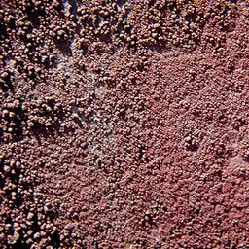
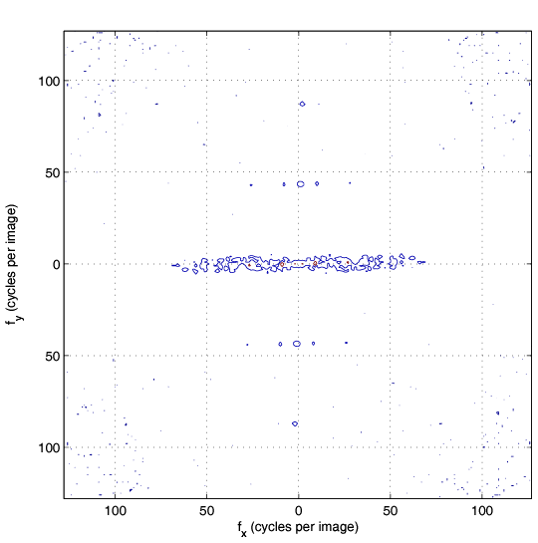
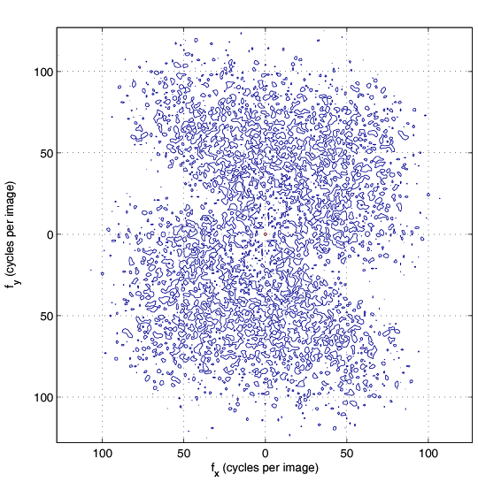
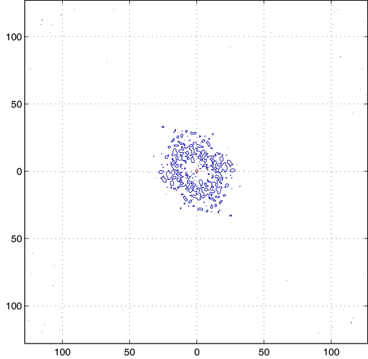
The DFT Game: find the right pairs
Images
A
B
C
DFT magnitude
1
2
3
fx(cycles/image pixel size)
fx(cycles/image pixel size)
fx(cycles/image pixel size)

Slide 56
The DFT Game: find the right pairs
(Solution in the class notes)

Slide 57
DFT
DFT squared magnitude (contrast compressed for visibility)
DFT
-1
Retain Fourier components corresponding to the repeating columns

Slide 58
DFT
DFT
-1
Remove Fourier components corresponding to the repeating columns

Slide 59
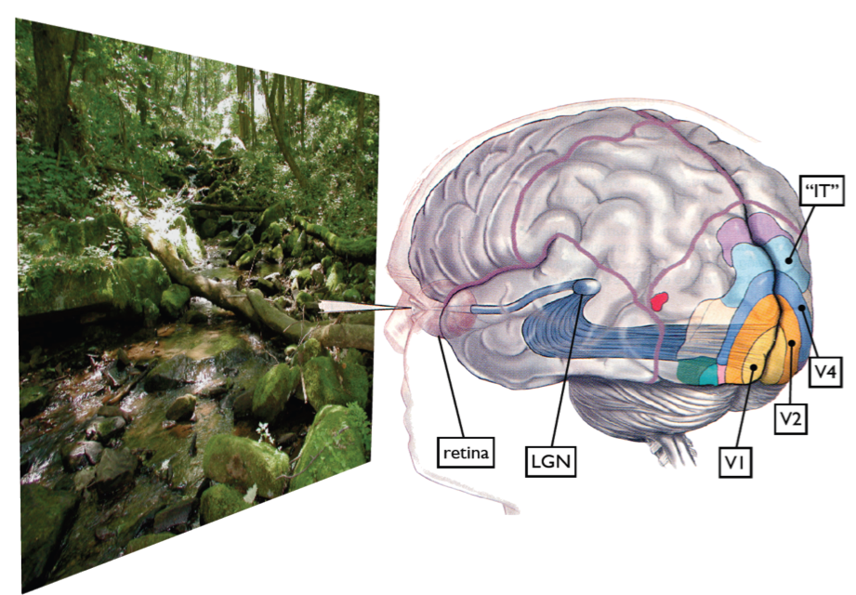
Some visual areas…
From M. Lewicky
Notes:
Slides from lewicki

Slide 60
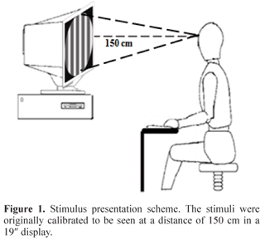

Slide 61
Campbell & Robson chart
Let’s define the following image:
n
m
With:
What do you think you should see when looking at this image?

Slide 64
Contrast Sensitivity Function
Blackmore & Campbell (1969)
Maximum sensitivity
~ 6 cycles / degree of visual angle
Invisible
visible
Contrast sensitivity
0.1
1
10
100
Low
Spatial frequency (cycles/degree)
High
Things that are very close and/or large are hard to see
Things far away are hard to see

Slide 65
1 2 3 4 5 6 7 8 9 10 11 12 13 14 15 16 17 18 19 20

Slide 66
Vasarely visual illusion

Slide 67
Input visual stimulus
Frequency filtering of human visual system
bandpass filtered output
-
Center-surround spatial filtering of human visual system is subtracting less positive intensity at the corners, giving a bright line there
-
+
-
-

Slide 68
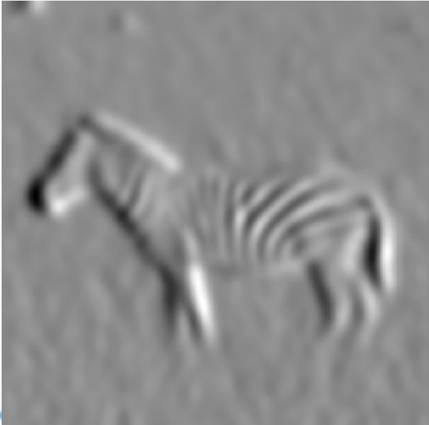
Today: A collection of useful filters
Low-pass filters
High-pass filters

Slide 69
Low pass-filters

Slide 70
Box filter
2N+1
1 | 1 | … | 1
1 | 1 |  | 1
1 | 1 |  | 1
…
1 | 1 | 1 | 1
2M+1
h[n]
with N=1
n=0
n

Slide 71
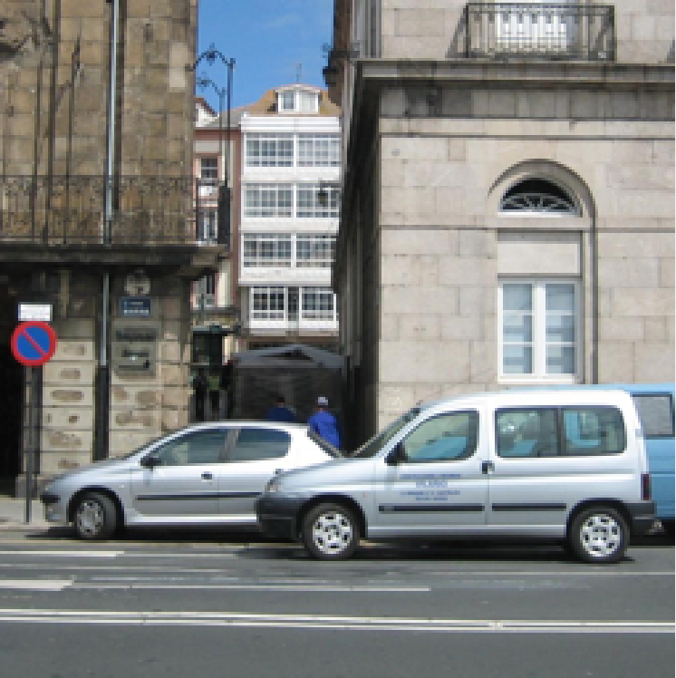
Box filter
mean
1
=
21X21
mean
256X256
256X256
What does it do?
• Replaces each pixel with an average of its neighborhood
• Achieve smoothing effect (remove sharp features)

Slide 72
Box filter
The box filter is separable as it can be written as the convolution of two 1D kernels
1
1
1
1 1 1 1 1 1
1 1
=

Slide 73
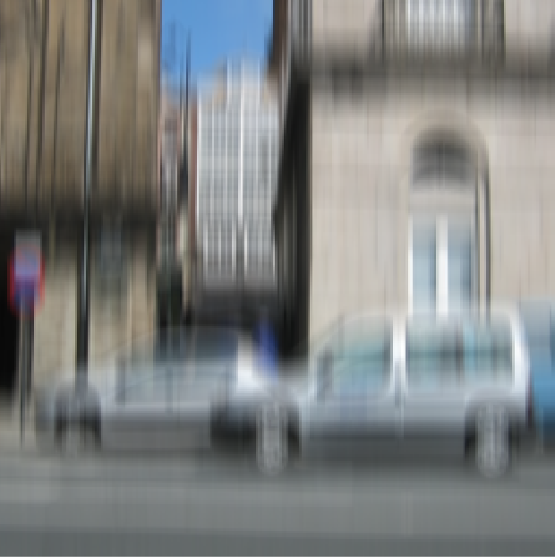
Box filter
1
1
21
21
256X256
256X256
Requires N+N sums, instead of N*N

Slide 74
Box filter
If you convolve two boxes:
1 1 1
1 1 1
=
1 2 3 2 1
=
The convolution of two box filters is not another box filter.
It is a triangular filter.

Slide 75
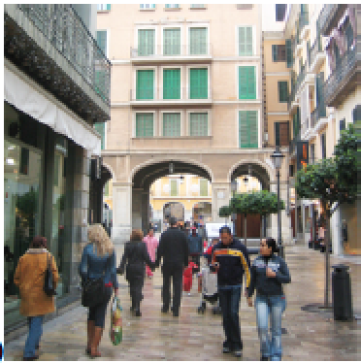
Box filter
=
It produces a blurry version of the input. But it is not a perfect blur.

Slide 76
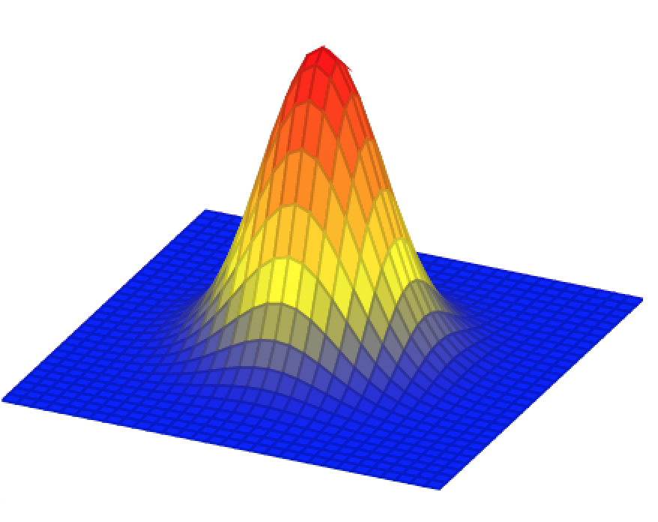
Gaussian filter
In the continuous domain:

Slide 77
Gaussian filter
Discretization of the Gaussian:
At 3σ the amplitude of the Gaussian is around 1% of its central value

Slide 78
Blur occurs under many natural situations

Slide 79
Blur occurs under many natural situations

Slide 80
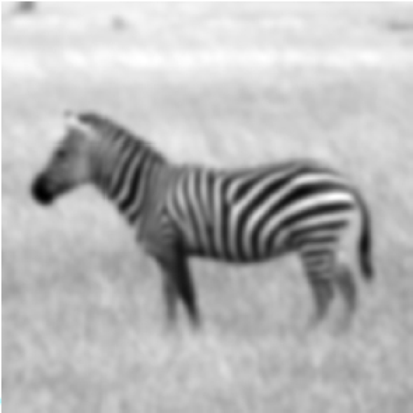
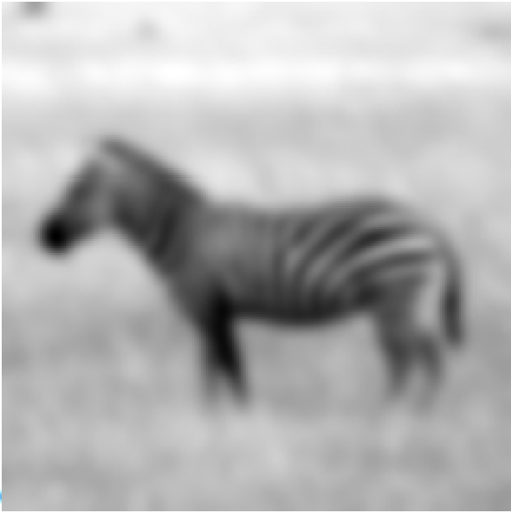
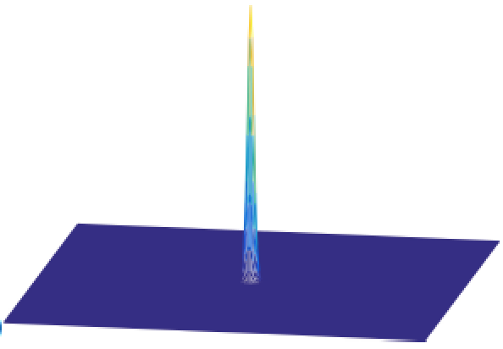
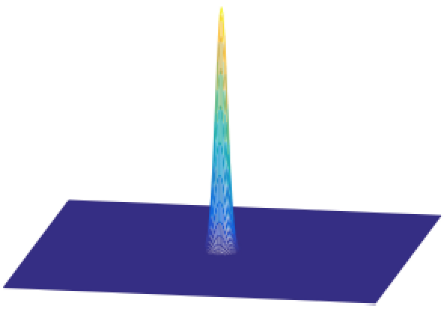
Scale

Slide 81
Gaussian filter for low-pass filtering
Dali

Slide 82
Properties of the Gaussian filter
The n-dimensional Gaussian is the only completely circularly symmetric operator that is separable.
The (continuous) Fourier transform of a Gaussian is another Gaussian

Slide 83
Properties of the Gaussian filter
The convolution of two n-dimensional Gaussians is an n-dimensional Gaussian.
where the variance of the result is the sum
(it is easy to prove this using the FT of the Gaussian)

Slide 84
Properties of the Gaussian filter
Repeated convolutions of any function concentrated in the origin result in a gaussian (central limit theorem).

Slide 85
Discretization of the Gaussian
There are very efficient approximations to the Gaussian filter for certain values of σ with nicer properties than when working with discretized gaussians.

Slide 86
Binomial filter
Binomial coefficients provide a compact approximation of the gaussian coefficients using only integers.
The simplest blur filter (low pass) is
[1 1]
Binomial filters in the family of filters obtained as
successive convolutions of [1 1]

Slide 87
Binomial filter
b₁ = [1 1]
b₂ =
[1 1] [1 1] = [1 2 1]
b₃ =
[1 1] [1 1] [1 1] = [1 3 3 1]

Slide 88
Binomial filter

Slide 89
Properties of binomial filters
Sum of the values is 2^{n}
The variance of b_{n} is
The convolution of two binomial filters is also a binomial filter
With a variance:
These properties are analogous to the gaussian property in the continuous domain (but the binomial filter is different than a discretization of a gaussian)

Slide 90
B2[n]
The simplest approximation to the Gaussian filter is the 3-tap kernel:

Slide 91
B2[n] versus the 3-tap box filter
[1 2 1]
[1 1 1]
Which one is better?

Slide 92
B2[n] versus the 3-tap box filter
(with N=20, and assuming periodic boundary extension)
B₂(u) = 2 + exp(-2πj u/N) + exp(2πj u/N) =
= 2 + 2 cos(2π u/N)
H₁(u) = 1 + exp(-2πj u/N) + exp(2πj u/N) =
= 1 + 2 cos(2π u/N)

Slide 93
2 + 2 cos(2π u/20)
1 + 2 cos(2π u/20)

Slide 94
B2[n]
[1, 1, 1] […, 1, -1, 1, -1, 1, -1, …] =
[…, -1, 1, -1, 1, -1, 1, …]
[1, 2, 1] […, 1, -1, 1, -1, 1, -1, …] =
[…, 0, 0, 0, 0, 0, 0, …]

Slide 95
B2[n]

Slide 96
Linear blur occurs under many natural situations
(from Fergus et al, 2007)
This is not a Gaussian kernel...
Notes:
UPDATED IMAGE.

Slide 97
What about the opposite of blurring?
Gaussian filter
Laplacian filter
+
-
-

Slide 98
Laplacian filter
+
-
Gaussian filter
-
+
=

Slide 99
Hybrid Images
Oliva & Schyns
Notes:
We start by taking two pictures, we isolate the details and contours in one, here the woman, and we blur the second face. as you can see, the man seems to go out of focus and the details of the woman are superposed.

Slide 100
Hybrid Images

Slide 101
+
=

Slide 102
Hybrid Images

Slide 104
http://cvcl.mit.edu/hybrid_gallery/gallery.html

Slide 105
High pass-filters

Slide 106
Finding edges in the image
Image gradient:
Approximation image derivative:
Edge strength
Edge orientation:
Edge normal:

Slide 107
Differential Geometry Descriptors

Slide 108
[-1 1]
[-1, 1]
=
h[m,n]
f[m,n]
g[m,n]

Slide 109
[-1 1]^{T}
[-1, 1]^{T}
=
h[m,n]
f[m,n]
g[m,n]

Slide 110
Discrete derivatives

Slide 111
Discrete derivatives
=
=

Slide 112
Discrete derivatives
=
=

Slide 113
[-1 1]
[-1, 1]
=
h[m,n]
f[m,n]
g[m,n]

Slide 114
[-1 1]^{T}
[-1, 1]^{T}
=
h[m,n]
f[m,n]
g[m,n]

Slide 115
Can you go from the derivatives
back to the original image?
?

Slide 116
Reconstruction from 1D derivatives
f = D g
c
=
c
Can we compute the inverse?

Slide 117
Reconstruction from 1D derivatives
f = D g
c
=
c

Slide 118
Reconstruction from 1D derivatives
What happens if we remove the output pixels affected by the boundary?

Slide 119
Reconstruction from 1D derivatives
What happens if we remove the output pixels affected by the boundary?
1
1
2
2
0
0
-1
0
2
=
Can we still recover the input?
If the derivative D is not invertible, we can compute the pseudo-inverse:
^
D = (D^{T}D)⁻¹ D^{T}

Slide 120
Reconstruction from 1D derivatives
^
D =
D =
Pseudo-inverse of derivative matrix
Derivative matrix (without boundary)

Slide 121
Reconstruction from derivatives
Derivative:
Input
Derivative
1
1
2
2
0
0
-1
0
2
=
Reconstruction:
Derivative
-0.2
-0.2
0.8
0.8
-1.2
0
-1
0
2
=
Reconstruction input
Did it work?

Slide 122
Reconstruction from 2D derivatives
In 2D, we have multiple derivatives (along n and m)
c
=
[-1 1]
c
[-1 1]^{T}
c
and we compute the pseudo-inverse of the full matrix.

Slide 123
Reconstruction from 2D derivatives
[1 -1]
[1 -1]^{T}

Slide 124
Editing the edge image
[1 -1]
[1 -1]^{T}

Slide 125
Thresholding edges

Slide 126
2D derivatives
There are several ways in which 2D derivatives can be approximated.
Robert-Cross operator:
And many more…

Slide 127
Issues with image derivatives
Derivatives are sensitive to noise
If we consider continuous image derivatives, they might not be defined in some regions (e.g., object boundaries, …)

Slide 128
Derivatives
We want to compute the image derivative:
If there is noise, we might want to “smooth” it with a blurring filter
But derivatives and convolutions are linear and we can move them around:

Slide 129
Gaussian derivatives
The continuous derivative is:

Slide 130
Gaussian derivatives
g_{x}(x,y)
In general:

Slide 131
Gaussian Scale
s=2
s=4
s=8

Slide 132
Derivatives of Gaussians: Scale
s=2
s=4
s=8

Slide 133
Orientation

Slide 134
Orientation
What about other orientations not axis aligned?

Slide 135
Orientation
The smoothed directional gradient is a linear combination of two kernels
Any orientation can be computed as a linear combination of two filtered images
Steereability of gaussian derivatives, Freeman & Adelson 92

Slide 136
Orientation
The derivative along an arbitrary direction is a linear combination of the derivatives along the two axis x and y.
Steereability of gaussian derivatives, Freeman & Adelson 92

Slide 137
Orientation
cos(α)
+sin(α)
=
Steereability of gaussian derivatives, Freeman & Adelson 92

Slide 138
n-th order Gaussian derivatives
DFT

Slide 139
Discretization Gaussian derivatives
There are many discrete approximations. For instance, we can take samples of the continuous functions. In practice it is common to use the discrete approximation given by the binomial filters.
Convolving the binomial coefficients with [1, -1]
[1, -1]

Slide 140
Discretization 2D Gaussian derivatives
As Gaussians are separable, we can approximate two 1D derivatives and then convolve them.
One example is the Sobel-Feldman operator:

Slide 141
n-th order Gaussian derivatives

Slide 142
n-th order Gaussian derivatives
Gaussian

Slide 143
n-th order Gaussian derivatives
Gaussian

Slide 144
n-th order Gaussian derivatives
Gaussian

Slide 145
n-th order Gaussian derivatives
Gaussian

Slide 146
Effect of different approximations

Slide 147
Effect of different approximations
[1,-1]
[1,0,-1]/2

Slide 148
Laplacian filter
Made popular by Marr and Hildreth in 1980 in the search for
operators that locate the boundaries between objects.
The Laplacian operator is defined as the sum of the second order partial derivatives of a function:
To reduce noise and undefined derivatives, we use the same trick:
Where:

Slide 149
Laplacian filter
The most popular approximation is the five-point formula which consists in convolving the image with the kernel
=

Slide 150
Comparison derivative and laplacian
Zero crossings

Slide 151
Image sharpening filter

Slide 152
Image sharpening filter
Subtract away the blurred components of the image:
This filter has an overall DC component of 1. It de-emphasizes the blur component of the image (low spatial frequencies).

Slide 153
Input image
Sharpened

Slide 154
Input image
Sharpened

Slide 155
Input image

Slide 156
Some visual areas…
From M. Lewicky
Notes:
Slides from lewicki

Slide 158
Other “naturally” occurring filters

Slide 159
Camera shake
(from Fergus et al, 2007)
This is not a Gaussian kernel...
Notes:
UPDATED IMAGE.

Slide 160
Artistic effects

