Slide 1
Lecture 7
Spatial Pyramids

Slide 2
Today’s lecture
Problem set 2 due today
Problem set 3 released today
Reading: course notes, chapter 20
Gaussian pyramid
application: recognition
neural network algorithms
Laplacian pyramid
application in image blending
neural network algorithms
Steerable pyramid
application in texture synthesis
neural network algorithms

Slide 3
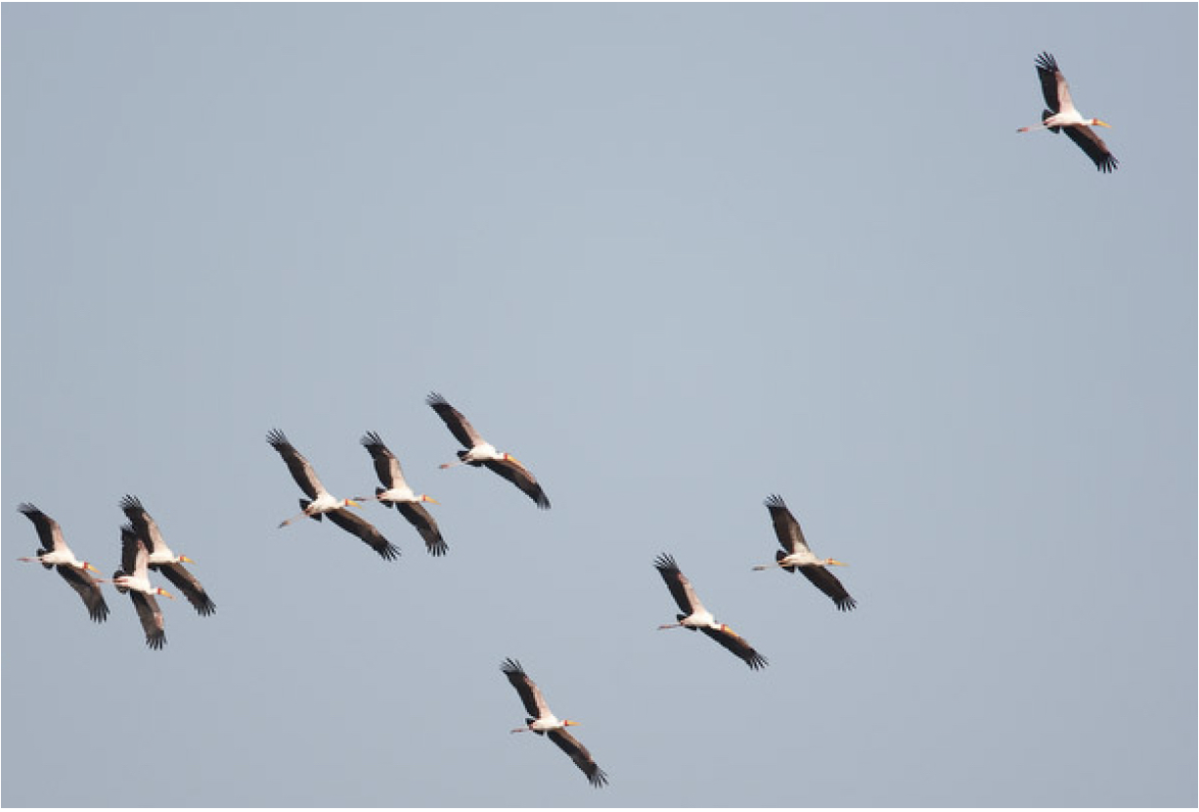
We need translation invariance

Slide 4
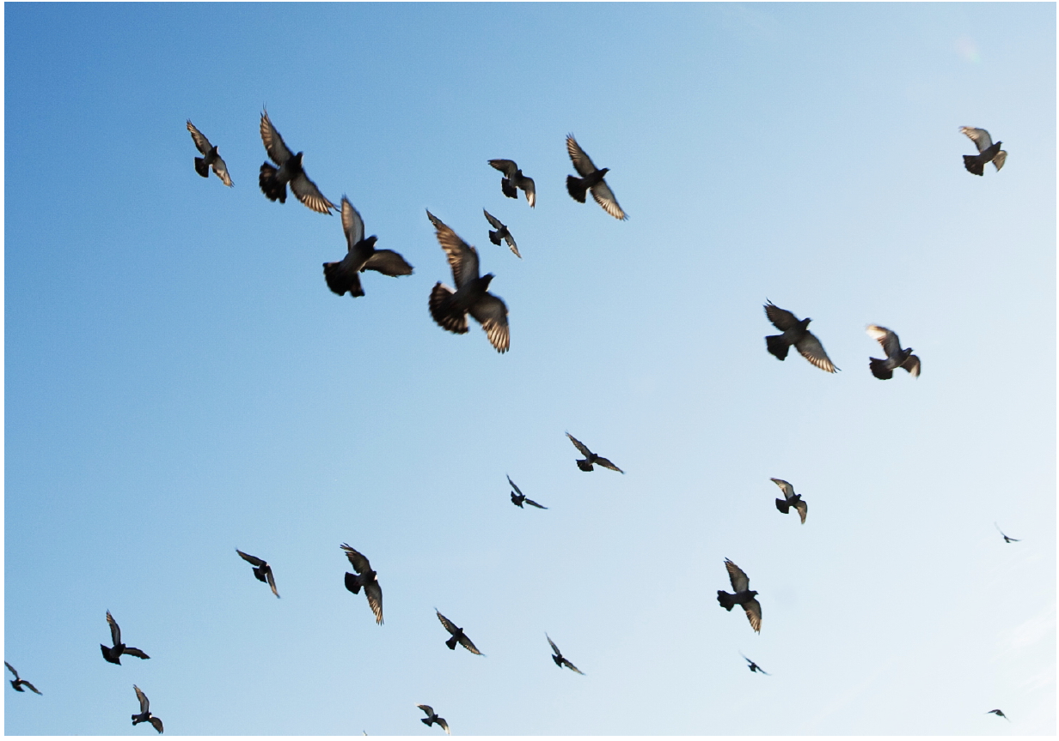
We need translation and scale invariance

Slide 5
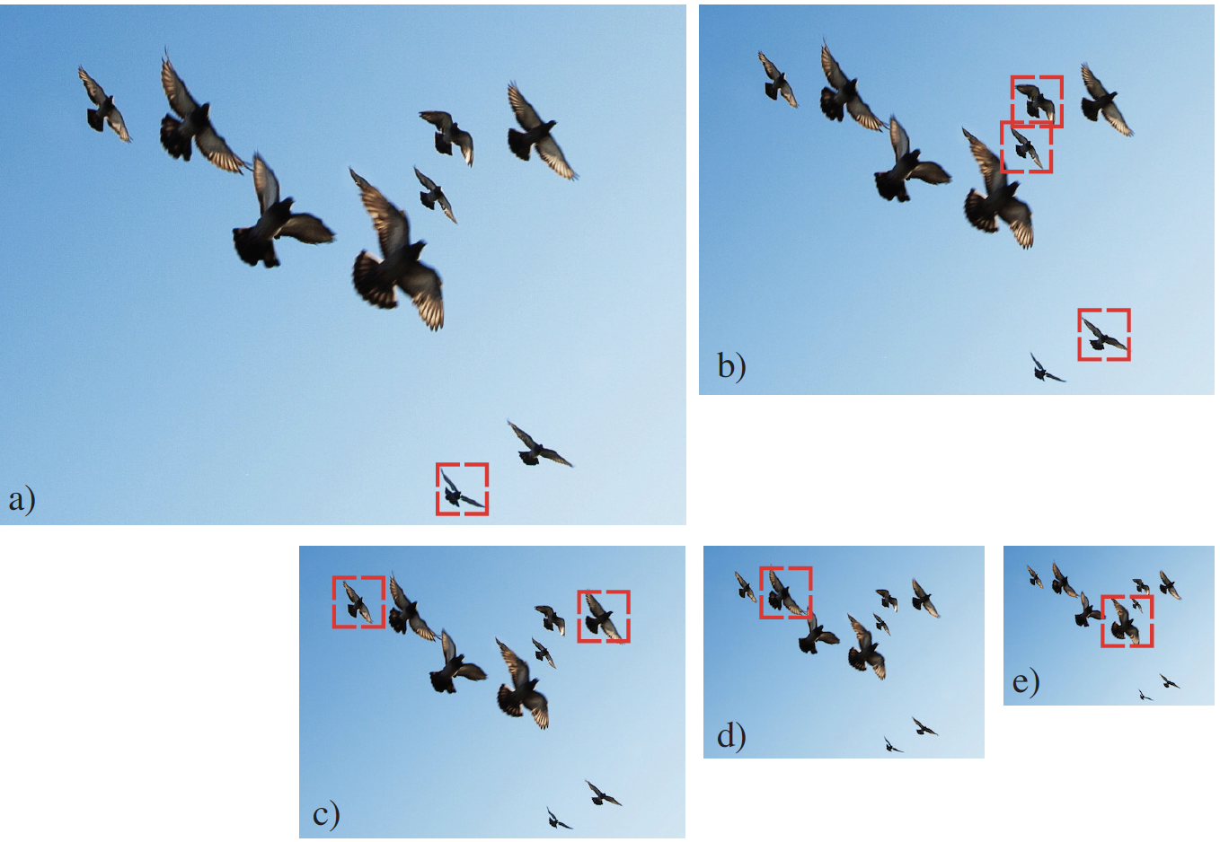
Image pyramids

Slide 6
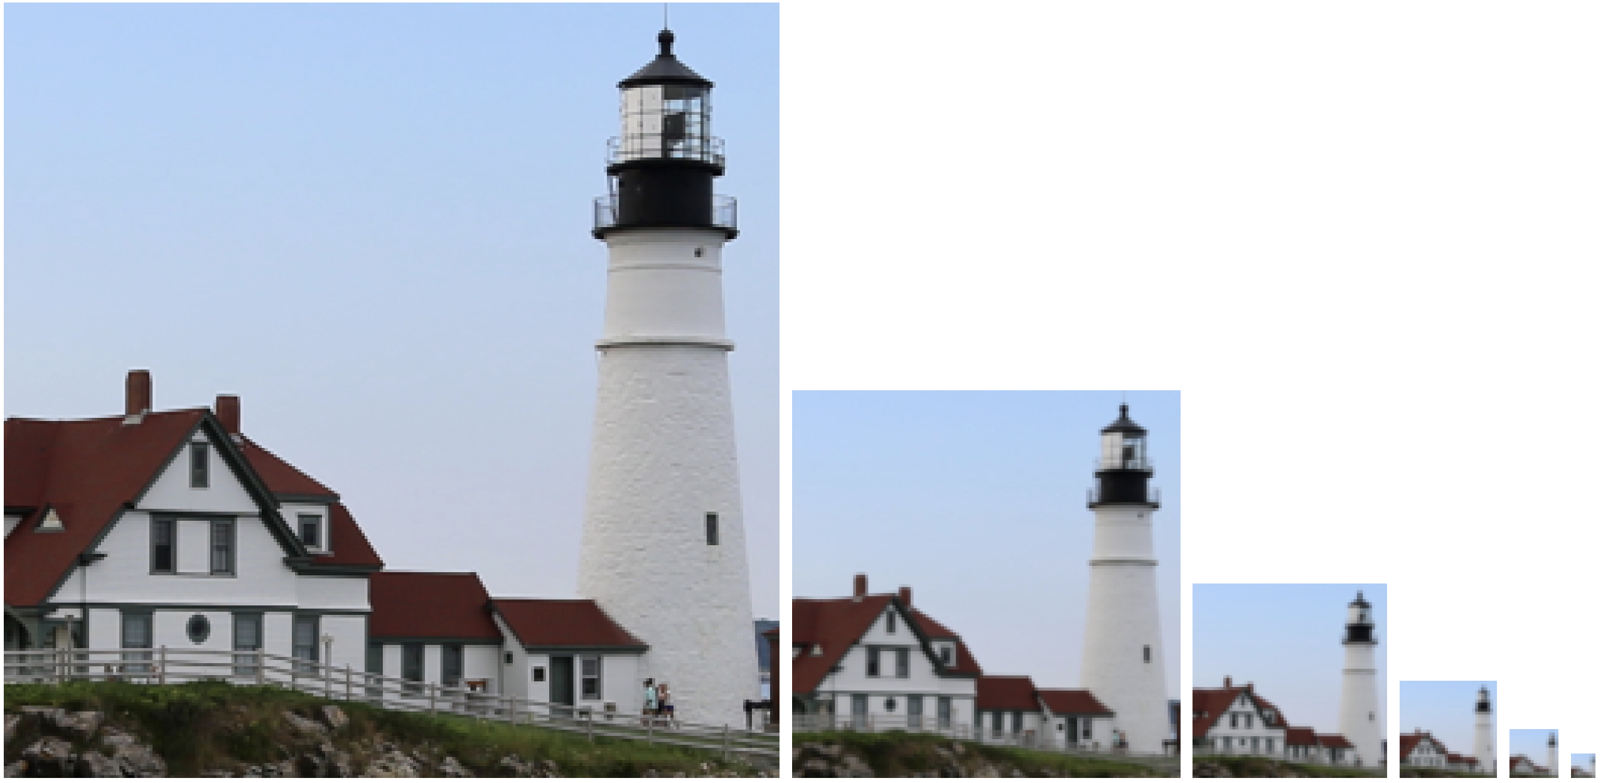
Gaussian Pyramid
1/2
1/2
1/2
1/2

Slide 7
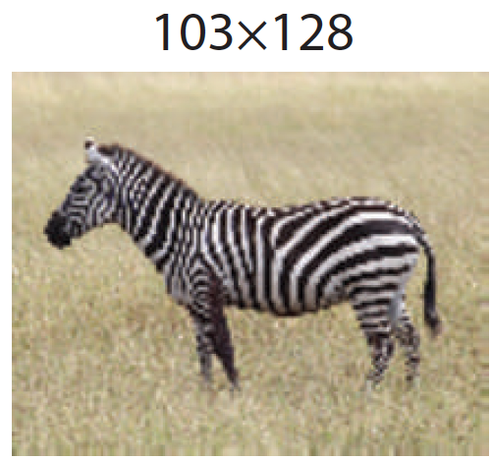
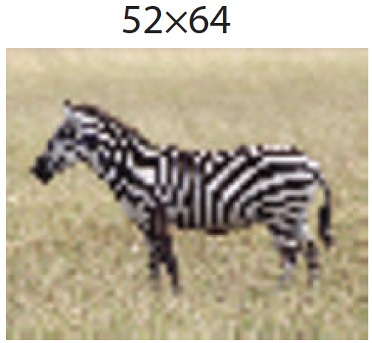
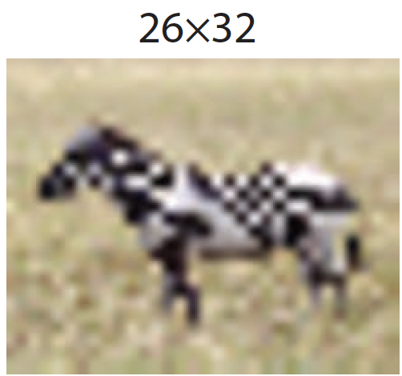
Subsampling and aliasing
1/2
1/2
Subsampling without blurring

Slide 8
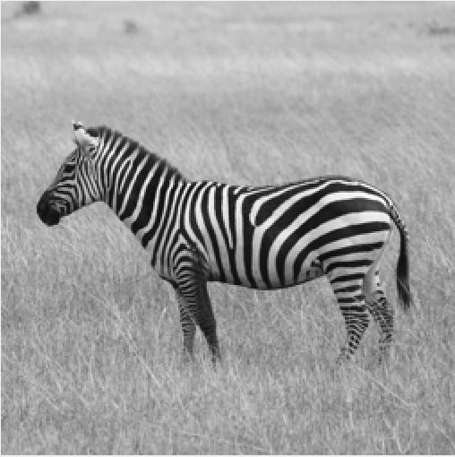
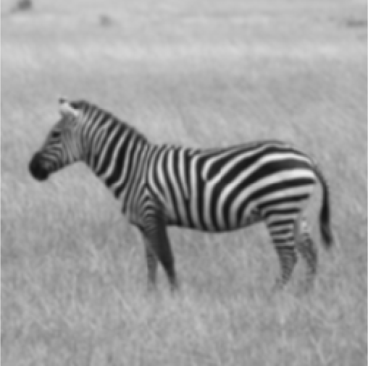
The Gaussian pyramid
For each level
1. Blur input image with a Gaussian (actually, binomial) low-pass filter
[1, 4, 6, 4, 1]
[1
4
6
4
1]
[1, 4, 6, 4, 1]

Slide 9
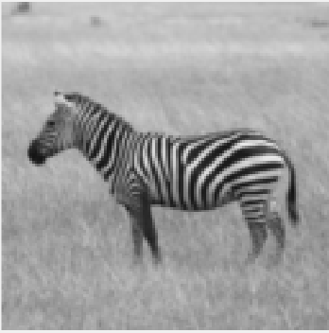
The Gaussian pyramid
For each level
1. Blur input image with a Gaussian filter
2. Downsample image

Slide 10
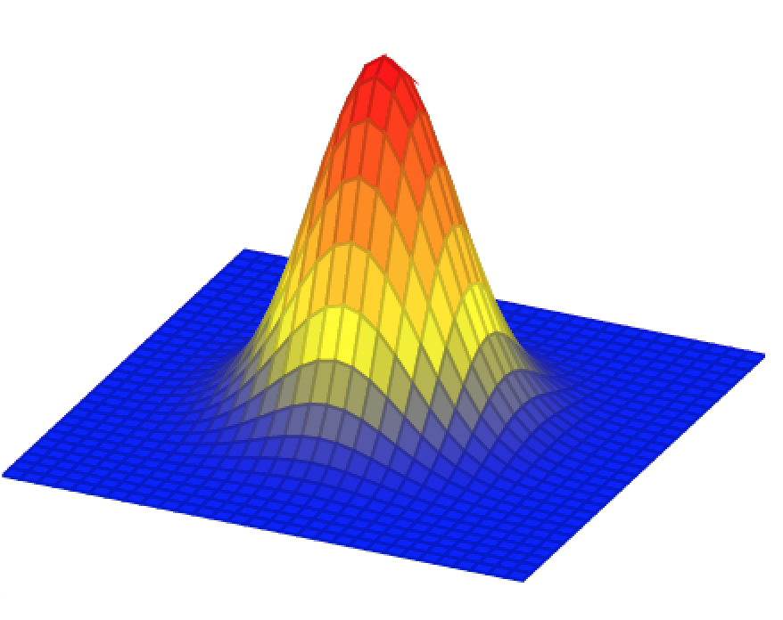
The Gaussian pyramid
256×256
128×128
64×64
32×32
2
2
2

Slide 11
The Gaussian pyramid
512×512
256×256
128×128
64×64
32×32
(original image)

Slide 12
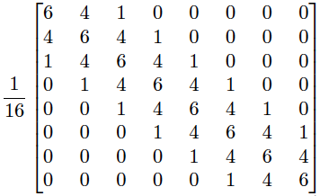
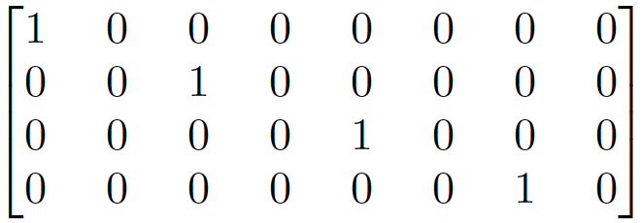
The Gaussian pyramid operators, in matrix form
[1, 4, 6, 4, 1]
$$g_{2}$$
$$g_{1}$$
[1, 4, 6, 4, 1]
$$g_{0}$$
$$g_{1}=G_{0}g_{0}$$

Slide 13
The Gaussian pyramid operators, in matrix form
[1, 4, 6, 4, 1]
$$g_{2}$$
$$g_{1}$$
[1, 4, 6, 4, 1]
$$g_{0}$$
$$g_{1}=G_{0}g_{0}$$

Slide 14
The Gaussian pyramid as a matrix multiplication
[1, 4, 6, 4, 1]
$$g_{2}$$
$$g_{1}$$
[1, 4, 6, 4, 1]
$$g_{0}$$
$$g_{2}=G_{1}g_{1}$$
$$I$$
$$g_{1}=G_{0}g_{0}$$
$$g_{0}$$
$$x$$
=
$$g_{2}=G_{1}G_{0}g_{0}$$
$$G_{0}$$
$$g_{1}$$
$$g_{2}$$
$$G_{1}G_{0}$$

Slide 15
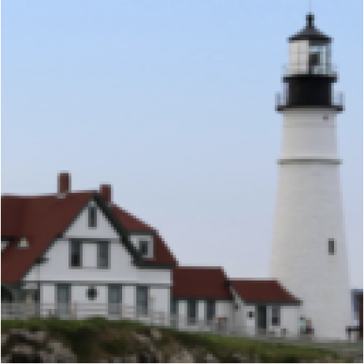
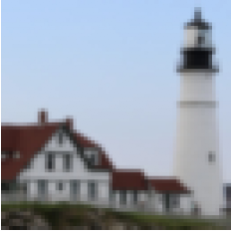
The Gaussian pyramid summary
For each level
1. Blur input image with a Gaussian filter
2. Downsample image

Slide 16
Gaussian pyramid applications
Object recognition
Neural Network image synthesis

Slide 17
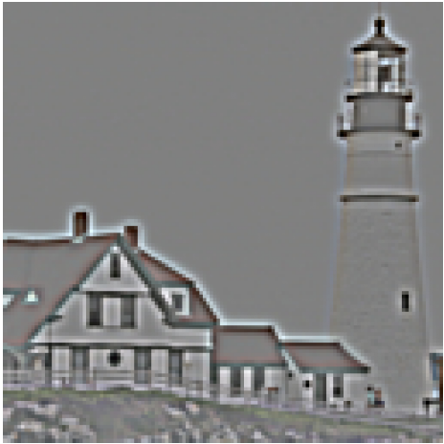
The Laplacian Pyramid
Compute the difference between upsampled Gaussian pyramid level k+1 and Gaussian pyramid level k.
+
-

Slide 18
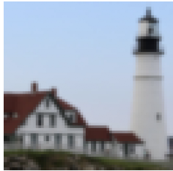
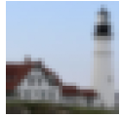
The Laplacian Pyramid
Gaussian pyramid

Slide 19
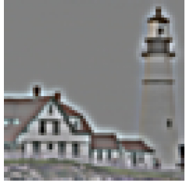
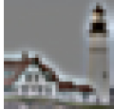
The Laplacian Pyramid
Gaussian pyramid
Laplacian pyramid

Slide 20
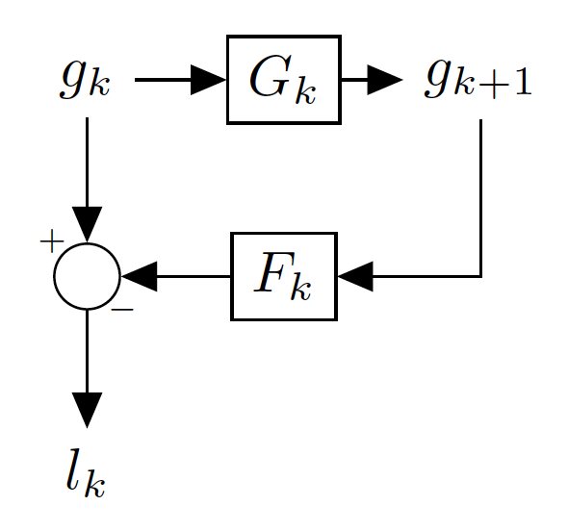
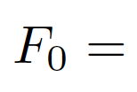
The Laplacian Pyramid operators in matrix form
Blurring and downsampling:
(Downsampling by 2)
Upsampling and blurring:
(blur)

Slide 21
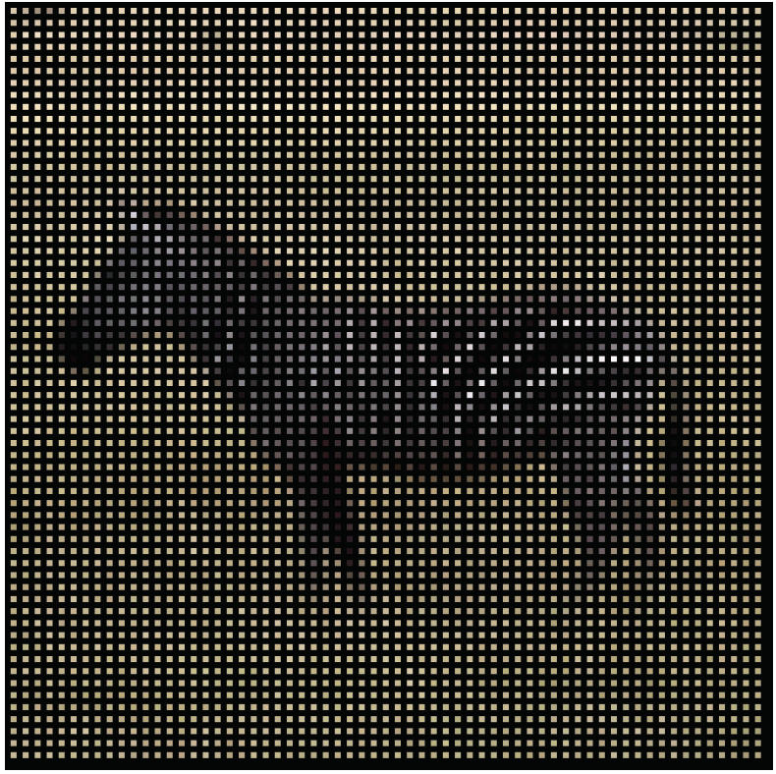
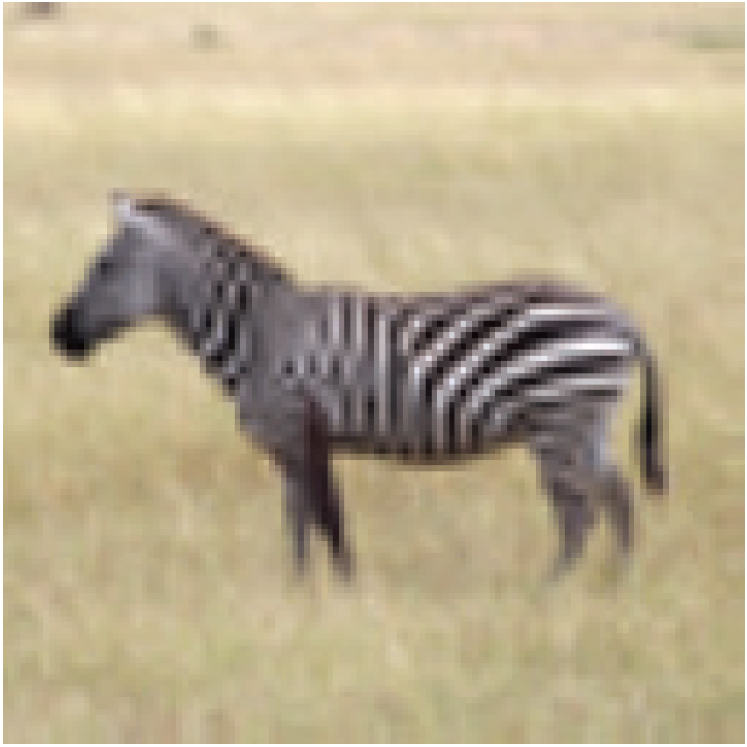
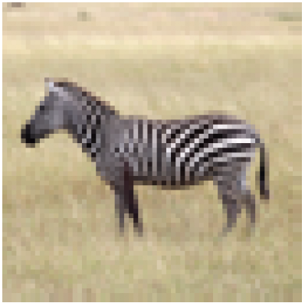
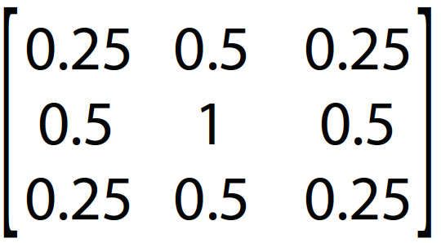
Upsampling
128x128
128x128
64x64
Insert zeros
=

Slide 22
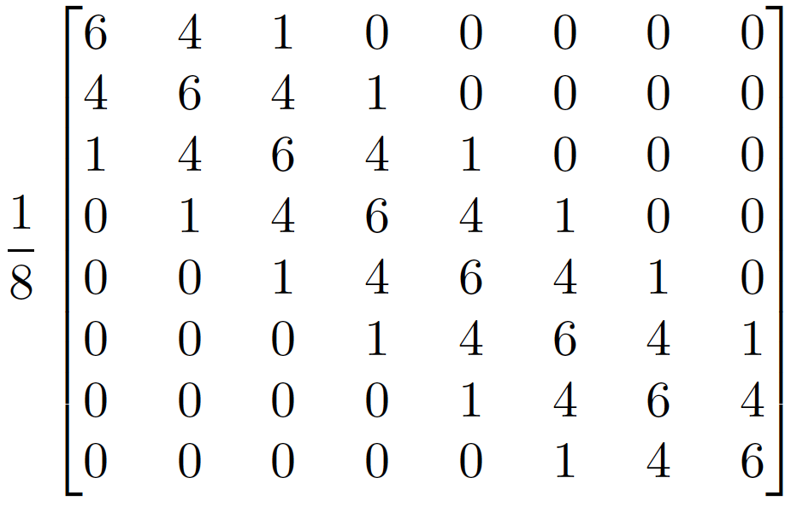
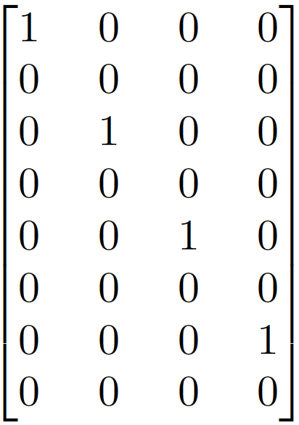
The Laplacian Pyramid operators in matrix form
Blurring and downsampling:
(Downsampling by 2)
Upsampling and blurring:
(blur)
(blur)
(Upsampling by 2)

Slide 23
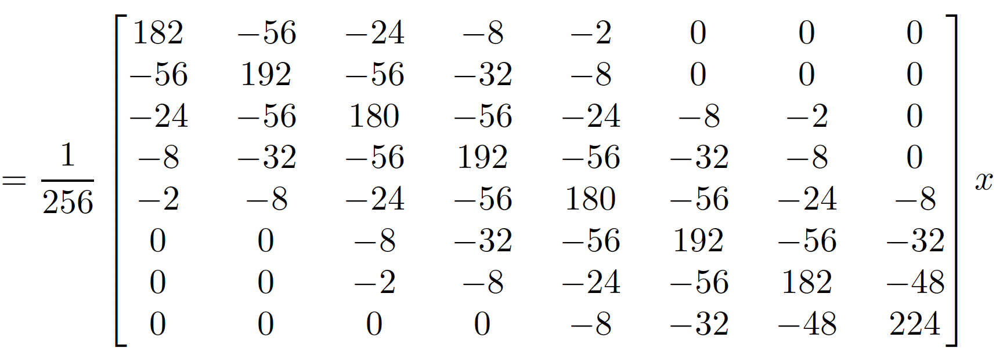
The Laplacian Pyramid

Slide 24
The Laplacian Pyramid shown in matrix form
Gaussian pyramid
$$l_{0}$$
$$x$$
=
Laplacian pyramid
$$l_{1}$$
$$g_{2}$$

Slide 25
Inverting the Laplacian Pyramid
Gaussian
residual
Laplacian pyramid
Can we invert the Laplacian Pyramid?

Slide 26
Inverting the Laplacian Pyramid
Gaussian pyramid
Laplacian pyramid

Slide 27
Inverting the Laplacian Pyramid
Gaussian pyramid
Laplacian pyramid

Slide 28
Inverting the Laplacian Pyramid
Gaussian pyramid
Laplacian pyramid

Slide 29
Inverting the Laplacian Pyramid
Gaussian pyramid
Laplacian pyramid

Slide 30
Inverting the Laplacian Pyramid
Gaussian pyramid
Laplacian pyramid
Analysis/Encoder
Synthesis/Decoder

Slide 31
Laplacian pyramid applications
Texture synthesis
Image compression
Noise removal
Computing image features (e.g., SIFT)
Image Blending…

Slide 32
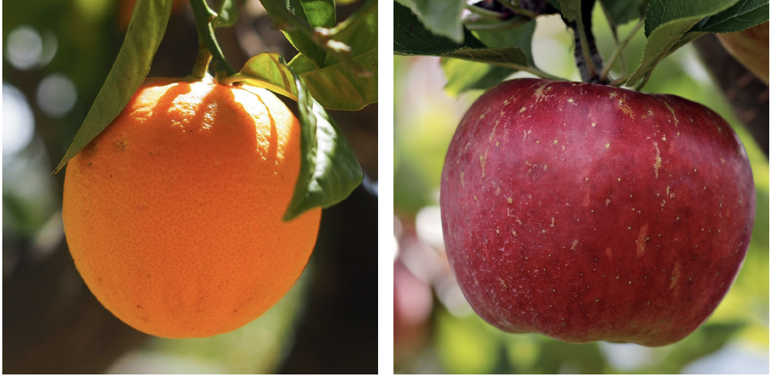
Image Blending

Slide 33
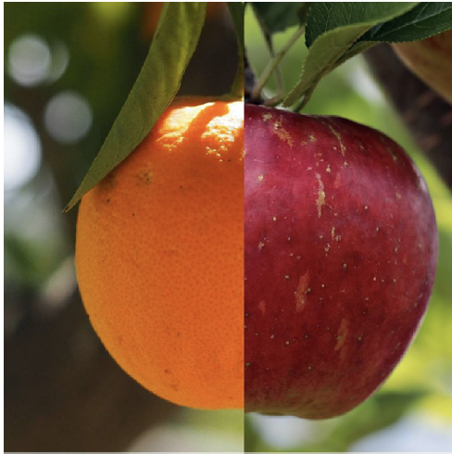
Image Blending

Slide 34
Image Blending
$$I^{A}$$
$$I^{B}$$
$$m$$
$$I$$
$$I=m*I^{A}+(1-m)*I^{B}$$

Slide 35
Image Blending
Slide by A. Efros

Slide 36
Image Blending
Slide by A. Efros

Slide 37
Image Blending
Slide by A. Efros

Slide 38
Image Blending
Slide by A. Efros

Slide 39
Image Blending
Slide by A. Efros

Slide 40
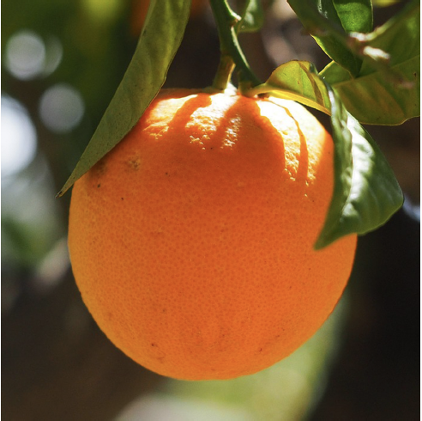
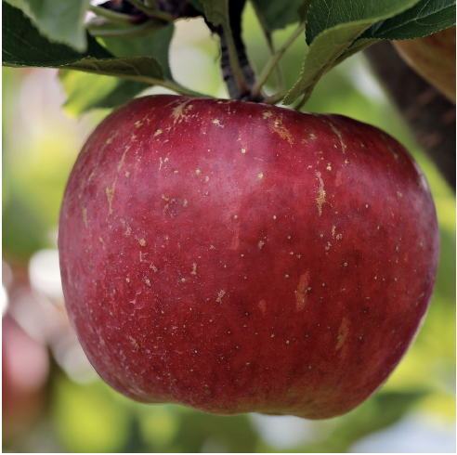
Image Blending with the Laplacian Pyramid

Slide 41
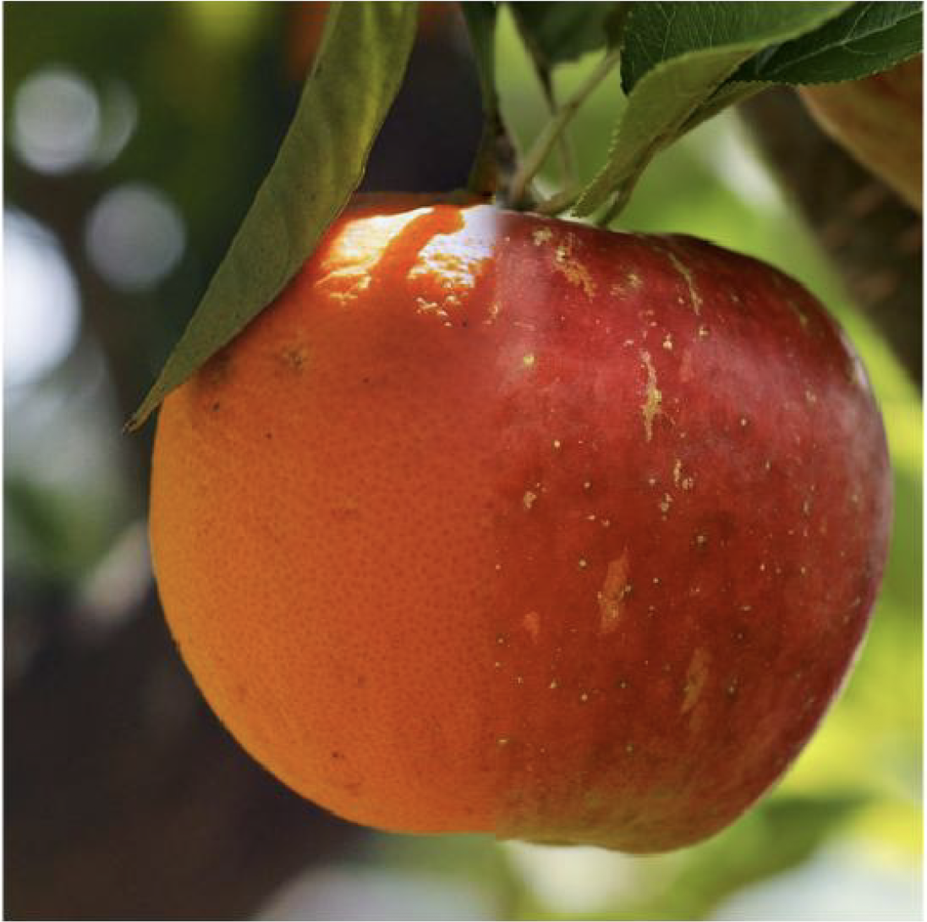
Image Blending with the Laplacian Pyramid

Slide 42
Image Blending with the Laplacian Pyramid
Build Laplacian pyramid for both images: LA, LB
Build Gaussian pyramid for mask: G
Build a combined Laplacian pyramid.
Collapse L to obtain the blended image.

Slide 43
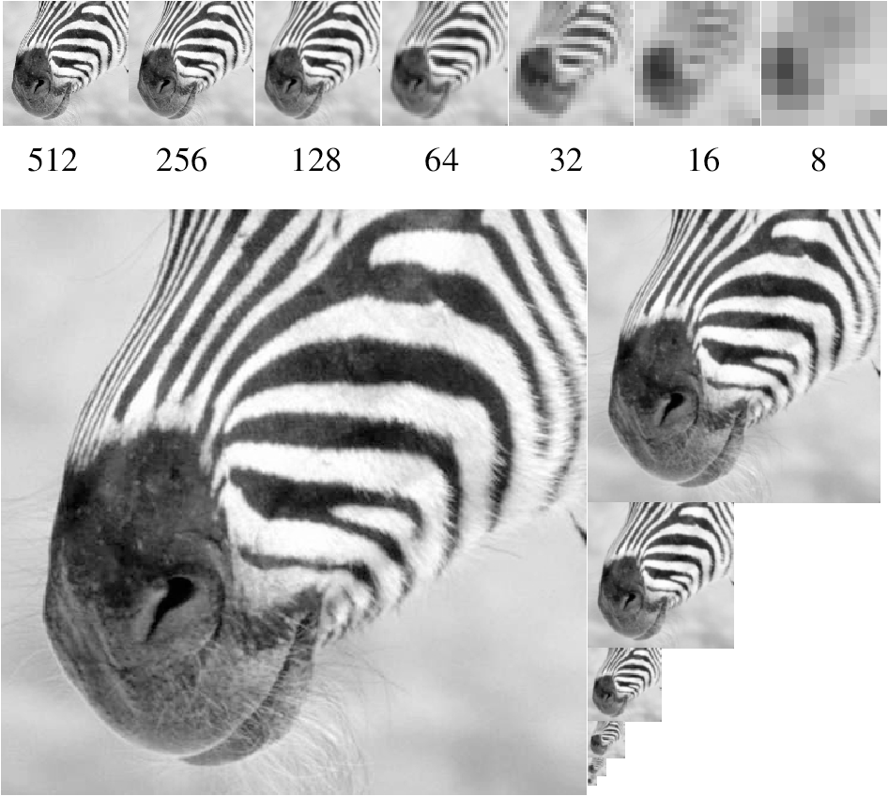
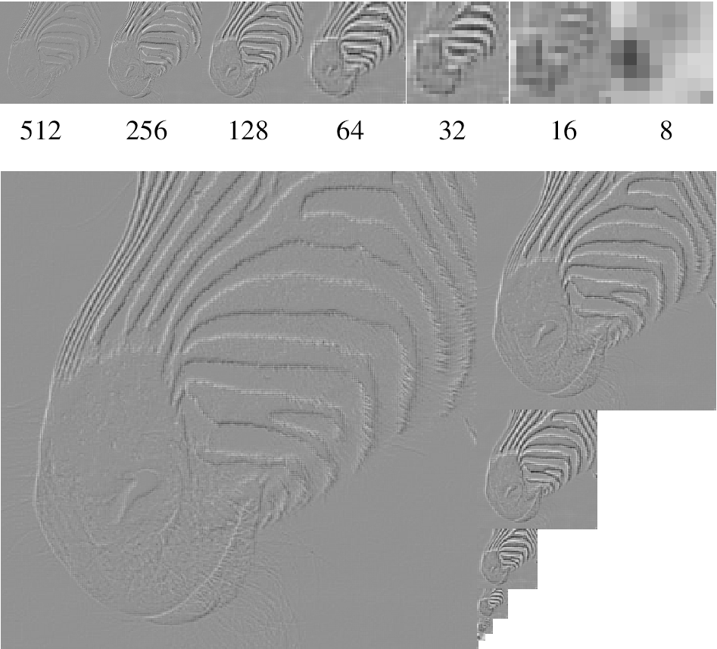
Image pyramids
Gaussian Pyr
Laplacian Pyr
(And many more: QMF, steerable, …
Convnets!)

Slide 44
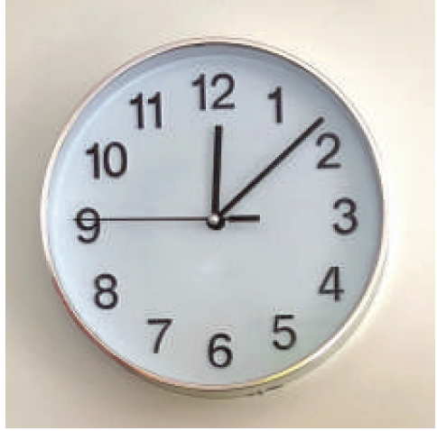
Orientations

Slide 45
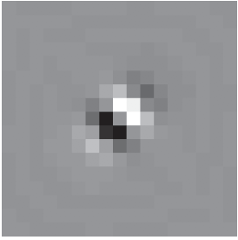
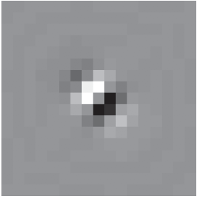
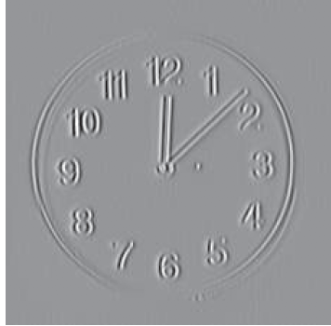
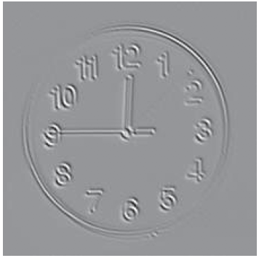
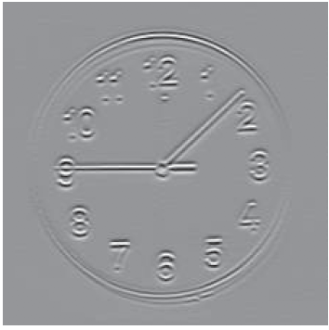
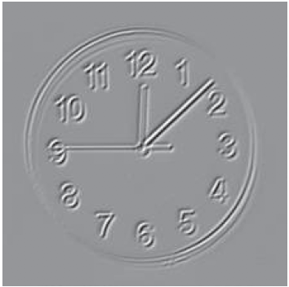
Steerable Pyramid
similar to Gabor filters, similar to early filters in human visual system, similar to early filters of trained neural networks: Oriented, spatially localized, multi-scale, multi-phase filter bank.

Slide 46
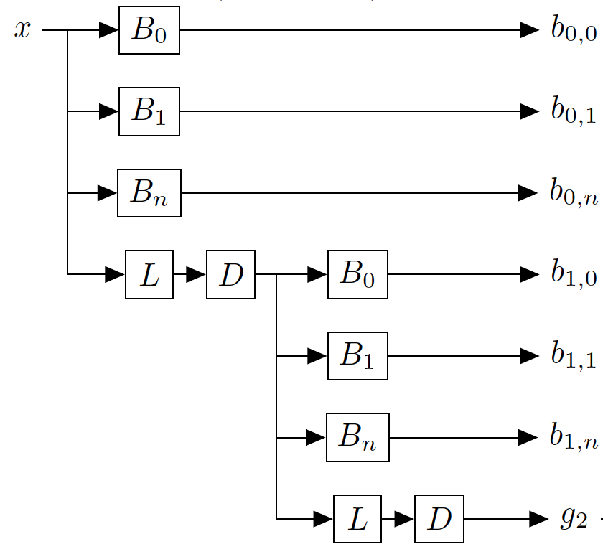
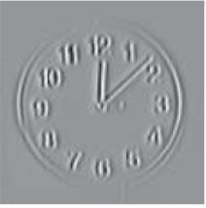
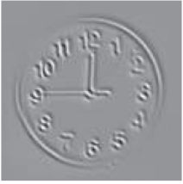
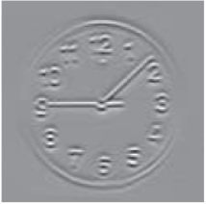
Steerable Pyramid
=
$$x$$

Slide 47
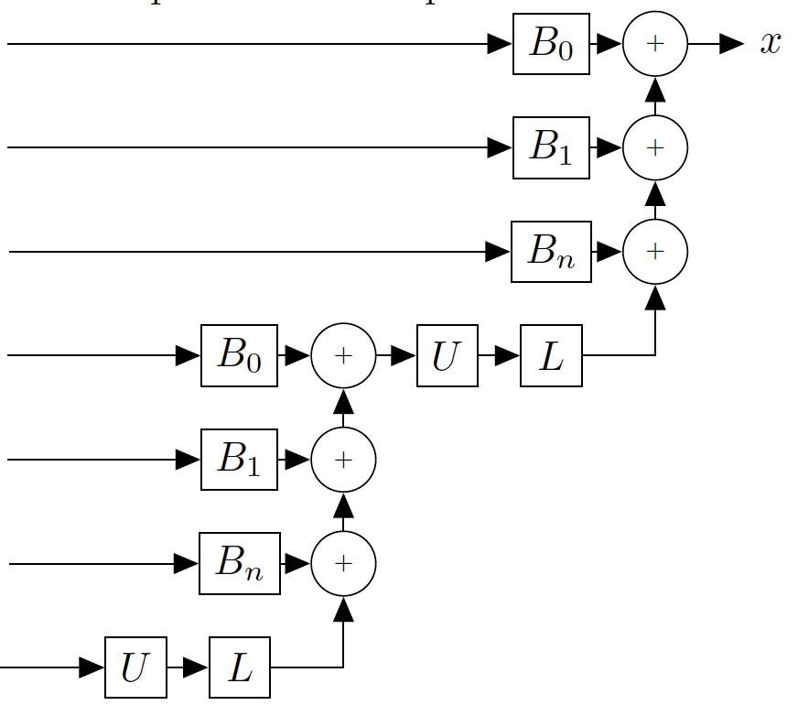
Steerable Pyramid
Analysis/Encoder
Synthesis/Decoder

Slide 48
Steerable pyramid applications
Texture synthesis
Noise removal
Motion analysis
Motion synthesis, motion magnification

Slide 49
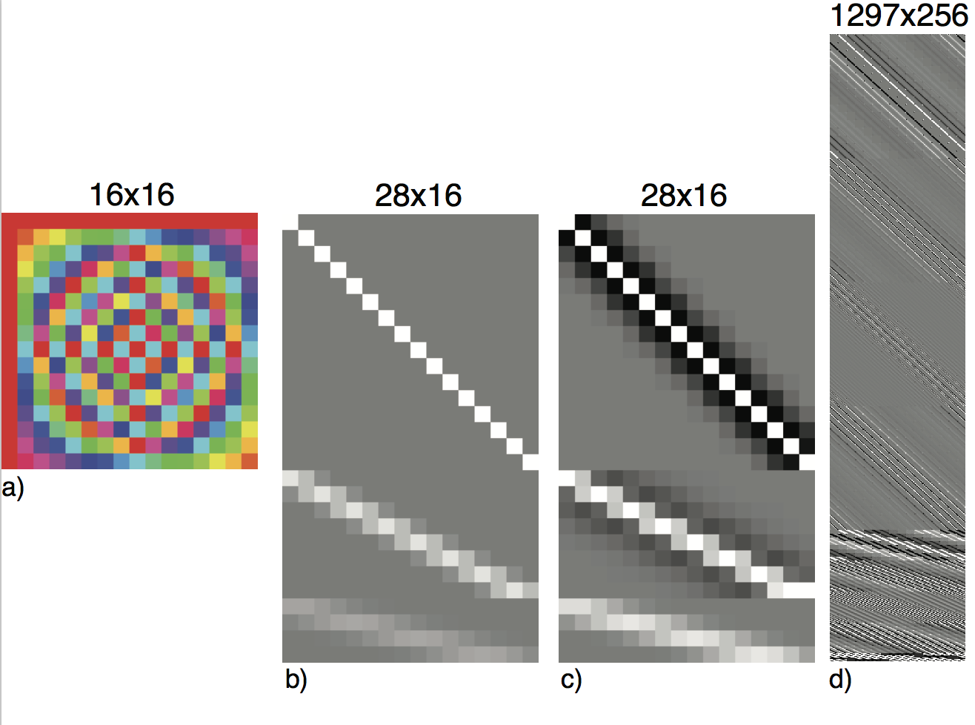
Linear Image Transforms

Slide 50
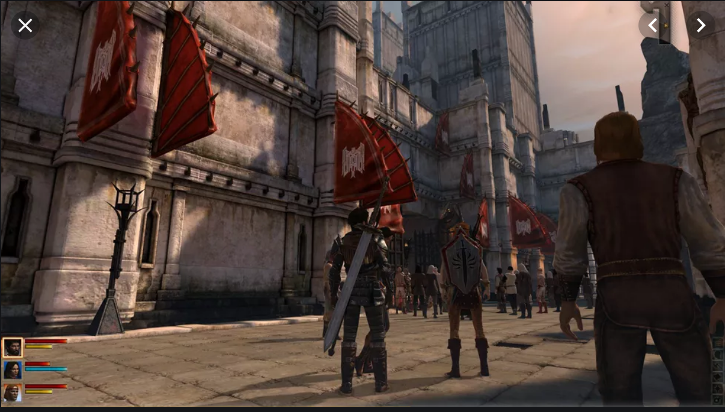
Making textures

Slide 52
Examples of Textures
Stationary
Stochastic

Slide 53
Pre-attentive texture discrimination
Bela Julesz, "Textons, the Elements of Texture Perception, and their Interactions". Nature 290: 91-97. March, 1981.

Slide 54
Pre-attentive texture discrimination
Bela Julesz, "Textons, the Elements of Texture Perception, and their Interactions". Nature 290: 91-97. March, 1981.

Slide 55
Pre-attentive texture discrimination
Bela Julesz, "Textons, the Elements of Texture Perception, and their Interactions". Nature 290: 91-97. March, 1981.

Slide 56
Pre-attentive texture discrimination
This texture pair is pre-attentively indistinguishable. Why?
Bela Julesz, "Textons, the Elements of Texture Perception, and their Interactions". Nature 290: 91-97. March, 1981.

Slide 58
Jim Bergen’s conjecture
“If matching the mean amplitude of a bandpass spatial filter’s response goes a little way towards mimicking human texture perception, then maybe matching the histogram of the responses of filters (the marginal statistics) will do an even better job of capturing human texture perception.”
Dave Heeger’s response
“You mean if I took a steerable pyramid of some random noise, and forced the histograms of each subband level to match those of some target texture, that the modified noise image would then look like that texture??? No way! I’ll prove it to you; here, let me try it out… hmm, gee, that worked pretty well…”

Slide 59
https://www.cns.nyu.edu/heegerlab/content/publications/Heeger-siggraph95.pdf
SIGGRAPH 1995

Slide 60
The main idea: it works by ‘kind of’ projecting a random image into the set of equivalent textures
Set of equivalent textures
Set of perceptually
equivalent textures
Space of all images

Slide 61
Overview of the algorithm
Two main tools:
1- steerable pyramid
2- matching histograms

Slide 62
1-The steerable pyramid
Steerable pyr
Input texture

Slide 63
Overview of the algorithm
Two main tools:
1- steerable pyramid
2- matching histograms

Slide 64
2-Matching histograms
Histograms
Cumulative Histograms
9% of pixels have an intensity value
within the range[0.37, 0.41]
75% of pixels have an intensity value
smaller than 0.5
5% of pixels have an intensity value
within the range[0.37, 0.41]

Slide 65
2-Matching histograms
Z(x,y)
We look for a transformation
of the image Y
Y’ = f (Y)
Such that
Hist(Y) = Hist(f(Z))
Problem: there are infinitely many functions
that can do this transformation.
A natural choice is to use f being:
pointwise non linearity
stationary
monotonic (most of the time invertible)
?
Y(x,y)

Slide 66
2-Matching cumulative histograms
The function f is just a look up table: it says, change all the pixels of
value Y into a value f(Y).
Y’ = f (Y)
Y(x,y)
Y= 0.8
Y’= 0.5
Original
intensity
New
intensity

Slide 67
2-Matching histograms
Y’ = f (Y)

Slide 68
Matching histograms example
Histograms
Cumulative Histograms
10% of pixels are black
and 90% are white
?
?
5% of pixels have an intensity value
within the range[0.37, 0.41]

Slide 69
Matching histograms example
The function f is just a look up table: it says, change all the pixels of
value Y into a value f(Y).
Y’ = f (Y)
Y(x,y)
Y= 0.8
Y’= 1
Original
intensity
New
intensity

Slide 70
Matching histograms example
Y’ = f (Y)
In this example, f is a step function.

Slide 71
Matching histograms of a subband

Slide 72
Matching histograms of a subband
Y’ = f (Y)

Slide 73
Texture analysis
Wavelet decomposition (steerable pyr)
(histogram)
Input texture
(histogram)
(Steerable pyr; Simoncelli & Freeman, ’95)
The texture is represented as a collection of
marginal histograms.

Slide 74
Texture synthesis
Heeger and Bergen, 1995
(histogram)
Input texture
(histogram)

Slide 75
Why does it work? (sort of)

Slide 76
Why does it work? (sort of)
The black and white
blocks appear by
thresholding (f) a
blobby image
Iteration 0
Filter bank
…

Slide 77
Why does it work? (sort of)
The black and white blocks appear by
thresholding (f) a blobby image

Slide 78
Why does it work? (sort of)
After 6 iterations
Histograms match ok
red = target histogram, blue = current iteration

Slide 79
Color textures
R
G
Three textures
B

Slide 80
Color textures
R
G
B

Slide 81
Color textures
R
This does not work
G
B

Slide 82
Color textures
Problem: we create new colors not present in the original image.
Why? Color channels are not independent.
R
G
B

Slide 83
PCA and decorrelation
R
G
B
In the original image, R and G are correlated, but, after synthesis,…
G
G
R
R

Slide 84
PCA and decorrelation
The texture synthesis algorithm assumes that the channels
are independent.
What we want to do is some rotation
G
U2
Rotation
U1
R
See that in this rotated space,
if I specify one coordinate the
other remains unconstrained.

Slide 85
PCA and decorrelation
G
correlation(R,G)
1.0000 0.9303 0.6034
0.9303 0.9438 0.6620
0.6034 0.6620 0.5569
C =
R
PCA finds the principal directions of variation of the data.
It gives a decomposition of the covariance matrix as:
0.6347 0.6072 0.4779
0.6306 -0.0496 -0.7745
0.4466 -0.7930 0.4144
C = D D’
D =
By transforming the original data (RGB) using D we get:
U1
U2
U3
=
D’
R
G
B
U2
3 x Npixels
3 x 3
3 x Npixels
U1
The new components (U1,U2,U3) are decorrelated.

Slide 86
SVD and decorrelation
G
correlation(R,G)
1.0000 0.9303 0.6034
0.9303 0.9438 0.6620
0.6034 0.6620 0.5569
C =
R
SVD finds the principal directions of variation of the data.
It gives a decomposition of the covariance matrix as:
-0.6347 0.6072 0.4779
-0.6306 -0.0496 -0.7745
-0.4466 -0.7930 0.4144
C = U S V’
V =
By transforming the original data (RGB) using D we get:
https://en.wikipedia.org/wiki/Singular_value_decomposition
U1
U2
U3
=
V’
R
G
B
U2
3 x Npixels
3 x 3
3 x Npixels
U1
The new components (U1,U2,U3) are decorrelated.

Slide 87
Color textures
R
G
Rotation
Matrix
(3x3)
B
D’
These three textures
look similar
(high dependency)
These three textures
Look less similar
(lower dependency)

Slide 88
Color textures
R
Inverse
Rotation
Matrix
G
D
B

Slide 89
Color textures
R
R
G
Inverse
Rotation
G
Rotation
Matrix
D
B
D’
B
These three textures
look similar
(high dependency)
These three textures
Look less similar
(lower dependency)

Slide 90
Color channels
Without PCA
With PCA

Slide 91
Color channels

Slide 92
Color channels

Slide 93
Examples from the paper
Heeger and Bergen, 1995

Slide 94
Examples from the paper

Slide 95
Examples not from the paper
Input
texture
Synthetic
texture
But, does it really work even when it seems to work?

Slide 96
But, does it really work??? How to measure how well the representation constraints the set of equivalent textures?
?
All the textures in this
set have the same
parameters.
?
?
?
?

Slide 97
How to identify the set of equivalent textures?
?
This does not reveal how poor
the representation actually is.

Slide 98
Portilla and Simoncelli
Parametric representation, based on Gaussian scale mixture prior model for images.
About 1000 numbers to describe a texture.
Better results than Heeger Bergen.

Slide 99
Portilla and Simoncelli

Slide 100
Portilla & Simoncelli
Heeger & Bergen
Portilla & Simoncelli

