Slide 1
Lecture 8
Introduction to Machine Learning

Slide 2
Announcements
Pset 3 due next Tuesday (in 1 week)
Pytorch tutorials Tues 4-6pm and Thurs 4-6pm

Slide 3
8. Introduction to Machine Learning
“It’s all about the data!”
Formalisms of learning (Data, Compute, Objective Function, Hypothesis Space, Optimizer)
Case study #1: Linear least-squares
Empirical risk minimization
Case study #2: Image classification
Softmax regression
The problem of generalization

Slide 4
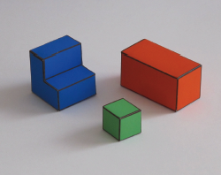
Edges
Occlusion
Horizontal 3D edge
Change of
Surface orientation
Vertical 3D edge
Contact edge
Shadow boundary

Slide 5
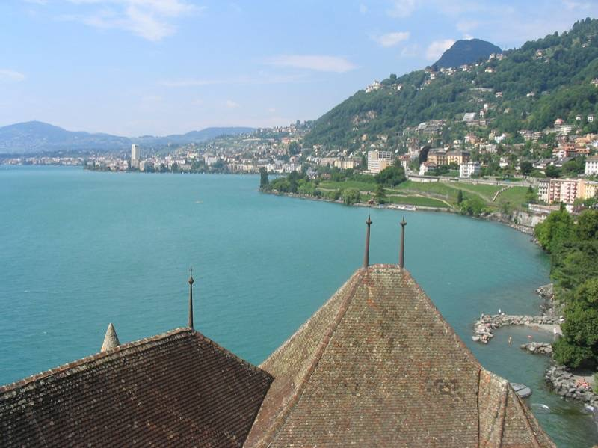
[Slide credit: Alexei Efros]
Notes:
Introduce gist.

Slide 6
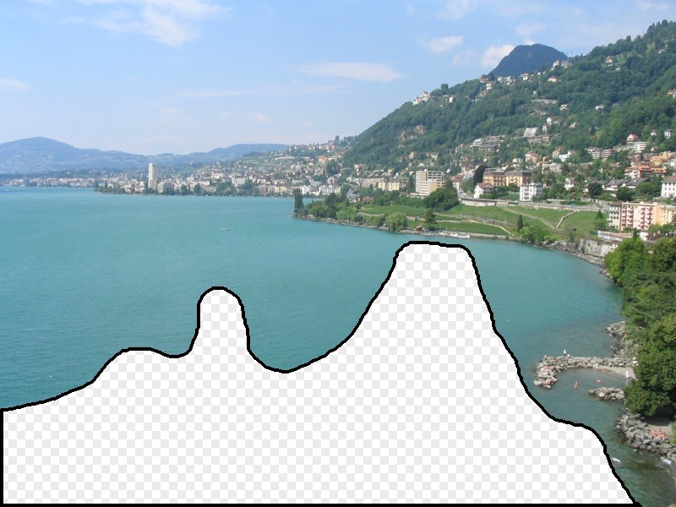
[Hays and Efros. Scene Completion Using Millions of Photographs. SIGGRAPH 2007 and CACM October 2008.]
[Slide credit: Alexei Efros]
Notes:
Introduce gist.

Slide 7
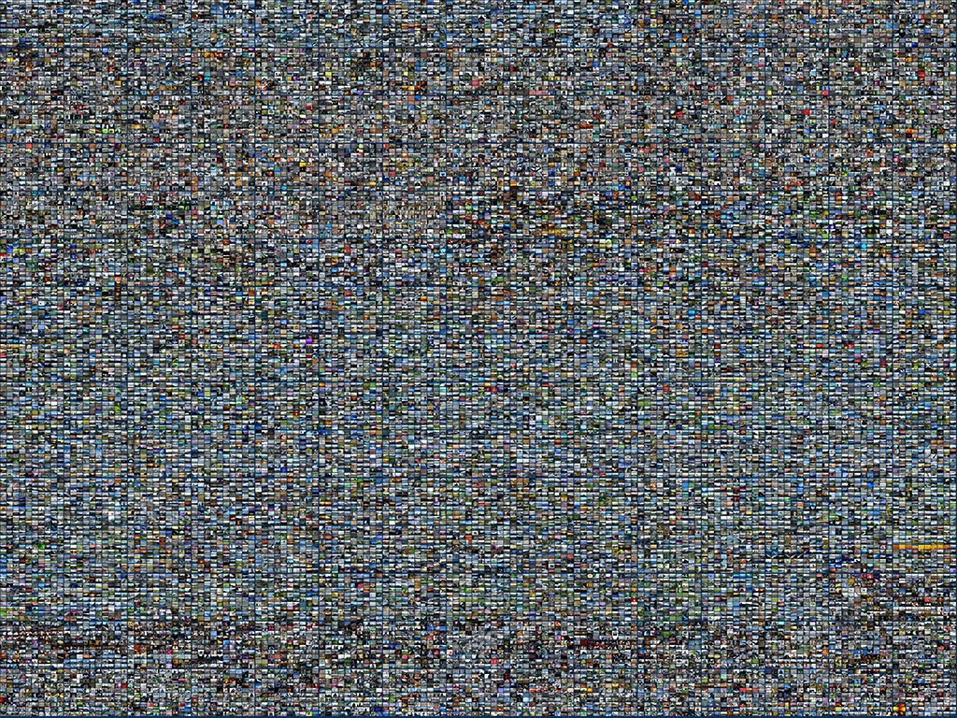
2 Million Flickr Images
[Slide credit: Alexei Efros]
Notes:
Now we take our gist (and mask and color image) and find it’s L2 nearest neighbors in the database of 2.3 million images, and here they are

Slide 8
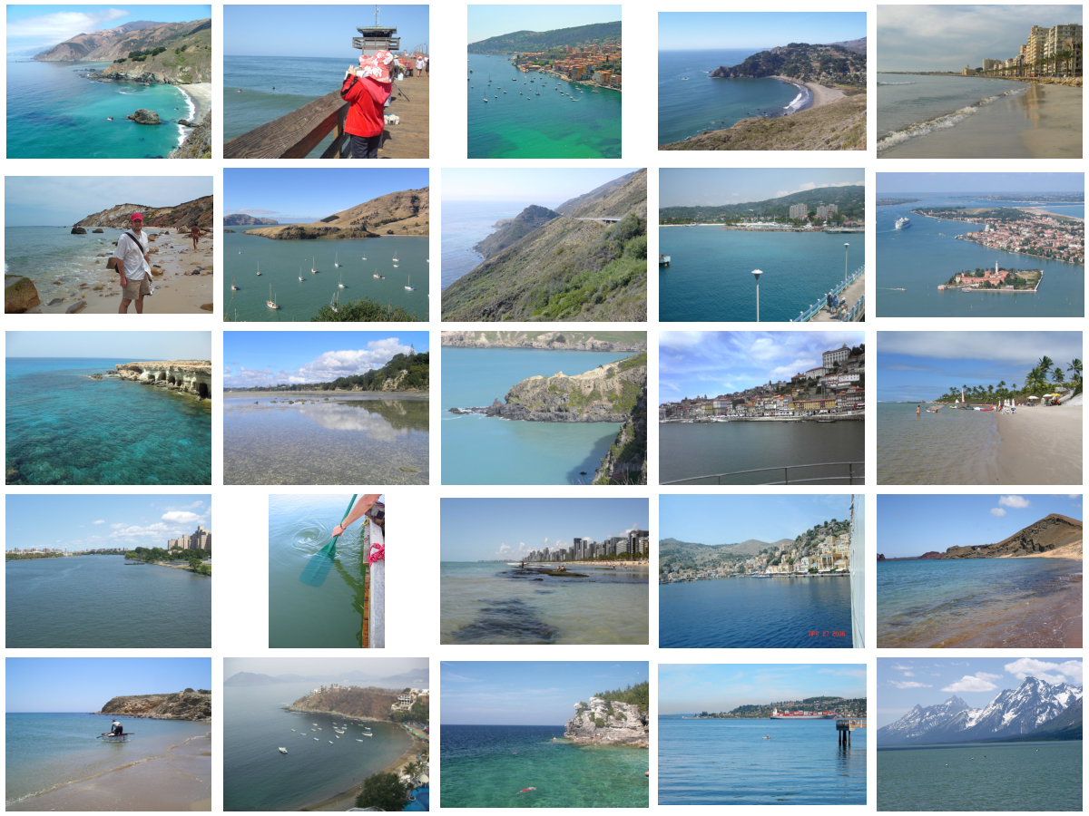
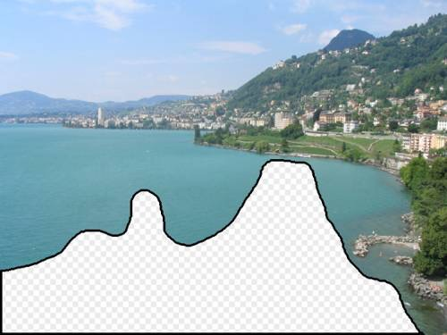
… 200 total
[Slide credit: Alexei Efros]

Slide 9
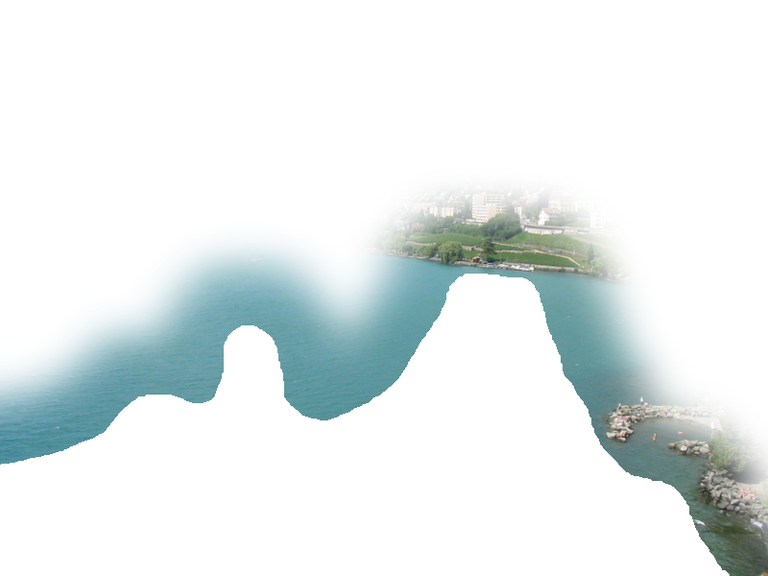
[Slide credit: Alexei Efros]

Slide 10
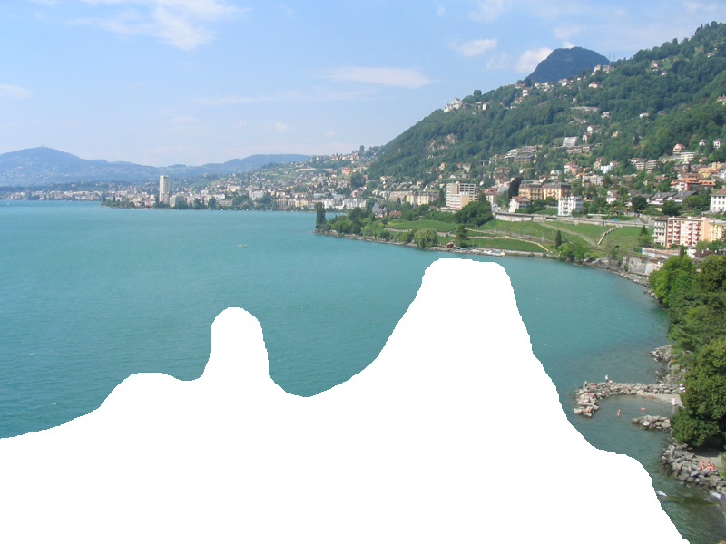
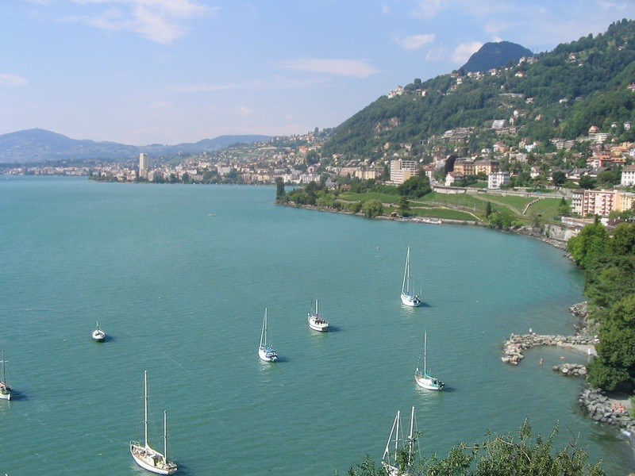

Slide 11
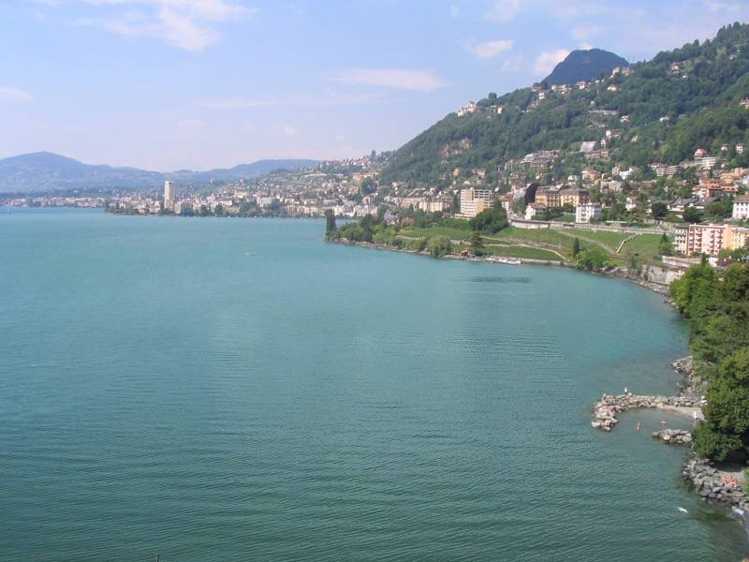
[Slide credit: Alexei Efros]

Slide 12
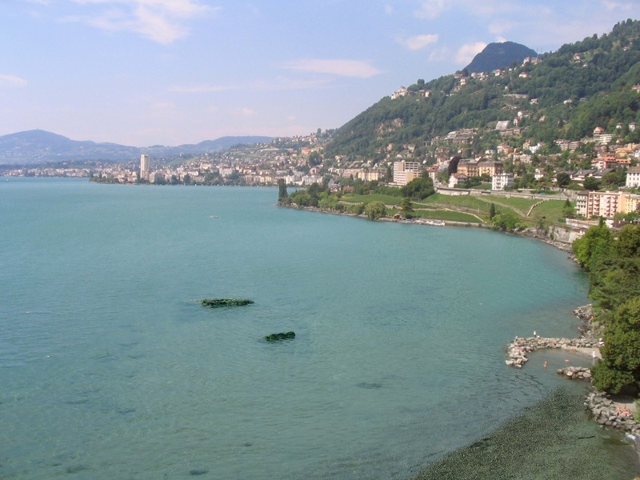
[Slide credit: Alexei Efros]

Slide 13
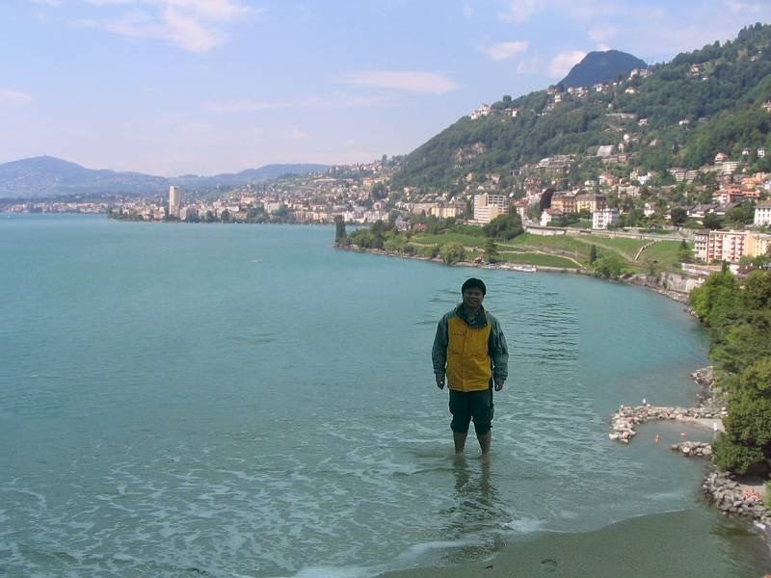
[Slide credit: Alexei Efros]

Slide 14
[Slide credit: Alexei Efros]

Slide 15
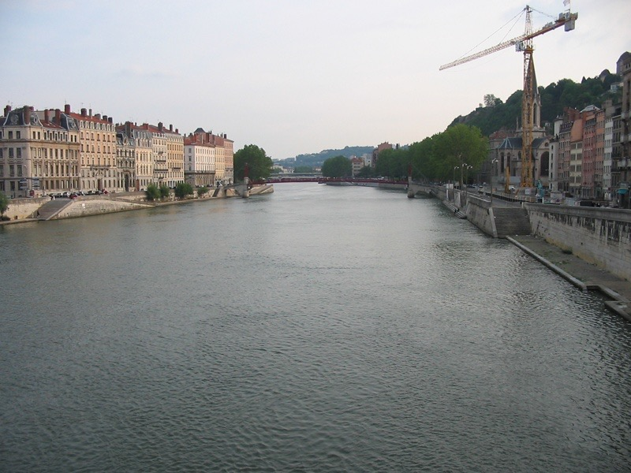
[Slide credit: Alexei Efros]

Slide 16
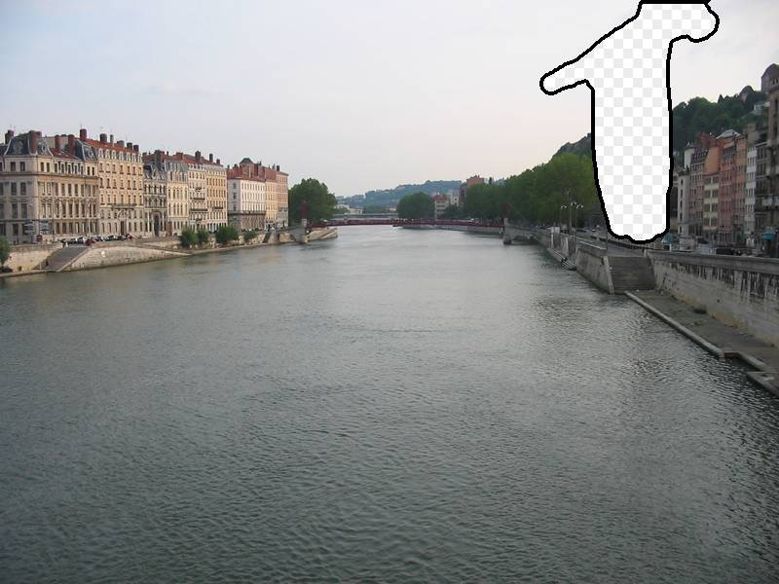
[Slide credit: Alexei Efros]

Slide 17
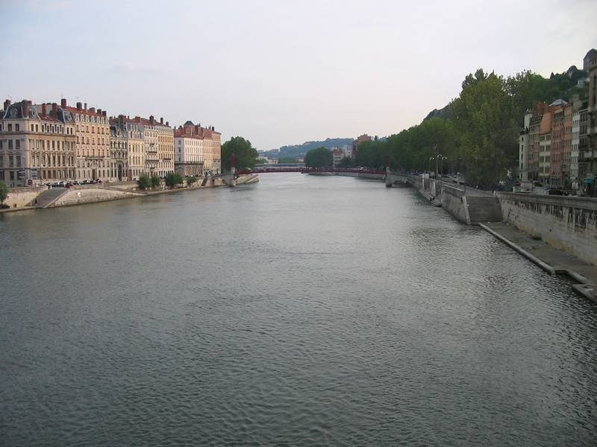
[Slide credit: Alexei Efros]

Slide 18
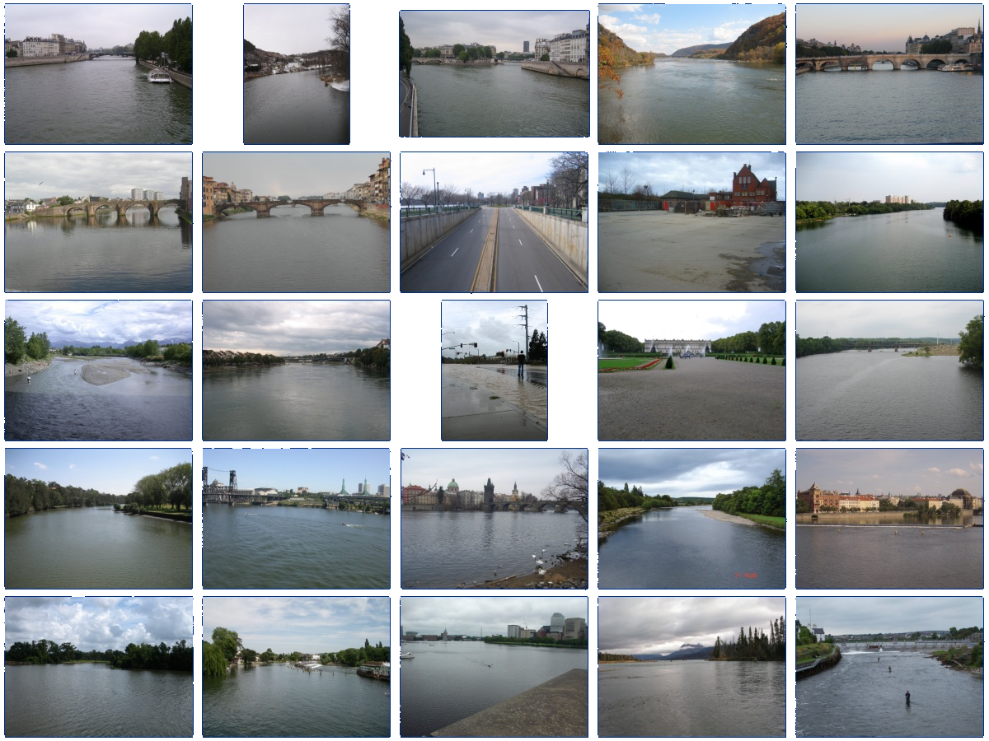
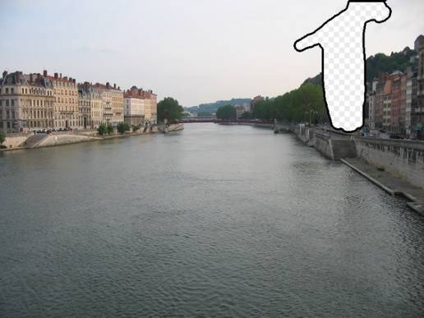
… 200 scene matches
[Slide credit: Alexei Efros]

Slide 19
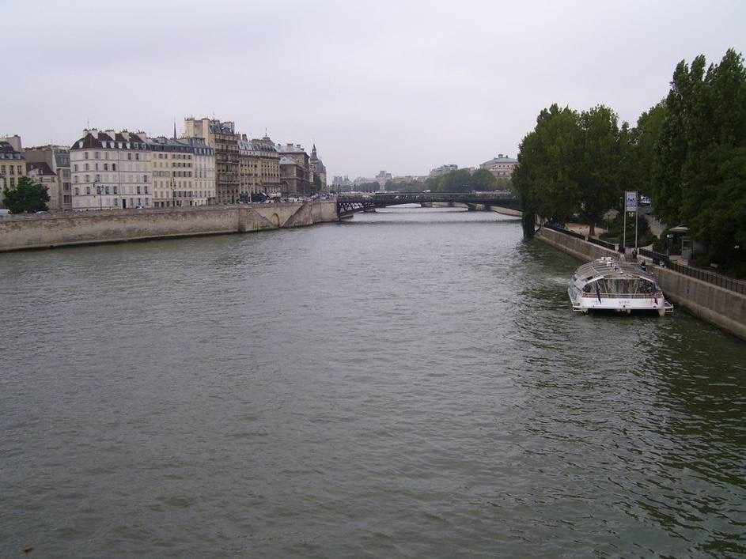
Notes:
Not actually the same scene, even though they’re startlingly similar

Slide 21
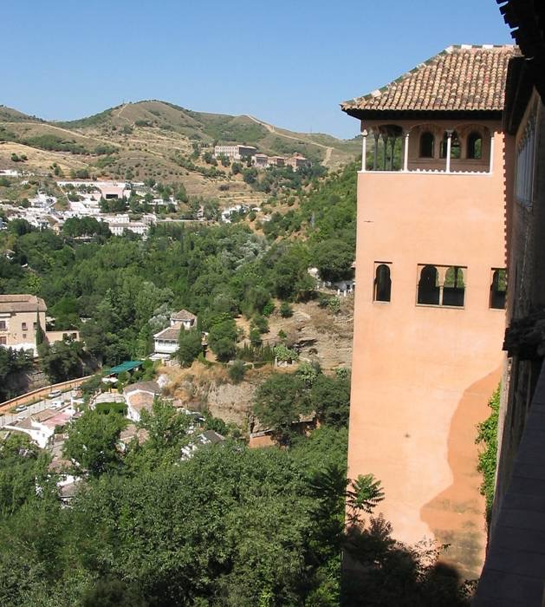
[Slide credit: Alexei Efros]

Slide 22
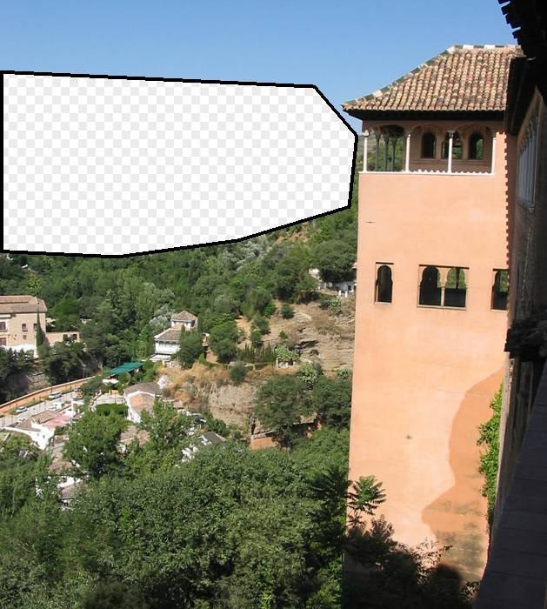
[Slide credit: Alexei Efros]

Slide 23
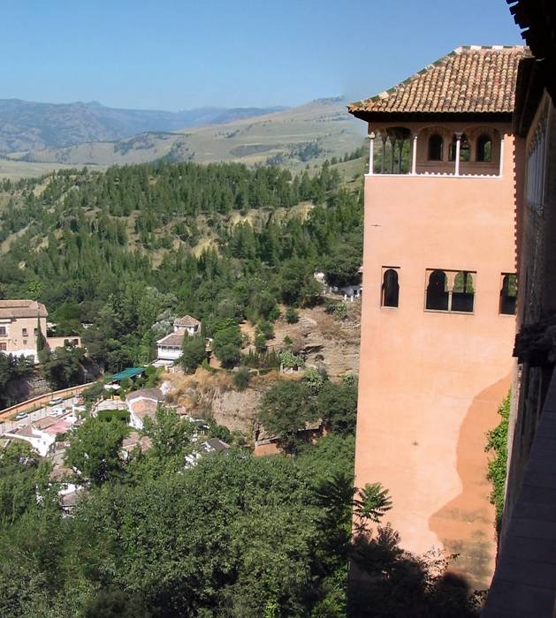
[Slide credit: Alexei Efros]

Slide 24
Why does it work?
[Slide credit: Alexei Efros]

Slide 25
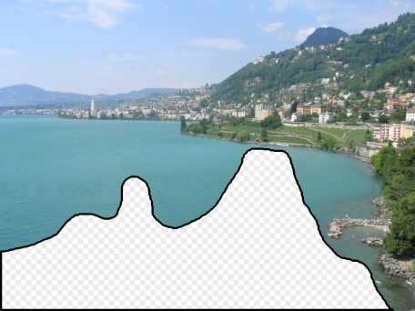
[Slide credit: Alexei Efros]
Notes:
10 nearest neighbors, 20,000 image database

Slide 26
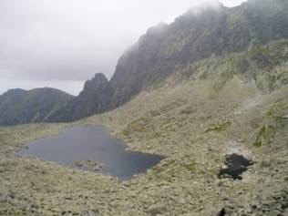
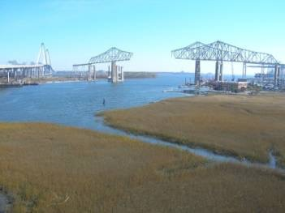
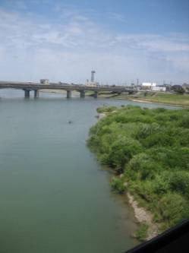
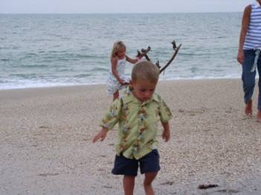
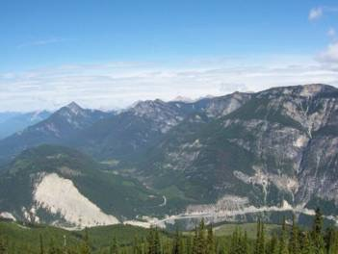
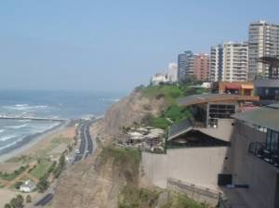
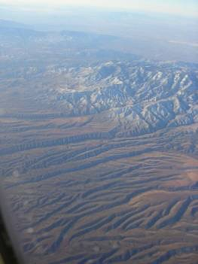
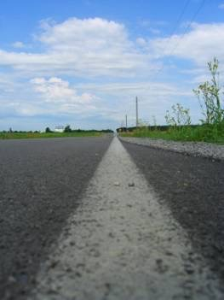
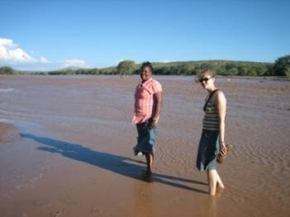
Nearest neighbors from a collection of 20 thousand images
[Slide credit: Alexei Efros]
Notes:
10 nearest neighbors, 20,000 image database
20000 images is still 5 times larger than the PASCAL training set

Slide 27
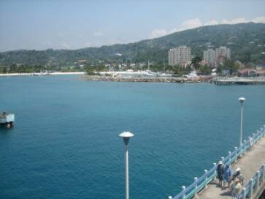
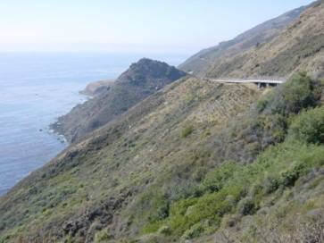
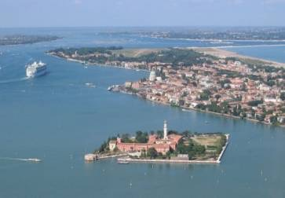
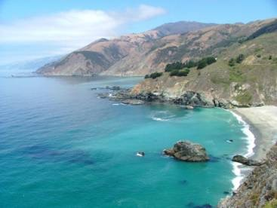
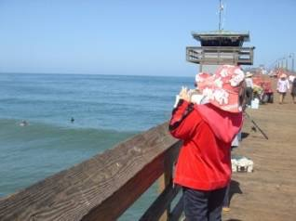
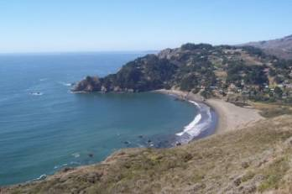
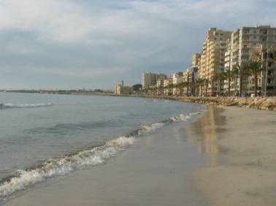
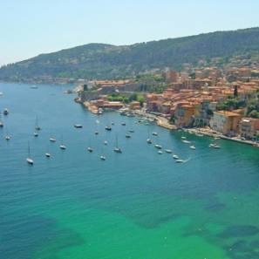
Nearest neighbors from a collection of 2 million images
[Slide credit: Alexei Efros]
Notes:
10 nearest neighbors, 2.3 million image database
This is one of the key results from my research – I’ve discovered that it’s possible to sample the space of scenes densely enough to permit photorealistic image manipulations, short circuiting the typical graphics pipelines. Say that this is surprising
DATA is the key

Slide 28
“Unreasonable Effectiveness of Data”
[Halevy, Norvig, Pereira 2009]
Parts of our world can be explained by elegant mathematics
physics, chemistry, astronomy, etc.
But much cannot
psychology, economics, genetics, etc.
Enter The Data!
Great advances in several fields:
e.g., speech recognition, machine translation
Case study: Google
“For many tasks, once we have a billion or so examples, we essentially have a closed set that represents (or at least approximates) what we need…”
[Slide credit: Alexei Efros]
Notes:
The visually world is hopelessly complex.
No way to do it by hand.
So we turn to extracting rules from big data.

Slide 29
Learning versus inference
Last lecture: Inference
Given a model , make inferences such as
This lecture: Learning
Given data, automatically come up with the model that best explains it
Notes:
P(x_1,x_2,x_3,\ldots)

Slide 30
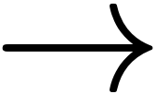

Slide 31
The goal of learning is to extract lessons from past experience in order to solve future problems.

Slide 32
What does ☆ do?
2 ☆ 3 = 36
7 ☆ 1 = 49
5 ☆ 2 = 100
2 ☆ 2 = 16

Slide 33
Goal: answer future queries involving ☆
Approach: figure out what ☆ is doing by observing its behavior on examples
Past experience
Future query
3 ☆ 5 = ?
2 ☆ 3 = 36
7 ☆ 1 = 49
5 ☆ 2 = 100
2 ☆ 2 = 16

Slide 34
2 ☆ 3 = 36
7 ☆ 1 = 49
☆
5 ☆ 2 = 100
2 ☆ 2 = 16
3 ☆ 5
☆
225

Slide 35
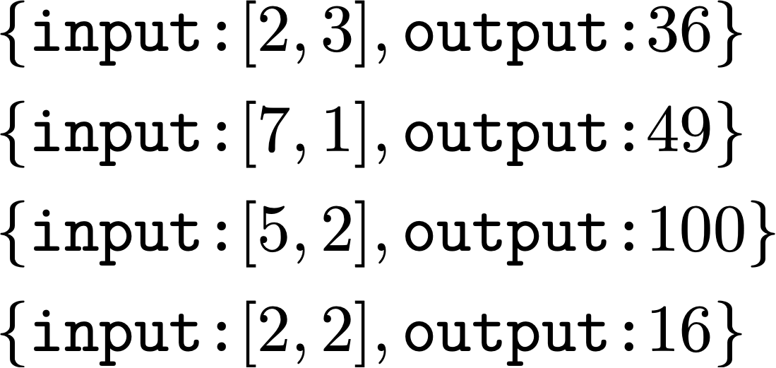
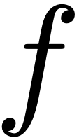
Learning from examples
(aka supervised learning)
Notes:
&\{\texttt{input:} [2,3], \texttt{output:} 36\}\nonumber \\
&\{\texttt{input:} [7,1], \texttt{output:}49\}\nonumber \\
&\{\texttt{input:} [5,2], \texttt{output:}100\}\nonumber \\
&\{\texttt{input:} [2,2], \texttt{output:}16\}\nonumber

Slide 36
Learning from examples
(aka supervised learning)

Slide 37
Learning from examples
(aka supervised learning)
…

Slide 38
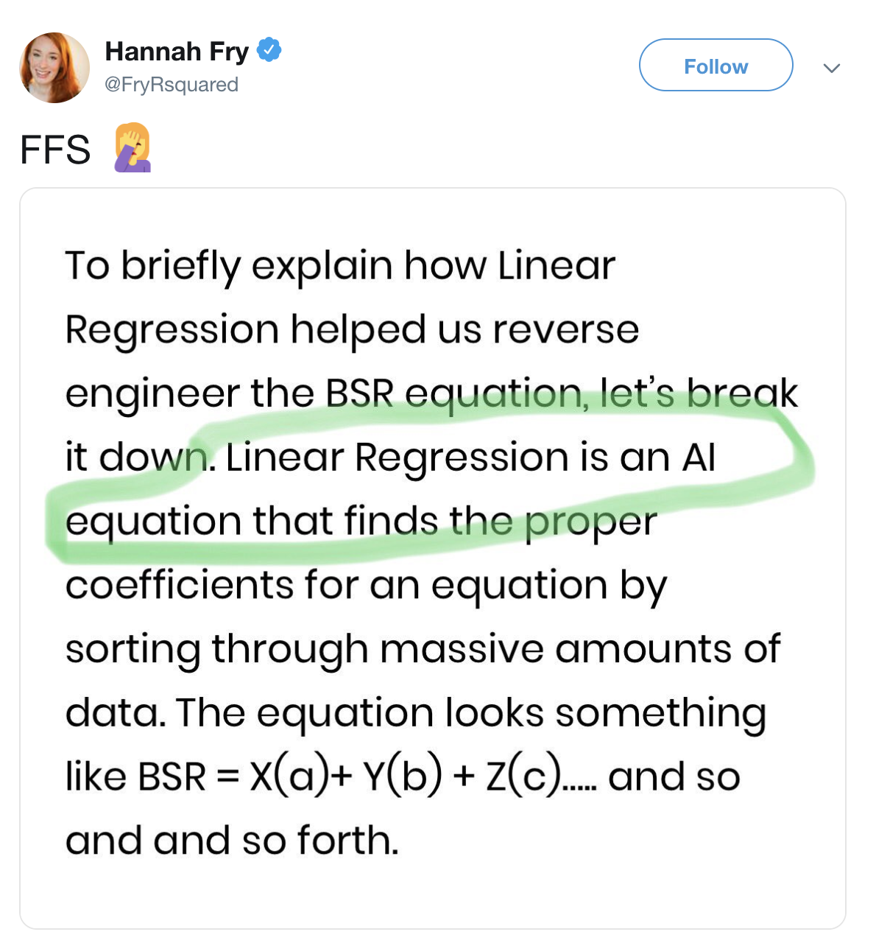
Case study #1: Linear least squares

Slide 39
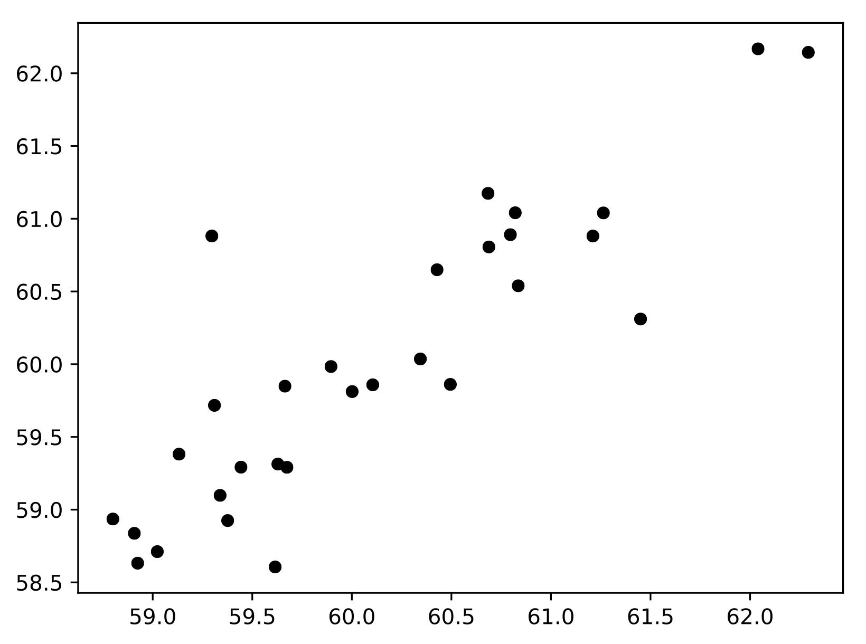
?

Slide 40
Hypothesis space
The relationship between X and Y is roughly linear:
Notes:
f_{\theta}(x) = \theta_1 x + \theta_0
y \approx \theta_1 x + \theta_0

Slide 41
Search for the parameters, ,
that best fit the data.
Best fit in what sense?
Notes:
A line cannot perfectly fit this data!
\theta = \{\theta_0, \theta_1\}

Slide 42
Search for the parameters, ,
that best fit the data.
Best fit in what sense?
The least-squares objective (aka loss) says the best fit is the function that minimizes the squared error between predictions and target values:
Notes:
\mathcal{L}(x,y) = (f_{\theta}(x) - y)^2

Slide 43
Search for the parameters, ,
that best fit the data.
Best fit in what sense?
The least-squares objective (aka loss) says the best fit is the function that minimizes the squared error between predictions and target values:
Notes:
\hat{y} \equiv f_{\theta}(x)
\mathcal{L}(\hat{y},y) = (\hat{y} - y)^2
\mathcal{L}(f_{\theta}(x),y) = (f_{\theta}(x) - y)^2

Slide 44
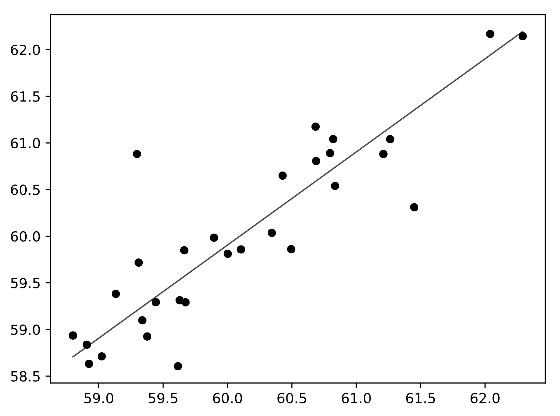
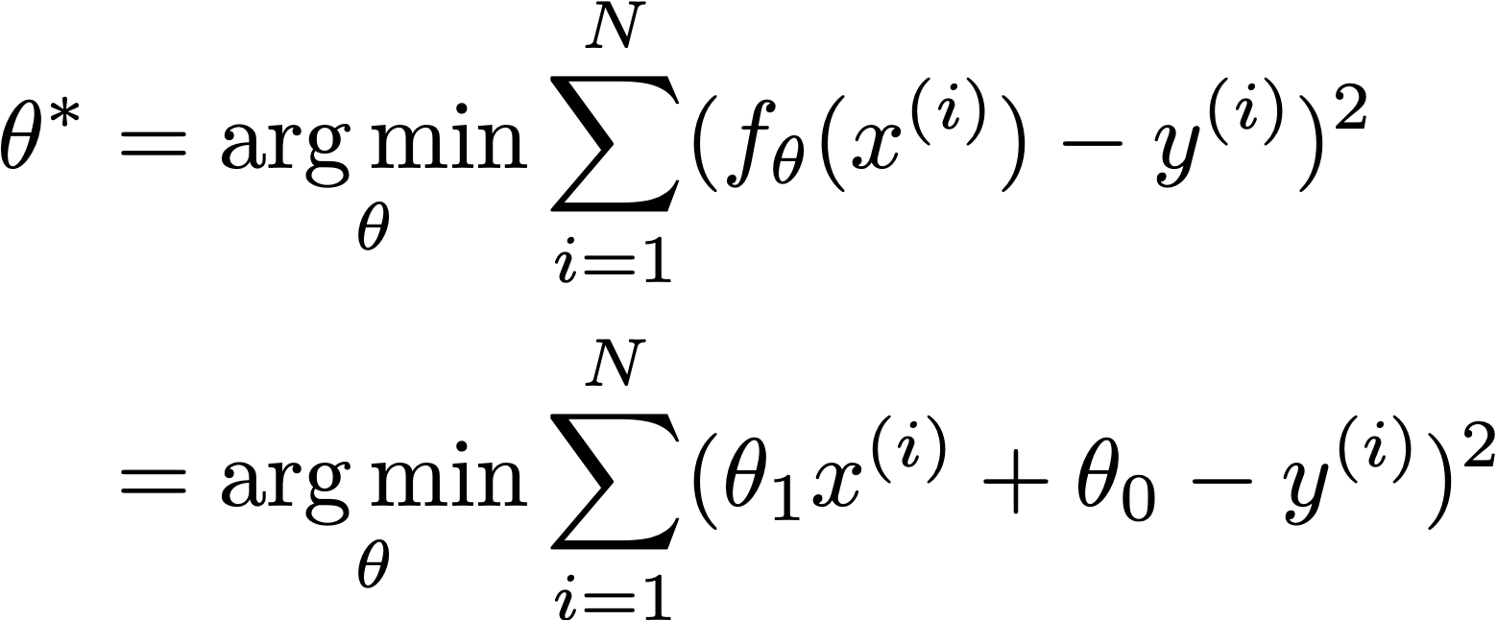
Complete learning problem:
Notes:
\theta^* &= \argmin_{\theta} \sum_{i=1}^N (f_{\theta}(x^{(i)}) - y^{(i)})^2\\
&= \argmin_{\theta} \sum_{i=1}^N (\theta_1 x^{(i)} + \theta_0 - y^{(i)})^2

Slide 45
?

Slide 47
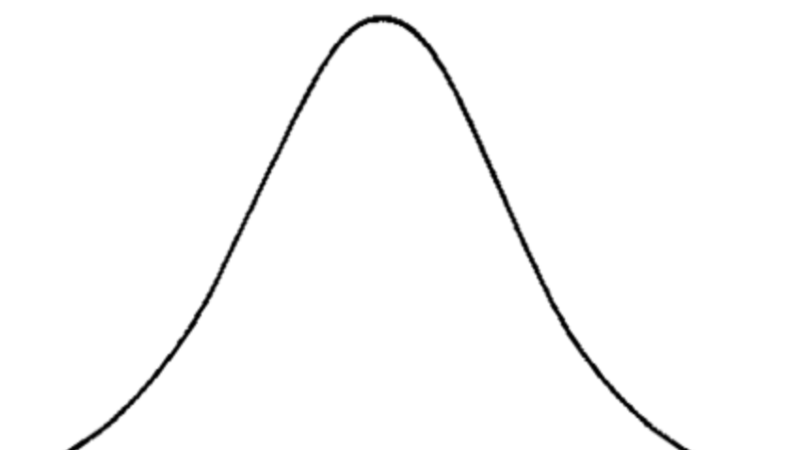
Why is squared error a good objective?
Follows from two modeling assumptions
1. Observed Y’s are corrupted by Gaussian noise:
2. Training datapoints are independently and identically distributed (iid):
Notes:
Y \approx f_{\theta}(X)
\epsilon = Y - f_{\theta}(X)
P_{\theta}(Y = y | X = x) \propto \exp{\frac{-(y-f_{\theta}(x))^2}{2\sigma^2}}
Pr(Y = [y-\epsilon, y+\epsilon] | X = x) &= \int_{y-\epsilon}^{y+\epsilon} \frac{1}{Z} \exp{\frac{-(Y-f_{\theta}(x))^2}{2 \sigma^2}}dY
P(\mathbf{y}|\mathbf{x}) = \prod_{i=1}^N p(y_i | x_i)
P_{\theta}(\{y^{(i)}\}_{i=1}^N|\{x^{(i)}\}_{i=1}^N) = \prod_{i=1}^N P_{\theta}(y^{(i)} | x^{(i)})

Slide 48
Why is squared error a good objective?
Notes:
\theta^* &= \argmax_{\theta} \prod_{i=1}^N P_{\theta}(y^{(i)} | x^{(i)})\\
&= \argmax_{\theta} \prod_{i=1}^N \exp{-\frac{(y^{(i)}-f_{\theta}(x^{(i)}))^2}{2\sigma^2}}\\
&= \argmax_{\theta} \log \prod_{i=1}^N \exp{-\frac{(y^{(i)}-f_{\theta}(x^{(i)}))^2}{2\sigma^2}}\\
&= \argmax_{\theta} \sum_{i=1}^N -\frac{(y^{(i)}-f_{\theta}(x^{(i)}))^2}{2\sigma^2}\\
&= \argmin_{\theta} \sum_{i=1}^N \frac{(y^{(i)}-f_{\theta}(x^{(i)}))^2}{2\sigma^2}\\
&= \argmin_{\theta} \sum_{i=1}^N (f_{\theta}(x^{(i)}) - y^{(i)})^2

Slide 49
Why is squared error a good objective?
Under the assumption that the data is distributed as:
The most probable estimate of θ is:
This is called the max likelihood estimator of θ.
Notes:
Notice that this does not depend on the functional form of f!
\theta^* = \argmin_{\theta} \sum_{i=1}^N (f_{\theta}(x^{(i)}) - y^{(i)})^2

Slide 50
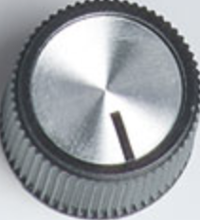
How to minimize the objective w.r.t. θ?
Use an optimizer!
Input
Output
Score
Machine with knobs
Notes:
You may think random search sounds silly, but it’s more or less the state of the art method on certain problems like reinforcement learning.
\mathbf{X} =
\begin{pmatrix}
x_1 & 1 \\
x_2 & 1 \\
\vdots & \vdots \\
x_N & 1
\end{pmatrix}
\theta^* = (\mathbf{X}^T\mathbf{X})^{-1}\mathbf{X}^T\mathbf{y}
\mathbf{X}\theta^* = \mathbf{y}
(\mathbf{X}^T\mathbf{X})\theta^* = \mathbf{X}^T\mathbf{y}
(\mathbf{y} - \mathbf{X}\theta)^T(\mathbf{y} - \mathbf{X}\theta)
\frac{\partial E(\theta)}{\partial \theta} \equiv \nabla_{\theta} E(\theta) = 2(\mathbf{X}^T \mathbf{X} \theta - \mathbf{X}^T \mathbf{y})
2(\mathbf{X}^T \mathbf{X} \theta^* - \mathbf{X}^T \mathbf{y}) = 0
\mathbf{X}^T \mathbf{X} \theta^* = \mathbf{X}^T \mathbf{y}

Slide 51
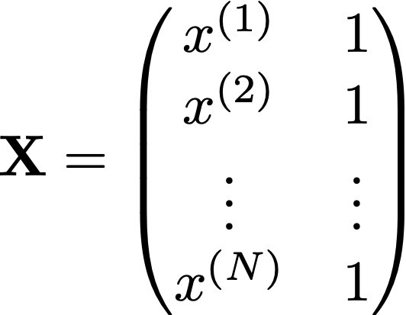
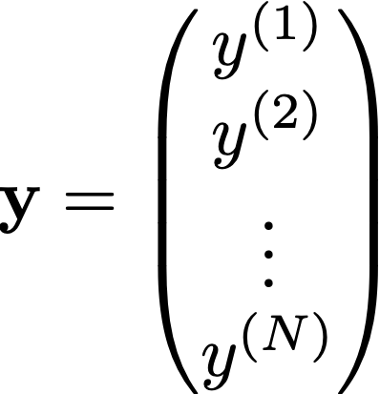
How to minimize the objective w.r.t. θ?
In the linear case:
Learning problem
Solution
Notes:
\theta^* = \argmin_{\theta} \sum_{i=1}^N (\theta_1 x^{(i)} + \theta_0 - y^{(i)})^2
\mathbf{X} =
\begin{pmatrix}
x^{(1)} & 1 \\
x^{(2)} & 1 \\
\vdots & \vdots \\
x^{(N)} & 1
\end{pmatrix}
\mathbf{y} =
\begin{pmatrix}
y^{(1)} \\
y^{(2)} \\
\vdots \\
y^{(N)}
\end{pmatrix}
\theta^* = (\mathbf{X}^T\mathbf{X})^{-1}\mathbf{X}^T\mathbf{y}
\mathbf{X}\theta^* = \mathbf{y}
(\mathbf{X}^T\mathbf{X})\theta^* = \mathbf{X}^T\mathbf{y}
(\mathbf{y} - \mathbf{X}\theta)^T(\mathbf{y} - \mathbf{X}\theta)
\frac{\partial E(\theta)}{\partial \theta} \equiv \nabla_{\theta} E(\theta) = 2(\mathbf{X}^T \mathbf{X} \theta - \mathbf{X}^T \mathbf{y})
2(\mathbf{X}^T \mathbf{X} \theta^* - \mathbf{X}^T \mathbf{y}) = 0
\mathbf{X}^T \mathbf{X} \theta^* = \mathbf{X}^T \mathbf{y}

Slide 52
Empirical Risk Minimization
(formalization of supervised learning)
Linear least squares learning problem
Notes:
\argmin_{f \in \mathcal{F}} \sum_{i=1}^N \mathcal{L}(f(\mathbf{x}_i), \mathbf{y}_i)
As designers, we usually want to just assume the optimizer can be made arbitrarily good. Then design the right objective, hypothesis space, and training data.

Slide 53
Empirical Risk Minimization
(formalization of supervised learning)
Objective function
(loss)
Training data
Hypothesis space
Notes:
f^* = \argmin_{f \in \mathcal{F}} \sum_{i=1}^N \mathcal{L}(f(\mathbf{x}^{(i)}), \mathbf{y}^{(i)})
As designers, we usually want to just assume the optimizer can be made arbitrarily good. Then design the right objective, hypothesis space, and training data.

Slide 54
Case study #1: Linear least squares
Notes:
\{x_i, y_i\}_{i=1}^N
f_{\theta}(x) = \theta x

Slide 55
Notes:
Model = [Objective, Hypothesis space]

Slide 56
Example 1: Linear least squares

Slide 57
Example 2: Program induction

Slide 58
Example 3: Deep learning

Slide 59
Space of all functions
Hypothesis space (haystack)
True solution (needle)
Space we will search

Slide 60
Space of all functions
Hypothesis space (haystack)
True solution (needle)
Space we will search
Deep nets

Slide 61
Space of all functions
Hypothesis space (haystack)
True solution (needle)
Space we will search
Linear functions
True solution is linear

Slide 62
Space of all functions
Hypothesis space (haystack)
True solution (needle)
Space we will search
Linear functions
True solution is nonlinear
Notes:
General advice: choose the smallest hypothesis space that you are sure contains the solution
(but overparameterize that hypothesis space to make optimization easy)

Slide 63
Space of all functions
Hypothesis space (haystack)
True solution (needle)
Hypotheses consistent with data

Slide 64
Space of all functions
Hypothesis space (haystack)
True solution (needle)
Hypotheses consistent with data
What happens as we increase the data?

Slide 65
Space of all functions
Hypothesis space (haystack)
True solution (needle)
Hypotheses consistent with data
What happens as we shrink the hypothesis space?

Slide 66
Learning for vision
Big questions:
How do you represent the input and output?
What is the objective?
What is the hypothesis space? (e.g., linear, polynomial, neural net?)
How do you optimize? (e.g., gradient descent, Newton’s method?)
What data do you train on?

Slide 67
Case study #2: Image classification
How do you represent the input and output?
What is the objective?
Assume hypothesis space is sufficienly expressive
Assume we optimize perfectly
Assume we train on exactly the data we care about

Slide 68
Image classification
Classifier
“Fish”
image x
label y

Slide 69
Image classification
Classifier
“Fish”
image x
label y

Slide 70
Image classification
Classifier
“Fish”
image x
label y

Slide 71
Image classification
Classifier
“Duck”
…
image x
label y

Slide 72
Training data
“Fish”
“Fish”
“Grizzly”
“Chameleon”
…
Notes:
\argmin_{f \in \mathcal{F}} \sum_{i=1}^N \mathcal{L}(f(\mathbf{x}^{(i)}), y^{(i)})
So formally, we are working in the Lab color space. The grayscale information is contained in the L, or lightness channel of the image, and is the input to our system.
The output is the ab, or color channels.
We’re looking to learn the mapping from L to ab using a CNN.
We can then take the predicted ab channels, concatenate them with the input, and hopefully get a plausible colorization of the input image. This is the graphics benefit of this problem.

Slide 73
How to represent class labels?
One-hot vector
Training data
Training data
Training data
“Fish”
1
[0,0,1]
“Grizzly”
2
[0,1,0]
“Chameleon”
3
[1,0,0]
…
…
…

Slide 74
What should the loss be?
0-1 loss (number of misclassifications)
discrete, NP-hard to optimize!
Cross entropy
continuous,
differentiable,
convex
Notes:
\mathcal{L}(\hat{y},y) = \mathbbm{1}(\hat{y}=y)
H(\mathbf{y}, \hat{\mathbf{y}}) = - \sum_{k=1}^K y_k \log \hat{y}_k

Slide 75
Ground truth label
[0,0,0,0,0,1,0,0,…]

Slide 76
Ground truth label
dolphin
…
cat
grizzly bear
angel fish
chameleon
clown fish
iguana
elephant
0
Prob
1

Slide 77
Prediction
Ground truth label
dolphin
cat
grizzly bear
angel fish
chameleon
clown fish
iguana
…
dolphin
cat
grizzly bear
angel fish
chameleon
clown fish
iguana
elephant
elephant
…
-
log prob
0
0
Prob
1

Slide 78
Prediction
Ground truth label
Score
dolphin
cat
grizzly bear
angel fish
How much better you could have done
chameleon
clown fish
iguana
…
dolphin
cat
grizzly bear
angel fish
chameleon
clown fish
iguana
elephant
elephant
…
-
log prob
0
0
Prob
1
-
- Loss
0

Slide 79
Prediction
Ground truth label
Score
dolphin
cat
grizzly bear
angel fish
chameleon
clown fish
iguana
…
dolphin
cat
grizzly bear
angel fish
chameleon
clown fish
iguana
elephant
elephant
…
-
log prob
0
0
Prob
1
-
- Loss
0

Slide 80
Prediction
Ground truth label
Score
dolphin
cat
grizzly bear
angel fish
chameleon
clown fish
iguana
…
dolphin
cat
grizzly bear
angel fish
chameleon
clown fish
iguana
elephant
elephant
…
-
log prob
0
0
Prob
1
-
- Loss
0

Slide 81
Softmax regression (a.k.a. multinomial logistic regression)
logits: vector of K scores, one for each class
squash into a non-negative vector that sums to 1 — i.e. a probability mass function!
dolphin
cat
grizzly bear
angel fish
chameleon
clown fish
iguana
elephant
…
…
0
1
Notes:
\mathbf{z} = f_{\theta}(\mathbf{x})
\equiv \texttt{softmax}(\mathbf{z})_j
\mathcal{L}(\mathbf{x}, \mathbf{y}) = H(\mathbf{y}, \texttt{softmax}(f_{\theta}(\mathbf{x})))

Slide 82
Softmax regression (a.k.a. multinomial logistic regression)
Probabilistic interpretation:
predicted probability of each class given input x
picks out the -log likelihood of the ground truth class under the model prediction
max likelihood learner!
Notes:
\equiv \texttt{softmax}(\mathbf{z})_j
\mathcal{L}(\mathbf{x}, \mathbf{y}) = H(\mathbf{y}, \texttt{softmax}(f_{\theta}(\mathbf{x})))
f^* = \argmin_{f\in\mathcal{F}} \sum_{i=1}^N H(\mathbf{y}^{(i)}, \hat{\mathbf{y}}^{(i)})

Slide 83
Softmax regression (a.k.a. multinomial logistic regression)
Notes:
\equiv \texttt{softmax}(\mathbf{z})_j
\mathcal{L}(\mathbf{x}, \mathbf{y}) = H(\mathbf{y}, \texttt{softmax}(f_{\theta}(\mathbf{x})))

Slide 84
The Problem of Generalization
Notes:
Occam image: https://en.wikipedia.org/wiki/Occam's_razor#/media/File:William_of_Ockham_-_Logica_1341.jpg

Slide 86
Thylacine
u/Rafael_P_S
Chopin

Slide 87
testing domain
(where we actual use our model)
training domain
Domain gap between and will cause us to fail to generalize.
Space of natural images
Training data
Test data

Slide 88
Linear regression
Notes:
f_{\theta}(x) = \theta_0 + \theta_1 x

Slide 89
Linear regression
Notes:
f_{\theta}(x) = \theta_0 + \theta_1 x

Slide 90
Polynomial regression
K-th degree polynomial regression
Notes:
f_{\theta}(x) = \theta_0 + \theta_1 x + \theta_2 x^2
f_{\theta}(x) = \sum_{k=0}^K \theta_k x^k

Slide 92
True data-generating process

Slide 93
True data-generating process
Notes:
\{x^{(i)}_{(\texttt{test})},y^{(i)}_{(\texttt{test})}\}_{i=1}^M
\{x^{(i)}_{(\texttt{test})},y^{(i)}_{(\texttt{test})}\} \stackrel{\texttt{iid}}{\sim} p_{\texttt{data}}
\{x^{(i)}_{(\texttt{train})},y^{(i)}_{(\texttt{train})}\}_{i=1}^N
\{x^{(i)}_{(\texttt{train})},y^{(i)}_{(\texttt{train})}\} \stackrel{\texttt{iid}}{\sim} p_{\texttt{data}}

Slide 94
Training objective:
Test time evaluation:
Notes:
\sum_{i=1}^N (f_{\theta}(x^{(i)}_{\texttt{train}}) - y^{(i)}_{\texttt{train}})^2
\sum_{i=1}^M (f_{\theta}(x^{(i)}_{\texttt{test}}) - y^{(i)}_{\texttt{test}})^2

Slide 95
Training objective:
True objective:
Notes:
\mathbb{E}_{\{x,y\} \sim p_{\texttt{data}}} [(f_{\theta}(x) - y)^2]
\{x,y\} \sim p_{\texttt{data}}

Slide 96
Generalization
“The central challenge in machine learning is that our algorithm must perform well on new, previously unseen inputs—not just those on which our model was trained. The ability to perform well on previously unobserved inputs is called generalization.
… [this is what] separates machine learning from optimization.”
— Deep Learning textbook (Goodfellow et al.)
Notes:
So everything seems great. Just make the hypothesis space expressive enough, and the optimizer powerful enough, state the objective we really care about, and we are in business. Not quite! Fitting to the training set does not guarantee generalization to the test set!

Slide 97
What does ☆ do?
2 ☆ 3 = 36
7 ☆ 1 = 49
5 ☆ 2 = 100
2 ☆ 2 = 16

Slide 98
What happens as we add more basis functions?
Notes:
f_{\theta}(x) = \theta_0 + \theta_1 x + \theta_2 x^2
f_{\theta}(x) = \sum_{k=0}^K \theta_k x^k

Slide 99
What happens as we add more basis functions?
K = 1
Notes:
f_{\theta}(x) = \theta_0 + \theta_1 x + \theta_2 x^2
f_{\theta}(x) = \sum_{k=0}^K \theta_k x^k

Slide 100
What happens as we add more basis functions?
K = 2
Notes:
f_{\theta}(x) = \theta_0 + \theta_1 x + \theta_2 x^2
f_{\theta}(x) = \sum_{k=0}^K \theta_k x^k

Slide 101
What happens as we add more basis functions?
K = 3
Notes:
f_{\theta}(x) = \theta_0 + \theta_1 x + \theta_2 x^2
f_{\theta}(x) = \sum_{k=0}^K \theta_k x^k

Slide 102
What happens as we add more basis functions?
K = 4
Notes:
f_{\theta}(x) = \theta_0 + \theta_1 x + \theta_2 x^2
f_{\theta}(x) = \sum_{k=0}^K \theta_k x^k

Slide 103
What happens as we add more basis functions?
K = 5
Notes:
f_{\theta}(x) = \theta_0 + \theta_1 x + \theta_2 x^2
f_{\theta}(x) = \sum_{k=0}^K \theta_k x^k

Slide 104
What happens as we add more basis functions?
K = 6
Notes:
f_{\theta}(x) = \theta_0 + \theta_1 x + \theta_2 x^2
f_{\theta}(x) = \sum_{k=0}^K \theta_k x^k

Slide 105
What happens as we add more basis functions?
K = 7
Notes:
f_{\theta}(x) = \theta_0 + \theta_1 x + \theta_2 x^2
f_{\theta}(x) = \sum_{k=0}^K \theta_k x^k

Slide 106
What happens as we add more basis functions?
K = 8
Notes:
f_{\theta}(x) = \theta_0 + \theta_1 x + \theta_2 x^2
f_{\theta}(x) = \sum_{k=0}^K \theta_k x^k

Slide 107
What happens as we add more basis functions?
K = 9
Notes:
f_{\theta}(x) = \theta_0 + \theta_1 x + \theta_2 x^2
f_{\theta}(x) = \sum_{k=0}^K \theta_k x^k

Slide 108
What happens as we add more basis functions?
K = 10
This phenomenon is called overfitting.
It occurs when we have too high capacity a model, e.g., too many free parameters, too few data points to pin these parameters down.
Notes:
f_{\theta}(x) = \theta_0 + \theta_1 x + \theta_2 x^2
f_{\theta}(x) = \sum_{k=0}^K \theta_k x^k

Slide 109
K = 1
When the model does not have the capacity to capture the true function, we call this underfitting.
An underfit model will have high error on the training points. This error is known as approximation error.

Slide 110
K = 2
The true function is a quadractic, so a quadractic model (K=2) fits quite well.

Slide 111
K = 10
Now we have zero approximation error — the curve passes exactly through each training point.
But we have high generalization error, reflected in the gap between the true function and the fit line. We want to do well on novel queries, which will be sampled from the green curve (plus noise).

Slide 112
Underfitting
Appropriate model
Overfitting
K = 1
K = 2
K = 10
High error on train set
Low error on train set
Lowest error on train set
High error on test set
Low error on test set
High error on test set

Slide 113
Underfitting
Appropriate model
Overfitting
K = 1
K = 2
K = 10
Simple model
Simple model
Complex model
Doesn’t fit the training data
Fits the training data
Fits the training data

Slide 114
Underfitting
Appropriate model
Overfitting
K = 1
K = 2
K = 10

Slide 115
Example #2: Fitting a classifier
What class is ?
Answer:
Answer:
Answer:
Underfitting
Appropriate model
Overfitting

Slide 116
We need to control the capacity of the model (e.g., use the appropriate number of free parameters).
The capacity may be defined as the number of hypotheses under consideration in the hypothesis space.
Complex models with many free parameters have high capacity.
Simple models have low capacity.

Slide 117
Training error versus generalization error
[“Deep Learning”, Goodfellow et al.]

Slide 118
How do we know if we are underfitting or overfitting?
Cross validation: measure prediction error on validation data
Notes:
\{x^{(i)}_{(\texttt{val})},y^{(i)}_{(\texttt{val})}\}_{i=1}^V

Slide 119
Fitting just right
Underfitting?
add more parameters (more features, more layers, etc.)
Overfitting?
remove parameters
add regularizers
Selecting a hypothesis space of functions with just the right capacity is known as model selection

Slide 120
Regularization
Emprirical risk minimization:
Notes:
So everything seems great. Just make the hypothesis space expressive enough, and the optimizer powerful enough, state the objective we really care about, and we are in business. Not quite! Fitting to the training set does not guarantee generalization to the test set!
f^* = \argmin_{\theta} \sum_{i=1}^N \mathcal{L}(f(\mathbf{x}^{(i)}), \mathbf{y}^{(i)}) + R(f)
\theta^* = \argmin_{\theta} \sum_{i=1}^N \mathcal{L}(f_{\theta}(\mathbf{x}^{(i)}), \mathbf{y}^{(i)}) + R(\theta)

Slide 121
Regularized least squares
Only use polynomial terms if you really need them! Most terms should be zero
ridge regression, a.k.a., Tikhonov regularization
(Probabilistic interpretation: R is a Gaussian prior over values of the parameters.)

Slide 122
A
B
C
Low λ — ?
Medium λ — ?
High λ — ?
[Adapted from “Deep Learning”, Goodfellow et al.]
Notes:
\theta^* = \argmin_{\theta} \sum_{i=1}^N \mathcal{L}(f_{\theta}(\mathbf{x}^{(i)}), \mathbf{y}^{(i)}) + \lambda \norm{\theta}^2_2

Slide 123
A
B
C
Low λ — C
Medium λ — B
High λ — A
[Adapted from “Deep Learning”, Goodfellow et al.]
Notes:
\theta^* = \argmin_{\theta} \sum_{i=1}^N \mathcal{L}(f_{\theta}(\mathbf{x}^{(i)}), \mathbf{y}^{(i)}) + \lambda \norm{\theta}^2_2

Slide 124
Regularized polynomial least squares regression
Notes:
\sum_{i=1}^N (f_{\theta}(x_i) - y_i)^2 + \lambda\theta^T\theta
\sum_{i=1}^N (f_{\theta}(x_i) - y_i)^2 + \lambda\norm{\theta}_2^2
\theta^* = (\mathbf{\Phi}^T\mathbf{\Phi} + \lambda I)^{-1}\mathbf{\Phi}^T\mathbf{y}

Slide 125
What’s the best prior? What’s a principle for selecting it?
[ITILA book, Chapter 28, MacKay, http://www.inference.org.uk/itprnn/book.pdf]

Slide 126
True data-generating process
Notes:
\{x^{(i)}_{(\texttt{test})},y^{(i)}_{(\texttt{test})}\}_{i=1}^M
\{x^{(i)}_{(\texttt{test})},y^{(i)}_{(\texttt{test})}\} \stackrel{\texttt{iid}}{\sim} p_{\texttt{data}}
\{x^{(i)}_{(\texttt{train})},y^{(i)}_{(\texttt{train})}\}_{i=1}^N
\{x^{(i)}_{(\texttt{train})},y^{(i)}_{(\texttt{train})}\} \stackrel{\texttt{iid}}{\sim} p_{\texttt{data}}

Slide 127
This is a huge assumption!
Almost never true in practice!
Notes:
\{x^{(i)}_{(\texttt{test})},y^{(i)}_{(\texttt{test})}\}_{i=1}^M
\{x^{(i)}_{(\texttt{test})},y^{(i)}_{(\texttt{test})}\} \stackrel{\texttt{iid}}{\sim} p_{\texttt{data}}
\{x^{(i)}_{(\texttt{train})},y^{(i)}_{(\texttt{train})}\}_{i=1}^N
\{x^{(i)}_{(\texttt{train})},y^{(i)}_{(\texttt{train})}\} \stackrel{\texttt{iid}}{\sim} p_{\texttt{data}}

Slide 128
Much more commonly, we have
Notes:
\{x^{(i)}_{(\texttt{train})},y^{(i)}_{(\texttt{train})}\} \stackrel{\texttt{iid}}{\sim} p_{\texttt{train}}
\{x^{(i)}_{(\texttt{test})},y^{(i)}_{(\texttt{test})}\} \stackrel{\texttt{iid}}{\sim} p_{\texttt{test}}

Slide 129
generalization error
Our training data did cover the part of the distribution that was tested
(biased data)
Notes:
\{x_i^{(\texttt{test})},y_i^{(\texttt{test})}\} \stackrel{\texttt{iid}}{\sim} p_{\texttt{test}}

Slide 131
Thylacine
u/Rafael_P_S
Chopin

Slide 132
8. Introduction to Machine Learning
“It’s all about the data!”
Formalisms of learning (Data, Compute, Objective Function, Hypothesis Space, Optimizer)
Case study #1: Linear least-squares
Empirical risk minimization
Case study #2: Image classification
Softmax regression
The problem of generalization

